Slide 1
Slow Control data logging in unstable networks
Armen Beglarian
Karlsruhe Institute of Technology
Institute for Data Processing and Electronics

Slide 2
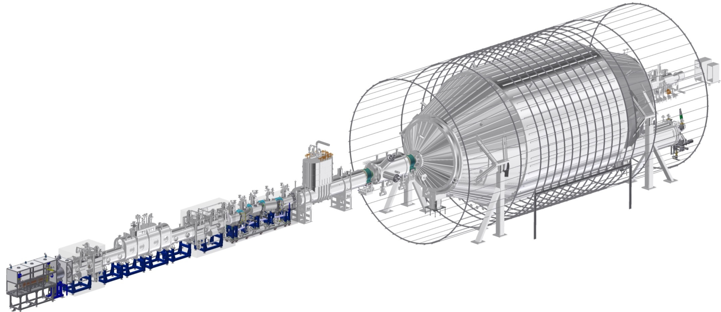
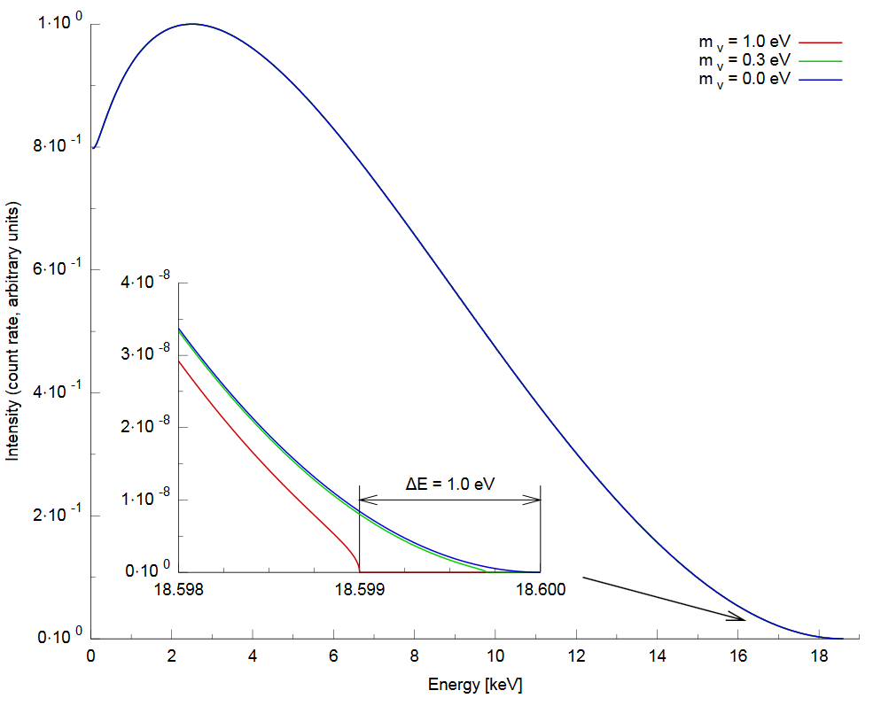
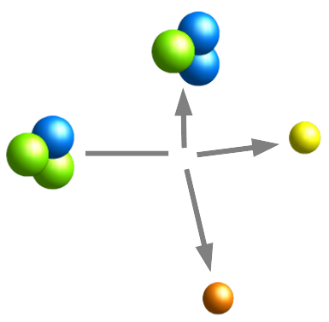
KATRIN experiment
Energy spectrum of the electrons
emitted in tritium beta decay
Beta decay
of Tritium
~70m long huge apparatus with thousand hardware components
Extra high vacuum
High precision instrumentation
Rear section: tritium + high voltage + high magnetic field
Spectrometer section: high voltage + high magnetic field
Dozens slow control data acquisition banks (NI and PCS7)
Number of channels >10k

Slide 3
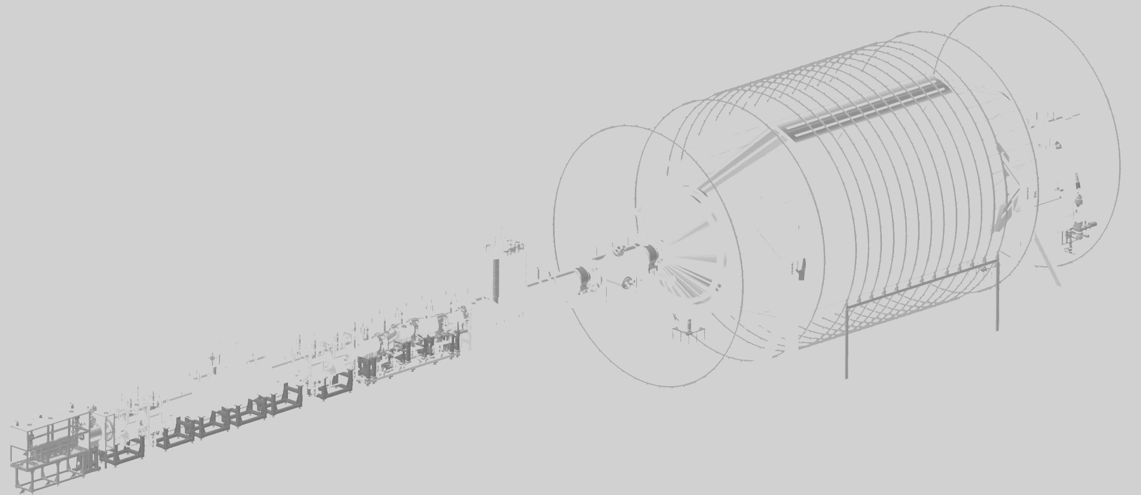
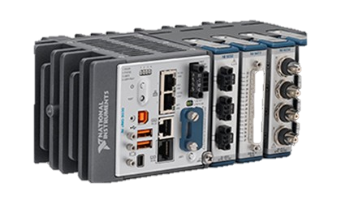
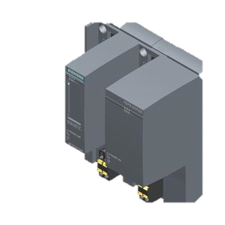
The LAN structure in KATRIN experiment
Spectrometer section
Client 1
Client 2
Client N
Experiment LAN (data transfer)
Field-point LAN (NI world)
Control System LAN (Siemens world)
Experiment LAN transfers data from the measurement banks to the database
Field-Point LAN provide data collection from all measurement banks
Control System LAN provides safe, secure environment for the experiment

Slide 4
Slow Control data collection structure before 2022
Real-Time target
(Pharlap, VX Works, Linux RT)
Mac
ORCA DAQ system provides script-based control to SC
Real-Time software
ZEUS server
Windows
ZEUS client
MsSQL Local DB
MsSQL Replicated KATRIN DB
Windows
Field-point LAN
Experiment LAN
GUI
operator control
KIT LAN
ZEUS (The Central Data Acquisition and Control System) developed in KIT at 2003-2005
Based on Easy TCP/IP protocol
Running stable at small systems (<50 channels)
No protection against network gaps

Slide 5
Challenges at KATRIN experiment
The KATRIN experiment slow control design started almost 20 years ago
Outdated network infrastructure
Obsolete instruments (no more support)
Channels number are steady growing due to upgrades which significantly overloads the ZEUS-based slow control data collection system -> danger to produce multiple gaps

Slide 6
Typical data gap ат KATRIN
Best way to observe the data gaps – timestamps distribution
ADEI – Advanced Data Extraction Infrastructure
->
Here the plot of timestamp values from the Rear Section Egun cRIO controller

Slide 7
New dotNET-based direct database logging software has been created in IPE
Author: Petra Rohr
MsSQL have to stay as a slow control database for KATRIN at least till 2025
Why dotNET?
DLL make a connection to the database and stores data in the MsSQL table
Optimized for big data volumes
Disadvantage: works only in Windows environment

Slide 8
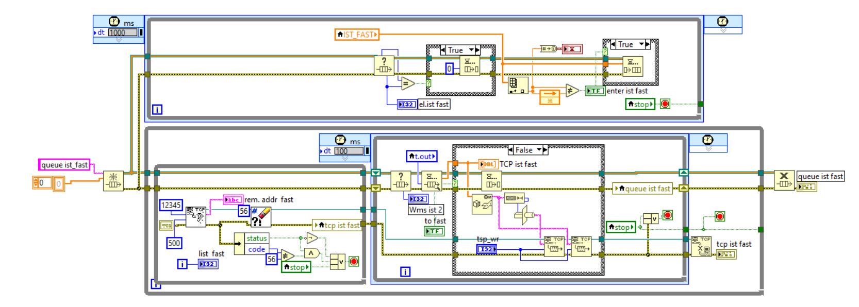
Server (TCP/IP protocol)
1
1
2
3
Data to transfer
Queue
TCP/IP
listener
To the client
Any controller at Field-point LAN
1
2
Simplified example
3

Slide 9
TCP/IP or UDP?
1
Data to transfer
Queue
UDP
listener
To the client
Any controller at Field-point LAN
Connection
detector
Read Variable with Timeout.vi is reacting fast on communication breakdown
2 years of using UDP with big slow control arrays (~1000ch.) shows no issue with the data transfer
In case of TCP/IP we still observing short gaps in case of black-out

Slide 10
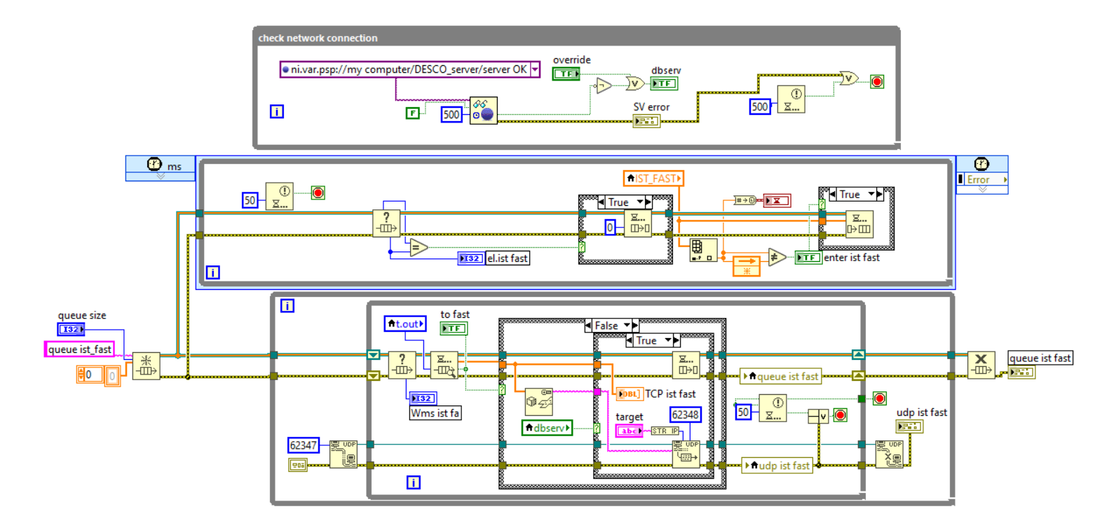
Detecting network connection loss in the target VI
Necessary to create a Network Published Shared Variable (any datatype)
In the target add the „Read Variable with Timeout“ vi.
Use „Timed out?” indication
Here we are using UDP protocol, which in fact gives us the better performance

Slide 11
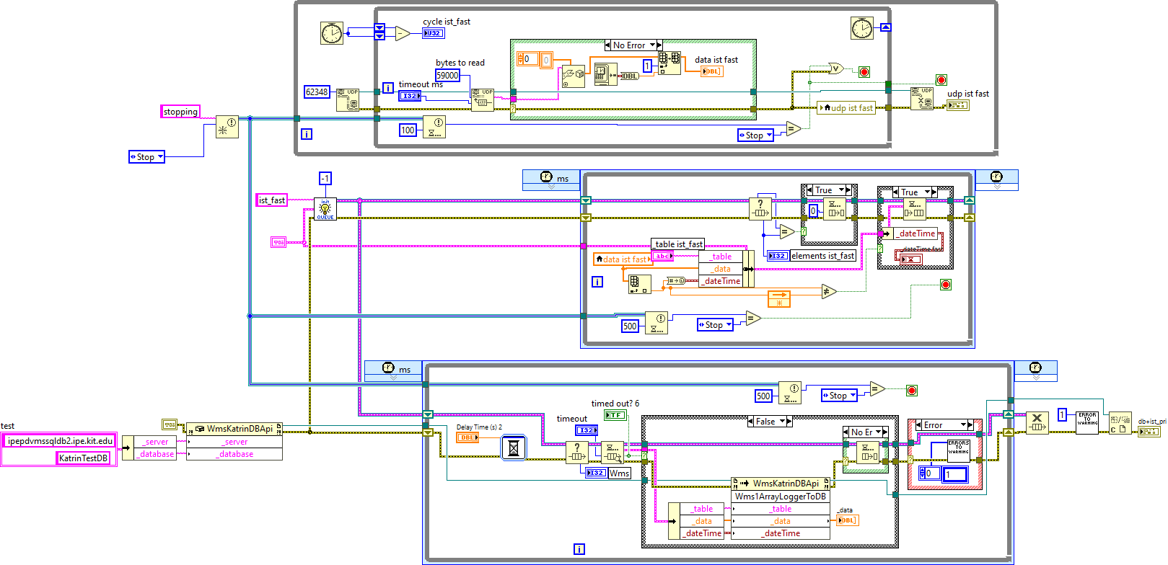
Client (UDP protocol)
1
Windows machine
1
2
3
3
Data receiver
Queue
dotNET
constructor
DB
From the Real-Time target
Field-point LAN
Experiment LAN
1
Simplified example
With UDP protocol
2
3

Slide 12
Double-queue lossless network data taking
Readout
Real-Time target
Windows machine
Windows server
machine
Queue
Engine
DB server
DB
(MS SQL)
TCP/IP (UDP)
Sender
Fieldpoint LAN
Experiment LAN

Slide 13
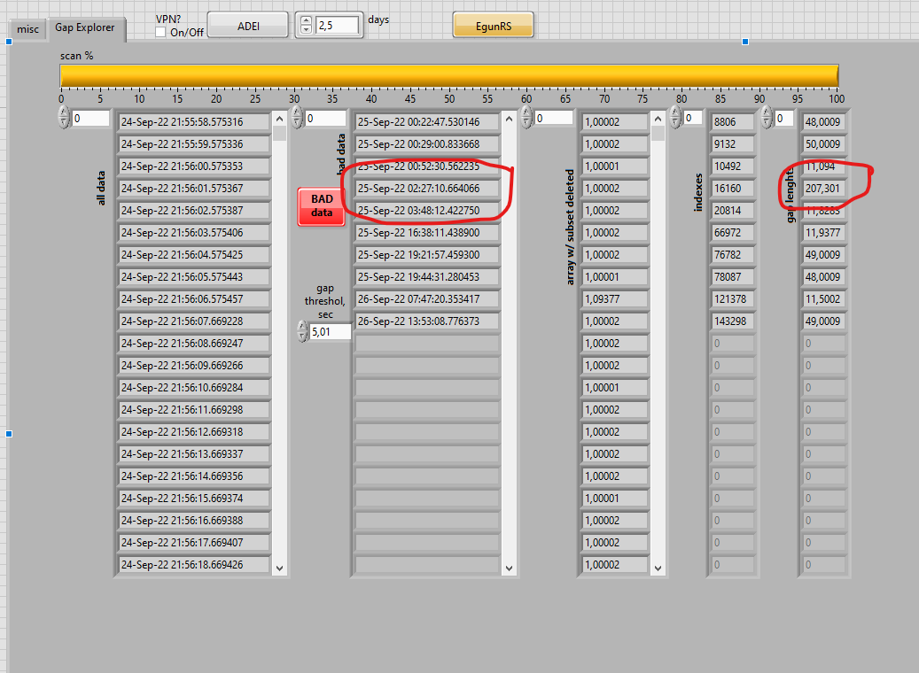
Practical tool: checking gaps in data
This tool checks for gaps by reading data from ADEI. Here you can see the advantage of the dotNET method compared to the ZEUS acquisition.
Simultaneous acquisition: ZEUS and QUEUE-based datalogging
18.03.2024
SEI-Tagung 2024 A.Beglarian

Slide 14
Summary and Outlook
New datalogging system has been created and running at KATRIN
It has a very precise timestamps and provides lossless data transfer to the database (proved with gap-explorer tool)
The server program executable is installed and running relative stable at MSSQL DB server
New system give us an opportunity to remove the ZEUS system and reduce data copies (storage costs), but they still running in parallel for redundancy
18.03.2024
SEI-Tagung 2024 A.Beglarian

Slide 15
Sample: the fast, slow and old ZEUS channels in ADEI after upgrade
This is actually the crystal dream for any slow control data and it came true since 2022:
Thank you
for attention and
follow-up questions
18.03.2024
SEI-Tagung 2024 A.Beglarian

