Slide 1
DTS at DESY
Now and during POF V

Slide 2
PoF IV DESY strategy
Develop a "DESY signature” detector technology: CMOS-sensors (PERCIVAL, UltraCam, 65nm MAPS, …)
Strengthen infrastructure via DDL: scale down ambition & look for new opportunities
Endcaps for LHC upgrade: in production
Detectors for European XFEL: running and in production
Strengthen detector activity in AP: group established
High transmission rates: silicon photonics R&D started
…

Slide 3
DESY is only in one Research Field: “Matter”
3 out of 4 research divisions are active in DTS:
High-Energy Physics (FH)
Photon-Science (FS)
Astroparticle (AP)
We have a monthly meeting between these three groups
In the Machine Division (M) there is a significant activity in ARD that has a large overlap with DTS: e.g. monitoring with fast detectors; electronics and feedback. Plan is to get increased exchange with them (invite representatives to the monthly meeting)

Slide 4
High-Energy Physics (FH)
With the start of POF V, LHC upgrades will be completed.
In POF V focus on enabling R&D for future experiments:
Precision experiments (e.g. Higgs factory), LUXE, others
New technologies introduced for non-collider program (cryogenic sensors, Quantum sensors, ..)
R&D activities
Strong focus on monolithic silicon pixel sensors & systems
Excellent spatial resolution
Timing resolution in the sub-ns regime
Highly granular calorimetry using SiPM-on-tile technology
Silicon photonics to address future data transfer needs
Cryogenic Sensors for Axion/Dark Matter detection
Build on DESY’s System design expertise
Extreme light weight Mechanics
Cooling
Strong involvement in the international R&D Effort
Part of the DRD 3, 5, 6, 7, and 8 collaborations
Key challenges:
Deal with the data rates
Data reduction on chip
Extreme mechanics

Slide 5
Photon-Science (FS)
During PoF III / IV:
a strong focus has been on large dynamic range, fast, burst-mode, X-ray imagers for FEL applications
In PoF IV / V:
a focus will be on X-ray imagers for PETRA IV (being the highest priority project at DESY).
Two systems to be developed:
Fast single photon time-stamping & fast photon counting imagers (based on Timepix-4 chip)
Fast integrating imagers running at > 150 kfps continuously (CORDIA-chip under development at DESY)
upgrade of XFEL detectors (smaller pixels and/or more memory)
(towards) a 1 MHz continuous frame rate imager
all systems will cause a large increase in data rate
➔data reduction close to detector head needed; Experiment specific !!
sensors for lower and for higher photon energies
Key challenges:
More functionality / area
Deal with the data rates
Data reduction close to detector

Slide 6
Astroparticle (AP)
Some of the "upgrade" R&D in PoF III+IV evolved into projects for PoF V
Technologies:
Silicon MAPS are still crucial (several projects-- sensors for tracking/vertexing, calorimetry, UV, dosimetry tests)
Systems for harsh environments; spectroradiometric calibrations
SiPMs+electronics (eg for CHEC/SST-CAM)
R&D for radio detection of neutrinos
Detector work at PITZ for FLASH radiotherapy: silicon, technology comparisons, new tech developments (NitroFLASH)
Quantum sensing (also in FH)
Key challenges:
Deal with the data rates
Harsh environments
Quantum sensing

Slide 7
Infrastructure:
Test beam: Essential work horse for detector development in particle and nuclear physics. National and international.
Currently available test beam: 1-6 GeV electrons. 3 beam lines.
PETRA IV requires changes to DESY-II ➔ a new test beam facility is needed and concepts are being developed
New beam telescope developments are in synergy with detector technology development.
Software tools for detector development
DESY is maintaining & developing several software tools & frameworks for the detector R&D community (e.g. Simulations: Allpix Squared, Testbeam reconstruction: Corryvreckan, Data acquisition: EUDAQ2)
User communities include, but are not limited to particle and nuclear physics, photon science and space applications
Detector integration facility (DAF)
Currently fully in use for LHC upgrades (expected until 2027)
Large clean rooms with equipment for detector assembly, testing, mechanical integration, cooling tests, metrology etc.
Can be partially some type of user facility in the future.

Slide 8
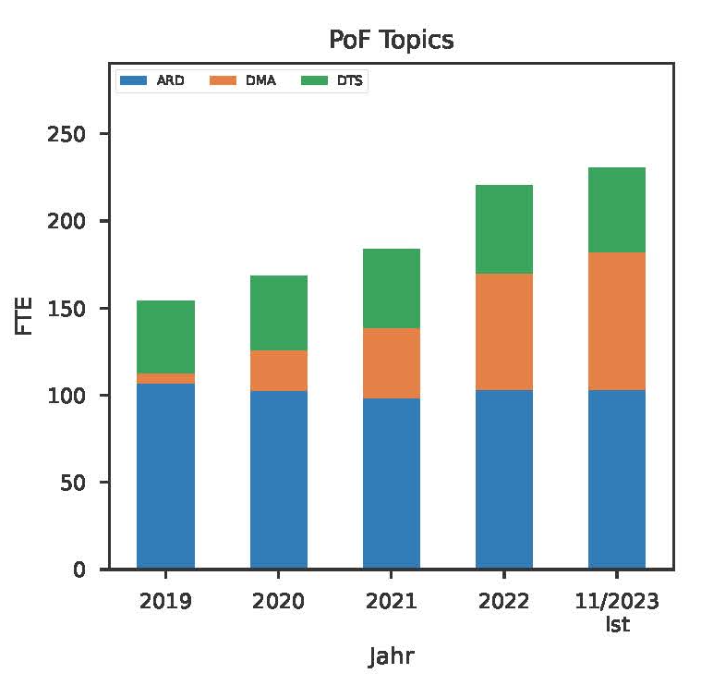
# of FTEs in DTS at DESY will (most likely) not change drasitically
Some increase expected from Zeuthen detector group (MU → MT)
~ 40 FTE

Slide 9
Heinz’ personal comment:
We have to prepare ourselves for the revolution AI will bring to our field.
We have started exploring possibilities of Machine Learning (data reduction)
Looking at the developments over the last 2-3 years: AI generated text, code, images, music, art, medicine, diagnoses, ..
What will be possible in 5-10 years (PoF V period):
AI designed electronic boards?
AI designed ASICs?
AI designed mechanics?

