Slide 1
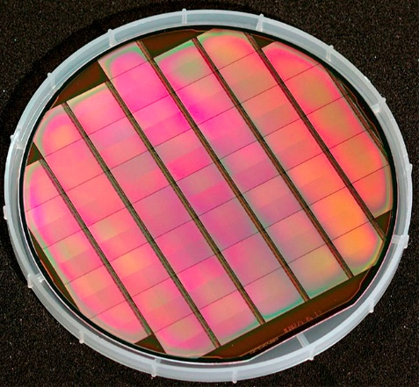
DTS at GSI in POF-V
C. J. Schmidt

Slide 2
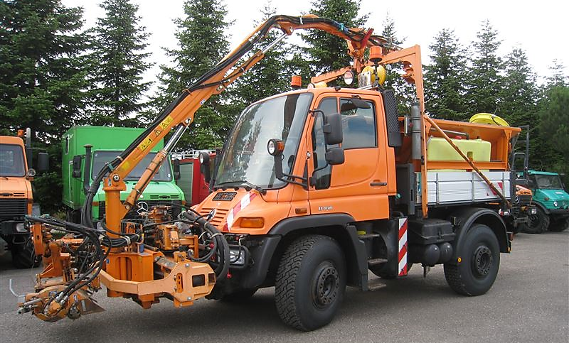
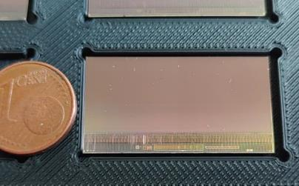
Plans on MAPS
R&D on tracking sensors for ALICE ITS3 / ALICE3
TPSCo 65nm imaging technology.
Stitching / thinning => Cylindrical wafer size sensors.
Together with IPHC Strasbourg, CERN, ALICE.
Focus on device testing
Configurable general tracking sensor
TPSCo 65nm, expect synergies with ALICE project.
Goal: 5µm, 25-400ns, 1-100 MHz/cm², 40-200 mW/cm².
Unique: Trade power vs. speed vs. granularity by slow control.
Build flexible technology chain suited for various users (FAIR-upgrade, Higgs factory,…).
Device testing, participation to design.
Together with IPHC, DESY, … within DRD3 (t.b.c).
UNIversal MOnolithic sensor for Ge- neral tracking applications

Slide 3
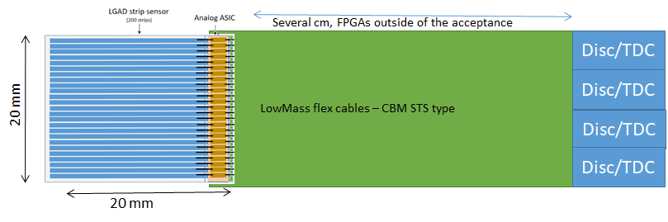
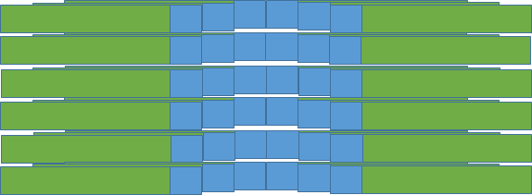
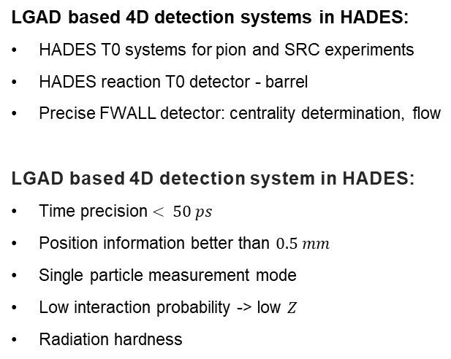
GSI LGAD strategy
LGAD based 4D detection systems in HADES:
HADES T0 systems for pion and SRC experiments
HADES reaction T0 detector - barrel
Precise FWALL detector: centrality determination, flow
LGAD based 4D detection system in HADES:
Time precision $< 50 ps$
Position information better than $0.5 mm$
Single particle measurement mode
Low interaction probability -> low $Z$
Radiation hardness
Large active area – single module
Amplifier ASIC for LGAD
Single module based on 20mm x 20mm sensor
Long term goal: single layer with large active area 12cm x 12cm
Arrangement of 6 x 6 modules
2024 .... :
New generation LGAD sensors. TI technology available and tested.
Reduce sensor thickness < 200um
Analog ASIC design and production
Feasibility study of low mass cables (STS like) – synergy with CBM
Digital electronics production: DiRich type of readout - synergy with CBM

Slide 4
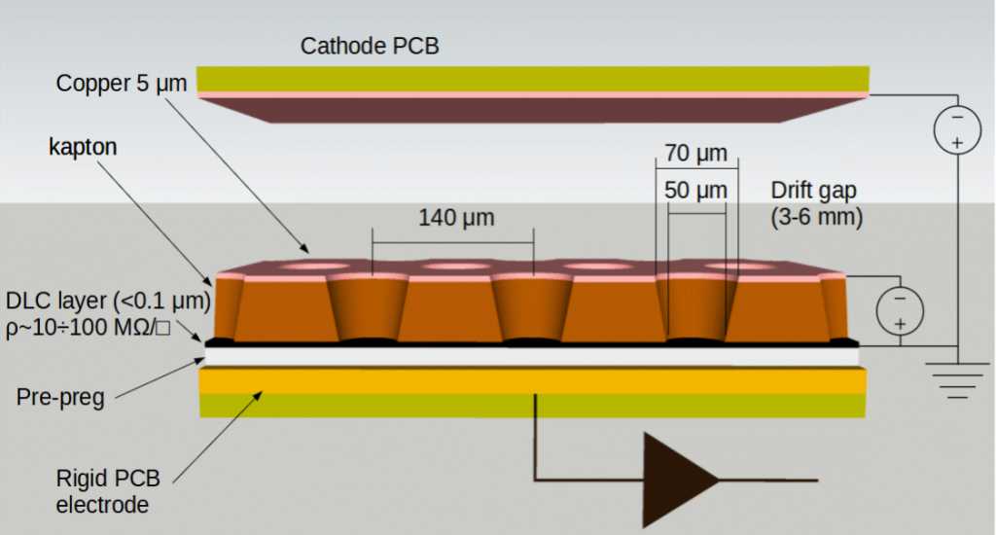
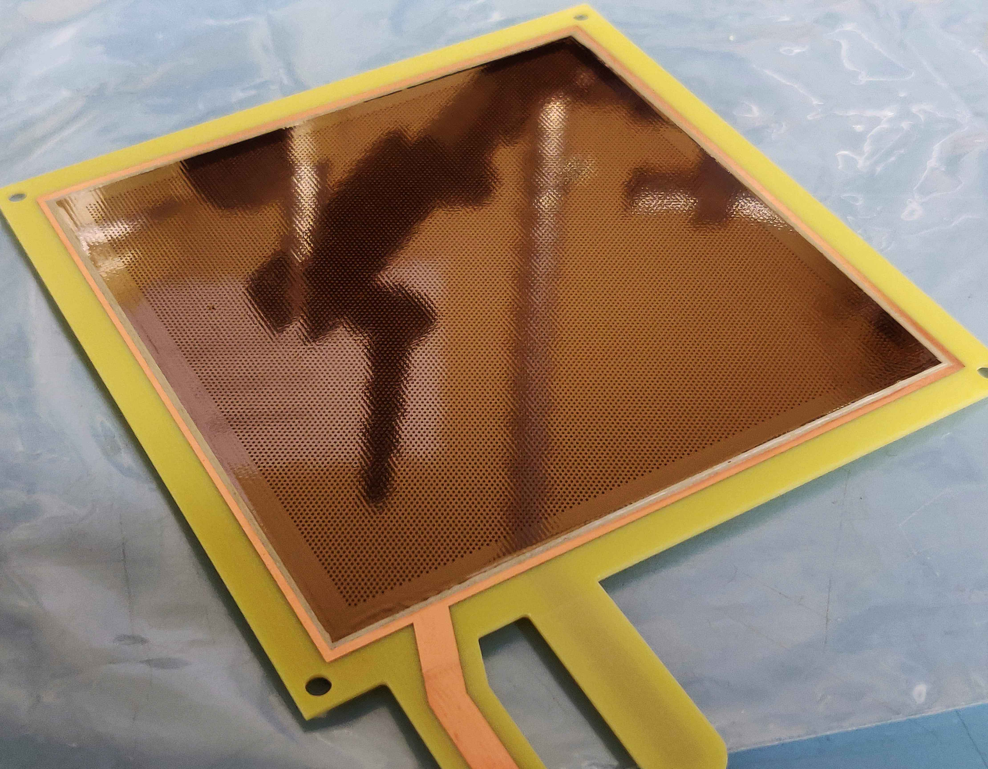
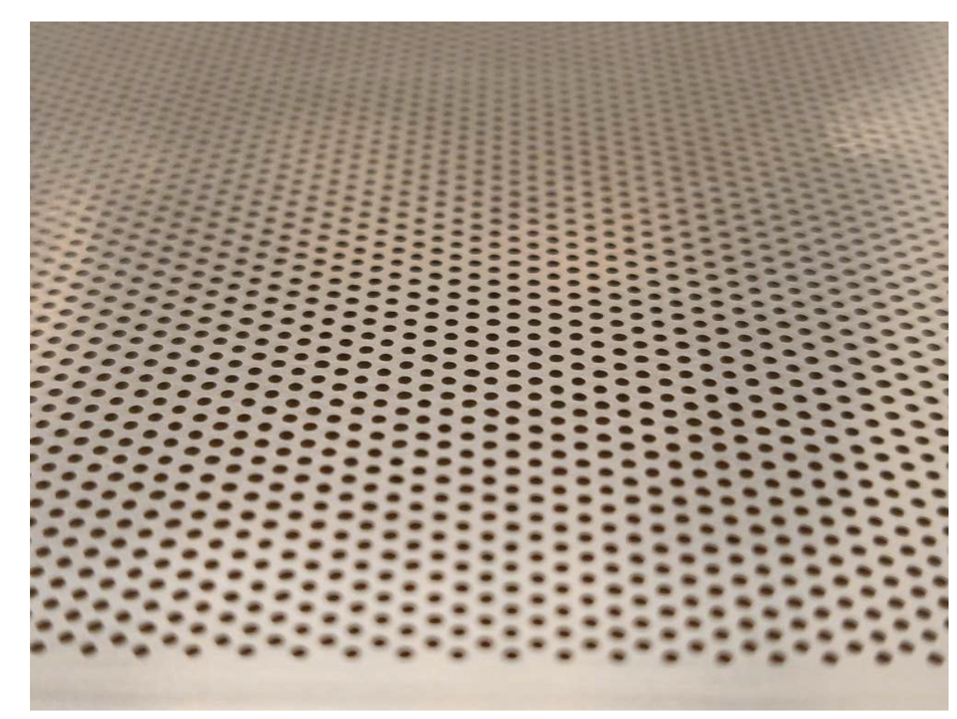
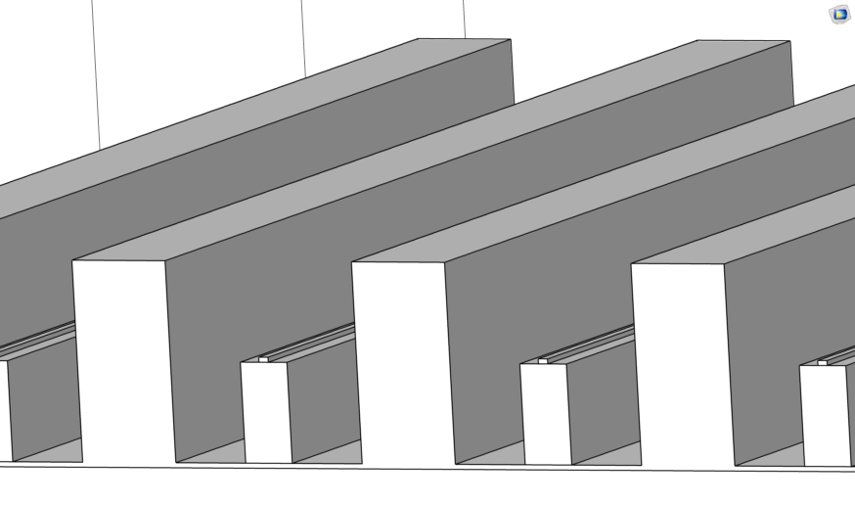
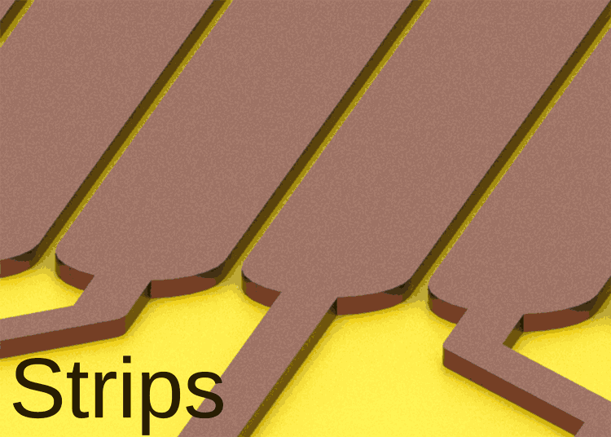
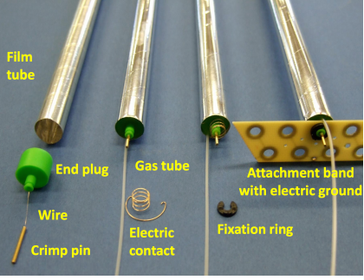
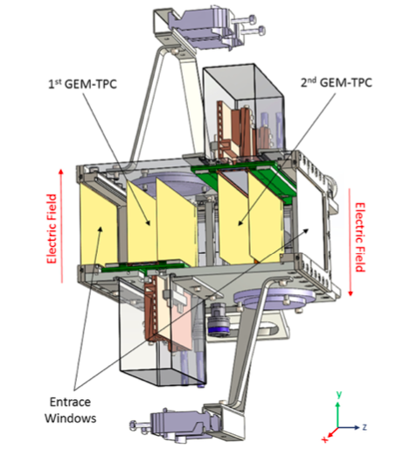
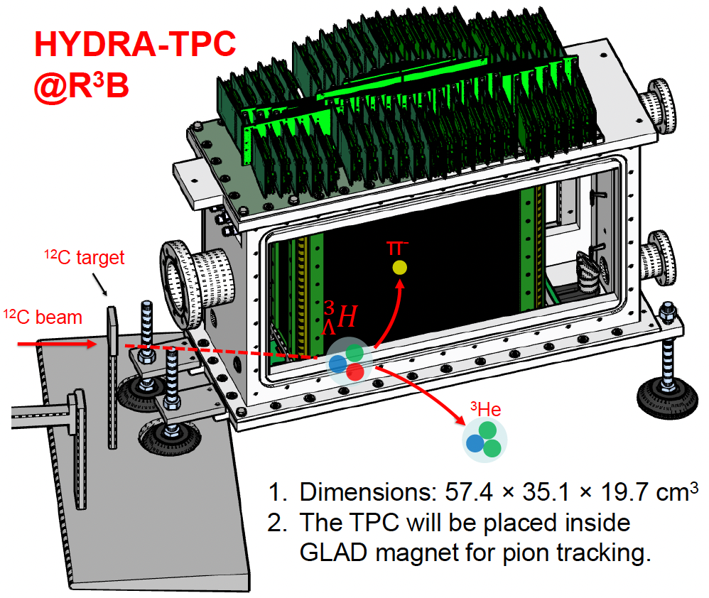
Novel gaseous detectors at GSI
MPGD structures R&D
MPGDs with resistive layers
Micro-RWELL
New materials (e.g. Mo-GEM)
Spark-Less Amplification Microstructures
MPGDs with pixel readout (e.g. GridPix)
TPCs
Wide dynamic range
Low-pressure
Beam monitoring
Optical readout
Straws
(together with FZJ)
Mechanics and material studies
PANDA tracker
Μ-RWELL
DLC-coated THGEM
Molybdenum THGEM
Microstrip-SLAM
Wire-SLAM
Straw tubes (FZJ)
SFRS TPC (HIP)
HYDRA TPC (TU Da + GSI)

Slide 5
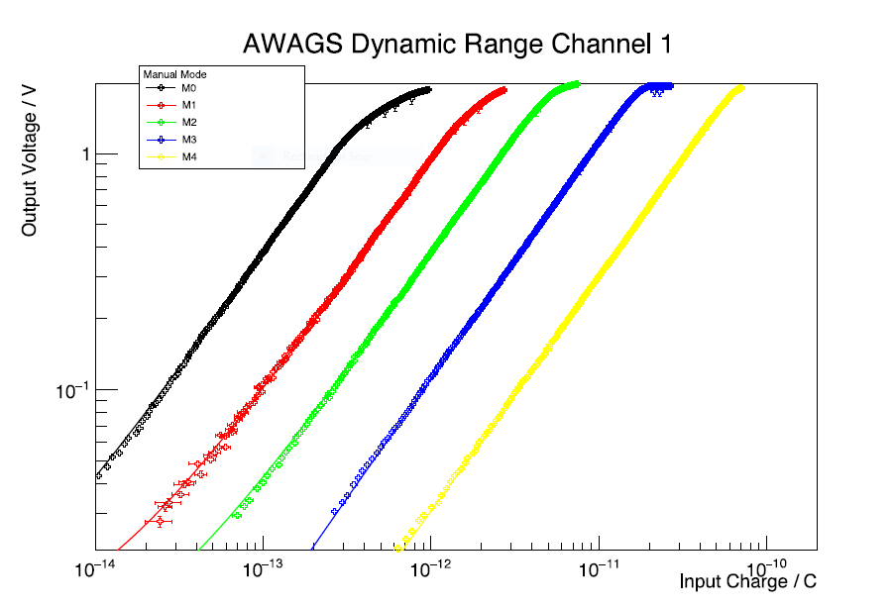
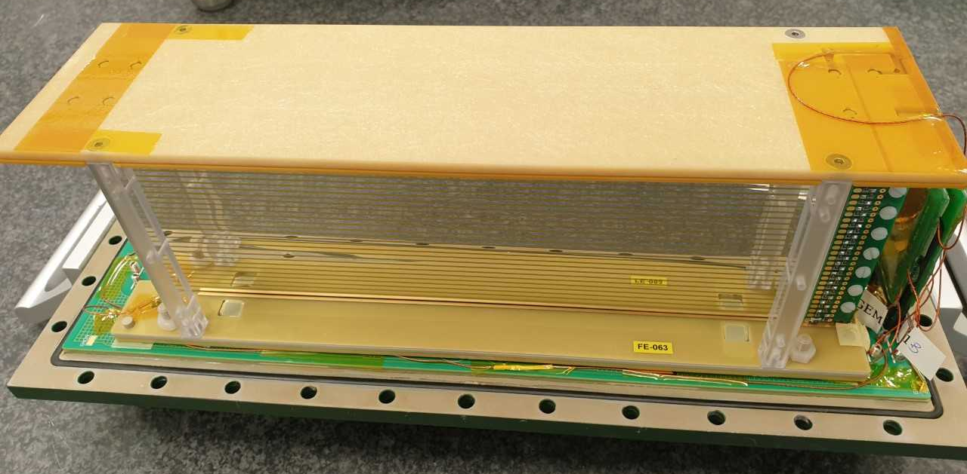
Tracking detector for heavy ions, low pressure TPCs
TPC at atmospheric and low pressure with huge dynamic range: from proton to uranium ions detection.
The Time Projection Chamber is successfully used as tracking detector for beam diagnostic in heavy ion beams facility (FRS and planned at Super-FRS and beyond)
Readout in strips of 0,25 mm with a 0,4 mm pitch
400 mm x 100 mm beam acceptance
Ar/CH₄ (90/10) starting gas mixture, but targeting no flammable gases with low transverse diffusion coefficient
Rate capability of double detector with opposite drift fields up to 2 kHz/mm²
5 gain amplification in manual or automatic mode and signal digitisation on chip and optical output
Field cage
Why is this cool?
Position determination (x,y coordinates)
Very low material budget
Uniform drift field
The CTR16* is a compact FEE (analog and digital part in one ASIC)
The CTR16 is based on the AWAGS** input stage charcterised by the huge dynamic range
Radiation tollerant ASIC
*H. Flemming, et al., JINST 17 (2022) C07002
**P. Wieczorek, et al., JINST 17 (2022) C06010
Links to others?
The FEE has been designed and developed by the EE department at the GSI
Field cage concept, design and production by B. Voss (GSI)
Initiating collaboration with TU Darmstadt (Obertelli) and INFN Frascati (Bencivenni)
At GSI: H. Flemming, S. Löchner, C. Nociforo, E. Rocco, P. Wieczorek

Slide 6
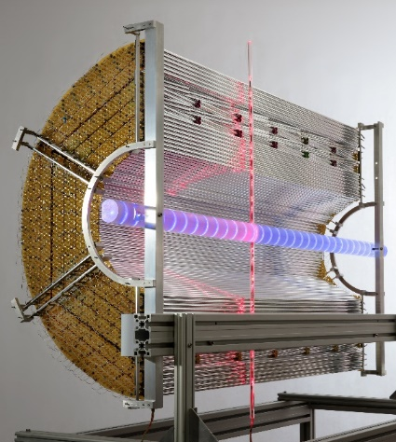
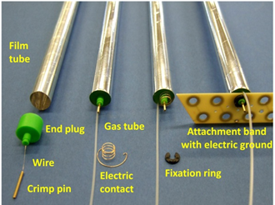
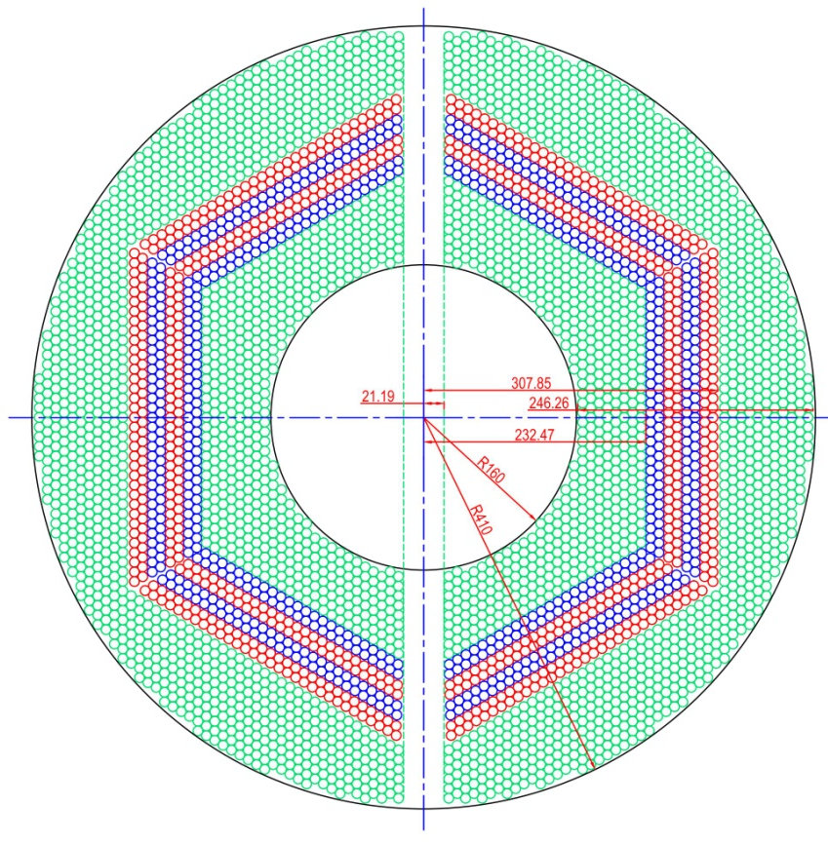
Straw Technology
Straw Tracker for Application in Hadron Physics
Technology
Gas-filled drift tubes (straws) with 27µm thin film walls (<0.04% X₀/straw)
Modules of close-packed, self-supporting straw layers at over-pressure (1 bar)
(4D+PID) Straw tracker with low material budget (<1.3% X₀ and 27 straw layers)
  Drift time readout for 3D-space and t0-extraction (4D)
  Charge readout (dE/dx) for PID in lower momentum region (<1GeV/c)
  Particle rates up to 1 MHz/straw, spatial resolution <150µm (σ)
Status: straw assemblies completed, electronic readout (ASIC) developed and existing
Next: set up one complete sector of a central barrel (4D+PID) straw tracker system
Why is this cool
Low material budget, but robust mechanics at 1bar over-pressure
Variety of detector geometries from planar to barrel shape
Next generation straw trackers have to fulfill 3D-space, t0 time and particle dE/dx measurement
Exciting straw R&D projects for new application
  ultra-thin (<15µm) straws for radiation length <0.02% X₀/straw
  ultra-long (5m) straws for large-area (50m²) tracker in vacuum
Links to others
Straw systems for HADES and PANDA at FAIR
  Partners: JU Krakow, AGH Krakow, IFIN-HH Bucharest, GSI
(4D+PID) Straw Tracker R&D project within DRD1@CERN
Broad field of straw application R&D within DRD1 beyond 2027
  High-energy physics at future colliders, Hadron physics
  Dark sector, Rare event searches, Neutrino physics

Slide 7
Sustainable operation of RPCs, Detector Gases and Climate Change

Slide 8
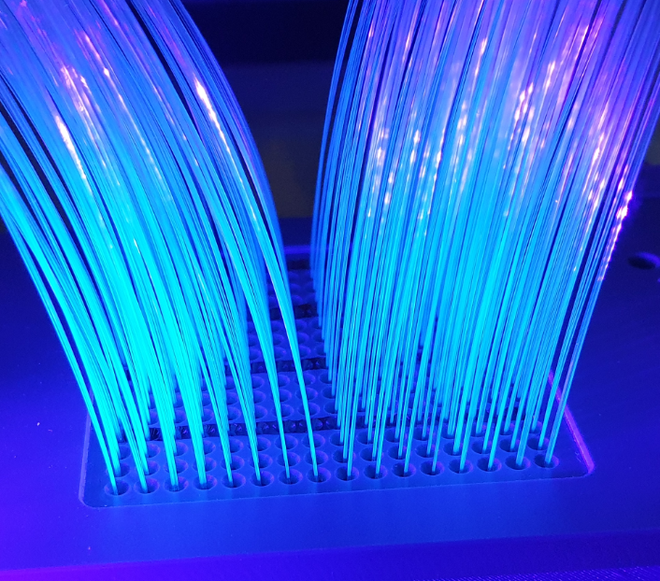
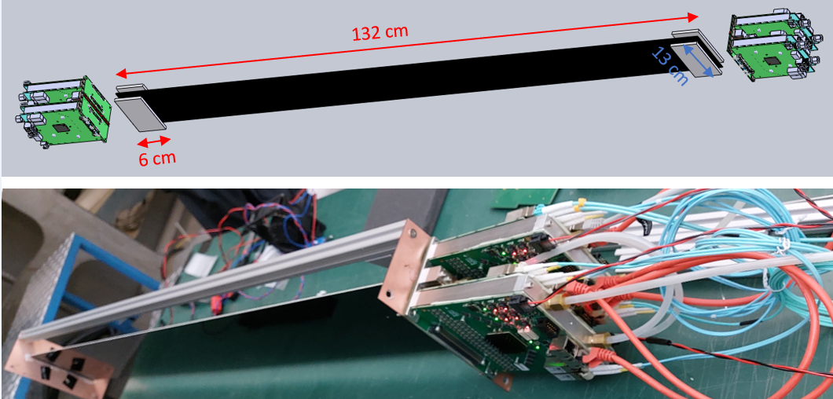
SciFi Tracker
Scintillating Fiber based 4d Tracker @ High Rates and with Large Dynamic Range
Large-area 4d Tracking detectors build from Scint. Fibers + MAPMT or SiPM
designed for tracking of ions (in NUSTAR)
Meets key challenges simultaneously :
    large area (up to approx. 200 x 100 cm2)
    large dynamic range (p to U)
    low material budget
    Fast, readout electronic designed @ GSI-EE (PreAmp+ FPGA TDC) 128 ch module with 200ps time resolution, includes ToT measurement
Proton Arm Spectrometer (PAS): multi layer ribbons for detection of protons
  55 modules, see picutre to the right / series production till 2028
SuperFRS beam tracking:
  optimization of ,form factor‘ and cooling for usage in vacuum / 15 units till 2027
Why is this cool?
One huge advantage of using fiber ribbons as active volume is the geometrical flexibility.
The low material budget and, last but not least, cost are additional positive factors.
evolution of the 3D-printing technique might pave new roads.
  inspired by e.g. photonic wire bonding one could think of printing scintillating fibers
Links to others?
• so far developed at GSI in collaboration with TU Darmstadt and Uni Frankfurt
• Besides the ’classical’ tracking detectors (e.g. LHCb upgrade) also beam monitors for e.g. therapy applications have currently been developed based on scintillating fiber ribbons.
project proposer: Christoph Caesar C.Caesar@gsi.de
Deniz Savran D.Savran@gsi.de
Michael Heil M.Heil@gsi.de

