Slide 1
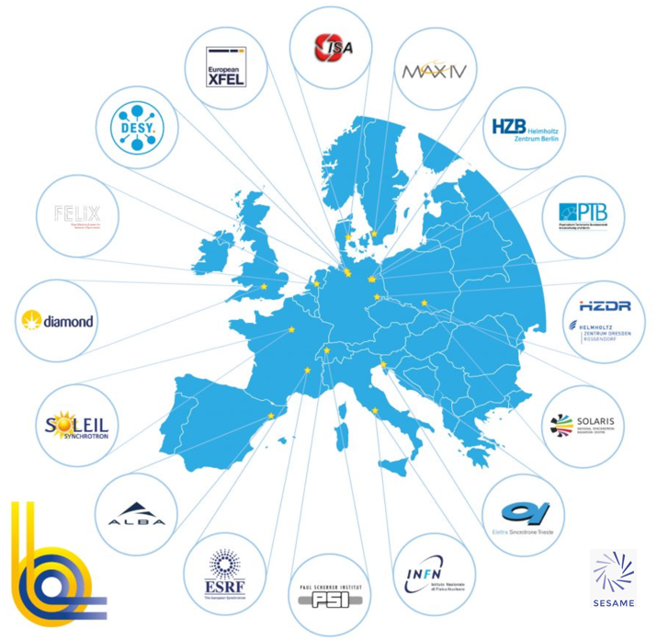
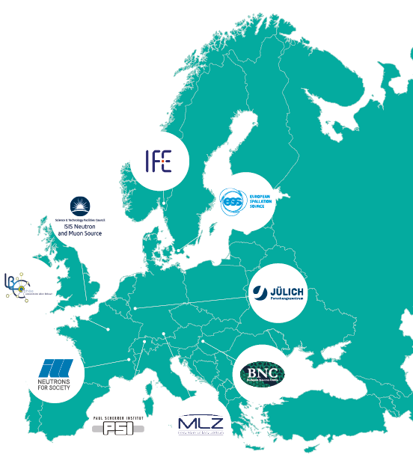
PaNOSC EOSC NODE
Next Steps
Photons (LEAPS)
Neutrons (LENS)

Slide 2
EOSC Federation Build Up Phase
The first phase of development of an operational EOSC Federation
The first wave will consist of around 7-10 nodes
The build-up phase will count on volunteer work by the participating organisations and the contribution of the EOSC EU Node.
The first wave of candidate EOSC Nodes will then kick-off the build-up phase in early 2025.
01 – Questionnaire 1
02 – 1st Stage dialogue
03 – Questionnaire 2
04 – 2nd stage dialogue
August 2024
December 2024
January 2025
January 2025
Confirm the commitment to join the build up phase of EOSC Federation
The questionnaire needs to be submitted by the 29 candidates by 07/01/2025
Focus on the organisational capacities and technical requirements to achieve the goals of the build-up phase
Expression of interest to join the EOSC Federation
121 candidates
29 candidates
29 candidates
10 candidates

Slide 3
First wave dialogue questionnaire
This questionnaire is addressed to the organisations that are invited to join the 1st stage dialogues
The inputs will be used to assess the capacity and readiness of the organisation to join the first wave of the build-up phase, with the aim to identify a reduced number of organisations to take part in the subsequent dialogue and eventually to be invited to join the first wave of the build-up phase.
Organisations are encouraged to coordinate with each other and with their thematic and/or national communities to commonly identify and propose to the Tripartite Group representative organisations to take part in the subsequent dialogue.
For PaN EOSC node, ESRF is tasked to compile the inputs from the 9 Ris which are ISIS, ILL, ESS, European-XFEL, PSI, MAX IV and ESRF, CELLS, Elettra.
NEXT Steps: Considering the imminent holiday season, all the 9 Ris listed above are requested to fill in the questionnaire and send it back to jean-francois.perrin@esrf.fr , jordi.bodera@esrf.fr, jayesh.wagh@esrf.fr by December 16, 2024 cob.

Slide 4
Next step, fill in the questionnaire latest by 16/12/2024
PaNOSC Node presented by Jean-Francois Perrin (ESRF) on 05/12/2024

Slide 5
Q1: Do you have the organisational capacity and the necessary resources to support delivering the goals of the EOSC Federation build-up phase?
Open Discussion: Approaches to Questionnaire Questions
Yes
Organizational Capacity & Current Resource Allocation: We (ESRF) possess the organizational capacity and resources to contribute to the goals of the EOSC Federation build-up phase within reason.
Example: Capable of supporting an additional 1,000 external users with data and resource sharing.
Constraints on Additional Development/Adjustments:
Limited resources are available for new development or adjustments beyond our existing infrastructure. Example: If the EOSC Federation requires a common accounting/monitoring dashboard, we currently lack the capacity to implement it or make significant modifications in our existing monitoring systems.
Key Consideration:
Our contributions are effective under the current scope but are contingent on the EOSC Federation not imposing resource-intensive additional development requirements.

Slide 6
Q3: Do you have or plan to develop an approach for sustaining your foreseen participation in the EOSC Federation after the end of the build-up phase, i.e. beyond 2025/2026?
Q2:Do you offer a digital infrastructure/system that provides access to research data
repositories and/or services that you (at least in part) would be interested to make
accessible to the users of the EOSC Federation?
Individual PaN RIs will need to provide separate responses to the related technical questions of Q2. We will then merge inputs from all the RIs as one single response to this question specifying digital infrastructure offered by the 9 RIs.
Yes
The sustainability plan will depend on the success of the EOSC federation.
Q4: What are the most pressing challenges for your organisation to join the EOSC
Federation?
Making Open Science the new normal for Photon and Neutron science. EOSC is the motor of FAIR data. If EOSC and/or PaNOSC would stop the momentum now, many activities will be (at the very least) slowed down.

