Slide 1
Writing a Simple Procedure in Karabo (How to Macro)
Anna Klimovskaia
Controls Group
Schenefeld, 01.03.2024

Slide 2
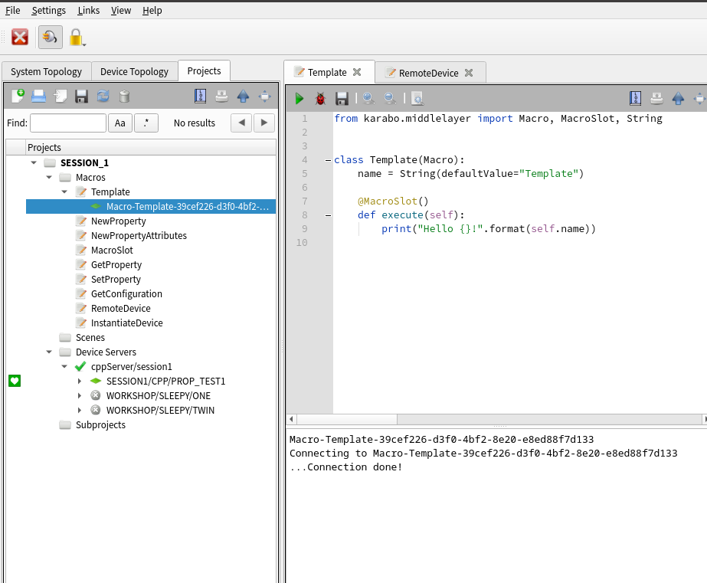
Macro Fundamentals
The Karabo framework provides scripting facilities which enable Instrument scientists to develop so-called ”macros”.
Macros are short python scripts that give the flexibility to write ad-hoc code by instrument staff directly in a karabo GUI without the involvement of CTRL group.

Slide 3
Macro Benefits
Macros can be written quickly by karabo users
Macros can be saved as part of project configurations – covers recurring task and calculations
Macros may be executed from the GUI
Simple syntax, while the same as middle-layer device
Interaction with karabo devices

Slide 4
Macro Limitation
Macros by concept should be restricted to simple
Should not have state machine (Only ACTIVE and PASSIVE automatically set)
Can be canceled
Macros utilize the Karabo Middlelayer API interface. However, macros are only suitable for simple use cases
There is no version control and limited support from CTRL group

Slide 5
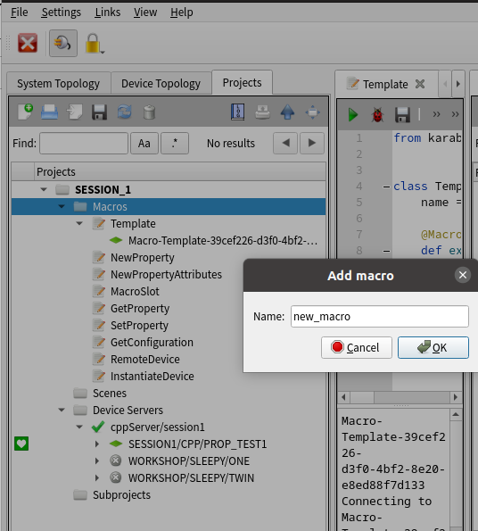
How To Create Macro
Connect to karabo (admin, localhost:44444)
Open project
Select the macro folder
Right-click and then click Add macro
Fill the dialog with a macro-name
As a result – new macro is added to the project with default content

Slide 6
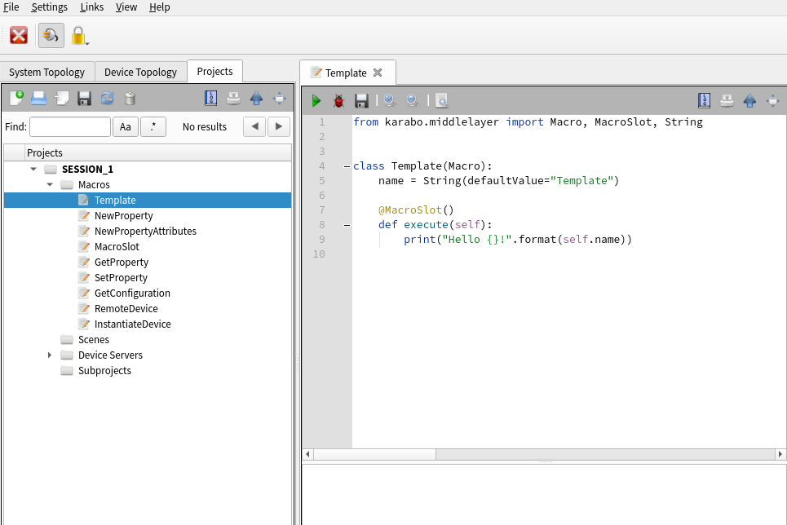
Macro Content
Import from middlelayer api
A Macro class
Properties (Karabo descriptors), e.g. String
MacroSlots to execute assigned functions
Note: A Macro always comes with a Cancel Slot – no need to define it

Slide 7
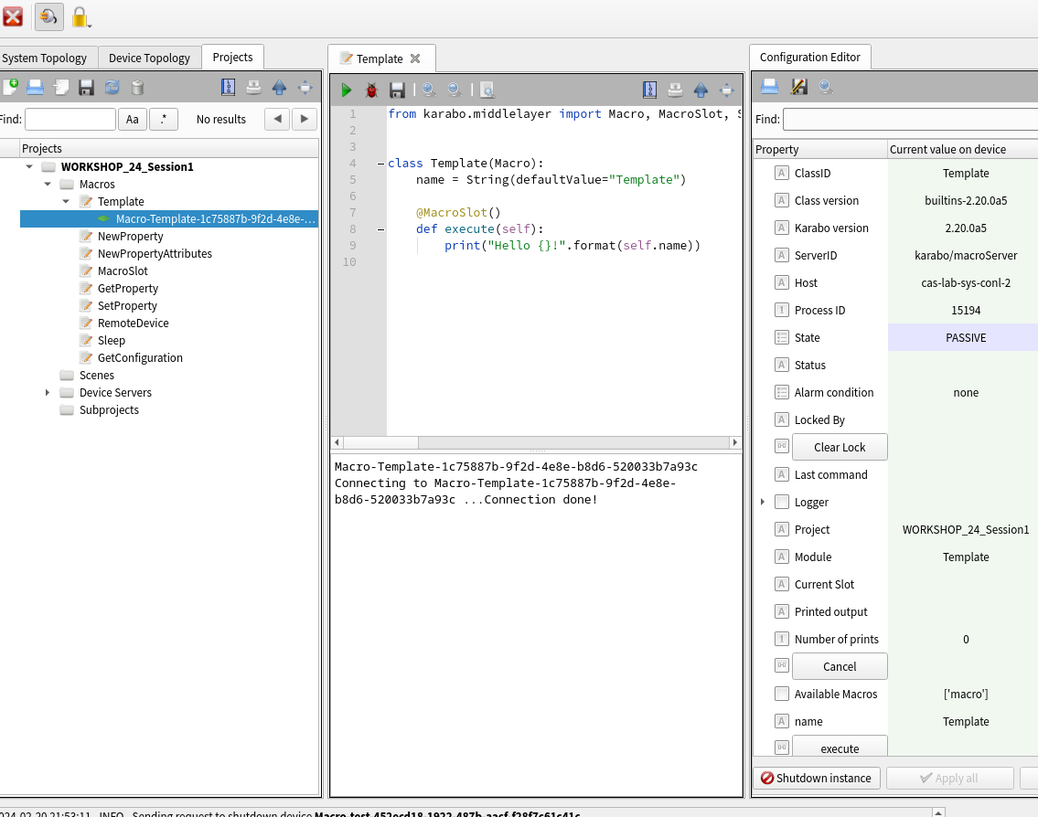
Macro Content
Import from middlelayer api
A Macro class
Properties (Karabo descriptors), e.g. String
MacroSlots to execute assigned functions
Note: A Macro always comes with a Cancel Slot – no need to define it

Slide 8
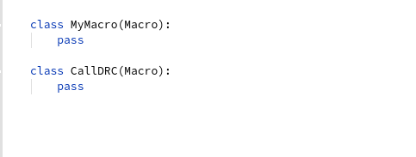
Code Style
Class Definitions – CamelCase starting with capital letter
Class Properties - camelCase, whereas non-exposed variables should have_underscores
Slots are camelCase, methods have_underscores.
It is preferred to check for conditions to be correct rather than using exceptions
Use Double and NOT Float

Slide 9
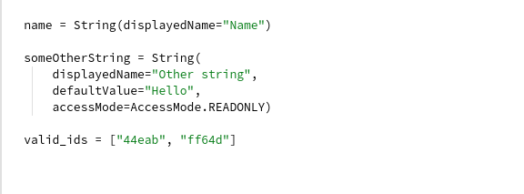
Code Style
Class Definitions – CamelCase starting with capital letter
Class Properties - camelCase, whereas non-exposed variables should have_underscores
Slots are camelCase, methods have_underscores.
It is preferred to check for conditions to be correct rather than using exceptions
Use Double and NOT Float

Slide 10
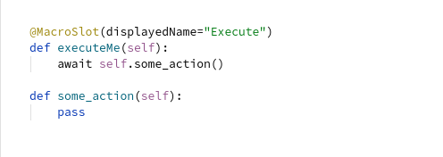
Code Style
Class Definitions – CamelCase starting with capital letter
Class Properties - camelCase, whereas non-exposed variables should have_underscores
Slots are camelCase, methods have_underscores.
It is preferred to check for conditions to be correct rather than using exceptions
Use Double and NOT Float

Slide 11
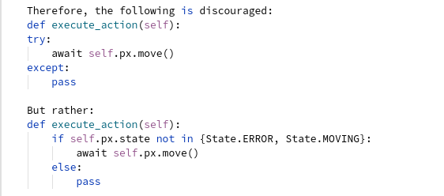
Code Style
Class Definitions – CamelCase starting with capital letter
Class Properties - camelCase, whereas non-exposed variables should have_underscores
Slots are camelCase, methods have_underscores.
It is preferred to check for conditions to be correct rather than using exceptions
Use Double and NOT Float

Slide 12
Code Examples
Template – default macro content
NewProperty – add new property
NewPropertyAttributes – property attributes
MacroSlot – add slot (button)
GetProperty – get property from another device
SetProperty – set new value to another device
GetConfiguration – get full configuration
RemoteDevice – monitor remote device
InstantiateDevice – instantiate device with required configuration

Slide 13
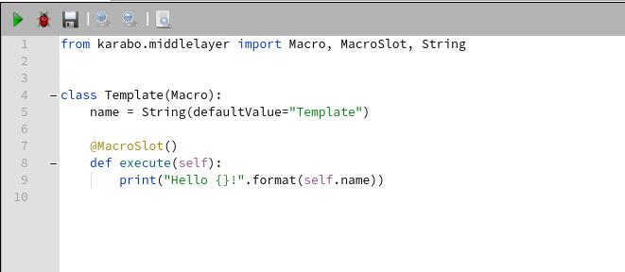
Template
Import
Instantiate on macro server
Instantiate on development macro server
Slot is a button
Execution output

Slide 14
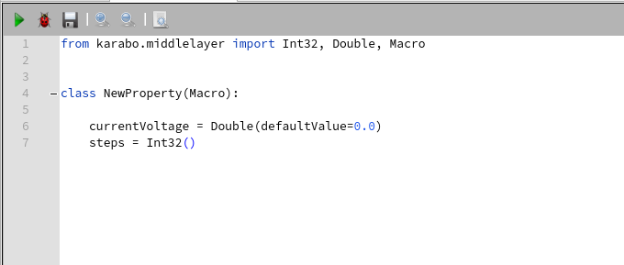
NewProperty
Different types
Properties order

Slide 15
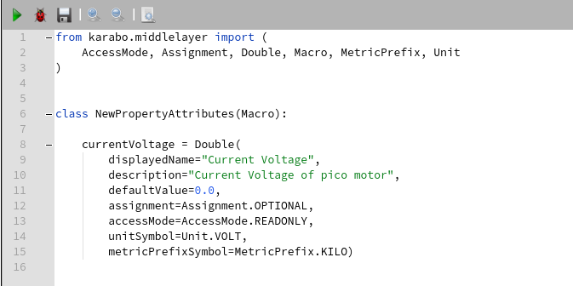
NewPropertyAttributes
Import
List of attributes

Slide 16
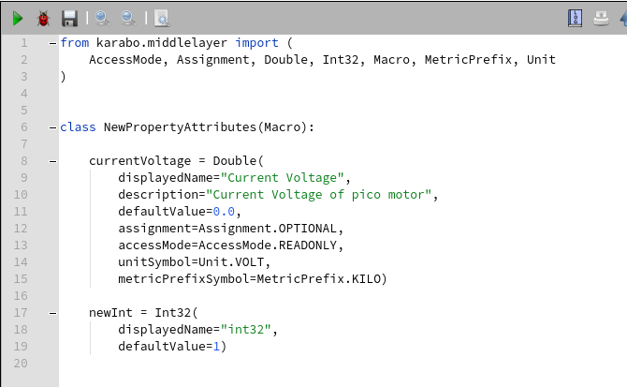
Task1 - NewPropertyAttributes
Add new Int32 property
Don’t forget to import proper type
Change property key
Set new default value

Slide 17
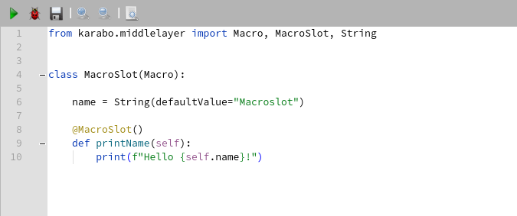
MacroSlot
Import
Execution output

Slide 18
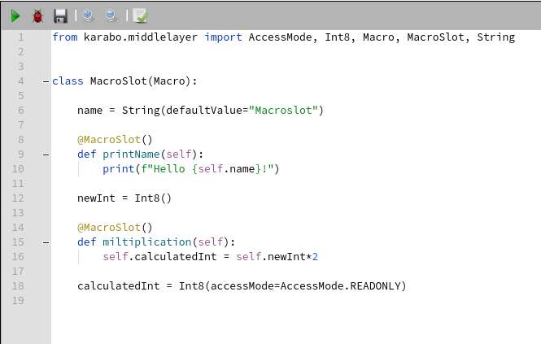
Task2 - MacroSlot
Calculate new value and set to macro property
Update import
Change displayed name
Add new properties
Set new value x2

Slide 19
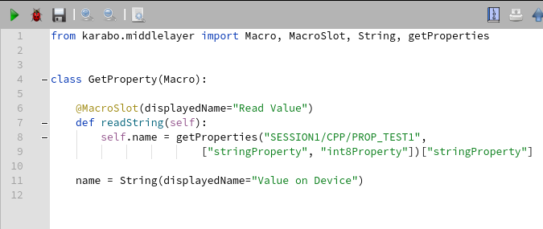
GetProperty
Import
GetProperties input parameters

Slide 20
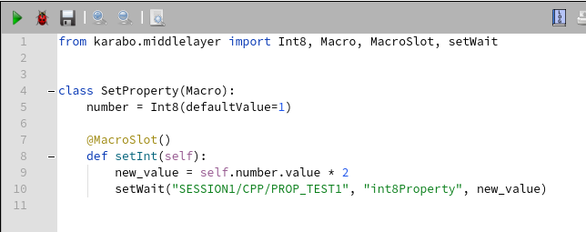
SetProperty
Import
Scene Set_Value

Slide 21
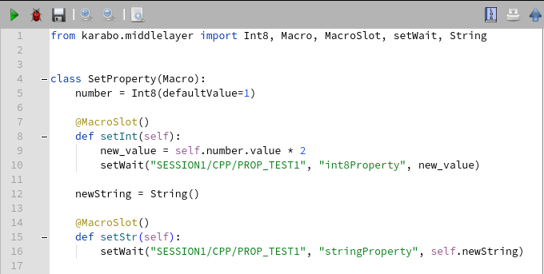
Task3 - SetProperty
Add new slot to set any other property on remote device
Don’t forget to import proper type
Change property key
Change set property key

Slide 22
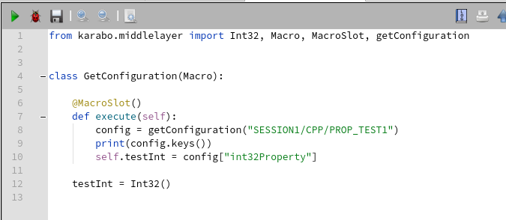
GetConfiguration
Import
getConfiguration input parameters

Slide 23
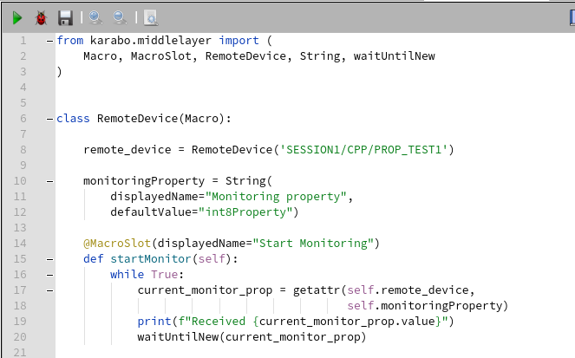
RemoteDevice
Import
RemoveDevice input parameters
WaitUntilNew
Change monitoring property

Slide 24
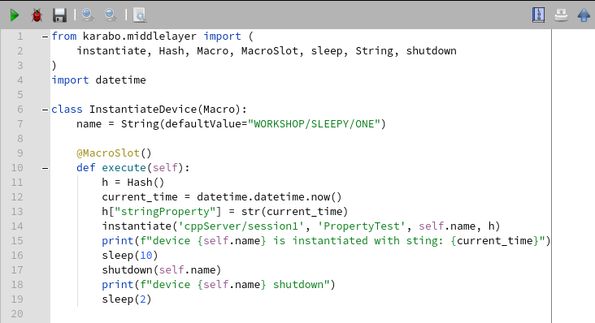
InstantiateDevice
Import
Sleep
Set several properties on instantiation

Slide 25
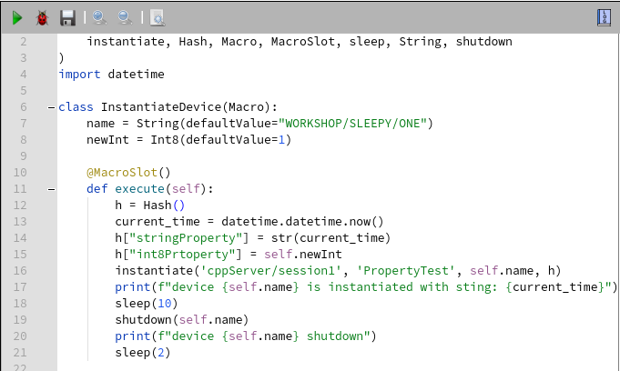
Task4 - InstantiateDevice
Add several properties to initial device configuration
Import types
Add new property to hash

