Slide 1
Karabo Developer Workshop: Writing (and Maintaining) a Middlelayer Device
Gero Flucke
Controls Group
Schenefeld, March 1st, 2024

Slide 2
Python asyncio as Foundation of the Karabo Middlelayer API
This tutorial is about writing a Karabo device using the Middlelayer (MDL) API
MDL is written in Python,
Largely relying on the advanced asyncio package – main take away:
coroutines, declared with async def asyncFunction(..):
to directly execute them, call with await asyncFunction(arguments)
(for experts: or use gather, allCompleted, background, etc.)
Technically, this allows cooperative multi-tasking in a single thread: at any await, other code can be executed before your coroutine continues
Note that also macros are based on MDL, but hide the async nature
“Synchronised coroutines” (a Karabo feature of many Karabo methods)
just work without await if used in a normal method (i.e. not in a coroutine),
but if used in a coroutine, the await has to be added (Caveat when converting a macro to a device!)

Slide 3
Karabo Middlelayer Device Basics
A Karabo MDL device is a class inheriting from karabo.middlelayer.Device
also other MDL classes and function should be imported from karabo.middlelayer
Do not mix with karabo.bound_api!
The simplest way to add a property is by adding something like this to the class:
propertyName = PropertyType(attribute1=aValue, attribute2=anotherValue, …)
Property types are e.g. String, Double, Int64, VectorBool, …
In this tutorial we will touch these attributes: displayedName, description, defaultValue, allowedStates, accessMode, unitSymbol, metricPrefixSymbol
E.g. myString = String(accessMode=AccessMode.READONLY, defaultValue=“Text”)
A slot is a coroutine with the @Slot decorator – the decorator can take attributes, e.g.

Slide 4
Selected Middlelayer Device Members
def __init__(self, config): If implemented, do not forget super().__init__(config)
async def onInitialization(self):
called once the device is up and participating in communication
use to connect to hardware or remote devices
self.state property: any of State.UNKNOWN, State.INIT, ...ON,...OFF,...MOVING,...
governs the state machine restrictions, i.e. what can/cannot be done when
self.status, a String property to convey information to the operator via Text Log widget of the GUI
self.logger.[info|warn|error](“message”)leaves message with timestamp etc. in log file
A note on setting properties:
self.property = value does not immediately publish the update.
Done at next await
But even if self.property is identical to value, a message is sent!
Often one may not want that, i.e. better check against equality before setting

Slide 5
Selected Tools for Interaction with Other Devices
dev = await connectDevice(remoteDeviceId):
an always up-to-date proxy to the remote device
to access remote device properties: remoteValue = dev.remoteProperty
to set remote properties: dev.remoteProperty = newValue
note: again, message to actually set the property is not sent immediately, but at next await
to call remote slot, e.g. await dev.move()
Lighter variant (not always up-to-date): await getDevice(remoteDeviceId)
await waitUntilNew(dev.state, dev.propertyA, dev.propertyB, …):
wait until any of the given properties has a new value
await waitUntil(function):
wait until the given function (e.g. lambda) containing remote device properties returns True
E.g. await waitUntil(lambda: dev.state == State.ON)

Slide 6
Documentation
If you want a deeper insight into coroutines and await: Read Python asyncio documentation
https://docs.python.org/3.11/library/asyncio-task.html
Middlelayer how-to documentation:
https://rtd.xfel.eu/docs/howtomiddlelayer/en/latest/chap1/intro_device.html
https://rtd.xfel.eu/docs/howtomiddlelayer/en/latest/chap2/intro_device_proxies.html

Slide 7
Development Tools and Procedures
Uniform coding style eases code readability and thus serves maintainability
We use flake8 and isort
Our git/GitLab development cycle for any new feature, bug fix or first implementation:
Start development by creating new branch from main branch: git checkout –b newBranch
Local git add changed_or_new_file.py and git commit
Push to GitLab: git push origin newBranch
Create “Merge Request” (MR) in GitLab (https://git.xfel.eu)
Should trigger tests of package (“Continuous Integration”, CI) in GitLab
Code review via GitLab (https://git.xfel.eu)
probably iterate with further push and review
Once review receives LGTM (“looks good to me”): merge via GitLab interface
Go back to main branch and pull the updates
git checkout main
git pull --prune --tags
Only tagged versions should be deployed (format: MAJOR.MINOR.PATCH, e.g. 2.19.3)

Slide 8
Hands-On
Part 1

Slide 9
Developing a Karabo Device: Prerequisites
What you need:
A running Karabo installation
Not a production installation!
Best is a local standalone one as in our VISA virtual machine.
A running Karabo GUI
A command line terminal with a Linux shell
An editor (vscode, PyCharm, emacs, gedit, vim, …)
For version control, a git installation is needed
Best with access to our EuXFEL GitLab https://git.xfel.eu/
First steps in terminal (not now!)
source ~/karabo/activate (in each new shell)
karabo-start (to start various Karabo servers)
Some code to start with
Create package from scratch (not now): karabo new thePackageName middlelayer
Or start from an existing one (already done in the virtual machine): karabo develop –b 1_initHello karaboWorkshop

Slide 10
Command Line Tools for an Activated Karabo Environment (Skip!)
karabo-check
karabo-start mdlServer/session2_a (starts single server)
karabo-start (no argument: acts on all servers)
karabo-add-deviceserver mdlServer/session2_c middlelayerserver
Creates new (middlelayer) server
Other commands:
karabo-stop (for clean shutdown of all servers)
karabo-kill –t <serverId> (for clean shutdown and restart of one) e.g. karabo-kill –t mdlServer/session2_a
karabo-kill –k <serverId> (to ‘kill -9’ a hanging process)

Slide 11
General Procedure for this Tutorial (Skip!)
cd ~/karabo/devices/karaboWorkshop
git checkout <XXX>
Restart mdlServer/session2_a
Via karabo-kill -t mdlServer/session2_a in a terminal with activated Karabo
Or via GUI
Start KARABO_TEST/MDL/HELLO_WORLD from project SESSION2 (database WORKSHOP)
Try out
Repeat until happy:
Edit: ~/karabo/devices/karaboWorkshop/src/karaboWorkshop/HelloWorld.py
Restart mdlServer/session2_a
Start device again from project
Try out
git diff <XXX>_done to compare with my solution
git stash to hide your code, but keep it available
git checkout <YYY>
Try out, edit code, …

Slide 12
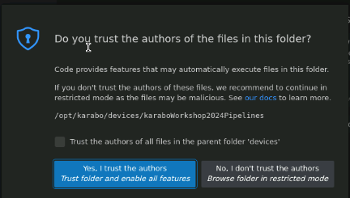
Hands-on in VISA: Start Our First Device
Do now in command line shell:
Note: all commands are attached to session in indico to copy/paste
source ~/karabo/activate
cd ~/karabo/devices/karaboWorkshop/
Sorry - please fix up the installation (see session2_copypaste.txt attached to hands-on):
git tag –d 1_initHello
pip install -e .
git tag 1_initHello
Open file in editor, e.g. via visual studio code (just click “Yes I trust…” and “Install” if these pop up)
code .
navigate to edit src/karaboWorkshop/HelloWorld.py
Optional: karabo-xterm mdlServer/session2_a to see log files
Some bugs prevent that the device starts, but show up only in these logs
karabo-start

Slide 13
Hands-on in VISA: Start Our First Device
Now use GUI:
Start GUI from icon, connect to localhost:44444
Open project SESSION2 (from database CAS_INTERNAL)
Start KARABO_TEST/MDL/HELLO_WORLD from
Press execute hello slot in Configuration editor
Watch how greeting property changes

Slide 14
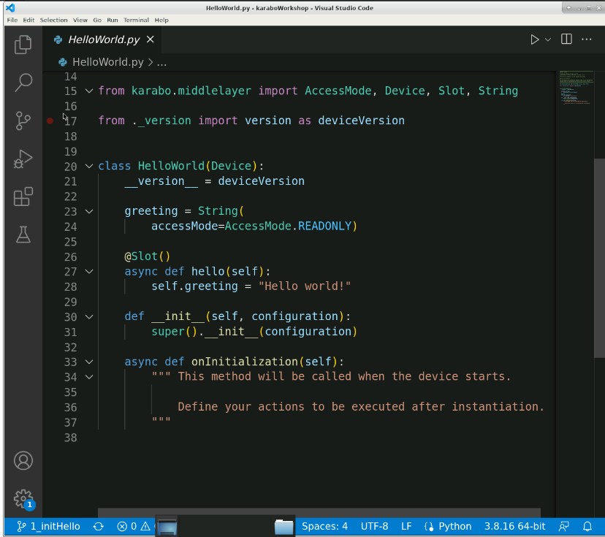
Hands-on: The Device Code
This is the skeleton – almost as you get it from the templates via karabo new helloWorld …
You will now work on your own
Extend HelloWorld.py in three exercises.
Then follow more exercises on a MotorProcedure.py.
Raise your hand if you need help.
To get your code changes active, save and shutdown mdlServer/session2_a
Not all code needs to be typed by you:
All steps are prepared for you via tags
git checkout <someTag>
if it complaints since you edited changes: first do git stash
git diff <aTag> <nextTag>

Slide 15
Hands-on: Property and Slot with Attributes
It is good practice to
make properties and slots appear in GUI as full, capitalized words,
add a description,
provide defaults where it makes sense.
Exercise:
Add displayedName, description attributes to property and slots and defaultValue for property
Simple hands-on (just to warm up):
git checkout 2_decorate
See how all but displayedName for slot hello is achieved
E.g. git diff 1_initHello 2_decorate
Start device again and try out (Do not forget to restart the server!)
Edit HelloWorld.py
Add the missing displayedName (e.g. “Hello Procedure”) for slot hello
In doubt, git diff 2_decorate 2_decorate_done shows what to do
Try out the device after your changes!

Slide 16
Hands-on: State Handling for Slots
Karabo devices should be in a well defined state
UNKNOWN (the default) means: lost contact to resources, e.g. hardware
The device base class defines self.state variable
Predefined (long…) list: State.ON, State.OFF, State.MOVING, State.ERROR, …
Depending on its state, actions on the device are allowed or not
Exercise:
Set device to OFF (or ON) in the beginning
Add slots off and on that switch to the corresponding states OFF and ON
But define allowedStates such that off slot can only be called if in ON state and vice versa
Also hello slot should only be callable in ON state
See how that is achieved for all but the on slot
E.g. git diff 2_decorate_done 3_states
Hands-on:
git checkout 3_states (if git complains since you edited: git stash before)
Restart device, try out and add the missing on slot (Do not forget to restart the server!)
In doubt, git diff 3_states 3_states_done shows what to do

Slide 17
Hands-on: Reconfigurable Properties with State Handling
So far, our property greeting could only be set from inside device code (since READONLY)
Exercise:
explicitly mark greeting as reconfigurable at run time (that would have been the MDL default…),
but only if in state OFF
Hands-on:
See how making it reconfigurable is achieved
E.g. git diff 3_states_done 4_reconfig
git checkout 4_reconfig (git stash before?)
Try out and add the restriction of the OFF state
In doubt, git diff 4_reconfig 4_reconfig_done shows what to do

Slide 18
Hands-On
Part 2

Slide 19
More on States and Slots
So far, our slots did not do much:
Their execution did not take long
and therefore their success (or failure) was quickly reported to the GUI (or whoever called them)
A procedure is different by nature:
First do something, then another thing, then wait a bit and finally do a third thing, …
If all this is directly programmed into a slot, it would time out
For @MacroSlot used in macros, the timeout is essentially swallowed
➔ Longer procedures (even like simple motor movement) have this pattern in Karabo:
A slot only triggers the procedure, i.e.
switches to some “*ING” state (e.g. MOVING, PROCESSING, CHANGING, STARTING, …)
and triggers the procedure, i.e. in MDL puts it into the background
If procedure done, leave “*ING” state again
Often to the state in which the slot can again be executed

Slide 20
Hands-on: Simple Motor Procedure
Exercise:
A new MotorProcedure device in ~/karabo/devices/karaboWorkshop/src/karaboWorkshop/MotorProcedure.py
Its slot moveMotor
connects to another device,
sets its targetPosition,
lets it move,
and waits until motor movement is done (i.e. motor not in State.MOVING anymore)
Hands-on:
Start device KARABO_TEST/MOTOR/X from project SESSION_2
Look at source code and the interplay between slot moveMotor and method motor_procedure
Add the three missing steps and try out (tip: await waitUntil(…))
You may monitor a bit what goes on with the scene SteerMotor (not everything on the scene is already available)
In doubt, git diff 4_reconfig_done 5_simple_done shows what to do

Slide 21
Hands-on: Monitoring Another Device
A device may want to constantly monitor another device and react on changes
Exercise:
Extend the MotorProcedure device:
add a Double property distanceToTarget
add a coroutine monitor_task()
put that into the background (in onInitialization)
monitor_task should
connect to the motor device,
whenever its targetPosition or actualPosition change, assign the difference to distanceToTarget
Hands-on:
git checkout 5_simple_done
Try to implement this (tipp: await waitUntilNew(..))
In doubt, git diff 5_simple_done 6_monitor_done shows what to do
or just git checkout 6_monitor_done, try out and investigate

Slide 22
Hands-on: Extend Motor Procedure to Three Steps
So far we just moved the motor
Could have done using the motor directly.
Now let’s have more steps in our procedure!
Exercise:
Extend to the motor_procedure() to
cache actualPosition and targetVelocity of the motor,
after first movement, sleep 5 seconds, move back at half speed, reset targetVelocity
(Extra: inform operators about what is going on by updating self.status)
Hands-on:
git checkout 6_monitor_done
Try to implement exercise
In doubt, git diff 6_monitor_done 7_3steps_done shows what to do
or just git checkout 7_3steps_done, try out and investigate

Slide 23
Hands-on: Cancel a Procedure
While a long running procedure executes, you may notice that things go wrong
We need something to cancel the procedure!
Exercise:
The background actually returns a future with that one can handle an ongoing procedure
Keep track of that in a member variable (e.g. self.task)
Add slot cancelMoveMotor that
has the proper allowedStates
calls cancel() of the future (and resets the holding the variable)
resets the state of the MotorProcedure to State.ON
(Extra: inform operators about cancellation by updating self.status)
Hands-on:
git checkout 7_3steps_done
Try to implement this
In doubt, git diff 7_3steps_done 8_cancel_done shows what to do
or just git checkout 8_cancel_done, try out and investigate

Slide 24
Hands-on: Make the Cancel Clean
Did you notice:
When we cancel our procedure while the motor moves, the motor just goes on!
If we cancel when moving back at half speed, the actualVelocity stays at half speed
Exercise:
Cancelling a future actually injects an asyncio.CancelledError, so better
protect the procedure with try:,
use finally: to do everything that needs to be cleaned-up (no matter if cancelled or not),
in except CancelledError: take care that motor stops
Caveat: if cancelled while we sleep, motor cannot be stopped since not moving!
Hands-on:
git checkout 8_cancel_done
Try to implement this
In doubt, git diff –b 8_cancel_done 9_cancelClean_done shows what to do
‘-b’ ignores changes of whitespace
or just git checkout 9_cancelClean_done, try out and investigate

Slide 25
Hands-on: Basic Testing as Good Developer Practice
A device is something long lived and probably will be developed further
How to make sure that a new feature does not break an existing one that you carefully tested?
You tested with the current Karabo version (and that of other libraries).
How to ensure that newer versions do not break your code?
Exercise:
Automated test procedures are needed!
tests should reside in …/src/karaboWorkshop/tests
We use the pytest and the “continuous integration” (CI) of GitLab
Hands-on:
git checkout 9_cancelClean_done
Have look at …/tests/test_helloworld.py
It is close to what karabo new … creates for you
pytest src/karaboWorkshop/tests/
git checkout 10_withTests_done and see how …/tests/test_motorProcedure.py tests basics of the procedure
In practice, it is tough to fully test procedurse since interacting with other devices…

Slide 26
Hands-on: Cancellation Still Has Loop Holes
Did you try to shutdown the motor during the procedure?
During the first movement?
During the sleep?
During the second movement?
Exercise:
Make use of the feature that dev.state will become State.UNKNOWN if the device behind proxy dev shuts down.
But since that is also a valid state for a device, check isAlive(dev)to take care of the device shutdown
Hands-on:
Do on your own now…

Slide 27
THE END: ENJOY YOUR LUNCH BREAK

