Slide 1



The PETRA IV machine project
Accelerator Middlelayer Workshop 19th-21th June 2024
Riccardo Bartolini
PETRA IV Machine Project Leader
DESY, June 19th 2024

Slide 2
  Outline
Scope of the PETRA IV machine project
Design challenges
Highlights of technical subsystems
Alternatives for the pre-injector
Conclusions

Slide 3
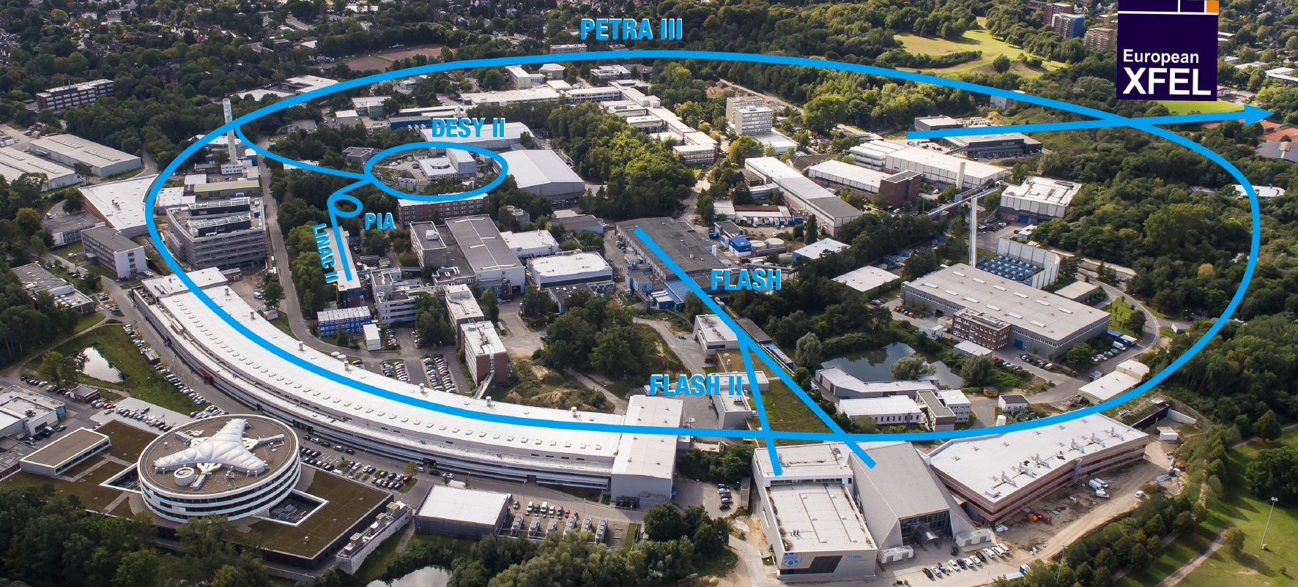
  PETRA III is one of the core facilities at DESY
Each year ~5000h of operation serve more than 3300 users
Ada Yonath Hall
Extension Hall East
Parameter | PETRA III
Energy [GeV] | 6
Circumference [m] | 2304
Emittance (hor./vert.) [nm] | 1.3 / 0.013
Total current [mA] | 100
Max von Laue Hall
Paul P. Ewald Hall
Extension Hall North

Slide 4
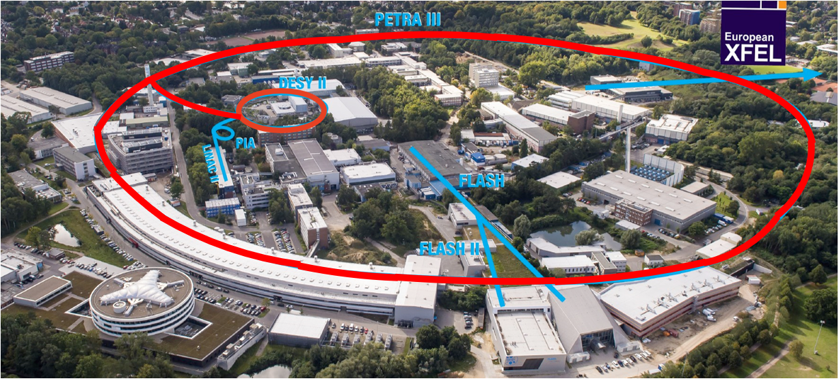
  PETRA III is one of the core facilities at DESY
Each year ~5000h of operation serve more than 3300 users
Ada Yonath Hall
Extension Hall East
Parameter | PETRA III
Energy [GeV] | 6
Circumference [m] | 2304
Emittance (hor./vert.) [nm] | 1.3 / 0.013
Total current [mA] | 100
PETRA III emittance 1300 pm
PETRA IV emittance 20 pm
65 times smaller
enabling 500 times larger
X-ray beams brightness
Max von Laue Hall
Paul P. Ewald Hall
Extension Hall North
PETRA IV project:
replacing PIII with an ultra-low emittance ring, adding a new Experimental Hall in two more octants,
replacing DESY II with a new low emittance booster

Slide 5
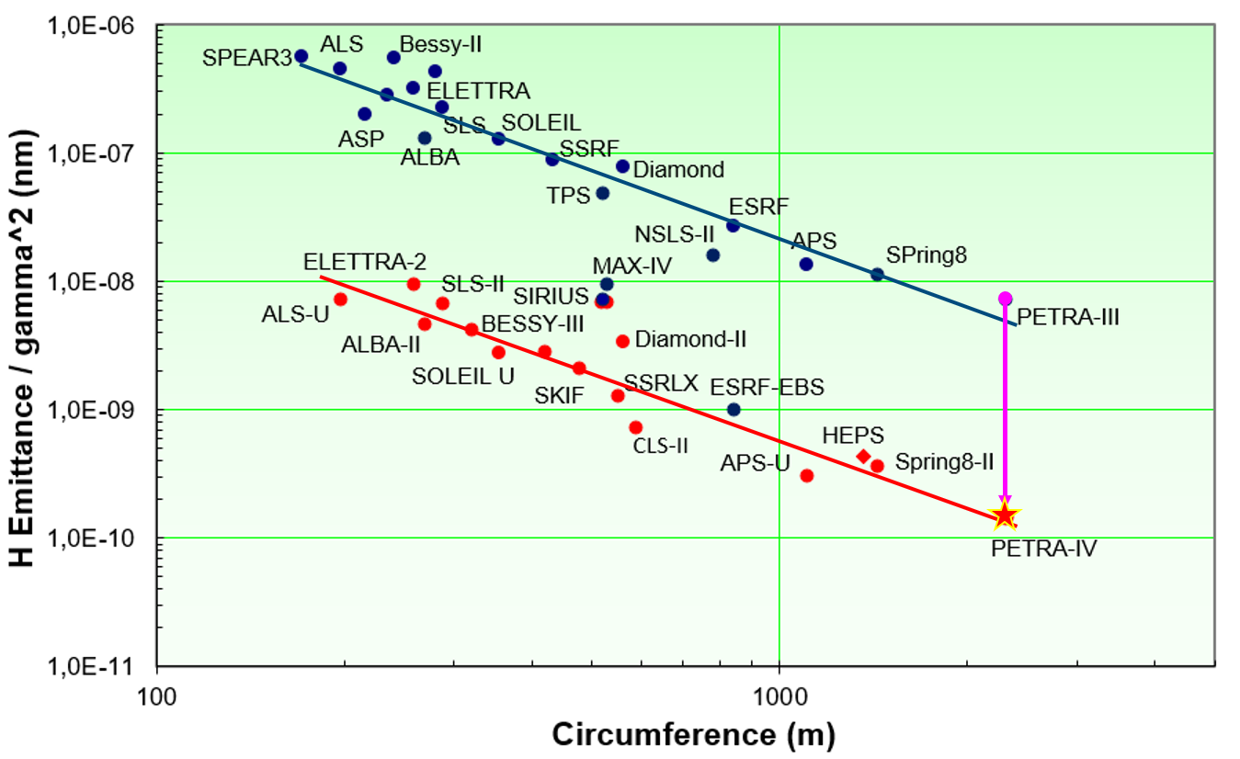
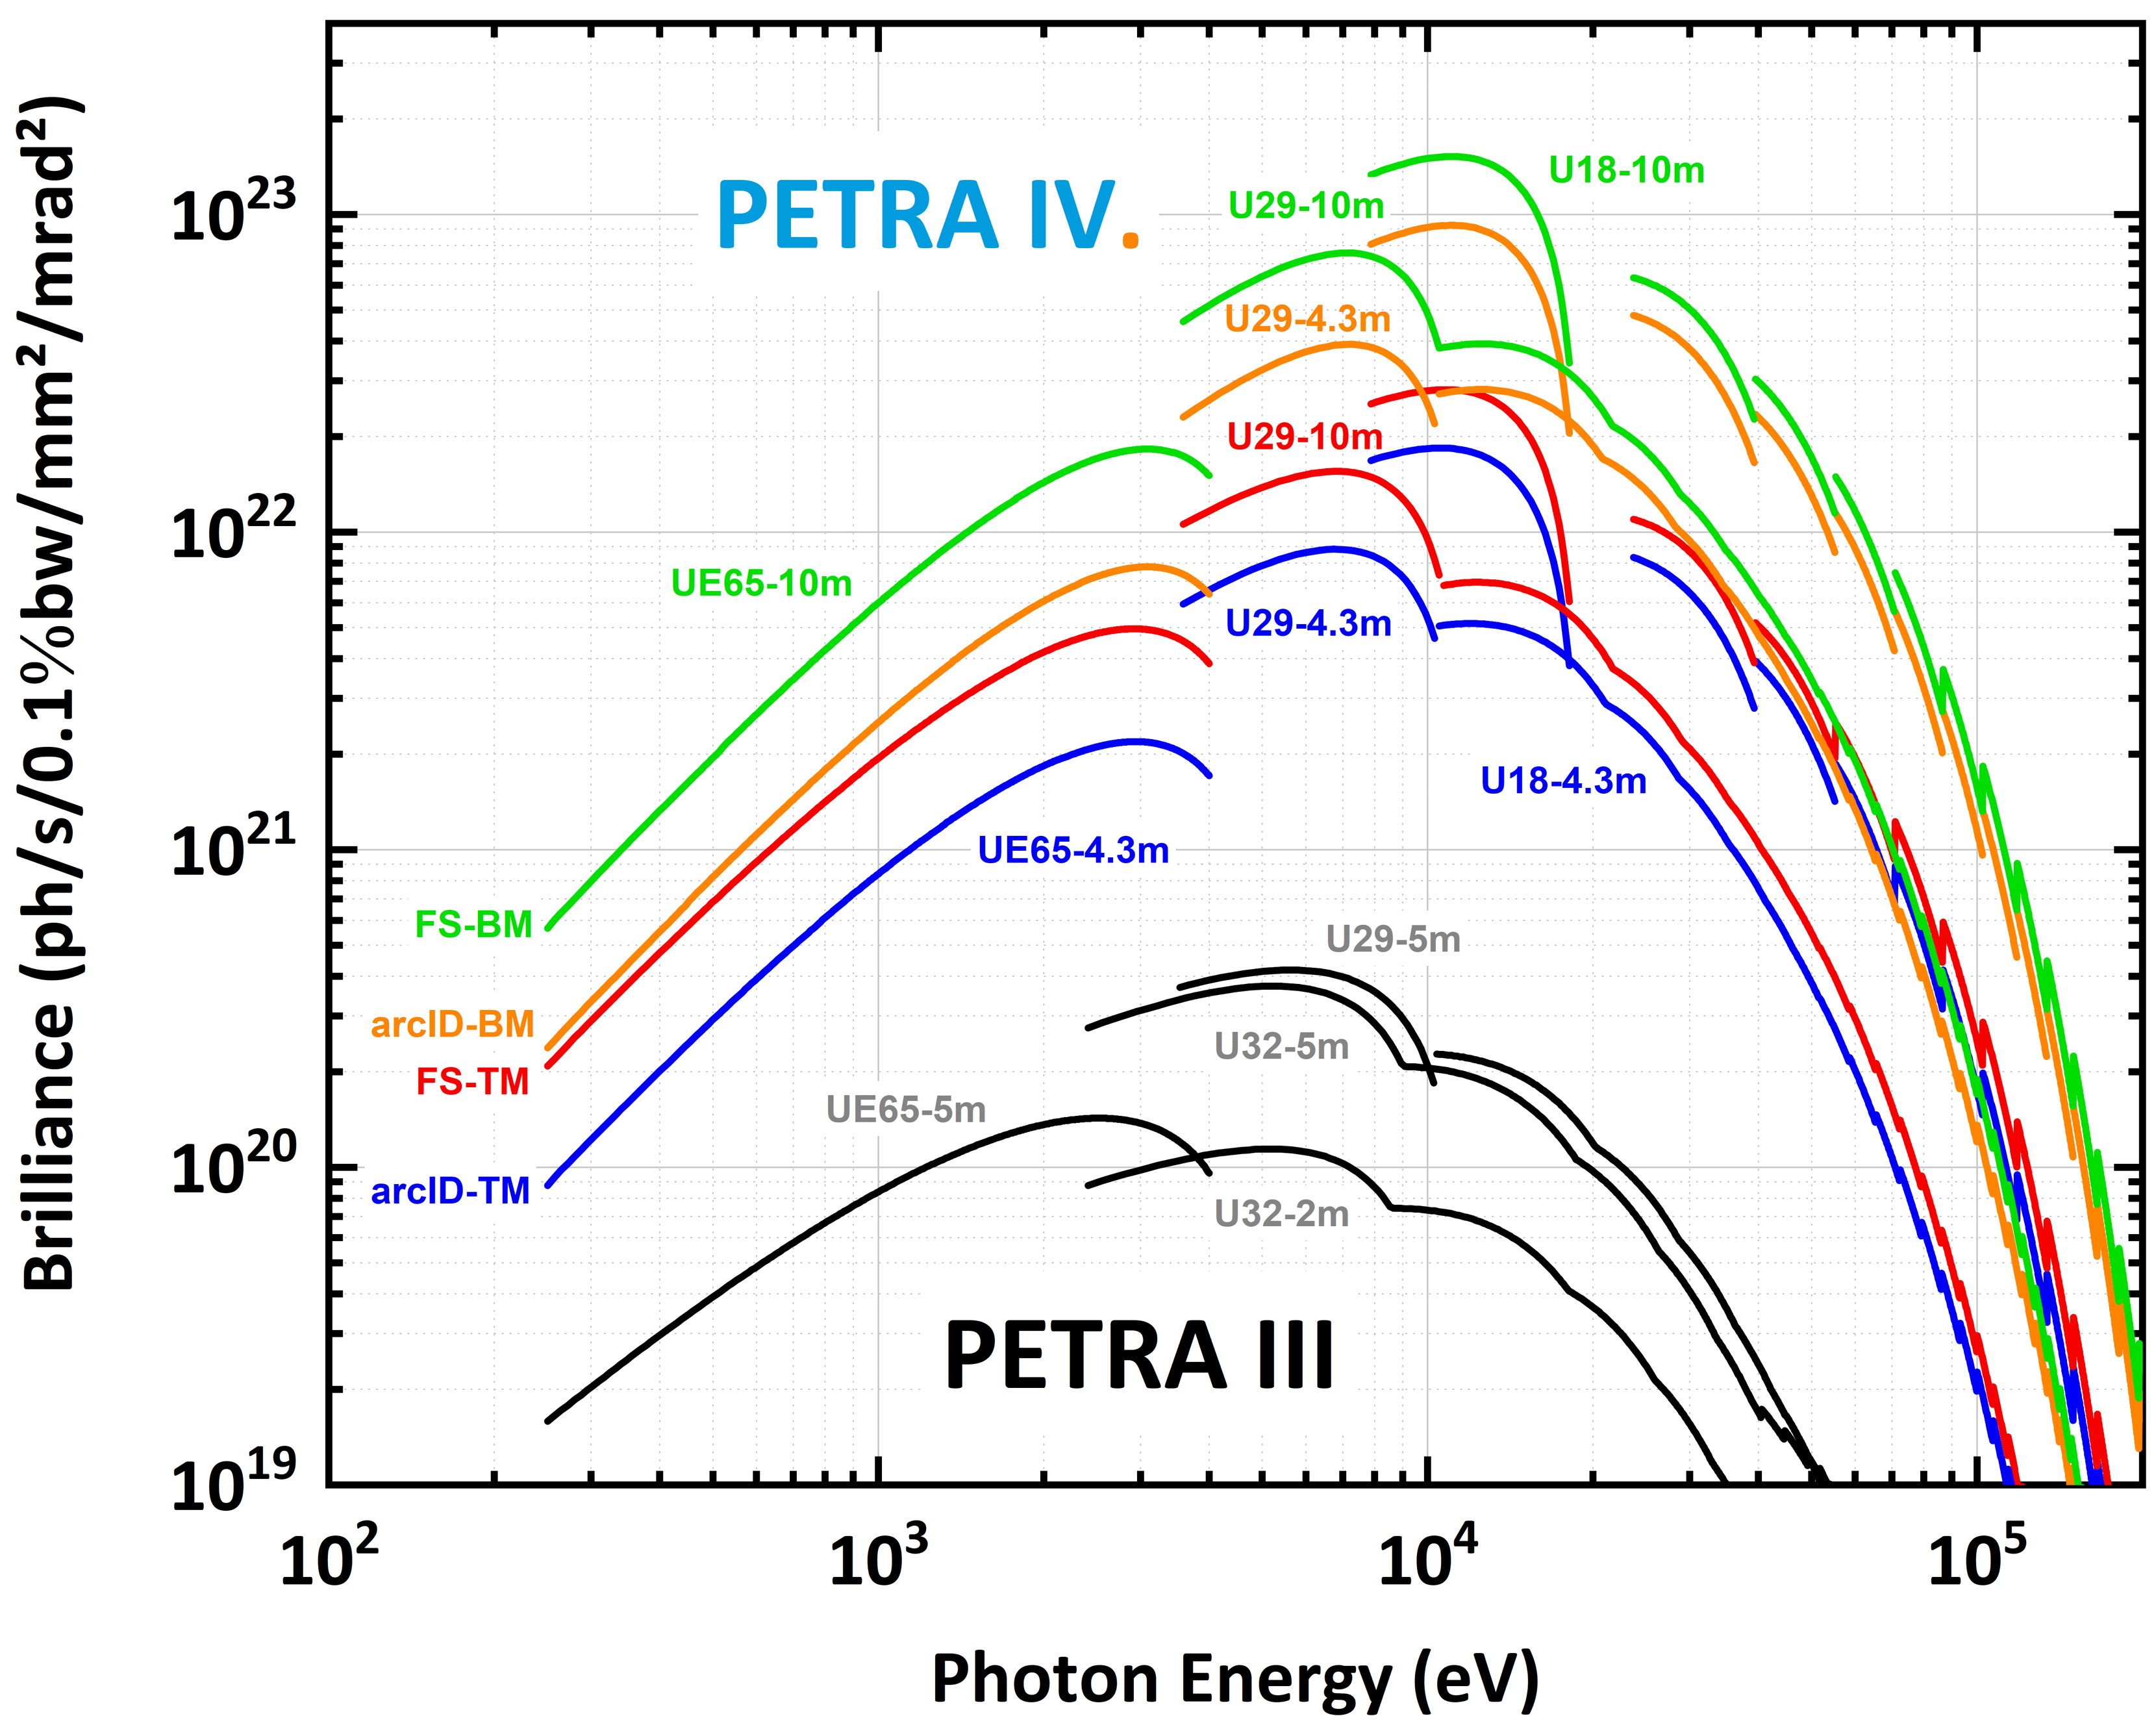
  Landscape of low emittance rings
decreasing electrons emittance ⇒ increasing X-ray brightness
DBA/TBA
MBA
+ technology
emittance: : ~ 20 x 4 pmrad²
undulators: 4.3 m and 10 m
optimised beta 2.2 m
ring current: 200 mA
Brightness increase: 500-1000
Multibend achromat technology underpins the development of diffraction-limited light sources
APS-U 42 pm (2024); HEPS <60 pm (2025); SPring8-II 50 pm (2029); PETRA IV 20 pm (2030);
Ultra-low emittance rings provide high brightness and coherence up to high photon energies

Slide 6
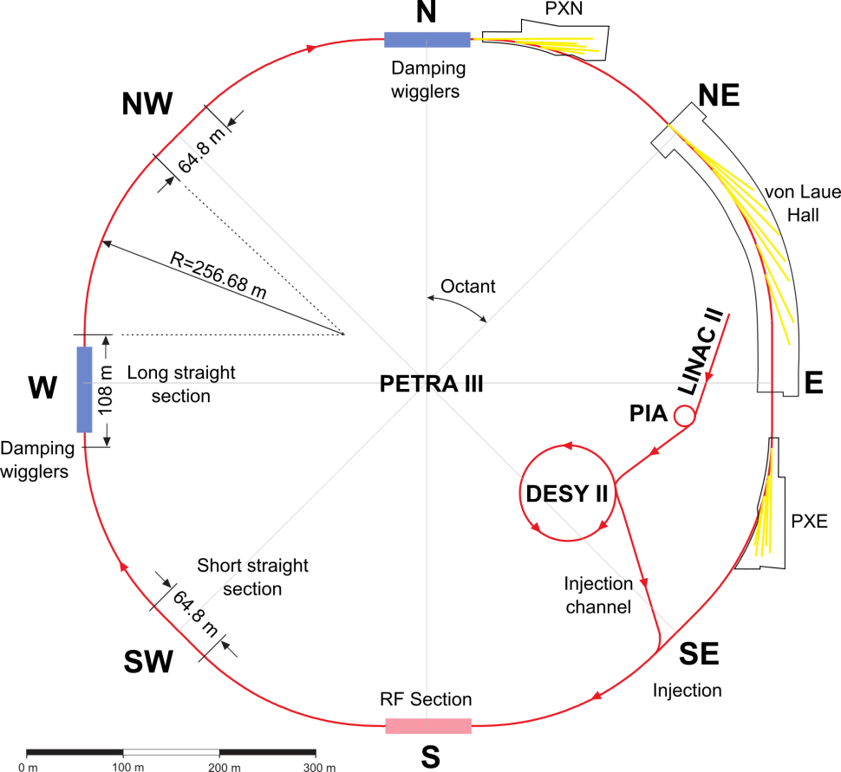
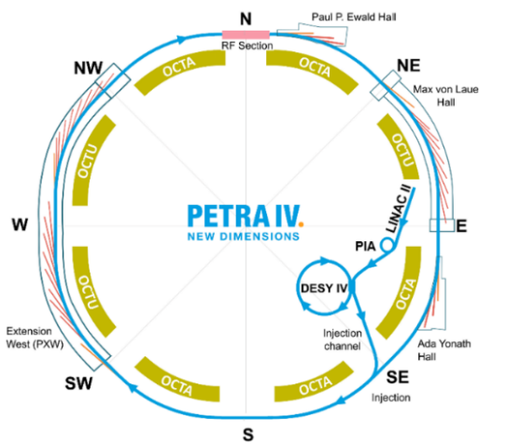
  from PETRA III to PETRA IV
1300 pm → 20 pm
Eight Arcs (45°), 201.6 m long
  One arc build from 9 DBA cells L_{cell} = 23 m, 5 m ID straight sections
  5 pure FODO-arcs + 2 modified FODO arcs with 2 DBA cells
Beamlines
  Max von-Laue Hall:14; PXN:5; PXE: 7
Eight Arcs (45°), 201.6 m long
  72 cells H6BA cells
  9 cells per arc L_{cell} = 22.75 m, 4.3 (TBC) m ID straight sections
Straights for Beamlines
  Max von-Laue Hall: 9; PXN: 3; PXE: 3 + New Hall: 9 + 9(8)

Slide 7
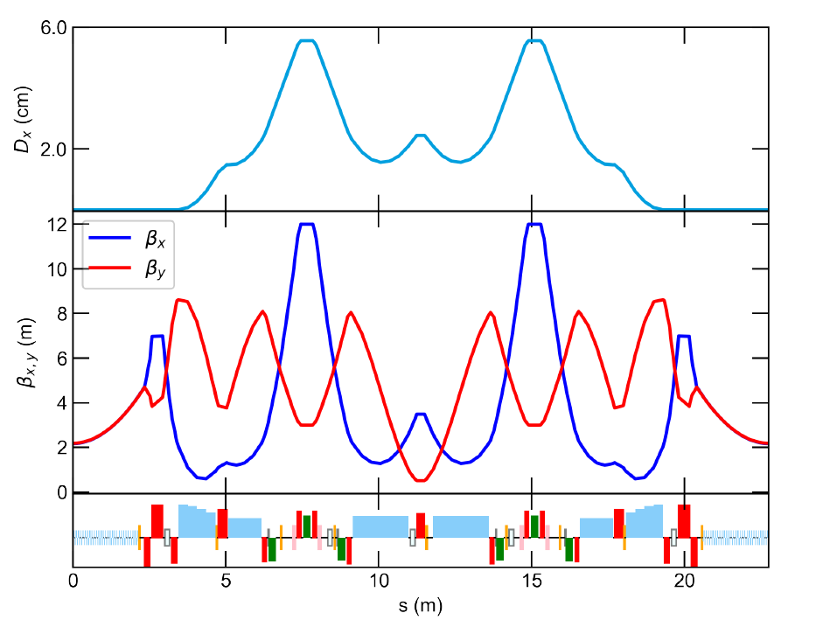
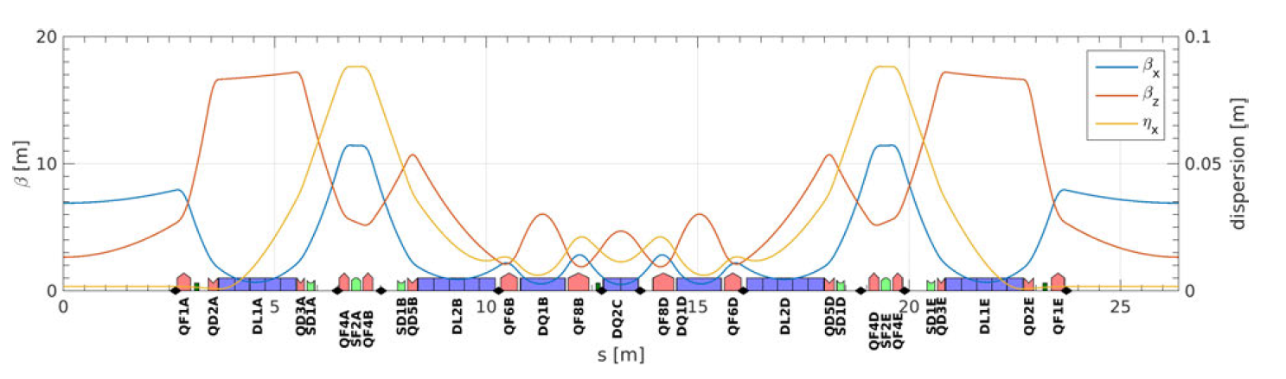
  The PETRA IV H6BA cell
The lattice is based on a novel cell structure (H6BA) that is replicated identical across all octants (72 cells)
The lattice cell is an evolution from the pioneering
hybrid multi-bend achromat cell (H7BA) proposed by P. Raimondi
In the H6BA cell, the dispersion bump is increased to compensate for the weaker dipoles
(because of the 72 cells/36 cells ratio)
emittance 42 pm decreased to 20 pm with damping wigglers in the straight with no undulators
U₀ = 1 Mev/turn → 4 MeV/turn

Slide 8
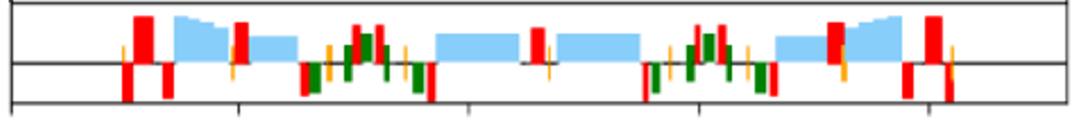
  Layout of the PETRA IV cell: main parameters
The lattice is based on a novel cell structure (H6BA) that is replicated identical across all octants (72 cells)
1
2
3
4
5
6
PQE:
L = 167 mm
r = 12.5 mm
84 T/m
700 W
0.37 l/m
PV poles
PQF:
L = 309 mm
r = 12.5 mm
69 T/m
900 W
0.49 l/m
PQA:
L = 229 mm
r = 12.5 mm
115 T/m
860 W
0.55 l/m
PV poles
PQB:
L = 404 mm
r = 11 mm
112 T/m
1100 W
0.79 l/m
PV poles
PQC:
L = 220 mm
r = 12.5 mm
89 T/m
900 W
0.56 l/m
PQD:
L = 338 mm
r = 12.5 mm
97 T/m
1200 W
0.86 l/m
PV poles
DLQ 1-2-3:
L = 0.30-0.27 mm per module
0.3-0.2 T
6-11 T/m
permanent magnets
PSA:
L = 314 mm
r = 12.5 mm
2500 T/m²
115 W
0.55 l/m
PO:
L = 153 mm
r = 12.5 mm
120000 T/m³
30 W
air cooled
Standalone correctors:
L = 150 mm
r = 12.5 mm
650 urad
115 W
air cooled

Slide 9
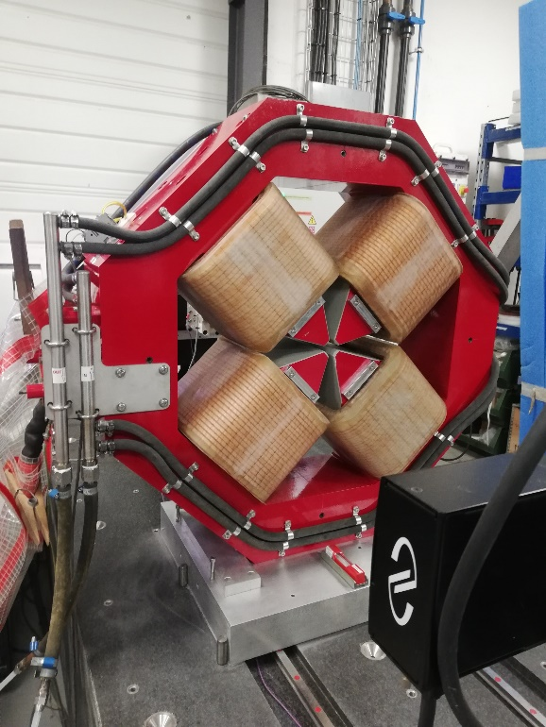
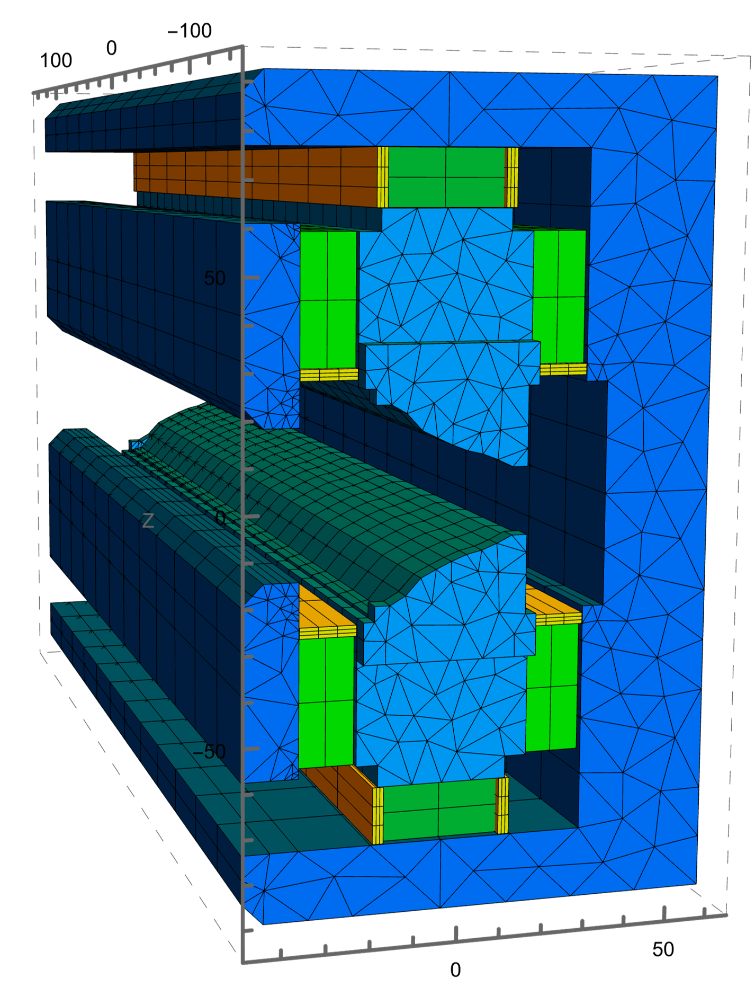
  Challenging magnets are prototyped and new concepts are developed based on the extensive use of permanent magnets
Magnet machining precision < 20 μm required to minimise magnetic errors
prototype PQA 115 T/m
Permanent magnet dipoles DLQs
The arcs contains (cell*72):
432 DLQs
1224 quadrupoles
432 sextupoles
288 octupoles
792 correctors
Including the straight sections,
PETRA IV will have ~3000 magnets
The power consumption of the resistive magnets in PETRA IV is about 2.3 MW. The design has been optimized to reduce the power consumption. The PM dipoles will save ~1.6 MW

Slide 10
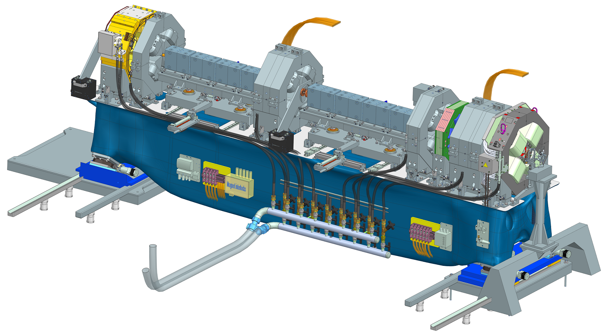
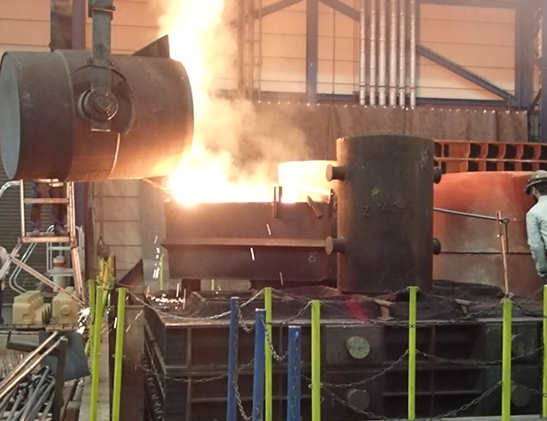
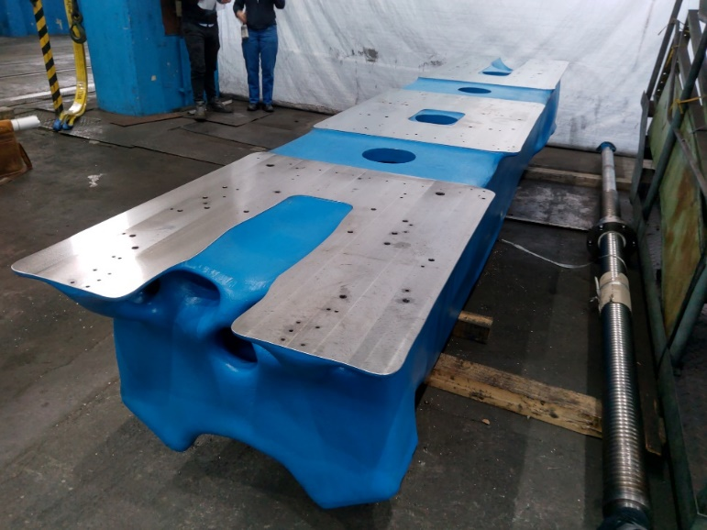
  PETRA IV girders prototype casted
Magnets, vacuum equipment, diagnostics will be assembled, aligned and tested on girder support structures. PETRA IV will have 288 girders. Girder assembly will be done in the girder assembly building (GAB)
The precision of positioning and alignment of magnets on girders will be <30 μm
Girder-to-girder alignment precision needs to be <100 μm

Slide 11
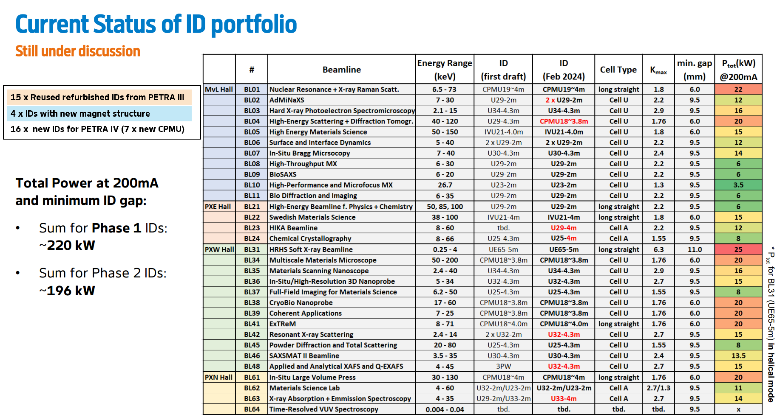
Emittance kept constant using variable gap DW
and control of the IDs gap:
200 kW from dipoles
800 kW total
Notes:
New: 4.3 m, 4 m, CPMU
Refurbished (MvL, all 2 m devices +Apple and in-vacuum 4m)

Slide 12
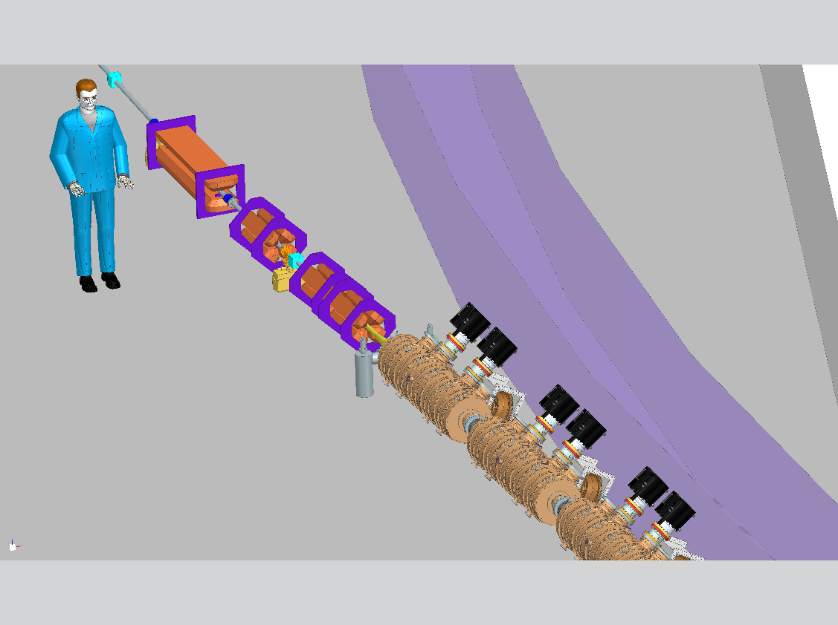
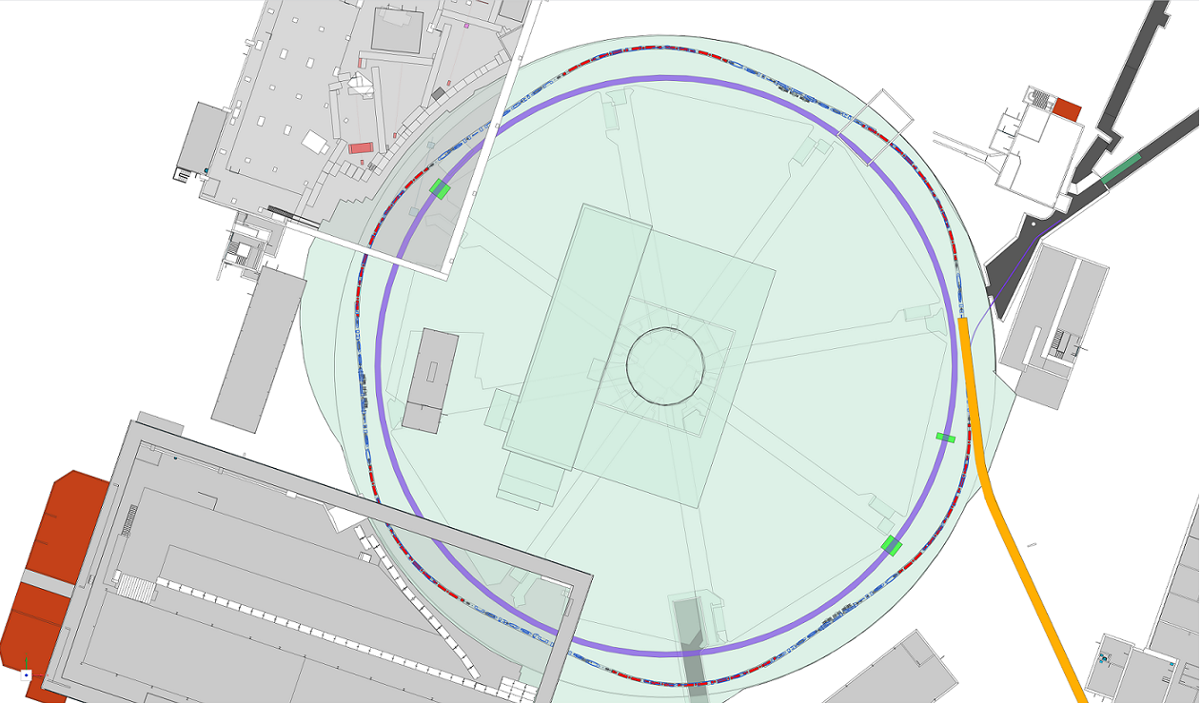
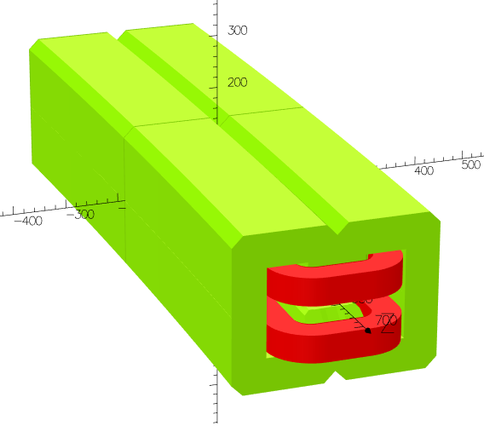
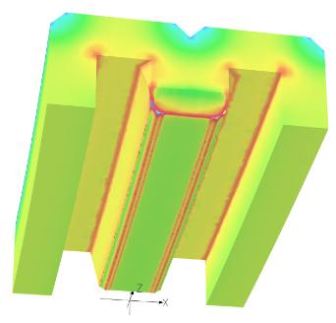
  The DESY IV booster
The PETRA IV project proposal includes the construction of a new booster DESY IV with lower emittance
than the existing DESY II (from 335 nm to 20 nm)
The lattice was frozen last year with a design
delivering 20 nm – 1 nC single bunch operation
reusing the LINAC-II and PIA ring
System design and
CAD integration progressed
Courtesy C. Kula
The DESY IV booster (316.8m) will have
252 magnets and 9 RF cavities

Slide 13
  DESY IV installation issues
The definition of detailed installation plans highlighted several issues:
Inherited building layout poses several constraints: installation on the ceiling turns out to be more costly than planned
and with a complex logistics – not impossible, but triggered a review…
Different options were analysed in terms of lattice layout,
stability and installation procedure:
Installation issues:
Close to the maximum load:
1.5 tons per magnet + 1.5 tons support
Difficulties in drilling the holes on the ceiling due to
the reinforced steel rod pattern on the ceiling
(no wet drilling)
Logistic concept requires a transport and lifting system
  and the outer floor load must be reinforced
Option 1: not favoured as the outer wall has no support
pillars underneath the floor
Option 2: Ringtrager discarded on the basis of stability issues
Option 4: not favoured as the removal of DESY II does not allow
start of installation before the PIII shutdown
DESY IV
2
4
1
3

Slide 14
  Alternative options for the pre-accelerator: LPA injector
Building on the strong R&D for the development of LPA at DESY, We propose to build a 6 GeV LPA injector for PETRA IV.
The next 3 years will be focused to the demonstration of high quality beam suitable for high efficiency injection in PIV AND high reliability of the injector
Challenges addressed with the RF dechirper experiment at LUX DESY and 450 MeV injection in DESY II by mid 2026

Slide 15
  Conclusions and future work
PETRA IV is the highest priority project at DESY
Storage ring lattice well defined. Many elements of the machine are close to their final design.
Prototypes are on the way
TDR ready
DESY IV programme under revision – new lattice done
Plans for a Laser Plasma injector strongly supported
Timescale still unclear depending on funding agency decision.
Present planes hinge on project approval 2026 and PIII shutdown in 2030-2032

Slide 16
Thanks to many colleagues that provided material for this summary
Thank you for your attention!
Thanks to I-FAST and LEAPS

