Slide 1
Control Tools and Architecture for the European XFEL Accelerator
Team • Goals • Strategy • Example Projects • Beam Dynamics Codes • Virtual Accelerators
Lars Fröhlich for the XFEL High-Level Controls Team
lars.froehlich@desy.de
2024-06-19

Slide 2
High-Level Controls: Team & Scope
Communication, Exchange, Development across Group Boundaries
Physical parameters in the control system
Automatization & procedures
Libraries, toolboxes
Central machine configuration database
User interfaces & status displays
Control concepts, strategies
Development & deployment standards
Operations ↔ Controls ↔ Physics
Focus on European XFEL, but also FLASH, ARES, etc.

Slide 3
Goal: Physical Parameters in the Control System
… as Opposed to “in Stand-Alone Applications”
Typical control system devices deliver raw data:
Beam positions, camera images, power supply currents, spectrometer intensity per channel
Interesting physical quantities often have to be derived by software:
Beam energy, emittance, magnetic field strength, bunch length
Stand-alone GUI applications are good at that, but…
they are hard to run 24/7,
they do not produce standard history data,
their results cannot easily be made available to other tools,
they encourage the proliferation of calibration data, component lists, etc., and
they do not compose well and are hard to use in automated workflows.
“Thin” graphical UX
(low/no code)
“Rich client apps” combine & evaluate data
Device
Device
Device

Slide 4
Goal: Physical Parameters in the Control System
… as Opposed to “in Stand-Alone Applications”
90 %
10 %
Typical control system devices deliver raw data:
Beam positions, camera images, power supply currents, spectrometer intensity per channel
Interesting physical quantities often have to be derived by software:
Beam energy, emittance, magnetic field strength, bunch length
Stand-alone GUI applications are good at that, but…
they are hard to run 24/7,
they do not produce standard history data,
their results cannot easily be made available to other tools,
they encourage the proliferation of calibration data, component lists, etc., and
they do not compose well and are hard to use in automated workflows.
“Thin” graphical UX,
(jddd rapid UX builder)
“Rich clients” (MATLAB, Python, Java)
Raise the level of abstraction by building reliable control system services to make physical quantities and meaningful operations directly accessible
Service
Service
Service
Device
Device
Device
DOOCS servers (mainly C++, recently Python)

Slide 5
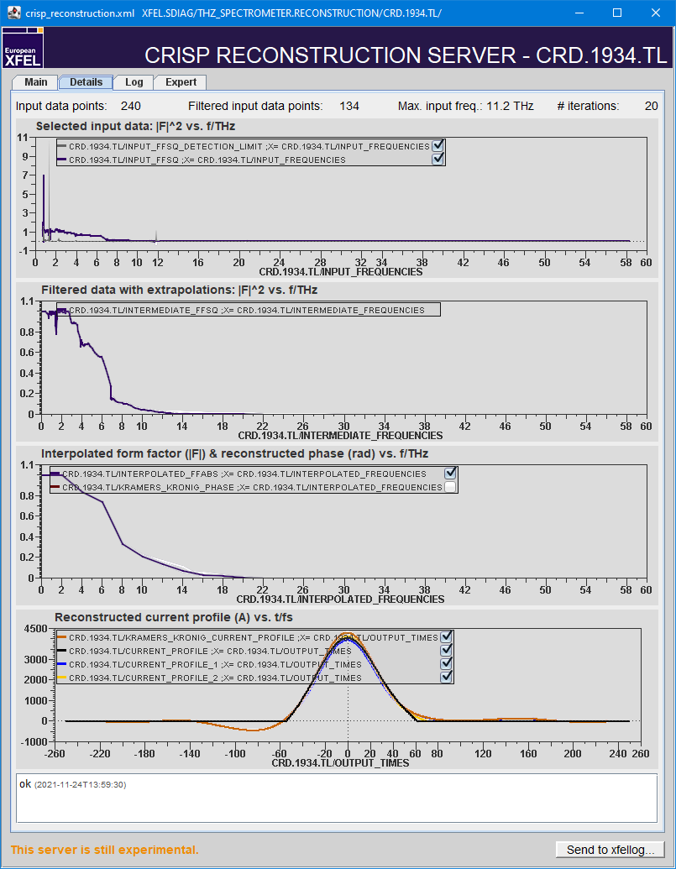
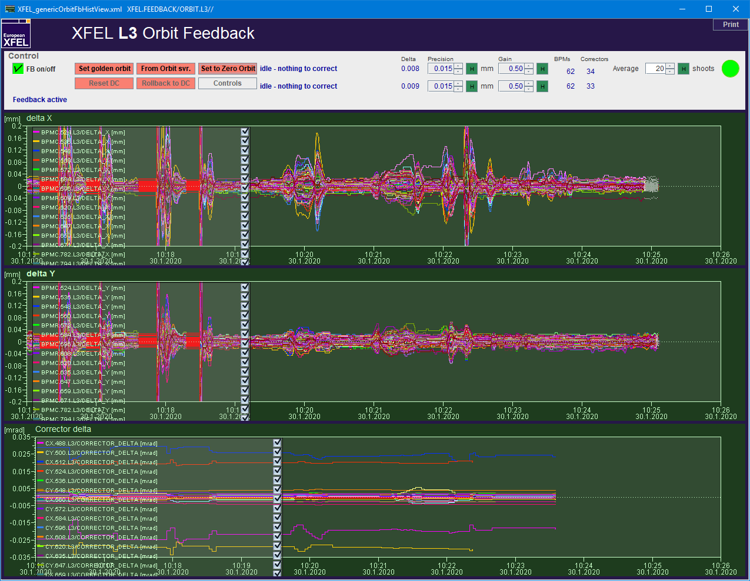
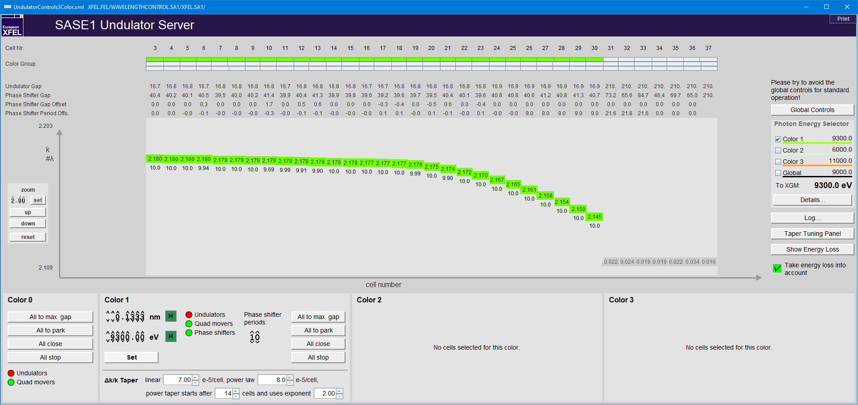
Goal: Physical Parameters in the Control System
Examples
Charge feedback
Specify desired bunch charge (not polarizer angle)
Orbit feedbacks
Orbit control via desired beam position (not corrector strengths)
Wavelength control
Set undulator gaps by photon energy or K parameter, desired taper shape (not gap sizes)
Longitudinal bunch profile
Reconstruct current profile from THz spectrometer data

Slide 6
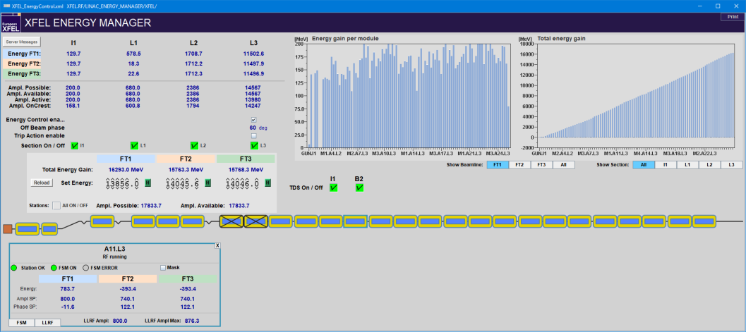
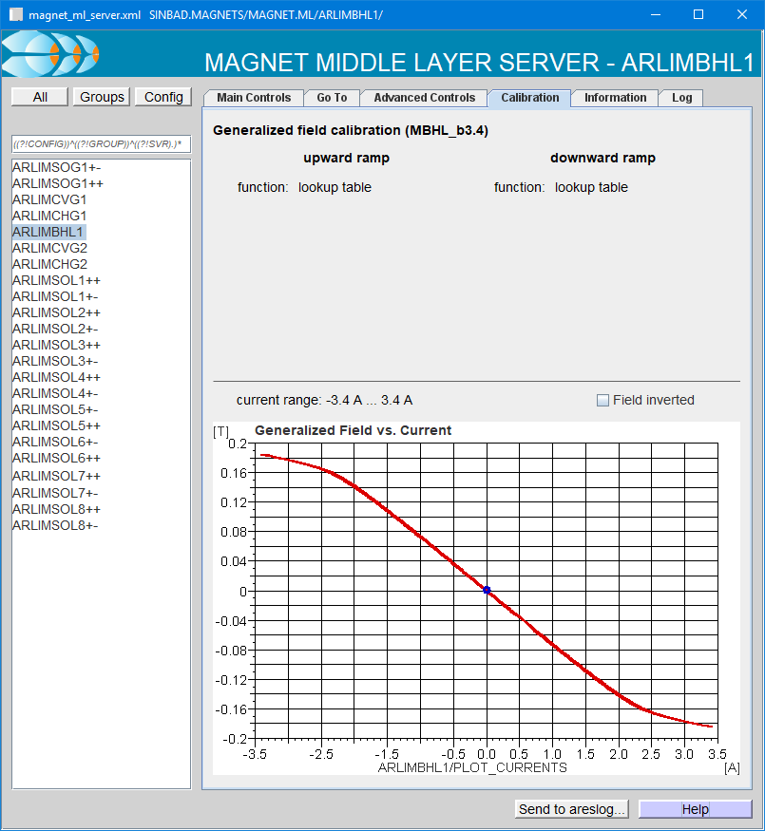
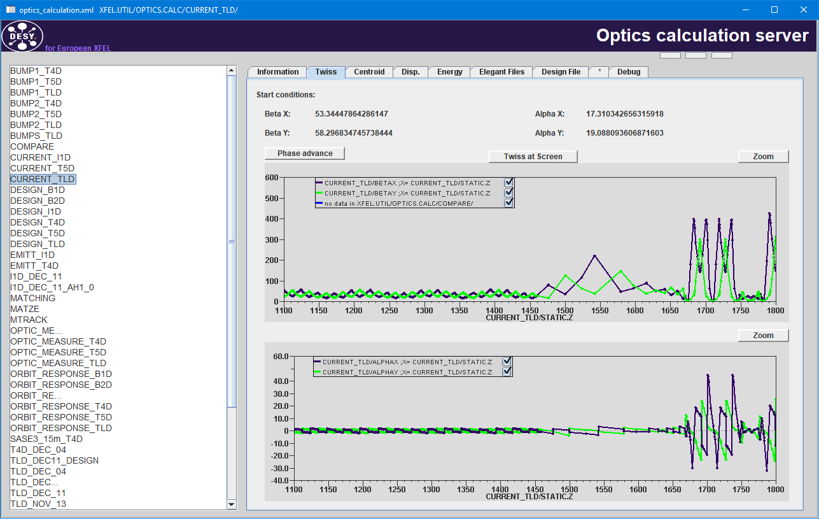
Goal: Physical Parameters in the Control System
Examples
Magnet ML server
Magnet control via field, strength, deflection angle etc., with hysteresis
Optics server & design optics server
Optics calculations in the control system
Setting certain groups of magnets to design values
Beam energy measurement
For arbitrary dispersive lattice segments
Energy manager, LLRF sumvoltage server
Setting RF parameters in terms of desired beam energy, chirp, curvature (not just amplitude & phase)

Slide 7
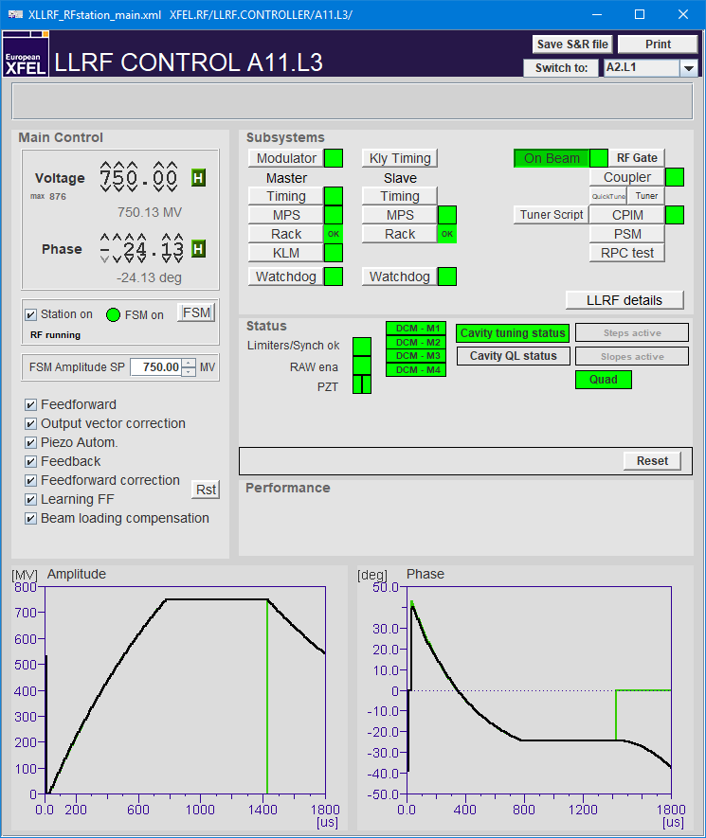
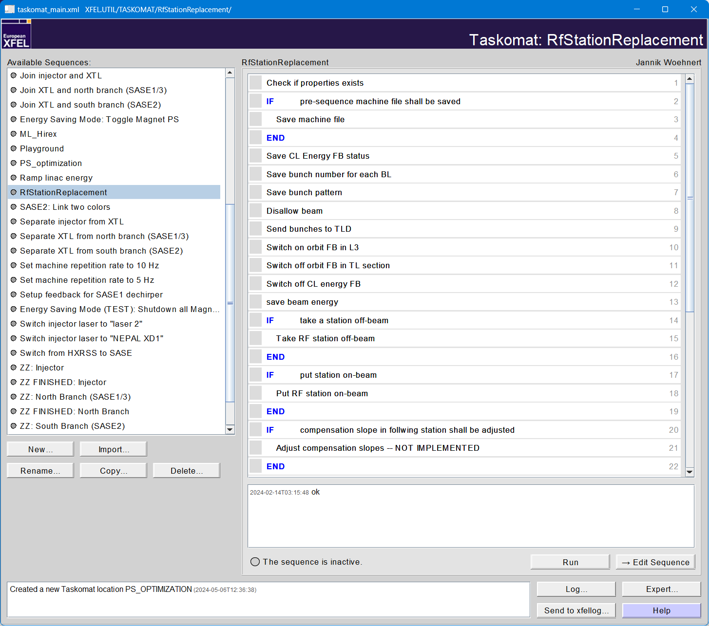
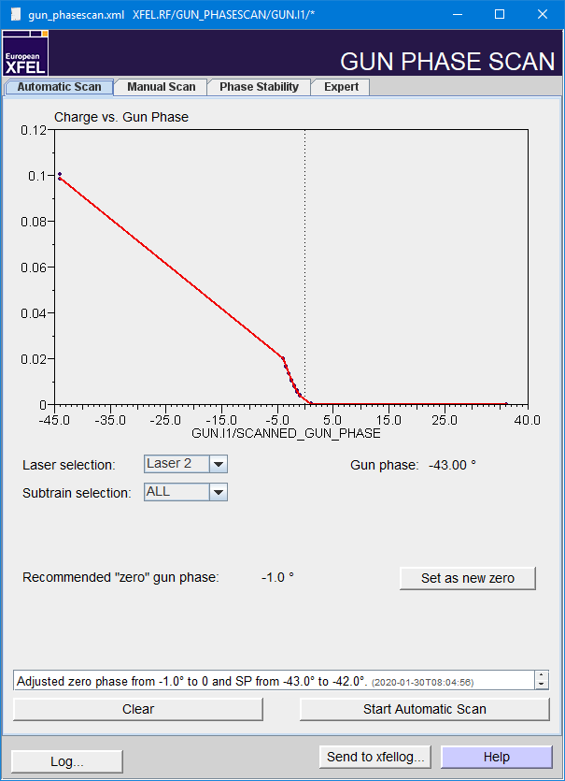
Goal: Automatization
Reducing Operator Clicks per Minute
Feedbacks
Finite State Machines (FSM) for RF stations
Automatically ramp up, configure, recover linac stations
Automatically start RF gun reproducibly, safe, and fast
Phase scans
RF gun phase scan
Transparent scan of linac stations under energy feedback
“Taskomat” sequencer
Powerful step-by-step automation suite
Steps programmable in Lua
Fully embedded in the control system

Slide 8
Central Machine Configuration Database
Providing a Single Source of Information
Software should agree which components exist in the machine and what their name, position and function is.
Tables in Oracle DB, to be transferred into a comprehensive configuration management system:
Standardized component lists for XFEL, FLASH, SINBAD-ARES, PETRA III, PETRA IV, FALCO
Calibrations (lookup tables etc.)
Other configuration information
Easy-access libraries/toolboxes for C++ and Matlab

Slide 9
Beam Dynamics Codes #1/3: HLC Tracking Library
Fast tracking in C++
C++ libraries
HLC SQL lib: General database access and specific classes for machine component lists
HLC machine lib: Machine-independent device access for various DESY accelerators
HLC numerics lib: Root finding, interpolation, Gaussian fits, …
HLC tracking lib: Fast particle tracking and online model of the accelerator lattice
…
HLC tracking lib
Fast (thousands of individual particle tracking operations per second)
Automatically updating online model
Linear optics, some nonlinear elements (magnets, RF, undulators, …)
Multi-particle tracking possible, but no collective effects
Trajectory fitting

Slide 10
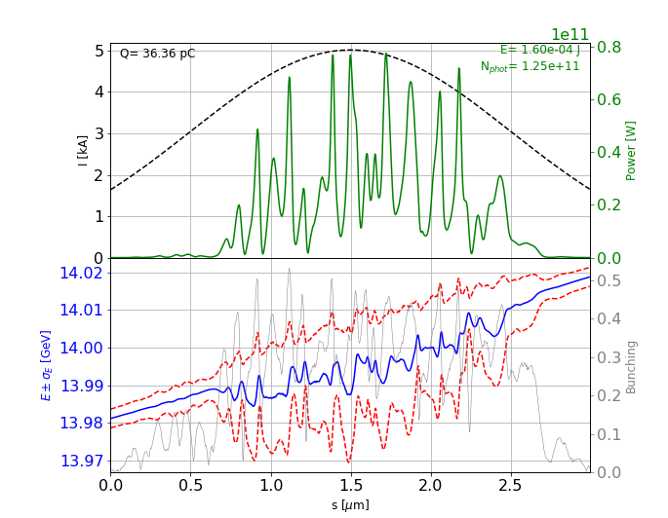
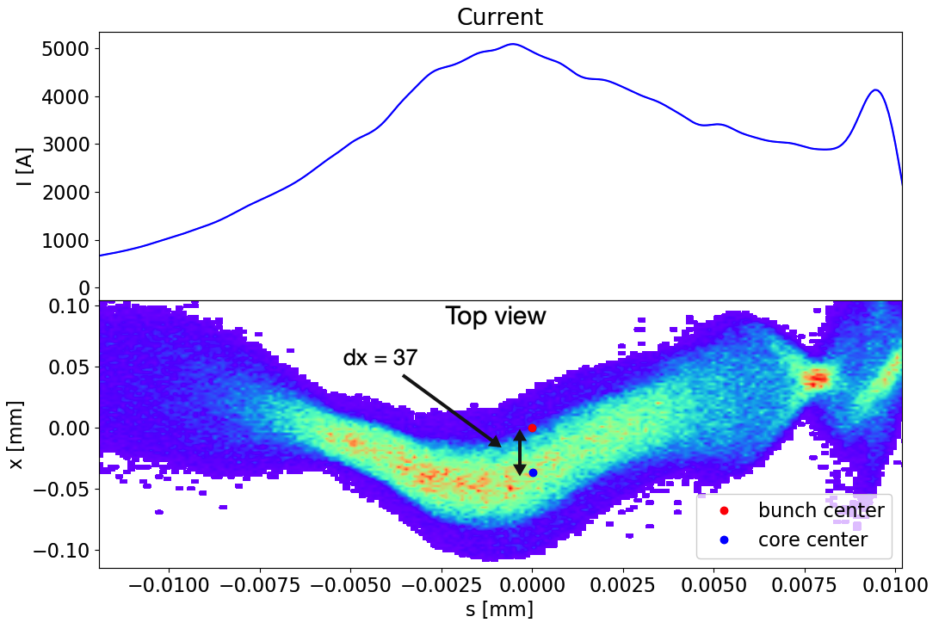
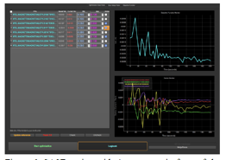
Beam Dynamics Codes #2/3: Ocelot
Multiphysics Simulation Toolkit for Studying FEL and Ring-Based Light Sources
Everything in Python
Focus on simplicity
Implement only physics
Open source (GitHub https://github.com/ocelot-collab/ocelot)
Stand-alone tools using Ocelot or originating from it
Ocelot
Photon field simulation
FEL simulations (genesis)
Spontaneous radiation (ocelot)
Wavefront propagation
FEL estimator
Charged Particle
Beam Dynamics (CPBD) module
(linacs, rings)
Online beam control
Orbit correction
Adaptive FB
Dechirper tool
Ocelot Optimizer
Slide courtesy of Sergey Tomin (DESY)

Slide 11
Beam Dynamics Codes #3/3: Optics Server
An Elaborate Wrapper around Elegant
DOOCS server
Writes an input file, starts an Elegant process, and parses the output
Slow
(Virtually) full Elegant feature set
Used for matching, many optics calculations

Slide 12
The Virtual XFEL
Virtual FLASH, Virtual PETRA IV, …
An accelerator facility in its own right (a digital twin of the control system).
An environment to test software, procedures, algorithms
before the real machine is available,
while the real machine is in operation,
when it is too hard to test on the real machine.
A training environment for operators and controls engineers.
G. Casqueiro via Wikimedia Commons, license: Creative Commons Attribution-Share Alike 3.0 Unported

Slide 13
Identical Interfaces for Different Facilities
XFEL.MAGNETS/MAGNET.ML/BB.100.I1/…
XFEL_SIM.MAGNETS/MAGNET.ML/BB.100.I1/…

Slide 14
Control System Architecture
XFEL Control System
Virtual XFEL Control System
GUIs, apps, ML servers: identical to real machine
Simulated frontend servers instead of access to hardware

Slide 15
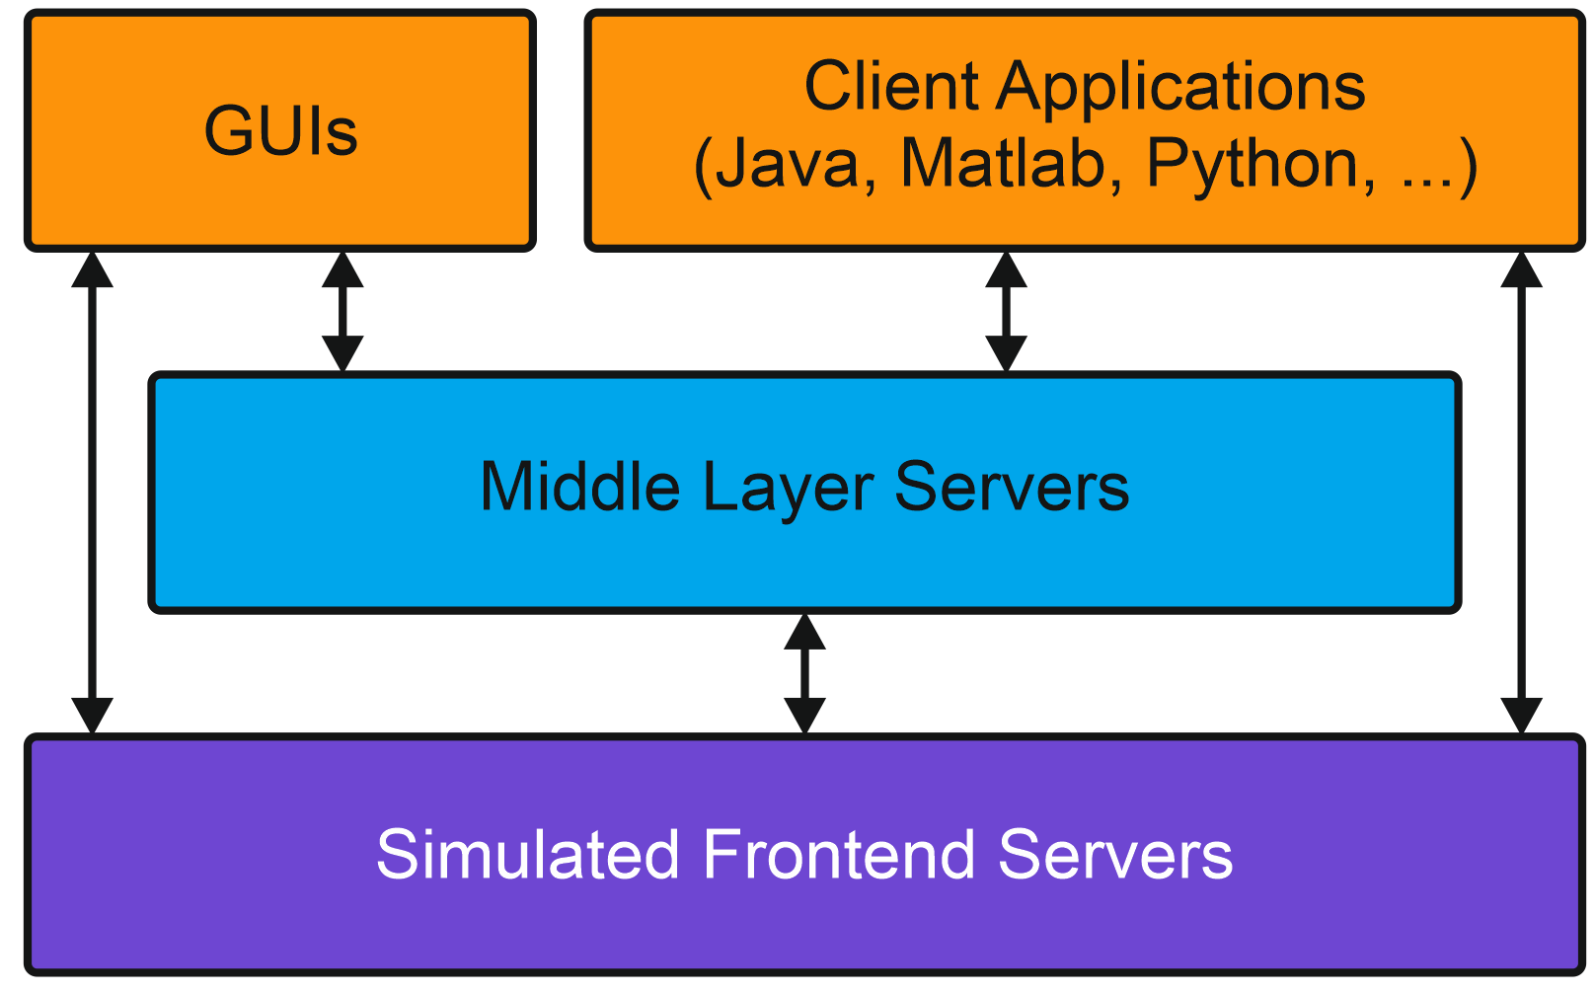
Virtual XFEL Physics Simulation
Yet another service…
Single-particle tracking
Beam position
Charge (full transmission up to |x|² + |y|² > r_{max}²)
Screens with Gaussian beam spots
Tracking in “real time” (at 10 Hz)
Using HLC tracking library (C++)
magnet, RF settings
VXFEL Physics Simulator
beam position & size, charge

Slide 16
Summary
HLC Team & Strategy
Intersection between operations, controls, physics
Physical parameters in the control system
Automatization & procedures
Libraries, toolboxes
Central machine configuration database
Focus on services over stand-alone applications
Virtual Accelerators
Digital twin of the accelerator control system
Simple physics simulation
Invaluable for testing software, procedures, algorithms, interoperability before deployment to the accelerator
15:00
by Rion via Wikimedia Commons under Creative Commons CC0 1.0 Universal Public Domain Dedication

