Slide 1
python accelerator middle layer / digital twin
Collaboration and project status
Accelerator Middle Layer Workshop, Hamburg, 21st June 2024

Slide 2
Status of the collaboration
Labs involved:
ESRF, HZB, Diamond, Alba, K4GSR, NSLS-II (BNL), DESY, LBNL, PSI, Sesame, Elettra, SLAC, Soleil, IHEPS, CLS, MAX-IV, IJClab, Solaris, CERN, KIT, ANSTO, Radiasoft
Other institutes to contact:
EuXFEL, Brazilian light source, etc. …
Status: informal collaboration. Shared brainstorming document with common intentions.
Looking for funds!

Slide 3
Large statistics
New developments
Indirect measurements
Accelerator operation
com. simulations
digital twin
digital shadow (online DT)
operation
User interfaces
User interfaces
Middle layer
Middle layer
Calibrations
Calibrations
Digital Twin
Digital Twin
tuning tools
Collimation
Mach. Learn.
Threading
injection
AC-LOCO
Artificial Int.
GUI or CLI mode
Control System or Simulations
Real or Simulated Control System
AC-BBA
Chroma
Par-BBA
Orbit
BBA
LOCO
RF
Tune
TbT
DA
pyNAAF
NOECO
cycling
etc..
OPEN FAIR DATA
OPEN FAIR DATA
OPEN FAIR DATA
Commissioning sequence
Automated Commissioning
Automated Commissioning
Anomalies
Anomalies
Real accelerator and/or HDB
Real accelerator
Computing clusters
Computing clusters
N Lattices with errors
Lattice model with errors
Lattice model with errors
pyAT
pyAT
pyAT
Simulated
Expected
Expected
Measured
training tools

Slide 4
Timeline strategy
Short term
Create from the existing codes a control agnostic python middle layer
Create from the existing codes a control agnostic digital twin for development of higher level tuning tools
Set up first/basic tuning tools in the digital-twin mode: such as orbit, tune and chromaticity
Test tools in operation-mode in at least 3 facilities with different control systems
etc..
Mid term
Set up a process of 1 release every 6 months (June/December). + regular workshops/meetings
Develop and test in digital-twin mode: LOCO, BBA, DA, etc…
Apply tuning tools to run virtual commissioning in a large computing cluster
Use available artificial intelligence for optimization (ex: pytorch, Badger/Xopt)
etc…

Slide 5
Timeline strategy
Long term
Develop in digital-twin-mode automated commissioning simulations sequences
Test above automated tuning for at least 3 different facilities
Include AI tuning in list of automated commissioning
Test use of tuning tools in continuous mode (slow feedback)
Feedback optics measurements to digital-shadow mode
Empower digital-shadow with heavy computations such as Lifetime, injection efficiency, dynamic aperture, losses, and collective effects continuous simulations
Add anomalies for more realistic virtual accelerator and more robust app development
Etc..
Full details in shared brainstorming document.

Slide 6
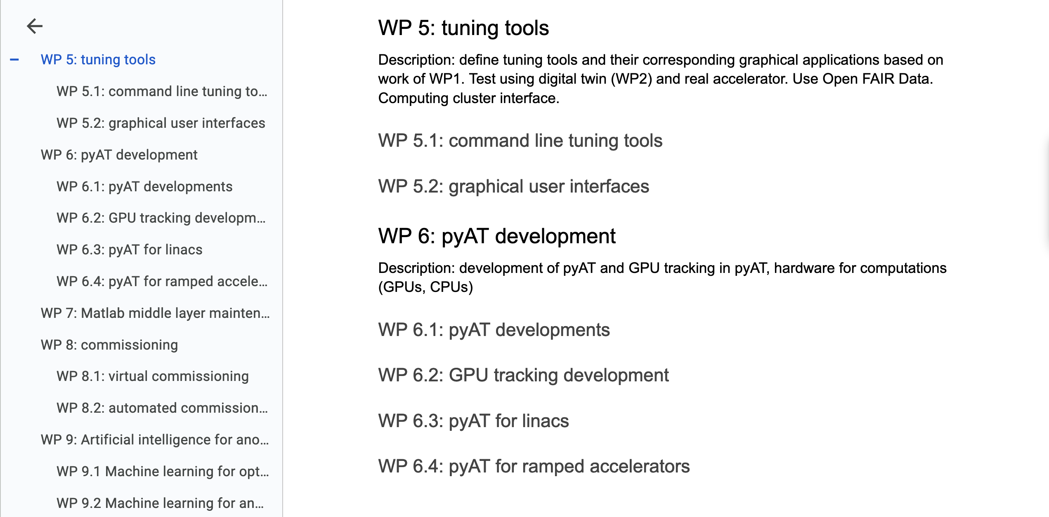
Draft Work package list

Slide 7
Where can we find resources? (people)
LEAPS → see presentation by M.Calvi
INFRA-TECH-2025 → not available at the moment
ERC
MSCA doctoral networks (needs about 12 PhD subjects with a common frame and exchange among the PhDs) DEADLINE SEPTEMBER 2024
MSCA Staff exchange (no gain in staff, but the staff members in exchange are paid for by Europe while in exchange mode? Not clear to me.) DEADLINE SEPTEMBER 2024
WIDERA → inquiry email sent on 30th May to french local contact (Solene Chevalier). Not GOOD FOR US. But we could do a COST (150kEuro/year, 15 pages file for submission, for networking activities)
https://www.cost.eu/
Key words from the last approved ERC
If you do not spot : accelerator, control, digital twin, storage ring, etc.. it is normal, they are not there.
May be is a good sign? May be not.

