Slide 1
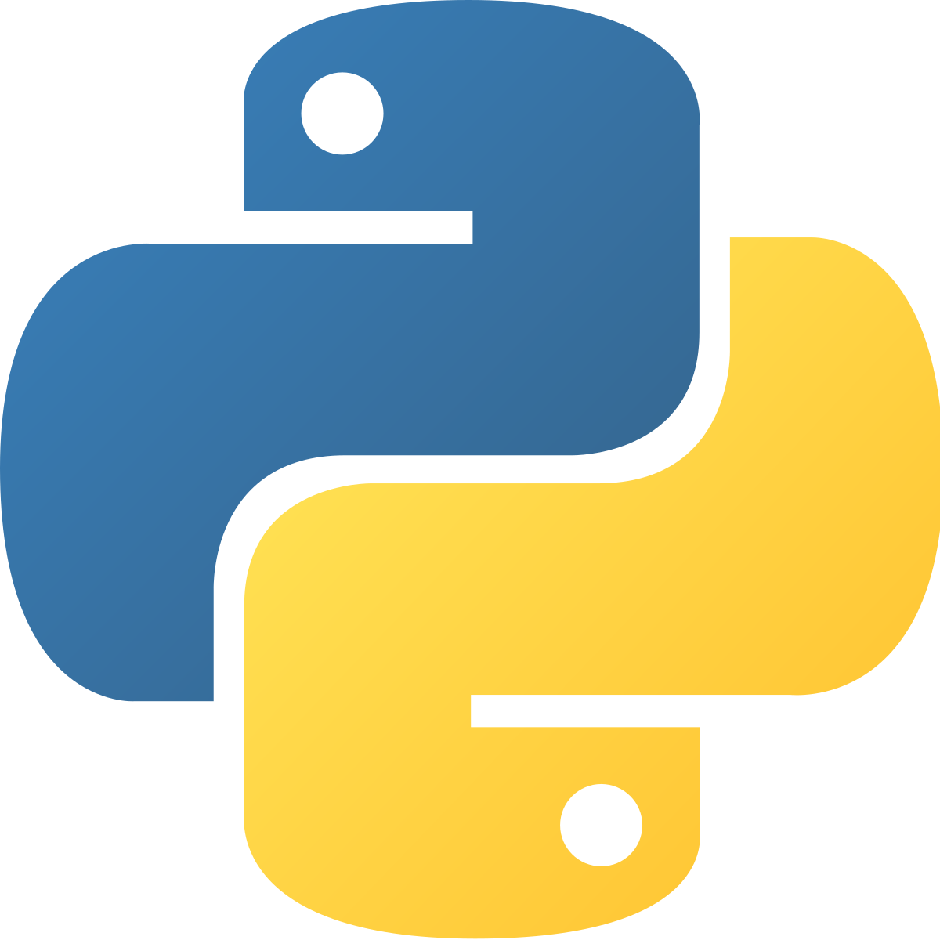
Python for Accelerator Controls at CERN
Ivan Sinkarenko (CERN, BE-CSS-SET)
June 2024

Slide 2
Contents
Accelerator & Technology Sector community at CERN
Role of Python in 2024
Zen of Acc-Py
Acc-Py portfolio
Operational application deployment
Package Repository
DevOps
Monitoring
Community, teaching & guidance

Slide 3
Accelerator & Technology Sector at CERN

Slide 4
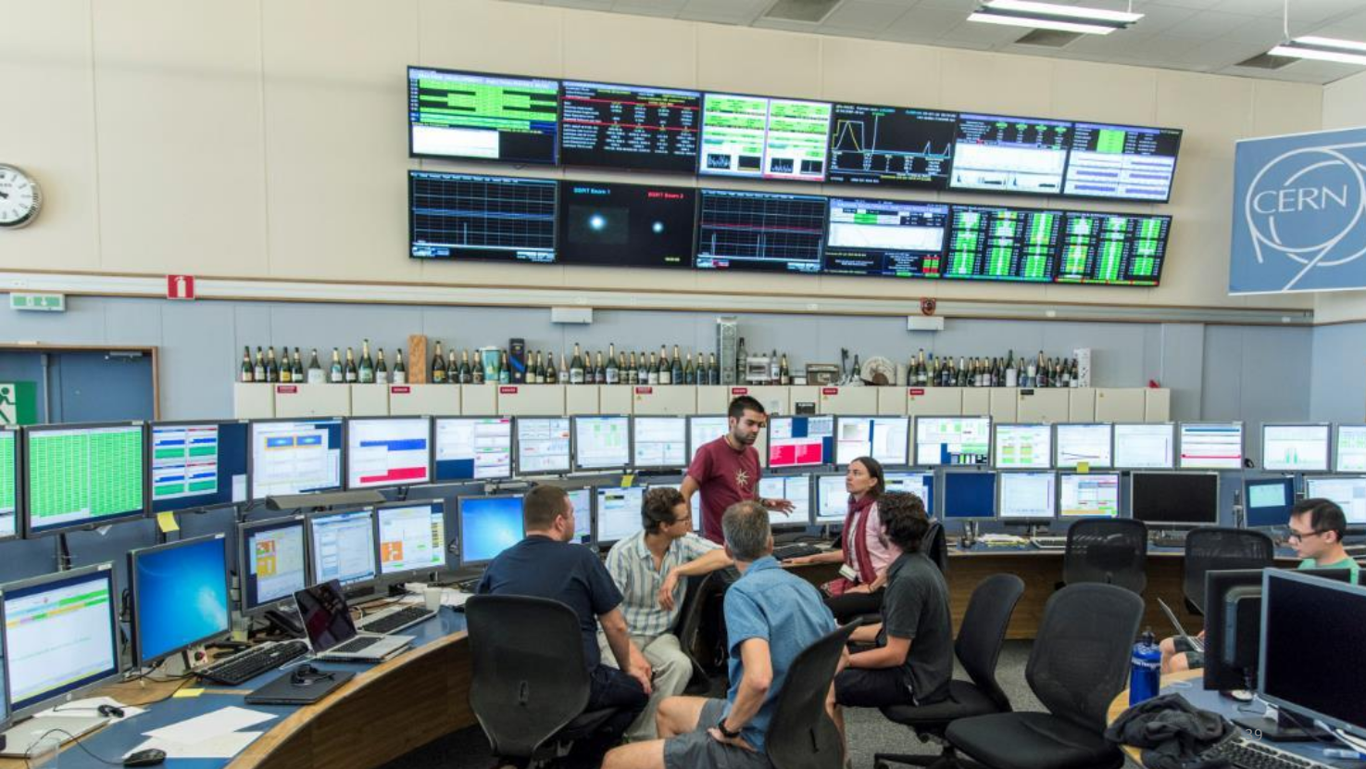
Software
developers
Physicists, operators,
hardware experts

Slide 5
Software
developers
Physicists, operators,
hardware experts
500+ people using Python
Different profiles:
Java
Python
C++
Industrial Controls
FPGAs
Work split between general-purpose network and Technical Network (without Internet access)

Slide 6
Role of Python in 2024

Slide 7
Role of Python: Before…
Python growth used to be uncoordinated, some tools developed for individual use gained popularity in an uncontrolled manner
We pay high cost for it even today
Python officially embraced by the Controls Group ~5 years ago, having created a dedicated Python support team (Acc-Py)
Initially many had reservations about allowing dynamic language into control rooms, because…
It’s possible to run non-compiled code from personal directories
Broken code does not crash until that line is executed
Dynamic typing leaves room for bugs
Early on, it was possible to get access to the most of control system functionality thanks to pre-existing Java libraries + Jpype, Py4J.

Slide 8
Role of Python: Today
Today many new projects are started with Python
Python occasionally chosen to write a new version of existing software using another technology
Efforts to bring Machine Learning into controls fully rely on Python
PyQt is appreciated for creating GUIs
Being the most popular language helps recruitment + easy to get started
Some find that fast development iterations with Python can produce better performing software due better tuning of the algorithms
Python evolution is coordinated through Acc-Py team

Slide 9
Zen of Acc-Py

Slide 10
Zen of Acc-Py
Ensure long-term stability of the code
Use of virtual environments in development (no single integrated environment)
Preference of packages over scripts
Explicitly declared dependencies
Code can be tested, released and easily maintained
For operational environments, ensure immutability of deployed code
Don’t follow the hype in tools and development practices
Use stdlib as much as possible, or well established tools, such as pip
Follow the trend only when it’s clear to become standard, e.g. pyproject.toml
No magical surprises
User-site-packages not allowed due to shared home directories
No setting of PYTHONPATH or LD_LIBRARY_PATH
People are free to choose the tools they like, except those that ensure operational stability
Python should be used for high-level software. Use in Front-End Computers* is discouraged.

Slide 11
Acc-Py portfolio

Slide 12
Acc-Py portfolio
Python distribution
Interactive environment
Devtools
Controls & GUI libraries
Container images
Gitlab CI templates
Package Repository
Documentation hosting service
Operational deployment tool
Monitoring
Python distribution
Interactive environment
Devtools
Controls & GUI libraries
Container images
Gitlab CI templates
Package Repository
Documentation hosting service
Operational deployment tool
Monitoring
Let’s focus on:
Operational deployment tool
Python distribution
Package Repository
Gitlab CI templates
Monitoring

Slide 13
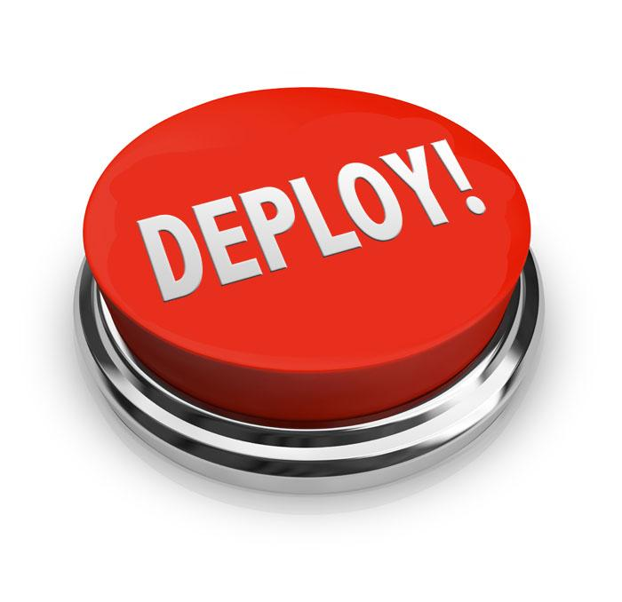
Operational deployment tool

Slide 14
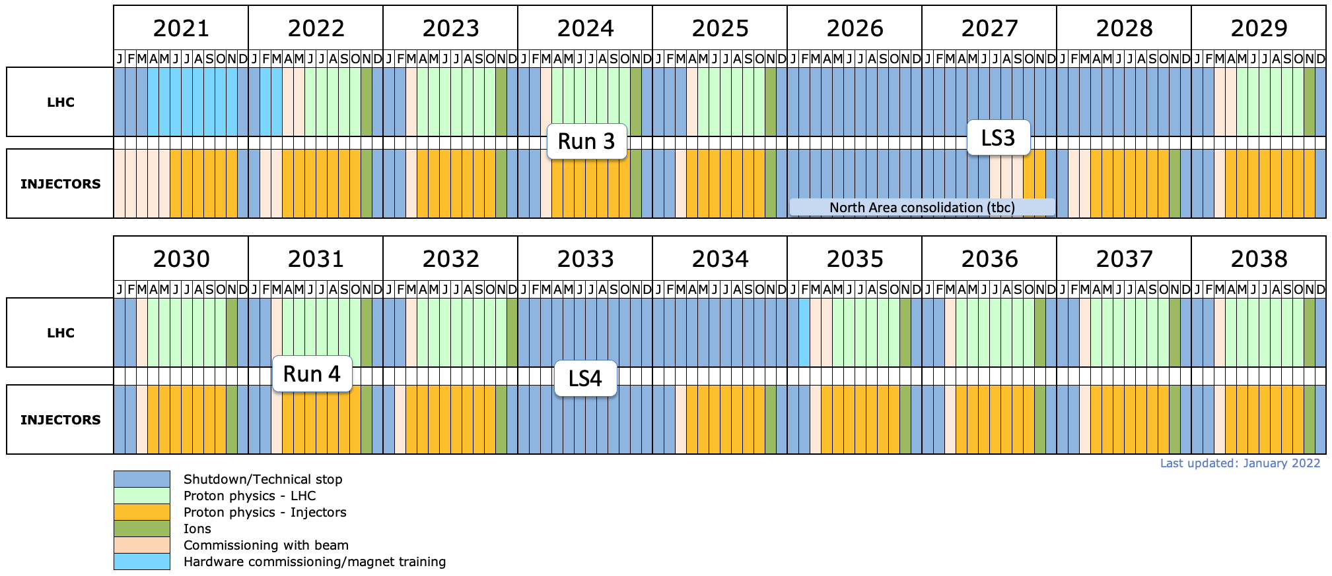
CERN accelerator schedule

Slide 15
Operational deployment tool
Traditionally, all control room applications are hosted on a shared NFS, accessible by any console in the room
With Python, we must ensure that deployed applications are immutable for the duration of the Run*
Versioning of the deployed applications
Dedicated venv and dependencies per app version
Fixed Python interpreter per app version
No user write access
Deployment of new versions restricted to known authors
Dependencies in development must match dependencies in production → lock files
Both Python and Java dependencies

Slide 16
Operational deployment tool
We provide a Python CLI tool that developers run themselves
Notes:
Emphasize lock and deploy bubbles, reduce opacity on the rest

Slide 17
Operational deployment tool
Traditionally, all control room applications are hosted on a shared NFS, accessible by any console in the room
With Python, we must ensure that deployed application is immutable for the duration of the Run*
Versioning of the deployed applications
Dedicated venv and dependencies per app version
Fixed Python interpreter per app version
No user write access
Deployment of new versions restricted to known authors
Dependencies in development must match dependencies in production → lock files
Both Python and Java dependencies

Slide 18
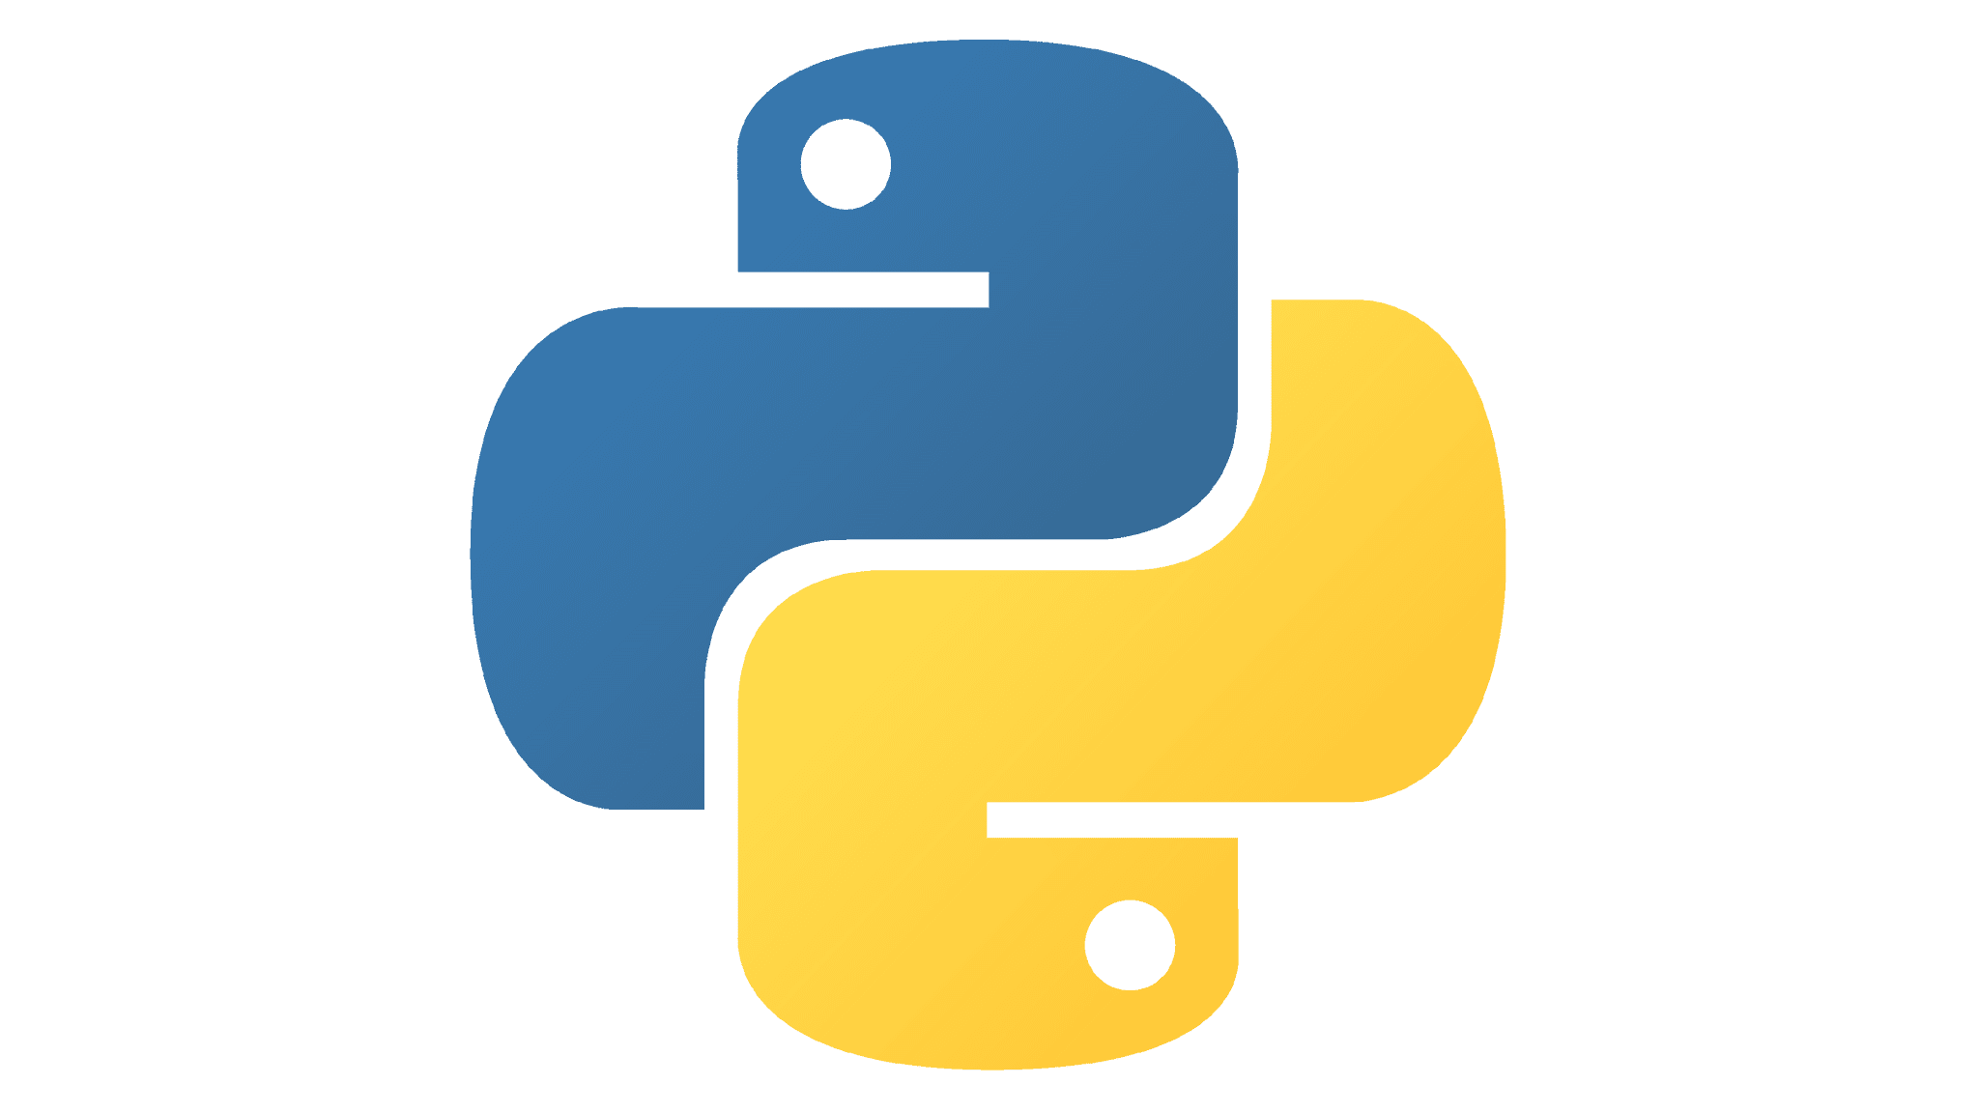
Python distribution

Slide 19
Python distribution
We maintain a curated list of Python interpreter versions
Released ~every 2 years. Currently - Python 3.7, 3.9, 3.11. Future - 3.13
Kept for the duration of the Run*
No user write access
No pip available outside of a venv
Ensures binary compatibility with low-level libraries, e.g. libstdc++
Every new release is tested against major control system libraries
Automatic monitoring of Python invocations
Same Python distribution can be used in development, CI & production

Slide 20
Python distribution
🤕 Before Acc-Py, people would interchangeably use
System Python
Anaconda
Python distribution provided by another group with pre-installed dependencies
Self-compiled Python
…

Slide 21
Python distribution
☺️ Nowadays everyone is using Acc-Py Python

Slide 22
Zen of Acc-Py
Ensure long-term stability of the code
Use of virtual environments in development (no single integrated environment)
Preference of packages over scripts
Explicitly declared dependencies
Code can be tested, released and easily maintained
For operational environments, ensure immutability of deployed code
Don’t follow the hype in tools and development practices
Use stdlib as much as possible, or well established tools, such as pip
Follow the trend only when it’s clear to become standard, e.g. pyproject.toml
No magical surprises
User-site-packages not allowed due to shared home directories
No setting of PYTHONPATH or LD_LIBRARY_PATH
People are free to choose the tools they like, except those that ensure operational stability
Python should be used for high-level software. Use in Front-End Computers* is discouraged.

Slide 23
Package Repository

Slide 24
Package Repository
You could release to PyPI.org, but…
Possibility for leaked secrets
Internal code rarely makes sense for the outside world
Creates a dependency on the 3rd-party service
Impossible to publish from technical network
We run an internal package repository that…
Hosts in-house packages locally
Mirrors PyPI.org packages with security considerations
Uses CERN internal authentication mechanisms
Allows custom logic for managing package visibility
pip is pre-configured to point to our internal repository

Slide 25
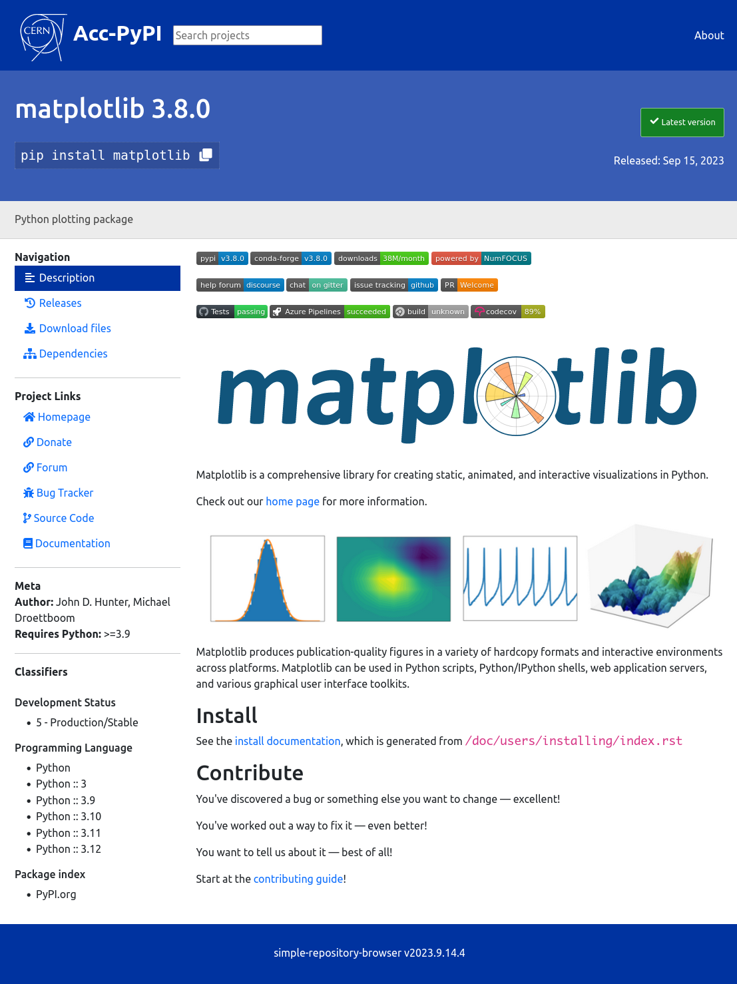
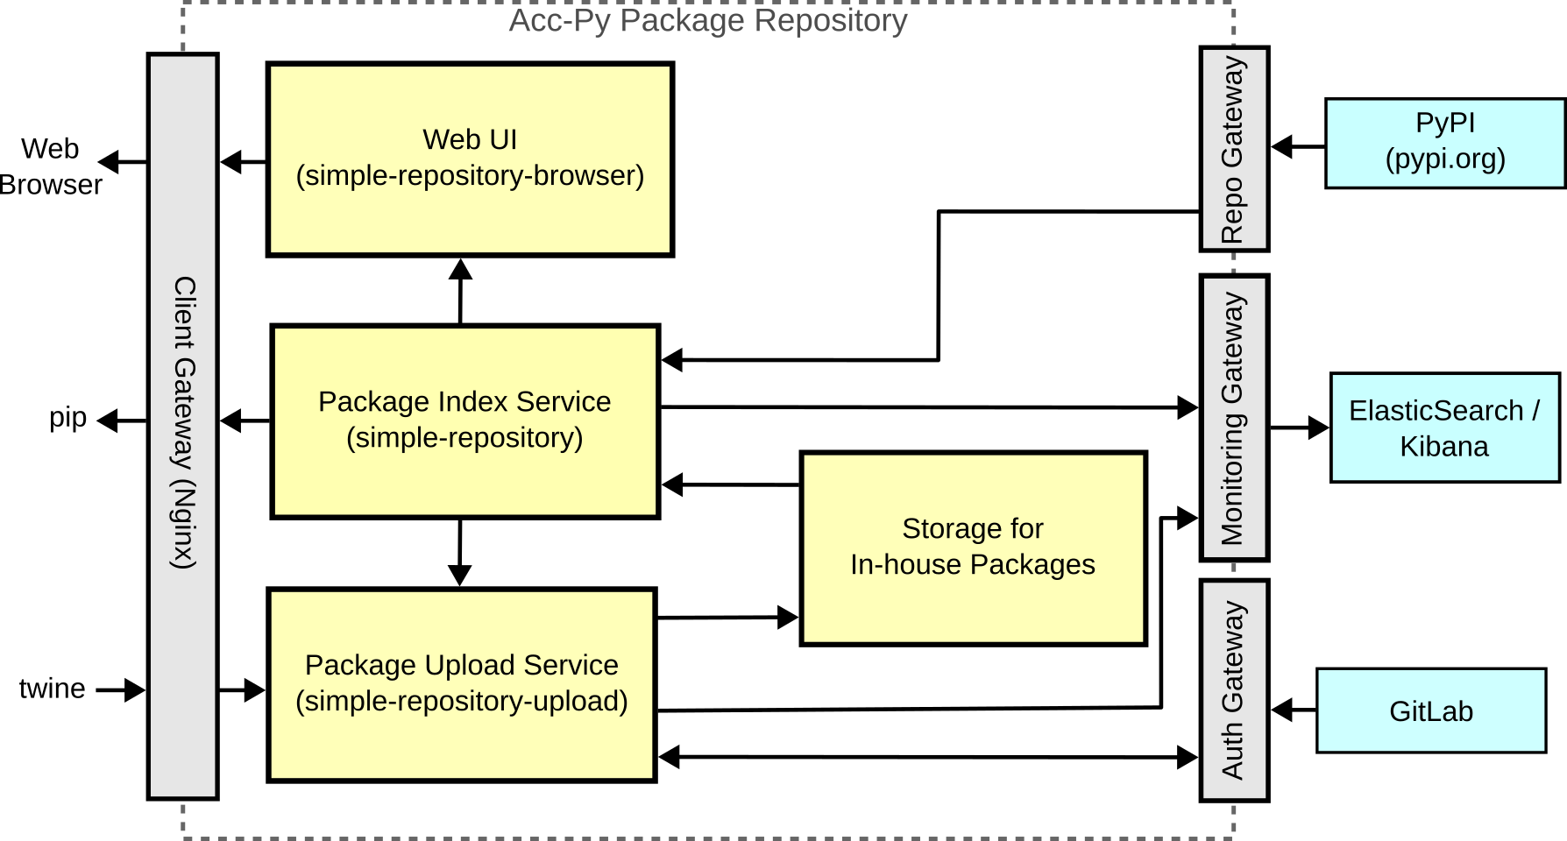
Package Repository
https://program.europython.eu/europython-2023/talk/LLHGKF/
https://accelconf.web.cern.ch/icalepcs2023/papers/thpdp067.pdf
Notes:
Say that we’re trying to figure out whether it’s gonna stay in-house or we can maintaining it as OSS

Slide 26
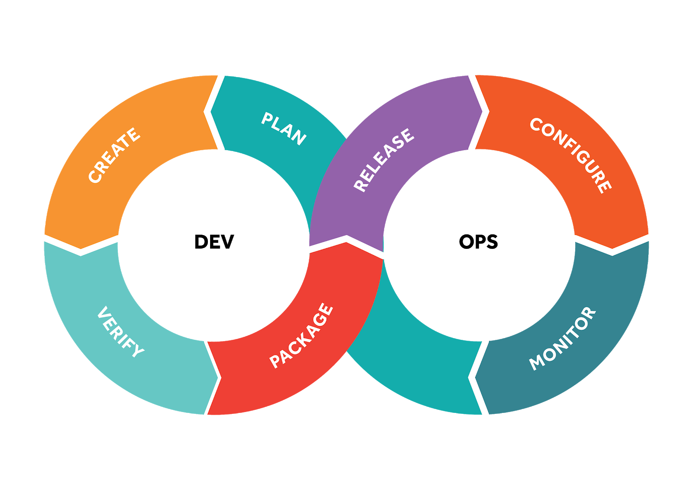
DevOps

Slide 27
DevOps
Gitlab CI is heavily encouraged for Python projects
We provide CI templates to
lint / test Python code
build & publish Python packages
build & publish documentation
(future) deploy operational applications
(future) scan for vulnerabilities
Templates use Container Images with built-in Acc-Py Python distribution, similar OS and the same binary as the one in deployment locations
Possible to use the matrix of all supported Python versions

Slide 28
Monitoring

Slide 29
Monitoring
We want to know our community
In practice, ~30 out of 500 users actively engage with us
We’ve tried running a user survey, but it proved to be high effort
Preparation of the survey
Spikes of responses only hours/a day after reminders
Classification of responses (often challenging, unless Yes/No question)
It is useful to prioritize ideas, but insufficient to know when is a good time to integrate them
So far, continuous monitoring was the most useful tool for analytics

Slide 30
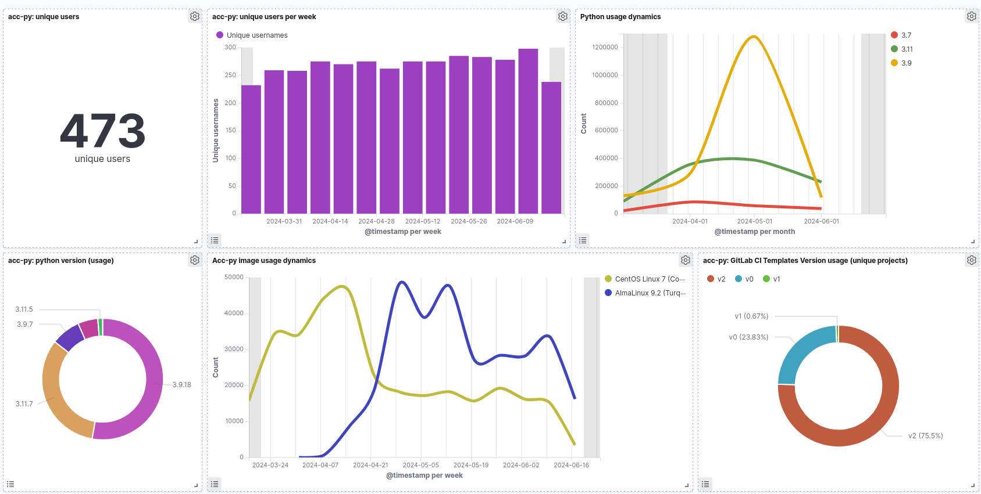
Monitoring: OpenSearch / Kibana

Slide 31
Monitoring: OpenSearch / Kibana
All Python invocations traced
From operational consoles & development PCs
Helps to know installed package versions, Python version, etc
Distinguishes when run from CI templates
Helps to know the adoption rate of features / products
Helps to know what can be deprecated / removed
Helps to study user preferences
Last resort for the emergency forensics

Slide 32
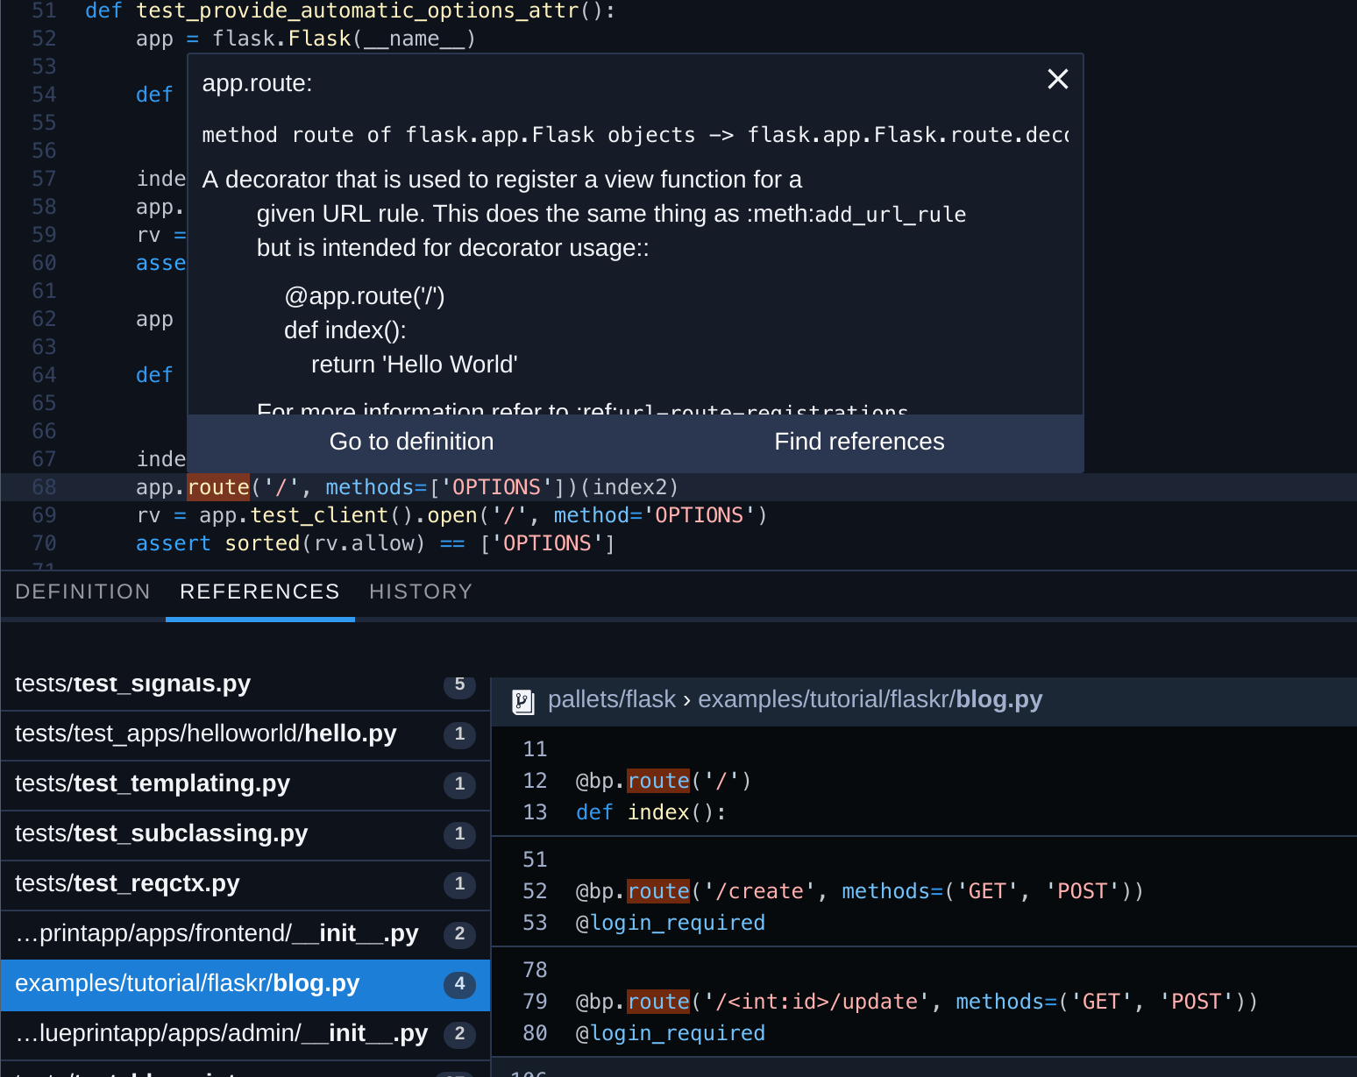
Monitoring: SourceGraph
Code search & navigation
Scans Gitlab repositories
Some Gitlab groups are scanned automatically
Others require user opt-in

Slide 33
Community, teaching & guidance

Slide 34
Community, teaching & guidance
All of community members join mattermost chat, where they can ask for help, or make suggestions
Mailing list alongside the mattermost chat is used for important announcements
We do regular presentations to give status updates and promote best practices
We participate in shaping the Python learning resources
Python team occasionally conducts code reviews for other teams within the group
Teaching & guidance is a never-ending process - reality of CERN contract rotations, and participation of “second-job developers”. We also learn new things every day!
Notes:
Highlight that we keep spam in mattermost chat minimal, because that includes every single member of the community (at least numbers in our chat and usage analytics are about the same).
Also say that that’s actually the only comm channel where we get access to the entire community. Others have less participation.

Slide 36
Useful links
Introducing Python as a Supported Language for Accelerator Controls at CERN
https://accelconf.web.cern.ch/icalepcs2021/papers/mopv040.pdf
The Python Package Repository Accelerating Software Development at CERN
https://program.europython.eu/europython-2023/talk/LLHGKF/
Towards a Flexible and Secure Python Package Repository Service
https://accelconf.web.cern.ch/icalepcs2023/papers/thpdp067.pdf
Protecting Your Controls Infrastructure Supply Chain
https://accelconf.web.cern.ch/icalepcs2023/papers/mo4bco03.pdf

Slide 37
Q&A

