Slide 1
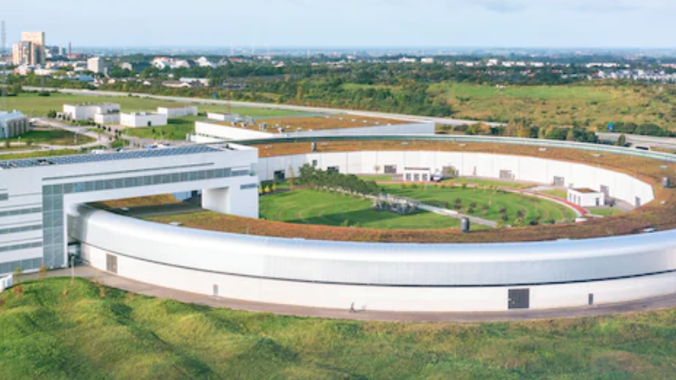
MiddleLayer and Python at MAXIV
Marco Apollonio – MAX IV, Accelerator Development Group

Slide 2
Layout
Introduction to MAX IV
Use of Python/MatlabML at MAXIV in different groups
Operations
Accelerator Development
Rings
LINAC
Summary/Conclusions
20-06-2024
Accelerator MiddleLayer Workshop, DESY, Hamburg
2

Slide 3
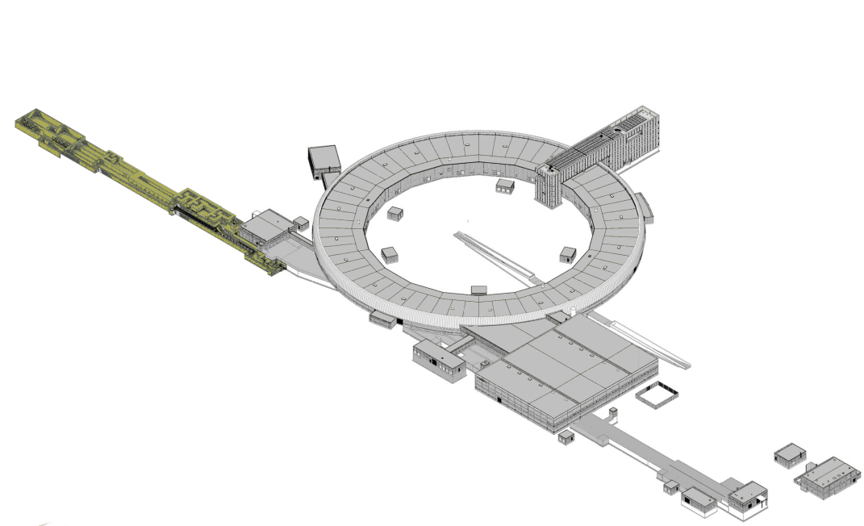
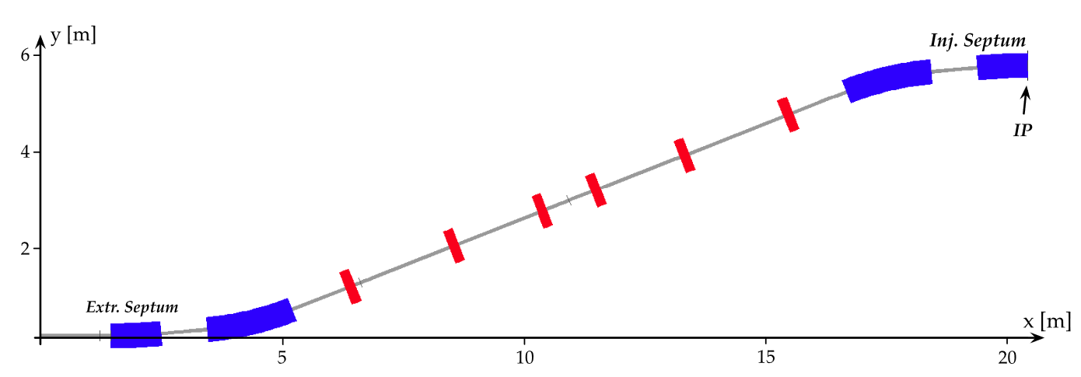
Introduction
MAXIV hosts three main machines:
LINAC
L = 368m
0 to 3.0 GeV
2 transfer lines
1 SPF beamline
R1 (1.5 GeV SR) – 143m
C = 96m
DBA technology
6 pm.rad
5 beamlines
R3 (3.0 GeV SR) - 273m
C = 528m
7BA technology
330 pm.rad
10 beamlines
DK
MIK
LINAC
3.0 GeV ring
1.5 GeV ring
DK
20-06-2024
Accelerator MiddleLayer Workshop, DESY, Hamburg
3

Slide 4
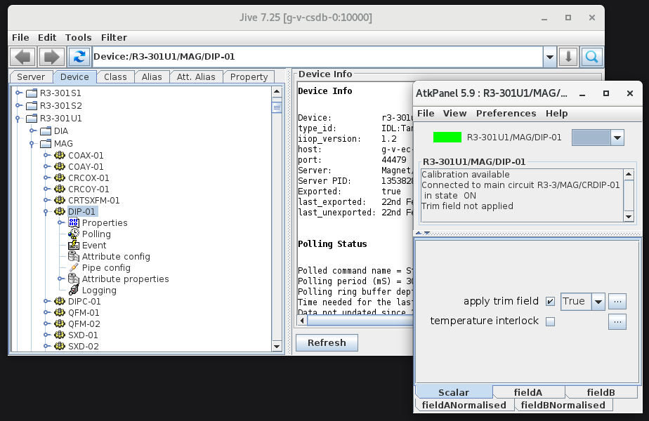
Operations Group
smooth everyday machine operation
monitoring
trouble-shooting
archiver
feedback systems
OC
tune
RF cavities
LINAC
Injection trimming
Python
Tango
“dialogue” with the machine
MAXIV
LINAC – R1 SR – R3 SR – Transfer Lines …
20-06-2024
Accelerator MiddleLayer Workshop, DESY, Hamburg
4

Slide 5
Operations Group
smooth everyday machine operation
monitoring
trouble-shooting
archiver
feedback systems
OC
tune
RF cavities
LINAC
Injection trimming
Acc. Devel. Group
RINGS
Quality checks
BBA
LOCO
NOECO
Beam diagnostics (size/emittance)
Machine model: AT2
Matlab ML
AT2
Python
Tango
“dialogue” with the machine
MAXIV
LINAC – R1 SR – R3 SR – Transfer Lines …
20-06-2024
Accelerator MiddleLayer Workshop, DESY, Hamburg
5

Slide 6
Operations Group
general control of the systems
monitoring
trouble-shooting
archiver
feedback systems
OC
tune
RF cavities
LINAC
???
Acc. Devel. Group
RINGS
Quality checks
BBA
LOCO
NOECO
Beam diagnostics (size/emittance)
Machine model: AT2
Matlab ML
AT2
Python
Acc. Devel. Group
LINAC
Quality checks
Injection trimming
Snapshot saved
Machine model: python wrapper to elegant
Matlab / Python
elegant
Tango
“dialogue” with the machine
MAXIV
LINAC – R1 SR – R3 SR – Transfer Lines …
20-06-2024
Accelerator MiddleLayer Workshop, DESY, Hamburg
6

Slide 7
Operations Group
smooth everyday machine operation
monitoring
trouble-shooting
archiver
feedback systems
OC
tune
RF cavities
LINAC
Injection trimming
Acc. Devel. Group
RINGS
Quality checks
BBA
LOCO
NOECO
Beam diagnostics (size/emittance)
Machine model: AT2
Matlab ML
AT2
Python
Acc. Devel. Group
LINAC
Quality checks
Injection trimming
Snapshot saved
Machine model: python wrapper to elegant
Matlab / Python
elegant
Tango
“dialogue” with the machine
MAXIV
LINAC – R1 SR – R3 SR – Transfer Lines …
20-06-2024
Accelerator MiddleLayer Workshop, DESY, Hamburg
7
Notes:
su

Slide 8
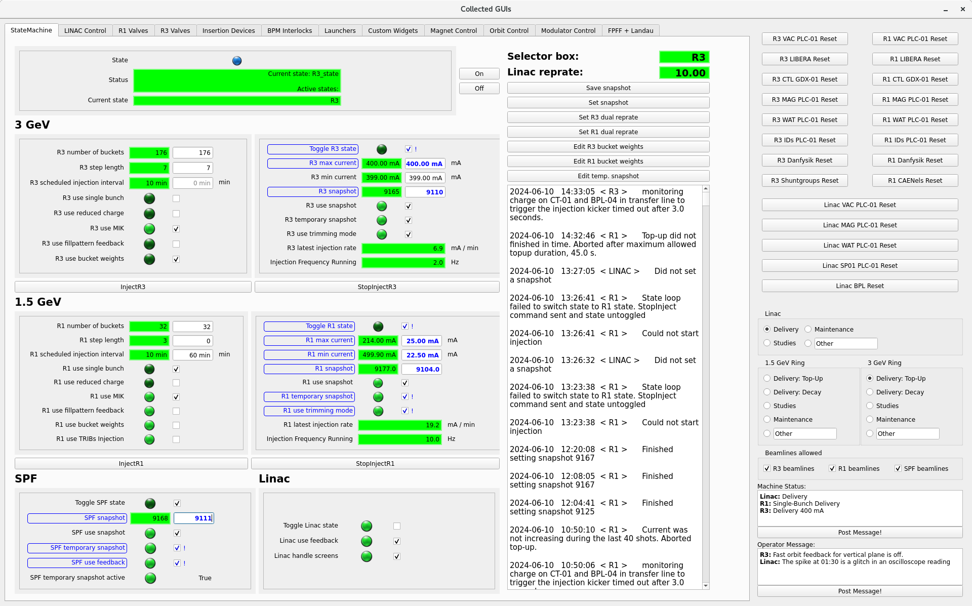
Operations Group
Python Collected GUIs
Main Panel: control processes of injection into the three machines
single / multi bunch
top-up mode
access to many other options …
20-06-2024
Accelerator MiddleLayer Workshop, DESY, Hamburg
8
Notes:
State Machine has been developed entirely inside the Ops group, great advantage in terms of getting rid of communication overhead, they know how to code

Slide 9
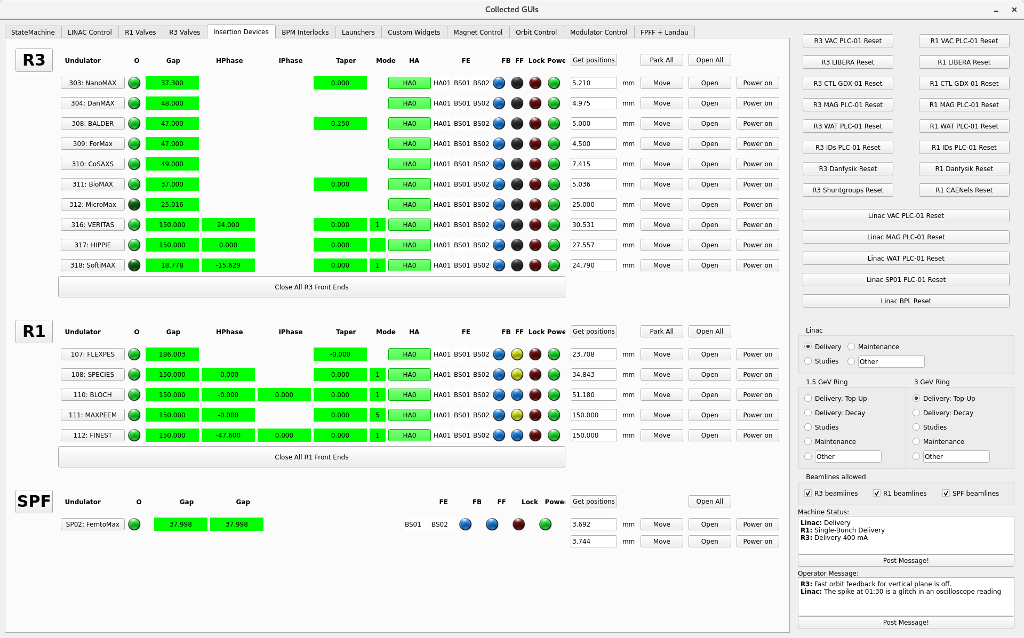
Operations Group
Python Collected GUIs
Auxiliary panels, e.g.
IDs control
20-06-2024
Accelerator MiddleLayer Workshop, DESY, Hamburg
9

Slide 10
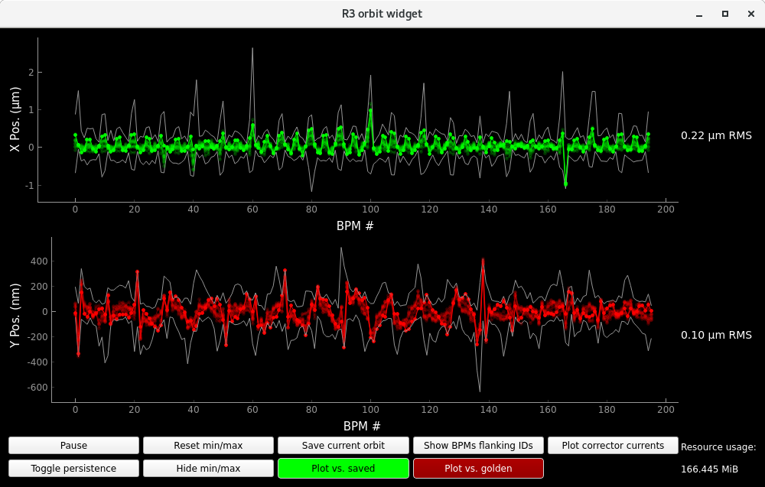
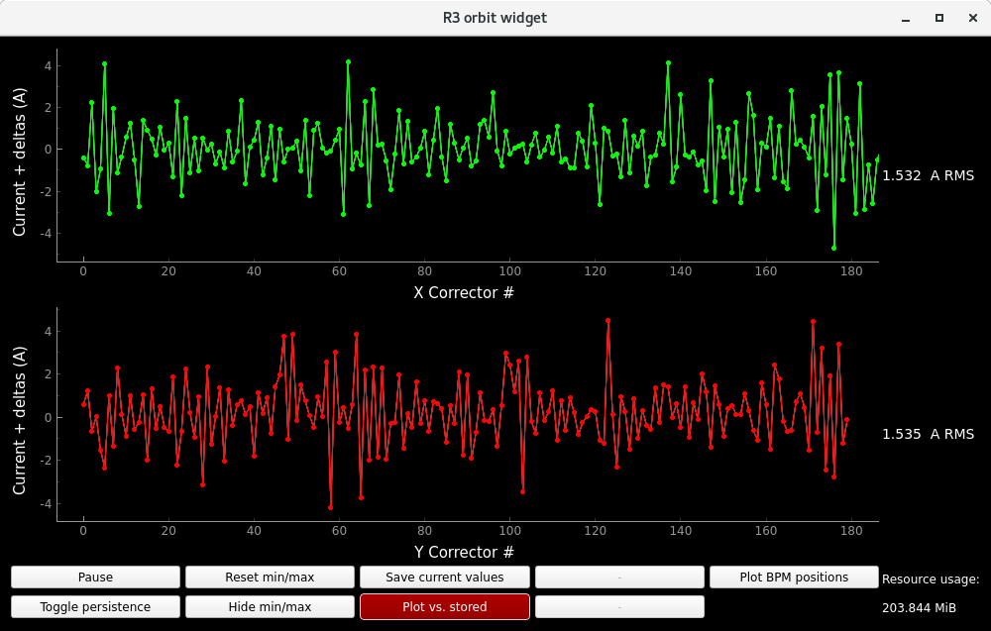
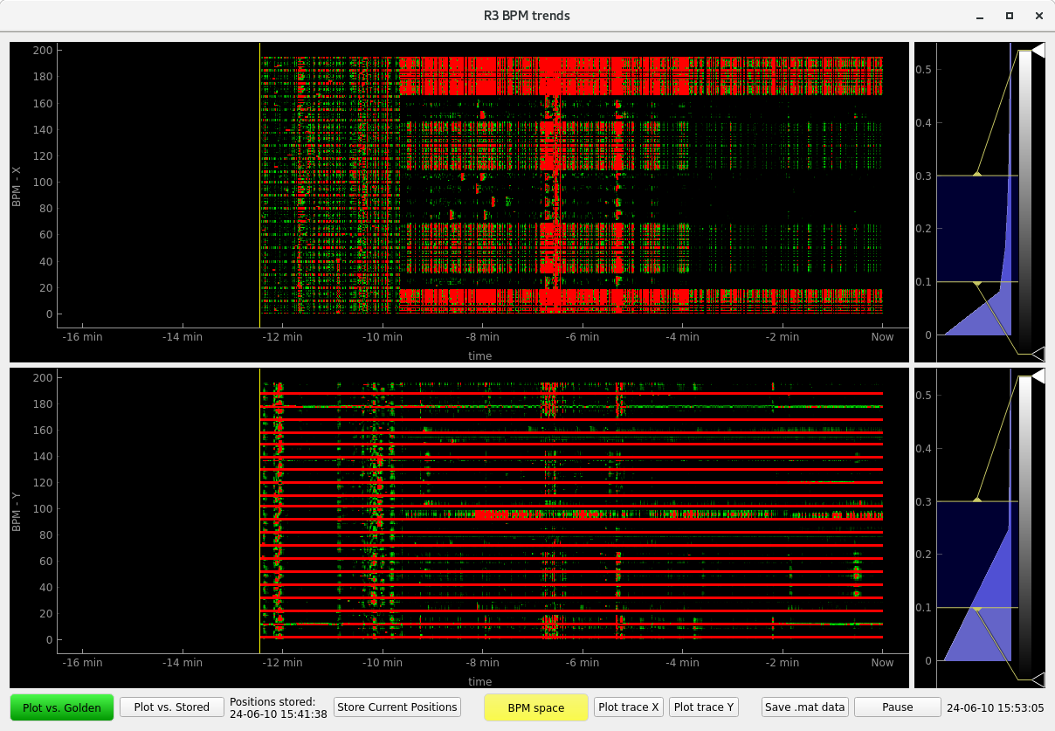
Operations Group
Orbit monitoring
CM monitoring
BPM/CM trends
20-06-2024
Accelerator MiddleLayer Workshop, DESY, Hamburg
10

Slide 11
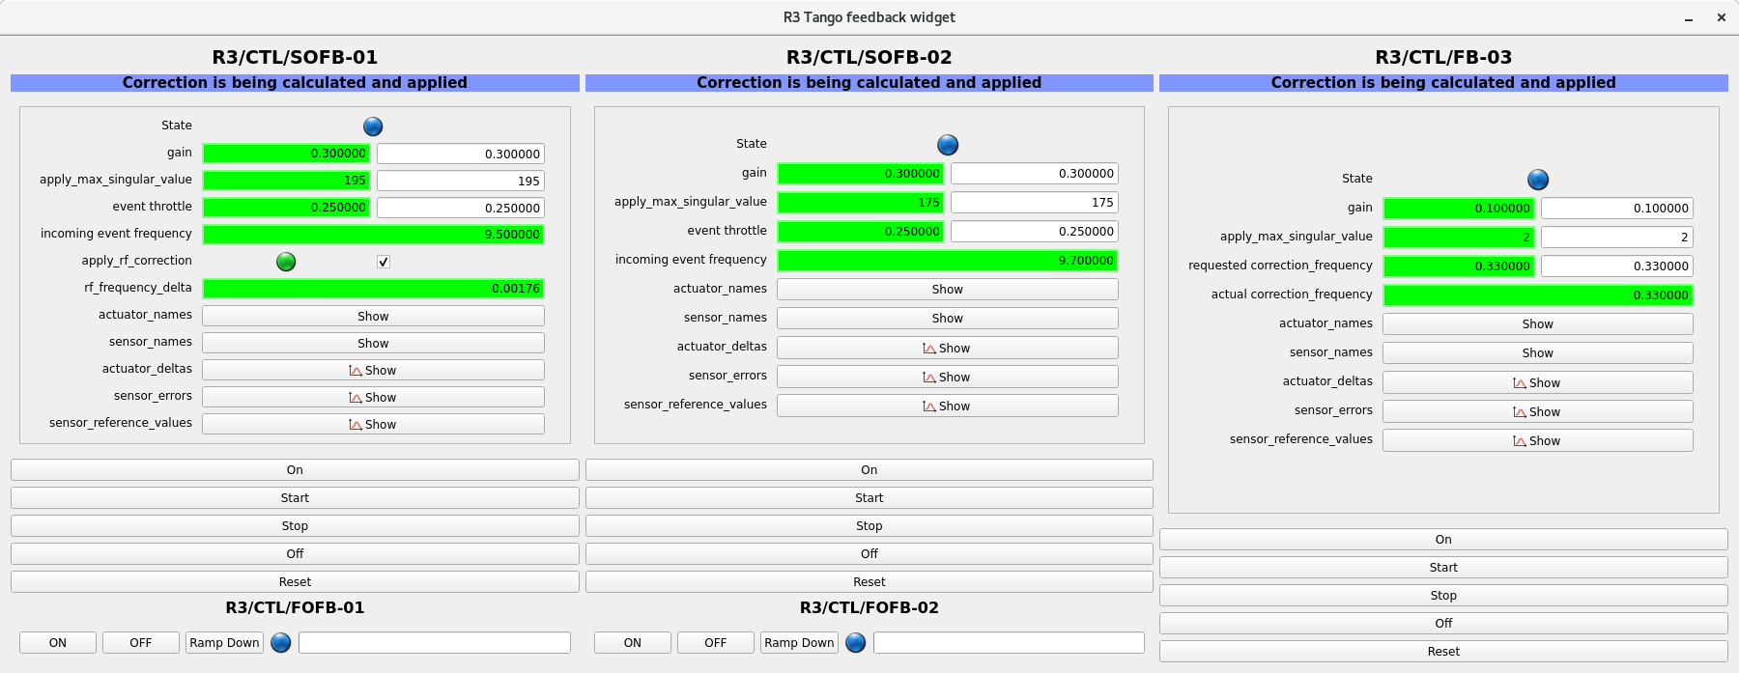
Operations Group
SOFB/FOFB/TFB
FB python coded
require initialization of the ORM via MML
20-06-2024
Accelerator MiddleLayer Workshop, DESY, Hamburg
11

Slide 12
Operations Group
– use of MML
chromaticity measurement/correction
measchro/stepchro
magnet cycling
srcycle → configure and activate tango cycling engine
savemachineconfig/getmachineconfig
automated BBA measurement
automated LOCO measurement
handsoff_loco_measurement.m
20-06-2024
Accelerator MiddleLayer Workshop, DESY, Hamburg
12

Slide 13
Operations Group
Python based MOGA for online optimisation of (IE, LT) [K. Yanartas]
No “ML” structure
stiff (read hardcoded) definition of magnet channels
however, easy communication with machine via pyTango
pyAT key performance parameters calculations (for new
low emittance lattices)
Development of a MOPSO optimiser (emittance, DA)
[R. Nieuwenhuis]
20-06-2024
Accelerator MiddleLayer Workshop, DESY, Hamburg
13

Slide 14
Accelerator Development Rings: archiver
Extremely useful tool
scripted performance comparison, post-proc etc
trace errors back to their origin → fix problem
Present use from MML (actual case after Shut Down with troublesome injection)
A = getam(‘QF’,’Resistance’); B = getam_archive(‘QF’,’Resistance’,<any date>)
C = (B-A)./A → spot short-circuited cases with anomalous resistance …
calls archiver_tool.py (AD.archive)
MML: handle pointing at a general function (switchable, AD global variable)
big change wrt early days with visual checks with web interface
In a pyML world, all could be embedded in one “pygetam(…, date)” directly accessing the
archiver_tool.py (easier/faster scripting …)
easy to pipe into a hw2physics command …
getmachineconfg(‘date’) or savemachineconfig(‘date’) why?
e.g. commissioning where we had some interesting config that was not saved
20-06-2024
Accelerator MiddleLayer Workshop, DESY, Hamburg
14

Slide 15
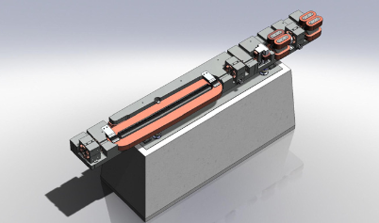
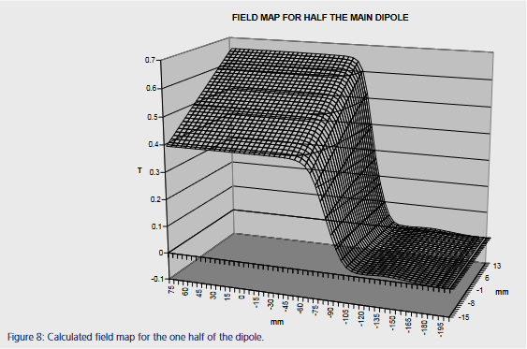
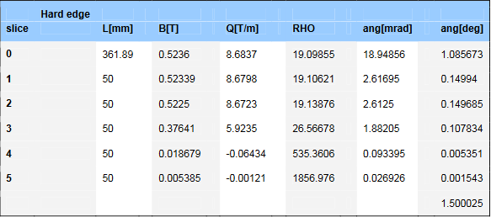
Accelerator Development Rings: magnet control → dipoles
DIPM, DIPMc sliced model
Main coil: I_{main}
Pole Face Strips (PFS), I_{PFS}: mainly tuning the gradient …
effect on the bending!
20-06-2024
Accelerator MiddleLayer Workshop, DESY, Hamburg
15
Notes:
MAXIV bending magnets are CF elements with negative focussing. They also have some PFS to tune the gradient (used in LOCO)

Slide 16
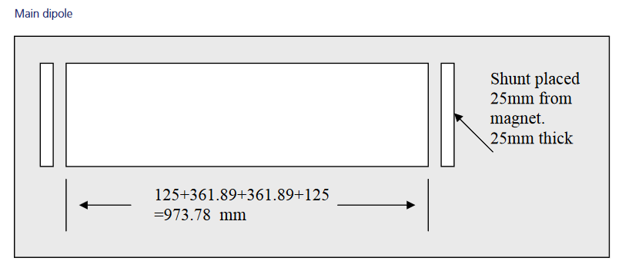
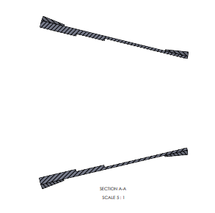
Accelerator Development Rings: magnet control → dipoles
In the model, dipole sliced to mimic the edge effect of the field/gradient
pole face strips are added to tune gradient
I_{main} + I_{PFS} → B_{main} + b_{PFS} → MML iterative procedure to re-balance the energy while reaching the desired gradient …
setPFSonline(Family, Field, NewSP, DeviceList, varargin)
…
computeBendSettings(integratedK, Energy, Status, DeviceList)
20-06-2024
Accelerator MiddleLayer Workshop, DESY, Hamburg
16
Notes:
Note: why iterative method? it is needed because the excitation curves are not linear, as such a simple superposition is not precise enough.
PFS family, check how to change the PFS gradient. The message here is that, in some situations one need to create an iterative process to target a certain gradient. This kind of situations should be condsetred in a future desgin

Slide 17
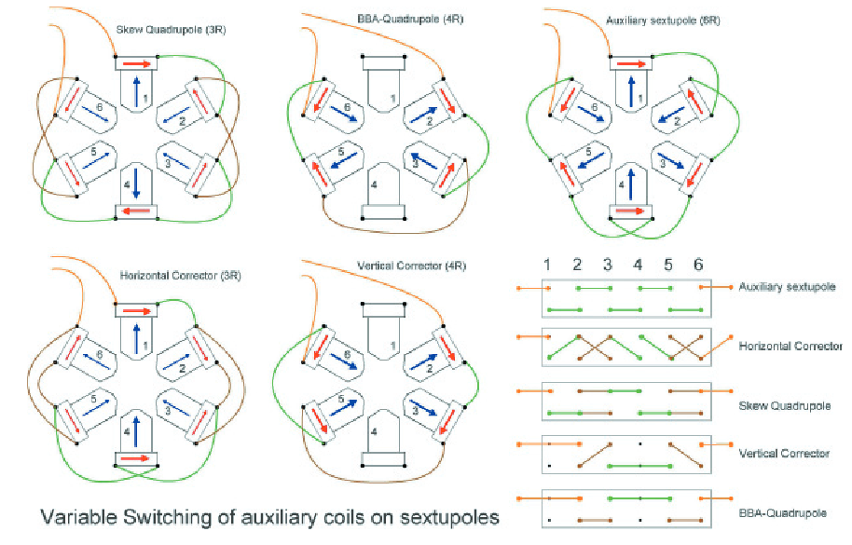
Accelerator Development Rings: magnet control → sextupoles
SFM: sextupoles at the Matching Cell
quadrupole component activated by
switching auxiliary coils
BBA at sextupole positions
sextupole saturation creating a difference
between magnetic centres
solution: switch off SFMs
Model-wise:
I_{SFM}, I_{trim} → two currents into an element
PolA, PolB determined by superposition
Inverse problem: given PolA/PolB, what
are the currents?
Practical solution: model aux. coils as ThinElements between sliced SFM, separate families
It would be nice to consider a PolA(n)/PolB(n) case
where the polynomial components for any
submagnet n are natively separated
20-06-2024
Accelerator MiddleLayer Workshop, DESY, Hamburg
17
Notes:
All SX and O have configurable TC for Q/D components (Norm+Skew) . Note: not all of them are presently equipped with PS (SD, OXY, OYY)

Slide 18
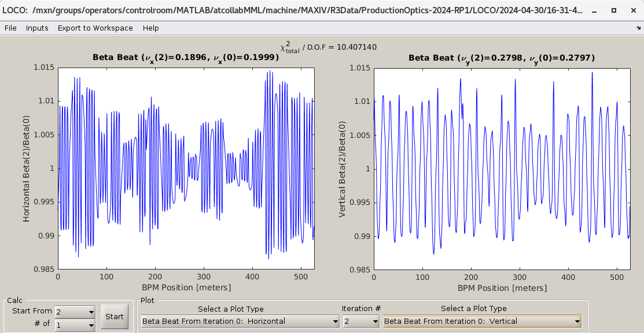
Accelerator Development Rings: linear dynamics fit → LOCO
LOCO
stems from the original code
(Safranek)
parallel computation of Jacobian
no-GUI automated (hands-off)
Use case: scripted scans for ID compensation
adapted to the MAX IV R1/R3 cases
virtual PFS family discussed before
fundamental for control of Lin. Dyn.
20-06-2024
Accelerator MiddleLayer Workshop, DESY, Hamburg
18
Notes:
In LOCO, set a grad in PFS requires to preserve the bending pwr in the DIPm. Note, there is no such thing as PFS family in the max4…m lattice file. The PFS rests upon a handle function that sets the gradient.

Slide 19
Accelerator Development Rings: Orbit Response Matrix
Part of LOCO measurements
been considering a fast ORM measurement
to speed up process (e.g. Diamond case)
- low priority so far, but highly sought for also for NOECO
to be considered in a future py-design scenario
20-06-2024
Accelerator MiddleLayer Workshop, DESY, Hamburg
19

Slide 20
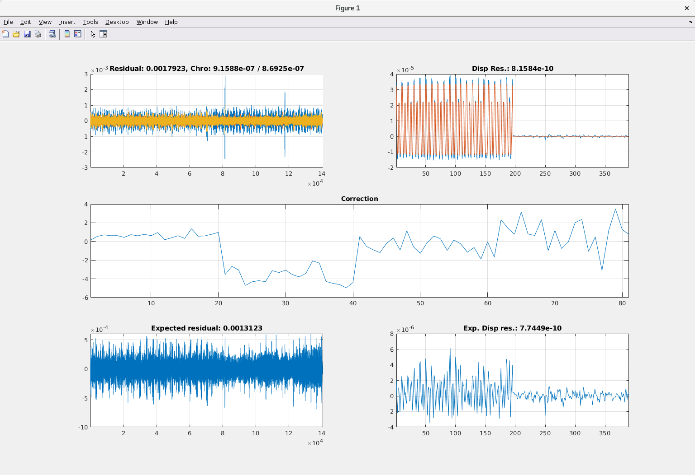
Accelerator Development Rings: non-lin. dynamics fit → NOECO
Non-linear optics from Off-Energy Closed Orbit
developed at MAX IV [*]
extremely powerful to control non-lin. dyn.
Significant improvement of lattice performance (LT x2)
definitely something we would like to have in a future py-design
[*] D.K.Olsson et al. PRAB 23, 102803 (2020)
20-06-2024
Accelerator MiddleLayer Workshop, DESY, Hamburg
20
Notes:
NB the implementation is expert. Not at the state of a LOCO GUI

Slide 21
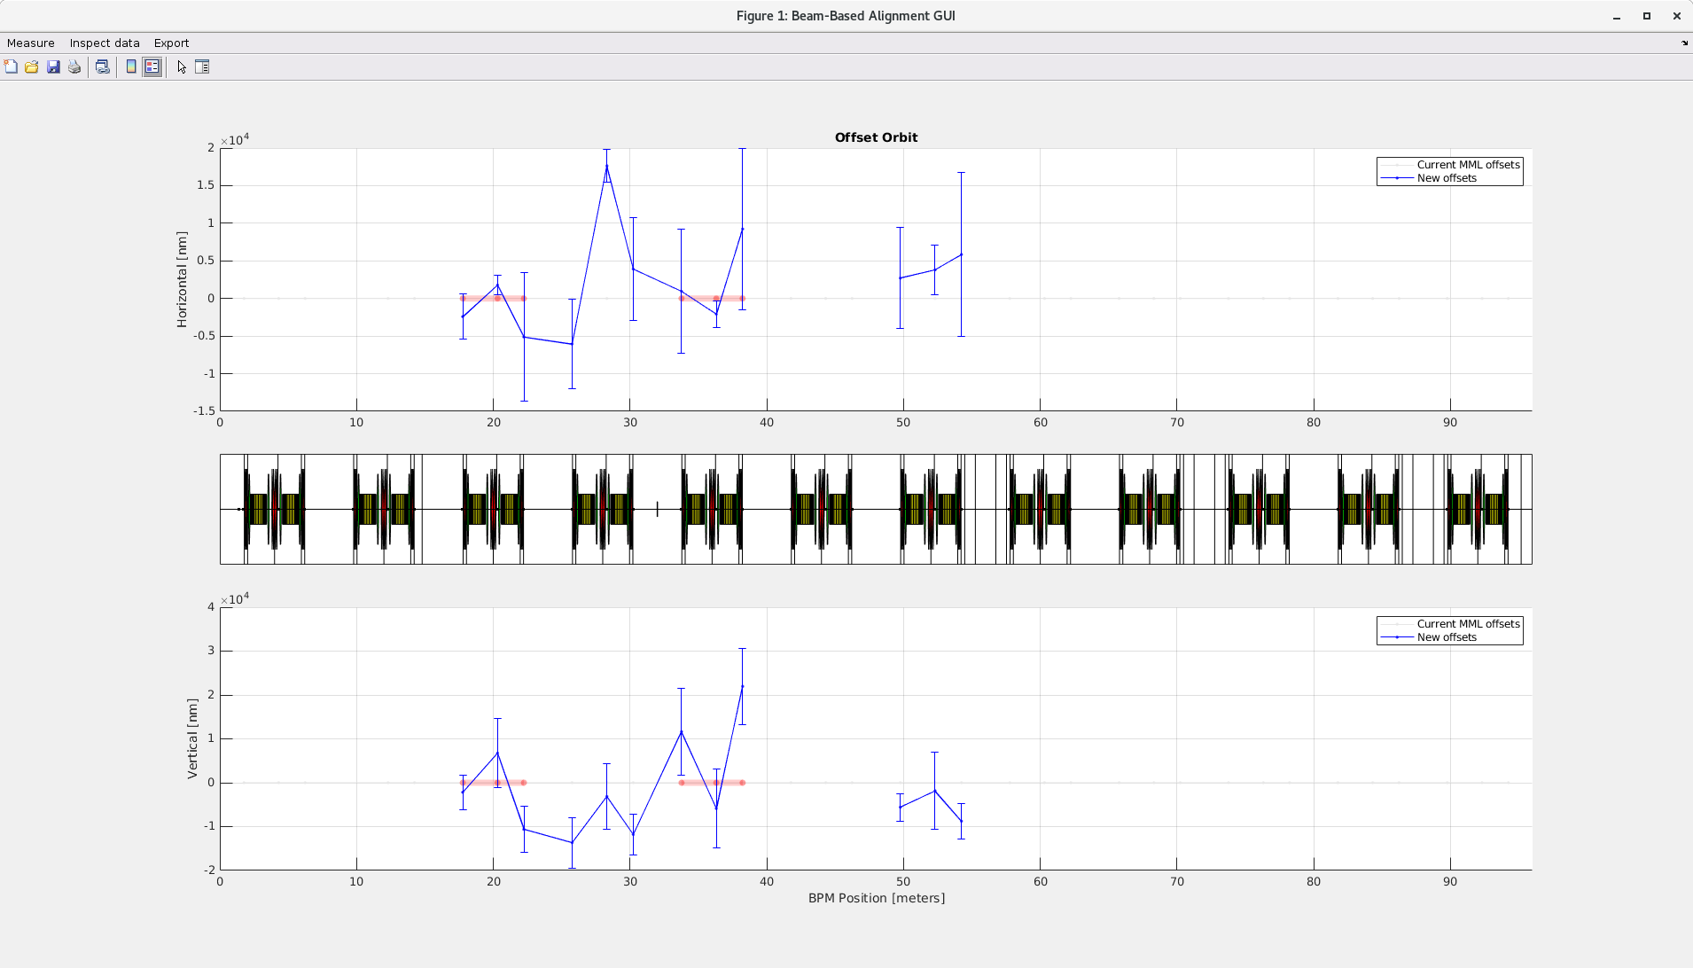
Accelerator Development Rings: Beam Based Alignment
BBA
adaptation of original MML BBA
quadcentring
Improved GUI to operate the process
automate process for Ops
special control of multi-function magnets
trims used to control coupling and vertical emi
are ramped down with orbit control
switch SX off
start campaign
frequent orbit control by activating the SOFB
In view of a py-design we should consider a
modular structure where OC are switchable
in an easy way
20-06-2024
Accelerator MiddleLayer Workshop, DESY, Hamburg
21
Notes:
In nomraml ops trims are typically used for the control of the vertical emittance, by exploiting their skew-quad capability. When a BBA campaign is started, first we need to ramp them down while controlling the orbit, then switch the sextupoles off, then start the quadcentre procedure. OC are don periodically to ensure beam stability.

Slide 22
Energy scaling script
Accelerator Development LINAC → Energy Scaling
A script to relatively scale the linac magnets energy attribute (Mathias Brandin, Lennart Isaksson)
A target bend must be chosen from the drop-down menu
The magnets to include are selected using the tick boxes.
The energies of the chosen bend and BC1 are calculated from their set currents, and the energy difference by subtraction.
The energy contribution from each modulator is calculated as a fraction of the difference, depending on the square of their HV setpoints. This energy distribution does not take off crest phase into account.
Pressing the Set Energy button will set the calculated energy to the energy attribute of the selected magnets.
Pressing the Scale Magnets button assumes the bend in either end has been changed and all other magnets are scaled accordingly.
20-06-2024
Accelerator MiddleLayer Workshop, DESY, Hamburg
22
Notes:
Confirm from Sara if this is Python

Slide 23
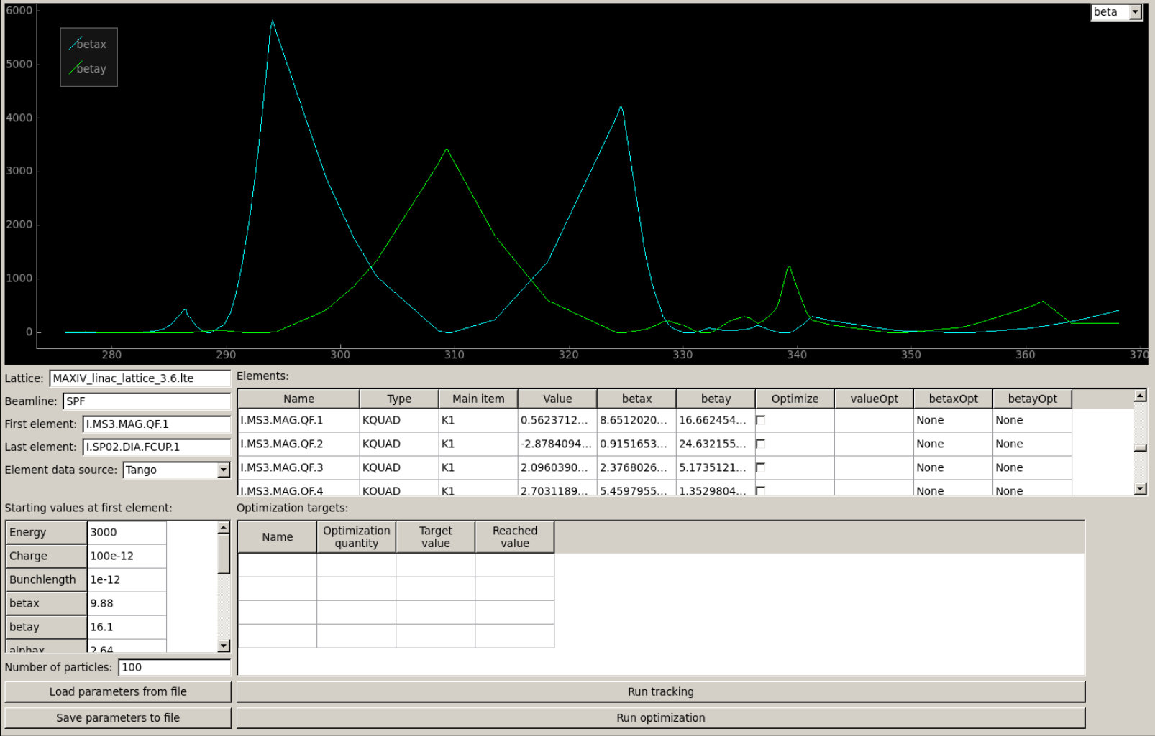
Machine model
Accelerator Development LINAC → model
Initially written in MATLAB
re-written in Python
Uses elegant for the linac model
20-06-2024
Accelerator MiddleLayer Workshop, DESY, Hamburg
23

Slide 24
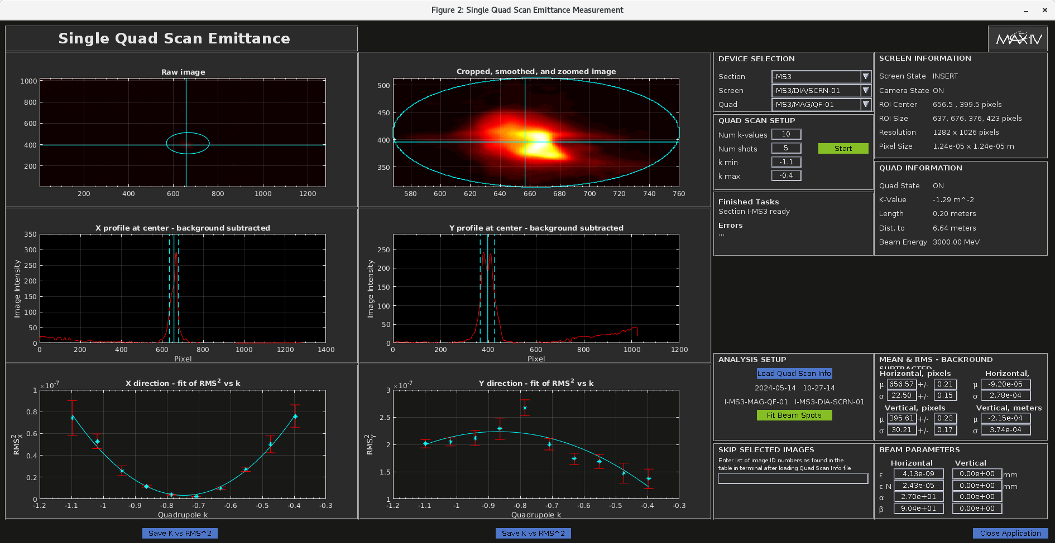
Accelerator Development LINAC → emittance measurements
Written in matlab
Sets k-values on a selected quad and reads out image from selected camera.
Calculates emittance, alpha and beta.
Uses many functions from a matlab library.
20-06-2024
Accelerator MiddleLayer Workshop, DESY, Hamburg
24

Slide 25
Summarizing …
Python widely used by MAX IV operators,
MML used sporadically when…
measuring some quantities like chromaticity
uploading/saving new (deployed) magnet configurations
cycling the magnets during a validation procedure
MAX IV Rings are controlled/conditioned via MML/AT2
Physics Model in AT2 (matlab)
LOCO/NOECO fits
BBA
Control of combined function magnets
MAX IV-MML: “bastardised” version of the original release, modified during the years to fit R1/R3 needs
as such, local (versioned) code in our GitLab repository (branched off on Aug 16th 2018 from GitHub)
MAX IV LINAC
relies on a portfolio of different codes/scripts based on Matlab, Python
Physics Model rests upon elegant
No ML structure
20-06-2024
Accelerator MiddleLayer Workshop, DESY, Hamburg
25
Notes:
NB: SOLEIL,

Slide 26
Conclusions (1)
Accelerator Development group
reduced number of people available for the pyML project (2)
on top of normal operations
on top of the involvement in the CDR for the new <100 pm.rad machine (max4U)
NB: commitment with max4U CDR is our 1st priority
fluent in MML, Matlab, not so in Python
Possibility recently transpired to involve the operations group
caveat: operators prime commitment is to ensure machine functioning
naturally fluent in python
huge experience in the control room
Necessity to identify few use cases for a start:
pyAT model of the actual machine
control of magnet families
pyLOCO/NOECO
pyArchiver
pyBBA
20-06-2024
Accelerator MiddleLayer Workshop, DESY, Hamburg
26

Slide 27
Conclusions (2)
given the limited resources we cannot start “from scratch”
possible way forward for us:
local collaboration between AccDev(physics) and Operations (Python coding)
possible working scheme: AccDev testing python scripts during Test Times
(e.g. Mondays or Study Weeks), with assistance from Ops
accept a previously defined and shared framework (as it was for MML)
explore few use cases
test code of common interest and/or
contribute with development of code
chance to include LINAC group in ML
20-06-2024
Accelerator MiddleLayer Workshop, DESY, Hamburg
27
Notes:
Timeline for m4U … 2030, we would like to have a functioning pyML

Slide 28
Many thanks for your attention …
… and many thanks to Stephen Molloy and Operations Group, Magnus Sjöström and Sara Thorin
for material and discussions
20-06-2024
Accelerator MiddleLayer Workshop, DESY, Hamburg
28

