Slide 1
Python library for simulated commissioning
Lukáš Malina
On behalf of:
Thorsten Hellert, Simone Liuzzo, Lina Hoummi, Bianca Veglia, Elaf Musa, Joachim Keil and Ilya Agapov
Hamburg, June 20th, 2024

Slide 2
Outline
Motivation and design approach
Translation from Matlab with the help of AI
Contents of the Python library
Commissioning simulations of PETRA IV
Experimental beam tests in PETRA III

Slide 3
What consists an accelerator?
How does it define commissioning simulations?
Designed: Groups of perfect and identical elements which are perfectly aligned
Specify (realistic) tolerances on the components themselves and their alignment
Can we pass from Built to Operational? -> Commissioning simulations
Store and “interface” errors, which are different for each single element
Provide high-level correction methods and separated performance analysis
Replicate many machines with all sorts of random errors (given the tolerances)
Built: Neither perfect nor identical elements, which feature residual misalignments
Does not work!
Need to commission, i.e. adjust settings using beam as a diagnostics tool
Single replication with errors -> Commissioning simulation with only changed interface
Operational: Same as built. However, with adjusted settings, it provides a designed performance

Slide 4
Python library for commissioning (being) developed
Collaboration with ESRF (EURIZON project) and LBNL
Written in Python and pyAT for beam dynamics
Python-based solutions gain momentum and user base
Translated the SC library with the help of AI
Improved the code maintainability and test coverage
Advancing correction methods
Implementing robust methods for the typically skipped steps in the commissioning chain
Trajectory BBA, RF-setup, Orbit BBA
New features
Charge-scaled BPM noise, error propagation
Bottom-up approach
Focus (temporarily) on single cases and fixing them
Advancing incrementally from the (commissioning) start to its end

Slide 5
ChatGPT-aided translation

Slide 6
Translation workflow made more efficient
Creating a project stub
Raw conversion by ChatGPT (Engine: code-davinci-002)
Python API or browser-based
Quotas and lower quality with distance in the text
Stripping off comments
Fix problems and “stitch” together manually
Method signatures, implicit definitions, etc
Create reasonable data structures, write type hints
Making everything run, producing correct results
Write automated tests

Slide 7
ChatGPT helped to translate SC
Python API
def remove_comments_in_file(ffile: str, source_dir: str = "") -> str: with open(f"{source_dir}{ffile}", "r") as mfile: lines = mfile.readlines() new_lines = [l.replace("\t", " ").strip("\n") for l in lines if not l.strip().strip("\t").startswith("%")] new_lines = [l for l in new_lines if l.strip(" \t\n")] return "\n".join(new_lines) def matlab_to_python(matlab_code: str, python_start: str = "") -> str: intro = "# Convert this from Matlab to Python:\n# Matlab version \n\n" ending = "\n# End\n# Python version\n\n“
prompt = intro + matlab_code + ending + python_start response = openai.Completion.create(model="code-davinci-002", temperature=0, top_p=1, frequency_penalty=0, presence_penalty=0, max_tokens=len(prompt), stop=[intro[:20]], prompt=prompt) return python_start + response.choices[0].text
Run on all SC Matlab files
A bigger part of the SC was roughly translated within an hour!

Slide 8
ChatGPT helped to translate SC
Browser-based translation

Slide 9
If we were just to translate MML to Python
Is this a viable approach? What would it take to become viable approach?
AI tools got most likely better (compared to early 2023)
Process could be smoother, more automatic, etc.
Cannot be one-to-one translation only
At the very least, we should redesign the structure / refactor to adapt to the language features (and pitfalls)
Requires to know what features we want to keep and how should the API look like
I see two main options, which can be combined:
Agree on at least coarse specifications
Create a “learning project” agreed in the beginning to be later abandoned or completely redesigned

Slide 10
Python library contents

Slide 11
Commissioning simulation library: General workflow
SimulatedCommissioning class
Ideal lattice
Uncertainties data
Realistic lattice
High-level methods
Modelling
Trajectory
Orbit
BBA
RF setup
…
pyAT Lattice
Uncertainties
Physical
machine
Settings interface
Adds errors to ideal setpoints
BPM reading
Adds errors to tracking data

Slide 12
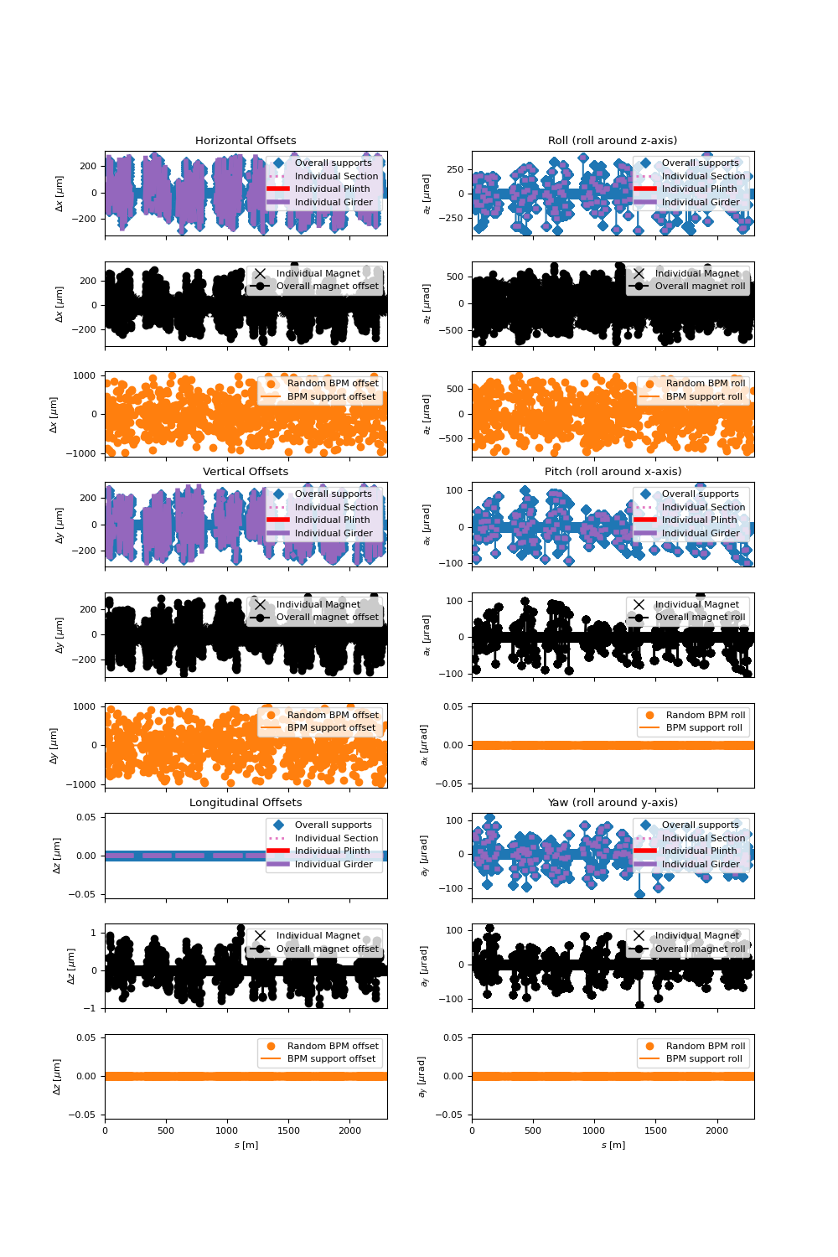
Error sources included
BPM Errors:
BPM offsets (2D)
BPM noise (CO, TBT)
BPM roll (1D)
BPM calibration
Magnet Errors:
Magnet offsets (3D)
Magnet rolls (3D)
Magnet calibration (strength)
Multipole errors (offsets and calibration)
Ring circumference error
Support structures (3 stackable types):
Offsets (3D)
Rolls (3D)
RF errors:
RF phase
RF frequency
RF Voltage
Injection errors:
Static errors (6D)
Jitter (6D)

Slide 13
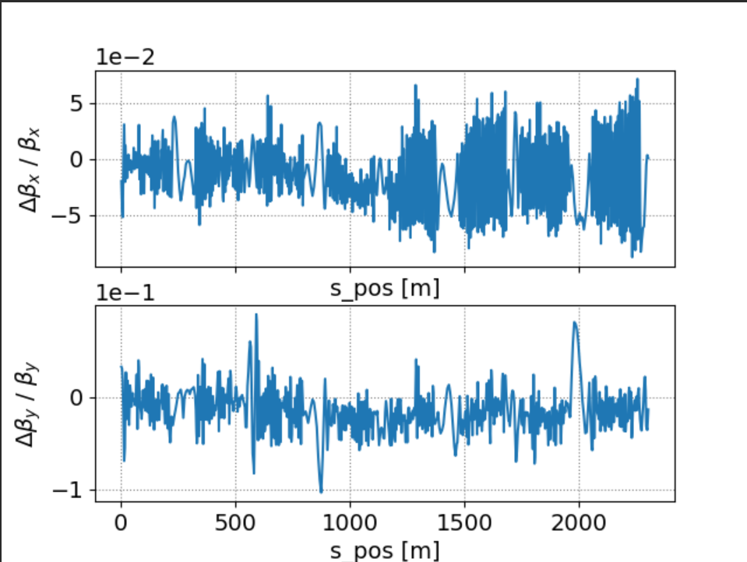
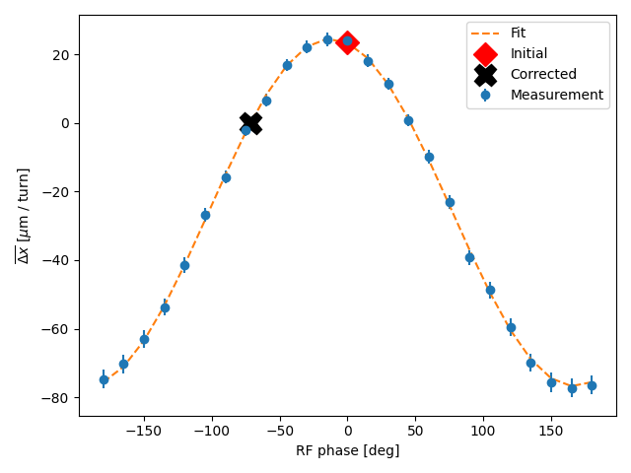
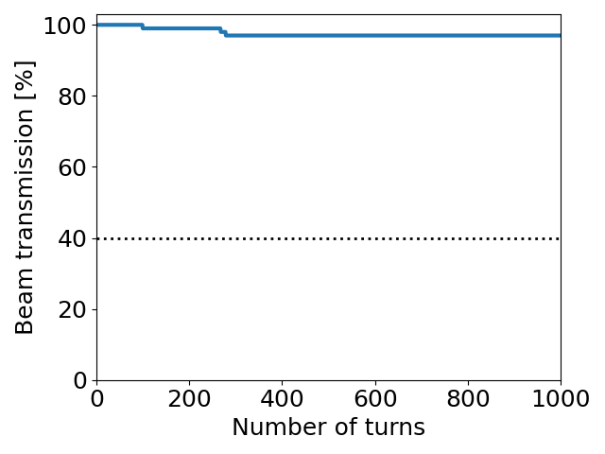
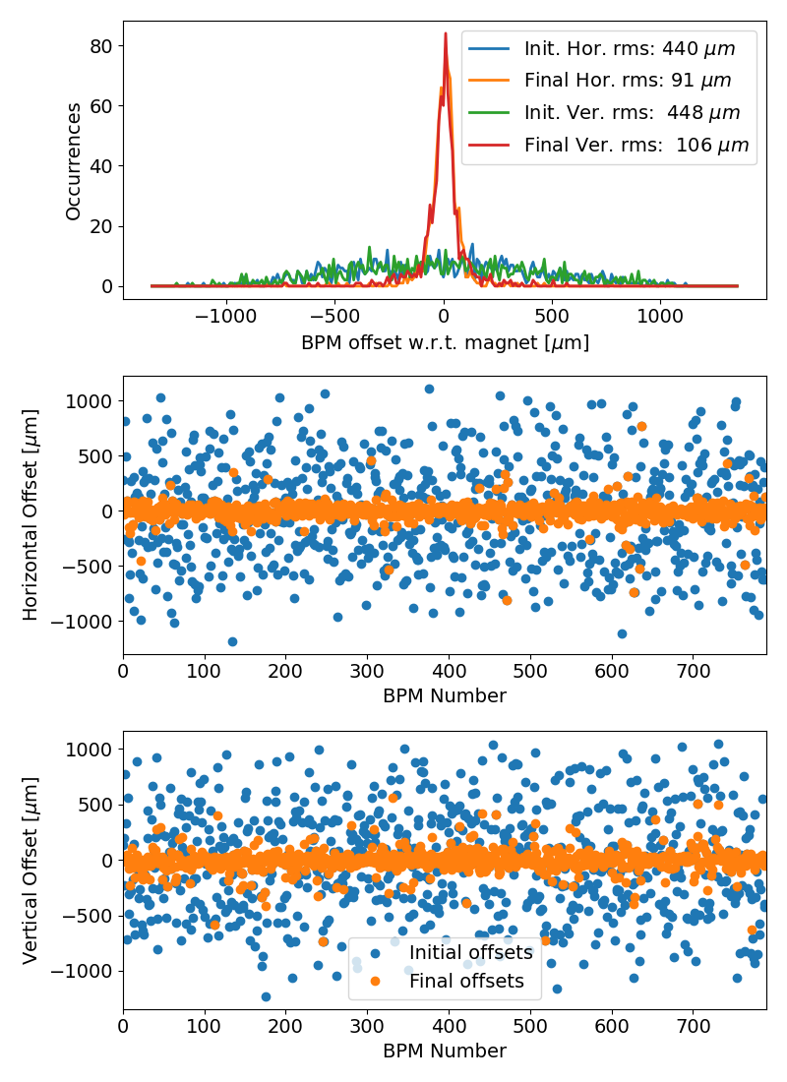
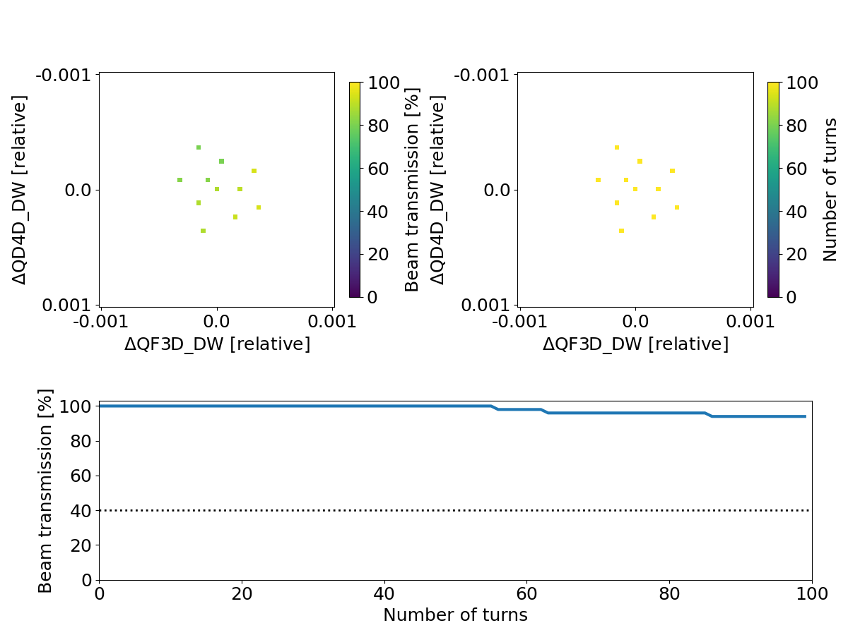
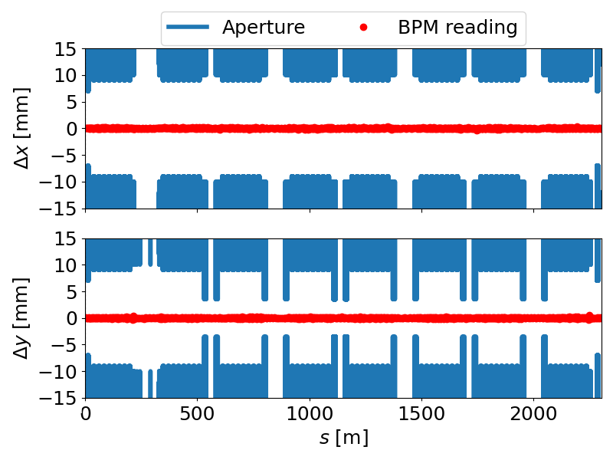
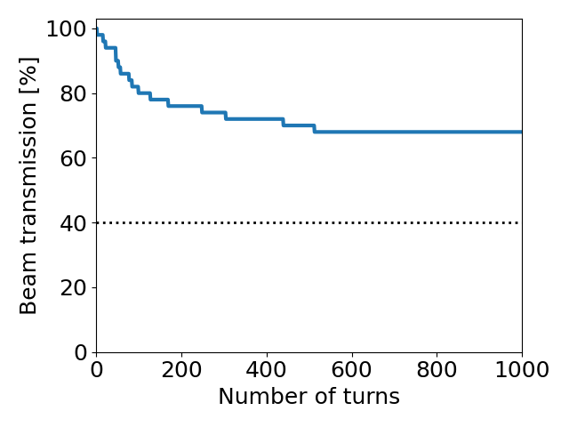
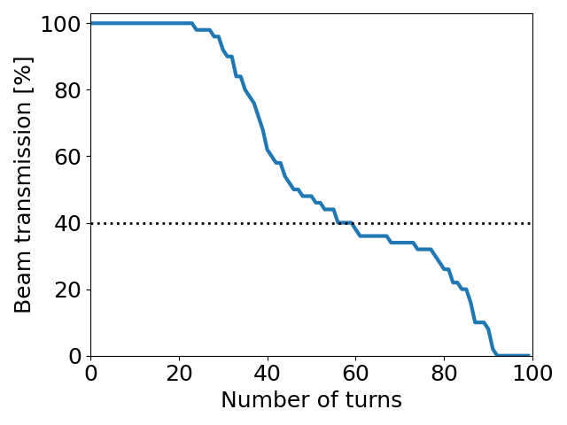
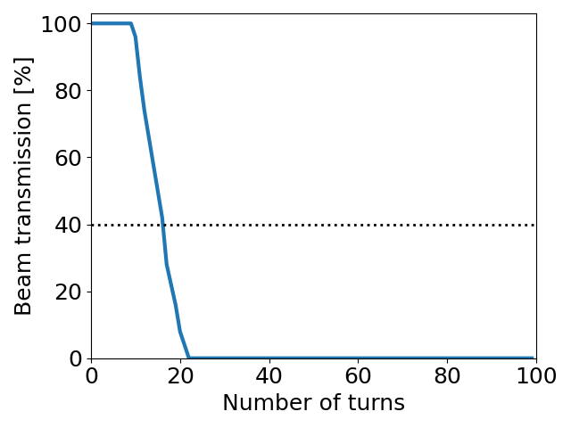
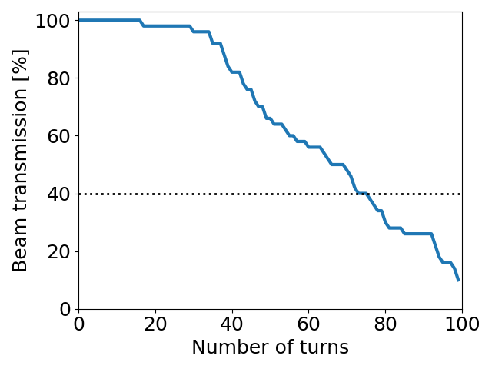
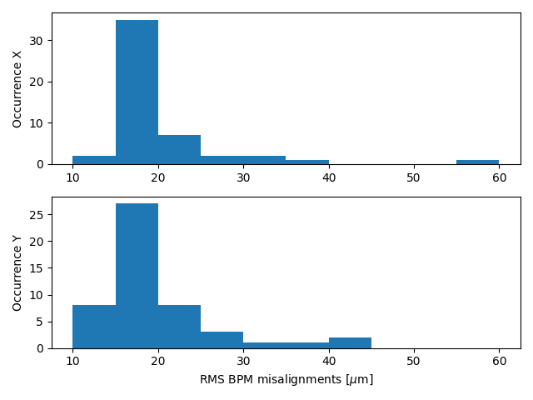
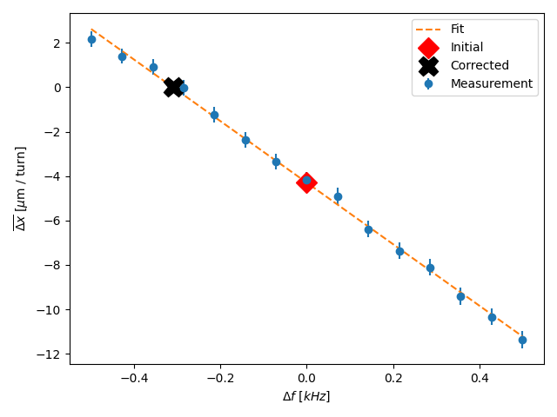
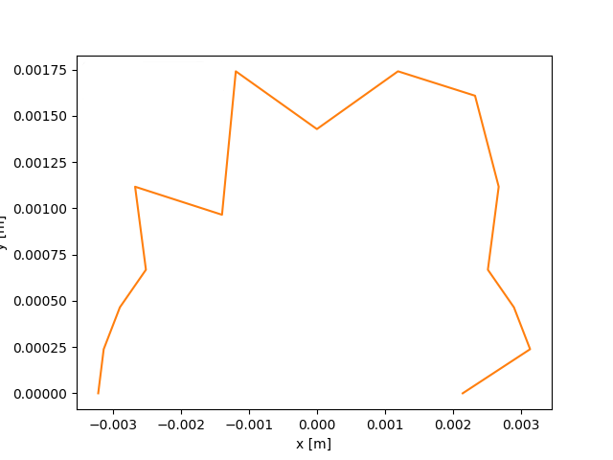
Methods chained in commissioning simulation: PETRA IV
First turn steering
Trajectory BBA
Multipole ramp-up
RF setup
Tune scan
Orbit BBA
Orbit correction
Optics correction (LOCO and TBT)
Dynamic Aperture
In progress

Slide 14
Where to find the library?
Public repository on GitHub
https://github.com/lmalina/pySC
https://lmalina.github.io/pySC/
Quick start for SC users: https://github.com/lmalina/pySC/blob/master/pySC/matlab_index.py
Presented at ICALEPCS 2023

Slide 15
PETRA IV commissioning simulations

Slide 16
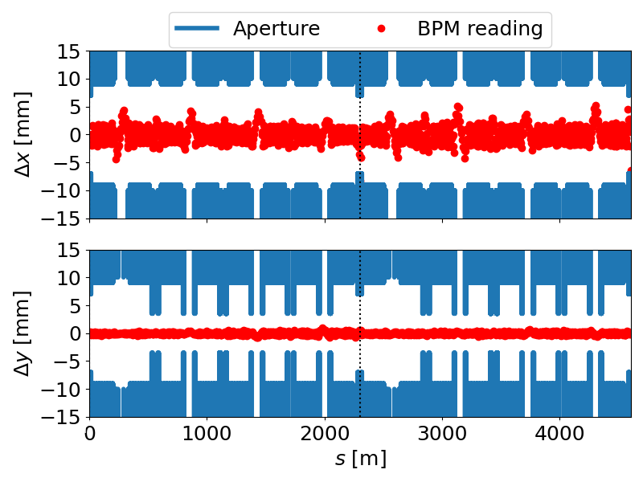
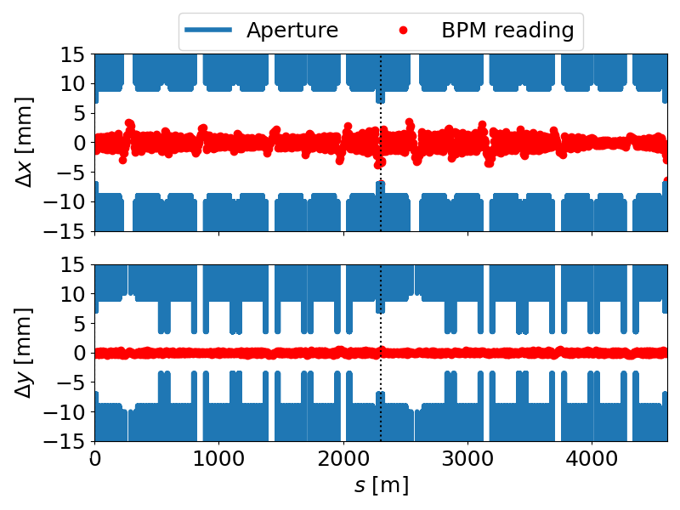
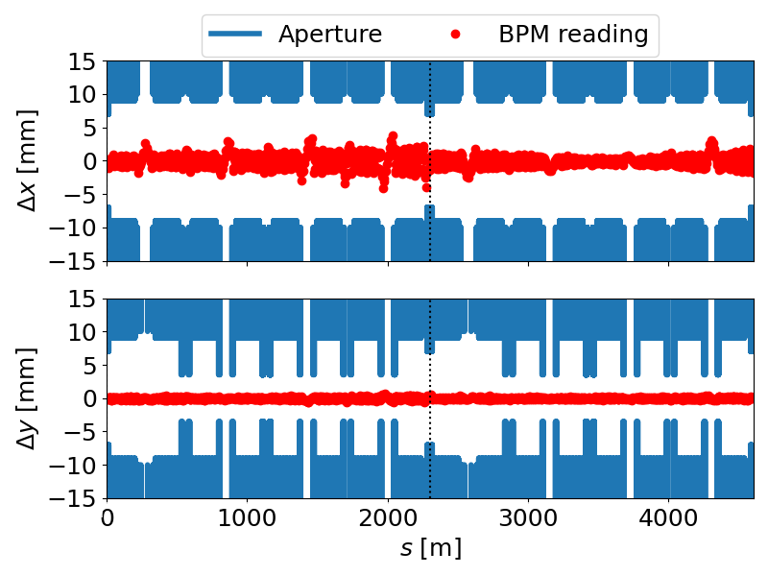
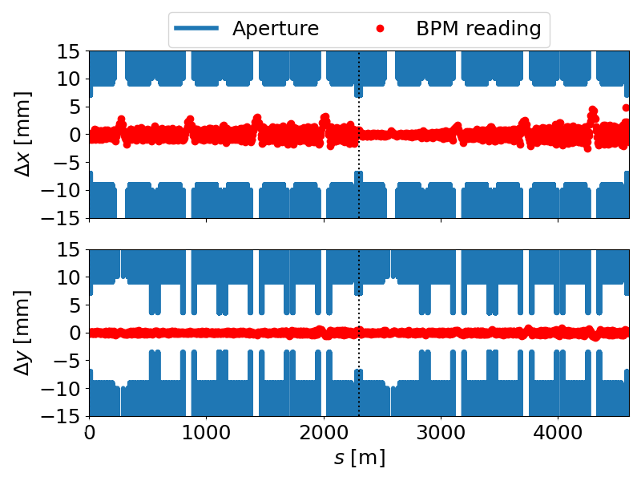
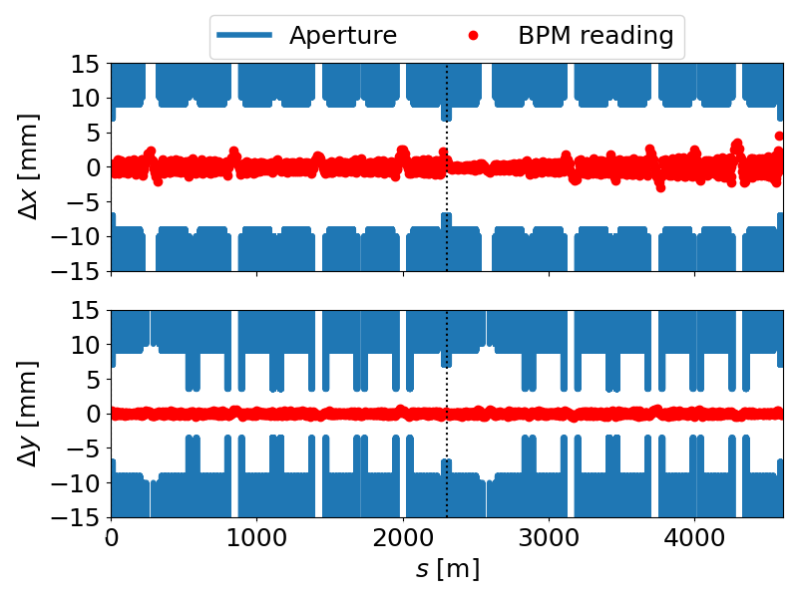
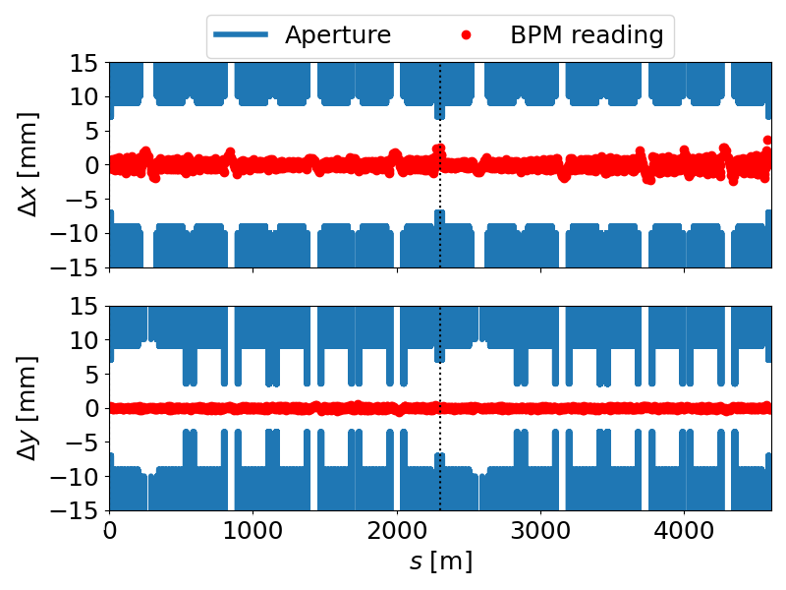
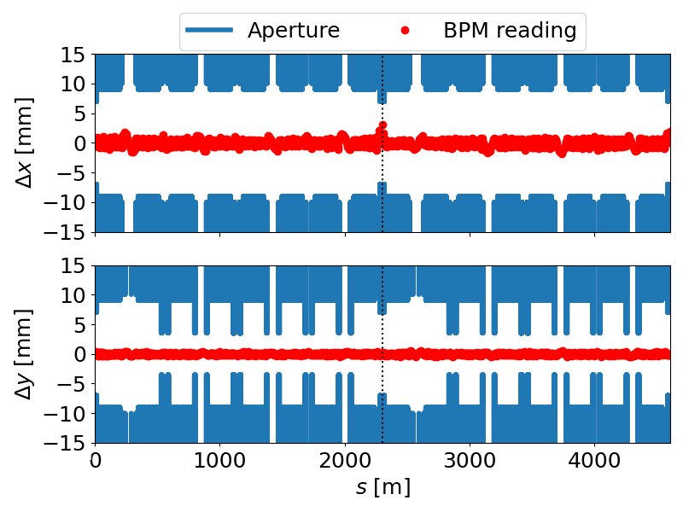
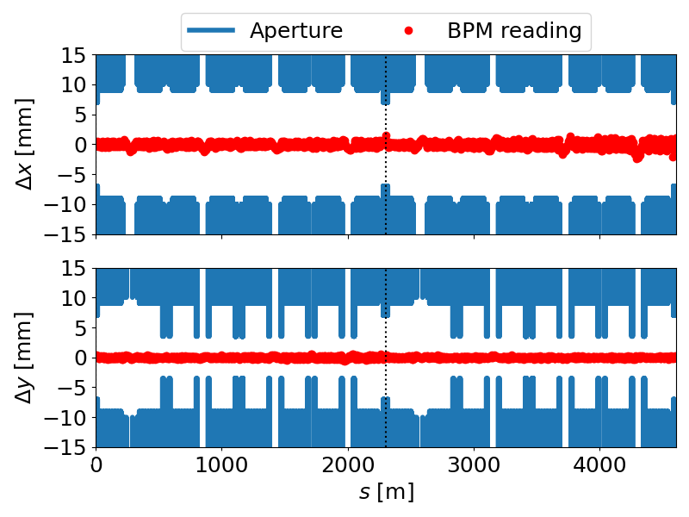
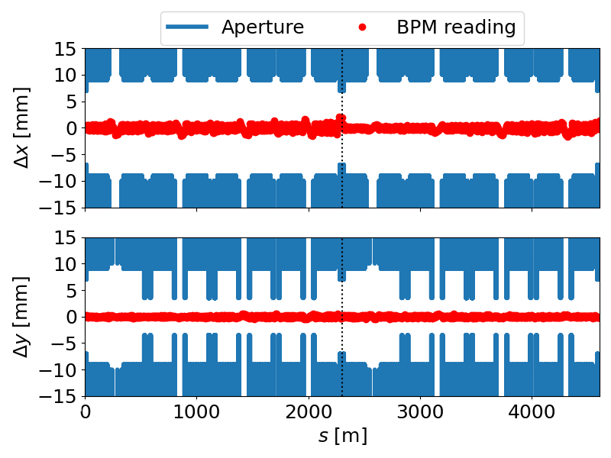
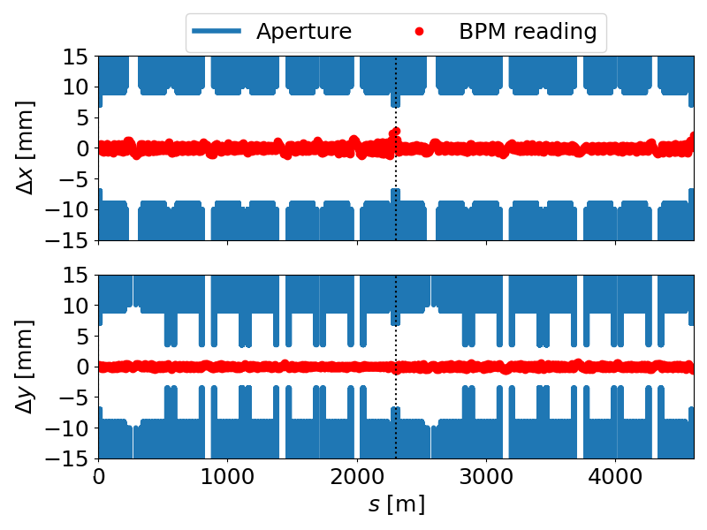
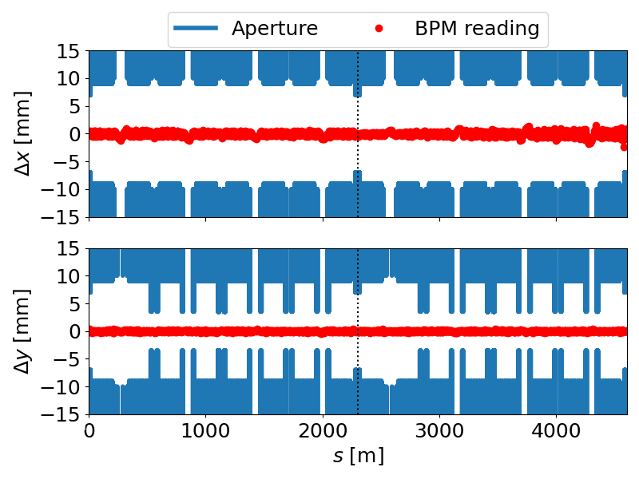
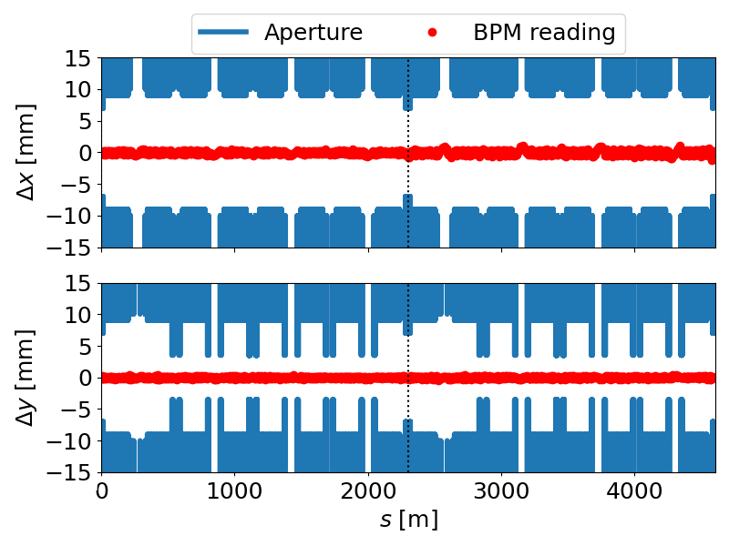
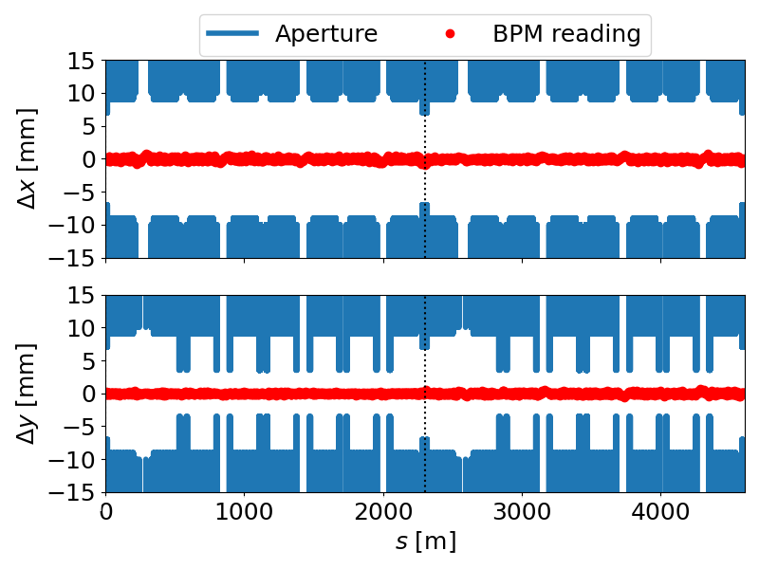
Towards failure-free automatic commissioning simulation
Disclaimer: you can always introduce enough errors to make the commissioning simulation fail
With realistic tolerances, obvious failures should ideally be avoided
Example of failure on the right is during the ramp-up of multipoles:
At some point, the interleaved 2-turn trajectory correction stops converging
Ultimately losing 2-turn transmission
Minimal solution:
Trajectory correction gain decreased to 30%
Avoid pushing the SVD regularisation parameter too low

Slide 17
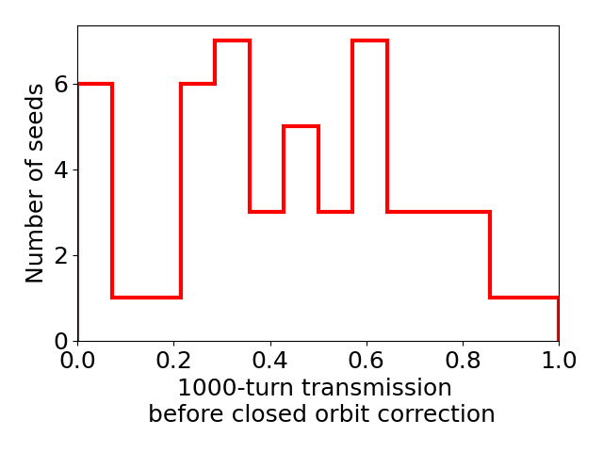
Towards failure-free automatic commissioning simulation
Improved modelling of girder alignment
Previous simulations assumed girder alignment errors with respect to a reference survey network (150 um rms)
This is the current pySC implementation
With girder-to-girder alignment, we actually constrain the relative position of one girder to the next within 150 um rms
this constraint is applied to three girders pairs per cell
the start of the downstream girder is aligned with respect to the end of the upstream girder within 150 um
Practically, it is last magnet and first magnet that are used
Leads to no failed seeds, and the closed orbit is established in automatic commissioning

Slide 18
Experimental beam tests in PETRA III

Slide 19
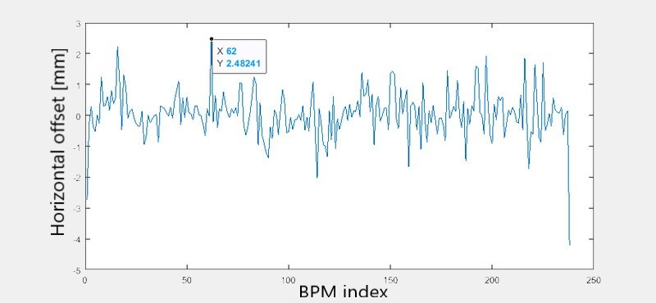
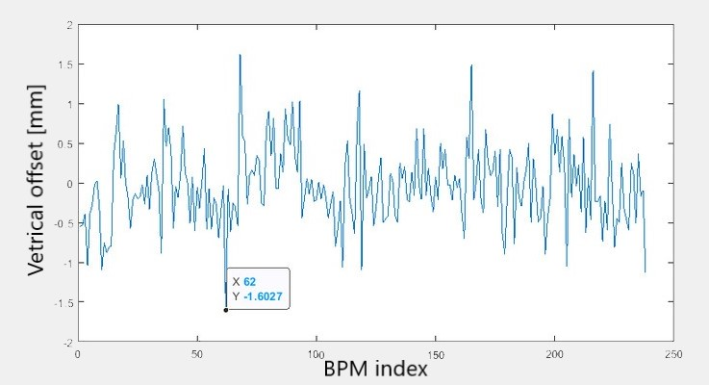
First-turn steering in PETRA III in more realistic scenarios
We need to circumvent the problem of not synchronised ADC data by combining a couple of injections to get first-turn trajectories at BPMs
Setup
Correctors, sextupoles and feedbacks off
Collimators and undulators open
On-axis injection
No BBA offsets of BPM taken into account
RMS offsets of 0.75 mm and 0.5 mm (horizontal and vertical)
Not far from current PETRA IV specifications

Slide 20
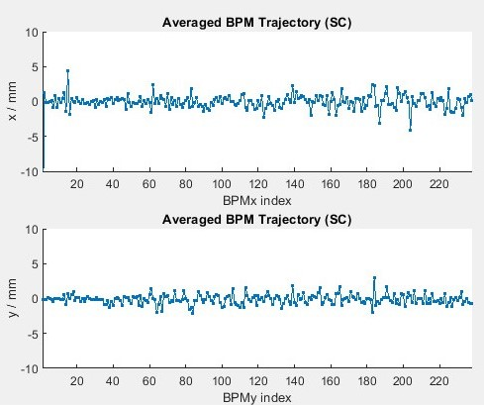
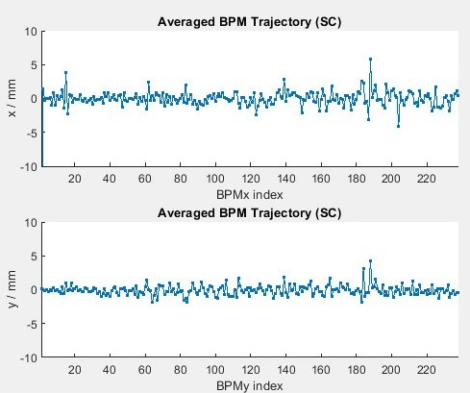
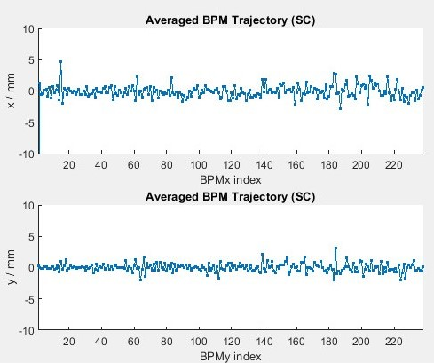
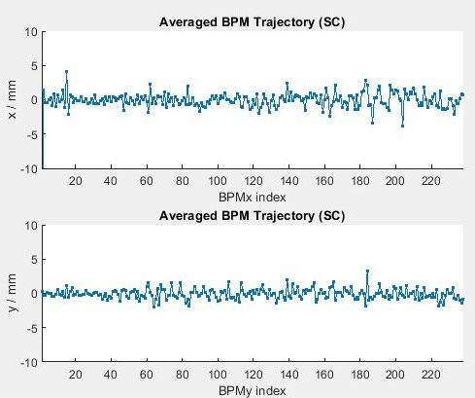
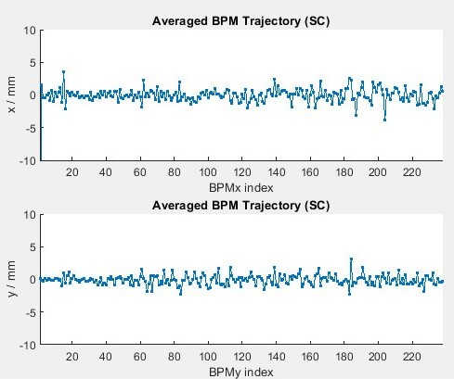
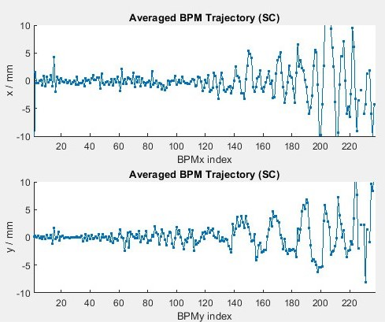
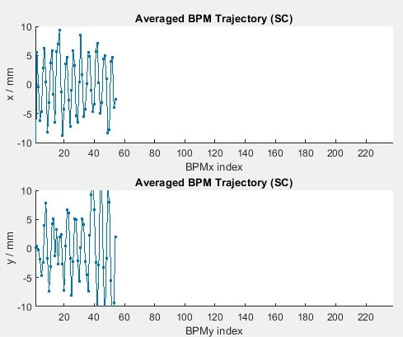
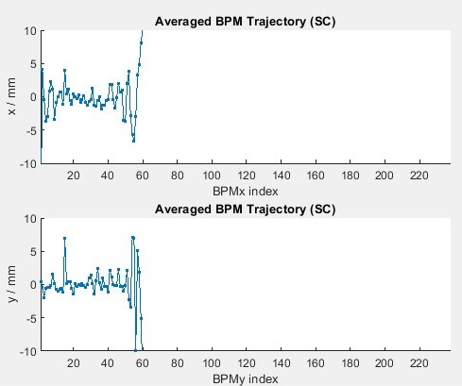
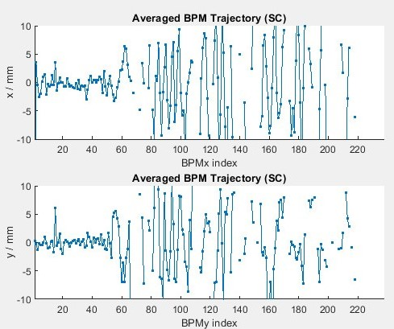
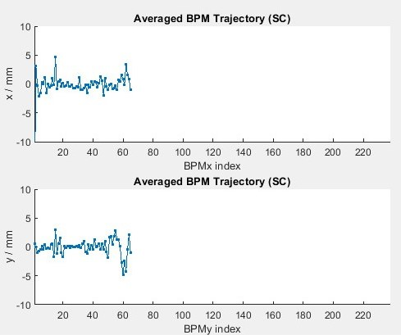
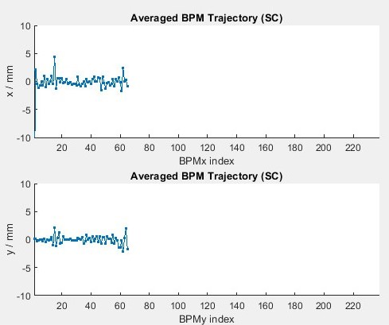
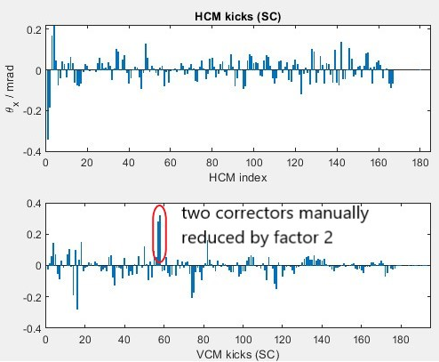
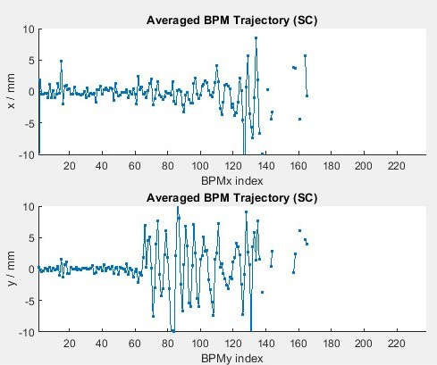
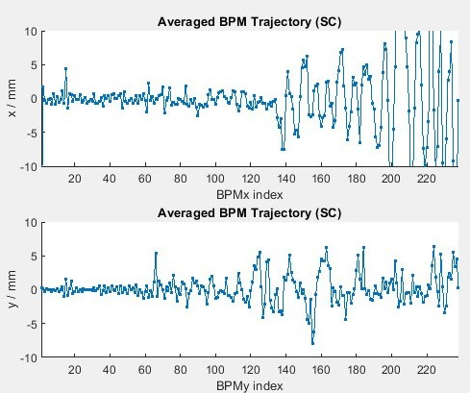
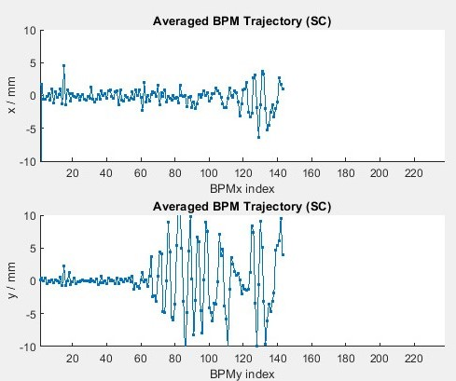
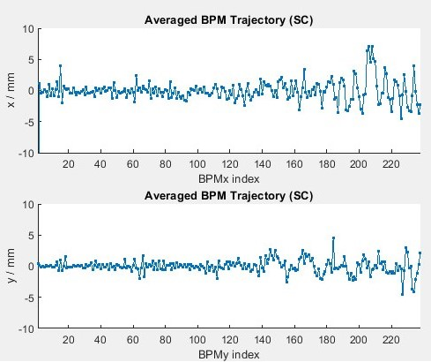
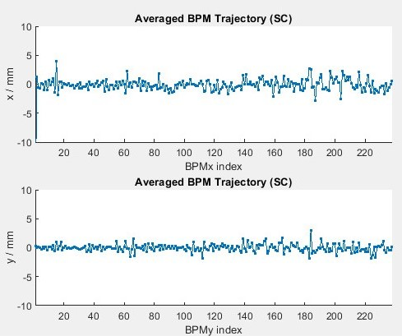
First turn steering and sextupole ramp-up demonstrated in PETRA III
Debugged and improved the validation of measured trajectory
Consider BPMs downstream of the first failing BPM
Limit on minimal beam intensity (Sum signal)
Trajectory has to be (roughly) within the aperture
Procedure:
First turn steering
Ramp up sextupoles with 1-turn trajectory correction
Without 1-turn orbit closure
In 4 steps by 25% of nominal strength
Result:
With the known setting of RF, this was sufficient to store about one third of the beam in PETRA III

Slide 21
Conclusions and future work
Developed Python library (pySC) to facilitate commissioning simulations
Good starting point for components of the pyML ecosystem and lessons learned
Building upon pySC in PETRA IV automated commissioning simulations
Slow and steady progress
Improvements are to be fed back to pySC
Both Matlab and Python environments are used for beam tests in PETRA III
Plan to complete interfaces to pySC as a next step

Slide 22
Thank you for your attention
Lukáš Malina
Lukas.malina@desy.de
+49 40 8998 5475

