Slide 1
Python control tools at SIRIUS
Fernando Henrique de Sá,
on behalf of the SIRIUS Team
fernando.sa@lnls.br
Accelerator Middle Layer Workshop
DESY Hamburg (DE), June 19-21, 2024

Slide 2
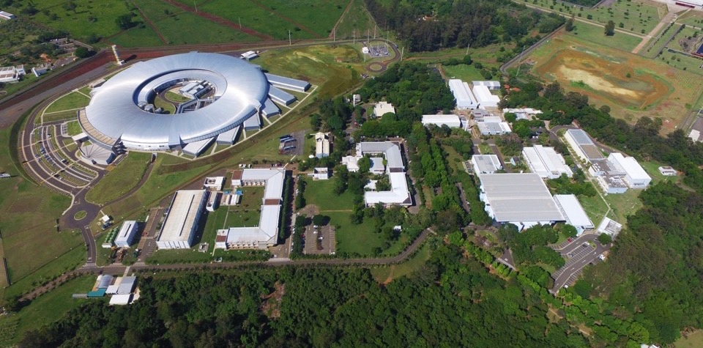
SIRIUS – 4GSR in Operation
SIRIUS design parameters
Energy 3.0 GeV
Circumference 518.4 m
Emittance 250 pm.rad
Current (top-up) 350 mA
UVX, 2nd generation light source (1997-2019)
Brazilian Center for Research in Energy and Materials (CNPEM)
CNPEM campus
Green-field facility
Construction: 2012 – 2020
Cost: US$ 500M (∼85% spent in Brazil)
1st regular users call: Nov. 2022
10 beamlines in operation
100 mA in top-mode mode, uniform fill
Phase-1 (end of 2024): 14 beamlines
Campinas
Brazil

Slide 3
Short history of python usage for SIRIUS
In UVX → AT and MML (no python);
2011-2012: SIRIUS project → large simulations (DA and MA) → AT + Tracy3;
2013: trackcpp + (pyaccel and pymodels) → first SIRIUS models in python;
2014:
expansion of pyaccel → python for automated update of wiki SIRIUS parameters;
trackcpp substitutes Tracy3 → incentive for python usage → DA and MA analysis migrated to python;
pyjobs: python server to distribute and manage SIRIUS simulations on PCs of CNPEM campus;
2015: virtual accelerator (VACA) → first contact with pcaspy and pyepics → siriuspy is created;
2016: good experience with pcaspy → all soft IOCs + PS IOCs in python → machine-applications creation;
2017: CS-Studio very disappointing → discovery of PyDM from SLAC → all control GUIs in python;
https://github.com/paulscherrerinstitute/pcaspy
https://github.com/slaclab/pydm

Slide 4
Overview of SIRIUS Software
EPICS IOCs
Control System Constants
mathphys
Archiver
Configurations
Database
pycolleff
trackcpp
pyaccel
network services
...
apsuite
siriuspy
idanalysis
pymodels
simulation
Libraries
ipython
jupyter
machine applications
EPICS Base IOCs
IOCs
vscode
scripts
siriushlafac
siriushla
GUI:
libraries and apps.
EDM
CS-Studio
Scripting
experiments
machine control
legend
…
Python env.
…
Non-python env.
A
B : A uses B

Slide 5
Python code development strategy
Principles:
Reuse existing code whenever possible;
Implement code as library instead of script;
Follow the coding style guidelines (documentation still not complete and logging still not standardized);
New simulation, experiment or control process
Create a class or function in pyaccel
N
Particular for SIRIUS?
Create a script or notebook using existing library
Create module or subpackage in apsuite
GUI needed?
Create GUI in siriushlafac
Y
Y
Simulation
What type of script?
Create GUI in siriushla
When script is mature enough, transform it in a library
Experiment
Y, GUI
Coding principles are enforced here, via pull request analysis on github.
GUI or IOC needed?
Control
Create module or subpackage in siriuspy
Y, IOC
Create soft IOC in machine applications

Slide 6
Packages statistics
All repositories are available at Github;
Most of the code was developed over the last 10 years by 4 or 5 people, on average;
Recently (last two years), developers' community inside LNLS has grown with the creation of a software group;
Periodic deploy (~ 1 per month) in control room PCs with ansible;
IOCs run in docker containers in dedicated workstations. Deploy whenever needed;
Package | Github page | Version | Pull Requests | Commits | Files | Lines
siriuspy | https://github.com/lnls-sirius/dev-packages | 2.89.0 | 1062 | 9027 | 816 | 166934
siriushla | https://github.com/lnls-sirius/hla | 1.1.0 | 674 | 4770 | 535 | 351650
machine-applications | https://github.com/lnls-sirius/machine-applications | 3.48.0 | 285 | 2089 | 339 | 34831
apsuite | https://github.com/lnls-fac/apsuite | 2.51.0 | 271 | 1872 | 96 | 29853
pyaccel | https://github.com/lnls-fac/pyaccel | 3.18.1 | 93 | 613 | 43 | 14258
pymodels | https://github.com/lnls-fac/pymodels | 1.18.1 | 84 | 661 | 43 | 8879
trackcpp | https://github.com/lnls-fac/trackcpp | 4.10.4 | 48 | 323 | 67 | 39593
mathphys | https://github.com/lnls-fac/mathphys | 2.9.0 | 26 | 233 | 25 | 7775
siriushlafac | https://github.com/lnls-fac/hlafac | 0.10.1 | 22 | 336 | 17 | 1713

Slide 7
High-level control

Slide 8
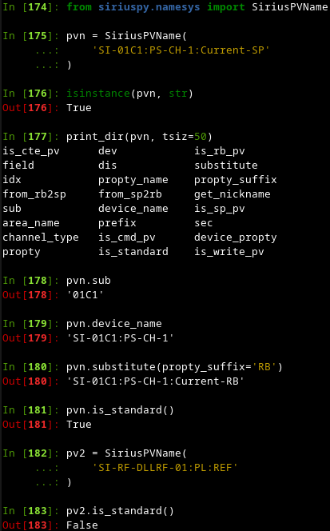
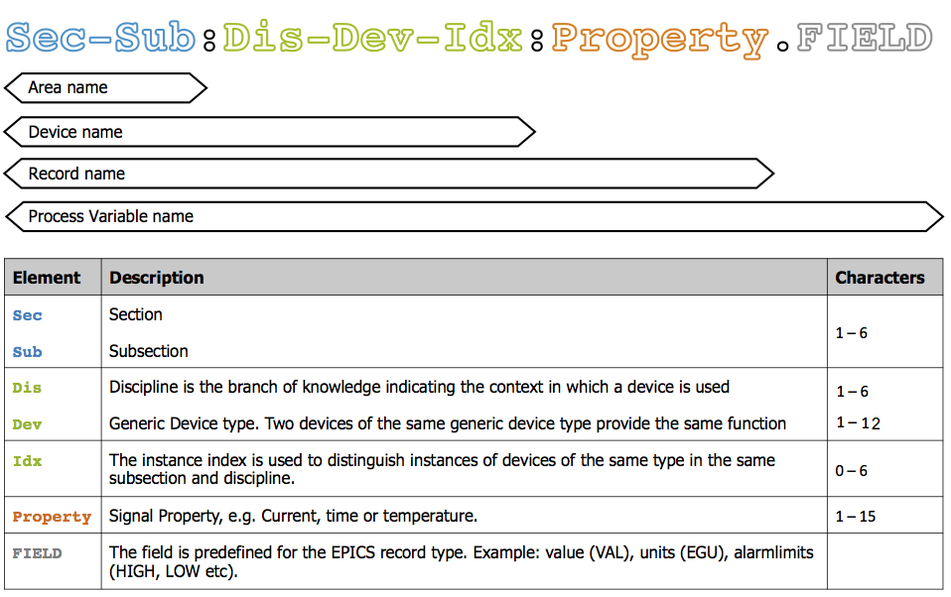
Structure of siriuspy
siriuspy
Library that transforms EPICS PV names into objects with properties that allow identification of the meaning of that PV, according to the naming system defined for SIRIUS.
clientconfigdb
clientarch
clientweb
epics
namesys
devices
…
Libs for specific control routines
…

Slide 9
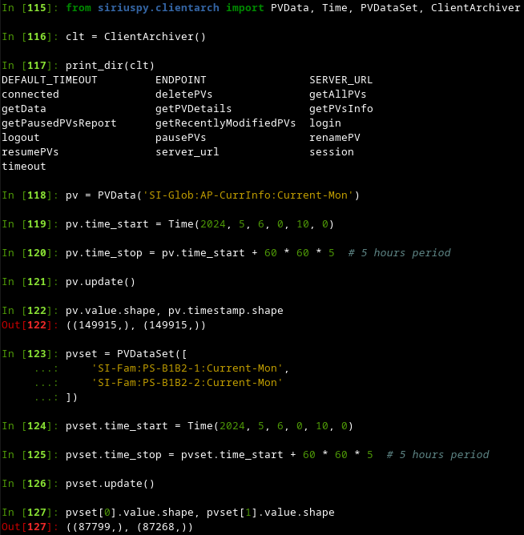
Structure of siriuspy
siriuspy
Library for interaction with EPICS Archiver
clientconfigdb
clientarch
clientweb
Library for interaction with web server that provides tables of control system constants, such as:
Magnet excitation curves
Magnet cycling parameters
Mapping of equipment connections and positions
epics
namesys
devices
…
Libs for specific control routines
…
Abstraction layer over pyepics

Slide 10
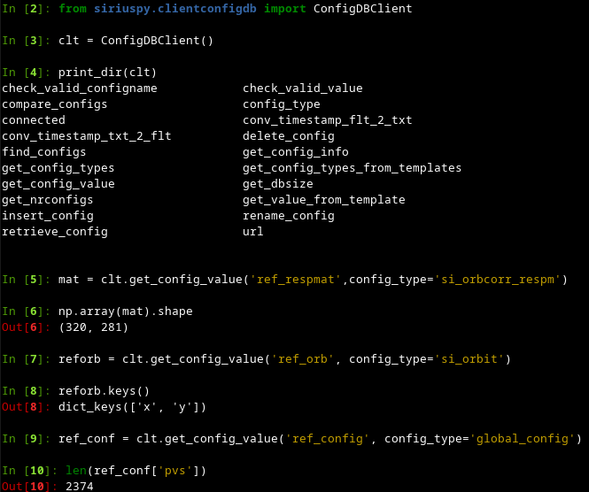
Structure of siriuspy
siriuspy
clientconfigdb
clientarch
Library for interaction with web server that provides access and control of Mongo database where machine configuration files are saved.
Examples of configuration types:
- PVs defining machine state
- orbit response matrices
- orbits and trajectories of interest
- ID feedforward tables
- booster ramp parameters
clientweb
epics
namesys
devices
…
Libs for specific control routines
…

Slide 11
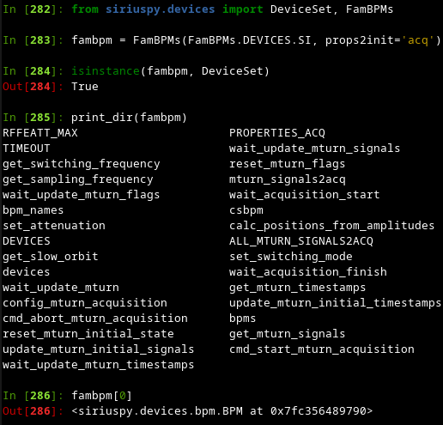
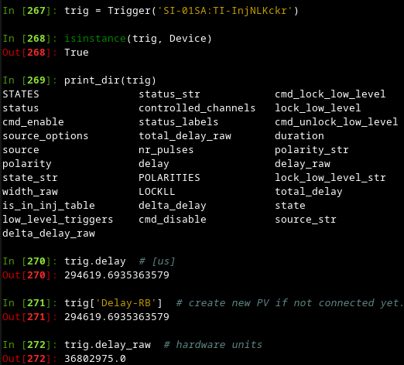
Structure of siriuspy
Interacts with a set of EPICS PVs from the same device or set of devices and group them in a single python object (similar to ophyd and class Device from pyepics).
siriuspy
clientconfigdb
clientarch
clientweb
epics
namesys
devices
…
Libs for specific control routines
…

Slide 12
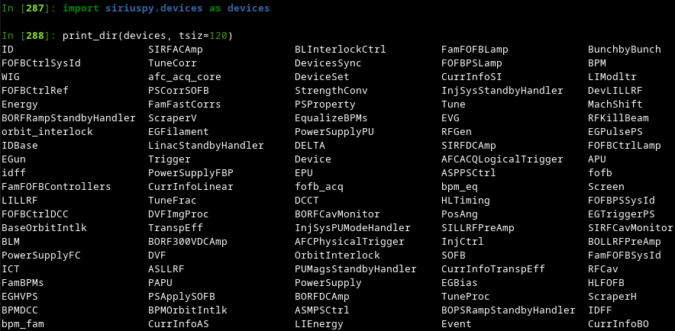
Structure of siriuspy
Interacts with a set of EPICS PVs from the same device or set of devices and group them in a single python object (similar to ophyd and class Device from pyepics).
siriuspy
clientconfigdb
clientarch
clientweb
epics
namesys
devices
…
Libs for specific control routines
…

Slide 13
Examples of high-level control tasks

Slide 14
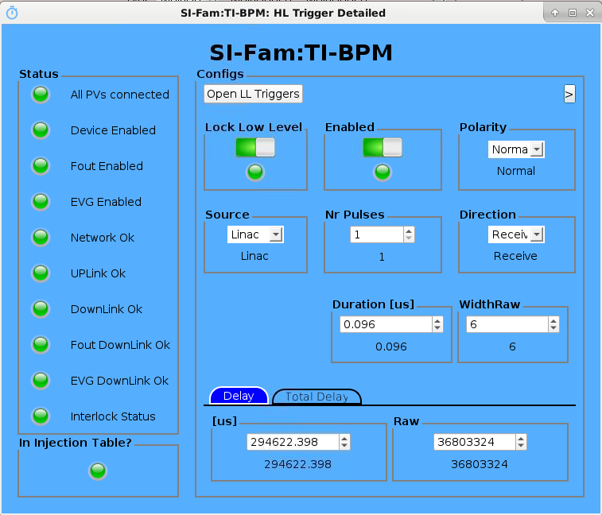
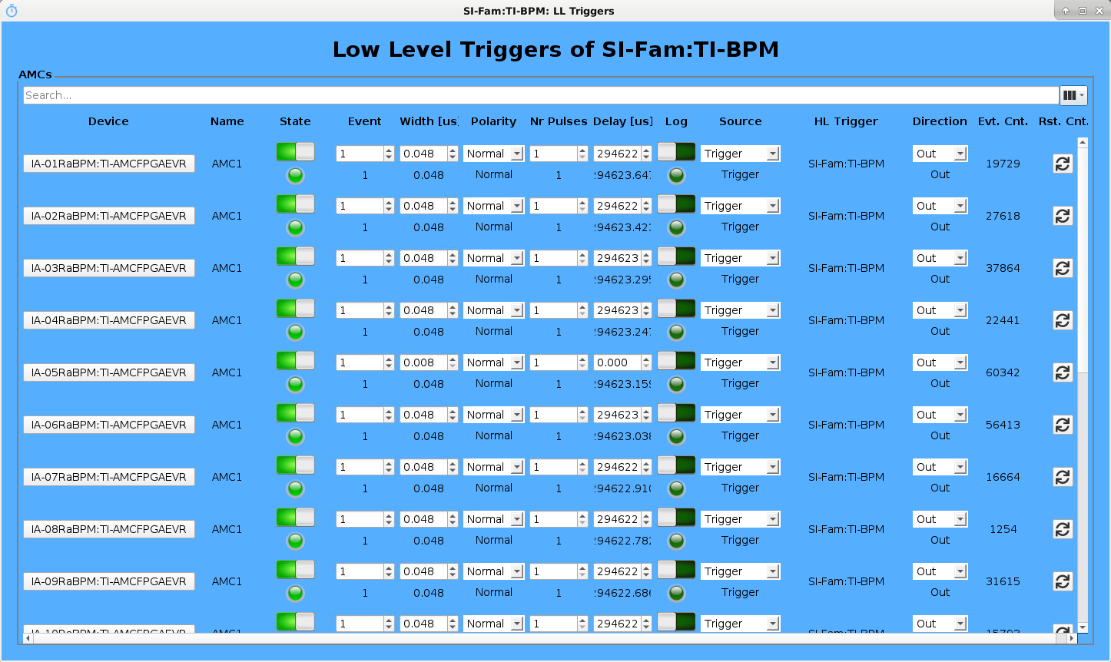
Common Tasks Performed by Soft IOCs
Distributed systems architecture abstraction and orchestration: timing, FOFB, orbit interlock;

Slide 15
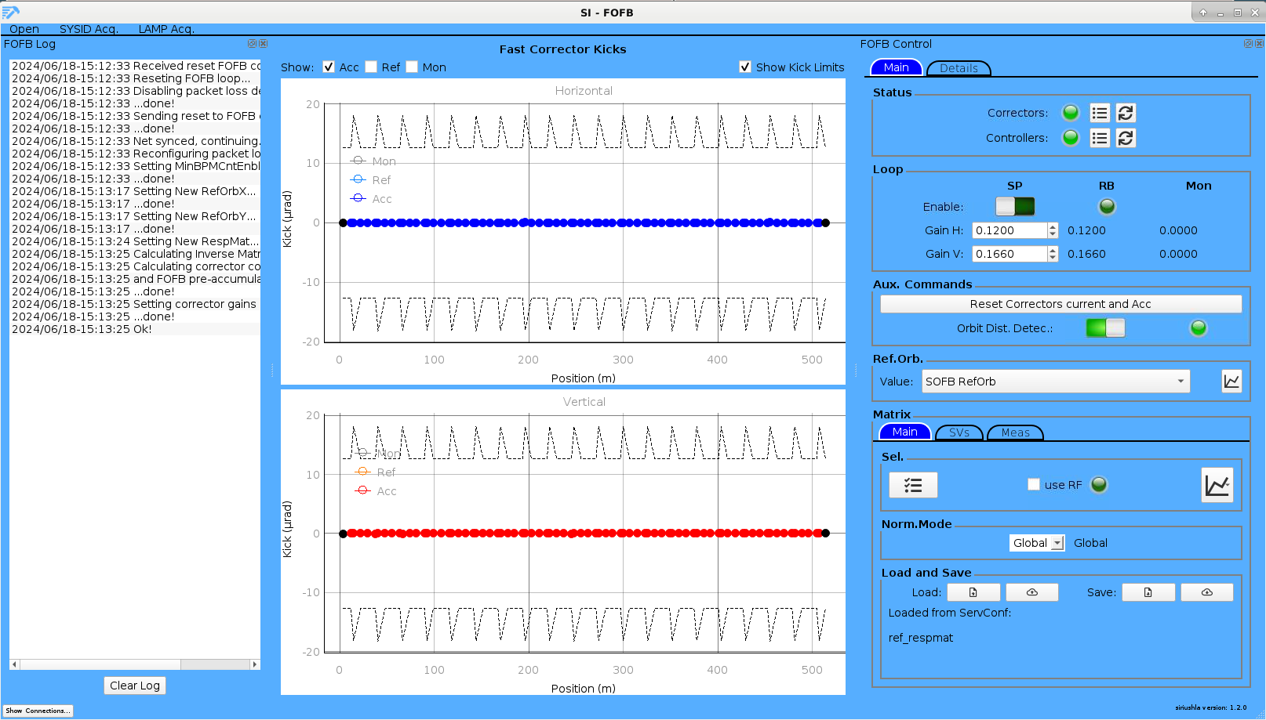
Common Tasks Performed by Soft IOCs
Distributed systems architecture abstraction and orchestration: timing, FOFB, orbit interlock;

Slide 16
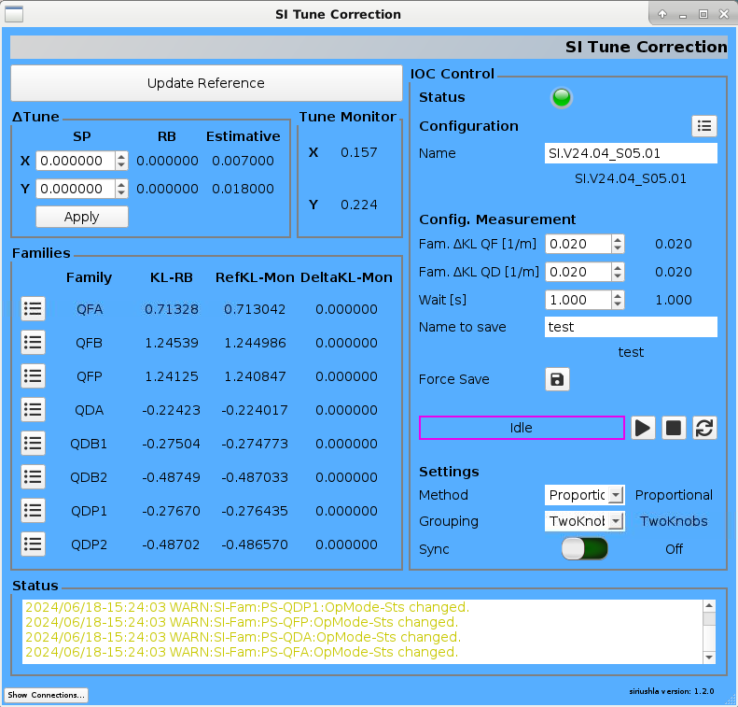
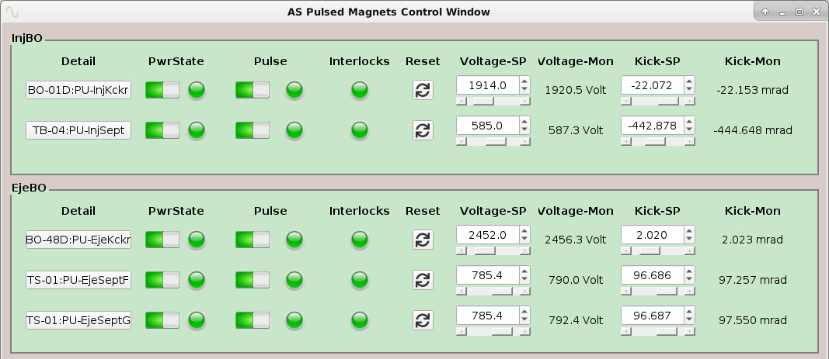
Common Tasks Performed by Soft IOCs
Distributed systems architecture abstraction and orchestration: timing, FOFB, orbit interlock;
Conversion from hardware to physics units: power supplies, pulsed magnets, etc;
Subsystems diagnostics: power supplies, RF, pulsed power supplies, LINAC devices, etc.;
Calculation of lifetime, integrated stored current, injected current, etc.;
Slow orbit correction and orbit response matrix measurement;
Injection trajectory (TbT) analysis and correction;
Calculation of injection efficiency between accelerators;
Correction of position and angle of injected beam;
Tune and chromaticity correction;
…

Slide 17
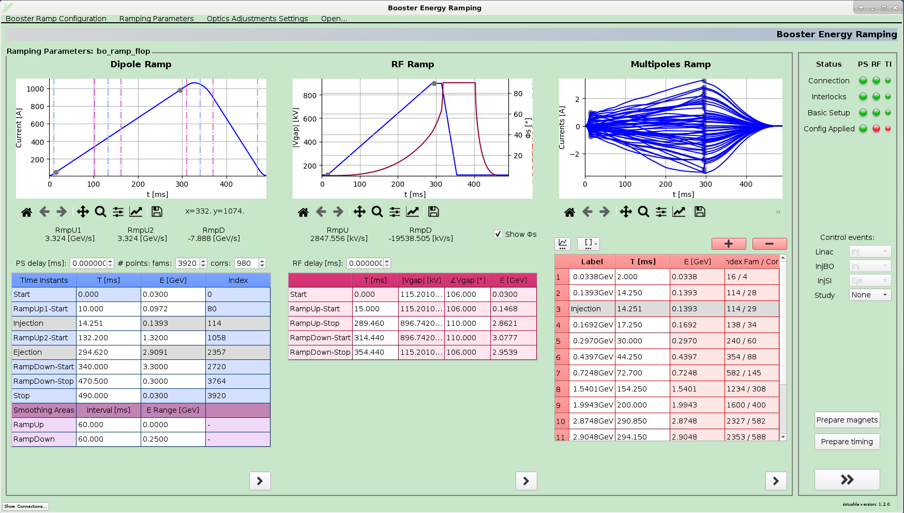
Common Tasks Performed by GUIs
Booster ramp configurations management and tuning;

Slide 18
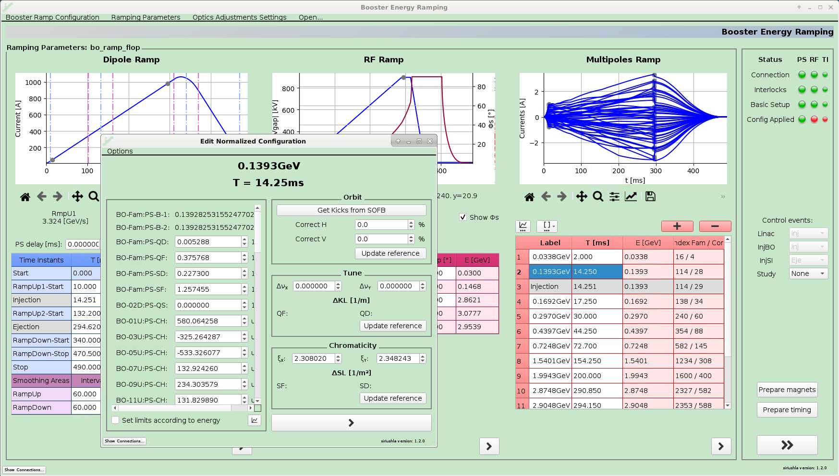
Common Tasks Performed by GUIs
Booster ramp configurations management and tuning;

Slide 19
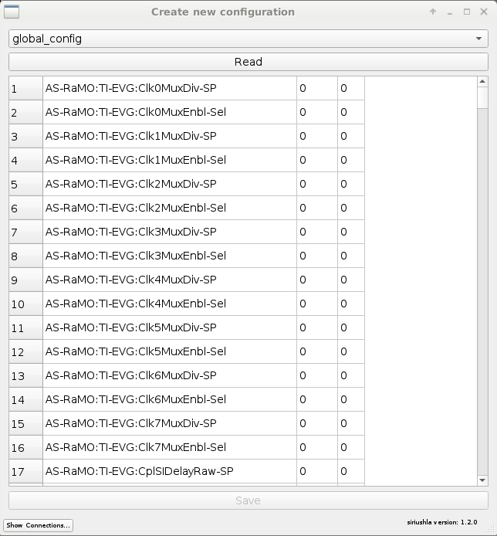
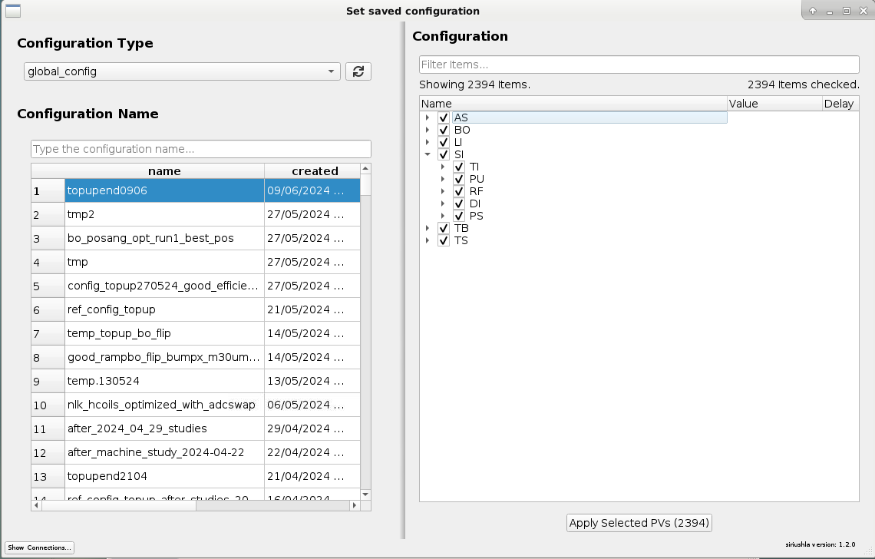
Common Tasks Performed by GUIs
Booster ramp configurations management and tuning;
Power supplies testing, turn-off and turn-on routines;
Save & restore machine configurations;
Magnets cycling and standardization;

Slide 20
Experiments control

Slide 21
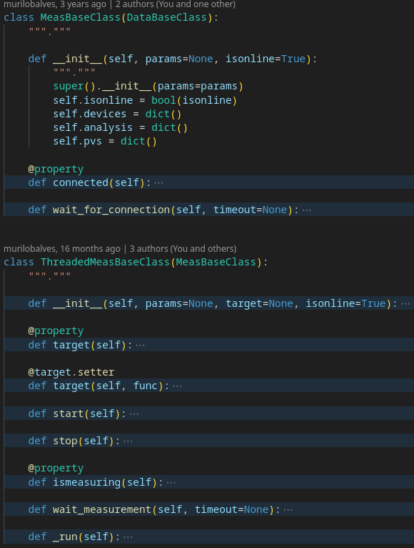
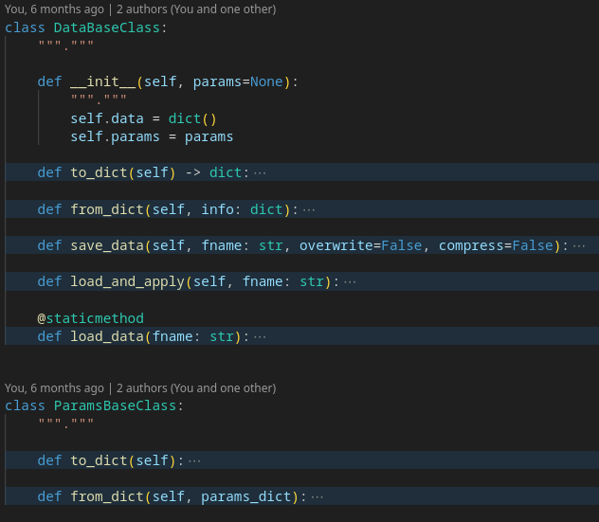
Structure of apsuite
apsuite
Contains classes of generic optimization algorithms (e.g., RCDS, Simulated annealing, scanning, PSO)
optimization
Contains classes to drive specific experiments
commisslib
utils.py
…
Simulation and LOCO packages
…
Defines base classes for optimization and commisslib. Standardize how data and metadata is saved and loaded.

Slide 22
Data organization for experiments
Shared folder among all PCs of the control room;
Also mounted read-only in our PCs;
Backup saved every day;
All experiments should have its own folder:
With name starting with the date and a short description;
Should contain script that ran the experiment and data + figures + processing files + etc. created;
Easy to find similar experiments done in the past;
Reuse and adapt old scripts made in previous experiments;

Slide 23
Examples of experiments

Slide 24
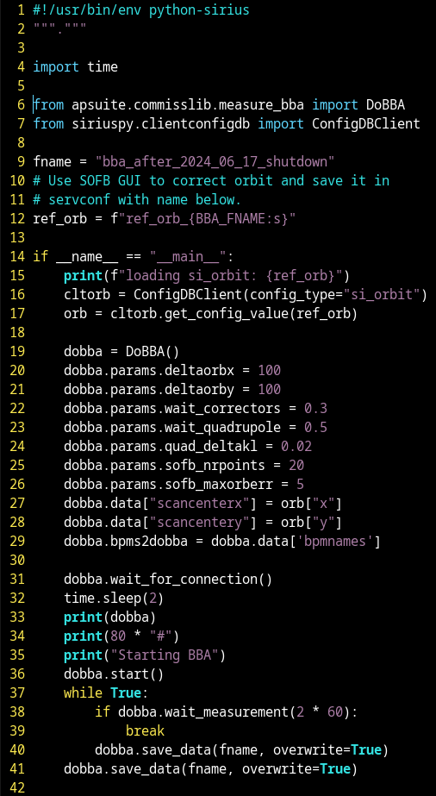
Experiments performed by scripts/notebooks
Acquisition of synchronized fast orbit or trajectory (TbT) from all BPMs;
Measurement of orbit response matrix using AC excitation of correctors;
LOCO analysis;
BBA of storage ring BPMs;

Slide 25
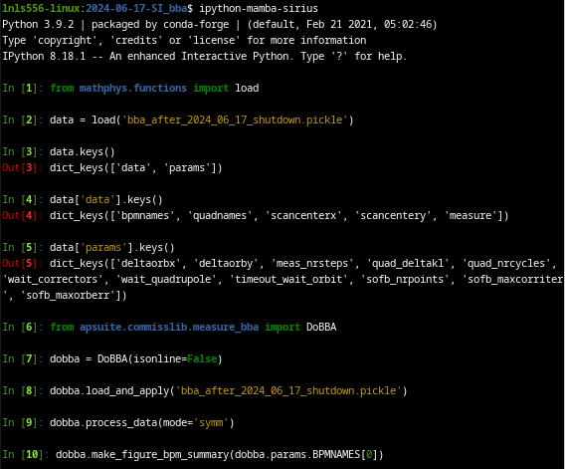
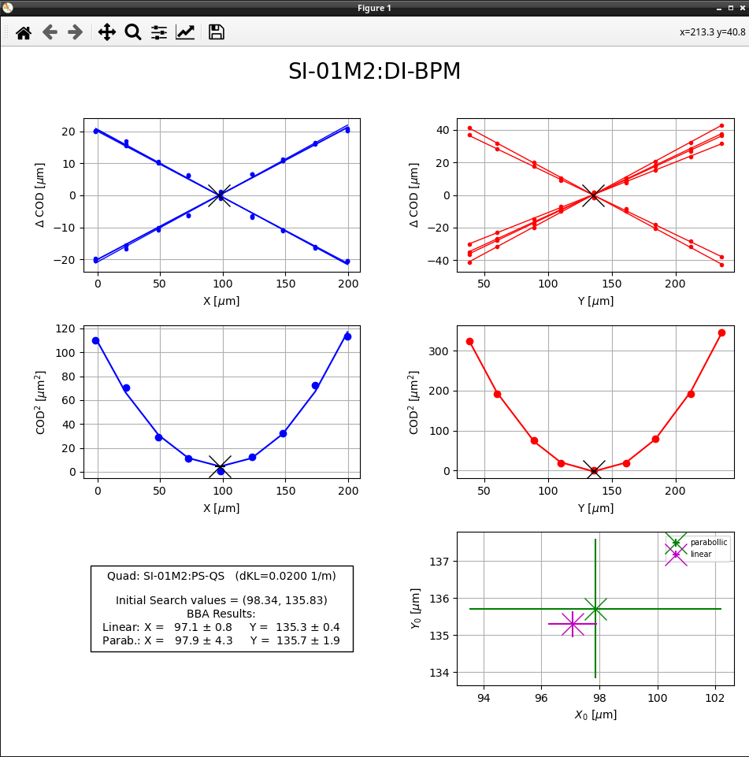
Experiments performed by scripts/notebooks
Acquisition of synchronized fast orbit or trajectory (TbT) from all BPMs;
Measurement of orbit response matrix using AC excitation of correctors;
LOCO analysis;
BBA of storage ring BPMs;

Slide 26
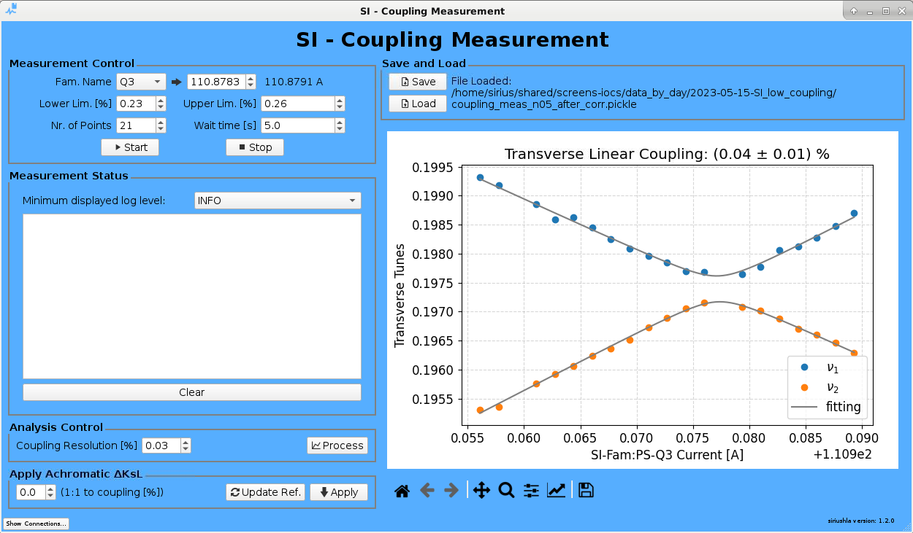
Experiments performed by GUIs

Slide 27
Summary
Python is the most used language for the SIRIUS high-level control system:
Span over simulation, experiments and control;
Provides a very versatile and flexible environment for developing new tools and perform complex tasks;
The code development workflow from scripting to library or GUI is well-defined and encouraged:
Code duplication is very rare;
Creation of applications for non-expert users is possible;
Use of basic libraries in scripts still possible;
Experiments control and data organization:
apsuite defines a standard way of saving data and metadata and creating experiment drivers;
Current methods does not handle partial loading of saved data. This feature would be useful;
Use of shared folder in control room PCs works well to separate and store experiment data, but does not provide security against accidental data losses;

Slide 28
Summary
siriuspy works well as an architecture and control system abstraction layer:
devices and epics subpackages abstract EPICS;
clientconfigdb and clientweb abstract configurations and constants servers.
Several high-level control tasks already performed by soft IOCs or servers;
Regarding virtual simulators:
Seamless exchange between real machine and virtual accelerator (VACA) via VACA_PREFIX environment variable existed in the past. However, VACA was discontinued a few years ago;
Use of virtual twin simulator is desired, but most of the measurements we develop nowadays involves acquisition of synchronized fast orbit, TbT, or bunch-by-bunch data. A virtual twin in a future middle-layer with such capabilities would be very useful.
In my perspective, the decision we took 10 years ago to move towards python and away from MATLAB really paid off!
I hope we can contribute with the community in the creation of a general python middle layer.

Slide 29
Thank you for your attention!
Thanks also to Ana Clara Oliveira for helping with the preparation of this presentation!

