Slide 1
ARES Operation Meeting
Summary of week 3 / 2024
Blae Stacey, on behalf of the ARES crew

Slide 2
Summary of week 3
Mon. 15.01. | Tue. 16.01. | Wed. 17.01. | Thu. 18.01. | Fri. 19.01.
Found on-crest phases for ballistic working point; Re-established velocity working point with weaker solenoid focusing in agreement with simulated results. | Focusing beam onto YAG screen in EA chamber; Optimising transmission with velocity bunching working point. | Focusing on SH.D1 screen; TWS1 phase scans to find bunch length minimum; | Continued with previous TWS1 phase scans (minimum of c. 40 fs achieved); Changed to previous working point (fault in simulations); Optimising transmission; PolariX phase shifter tests. | TWS1 phase scans to find bunch length minimum (again); Minimum observed around 88deg with bunch length of 10.2 fs rms.
TWS1 modulator water flow values were too low - fixed by restarting modulator); Camera EA.R1 not worked – fixed by experts; Can’t view laser alignment on cathode after works. | Extra focus required to pass through p4 kicker magnet; TWS1 modulator fault (water flow related); Screen movers and cameras not working (fixed overnight).
PolariX LLRF voltage drive was rescaled so curves for SP and RBV match (SP higher by factor of 2.93). |  |  |  | PolariX conditioning over the weekend.
Achievements
Difficulties
Notes

Slide 3
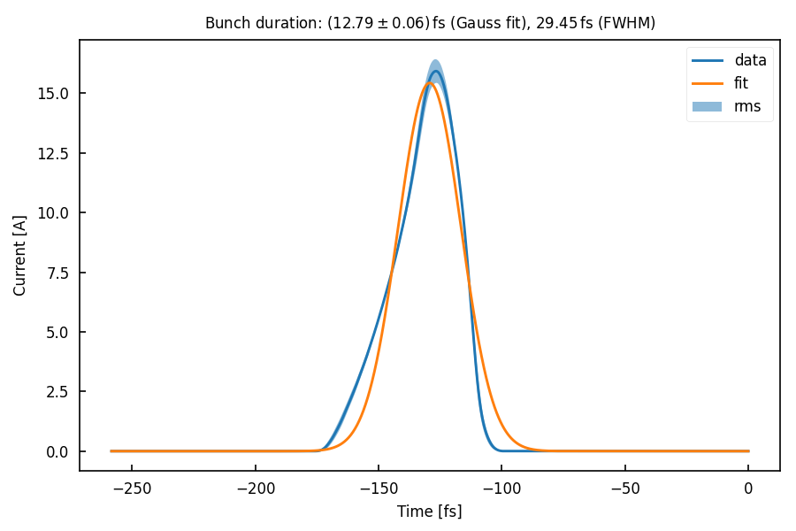
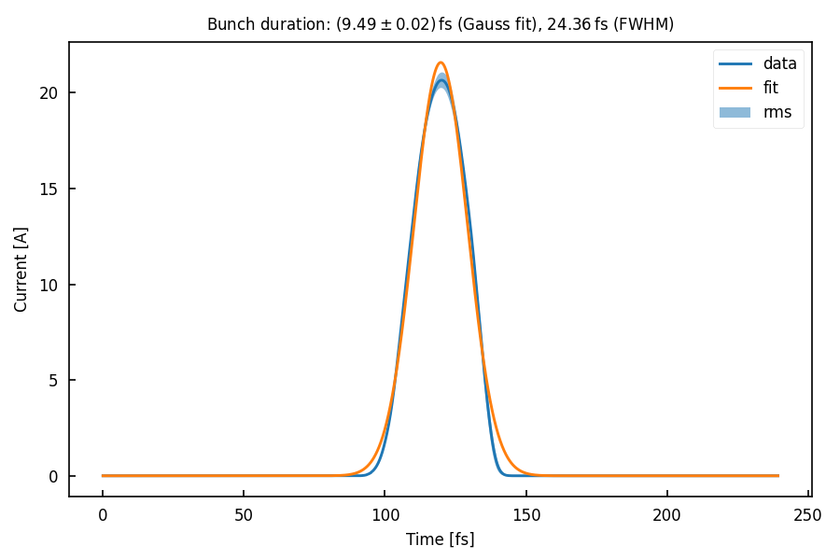
PolariX Bunch Length Measurements

Slide 4
Schedule and Plan for the Week
Week 4
Date | Shift Crew
22.01. | Blae, Sonja
23.01. | Blae, Willi, Max (AM)
24.01. | Blae, Thomas
25.01. | Blae, Frank, Hannes
26.01. | Blae, Hannes, Max
Mon: Works on pressurised air line in the tunnel (mainly for Kaldera red area)
Spacechip
If you want to learn or join the shift: please give the shift leader a call (BKR 2840 / SINBAD Box 2454)

