Slide 1
Angles and demons / Ptarmigan v1.3.4
Tom Blackburn
Department of Physics, University of Gothenburg
29 January 2024
Simulation and Analysis Task Force

Slide 2
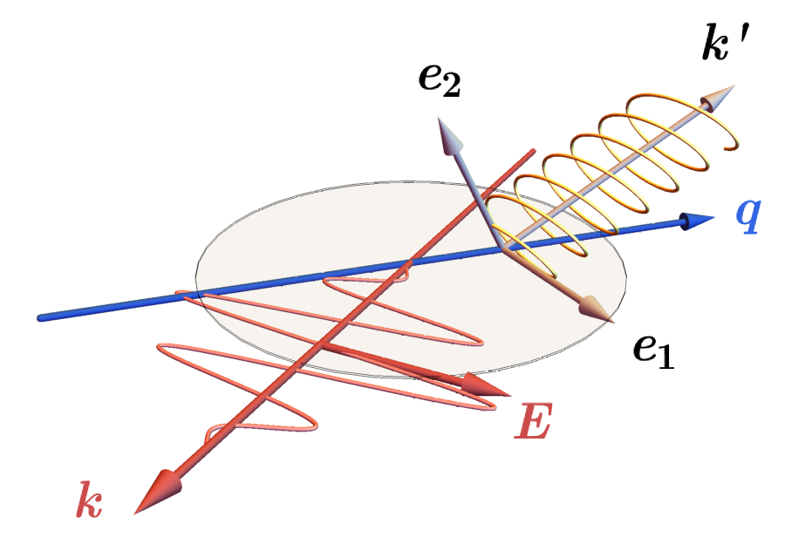
Ptarmigan v1.3.4
Polarization rotation
Currently, laser electric field oscillates in the x-z plane (plane containing k and electron beam momentum q).

Slide 3
Ptarmigan v1.3.4
Polarization rotation
Currently, laser electric field oscillates in the x-z plane (plane containing k and electron beam momentum q).
Now polarization will accept:
linear || x (or just linear)
linear || y
linear @ angle
Angle expects a math expression, e.g. linear @ 30 * degree

Slide 4
Ptarmigan v1.3.4
Example: γ-ray angular profiles
ξ = 5.0, phase 0:
Colour scale gives photons/e/BX/mrad² (left: all photons, right: x-polarized)
Laser polarization direction given in red.

Slide 5
Ptarmigan v1.3.4
Example: γ-ray angular profiles
ξ = 15.0, phase 1:
Colour scale gives photons/e/BX/mrad² (left: all photons, right: x-polarized)
Laser polarization direction given in red.

Slide 6
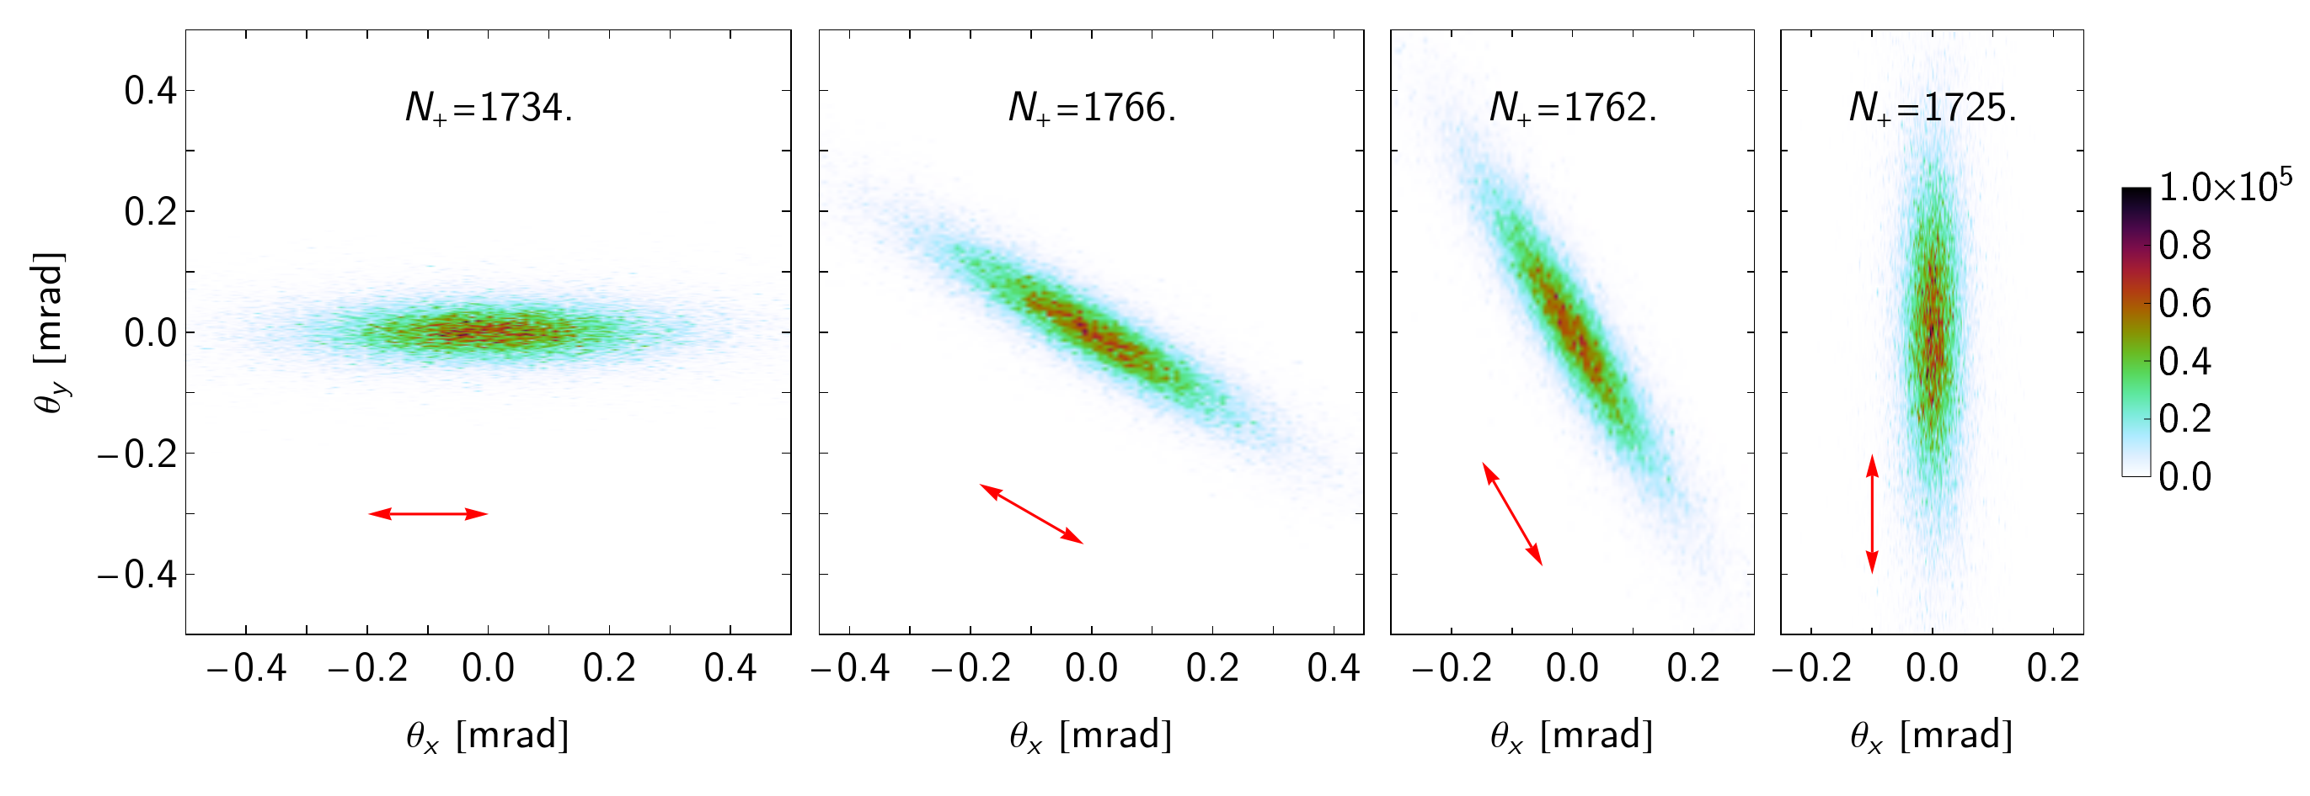
Ptarmigan v1.3.4
Example: positron angular profiles
ξ = 5.0, phase 0:
Colour scale gives positrons/BX/mrad², laser polarization direction given in red.
Positron yield should not be affected.

Slide 7
Ptarmigan v1.3.4
Summary
Laser polarization angle:
Extended syntax in laser block: polarization: linear @ angle
Sets angle between laser electric field and x-z plane, meaningful only for linear polarization.
Angle written to laser/polarization_angle in HDF5 file.
Choice of collision plane:
New field in beam block: collision_plane: horizontal | vertical
Sets angle at which electron passes through x-z plane.
Equivalent angle written to beam/collision_plane_angle in HDF5 file.

