Slide 1
ARES Operation Meeting
Summary of week 4 / 2024
Blae Stacey, on behalf of the ARES crew

Slide 2
Summary of week 4
Mon. 22.01. | Tue. 23.01. | Wed. 24.01. | Thu. 25.01. | Fri. 26.01.
Re-established velocity bunching working point using fewer quads; 25 fs bunch length measured using PolariX. | Gun and TWS2 MMG phases checked; Orbit improved; TWS1 phase scan to minimise bunch length; Work on SH.D1 timing. | Transmission through DLA optimized; Intensity measurement on EA.L2 with ROI and background subtraction set up; TWS1 phase scans to find bunch length minimum. | TDS temperature tuning to reduce kick; Shear parameter measurements; PolariX OVC turned on; Focus in EA made asymmetric (bunches still long); Focus in EA removed and bunch length minimised; PolariX measurement and analysis scripts developed; Testing quad scan script on SH.D1. | Fine TWS1 phase scans; Unused quads turned off; Unused correctors turned off; Emittance measurement on SH.D1; Bunch length measured at low charge with shear parameter measurements at various TDS power settings; Energy measurement; Longitudinal phase space measurement tests; Quadrupole scan with varied streaking angle.
 | Some shots on SH.D1 camera contained two beams – fixed by Frank. |  |  | Saturday: TWS1 modulator fault due to low solenoid water flow rate – fixed.
Achievements
Difficulties
Notes

Slide 3
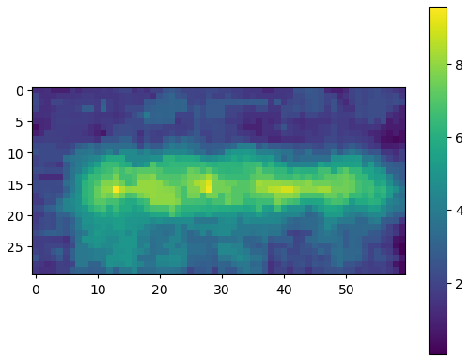
EA.L2 Camera
ROI and background subtraction applied;
Likely Cherenkov/Smith-Purcell;
Shows no coherence yet (bunches were not short enough to see coherence effects).

Slide 4
PolariX development during the last week
OVC switched on.
Tested further detuning of the BOC by using higher water temperatures (worse result, back to 30 C).
Conditioning of both vertical and horizontal streaking continued.
Measurement and analysis script development.
Analysis can now run on sinbaduser1 and automatically reads in all required parameters from the last measurement and last shear parameter calibration. Streaking angle still needs to be set manually, to be implemented in the future.

Slide 5
PolariX measurements
Streaking along vario19 angles covering the full range of the phase shifter (3D tomography). (Approximately covering 178 deg)
Emittance measurement using DLQZM1 and the D1 screen.
3D tomography data recorded for 11 phase advance combinations using 9 streaking angles.
Horizontal streaking

Slide 6
Schedule and Plan for the Week
Week 5
Date | Shift Crew
29.01. | Blae, Sonja
30.01. | Blae, Frank
31.01. | Blae, Thomas
01.02. | Willi
02.02. | Hannes
Mon: Kicker magnet connected, in-air stages installed, laser work (?)
Tues & Wed: Spacechip
Thurs: AutoAcc beamtime
Fri: Preparation for UKE beamtime
If you want to learn or join the shift: please give the shift leader a call (BKR 2840 / SINBAD Box 2454)

