Slide 1
Single Kaon Energy Reconstruction without BIB

Slide 2
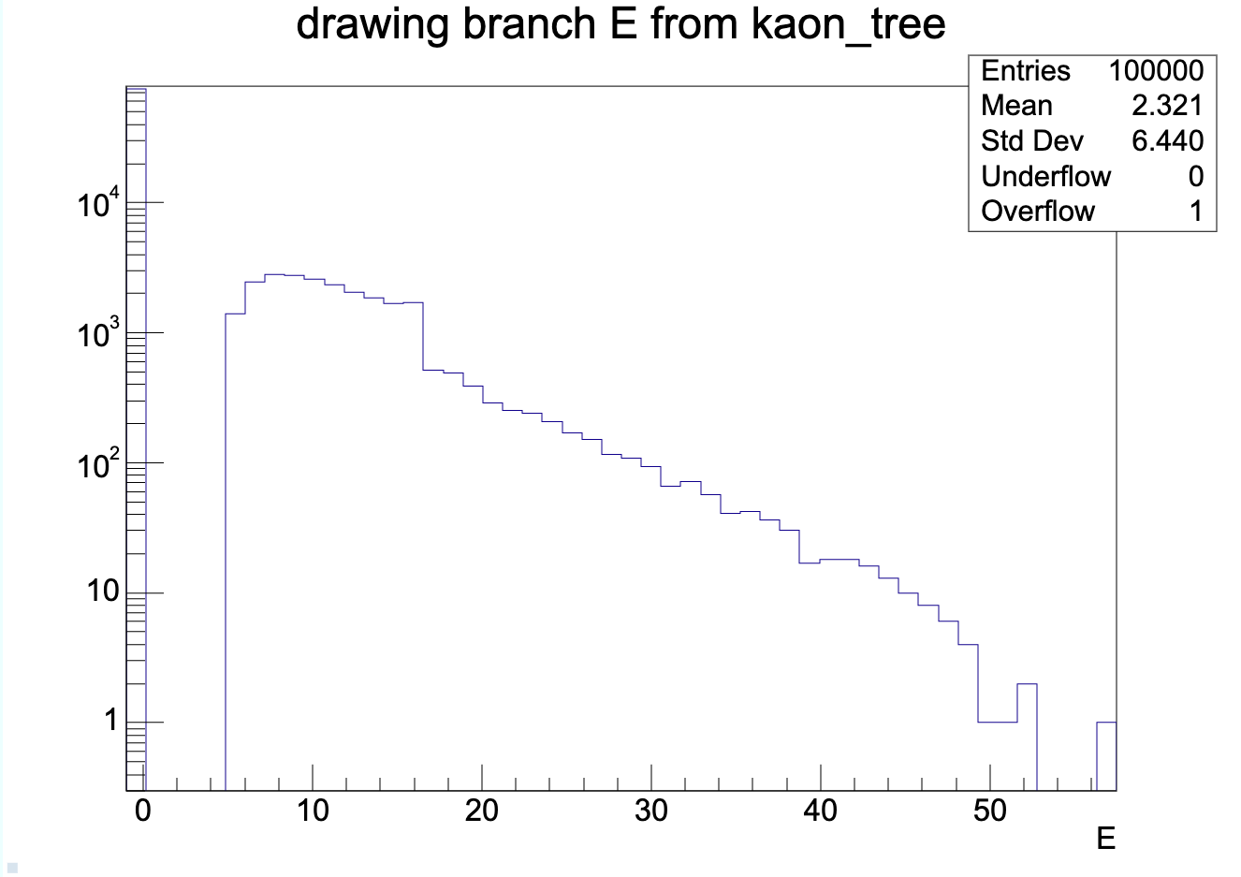
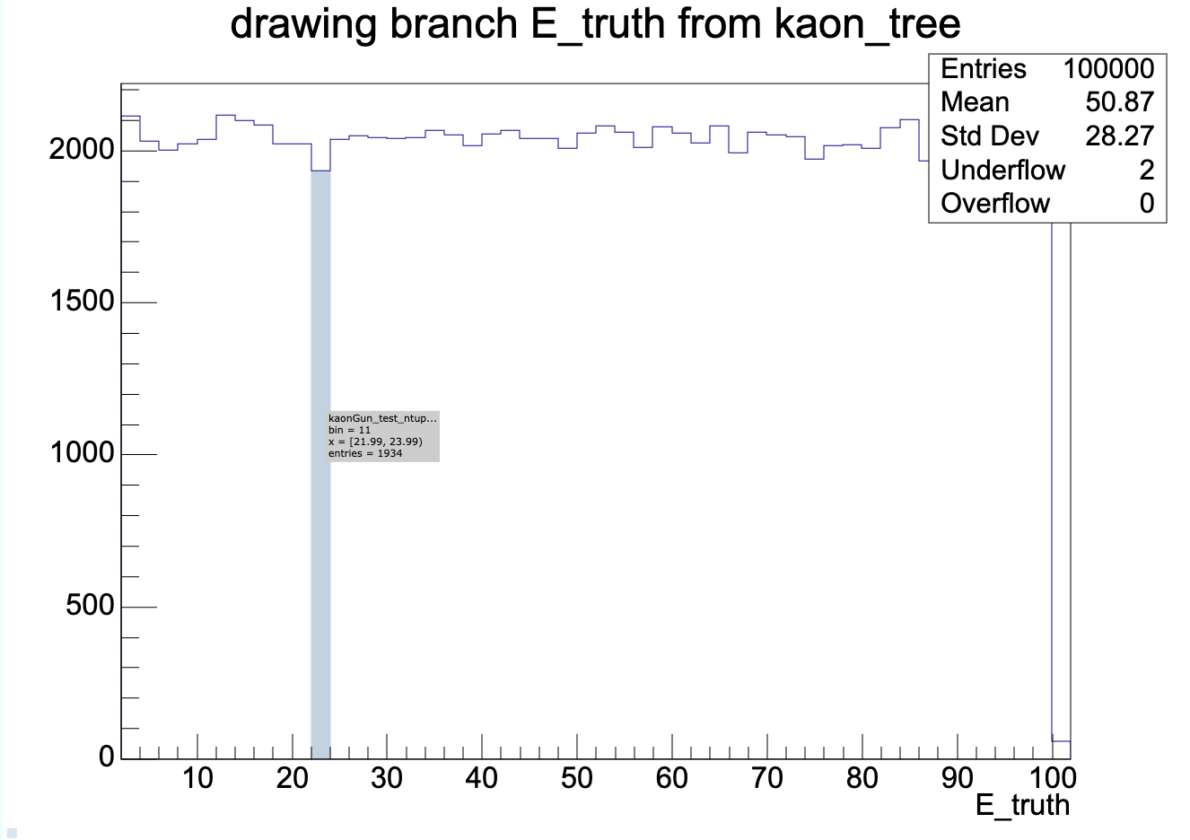
Initial Energy
Reco Energy
Kaon Energy Reconstruction
  Higher energy kaons are not being reconstructed with their full energy
True Energy

Slide 3
Jet Matching
Mismatched Jets
  Significantly more initial kaons do not result in a matched jet being being found than generator pions

Slide 4
Jet Resolution

