Slide 1
A Specialised Information
Service for Physics
Holger Israel
2024-02-20
PUNCH TA4 WP2 meeting

Slide 2
What is a Specialised Information Service / Fachinformationsdienst (FID)
Historical Context:
  Originated from the Special Subject Collections (Sondersammelgebiete) in Germany.
      System of supra-regional literature supply funded by DFG from 1949 to 2014.
      Libraries collaborated to acquire specialized scientific literature, ensuring availability in Germany.
  Transformation from Special Subject Collections to Specialized Information Services.
  DFG funding initiated in 2014, currently limited up to 12 years per project.
Present State:
  Aims to support research, complementing local infrastructures at universities and research institutions.
  Focus on detailed examination of specialist communities' needs to develop tailored services.
  Offers added value compared to basic tasks of research libraries and information services.
  Each service should be related to specific subjects or specialist communities.
  Designed to align with the interests of the research community in each discipline.
  Facilitates quick access to specialised literature and research-specific information.
  Currently, 40 specialized information services are funded by the DFG.
Special Subject Collections
Specialised Information Services

Slide 3
What is a Specialised Information Service?
Principles of FID Services:
Continuous Professional Support:
    Dialogue with specialist communities focuses on research interests
    Emphasis on ongoing professional support and systematic feedback
Extended Scope Beyond Basics:
    FID services go beyond fundamental discipline needs
    Aim for “top research needs" and provide added value for research
Digital Preference policy for the acquisition of media
BAUdigital
Biodiversity research
Geosciences
Cartography and basic geodata
Materials Science and Materials Engineering
Mobility and transport research
Mining (mining and metallurgy)
Pharmacy

Slide 4








What is a Specialised Information Service?
Specialised Information Services with the participation of the TIB
since 2021
FID Physik
in planning
since 2018
FID Chemie
in planning
2015 – 2017
2020-2023
now

Slide 5



Fachinformationsdienst Physik
„FID Physik“

Slide 6
Fachinformationsdienst Physik
Proposal due 2024-09-15
Aiming at services for researchers in all of physics
Pilot community: physics of (cold) plasmas
Second tier: (quantum) optics, photonics, atomic & molecular physics
Metrology as common ground
Complementary to NFDI (FAIR-minded, but no focus on RDM)
„FID Physik“

Slide 7
Fachinformationsdienst Physik
Proposal due 2024-09-15
Aiming at services for researchers in all of physics
Pilot community: physics of (cold) plasmas
Second tier: (quantum) optics, photonics, atomic & molecular physics
Metrology as common ground
Complementary to NFDI (FAIR-minded, but no focus on RDM)
Preliminary programme
Search and service portal
Curation, aggregation and linking of high-quality metadata, based on controlled vocabulary
AI for information retrieval
Promoting audiovisual scientific publications
Constant communication with our research communities
Tailored services for plasma physics use cases
„FID Physik“

Slide 8
Fachinformationsdienst Physik
Proposal due 2024-09-15
Aiming at services for researchers in all of physics
Pilot community: physics of (cold) plasmas
Second tier: (quantum) optics, photonics, atomic & molecular physics
Metrology as common ground
Complementary to NFDI (FAIR-minded, but no focus on RDM)
Preliminary programme
Search and service portal
Curation, aggregation and linking of high-quality metadata, based on controlled vocabulary
AI for information retrieval
Promoting audiovisual scientific publications
Constant communication with our research communities
Tailored services for plasma physics use cases
„FID Physik“

Slide 9
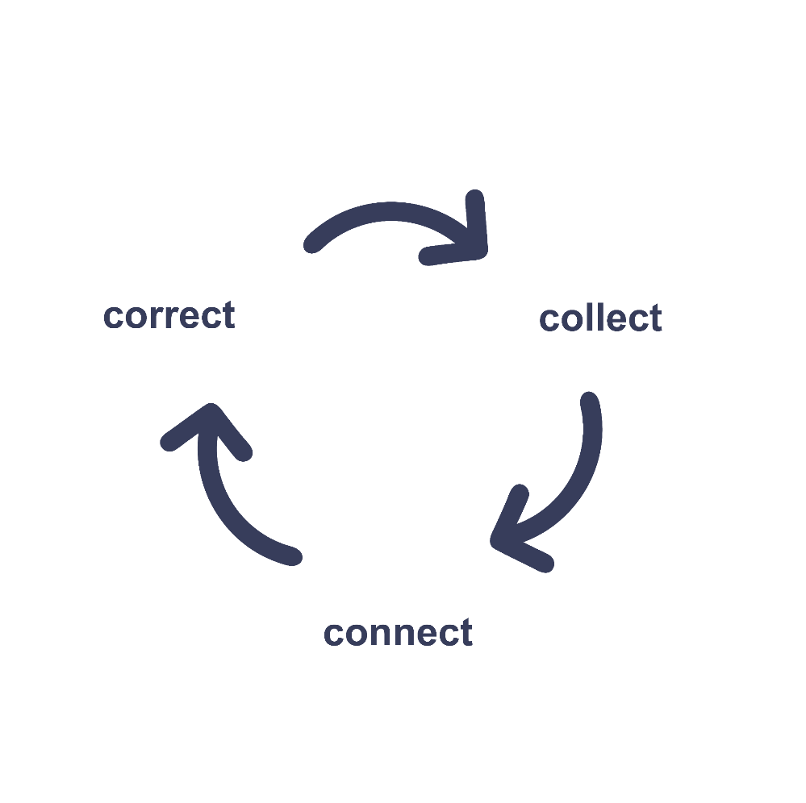
Metadata and terminologies: Mission of FID Physik
Status quo
Poor or missing metadata prevent the discoverability of scientific information in physics
Low FAIRness levels limit semantic technologies (e.g.
knowledge graphs, narrative search, …)
Researchers miss out on the state-of-the-art in information discovery
Mission of FID Physik: quality-assured metadata for physics research
Addressing all relevant stakeholders near and far, and covering all relevant media
Building crosswalks between the different community terminologies, we plan to develop a controlled vocabulary
Making links explicit via persistent identifiers → pervasive metadata
Improving and maintaining metadata quality via curation and quality assurance.

Slide 10
Metadata and terminologies: Proposed Work Packages
Physics metadata forum (user help desk; round table with stakeholders)
Creation of controlled vocabulary (thesauri on TIB Terminology Service, reusing terminology from high-quality sources, e.g. INSPEC, PlasmaMDS, VIM (metrology), Unified Astronomy Thesaurus, NFDI consortia, …)
Dissemination towards Gemeinsame Normdatei (GND) and Wikidata
Application profiles for demonstrator use cases (e.g. targeted ontologies),
possibly a modular application profile kit
Assistance tool for suggesting keyword (functionality like MeSHOnDemand: Input your abstract, and get keywords for your thesis or poster submission)
Best practices for pervasive metadata (feat. PIDs for instruments)
Metadata curation workflow for ReSoDaTe (REsearch SOftware, DAta and TErmiologies) meta search engine

Slide 11
PUNCH – FID Physik Collaboration
Specific cooperation between FID Physik and PUNCH on metadata topics
Inclusion of PUNCH resources in FID Physik portal
Links to consortia webpage and services: „For research data management in high energy and astrophysics, please visit …“
Federated search (higher value – needs more preparation and maintenance)
Possible joint events (e.g. training for PhD students)
Mutual letters of support
…

Slide 12
PUNCH – FID Physik Collaboration
General cooperation between FID Physik and physics-related NFDI consortia
Crosswalks from PUNCH terminologies into plasma physics and related fields
Applications of the PUNCH prototype metadata scheme (D-TA4-WP2-1) in plasma physics and related fields
PUNCH representation in physics metadata forum
What do you think could we offer to you?

Slide 13
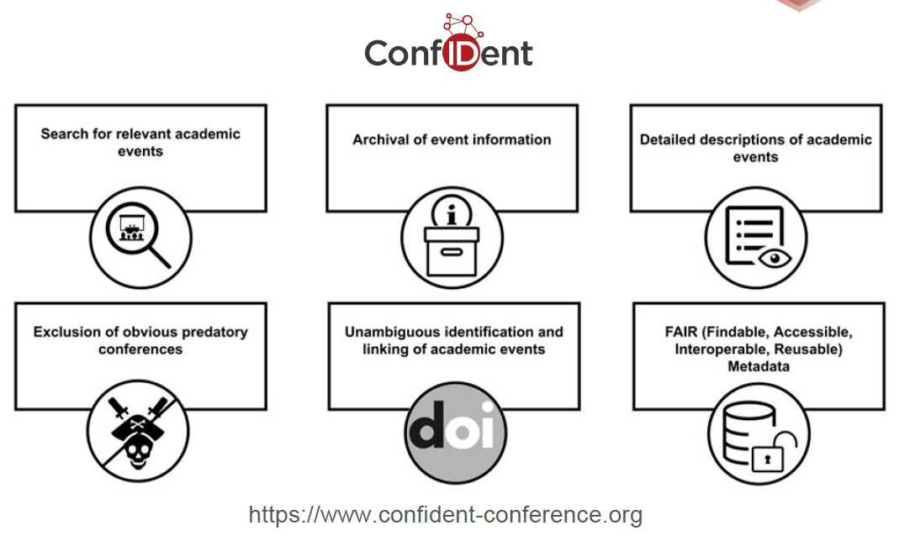
ConfIDent
FID Physik likely to feature a conference search based on ConfIDent
ConfIDent is planning an INDICO plugin

Slide 14
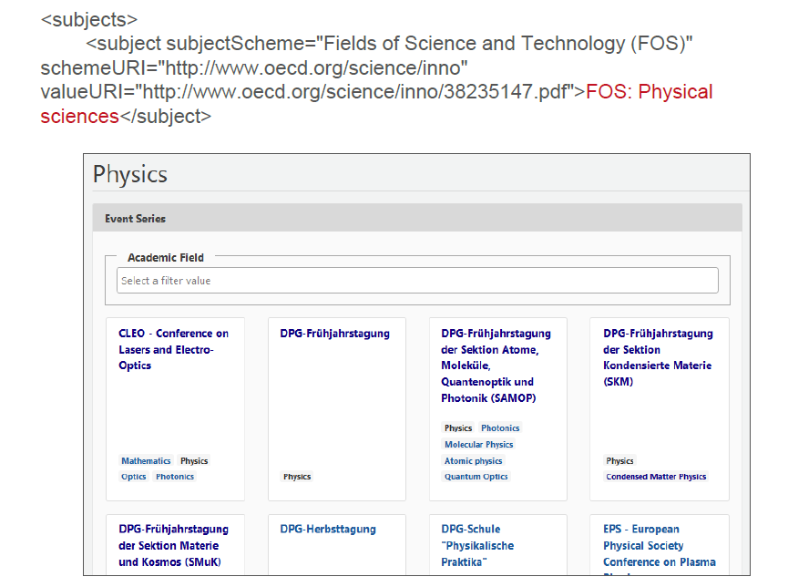
ConfIDent

Slide 15
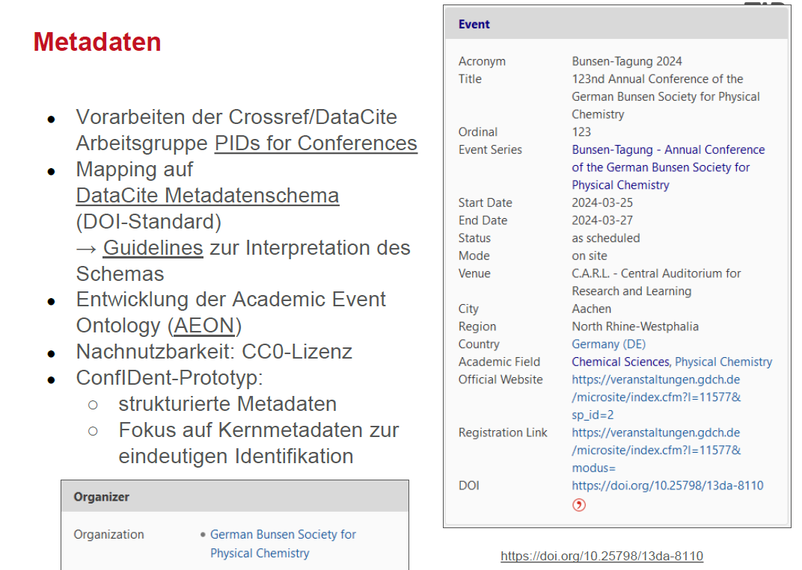
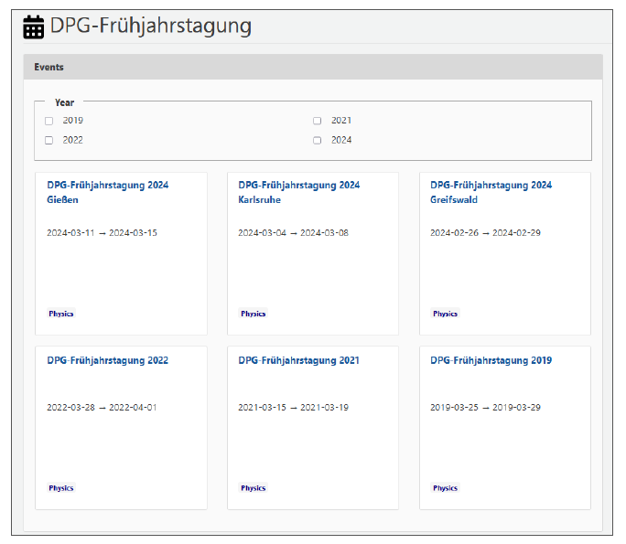
ConfIDent: Metadata

Slide 16
MORE INFORMATION www.tib.eu
Contact
Dr. Holger Israel
T +49 511 762-3979
holger.israel@tib.eu

