Slide 1
PATOF General Meeting
Thomas Schörner
5 February 2024

Slide 2
Today
Tour de table
Very brief intro and reminder
Reports from WPs 1-3
Next steps
Future funding opportunities
AOB
Notes:
Add picture of WPC

Slide 3
The project
Summary from the annual report
The main goal of PATOF is to make the data of a number of participating experiments fully publicly available and FAIR as far as possible. The work is building on first experience gained at the Mainz A4 nucleon structure experiment (1999-2012). Here, the analysis, reorganisation, preparation and subsequent publication of the A4 data and A4 analysis environment according to FAIR principles shall be achieved. The lessons learned at A4 are then to be applied to other experiments at DESY (ALPS II, LUXE) and Mainz (PRIMA, P2), collectively called APPLe experiments. In the process, a general and living cookbook – or at least a first collection of recipes – on how to create metadata for PUNCH experiments and how to make their data FAIR is also aimed for. The cookbook will capture the methodology for making individual experiment-specific metadata schemas FAIR. Another output is the “FAIR metadata factory”, i.e. a process to create a naturally evolved metadata schema for different experiments by extending the DataCite schema without discarding the original metadata concepts.
Notes:
Add picture of WPC

Slide 4
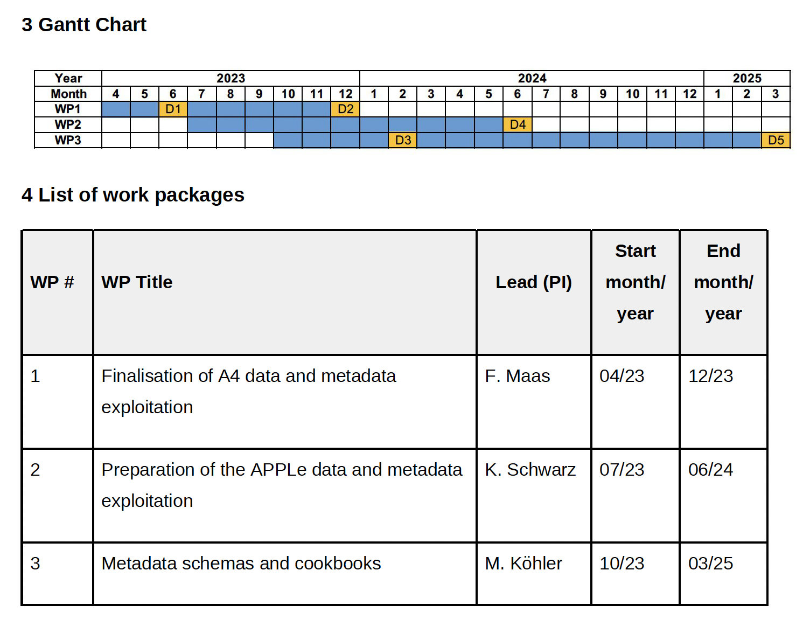
The project
Work packages
Notes:
Add picture of WPC

Slide 5
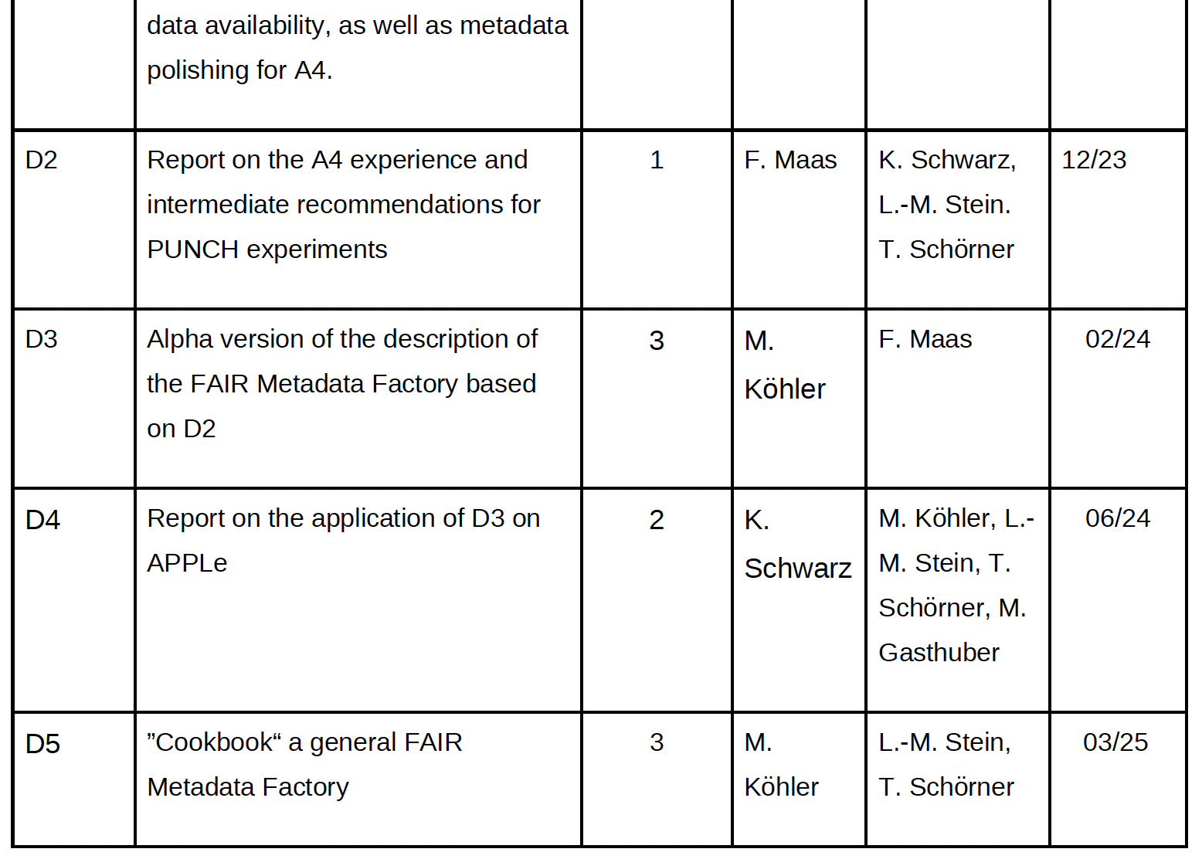
The project
Deliverables
Achieved
Postponed to May 2024
Concept drafted
On track for 06/2024
On track for 03/2025
Notes:
Add picture of WPC

Slide 6
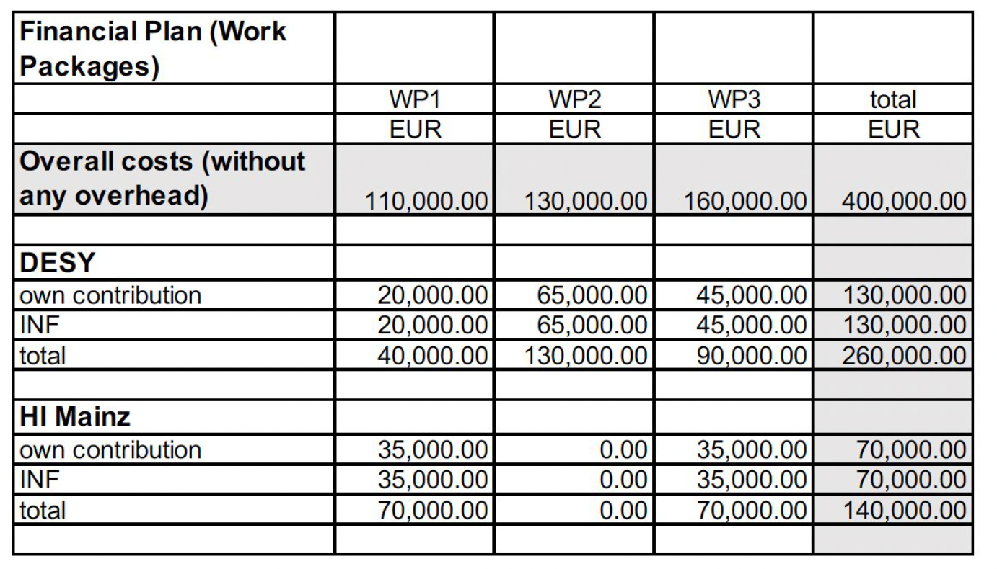
The project
Finances
Notes:
Add picture of WPC

Slide 7
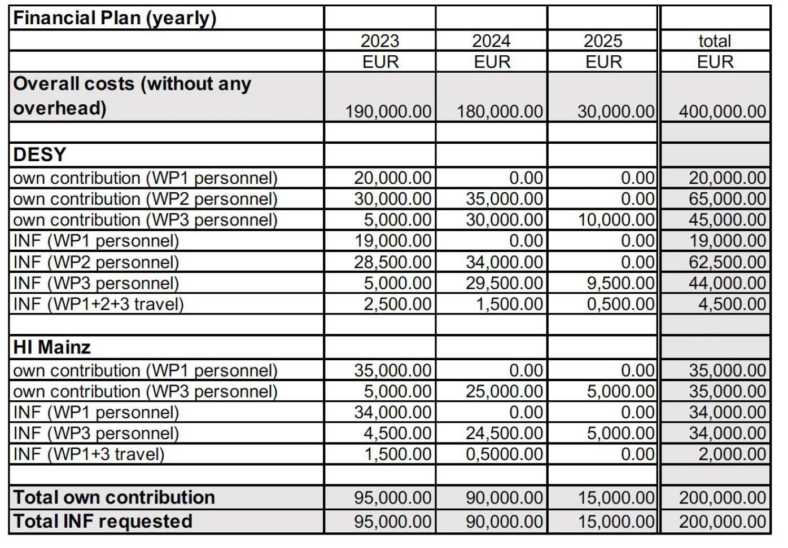
The project
Finances
Notes:
Add picture of WPC

Slide 8
The project
Personnel
Notes:
Add picture of WPC

Slide 9
The project
Publication type | Author | Title |  | In case of conference contributions: Name and date of conference
Conference poster | Ding-Ze Hu | PATOF – From the PAst TO the Future: Legacy Data in Small and Medium-Scale “PUNCH” Experiments – a Blueprint for PUNCH and Other Disciplines |  | CoRDI (1st Conference on Research Data Infrastruture), September 12th – 14th, 2023
Conference poster | Ding-Ze Hu | PATOF – From the PAst TO the Future: Legacy Data in Small and Medium-Scale “PUNCH” Experiments – a Blueprint for PUNCH and Other Disciplines |  | HMC Conference , October 10-12, 2023
Conference poster and proceedings | S. Karstensen et al. | Creating of HDF5 Files as Data Source for Analyses Using the Example of ALPS IIc and the DOOCS Control System |  | The 19th Biennial International Conference on Accelerator and Large Experimental Physics Control Systems 9 - 13 October 2023
Conference poster | Gerrit Günther | Towards Intelligible Metadata |  | FAIRmat User Meeting, Berlin, 7 June 2023
Conference talk | Gerrit Günther | Use Cases in HMC – from Generation to Reuse of Data |  | HMC Conference 2022, Berlin, 5/6 October 2022
Conference poster | Gerrit Günther | IR of FAIR - Principles at the Instrument Level |  | HELIPORT Workshop, Dresden, 12-14 June 2023
Conference talk | Gerrit Günther | IR of FAIR - Principles at the Instrument Level |  | HELPMI Workshop, GSI, 13/14 November 2023
Conference poster | Gerrit Günther | The A4 Experiment – from Data to Data Publication |  | 8. Annual MT Meeting, 26.–27. Sept. 2022
Conference presentation and proceedings | Gerrit Günther | IR of FAIR – Principles at the Instrument Level |  | The 19th Biennial International Conference on Accelerator and Large Experimental Physics Control Systems 9 - 13 October 2023
Output
Notes:
Add picture of WPC

Slide 10
Reporting
Progress report (deadline 29 Jan 2023)
Report 2023 just delivered – thanks for your help and input!
Annual report to IVF
Next one due 30 April 2024
Mostly same template, will try to do with updates to progress report. Some additional information required (spending profile etc.).
Notes:
Add picture of WPC

Slide 11
WP Reports
Notes:
Add picture of WPC

Slide 12
Next Steps
Next deliverables?
Achieved
Postponed to May 2024
Concept drafted
On track for 06/2024
On track for 03/2025
Notes:
Add picture of WPC

Slide 13
Future Funding Opportunities
HMC calls (next call in early summer?)?
EU OSCARS calls (March + ~November)
ErUM-Data RDM (community/institute-overarching)

Slide 14
AOB
Connection to e.g. PUNCH4NFDI?
Binding in additional partners?
Connection to cookbook WG of NFDI section common infrastructures / metadata?
Next meeting in about 6-7 months
Immediate steps / action items
“Understanding ALPS II”
PUNCH – PATOF
Funding calls
“next but one” experiment
Helmholtz Strategy Paper Matter – impact?
Notes:
Add picture of WPC

