Slide 1
ARES Operation Meeting
Summary of week 5 / 2024
Blae Stacey, on behalf of the ARES crew

Slide 2
Summary of week 5
Mon. 29.01. | Tue. 30.01. | Wed. 31.01. | Thu. 01.02. | Fri. 02.02.
Established velocity bunching working point from Friday; Setting MMG phases; TWS1 phase scans with PolariX bunch length measurements (18fs FWHM minimum). | Orbit improved using fewer steerers; Screen based phase advance measurements; Transmission through DLA established; Tuning TWS1 phase and looking at EA.L2 for increased signal intensity. | Scanning TWS1 phase to find increased signal intensity; Scanning charge to study coherence effects (no coherence observed); ZZ to trigger EA.L2 camera; Detailed Schottky scan ran overnight. | Beam steered to transmit vertically central through DLA and avoid dead pixels on EA.L2 camera; Continued with TWS1 and charge scans; Detailed scan overnight; Script work for PolariX measurements on SH.E1 and SH.E2 screens. | Reestablishing transmission through DLA; TWS1 phase scanned to find max signal intensity on EA.L2 (changed by c. 1 deg); Transmission to end of machine and PolariX bunch length measurement on SH.E2 (25fs FWHM); MMG phases found; Possibly reached 6 MW with PolariX; Autonomous Accelerator studies.
 |  | TWS1 modulator in fault but recovered independently. | TDS modulator water flow fault – fixed by MIN. | SH.E2 camera not fixable – fixed by experts; TWS1 in fault from water flow rate limit – fixed; Problems with python environments.
 |  | EA.L2 camera now triggered using SH.D1 cable – needs changing back on Monday |  | PolariX conditioning (SP 35) over weekend
Achievements
Difficulties
Notes

Slide 3
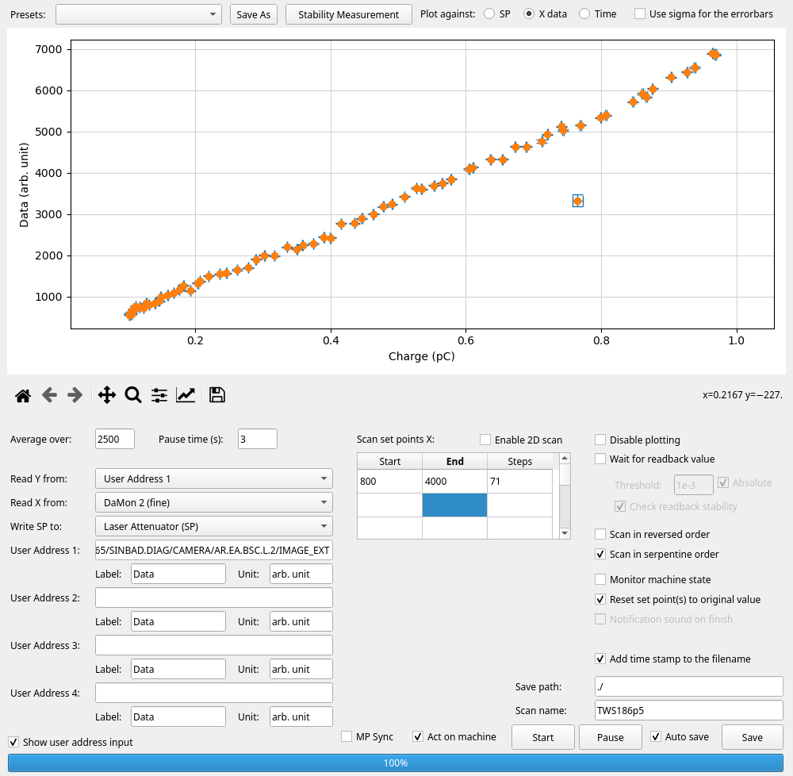
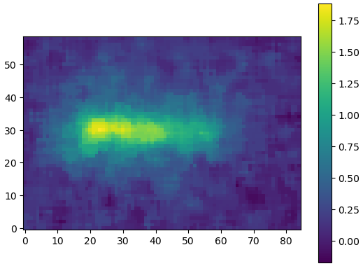
SPACEChip
Intensity on EA.L2 ROI vs. transmitted charge
Beam streaked on SH.E2 w low power
ROI on EA.L2 camera

Slide 4
Schedule and Plan for the Week
Week 6
Date | Shift Crew
05.02. | Thomas
06.02. | Willi, Hannes & Frank (pm)
07.02. | Max, Hannes & Willi
08.02. | Frank & Florian
09.02. | Frank & Blae
Mon: SH.D1 camera triggered and recalibrated, large water tank installed in FL section, and machine prep for UKE beamtime
Tues: Machine prep for UKE beamtime
Wed – Fri: UKE user beamtime
If you want to learn or join the shift: please give the shift leader a call (BKR 2840 / SINBAD Box 2454)

