Slide 1
ARES Operation Meeting
Summary of week 6 / 2024
Willi Kuropka, on behalf of the ARES crew

Slide 2
Summary of week 6
Mon. 05.02. | Tue. 06.02. | Wed. 07.02. | Thu. 08.02. | Fri. 09.02.
PolariX conditioning was running over the weekend UKE experiments prep. Established 20MeV WP with max. 0.4pC | 20MeV dosimetry film irradiation for comparison PolariX conditioning from midday Triple on-crest 40pC WP established | Water tank experiment for depth-dose-dependence Removed water tank and reset stages in FL section 3 irradiation runs for pattern uniformity tests | Opened tunnel to retrieve the last dosimetry films Detached the cabling from the laser table Triple on-crest 20pC WP established for D3 detector tests Velocity bunching WP for short bunch characterization | More short-bunch characterization Velocity bunching until lunch Magnetic compression in the afternoon Opened tunnel for shutdown this week
Achievements
Difficulties
Notes

Slide 3
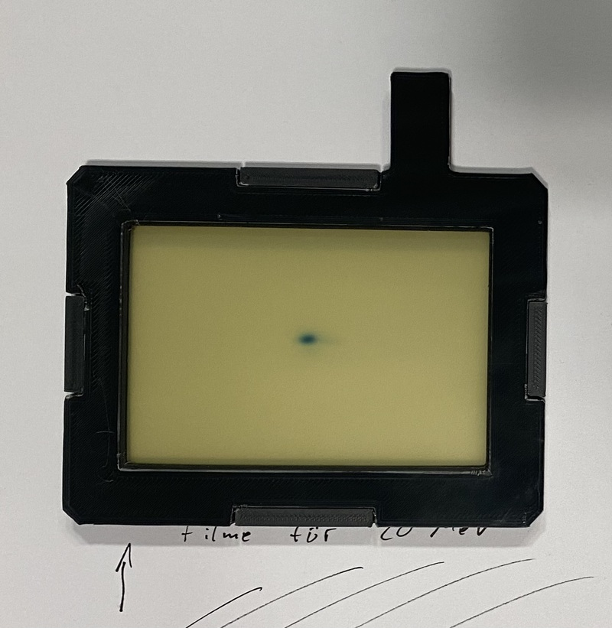
20MeV irradiation

Slide 4
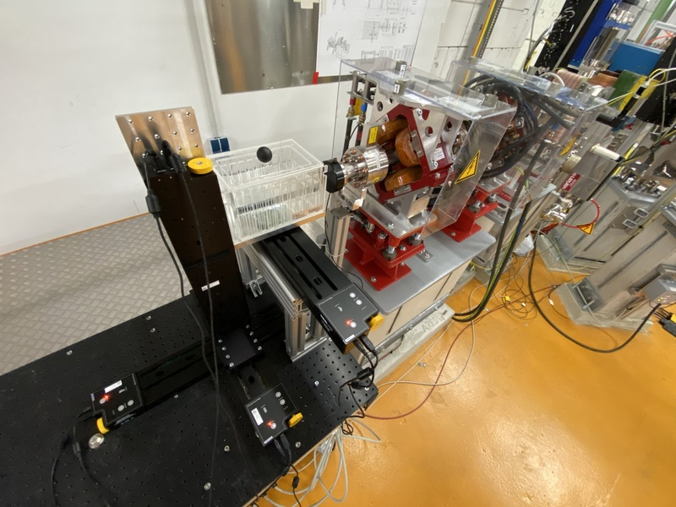
Water tank depth-dose measurement

Slide 5
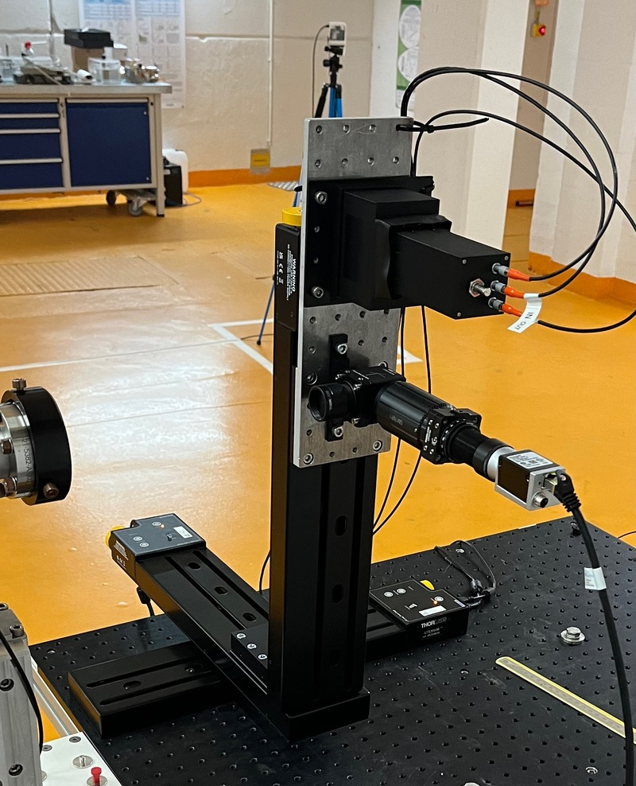
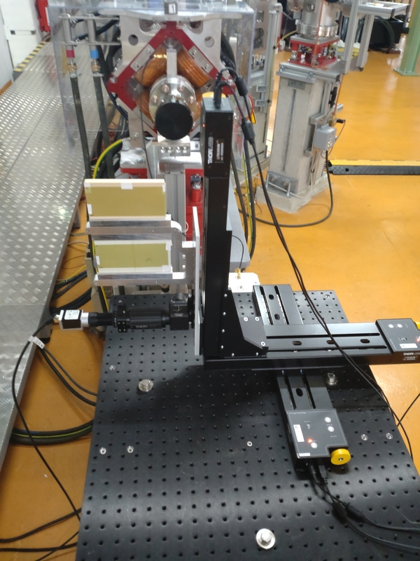
UKE pattern uniformity / D3 Cherenkov detector

Slide 6
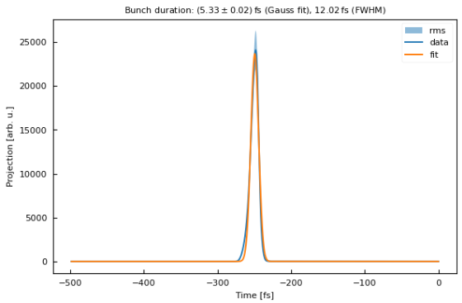
Velocity bunching – bunch length

Slide 7
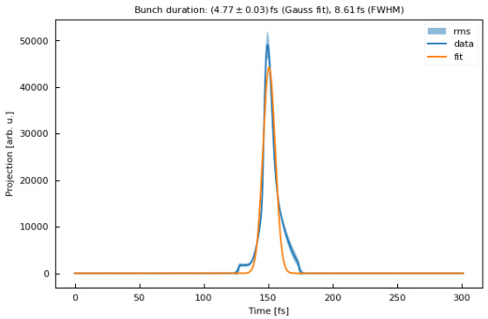
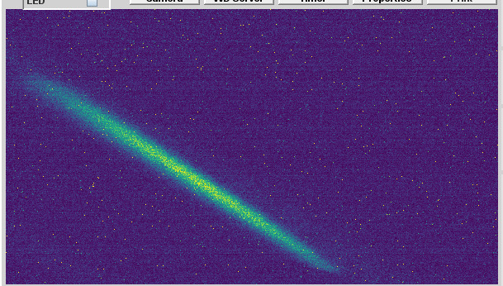
Magnetic compression – bunch length, LPS
Fully compressed
Not fully compressed
Longitudinal coordinate
Momentum

Slide 8
Schedule and Plan for the Week
Week 7
Date | Shift Crew
12.02. | -
13.02. | tbd
14.02. | tbd
15.02. | tbd
16.02. | tbd
Baseplate exchange with installation of tubes for TWAC – pumping down EA section
Photocathode laser beam pointing stabilizer re-alignment
Re-evaluation of photocathode laser position on cathode
If you want to learn or join the shift: please give the shift leader a call (BKR 2840 / SINBAD Box 2454)

