Slide 1
Maximal Unitarity at Two Loops
David A. Kosower Institut de Physique Théorique, CEA–Saclay
work with Kasper Larsen 1108.1180 & in progress & work of Simon Caron-Huot & Kasper Larsen (to appear)
Loops & Legs 2012 Wernigerode, Germany April 20, 2012

Slide 2
Amplitudes in Gauge Theories
Basic building block for physics predictions in QCD
NLO calculations give the first quantitative predictions for LHC physics, and are essential to controlling backgrounds: require one-loop amplitudes ⇒ many talks
For some processes (gg → W⁺W⁻, gg → ZZ) two-loop amplitudes are needed
For NNLO & precision physics, we also need to go beyond one loop ⇒ talks by Pires, Mastrolia, Gehrmann, von Manteuffel, Abelof, Mitov,
Explicit calculations in N=4 SUSY have lead to a lot of progress in discovering new symmetries (dual conformal symmetry) and new structures not manifest in the Lagrangian or on general grounds

Slide 3
On-Shell Methods
Use only information from physical states
Use properties of amplitudes as calculational tools
Factorization → on-shell recursion (Britto, Cachazo, Feng, Witten,…)
Unitarity → unitarity method (Bern, Dixon, Dunbar, DAK,…)
Underlying field theory → integral basis
Formalism
For analytics, independent integral basis is nice; for numerics, essential
Known integral basis:
On-shell Recursion; D-dimensional unitarity via ∫ mass
Unitarity

Slide 4
Knowledge of Integrals
Master Integrals for Feynman-diagram based calculations
Not essential in principle
Don’t have to be algebraically independent
Required only to streamline calculations
Process-dependent basis integrals
Needed for ‘minimal generalized unitarity’ calculations (just enough cuts to break apart process into trees)
Can be deduced as part of the unitarity calculation, on a process-by-process basis
All-multiplicity results & Numerical applications of unitarity
Require a priori knowledge of algebraically independent integral basis

Slide 5
Higher Loops
Two kinds of integral bases
To all orders in ε (“D-dimensional basis”)
Ignoring terms of O(ε) (“Regulated four-dimensional basis”)
Loop momenta D-dimensional
External momenta, polarization vectors, and spinors are strictly four-dimensional
Basis is finite
Abstract proof by A. Smirnov and Petuchov (2010)
Use tensor reduction + IBP + Grobner bases + generating vectors + Gram dets to find them explicitly
Brown & Feynman (1952); Passarino & Veltman (1979)
Tkachov & Chetyrkin (1981); Laporta (2001); Anastasiou & Lazopoulos (2004); A. Smirnov (2008)
Buchberger (1965), …

Slide 6
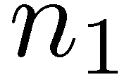
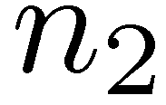
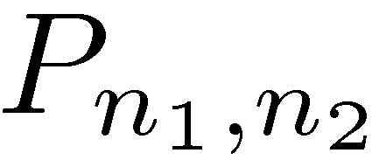
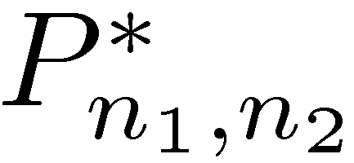
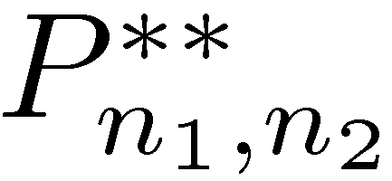
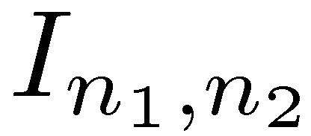
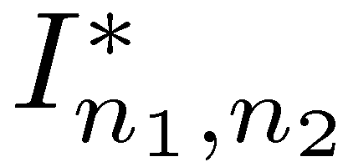
Planar Two-Loop Integrals
Massless internal lines; massless or massive external lines

Slide 7
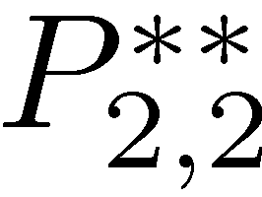
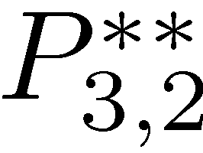
Examples
Massless, one-mass, diagonal two-mass, long-side two-mass double boxes : two integrals
Short-side two-mass, three-mass double boxes: three integrals
Four-mass double box: four integrals
Massless pentabox : three integrals
All integrals with n₂ ≤ n₁ ≤ 4, that is with up to 11 propagators
⇒ This is the D-dimensional basis

Slide 8
Dropping terms of O (ε):
Same double boxes
Only one pentabox (reduced from three)
Eliminate all integrals beyond the pentabox , that is all integrals with more than eight propagators
⇒ Regulated four-dimensional basis

Slide 9
Unitarity-Based Calculations
Bern, Dixon, Dunbar, & DAK, ph/9403226, ph/9409265
Replace two propagators by on-shell delta functions
⇒ Sum of integrals with coefficients; separate them by algebra

Slide 10
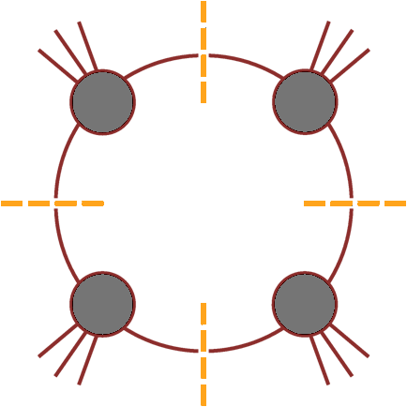
Maximal Generalized Unitarity
Isolate a single integral
D = 4 → loop momentum has four components
Cut four specified propagators (quadruple cut) would isolate a single box
Britto, Cachazo & Feng (2004)

Slide 11
Quadruple Cuts
Work in D=4 for the algebra
Four degrees of freedom & four delta functions
… but are there any solutions?

Slide 12
A Subtlety
The delta functions instruct us to solve
1 quadratic, 3 linear equations ⇒ 2 solutions
If k₁ and k₄ are massless, we can write down the solutions explicitly
solves eqs 1,2,4;
Impose 3rd to find
or

Slide 13
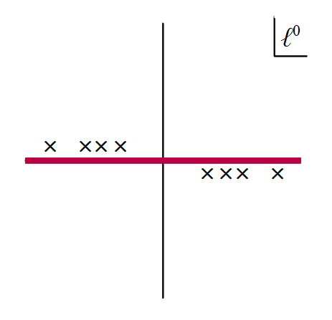
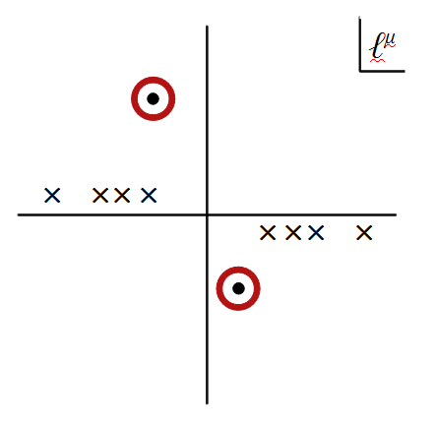
Solutions are complex
The delta functions would actually give zero!
Need to reinterpret delta functions as contour integrals around a global pole
Reinterpret cutting as contour replacement

Slide 14
Two Problems
We don’t know how to choose the contour
Deforming the contour can break equations:
is no longer true if we deform the real contour to circle one of the poles
Remarkably, these two problems cancel each other out

Slide 15
Require vanishing Feynman integrals to continue vanishing on cuts
General contour
⇒ a₁ = a₂

Slide 16
Box Coefficient
A
B
D
C
Go back to master equation
Deform to quadruple-cut contour C on both sides
Solve:
No algebraic reductions needed: suitable for pure numerics
Britto, Cachazo & Feng (2004)

Slide 17
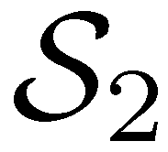
Massless Planar Double Box
[Generalization of OPP: Ossola & Mastrolia (2011)]
Here, generalize work of Britto, Cachazo & Feng, and Forde
Take a heptacut — freeze seven of eight degrees of freedom
One remaining integration variable z
Six solutions, for example

Slide 18
Need to choose contour for z within each solution
Jacobian from other degrees of freedom has poles in z: naively, 14 solutions aka global poles
Note that the Jacobian from contour integration is 1/J, not 1/|J|
Different from leading singularities
Cachazo & Buchbinder (2005)

Slide 19
Parametrize momenta

Slide 20
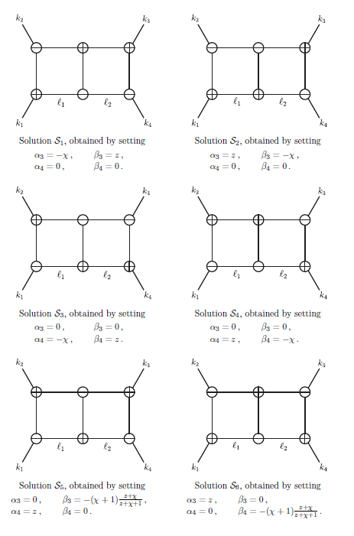
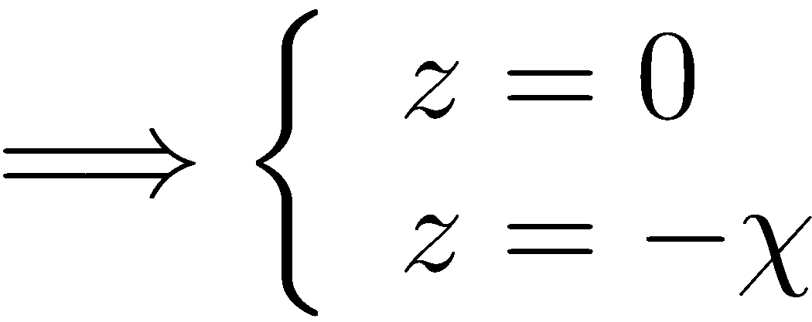
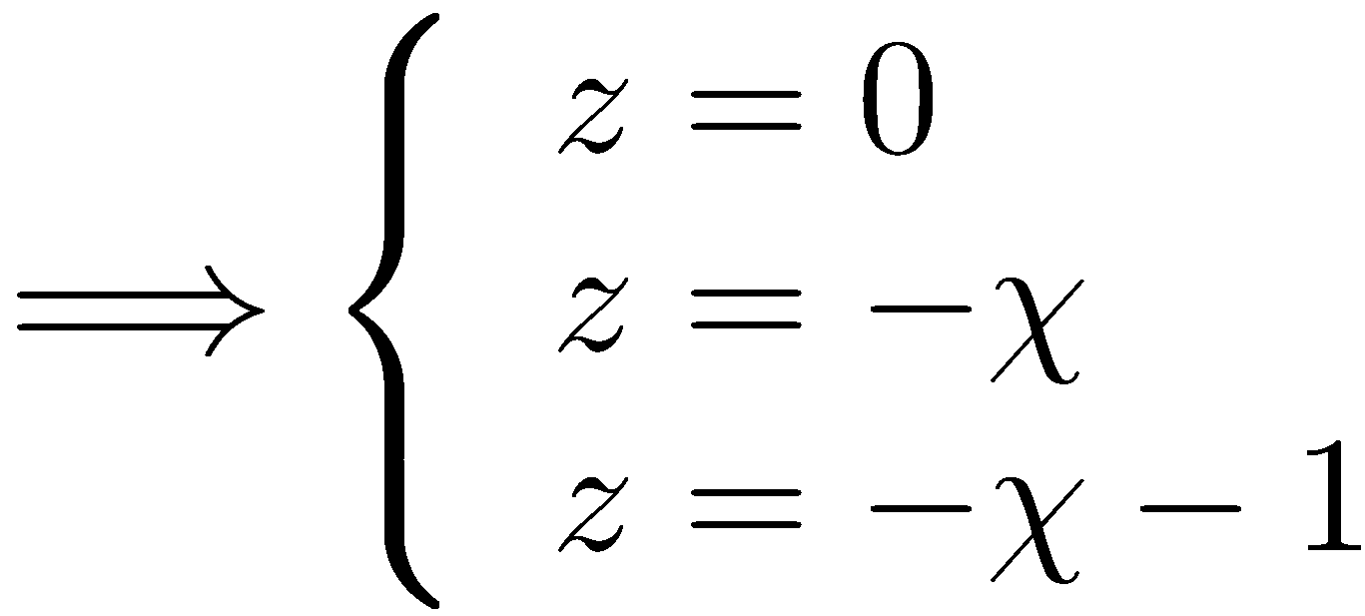
Solut
Solutions

Slide 21
How Many Solutions Do We Really Have?
Caron-Huot & Larsen (2012)
Parametrization
All heptacut solutions have
Here, naively two global poles each at z = 0, −χ
Overall, we are left with 8 distinct global poles
same!

Slide 22
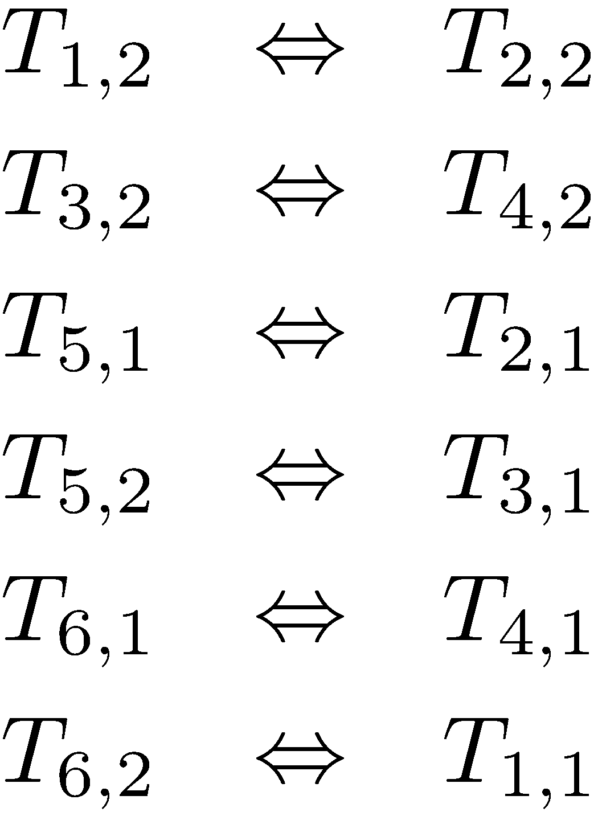
Similarly
so we are left with 8 distinct global poles

Slide 23
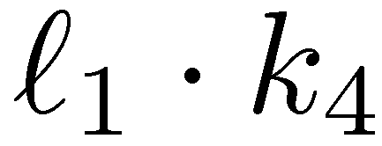
Two basis or ‘master’ integrals: I₄[1] and I₄[ℓ₁∙k₄] in massless case
Want their coefficients

Slide 24
Picking Contours
A priori, we can deform the integration contour to any linear combination of the 8; which one should we pick?
Need to enforce vanishing of all total derivatives:
5 insertions of ε tensors
⇒ 4 independent constraints
20 insertions of IBP equations
⇒ 2 additional independent constraints
Seek two independent “projectors”, giving formulæ for the coefficients of each master integral
In each projector, require that other basis integral vanish
Work to O (ε⁰); higher order terms in general require going beyond four-dimensional cuts

Slide 25
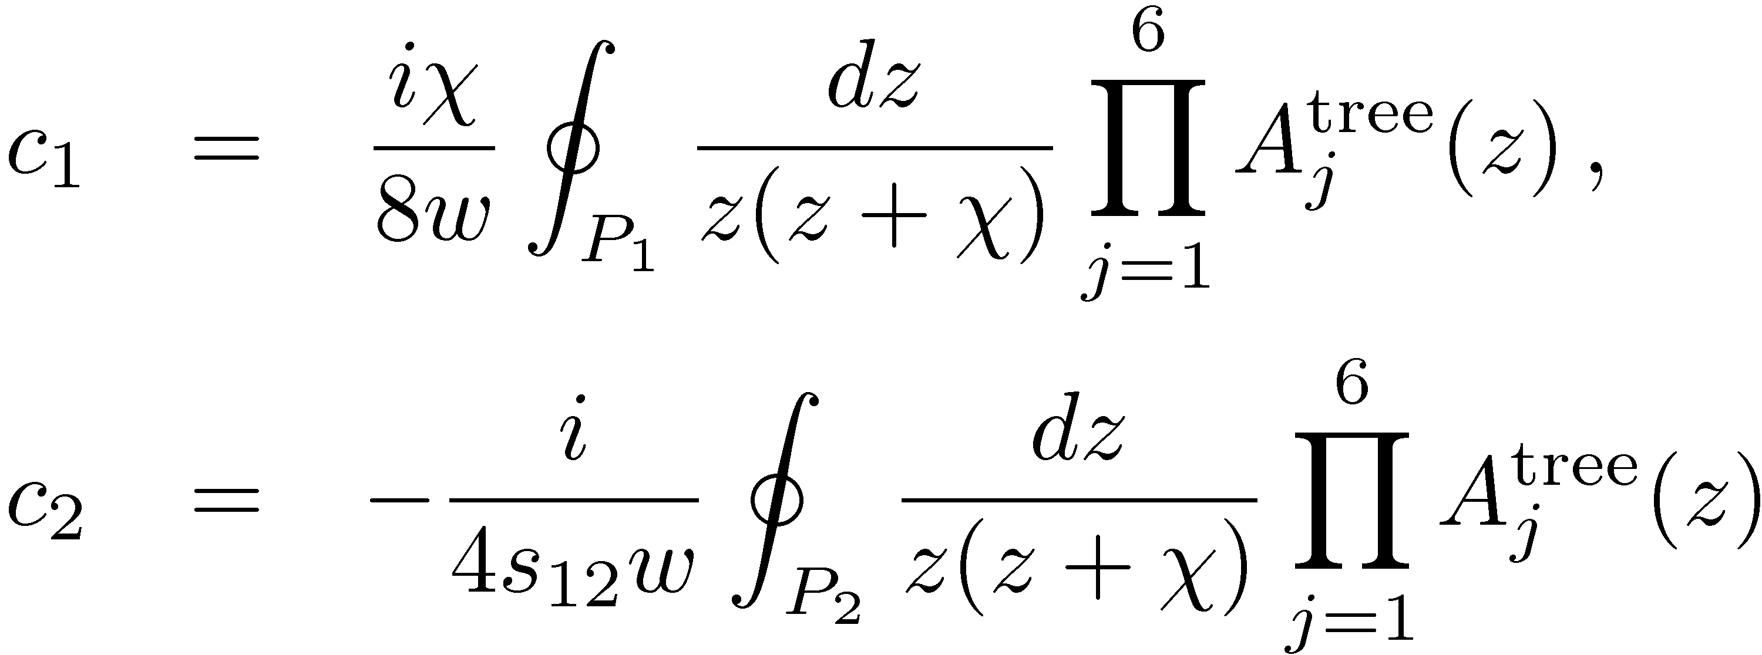
Master formulæ for basis integrals
To O (ε⁰); higher order terms require going beyond four-dimensional cuts

Slide 26
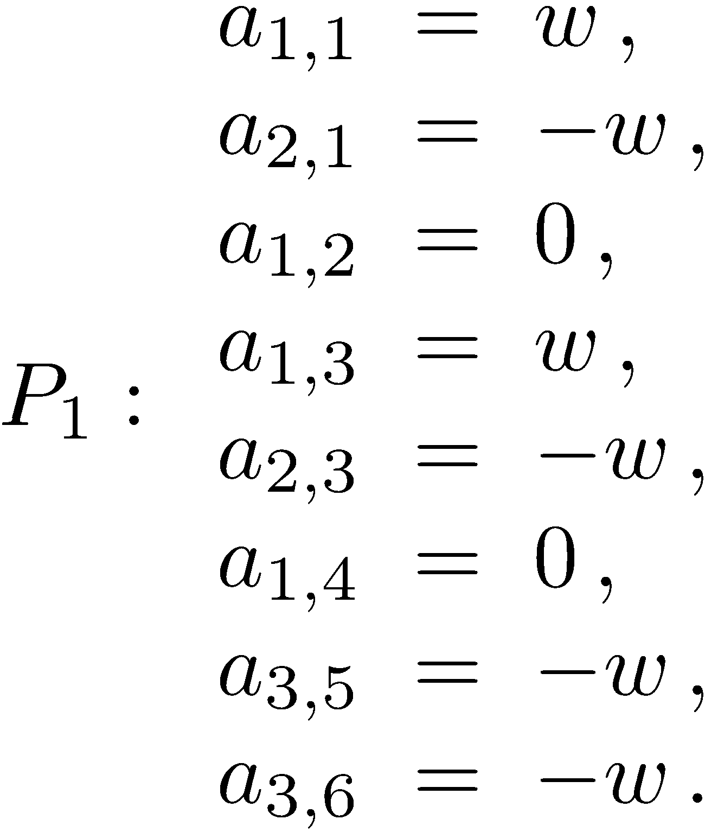
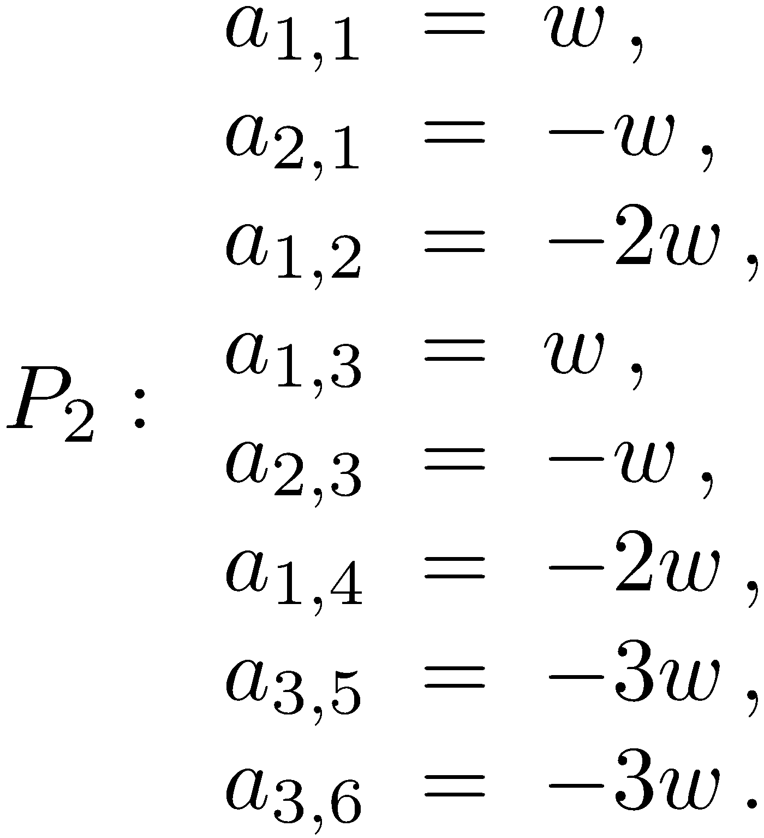
Contours
Up to an irrelevant overall normalization, the projectors are unique, just as at one loop
More explicitly,

Slide 27
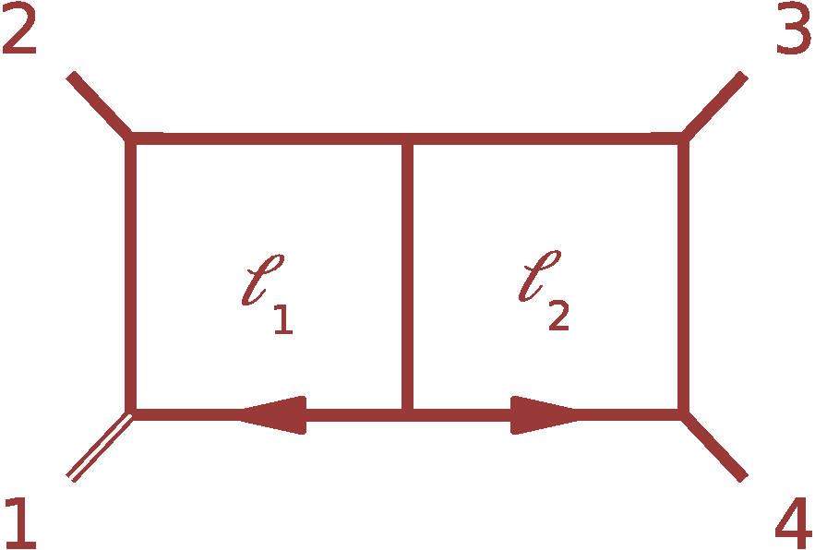
One-Mass & Some Two-Mass Double Boxes
Take leg 1 massive; legs 1 & 3 massive; legs 1 & 4 massive
Again, two master integrals
Choose same numerators as for massless double box: 1 and
Structure of heptacuts similar
Again 8 true global poles
6 constraint equations from ε tensors and IBP relations
Unique projectors — same coefficients as for massless DB (one-mass or diagonal two-mass), shifted for long-side two-mass

Slide 28
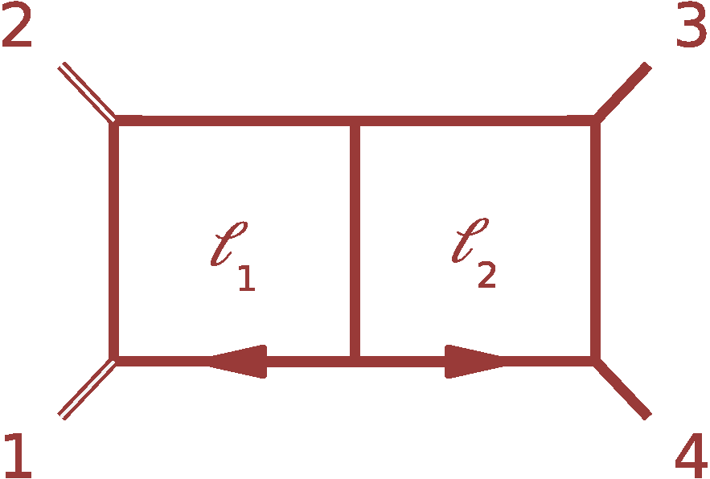
Short-side Two-Mass Double Box
Take legs 1 & 2 to be massive
Three master integrals: I₄[1], I₄[ℓ₁∙k₄] and I₄[ℓ₂∙k₁]
Structure of heptacut equations is different: 12 naïve poles
…again 8 global poles
Only 5 constraint equations
Three independent projectors
Projectors again unique (but different from massless or one-mass case)

Slide 29
Summary
First steps towards a numerical unitarity formalism at two loops
Knowledge of an independent integral basis
Criterion for constructing explicit formulæ for coefficients of basis integrals
Four-point examples: massless, one-mass, two-mass double boxes

