Slide 1
Niobium-Oxides: The link between quantum computing and mid-T heat treatment or:
Both ends of the scale: high and low E_{acc}
7.2.2024
Marc Wenskat

Slide 2
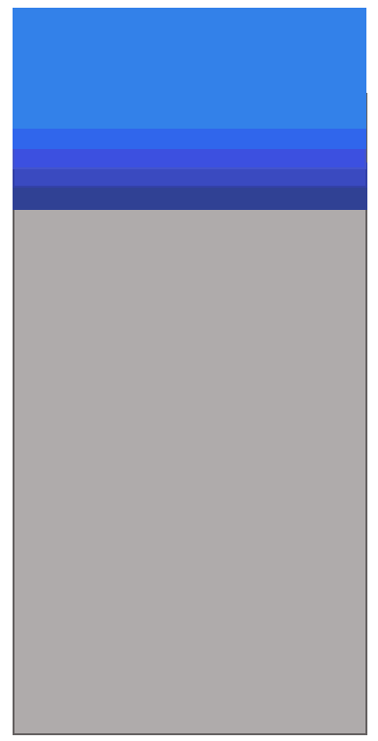
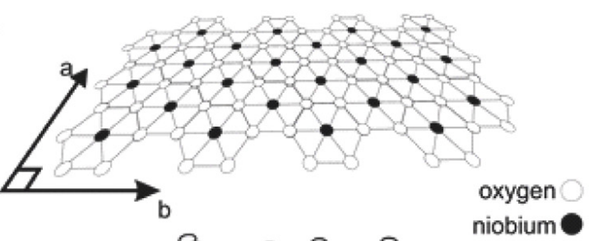
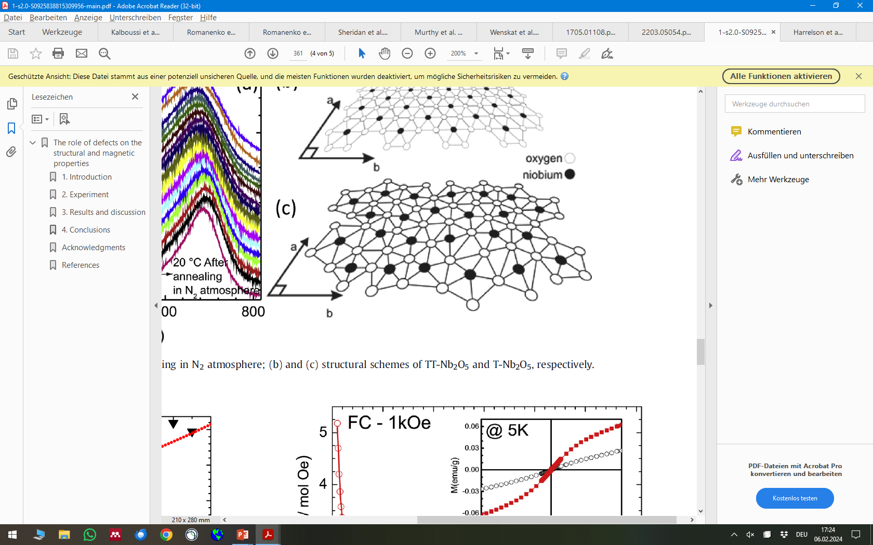
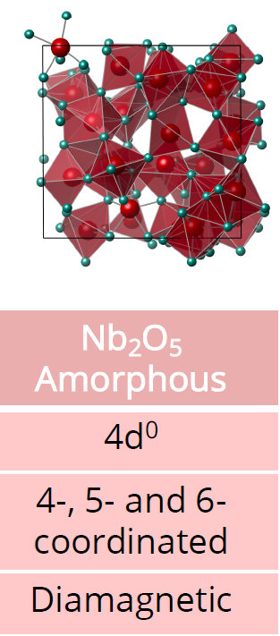
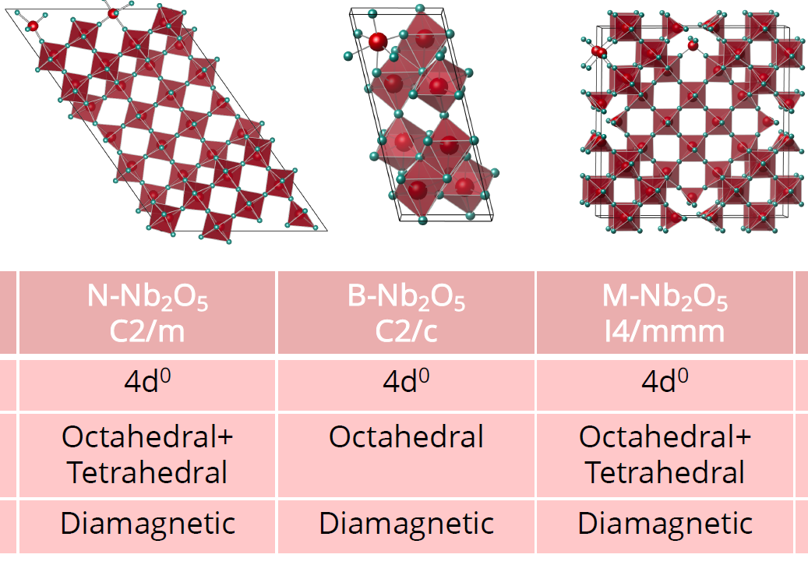



What do we know about Nb-oxides? It‘s complicated!
$${Nb}_{2}O_{5}$$
~5 nm
Periodic Lattice
$$NbO2, NbO,NbOx$$
$$Nb$$
Off-stochiometric phase
Globaly, the ratio 2 Nb : 5 O is achieved
Locally, maybe Nb₁₀O₂₃ → O-depletion
Not vacancies in a lattice, simply bad matching
„Unbound binding electrons“ of Nb = dangling bonds
Reality: Energetically not favored at RT, not “our” Nb₂O₅
[Sheridan, Evan, et al., arXiv preprint arXiv:2111.11684 (2021)]
[Harrelson, Thomas, et al., arXiv preprint arXiv:2111.11590 (2021)]
[Murthy, Akshay A., et al. ACS nano 16.10 (2022): 17257-17262.]
[Herval, Leonilson KS, et al. Journal of Alloys and Compounds 653 (2015): 358-362.]

Slide 3
Why does it matter if the Nb-oxide is O-depleted?
The same microscopic situation is described / modelled / labelled different, depending on the amplitude of the applied field because different effects dominate
As both regimes are linked by the same microscopic origin: if we measure one, we might learn about the other
E_{acc} (number of photons)
low
high
Electron spins alignment (dangling bond) can be in two different configuration → Two-Level System
Application: Quantum computing
Magnetic moment of unbound spin act as magnetic scattering site, causes pair breaking → Magnetic impurities
Application: Accelerators

Slide 4
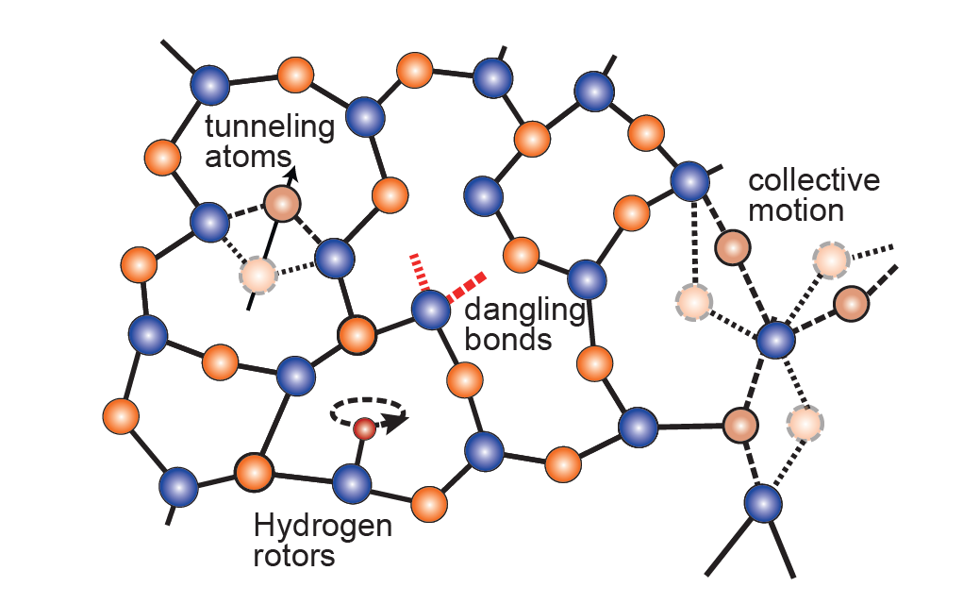
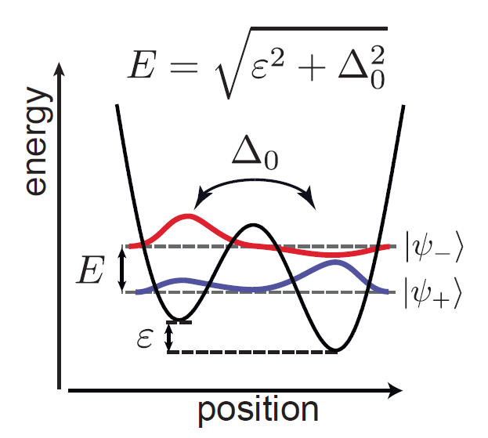
Two-Level System: Assumptions
The TLS can exist in one of two energetically similar configurations.
These configurations are modelled as two minima in a double-well potential which are separated by a barrier.
At sufficiently low temperatures, thermal activation over the barrier is suppressed and the dynamics are governed by quantum tunneling through the barrier.
In general, the system couples to applied electric fields in such a way that transitions can be driven between the states.
Due to the multiple/random arrangements, an ensemble of TLS is characterized by a wide distribution of potential barrier heights and thus spans a large range of switching rates and eigenenergies.
[Müller, Clemens, Jared H. Cole, and Jürgen Lisenfeld. Reports on Progress in Physics 82.12 (2019): 124501.]

Slide 5
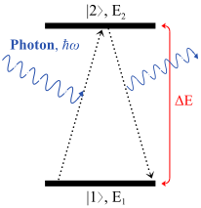
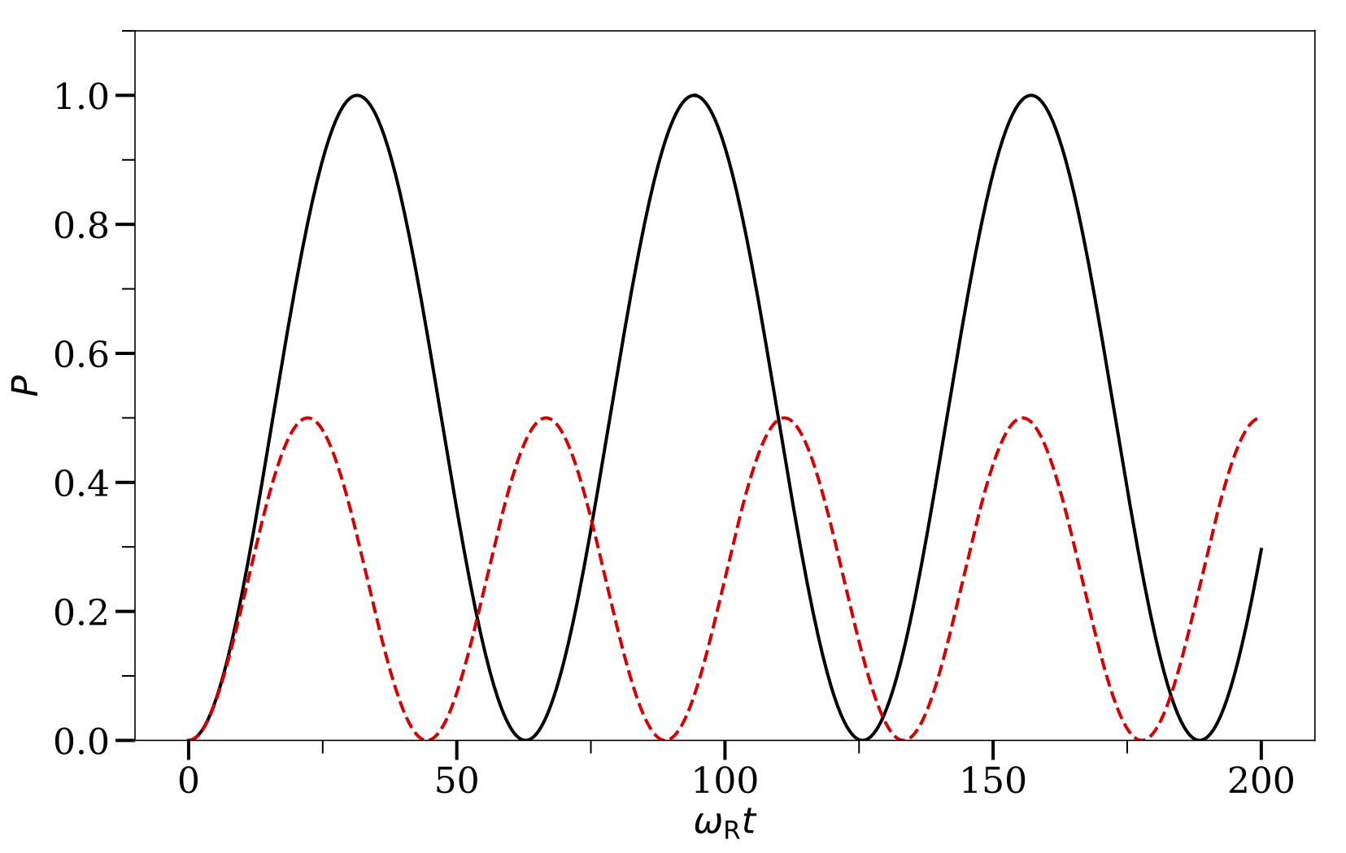

Rabi-Oscillation
When TLS couple through an electric dipole moment d to oscillating electric fields, they can resonantly absorb energy (and give rise to dielectric loss).
Probability P to find TLS in excited state is proportional to sin²(Ω_{Rabi}t/2)
$$Ω_{Rabi}=\frac{{\vec{d}}_{1,2}∙{\vec{E}}_{0}}{ℏ}$$

Slide 6
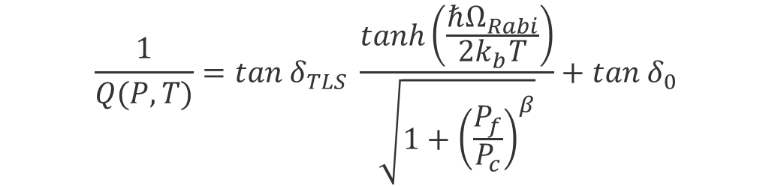
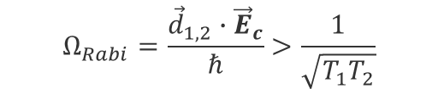
Power dependent losses
In order to get into excited state, the TLS needs to be in its ground state. If all TLS are in the excited state, no absorption and hence no losses.
When a TLS is driven above a certain critical power P_{c} , Ω_{Rabi} will be larger than the TLS loss rates
If the excitation happens faster than the decay (P_{f}>P_{c}), we saturate the losses
$$Ω_{Rabi}=\frac{{\vec{d}}_{1,2}∙{\vec{E}}_{c}}{ℏ}>\frac{1}{\sqrt{T_{1}T_{2}}}$$
$$\frac{1}{Q(P,T)}=tan{ δ}_{TLS} \frac{tanh\left(\frac{ℏΩ_{Rabi}}{2k_{b}T}\right)}{\sqrt{1+{\left(\frac{P_{f}}{P_{c}}\right)}^{β}}}+tan{ δ}_{0}$$
Single species, non-interacting TLS
[Müller, Clemens, Jared H. Cole, and Jürgen Lisenfeld. Reports on Progress in Physics 82.12 (2019): 124501.]

Slide 7
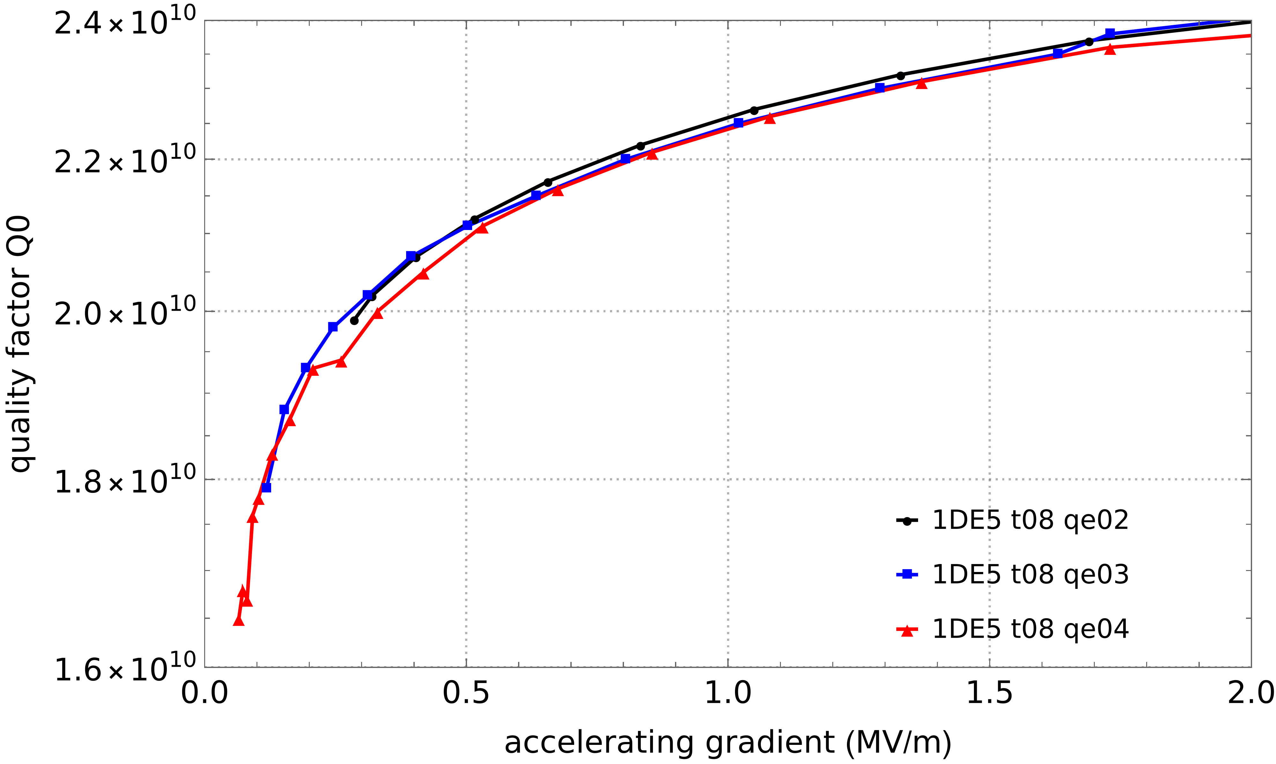
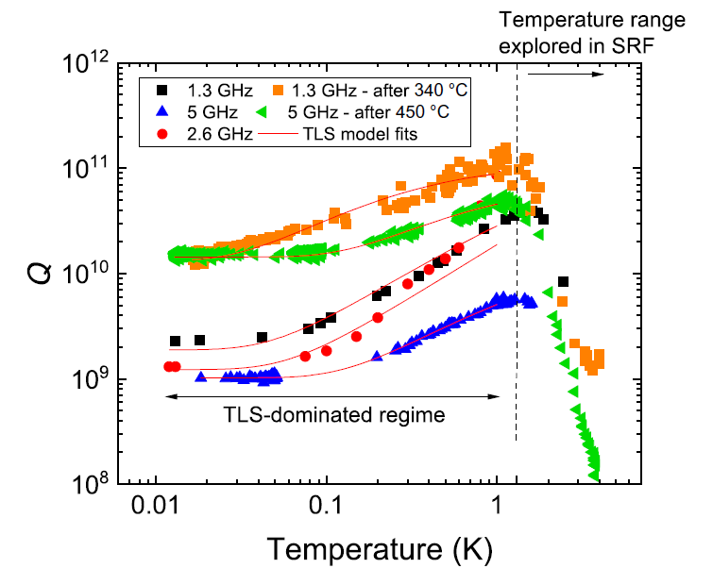
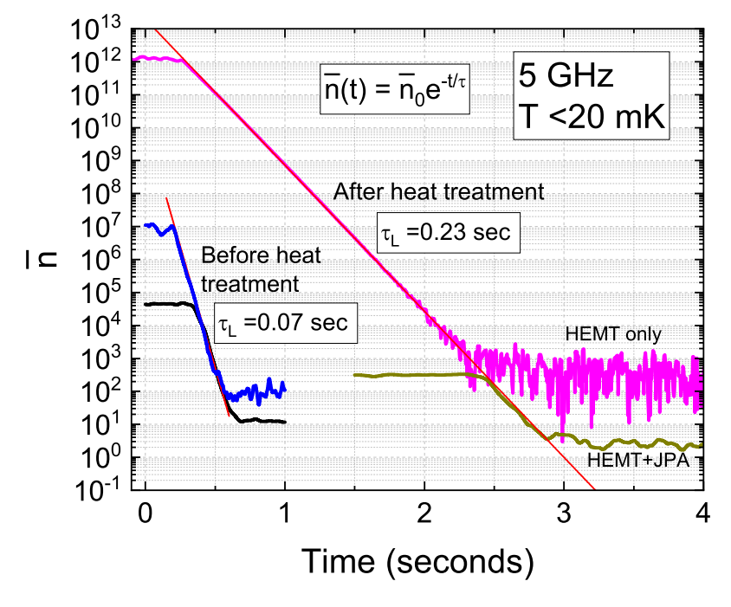
For QC applications: How does Q behave at low T/E_{acc}?
No oxide: lowest losses
Lifetime improves by the in situ heat treatments at 340-450°C
1MV/m ≈ 10²² photons
10⁻⁵ MV/m ≈ 10¹² photons
[Romanenko, A., et al. Physical Review Applied 13.3 (2020): 034032.]

Slide 8
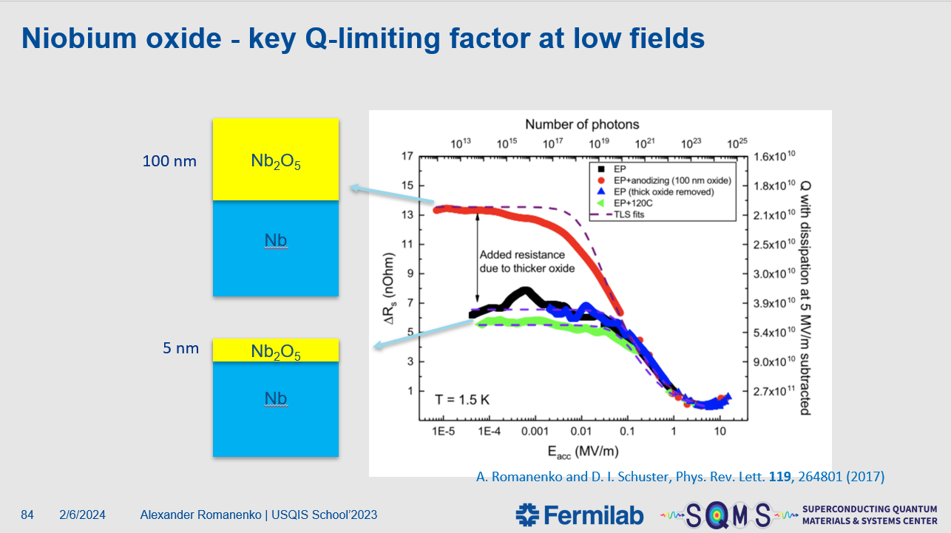

Slide 9
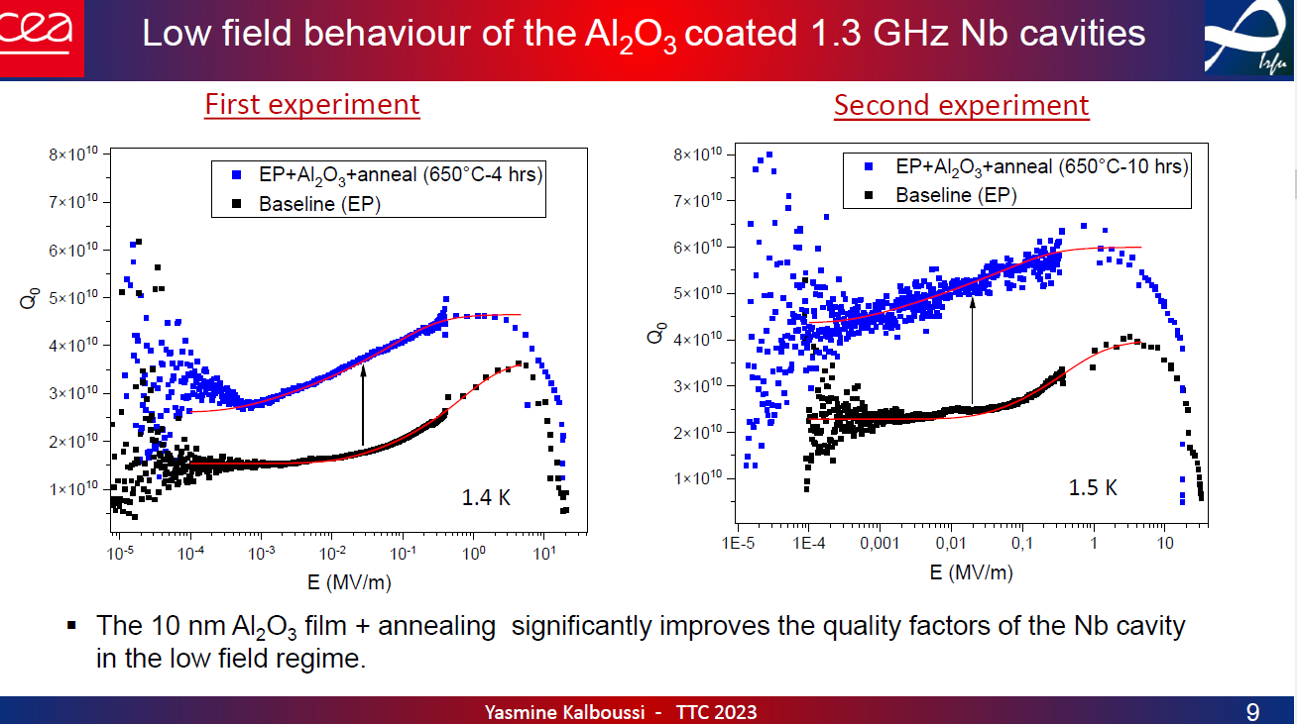
How do coated cavities behave?

Slide 10
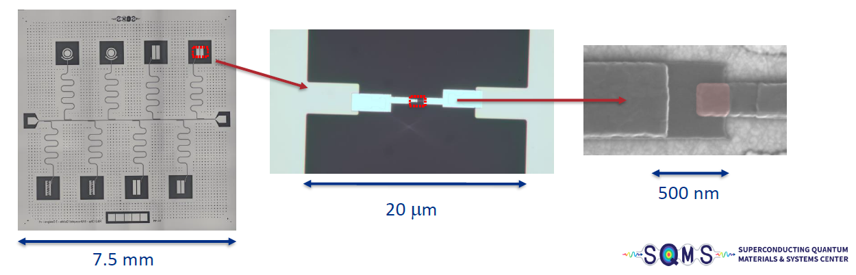
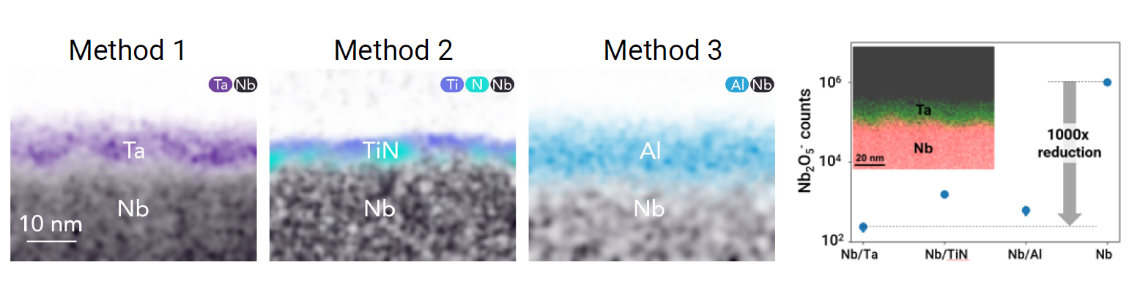
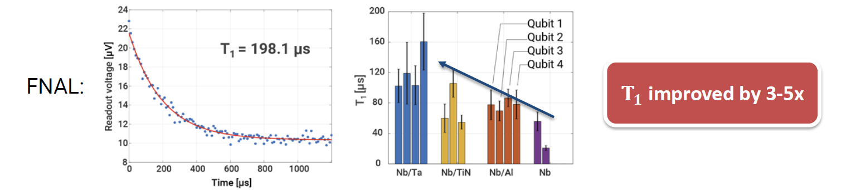
Encapsulating Nb based qubit improves coherence
[Bal, Mustafa, et al., arXiv preprint arXiv:2304.13257 (2023)]

Slide 11
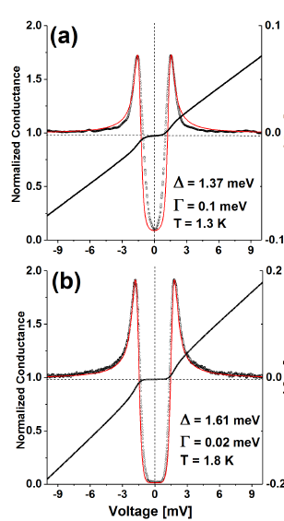
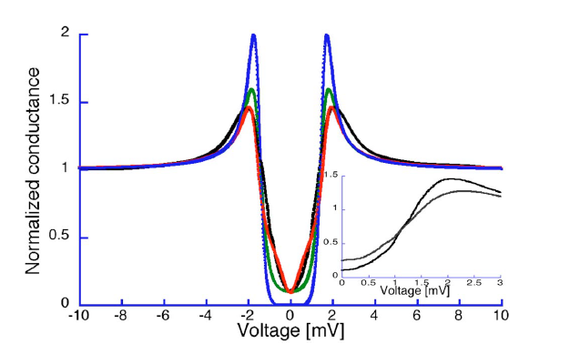

Now high E_{acc}: Magnetic impurities
[Proslier, Thomas, et al. IEEE Trans. Appl. Supercond 21.3 (2011): 2619-2622.]
[Groll, N. R., et al. arXiv preprint arXiv:1805.06359 (2018).]
[Shiba, Hiroyuki. Progress of Theoretical Physics 50.1 (1973): 50-73.]
[Weissmann, M., et al., Physica B: Condens 398.2 (2007): 179-183.]
[Venkatesan, M., et al. Nature 430.7000 (2004): 630-630.]
[Hong, N.H., et al. Phys. Rev. B 73.13 (2006): 132404.]
Magnetic impurities are not new in SRF and correlation with RF behavior was shown already
Gap smearing described by Dynes-Parameter Γ
Shiba-Model based on magnetic impurities describes DOS best
Some experimental observation:
  FNAL: For Cavities with no oxides (in-situ mid-T) showed reduced R_{res} < 1nΩ
  Proslier: strong evidence for Nb-oxides as „host“ for MI
  Own MOKE measurements allow interpretation of interacting MI forming magnetic domanes in Nb-oxide
$$\frac{N(ω)}{N_{0}}=Re\left[\frac{ω+iΓ}{\sqrt{{\left(ω+iΓ\right)}^{2}−Δ^{2}}}\right]$$
DOS / Gap
Cut-Outs
Hot Spots
Data
BCS
Dynes
Shiba
Cold Spots

Slide 12
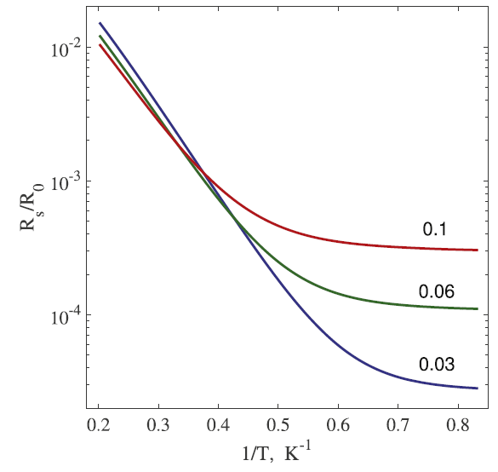
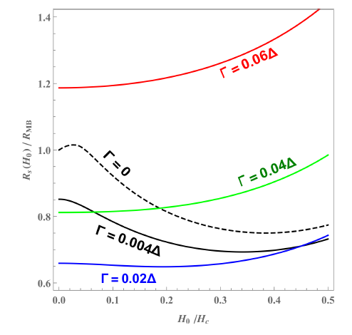
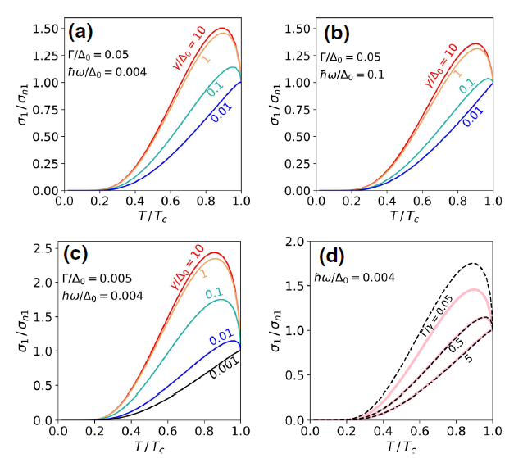
Impact on R_{res}, dQ/dE, fvT
[Kharitonov et al., PRB 86, 024514 (2012).]
[Kubo and Gurevich, PRB 100, 064522 (2019)]
[Gurevich, A., Supercond. Sci. Technol. 30 (2017) 034004]
[Gurevich, PRL 113, 087001 (2014)]
[Gurevich and Kubo, PRB 96, 184515 (2017)]
[Herman, F. et al., Phys. Rev. B 104, 094519 (2021)]
[Kubo, T. et al., Phys. Rev. Appl. 17, 014018 (2022)]
Sub-gap states create „intrinsic“ R_{res}
DOS shape creates anti-Q-slope
Dip in fvT also depends Δ, Γ → first analysis in BSc Thesis T. Meyer

Slide 13
What can we learn from low E_{acc} measurements?
How do various treatments affect Q-saturation?
  Mid-T w. oxide, coating, coating + annealing
  Coating with Al₂O₃ (1DE18/1DE10), Ta₂O₅ (MSc. M. Voige), PEALD Al₂O₃ /TiN/NbTiN
Single-species of TLS, not interacting? TLS more “glassy” or “atomic”?
  Apply different models and discuss them
Do we see correlations with R_{res}, dQ/dE_{acc}, dip-properties?
  Learn about the common origin – might help to understand mid-T better
We need 1.5K and at least 10 kV/m, better 1 kV/m resolution

Slide 14

Thank you
Questions?

Slide 15
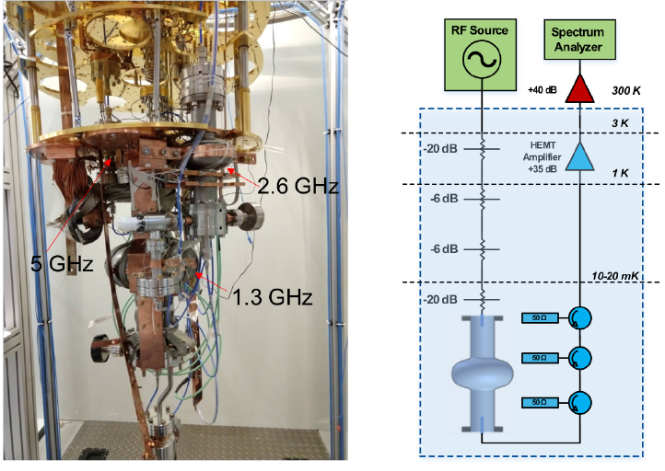
Measurement at FNAL
[Romanenko, A., et al. Physical Review Applied 13.3 (2020): 034032.]

