Slide 1
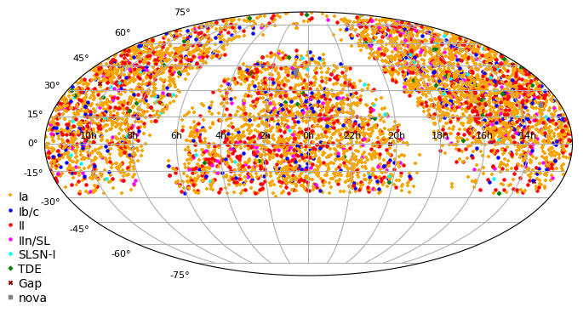
The Zwicky Transient Facility
Bright Transient Survey
Daniel Perley
(Liverpool John Moores University)
Christoffer Fremling (Caltech),
Yu-Jing Qin (Caltech)
Adam Miller (Northwestern),
Jesper Sollerman (Stockholm),
Shri Kulkarni (Caltech),
Yashvi Sharma (Caltech)
Aishwarya Dahiwale (Caltech)
K-Ryan Hinds (LJMU)
Jacob Wise (LJMU)
+ the BTS/RCF team

Slide 2

Individuals, Samples, Populations...

Slide 3
Population studies for optical transients
Needed to address:
How common things are (rates)
How events group into classes ("phase space")
What does not exist (rate limits)
Where things happen (host galaxies)
Anything systematics-limited (e.g. cosmology)

Slide 4
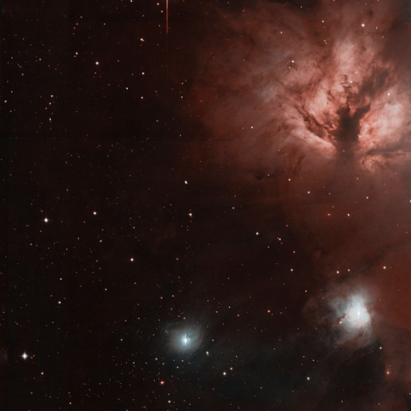
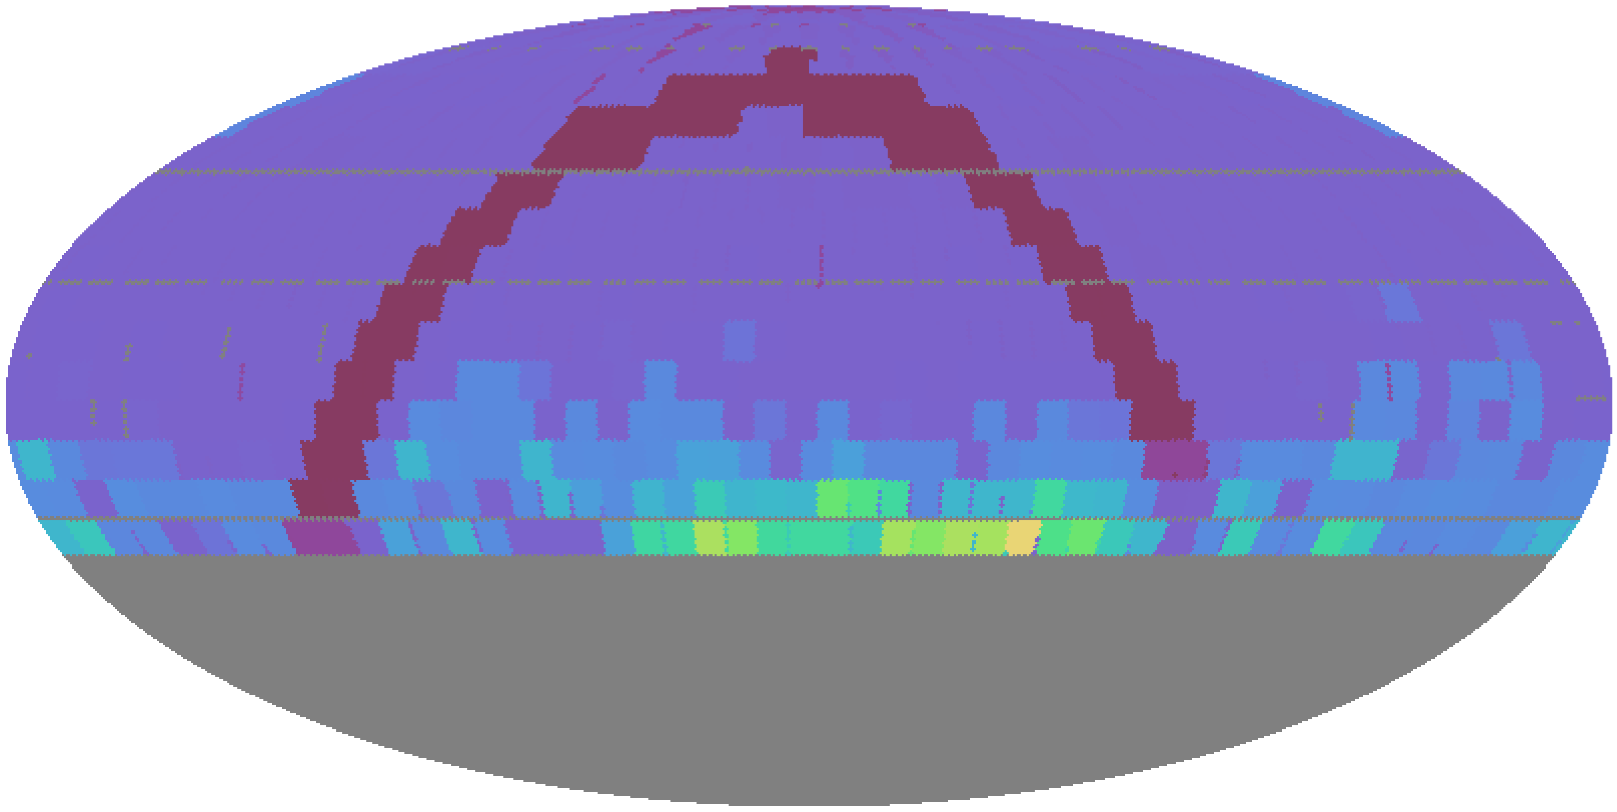
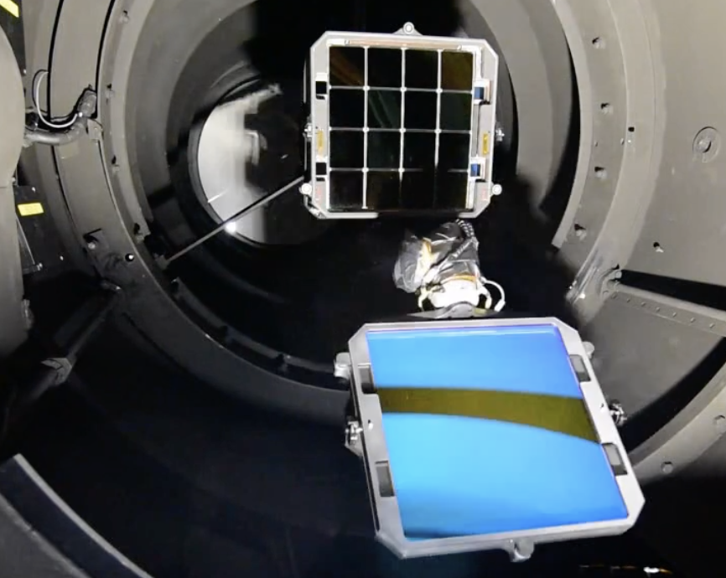
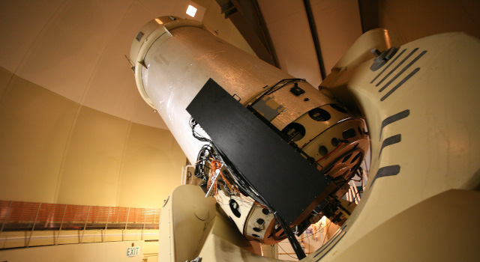





ZTF: The ideal transient population survey
Wide footprint
(~40% of
sky)
Significant
depth
(20 mag)
High cadence
(2-3 days)
Dedicated
spectroscopy
Multiple filters
Open
alerts

Slide 5
BTS: ZTF's mag-limited transient survey
Mag limit | Predicted SNe/year
17 | 155
17.5 | 300
18 | 585
18.5 | 1130
19 | 2220
19.5 | 4370
20 | 8500
20.5 | 16500
Catalog all (public, extragalactic) ZTF transients to m < 19*
Classify all ZTF transients to m < 18.5, unless setting or peak missed ("statistical sample")
Catalogue to m=19
Classify to m=18.5
(deeper when possible!)
(deeper since 2021)
* Now being extended to m < 19.8

Slide 6

Selection in Practice
ZTF public alert stream
(10⁵ alerts/night)
Classified SN
(~3/day sent to TNS)
Real, not moving, no long-term history,
not by a bright star, <19 mag, |b|>7
classify
filter
Other spectrographs
(LT, P200, etc.)
Candidates list
(~100 alerts/night)
Unambiguous
classification
reassign
Ambiguous
m_{peak} < 18.5, and fading?
Ambiguous
and m<18.5?
scan
Not obviously stellar/AGN/bogus
assign
Saved event list
(~10/night sent to TNS)
m < 18.5,
not CV
SEDM queue
(~5 requests/night)

Slide 7
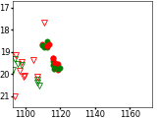

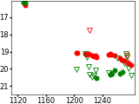
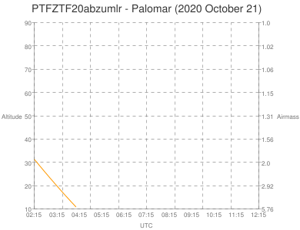
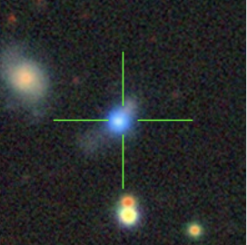
Variables, Setting Transients, Bad Weather...

Slide 8
The Statistical Sample: Quality Cut
Ensure transient was observable to P60 and has a useable light curve by requiring both:
Pre-peak and post-peak P48 coverage of field
(1 week before, 1 week after)
- and -
Field is not setting (remains above 30 degrees >1 hour per night, 30 days post-peak)
+ Not taken immediately after the end of reference building

Slide 9
The Statistical Sample: Purity Cut
Remove AGNs and CVs (even without spectroscopy) by requiring either:
Coincidence with a galaxy (and not nucleus)
- or -
A light curve "similar to" a supernova (per half-to-peak rise and fade times)

Slide 10
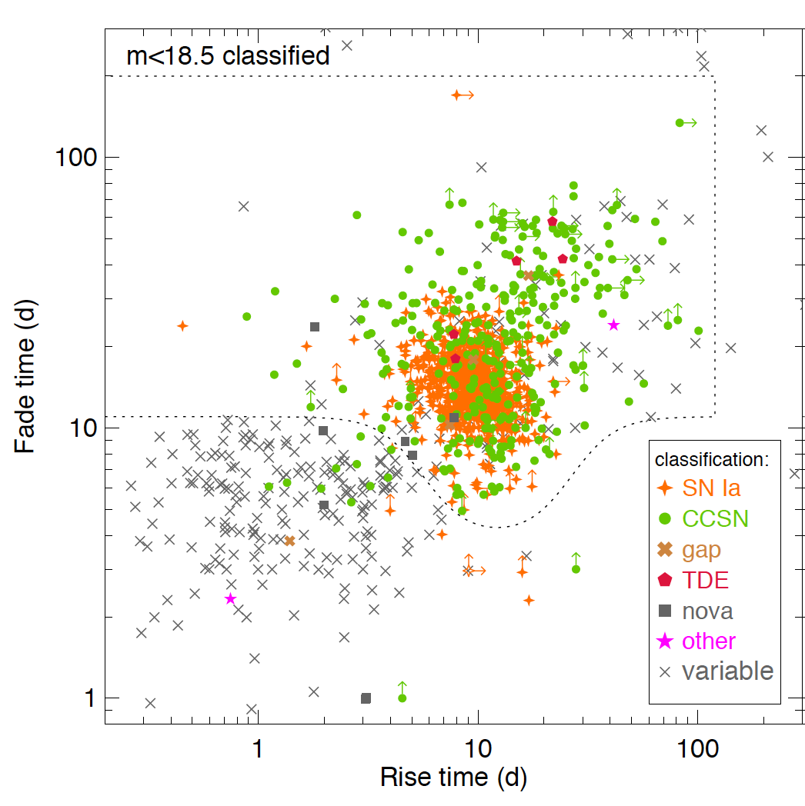
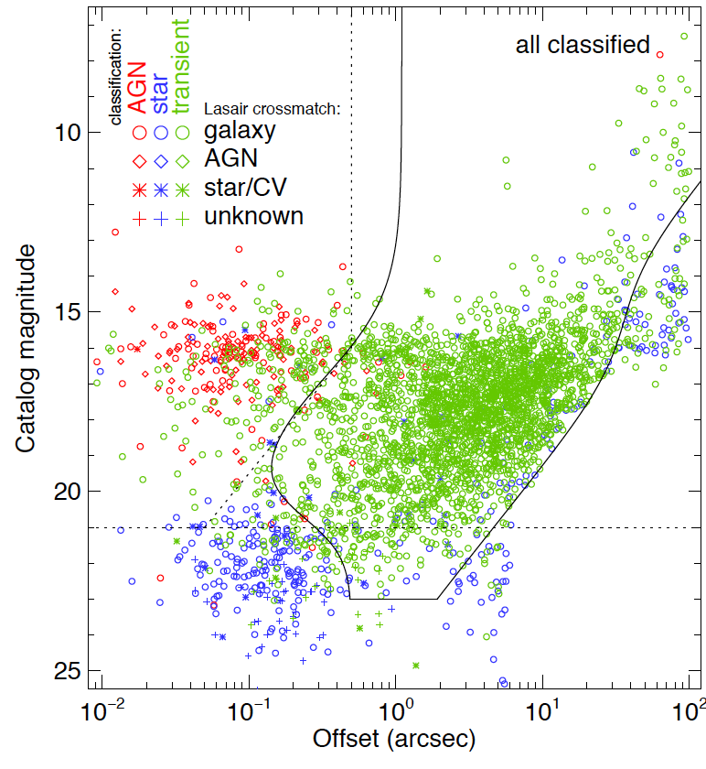
The Statistical Sample: Purity Cut
- or -
pass
suspect AGN
pass
suspect AGN
Fade time (days)
Host magnitude
suspect CV
suspect CV
Rise time (days)
Offset (arcsec)

Slide 11
Classifications to Date
7763 classified transients
3102 in
m<18.5 statistical sample
>95% complete
http://sites.astro.caltech.edu/ztf/rcf/status.php

Slide 12
Classified SN Count (2018-present)
Spectroscopically
m < 19 (incomplete)
7650 supernovae
5581 Ia
incl. 21 Iax, 14 Ia-CSM
385 Ib/c
incl. 26 Ibn, 56 Ic-BL, 64 SLSN-I
1516 II
incl. 106 IIb, 205 IIn, 36 SLSN-II
+ 48 TDEs, + 39 novae
+ 21 "other" (ILRTs, FBOTs, GRBs)
m < 18.5 passing cuts
3055 supernovae
2292 Ia
incl. 9 Iax, 4 Ia-CSM
166 Ib/c
incl. 15 Ibn, 32 Ic-BL, 19 SLSN-I
542 II
incl. 43 IIb, 86 IIn, 10 SLSN-II
+ 11 TDEs, + 25 novae
+ 8 "other"
+ 4347 unclassified (36%)
+ 153 unclassified (5%)

Slide 13
Community-oriented
Filters/follow-up based only on public data, released in real time via brokers
Classifications submitted to TNS immediately
Catalogs served to public via BTS Explorer
→ classification assistance,
public credibility

Slide 14
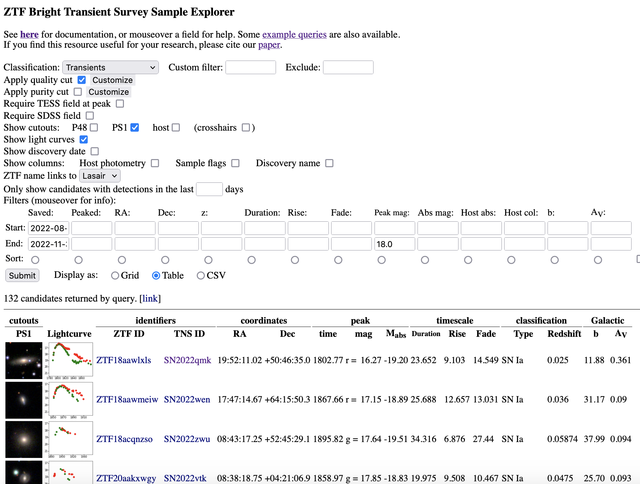
https://sites.astro.caltech.edu/ztf/bts/explorer.php
https://sites.astro.caltech.edu/ztf/rcf/explorer.php

Slide 16
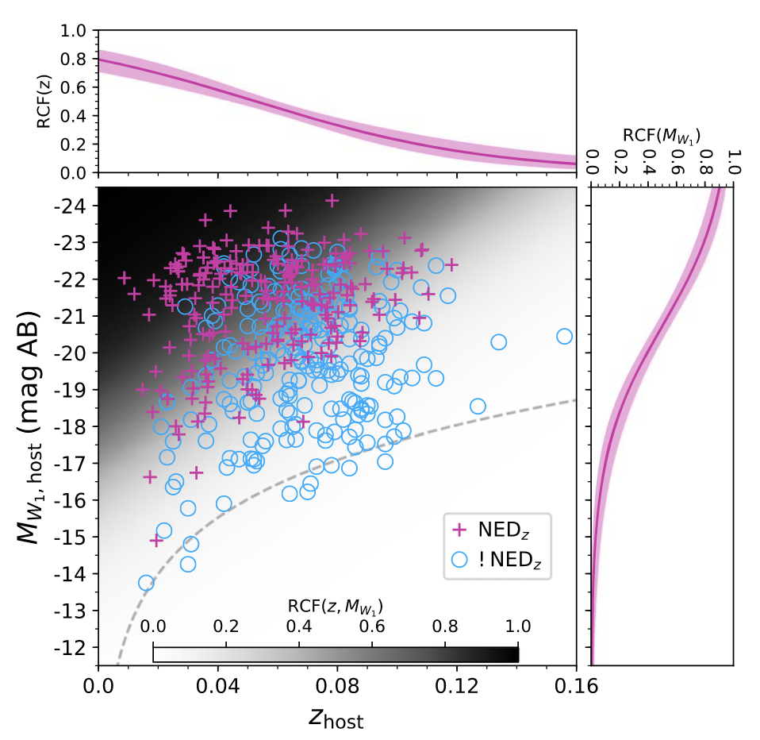
Redshift Completeness Factor
What proportion of transients are in galaxies of known redshift?
63 %
(to z=0.05 / 200 Mpc)
Fremling+2020

Slide 17
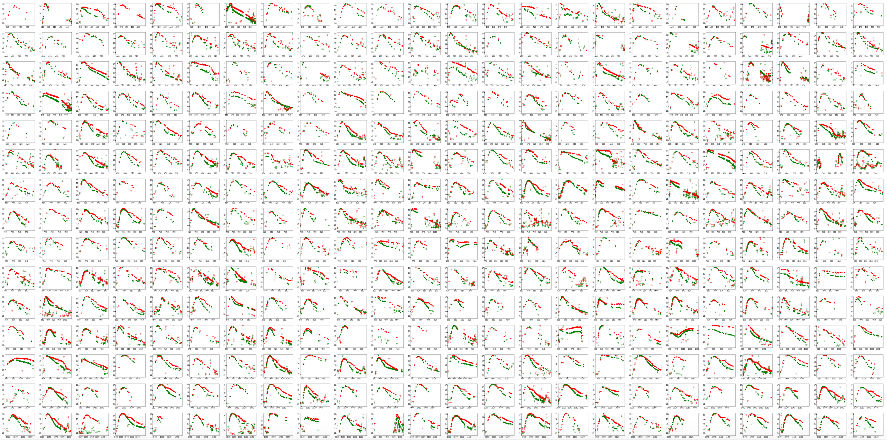
Light Curves Galore

Slide 18
Transient Parameter Space
m < 18.5
m > 18.5
SN Ia
SN Iax
SN II
SN IIb
SN IIn
SN Ibn
SN Icn
SN Ibc
SN Ic-BL
SLSN-I
SLSN-II
TDE
LBV
Ca-rich
ILRT/LRN
FBOT
Nucleosynthesis
Radius /
CSM /
Engine
Velocity
Peak absolute magnitude (AB)
Mass
Opacity
Distance errors
Dust
Rest-frame duration (days)
Perley+2020

Slide 19
Transient Parameter Space
m < 18.5
m > 18.5
"Featureless TDE"
SN Ia
SN Iax
SN II
SN IIb
SN IIn
SN Ibn
SN Icn
SN Ibc
SN Ic-BL
SLSN-I
SLSN-II
TDE
LBV
Ca-rich
ILRT/LRN
FBOT
SLSN-I
SLSN-II
Nucleosynthesis
FBOT
Ibn
Ia
IIn
II
w/SBO
Ib/c
Radius /
CSM /
Engine
Ib/c
II
Velocity
Peak absolute magnitude (AB)
ILRT
Mass
Opacity
Distance errors
nova
Dust
Rest-frame duration (days)
Perley+2020

Slide 20
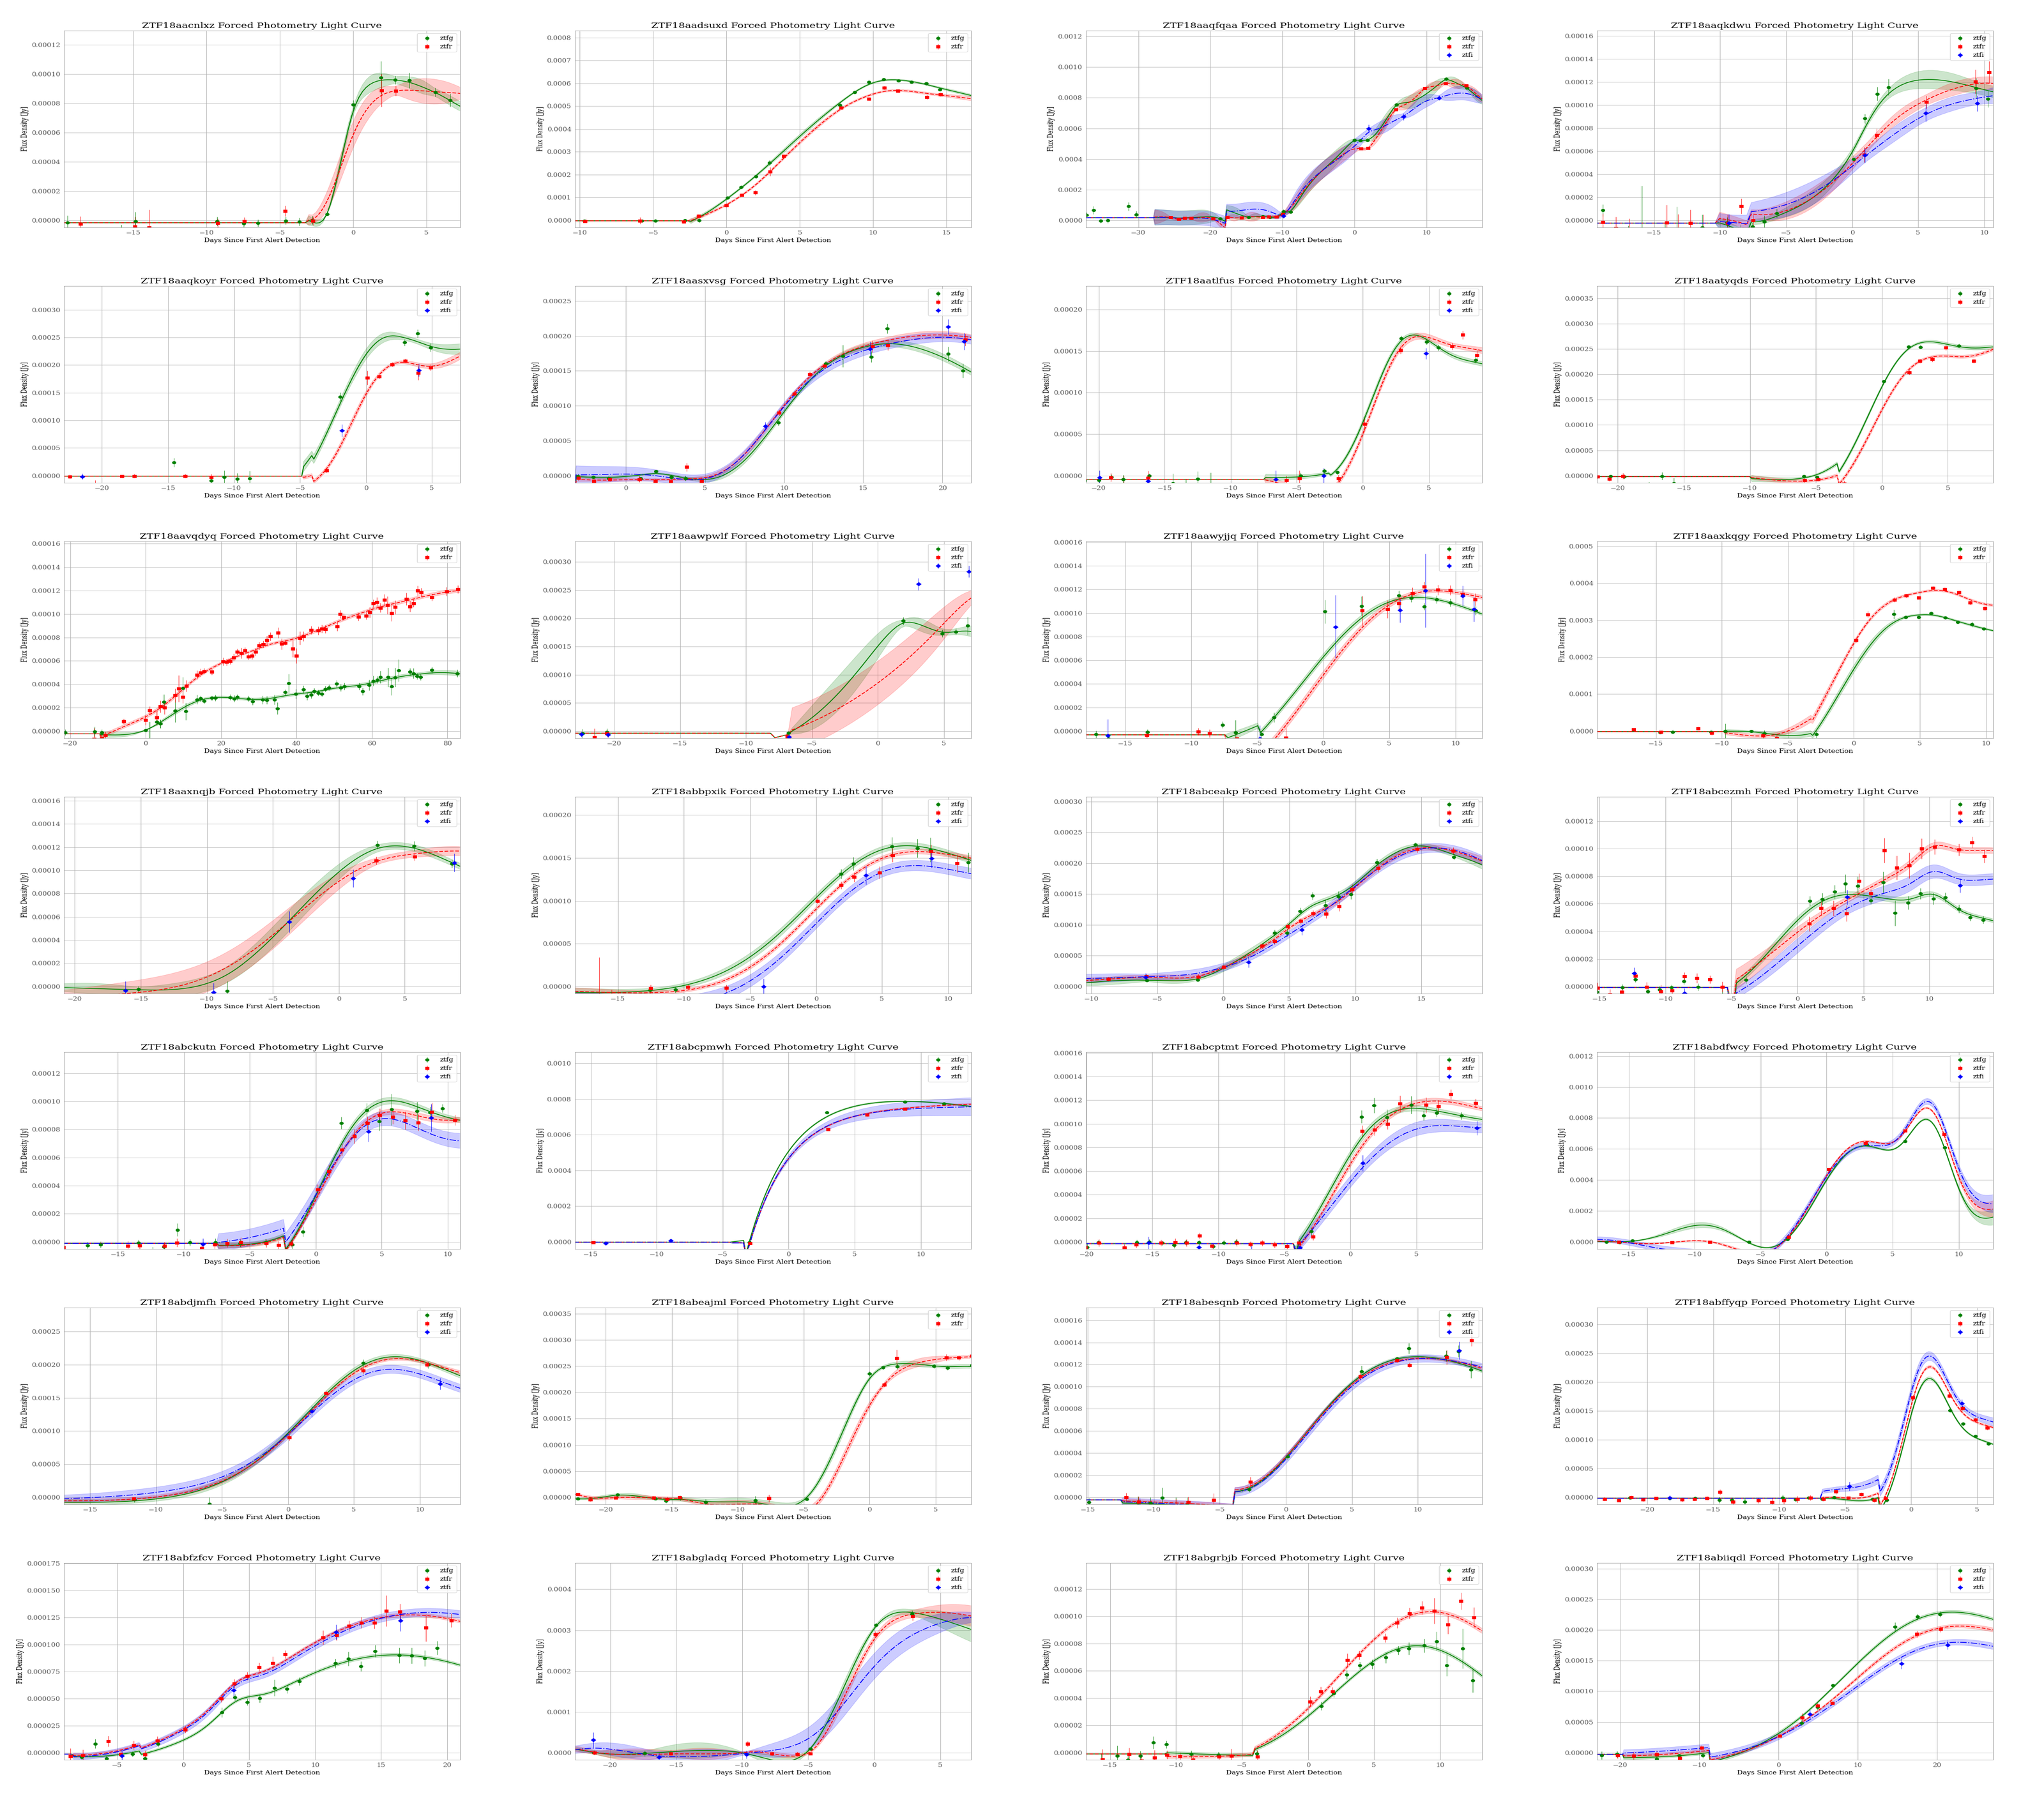
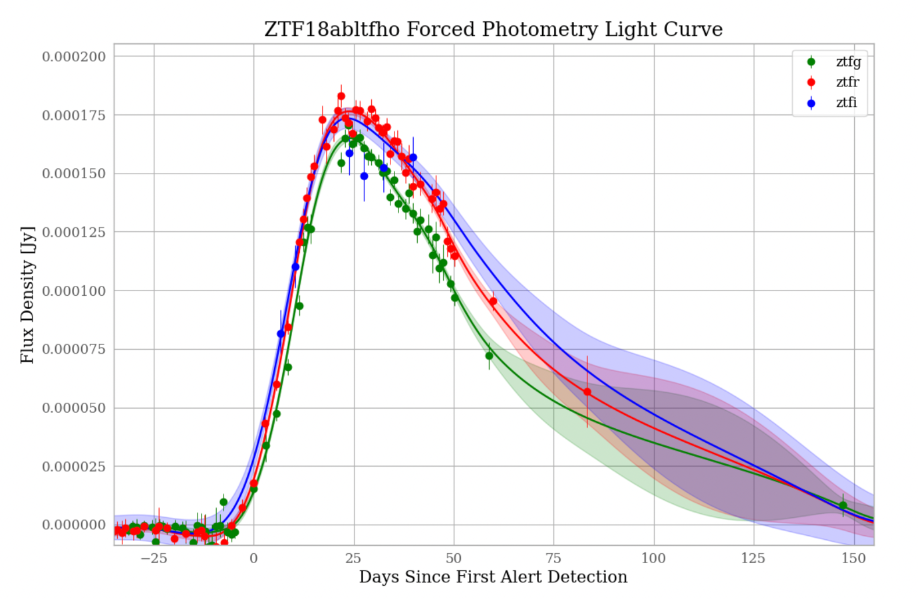
Forced Photometry & GP Regression
Hinds+2023 (in prep)

Slide 21
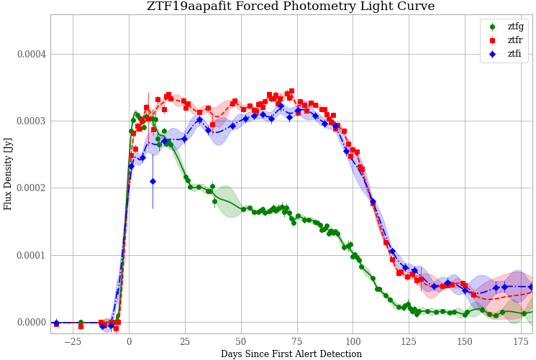
Other Metrics
Peak colours
& lag times
Plateau duration
Peak magnitude/time
Magnitude declines
End of
plateau colour
Fade times
Radioactive tail
Rise times
General colour evolution
Hinds+2023 (in prep)

Slide 22
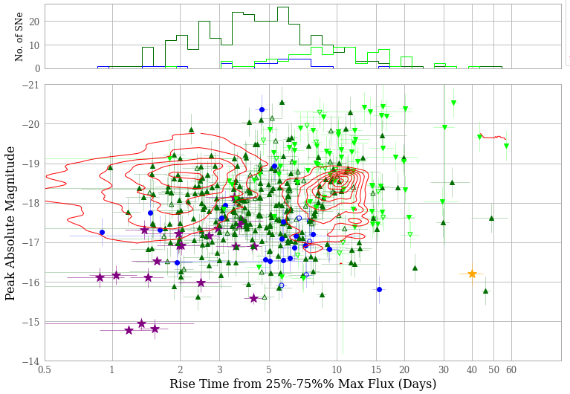
Type II rise time: not bimodal
Hinds+2023 (in prep)

Slide 23
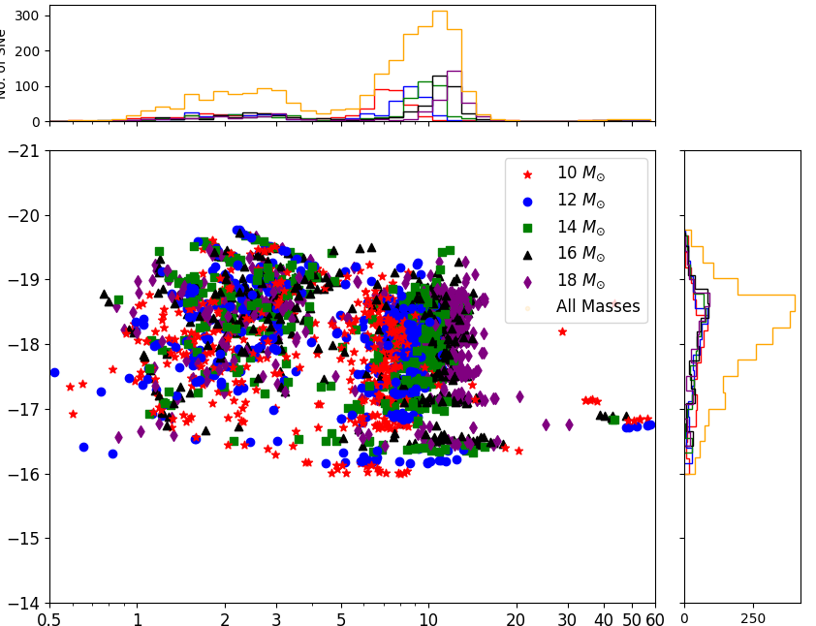
Type II rise time: not bimodal
Hinds+2023 (in prep)
vs Moriya+2023 (prediction)

Slide 24
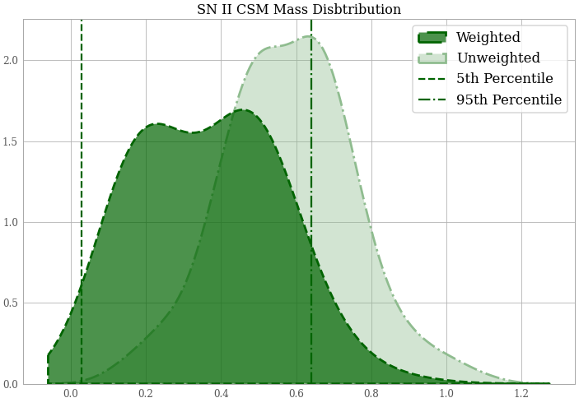
Pre-explosion mass loss is very common
Consistent with
no CSM enhancement
Requires major CSM enhancement
Hinds+2023 (in prep)

Slide 25
Supernova Rates
core collapse total rate
CCSN: 7.3 × 10⁴ Gpc⁻³ yr⁻¹
Ia: 2.4 × 10⁴ Gpc⁻³ yr⁻¹
Ia total rate
Rate (Gpc⁻³ mag⁻¹ yr⁻¹)
Absolute magnitude

Slide 26
CCSN Rates by Subtype
SN II: ~75% of CCSN rate
SN Ib/c: 22% (±6%) of CCSN rate
IIn: 2-5%
Ic-BL: 1-4% (5-20% of Ib/c)
Ibn: 0.05-0.5%
SLSN I: 0.01-0.05%
SLSN II: 0.01-0.03%
Also: Ia-CSM, afterglows, FBOTs,
Icn, kilonovae...

Slide 27
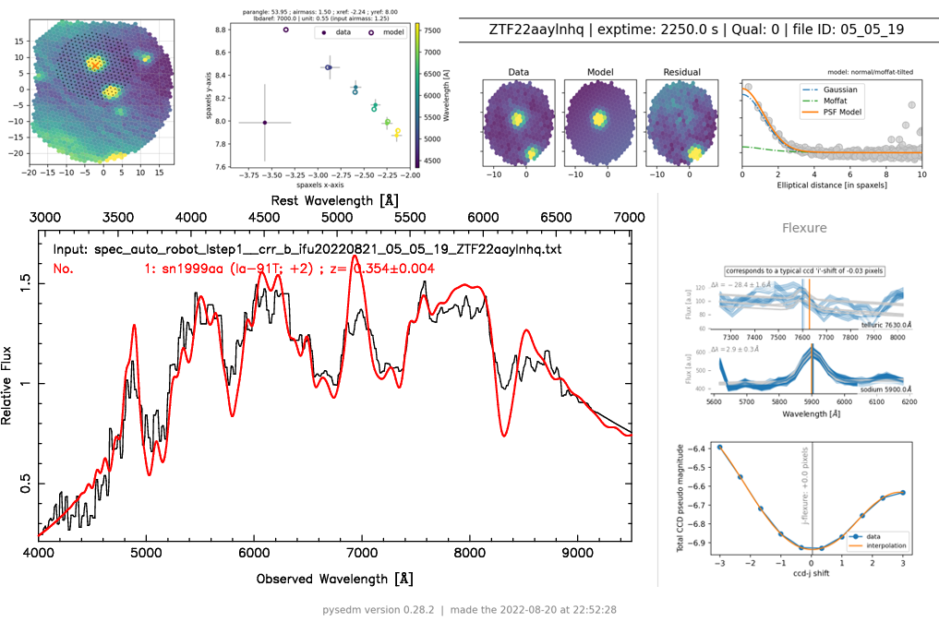
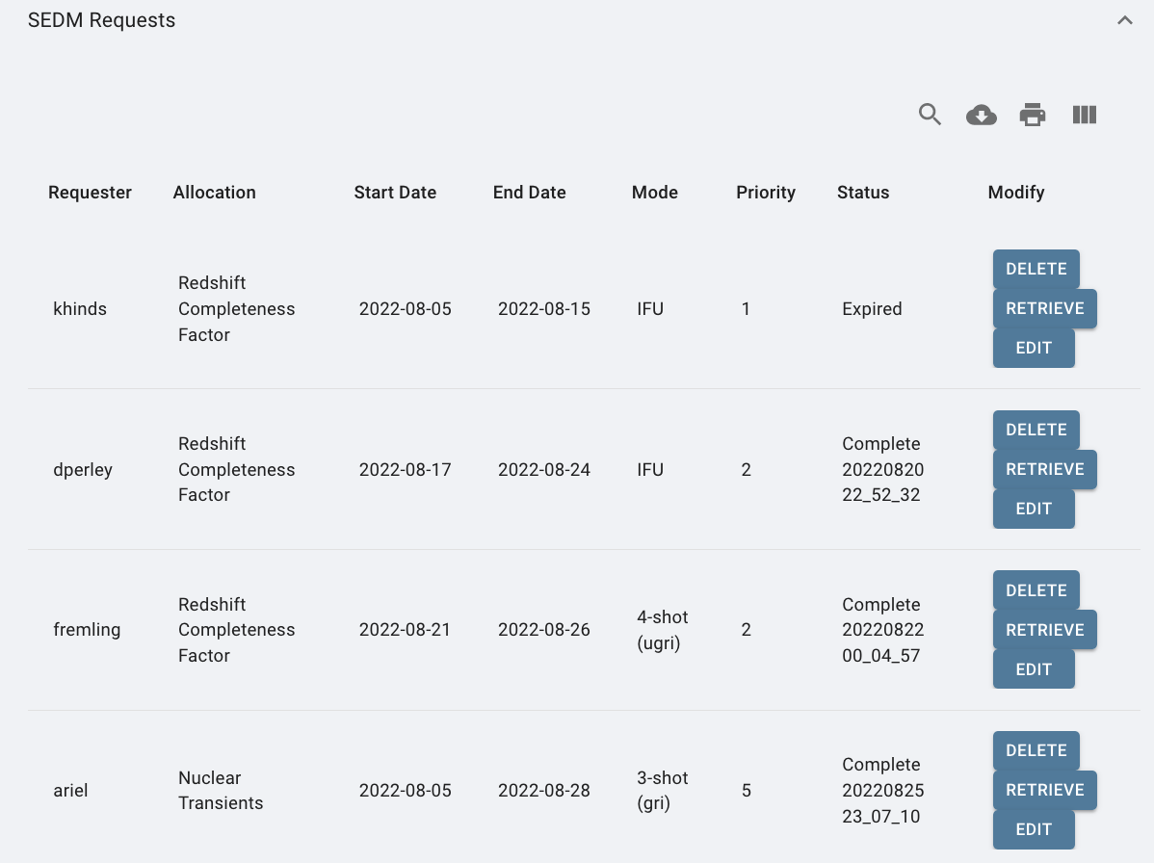
Classify everything → Find rare things!
SN 2022qmx ("Zwicky"): gravitationally lensed Type Ia SN at z=0.35!

Slide 29
Ongoing Efforts
Forced photometry for release
Final spectra, classifications, and redshifts
Improved automation
"Deep Transient Survey":
Scanning/saving all transients to ~20 mag
Host galaxy populations
(Even) more completeness checks

Slide 31
Deep Survey (Real-time)

Slide 32
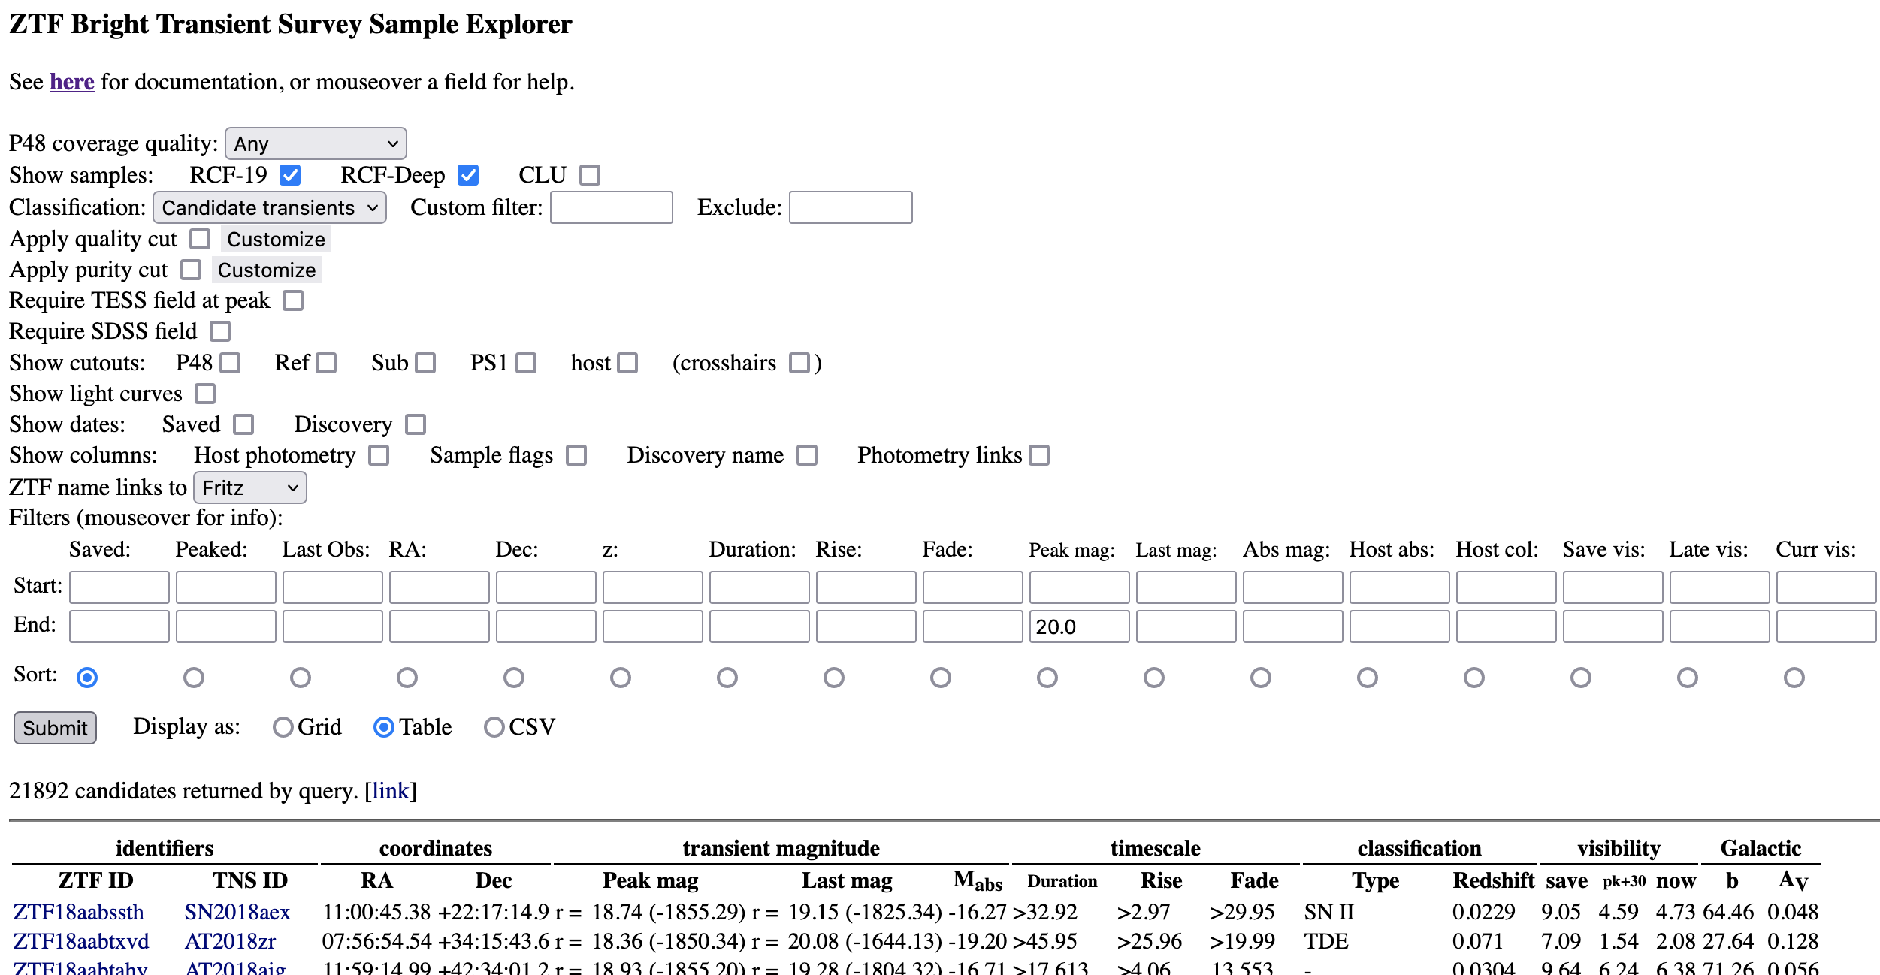
Deep Transient Survey

Slide 33
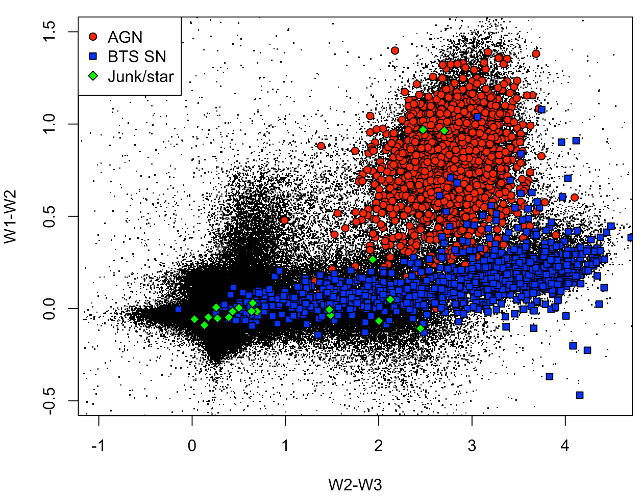
Deep Transient Survey (Retroactive)

Slide 35
Upcoming Opportunities
Synergy with ATLAS (+others)
Stacking, rebuilt references
SEDM2 : Twice the classification capability
DESI : Host galaxy redshifts en masse
ZTF-III : g+r+i-band? 1-night cadence?

