Slide 1
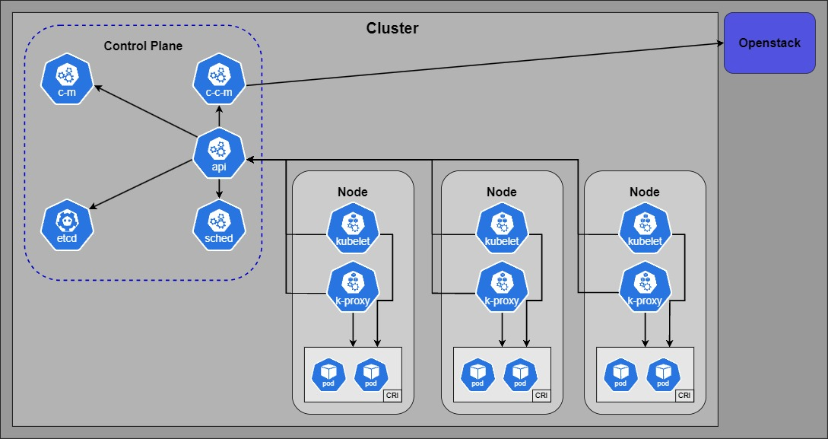
Cluster Architecture
Notes:
OpenStack
is an open-source cloud computing platform that provides Infrastructure as a Service (IaaS)
is designed to be flexible and scalable, enabling organizations to deploy and manage large networks of virtual machines
can provide the virtual machines or bare metal servers on which Kubernetes clusters are deployed
This setup uses OpenStack's capabilities to manage the infrastructure layer
Kubernetes focuses on container orchestration
OpenStack can offer backend services to Kubernetes:
Cinder (Block Storage)
Keystone (Identity Service)
Horizon (Dashboard)
!Gibt noch mehr und wahrscheinlich nutzen wir auch noch mehr, aber das sind die die ich kenne und weiss, dass wir diese nutzen!
Kubernetes
also known as K8s, is an open-source system for automating deployment, scaling, and management of containerized applications
It groups containers that make up an application into logical units for easy management and discovery
can be deployed on top of OpenStack to take advantage of OpenStack's infrastructure services
Services, Deployments, and Volumes are among the key abstractions that Kubernetes uses to manage its resources
These abstractions allow Kubernetes to deploy and manage containerized applications efficiently and flexibly
Kubernetes Structure
Control Plane (Master Node):
The control plane's components make global decisions about the cluster (for example, scheduling)
kube-apiserver(api): The API server is a component of the Kubernetes control plane that exposes the Kubernetes API
etcd: A consistent and highly-available key value store used as Kubernetes' backing store for all cluster data
kube-scheduler(sched): Watches for newly created pods with no assigned node, and selects a node for them to run on
kube-controller-manager(c-m): Runs controller processes, which are background threads that handle routine tasks in the cluster
cloud-controller-manager(c-c-m): Lets you link your cluster into your cloud provider's API, and separates out the components that interact with that cloud platform from components that just interact with your cluster
Worker Nodes (Node):
These machines perform the requested, necessary work
Each node is managed by the control plane and contains the services needed to run pods
kubelet: An agent that runs on each node in the cluster. It makes sure that containers are running in a Pod
kube-proxy: Maintains network rules on nodes. These network rules allow network communication to your Pods from network sessions inside or outside of your cluster
Container Runtime: The software responsible for running containers. Kubernetes supports several container runtimes: Docker, containerd, CRI-O, and any implementation of the Kubernetes CRI (Container Runtime Interface)
CRI (Container Runtime Interface): is the main protocol for the communication between the kubelet and Container Runtime
Pod:
are the smallest deployable unit of computing that can be created and managed in Kubernetes
is a group of one or more containers, with shared storage/network, and a specification for how to run the containers
Deployment and Management in Kubernetes(example web application):
Once the application components are containerized, they are deployed and managed in Kubernetes using several key resources:
Deployments:
manage the deployment and scaling of a set of replicas of your application containers
You would typically have separate deployments for the frontend and backend components of your web application
Deployments ensure that a specified number of pod replicas are running at any given time
Services:
Kubernetes Services provide stable endpoints for accessing the pods
A service enables network access to a set of pods, regardless of which nodes they are on or how many there are
For a web application, you might have one service for the frontend, allowing users to access the web UI through a browser, and another for the backend, through which the frontend communicates
Ingress:
An Ingress is a Kubernetes resource that manages external access to the services within the cluster, typically HTTP
Ingress can provide load balancing, SSL termination, and name-based virtual hosting for a web application
ConfigMaps and Secrets:
These Kubernetes resources store configuration data and sensitive information
For example, the database connection string might be stored in a Secret, while application configuration like feature toggles could be stored in a ConfigMap
Persistent Volumes (PV) and Persistent Volume Claims (PVC):
For stateful components like MongoDB, Kubernetes uses PVs and PVCs to manage durable storage
This ensures that the database retains its data across pod restarts and deployments

Slide 2
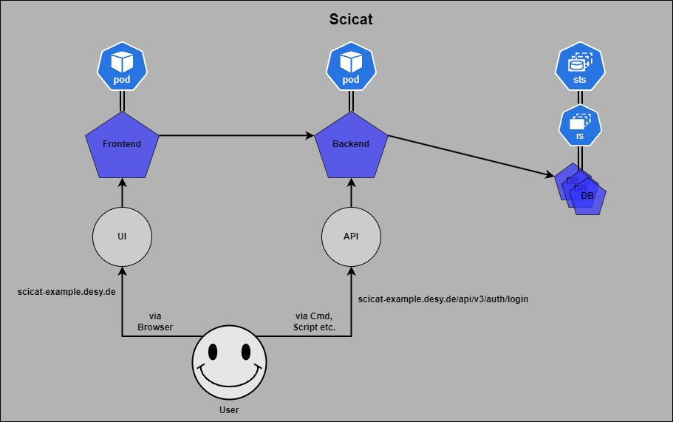
Scicat in K8s
Notes:
Scicat
Running in a Kubernetes cluster
Scicat instances separated in Kubernetes in namespaces 1 namespace = 1 Scicat instance
Inside an instance are running pods for each different part of Scicat, mongoDB running as a StatefulSet
Frontend:
Deployed in a Pod
The user interface of the web application, built with Angular, is containerized
This means packaging the frontend application and its runtime environment into a Docker container image
Backend:
Deployed in a Pod
The server-side logic, written in Nest.js, is also containerized in its own Docker image.
This component handles client requests, processes application logic, and interacts with the MongoDB database
MongoDB:
Deployed in a StatefulSet with a ReplicaSet of 3
The database can be run in a container as well, or alternatively, it can be deployed using Kubernetes StatefulSets or a managed database service that is accessible within the Kubernetes cluster
StatefulSets:
are specifically designed to manage stateful applications like databases
Deploying MongoDB using a StatefulSet provides several advantages:
Stable Network Identity:
StatefulSet ensures that each MongoDB instance (pod) has a stable hostname and network identity
This stability is crucial for MongoDB replica sets, as each member must have a consistent identity for replication and failover processes
Persistent Storage:
StatefulSets automatically manage Persistent Volumes according to the specified Persistent Volume Claims
This ensures that each MongoDB pod has its own dedicated storage that persists across pod restarts and rescheduling, maintaining data integrity
Ordered, Graceful Deployment and Scaling:
StatefulSets deploy and scale pods in a predictable order
For MongoDB, this means that you can control the order of replica set initialization and scaling, which is important for maintaining the replica set configuration and ensuring data consistency
Automated Rollouts and Rollbacks:
Updates to StatefulSets, including container image updates and configuration changes, are handled gracefully, ensuring that the MongoDB cluster remains available and consistent during updates

