Slide 1
ARES Operation Meeting
Summary of week 07 / 2024
Max Kellermeier, on behalf of the ARES crew

Slide 2
Summary of week 07
Mon. 12th Feb | Tue. 13th Feb | Wed. 14th Feb | Thu. 15th Feb | Fri. 16th Feb
MVS: installation of new Baseplate assembly MKK3: preparations for ventilation system (removal of yellow fence) MEA2: laser interlock panel checked MKK2: replacement of water valves/filters at RF stations | MVS: de-assembly of clean room tent MEA: EA laser table put back in place Hexapod movements thoroughly tested Re-cabling of EA chamber diagnostic | MVS: Conditioning of leakage pump on EA chamber | UV photocathode laser alignment on Beam pointing stabilizer | UV laser on beam pointing stabilizer established Beam-based Laser-on-cathode alignment improved Gun phase stability over night
Glass capillary broke during installation → replaced, but fragments remain in chamber | EA LED periodically lights up, unintended |  |  | 11:15 water flow too low for TWS1 RF station 12:50 DIO1 does not switch on Temp and Humidity Servers off partially
MCS: Windows updates on BKR machines |  | Visit by Beate Heinemann Reference Phase Tracking for Gun enabled
Achievements
Difficulties
Notes

Slide 3
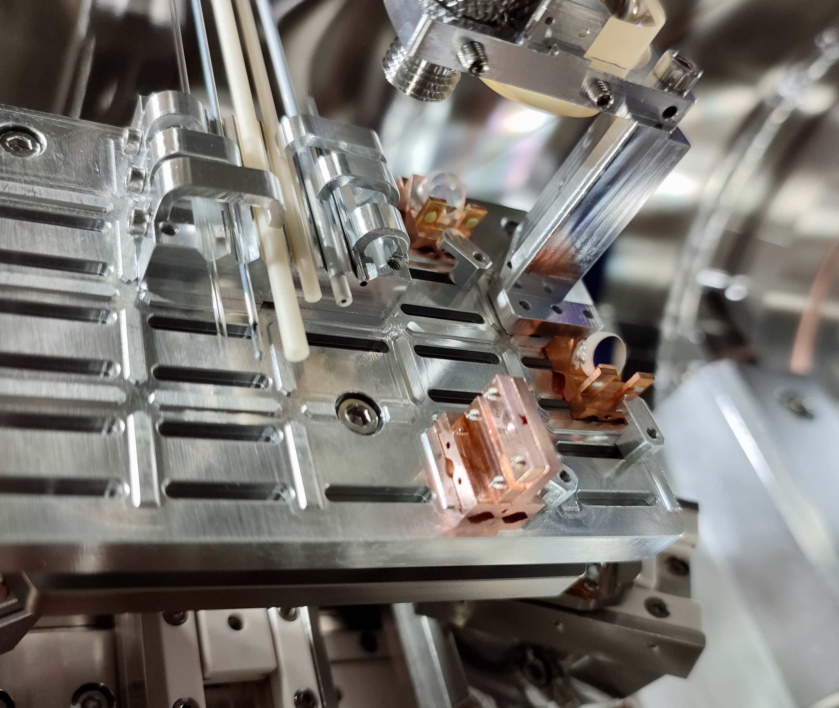
New Baseplate Installed

Slide 4
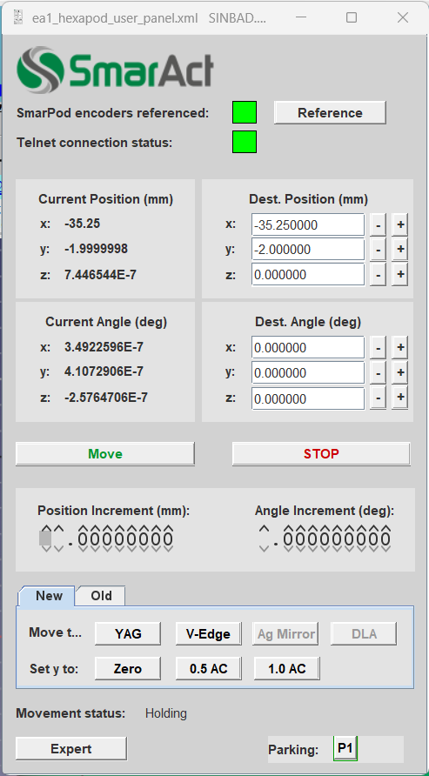
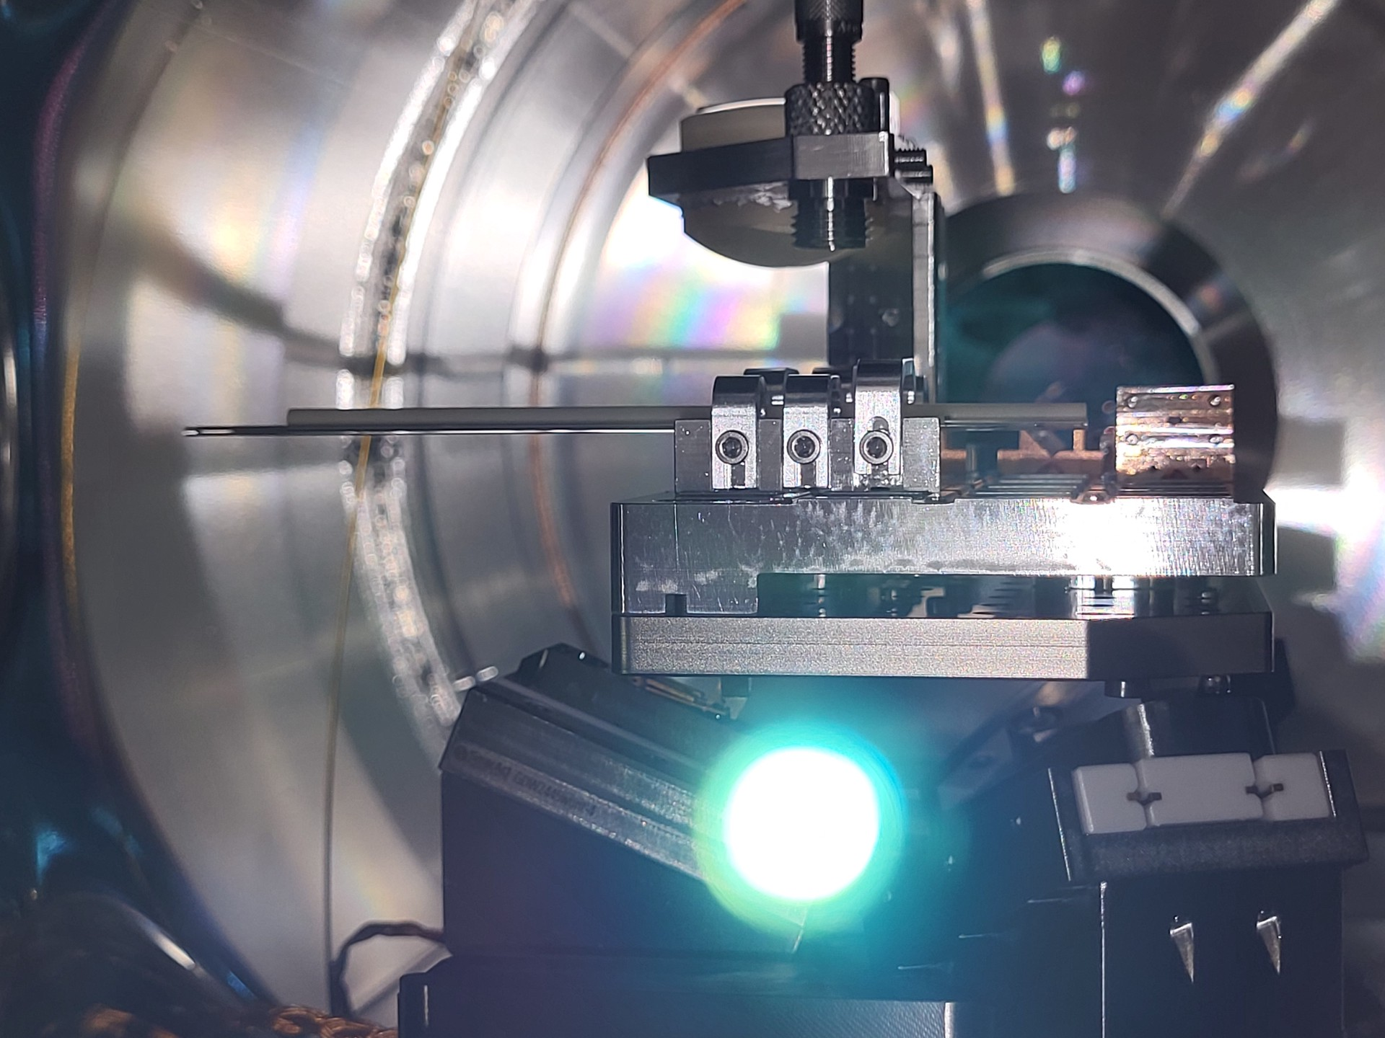
New Pre-defined Hexapod Positions

Slide 5
UV beam on virtual cathode cam

Slide 6
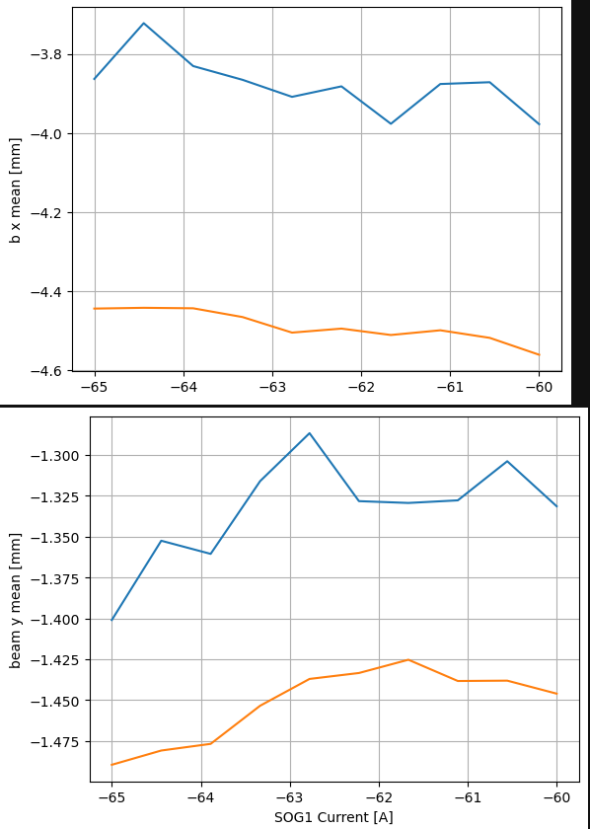
Beam based alignment of UV cathode laser
Adjusting BPS picomotors
On LI.R1
Before
After

Slide 7
Schedule and Plan for the Week
Week 08
Date | Shift Crew
19.02. | Max, Frank
20.02. | Thomas, Max (morning)
21.02. | Thomas, Max
22.02. | Thomas, Hannes
23.02. | Thomas, Max
Mon: Petra IV
Tue – Fri, KW 09: TWAC
If you want to learn or join the shift: please give the shift leader a call (BKR 2840 / SINBAD Box 2454)

