Slide 1
Follow-Up: Discussion about CSI for MAGO
New block diagram
SEL / GDR ?
21.02.2024

Slide 2
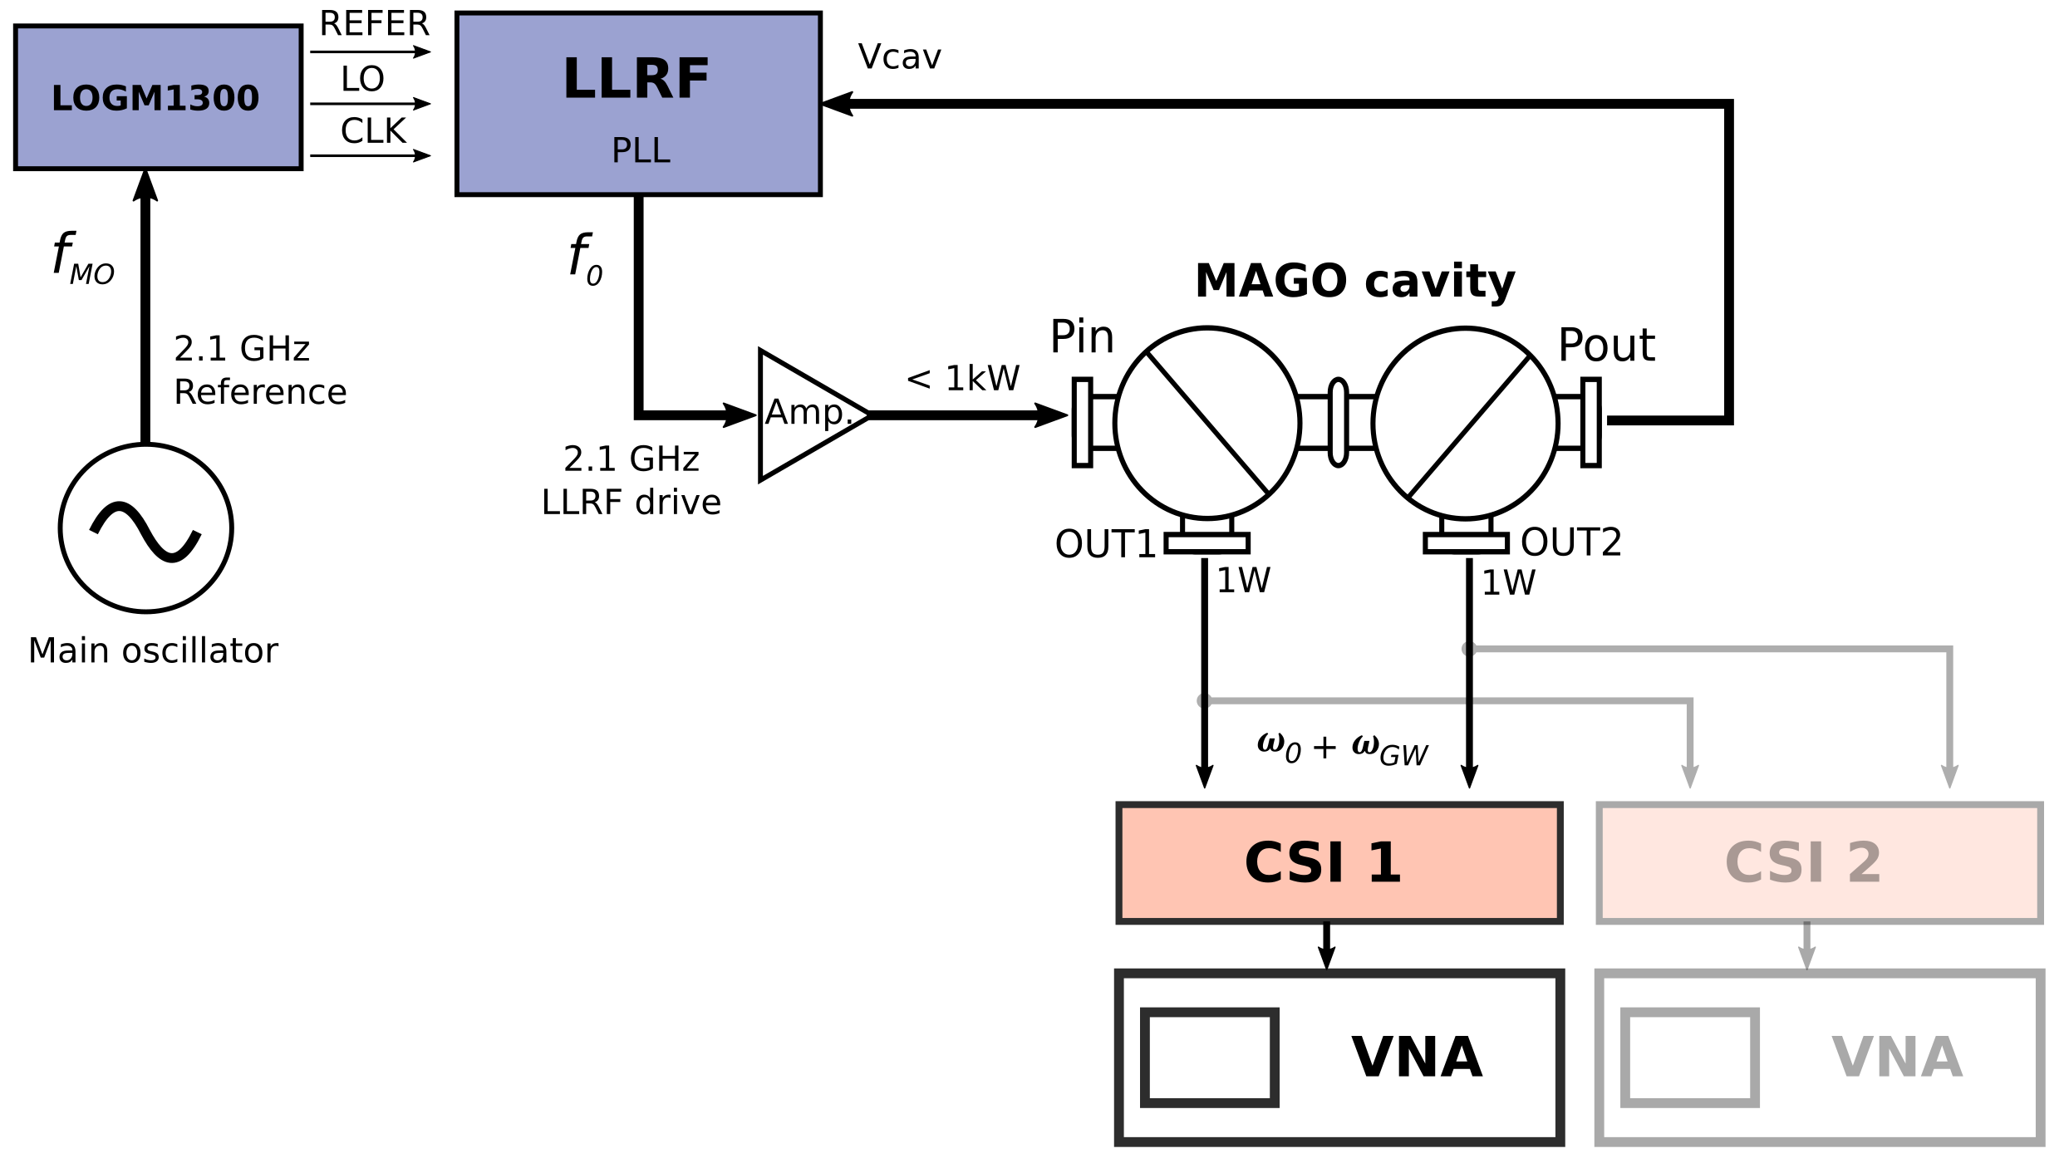
Latest Block Diagram

Slide 3
Block diagram suggestions/questions
phase feedback
spectrum analysis
use phase from CSI as PLL feedback to prevent CSI drift effects (Uros)
Carrier is missing at CSI output –> commercial devices will not work, use LLRF for spectrum analysis
CSI is not part of the control loop -> wasted potential?

Slide 4
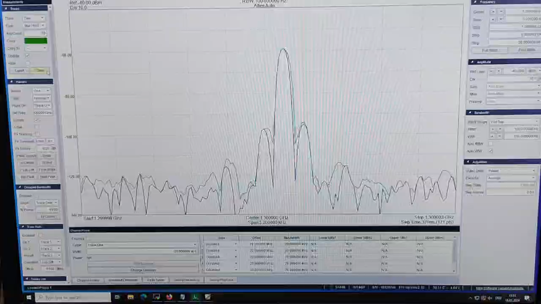
CSI with SEL?
Spectrum Analyzer, Span 5 kHz
LLRF
CSI
distortion from
neighboring lab
Ref
RF in
SMF100A
1300 MHz
SMB100A
1300 MHz f_mod=100 Hz
P_mod=0.1 Hz
SEL simulation
SMB100B 10 MHz
Check carrier suppression behavior -> setup shows slight frequency dependency
Measurements show questionable results without active modulation -> too many signal sources?
With modulation no measurement results achievable at the moment -> calibration routines fail

Slide 5
CSI with SEL?
Spectrum Analyzer, Span 5 kHz
VM
LLRF
CSI
distortion from
neighboring lab
Ref
RF in
SMF100A
1300 MHz
SMB100A
1300 MHz f_mod=100 Hz
P_mod=0.1 Hz
SEL simulation
SMB100B 10 MHz
Check carrier suppression behavior -> setup shows slight frequency dependency
Measurement result show questionable results without active modulation -> too many signal sources?
With modulation no measurement results achievable at the moment
Vector modulator output with modulation as probe and reference signal

Slide 6
Back-Up

Slide 7
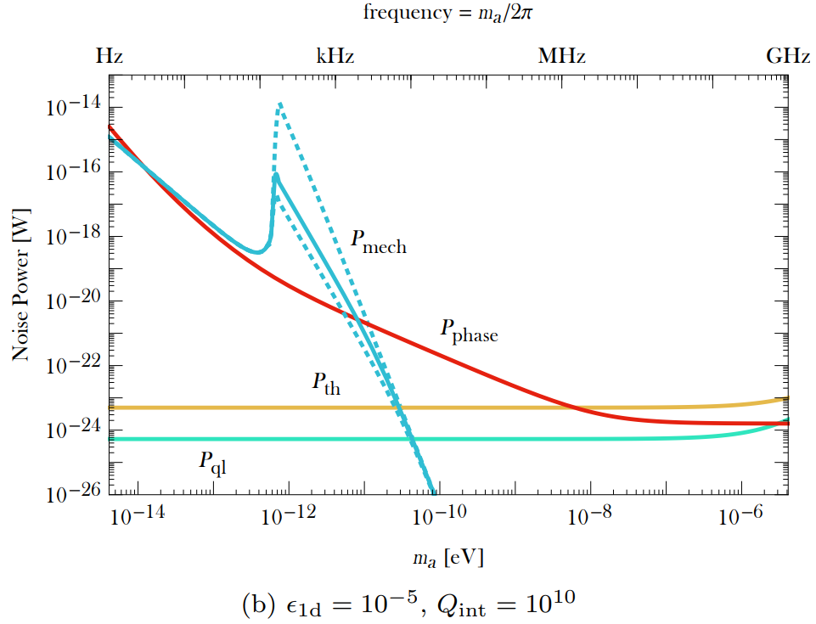

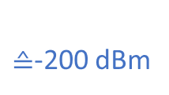




$$P_{dBm}=10\log_{10}{(1000∗P_{W} / 1W)}$$
thermal limit ≙-174 dBm
$${10}^{−21}$$
$≙$-200 dBm
For frequency resolution:
$$\tan{φ ≈2 Q_{L}\frac{∆ω}{ω}}$$
$${10}^{−23}$$
-> $∆f≈$2e-5 Hz (with $Q_{L}=10e7$)
Source: Axion Dark Matter Detection by Superconducting Resonant Frequency Conversion, Berlin et. al

