Slide 1
Heat load at the ILC positron target and collimator system
O. S. Adeyemi¹, V. Kovalenko¹, G. Moortgat-Pick^{1;2}
L. Malysheva^{1,} S. Riemann², F. Staufenbiel², A. Ushakov¹
¹University of Hamburg
²DESY
- methods for positron production
- temperature simulations in a photon collimator system
- temperature simulations in the ILC positron target region
- conclusion
F.Staufenbiel / 15.7.11 / 2.LC Forum

Slide 2
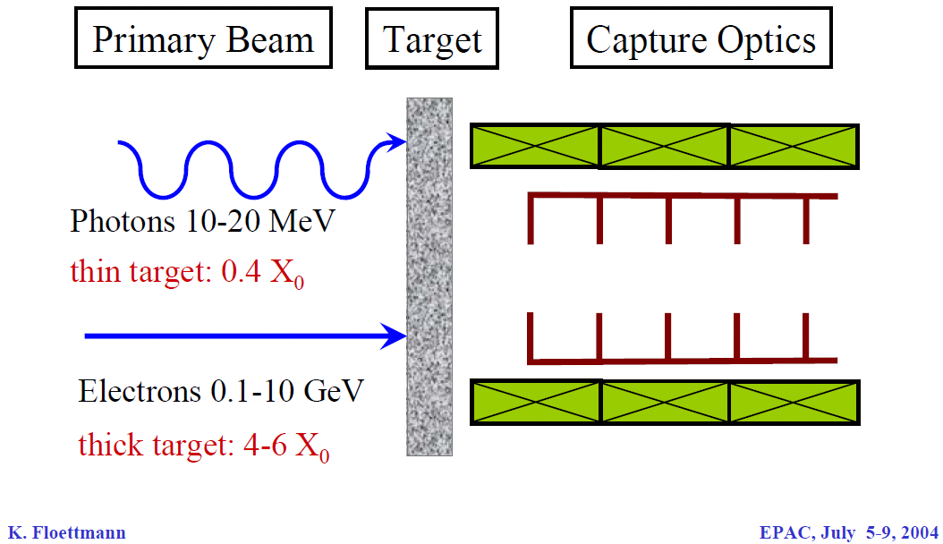
polarised positron production
what we want to have !
2*10¹⁰ e⁺ /bunch at IP
2625 bunch /train (0.97ms)
5 train /s
photon source
e⁺ polarisation possible
conventional source
no e⁺ polarisation!
F.Staufenbiel / 15.7.11 / 2.LC Forum

Slide 3
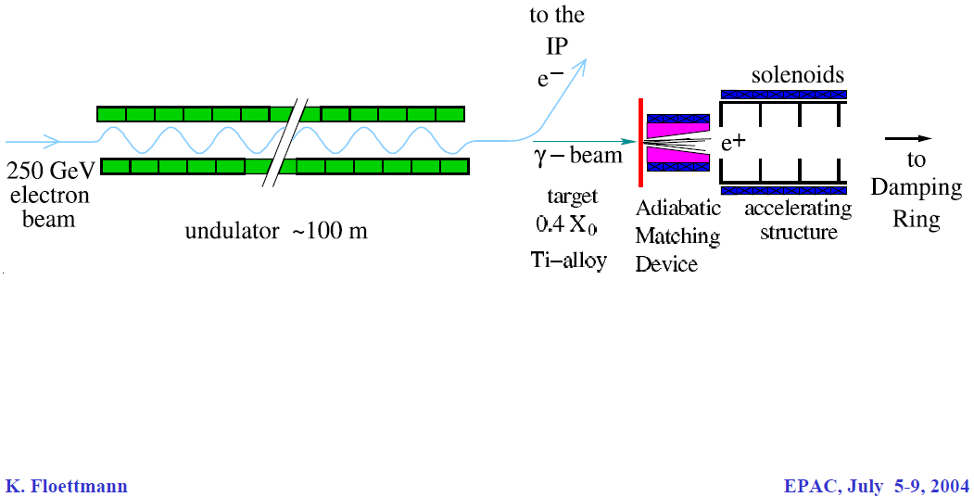
polarised positron production
what we want to have !
2*10¹⁰ e⁺ /bunch at IP
2625 bunch /train (0.97ms)
5 train /s
F.Staufenbiel / 15.7.11 / 2.LC Forum

Slide 4
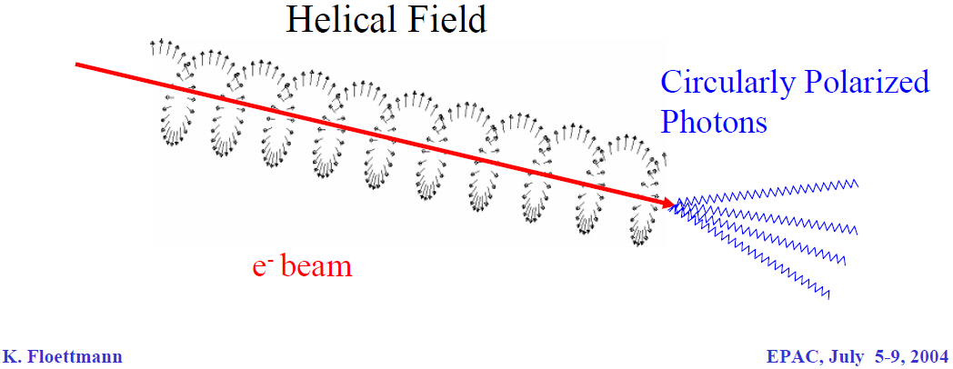
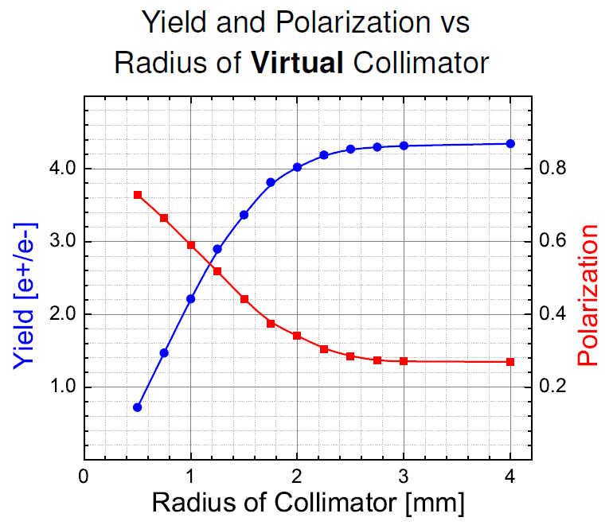
polarised positron production
collimator
 | Pe+ | Yield [e+/e-]
no collimator | 27 % | 4.4 (100%)
2 mm | 35 % | 4.0 (91%)
1.4 mm | 47 % | 3.2 (73%)
1.0 mm | 60 % | 2.2 (50%)
F.Staufenbiel / 15.7.11 / 2.LC Forum

Slide 5
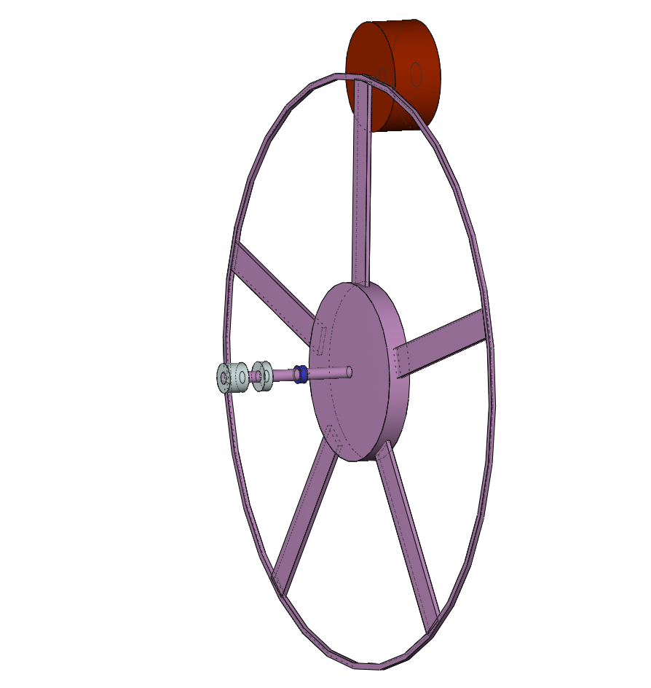
modelling the ILC-target unit
2*10¹⁰ e⁻ / bunch = 3.2 nC / bunch
2625 bunch / train (0.97ms) = 2.7062 MHz repetition rate
5 train / s
-> 4.6*10¹⁵ photon / train
Titan target for polarised positron production
~ 14.4 MeV e⁺
250 GeV e⁻
~ 28.8 MeV photon beam
helical undulator
distribution of
heat load !!
v_{rim} = 100 m/s
( 955 rpm = 15.9Hz )
r
r = 1 m
F.Staufenbiel / 15.7.11 / 2.LC Forum

Slide 6
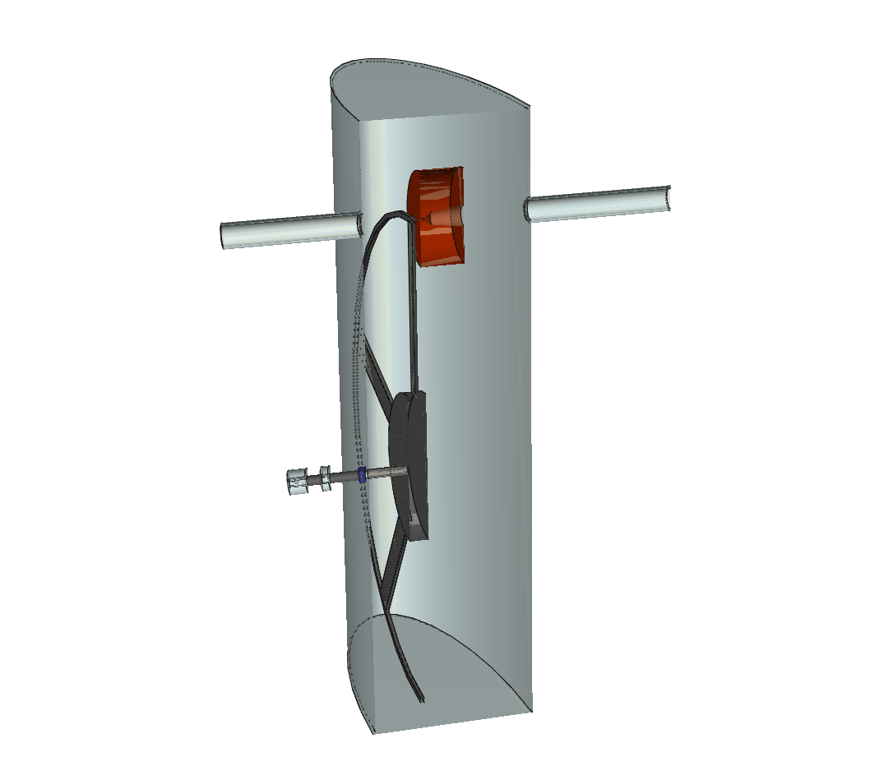
modelling the ILC-target unit
flux concentrator
beam pipe
~ 28.8 MeV photon beam
bearing
chamber
motor
d₁ = 1.0 cm , l₁ = 5.0 cm
d₂ = 5.0 cm , l₂ = 3.0 cm
d₃ = 8.0 cm , l₃ = 12.5 cm
vacuum seal
F.Staufenbiel / 15.7.11 / 2.LC Forum

Slide 7
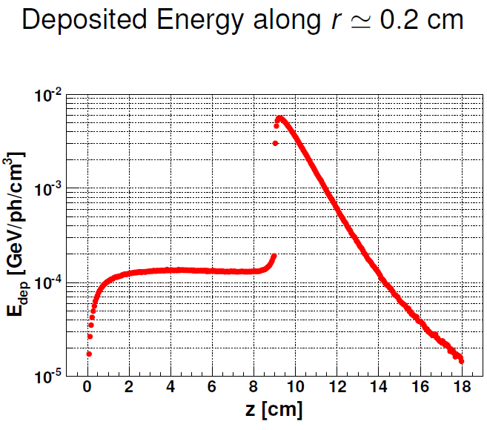
Δ Q
flux concentrator
~
T_{W} = 1800 K / train
m c_{v}
~
beam pipe
C W
collimator
~ 28.8 MeV photon beam
r = 0.1 cm -> _____ K / train
14 000
???
this is to much !!
bearing
chamber
motor
vacuum seal
F.Staufenbiel / 15.7.11 / 2.LC Forum

Slide 8
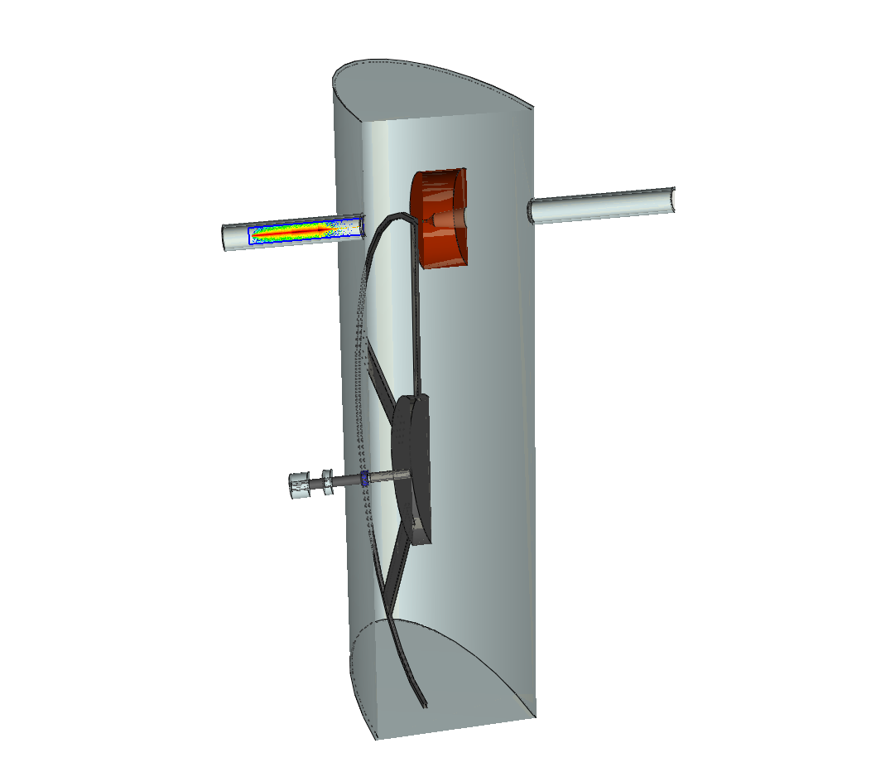
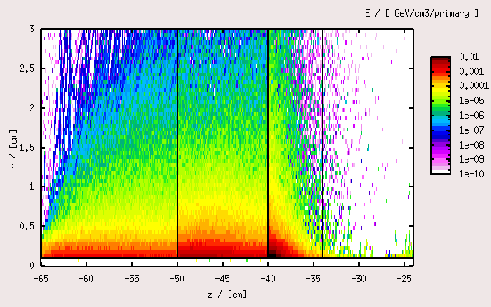
modelling the collimator
C Ti W
r = 0.1 cm
~
Δ T_{C} 500 K / train
~
~
Δ T_{Ti} 1300 K / train
~
~
Δ T_{W} 3600 K / train
~
but this is still to much !!
F.Staufenbiel / 15.7.11 / 2.LC Forum

Slide 9
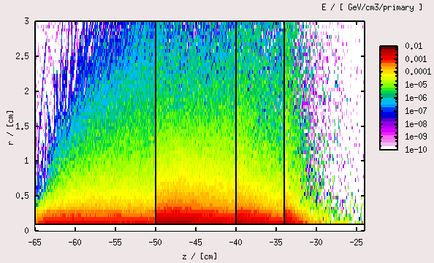
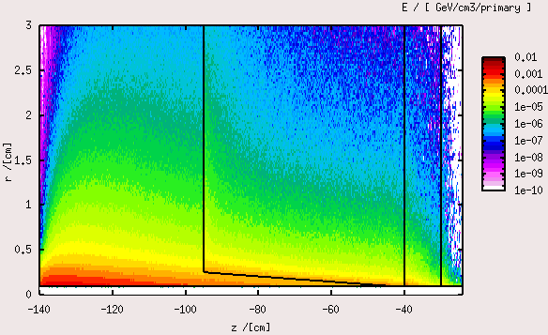
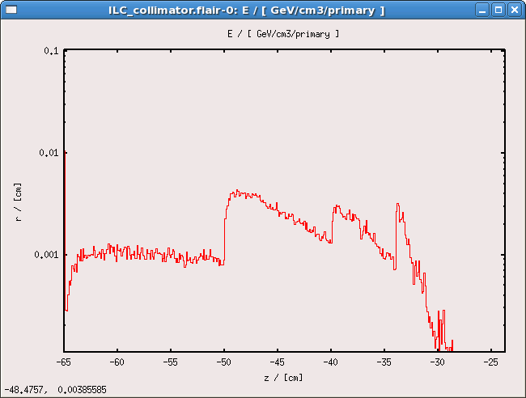
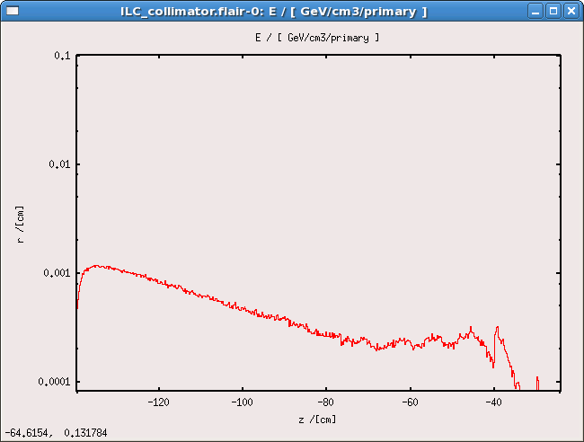
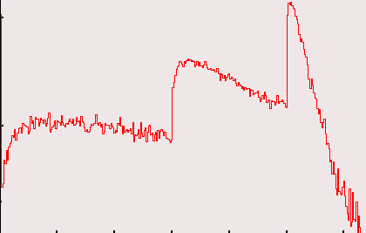
modelling the collimator
C Ti Fe W
C Ti Fe W
C Ti W
r = 0.1 cm
~
z = 1.2 m
Δ T_{C} 500 K / train
~
~
-> 40 K / train
Δ T_{Ti} 1300 K / train
~
~
-> 40 K / train
Δ T_{Fe} 600 K / train
~
~
-> 20 K / train
Δ T_{W} 900 K / train
~
~
Δ T_{W} 3600 K / train
~
F.Staufenbiel / 15.7.11 / 2.LC Forum

Slide 10
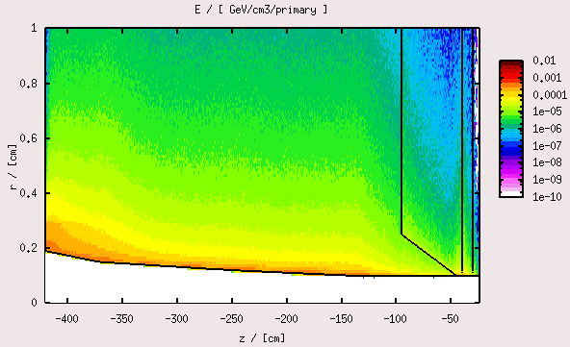
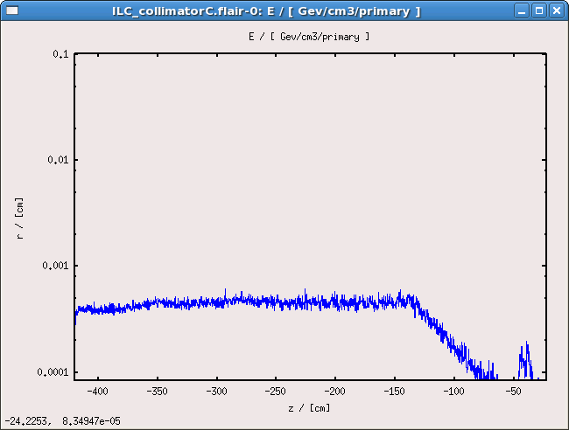
modelling the collimator
C Ti
r = 0.1 cm
~
-> 200 K / train
z = 1.2 m
Δ T_{C} 500 K / train
~
~
-> 40 K / train
z = 4.0 m
Δ T_{Ti} 1300 K / train
~
~
-> 40 K / train
Δ T_{Fe} 600 K / train
~
~
-> 20 K / train
Δ T_{W} 900 K / train
~
F.Staufenbiel / 15.7.11 / 2.LC Forum

Slide 11
modelling the collimator
300K
l = r – r₀
C Ti Fe W
r = 0.1 cm
800K
z = 1.2 m
~
-> 200 K / train
Δ T_{C} 500 K / train
~
~
-> 40 K / train
Δ T_{Ti} 1300 K / train
~
~
-> 40 K / train
Δ T_{Fe} 600 K / train
~
~
-> 20 K / train
Δ T_{W} 900 K / train
~
.
λ_{C} A ΔT
Q_{C} =
l
λ : heat conduction coefficient [W/m/K]
A_{zyl} : mean girthed area of the collimator [m²]
l : heat conduction path length [m]
ΔT : difference in temperature [K]
.
Q : heat current
F.Staufenbiel / 15.7.11 / 2.LC Forum

Slide 12
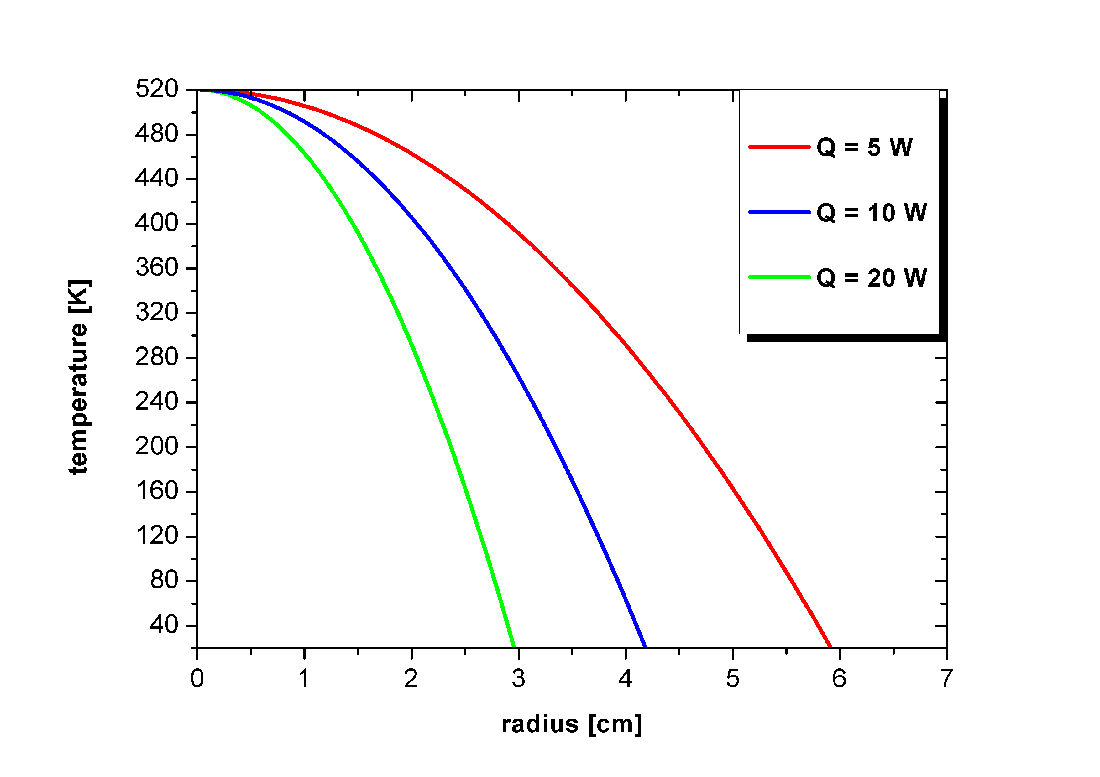
modelling the collimator
z = 1.0 cm
.
.
.
r = 0.1 cm
.
λ_{C} A ΔT
zyl.
λ_{C} 2π ( r-r₀ ) z ΔT
Q_{C} =
l
=
ln( r / r₀ )
λ : heat conduction coefficient [W/m/K]
A_{zyl} : mean girthed area of the collimator [m²]
l : heat conduction path length [m]
ΔT : difference in temperature [K]
.
Q : heat current
F.Staufenbiel / 15.7.11 / 2.LC Forum

Slide 13
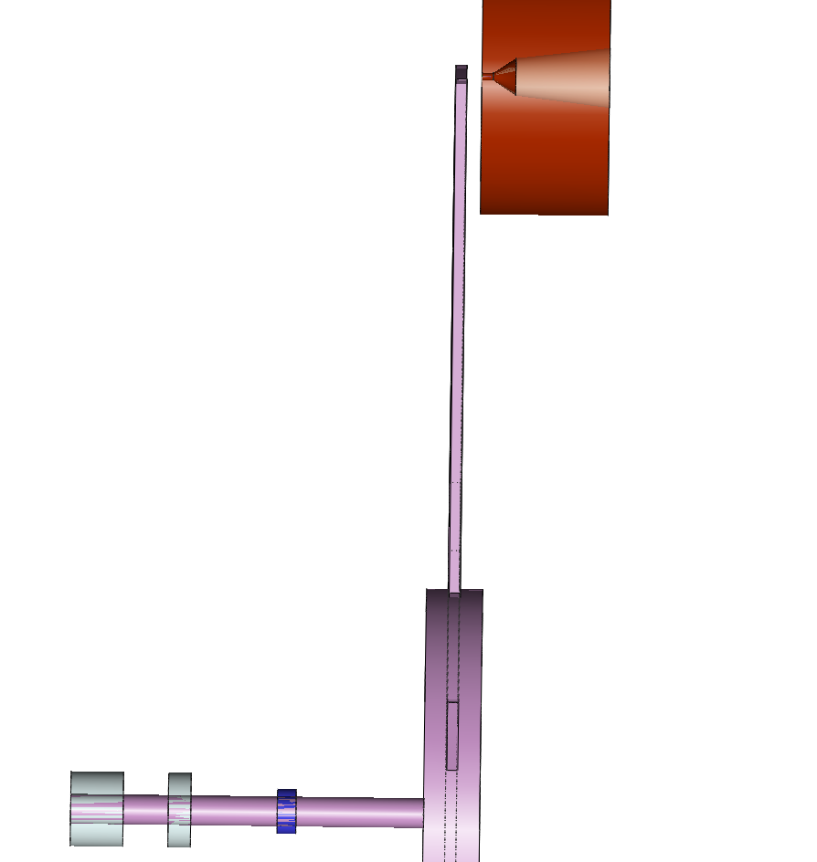
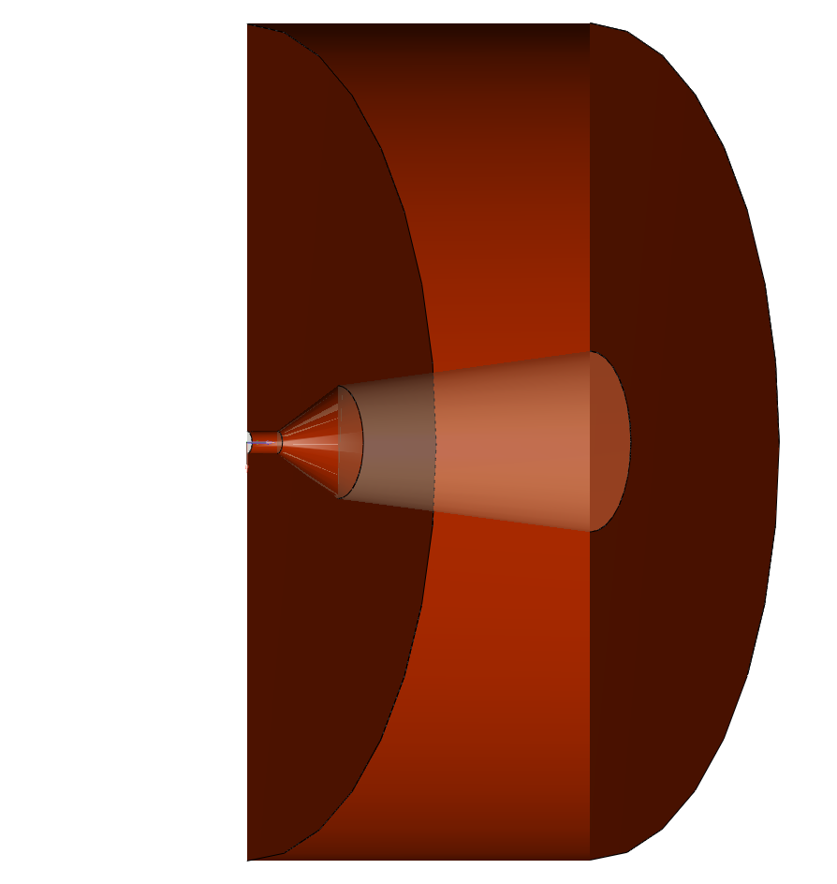
modelling the flux concentrator
2.0 cm
m
b
s
l₁
a b c d
d₁
d₂
d₃
l₂
l₃
d₁ = 1.0 cm , l₁ = 5.0 cm
d₂ = 5.0 cm , l₂ = 3.0 cm
d₃ = 8.0 cm , l₃ = 12.5 cm
F.Staufenbiel / 15.7.11 / 2.LC Forum

Slide 14
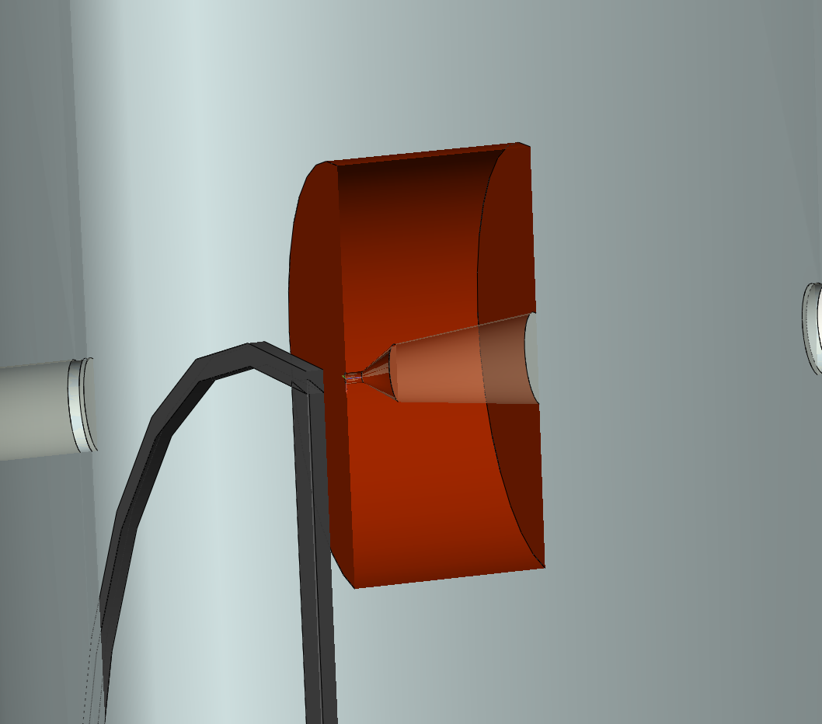
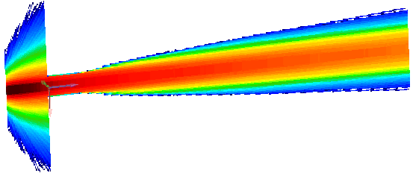
~ 130 K / train
|
2.0 cm
-
POSITRON beam
Q_{Ti target}
~
6 kW / train
~
1.5 cm
v_{rim} = 100 m/s
-> 50 pulses hits in
the same position
tungsten collimator
for flux concentrator
F.Staufenbiel / 15.7.11 / 2.LC Forum

Slide 15
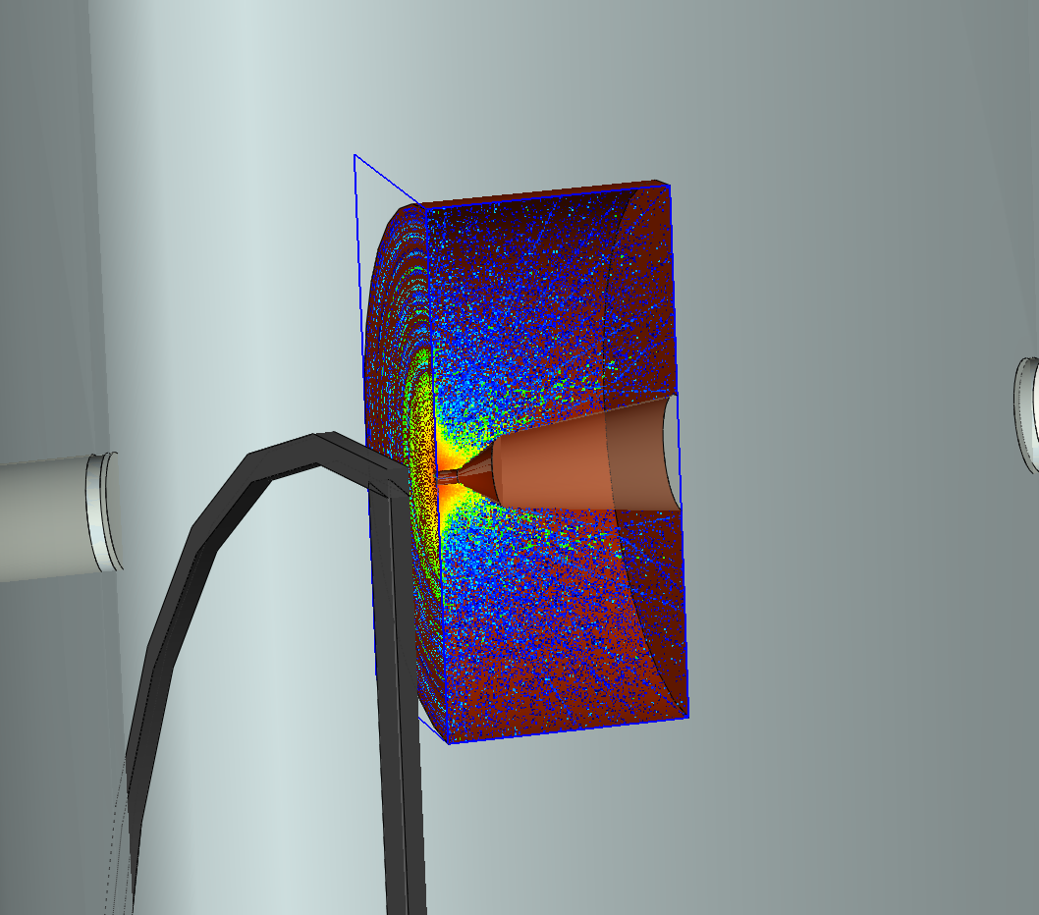
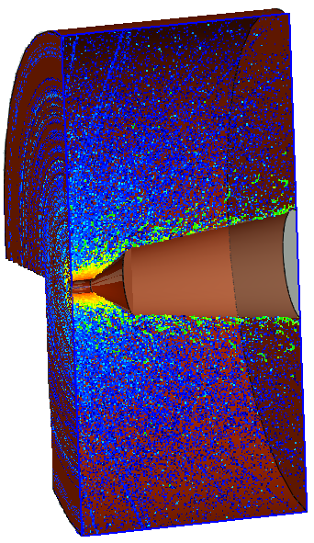
~ 50 K / train
|
~ 80 K / train
|
~ 320 K / train
|
flux concentrator
-
Q_{Ti target}
~
6 kW / train
~
-
Q_{W colli}
~
115 kW / train
~
-
Q_{flux con+W}
~
20 kW / train
tungsten collimator
for flux concentrator
~
-
Q_{flux con-W}
~
100 kW / train
~
F.Staufenbiel / 15.7.11 / 2.LC Forum

Slide 16
Conclusion
- heat loads (temperatures) for different collimator designs are simulated
-> transfered in manageable regions
- heat load in the target and flux concentrator are simulated
 | temperature | power
target | 80 K/train | 6 kW/train
flux concentrator - W_{colli} | 80 K/train | 115 kW/train
flux concentrator + W_{colli} | 50 K/train | 20 kW/train
W_{collimator} | 320 K/train | 100 kW/train
->
C Ti W
C Ti Fe W
->
->
C Ti Fe W
C Ti
F.Staufenbiel / 15.7.11 / 2.LC Forum

Slide 17
Conclusion
- heat loads (temperatures) for different collimator designs are simulated
-> transfered in manageable regions
- heat load in the target and flux concentrator are simulated
 | temperature | power
target | 80 K/train | 6 kW/train
flux concentrator - W_{colli} | 80 K/train | 115 kW/train
flux concentrator + W_{colli} | 50 K/train | 20 kW/train
W_{collimator} | 320 K/train | 100 kW/train
- what is now to do ?
-> heat evolution studies in the single components + induced mechanical
stress due to heat evolution facilitate by ANSYS simulation software
F.Staufenbiel / 15.7.11 / 2.LC Forum

