Slide 1
WP-2 High performance RF systems
L. Monaco and E. Cenni
7 May 2024 (on-line)
EAJADE – General Meeting

Slide 2
Outline
Work program
Status of deliverables
First year:
WP2 secondments done
Results and highlights so far obtained
Second year:
WP2 secondments foreseen
Open questions

Slide 3
From the updated Pivot table, in total (63->54) months
Participants:
CNRS (8), CEA (13), INFN (15), UHH (17), IFIC (9), CERN (1)
Task 2.5 will benefit from results obtained in other tasks, in terms of cost reduction, sustainability, etc.
WP4 topics synergic with WP2 tasks

Slide 4
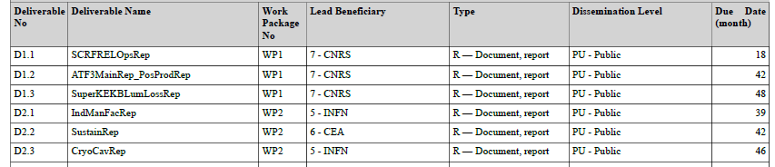
Deliverables & Time scale
Deliverables
Note: Deliverables 2.3&2.4 have been merged as D2.3 CryoCavRep (month 46, tasks 2.1, 2.2, 2.3, 2.4)
Task 2.1: RF cavities materials, treatments and performance reliability
Task 2.2: SRF cryomodule preparation and operation
Task 2.3: Diagnostic
Task 2.4: NCRF and high-power sources
Task 2.5: Industrialization and cost reduction

Slide 5
Secondments balance per institutes (1st year)
Beneficiary | Sec./month | Host institute | Main Topic | Period
INFN | none
CNRS | 1 x 0.7 | JLab | Plasma processing studies and RF simulation (Task 2.1), TTC Meeting | 26/11 – 15/12
CEA | 1 x 1 | KEK | SRF cavity preparation and manufacturing, cryomodule testing (diagnostics). Tasks 2.1, 2.3 and 2.5 | 6/7 – 8/8
 | 1 x 2 | FNAL | The secondment was spent in Fermilab studying a new cryomodule string alignment tool. The activities are linked to Task 2.2 | 7/1 – 3/3
UHH | none
Main reasons of missing secondments:
UHH:
Both PhD students do not receive VISA (Iranian/Russian Nationalities)
KEK delayed due to experimental issues / lack of funding in Japan
New PhD students at UHH that will start doing secondments in 2025
INFN:
Bureaucratic issue on fund allocation
Now solved -> EAJADE funds used starting from April 2024
See table with secondments foreseen for the 2nd EAJADE year for details

Slide 6
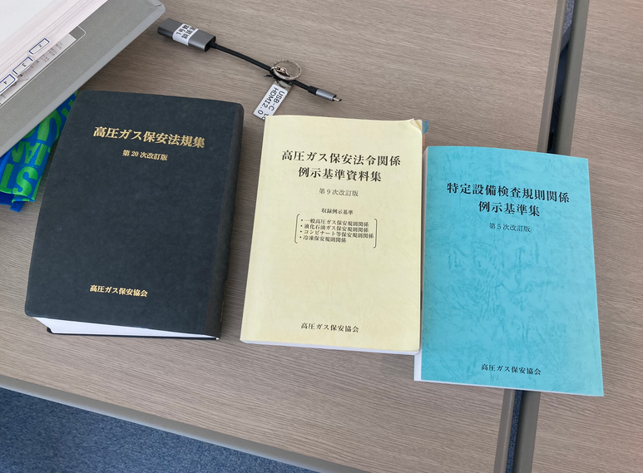
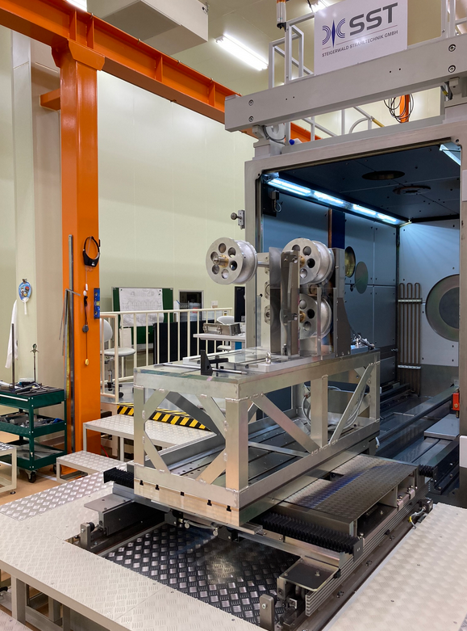
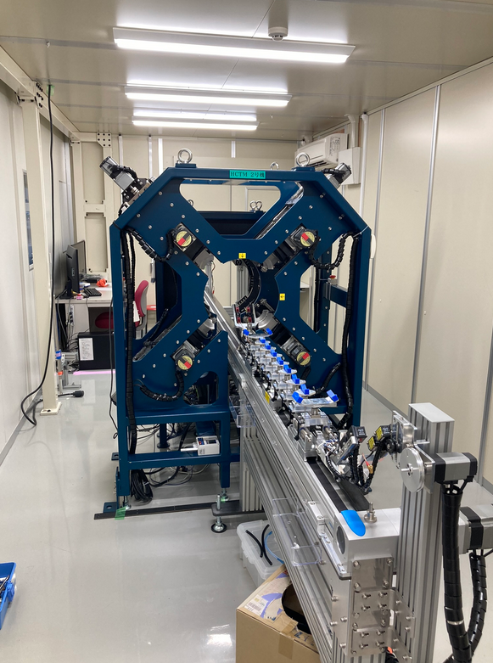
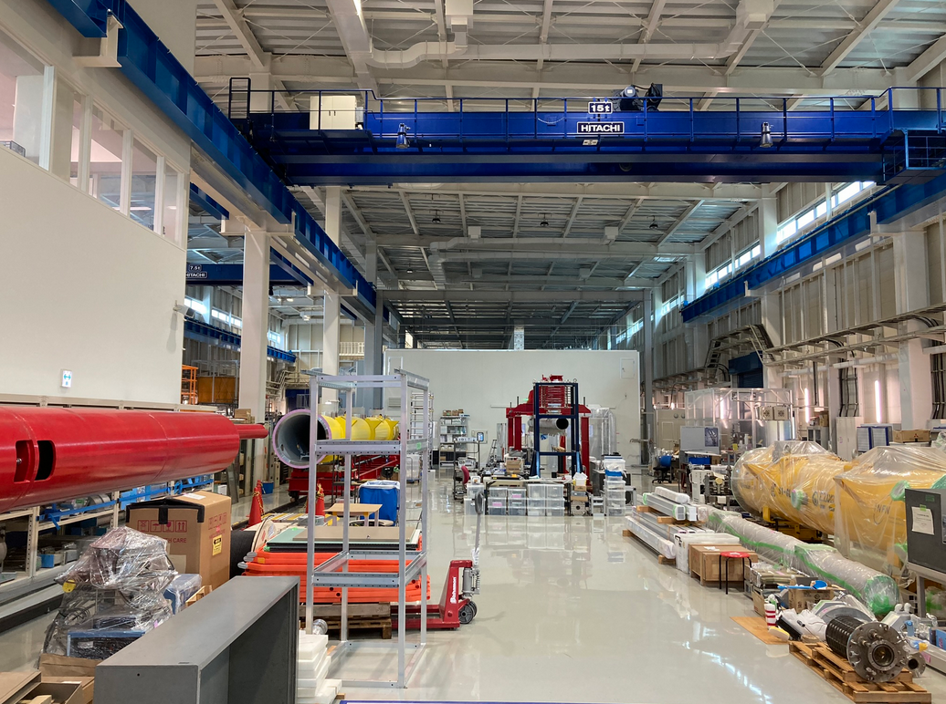
CEA: Summary of activities at KEK
ITN collaboration:
HPGS study for cavity manufacturing in Europe
Cavity preparation discussion and study plan
Cavity fabrication facility (CFF)
Dumbbell preparation for electron beam welding
COI facility visit (clean room, HPR, bunker location)
E. Cenni

Slide 7
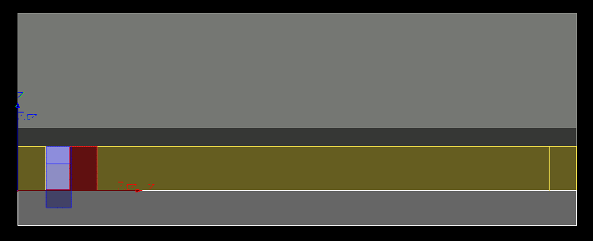
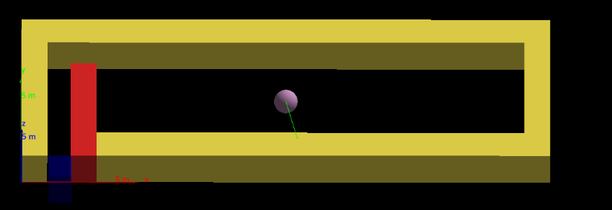
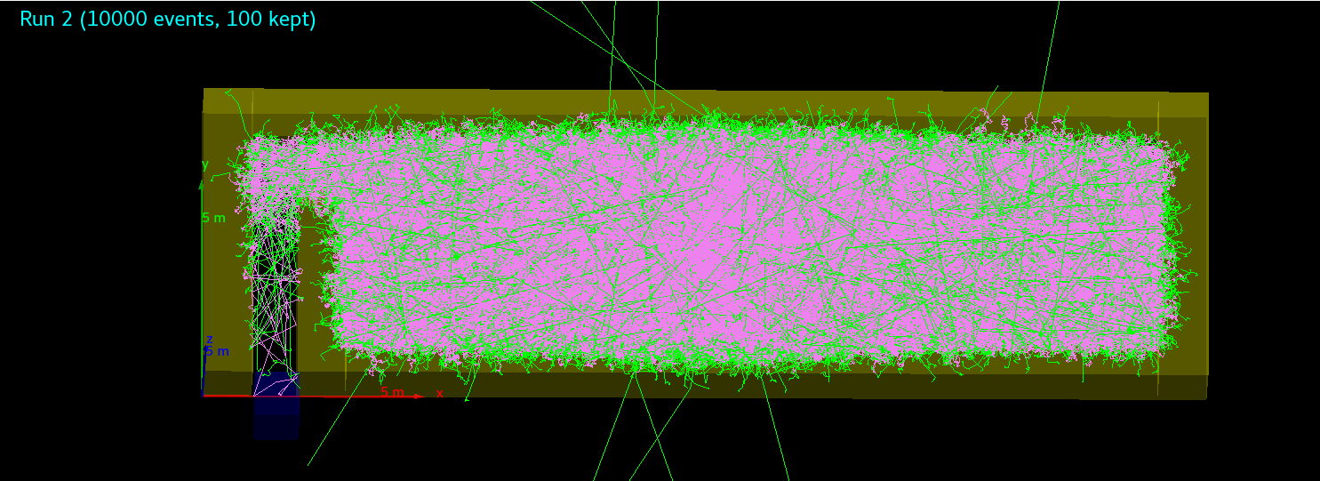
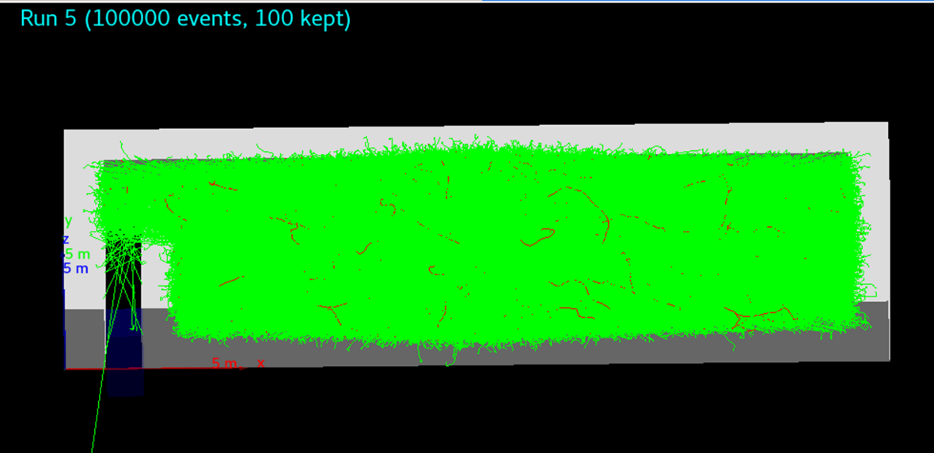
CEA: Summary of activities at KEK
Preliminary design evaluation for Cryomodule Test Facility in (COI):
Maze study
Image color code:
Gray: Roof and Floor
Yellow: side walls
Red: Inner wall
Purple: Source
Transparent blue: “detector door”
Source
1MeV neutrons
E. Cenni
1MeV gamma

Slide 8
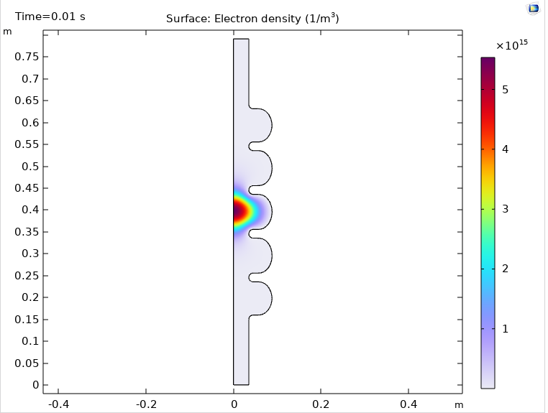
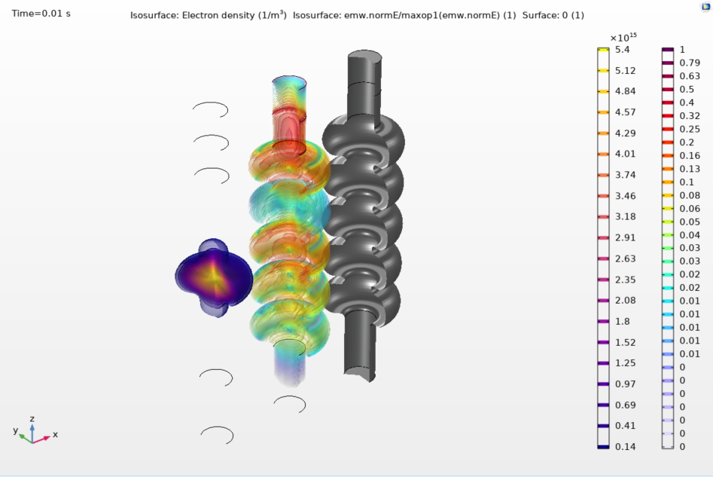
CNRS (IJCLab): Summary of activities at JLab
From Nov. 27 to Dec. 4: Visit at JLab
Training on JLab’s plasma processing test bench (“C75 cavity”).
Learned how to:
move the plasma from cell to cell using different RF frequencies,
pollute the cavity with methane, and read the RGA signal,
read the frequency shift “fingerprint” to determine plasma location.
From Dec. 5 to 8: attendance to TTC Meeting at Fermilab
Presented a 10 min. talk on plasma processing activities at IJCLab (https://indico.fnal.gov/event/60446/contributions/277987/attachments/173134/234606/TTC_meeting_plasma_IJCLab_CHENEY.pdf)
From Dec. 11 to 15: Back to JLab
Learned plasma simulations using COMSOL Multiphysics.
1st step: RF simulations,
2nd step: plasma chemistry + how to find input data for the simulations,
3rd step: combining RF and plasma in a multiphysics simulation in a C75 elliptical cavity.
Future secondment in the USA or Japan
Not yet planned
2D RF simulation
2D RF + plasma simulation
3D electron density & normalized E-field
C. Cheney

Slide 9
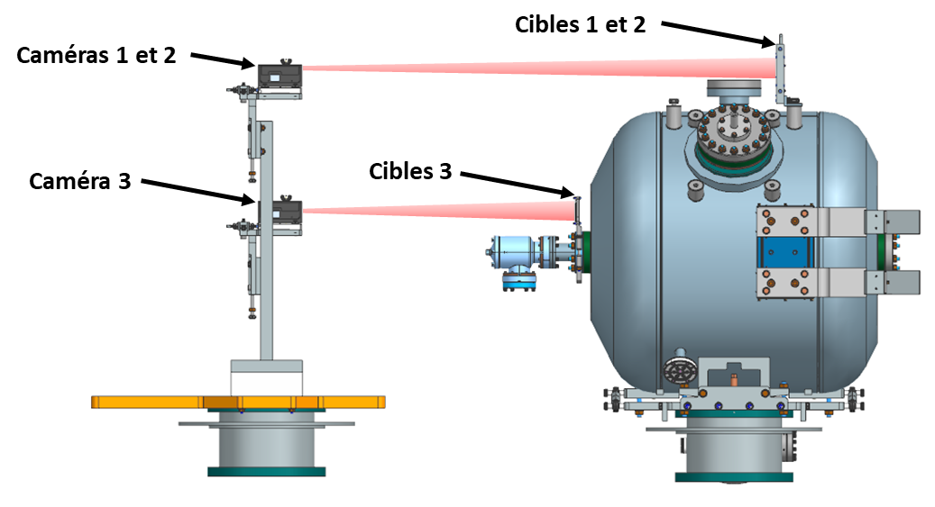
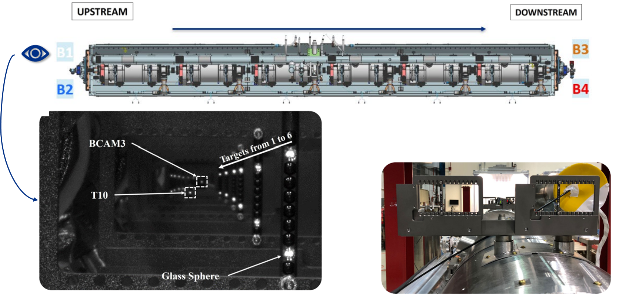
CEA: Summary of activities at FNAL
(HBcam studies for PIP-II cryomodule applications)
HBcam as alignment tool for PIP-II cryomodules
Spoke Test Cryostat (single cavity):
Coding of the acquisition program at STC
Coding of analysis program for HBcam data
Multiple measurements and acquisition campaign to validate thermo-mechanical simulation
Cryomodule :
Coding of the acquisition program for data coming from cryomodule test
A. Gonzales-Moreau

Slide 10
Secondments outlook per institutes (2nd year, Mar. 24-Feb. 25)
Beneficiary | Sec./month | Host institute | Main Topic | Period
INFN | 1 x 0.2 | Jlab/FNAL | Plasma-processing, surface treatments, RF/mec design tool (2.1/2.3/2.5) | 7/4 – 20/4
 | 1 x 0.2 | Jlab/FNAL | Plasma processing, surface treatments, RF/mec design tool (2.1/2.3/2.5) | 7/4 – 20/4
 | 1 x ~1 | KEK | Cavity fabrication, cost reduction, VT and diagnostic (ITN), LCWS24 (2.1/2.2/2.3/2.5) | 28/6 – 18/7
 | 1 x ~1 | KEK | Cavity fabrication, cost reduction, VT and diagnostic (ITN), LCWS24 (2.1/2.2/2.3/2.5) | 28/6 – 18/7
 | 1 x 0.5 | Scandinova | Studies for the power stations development to achieve High repetition rate (1 kHz), test of high efficiency klystrons, improvement of video pulse shape and IGBTs control (2.5) | Oct-Dec
 | 2 x 0.5 | KEK | ERL and Machine operation, ERL workshop | September
CNRS | - | US/Japan | To be defined (plasma processing) (2.1) | To be planned
 | - | KEK | To be defined (cavity treatments, ERL), ERL24 (2.1/2.2/2.5) | To be planned
CEA | 1 x ~1.5 | KEK | Cavity fabrication, cost reduction, VT and diagnostic (ITN), LCWS24 (2.1/2.2/2.3/2.5) | Jun-Jul
 | - | KEK | Robotization, cavity string assembly operation in clean room environment (2.2) | To be planned
 | 1 x ~1 | KEK | Thin film, cavity fabrication, mechanical polishing (2.1) | To be planned
 | - | FNAL | Thin film, cavity testing (2.1) | To be planned
UHH | 1 x ~1 | FNAL | New testing scheme for new cavity design (task 2.1/2.3/2.5) | Jul-Sep
 | 1 x ~1 | KEK | Testing of coated Nb with new system at KEK (2.1) | Jul-Sep
*ERL conference (Sept. 2024) & SRF conference (Sept. 2025) in Tokyo -> expected EAJADE secondments increase for that years

Slide 11
Open Questions
Task 2.4 is almost “empty” -> NCRF cavities!
No unique deliverable but to understand how to enrich this expected task
CEA plan to move secondments from US to Japan -> is it possible?
Also driven by the increase of travelling costs

