Slide 1
Decay from False Vacuum Measurement (in 1-d)
Omri Rosner
PI: Prof. Kfir Blum
Weizmann Institute of Science
Israel

Slide 2
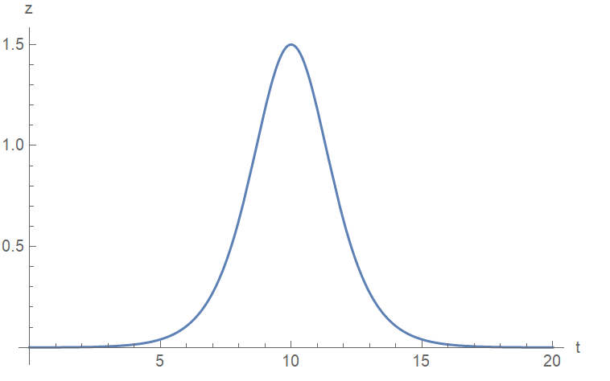
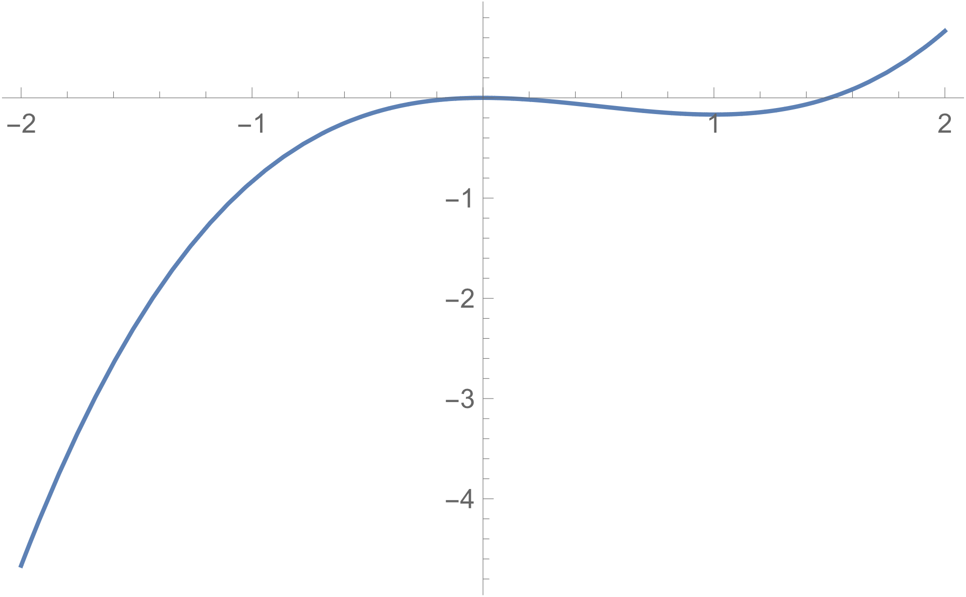
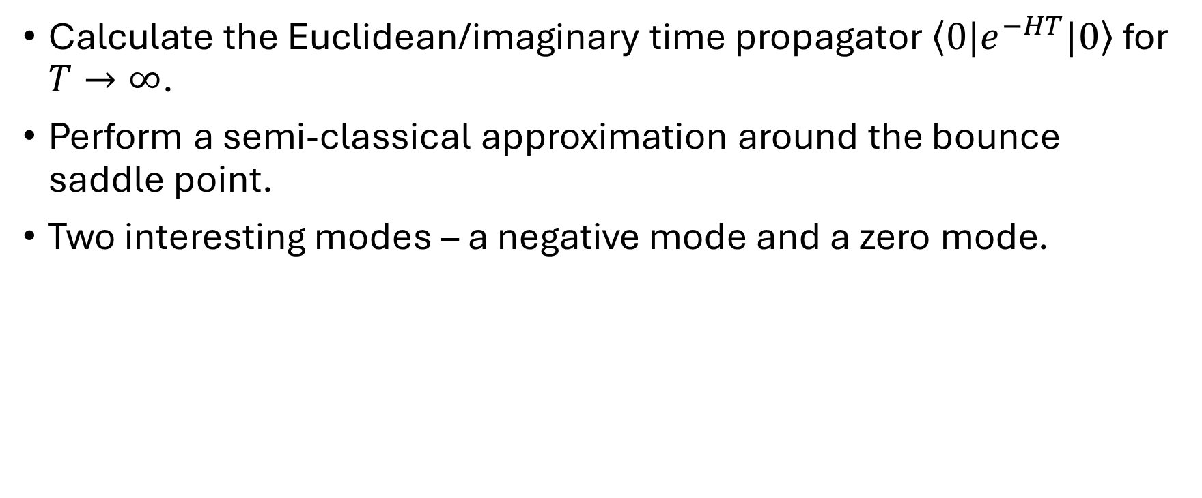
Coleman’s Picture for false vacuum decay
Calculate the Euclidean/imaginary time propagator $\left\langle 0|e^{−HT}|0\right\rangle$ for $T→∞$.
Perform a semi-classical approximation around the bounce saddle point.
Two interesting modes – a negative mode and a zero mode.

Slide 3
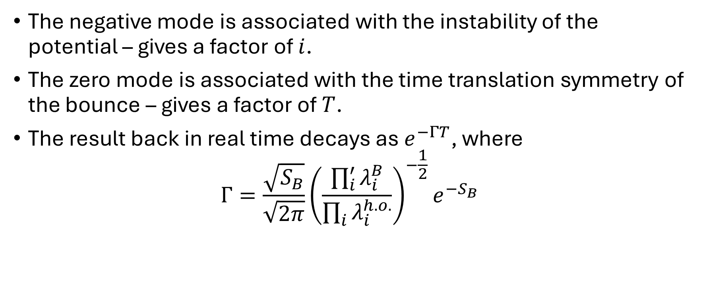
Coleman’s Picture for false vacuum decay
The negative mode is associated with the instability of the potential – gives a factor of $i$.
The zero mode is associated with the time translation symmetry of the bounce – gives a factor of $T$.
The result back in real time decays as $e^{−ΓT}$, where
$$Γ=\frac{\sqrt{S_{B}}}{\sqrt{2π}}{\left(\frac{\prod_{i}^{′}{λ_{i}^{B}}}{\prod_{i}{λ_{i}^{h.o.}}}\right)}^{−\frac{1}{2}}e^{−S_{B}}$$

Slide 4
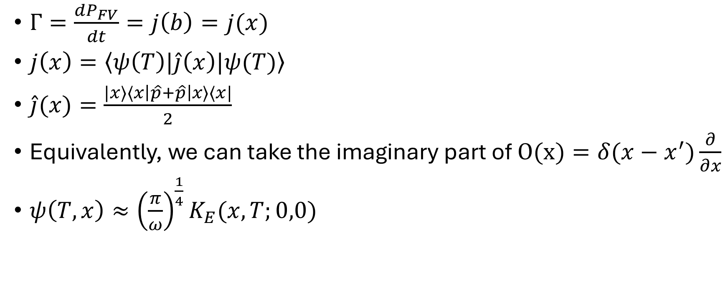
Measuring current inside the FV
$Γ=\frac{dP_{FV}}{dt}=j\left(b\right)=j(x)$
$j\left(x\right)=\left\langle ψ\left(T\right)|\hat{j}\left(x\right)|ψ(T)\right\rangle$
$\hat{j}(x)=\frac{|x⟩⟨x\left|\hat{p}+\hat{p}\right|x⟩⟨x|}{2}$
Equivalently, we can take the imaginary part of $O(x)=δ(x−x^{′})\frac{∂}{∂x}$
$ψ\left(T,x\right)≈{\left(\frac{π}{ω}\right)}^{\frac{1}{4}}K_{E}(x,T;0,0)$

Slide 5
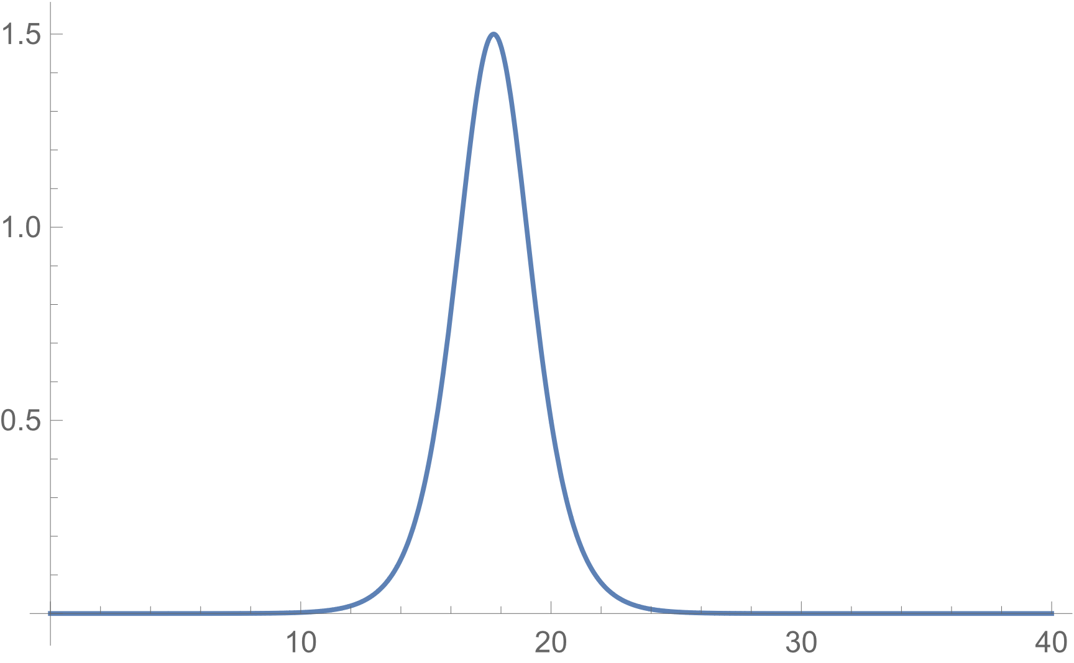
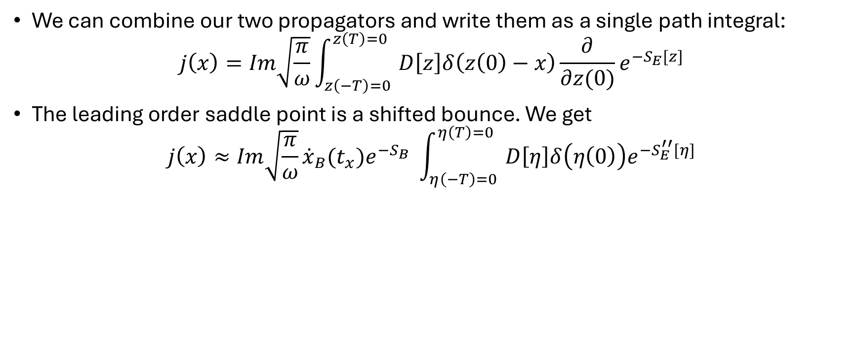
Single path integral method
We can combine our two propagators and write them as a single path integral:
$$j\left(x\right)=Im\sqrt{\frac{π}{ω}}\int_{z\left(−T\right)=0 }^{z\left(T\right)=0}{D\left[z\right]δ\left(z\left(0\right)−x\right)\frac{∂}{∂z(0)}e^{−S_{E}[z]}}$$
The leading order saddle point is a shifted bounce. We get
$$j\left(x\right)≈Im\sqrt{\frac{π}{ω}}{\dot{x}}_{B}(t_{x})e^{−S_{B}} \int_{η\left(−T\right)=0 }^{η\left(T\right)=0}{D\left[η\right]δ\left(η\left(0\right)\right)e^{−S_{E}^{′′}[η]}}$$
x

Slide 6
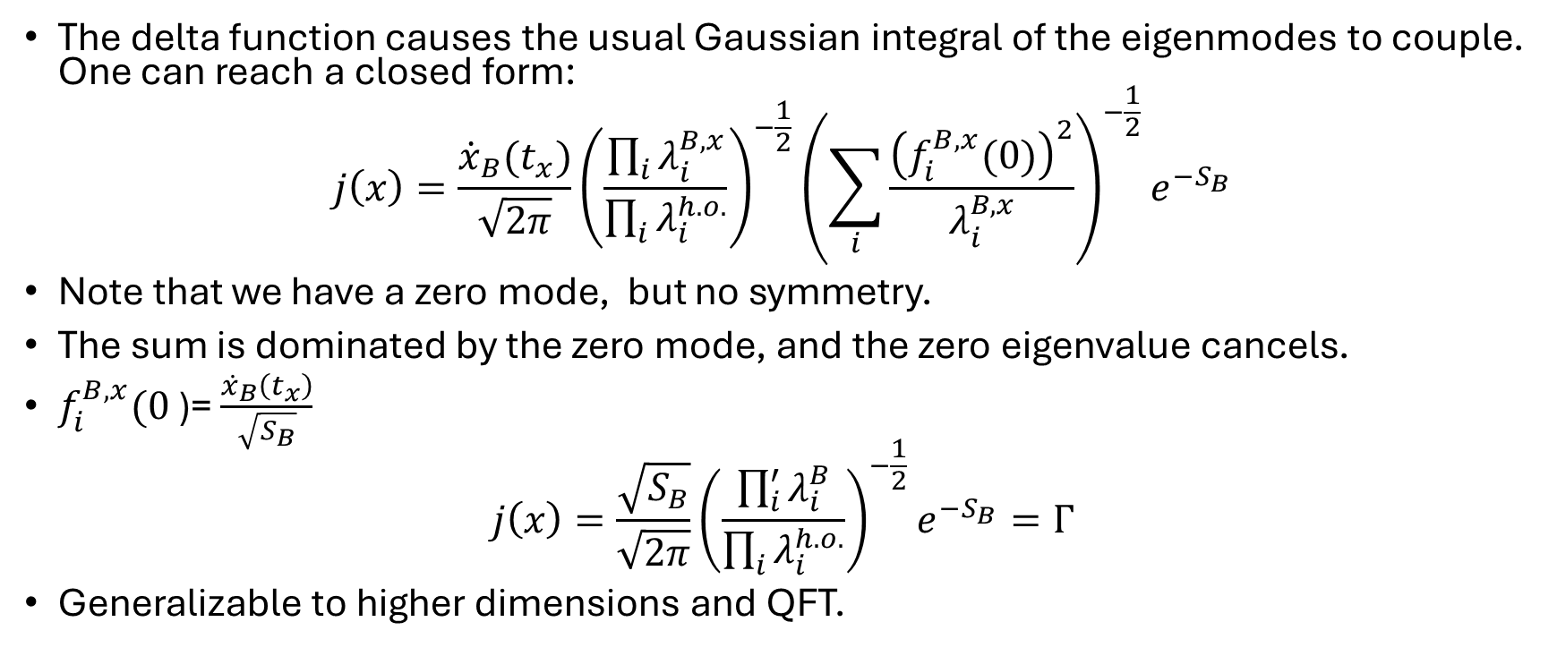
Single path integral method
The delta function causes the usual Gaussian integral of the eigenmodes to couple. One can reach a closed form:
$$j\left(x\right)=\frac{{\dot{x}}_{B}(t_{x})}{\sqrt{2π}}{\left(\frac{\prod_{i}{λ_{i}^{B,x}}}{\prod_{i}{λ_{i}^{h.o.}}}\right)}^{−\frac{1}{2}}{\left(\sum_{i}{\frac{{\left(f_{i}^{B,x}(0)\right)}^{2}}{λ_{i}^{B,x}}}\right)}^{−\frac{1}{2}}e^{−S_{B}}$$
Note that we have a zero mode, but no symmetry.
The sum is dominated by the zero mode, and the zero eigenvalue cancels.
$f_{i}^{B,x}(0$)= $\frac{{\dot{x}}_{B}\left(t_{x}\right)}{\sqrt{S_{B}}}$
$$j\left(x\right)=\frac{\sqrt{S_{B}}}{\sqrt{2π}}{\left(\frac{\prod_{i}^{′}{λ_{i}^{B}}}{\prod_{i}{λ_{i}^{h.o.}}}\right)}^{−\frac{1}{2}}e^{−S_{B}}=Γ$$
Generalizable to higher dimensions and QFT.

