Slide 1

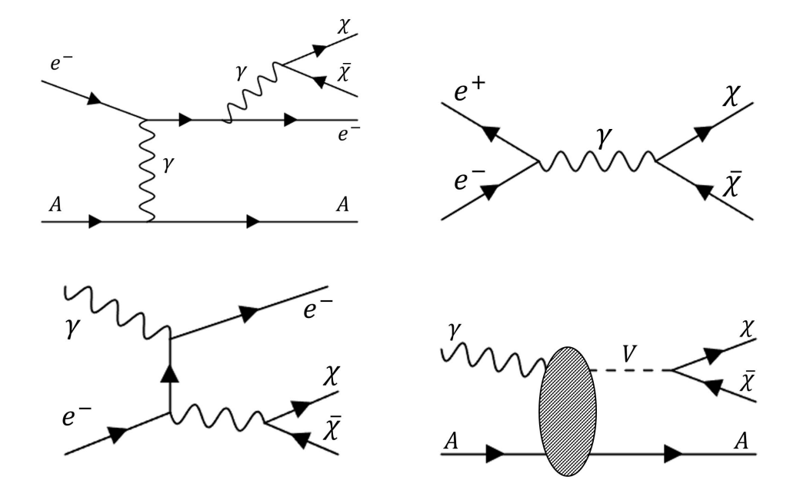
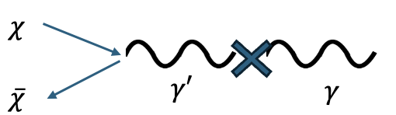
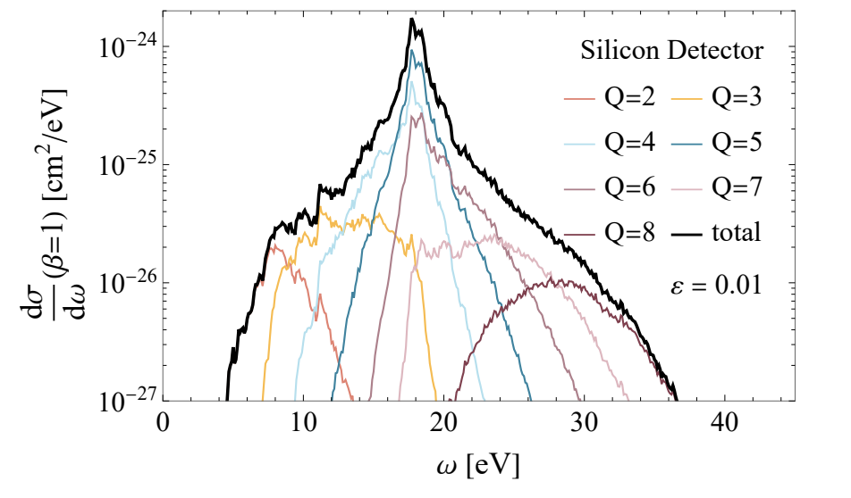
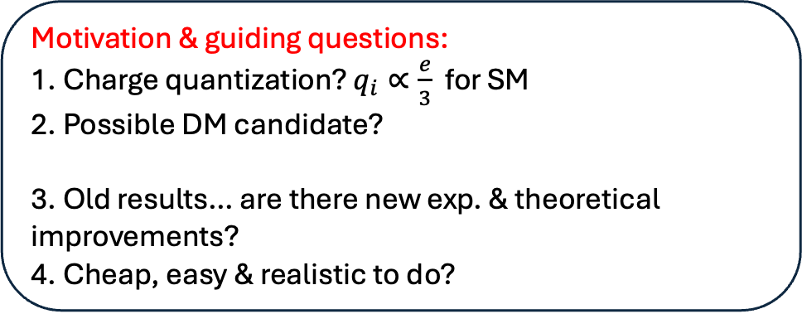
Probing Millicharged Particles at an Electron Beam Dump with Ultralow-Threshold Sensors
R. Essig, P. Li, Z. Liu, MM, R Plestid, H. Xu [2412.09652]
Improved calculation of mcp production at EBD
Motivation & guiding questions:
1. Charge quantization? $q_{i}∝\frac{e}{3}$ for SM
2. Possible DM candidate?
3. Old results… are there new exp. & theoretical improvements?
4. Cheap, easy & realistic to do?
Trident
e+ e-
annihilation
Vector
meson
decay
Compton
Ultralow threshold sensors capture interesting low energy signal. Allows for a well motivated zero-background search

Slide 2

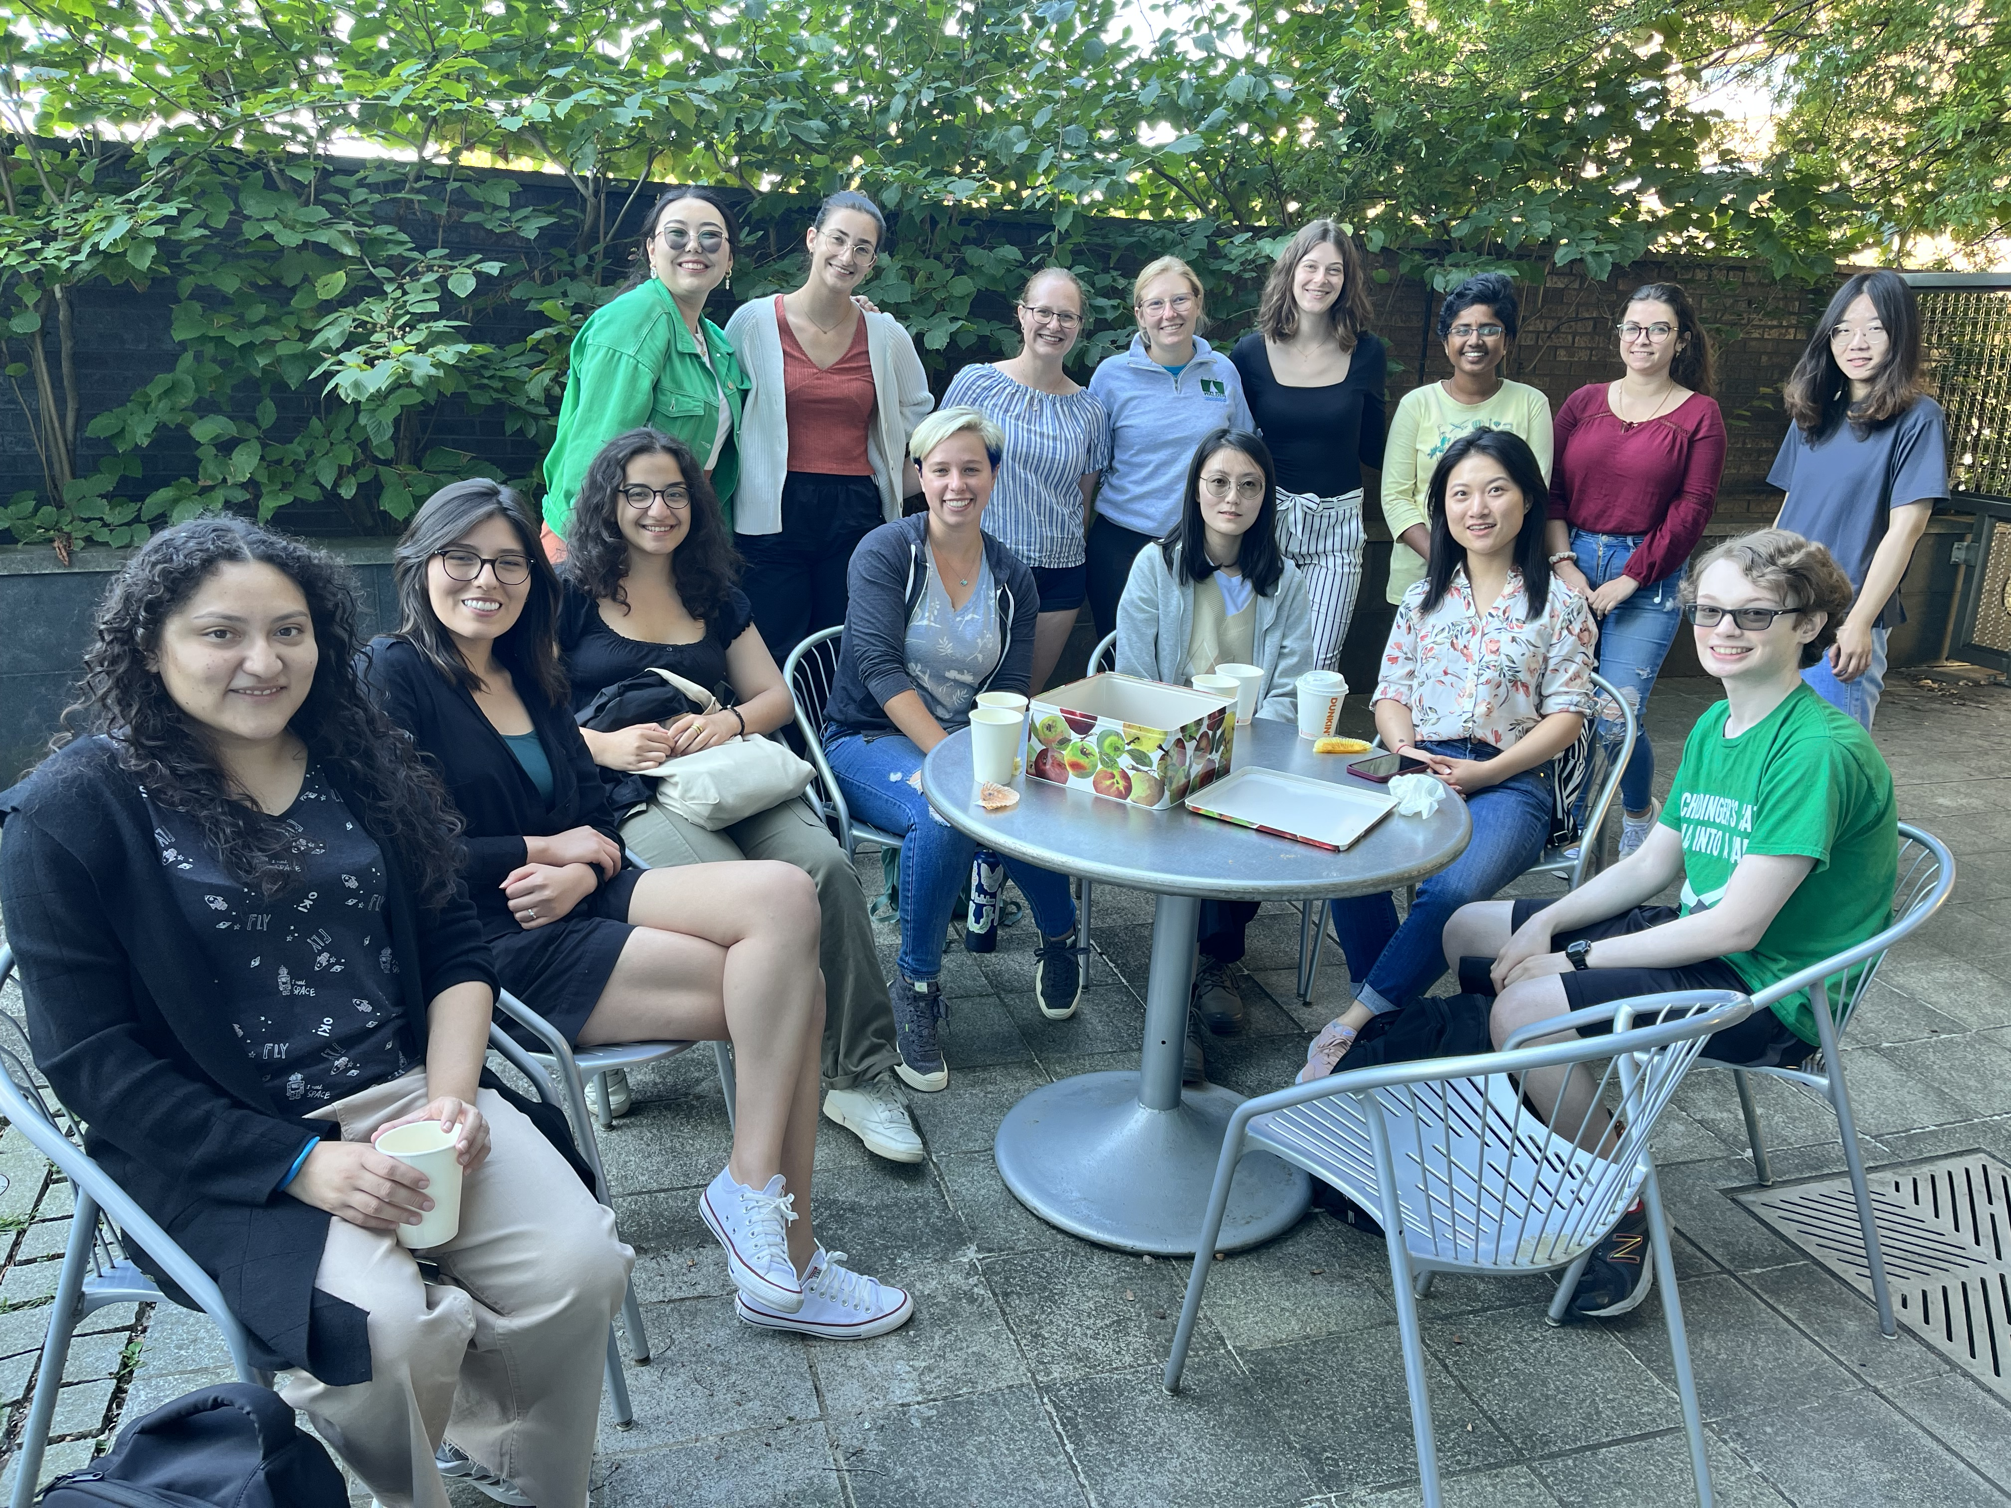
About Megan McDuffie ☺
4th year (2+2) PhD student at Yang Institute for Theoretical Physics
From San Diego, CA ☀️
Other research interests: DM direct detection 🔍 dissipative DM models & cosmology probes 🌌
Other interests: ⛹️‍♀️ 🧘‍♀️ 🏖️ 🚶‍♀️📺 📖

Slide 3
Backup Slides

Slide 4

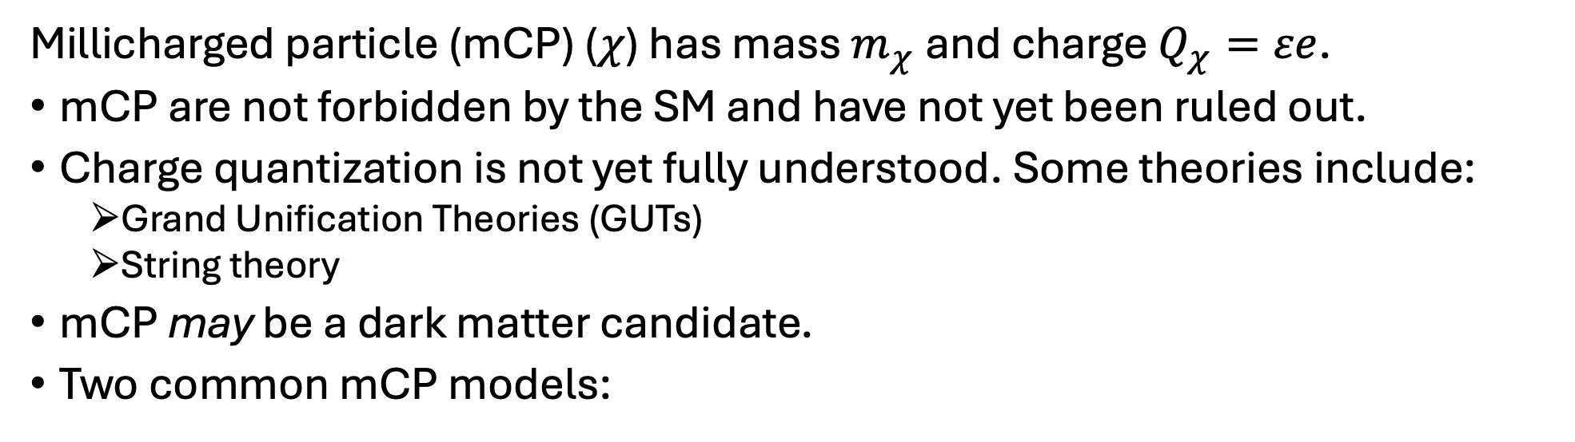


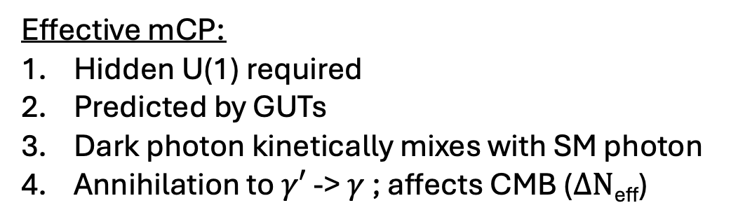

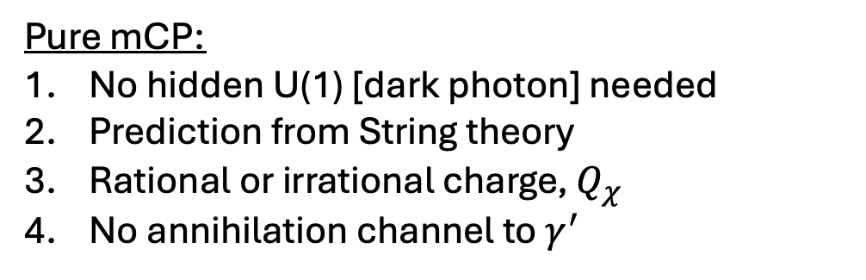

Theoretical Motivation for millicharged particles
Millicharged particle (mCP) ($χ$) has mass $m_{χ}$ and charge $Q_{χ}=εe$.
mCP are not forbidden by the SM and have not yet been ruled out.
Charge quantization is not yet fully understood. Some theories include:
  Grand Unification Theories (GUTs)
  String theory
mCP may be a dark matter candidate.
Two common mCP models:
$$χ$$
$$γ′$$
Pure mCP:
No hidden U(1) [dark photon] needed
Prediction from String theory
Rational or irrational charge, $Q_{χ}$
No annihilation channel to $γ^{′}$
Effective mCP:
Hidden U(1) required
Predicted by GUTs
Dark photon kinetically mixes with SM photon
Annihilation to $γ′$ -> $γ$ ; affects CMB ($ΔN$_{eff})
$$\overline{χ}$$
$$γ$$
Notes:
String theory : Dirac quantization, Dirac strings, compact space, magnetic monopoles
GUTs: SM is low energy EFT [ie. subgroup of SU(5) ]

Slide 5
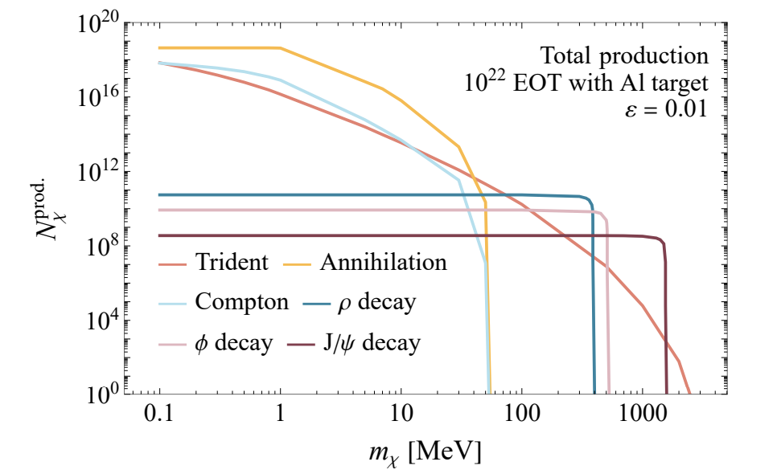
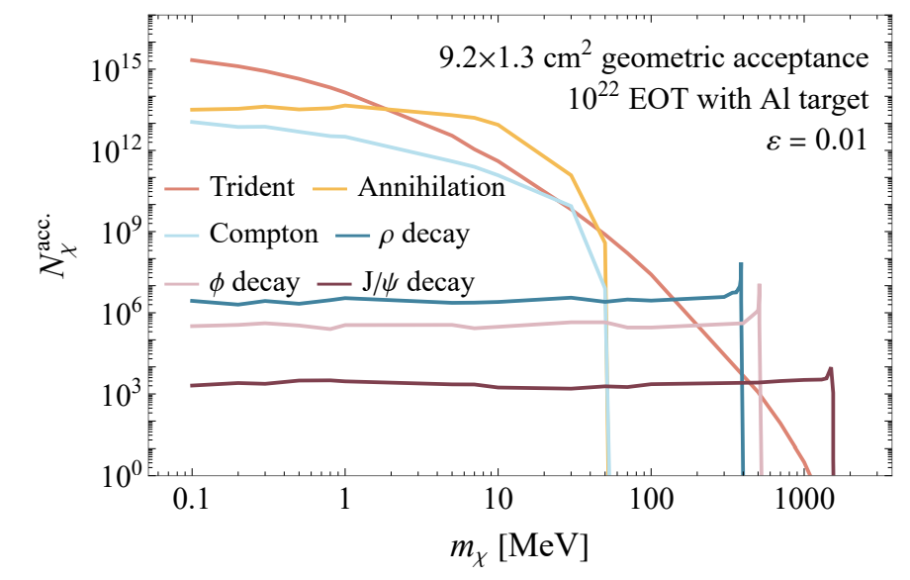
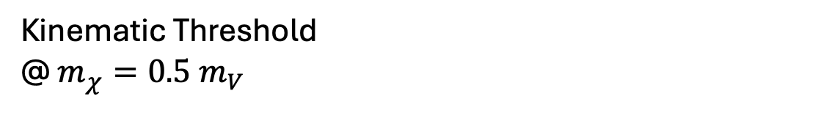

mCP production and geometric acceptance
Kinematic Threshold
@ $m_{χ}=0.5 m_{V}$
Kinematic Threshold ~50 MeV
Condition: $4m_{χ}^{2}\sim s=2meEe+m_{e}^{2}$

Slide 6
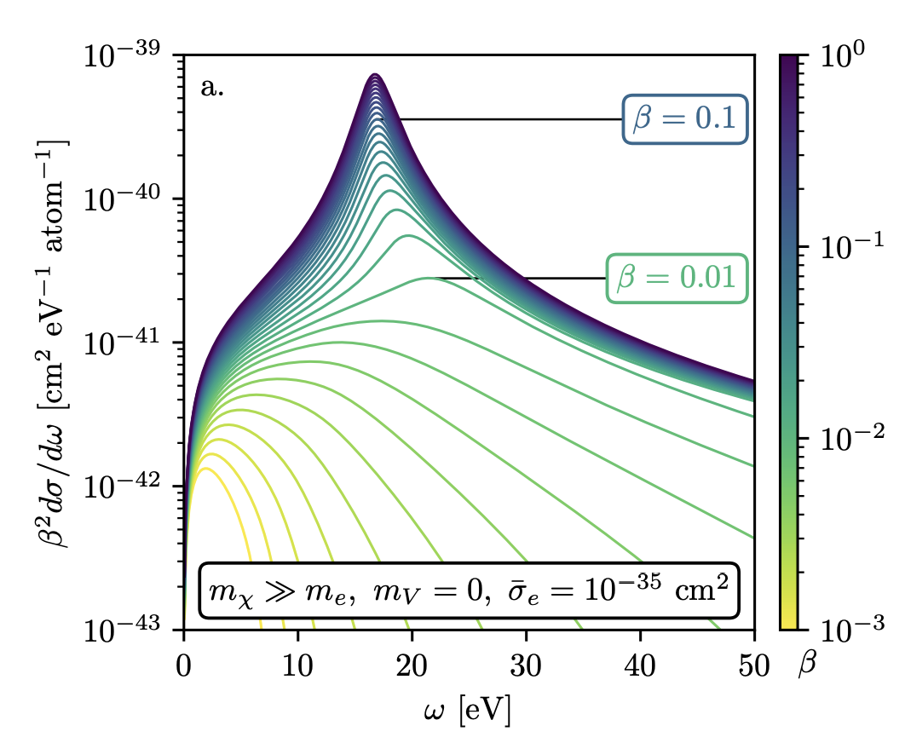
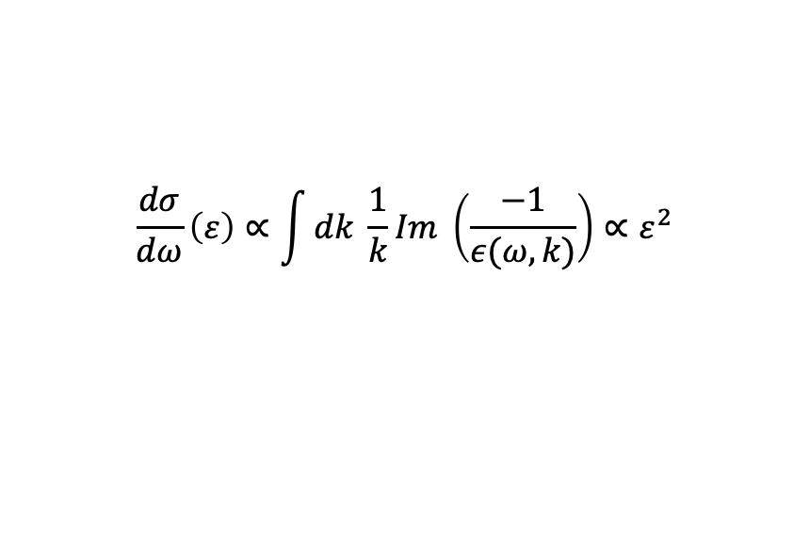

mCP detection with Skipper CCDs: Signal Prediction
$$\frac{dσ}{dω}\left(ε\right)∝\int{dk \frac{1}{k}Im \left(\frac{−1}{ε(ω,k)}\right)}∝ε^{2}$$
mCP, $β=1$
Dominant signal ~ 18 eV
Higher threshold detectors miss enhancement from collective excitations
Better rejection of background without loss of signal.
SENSEI has demonstrated background-free searches in this signal region.
Notes:
Clarify zero-background --> in signal region with masking high energy events.

Slide 7
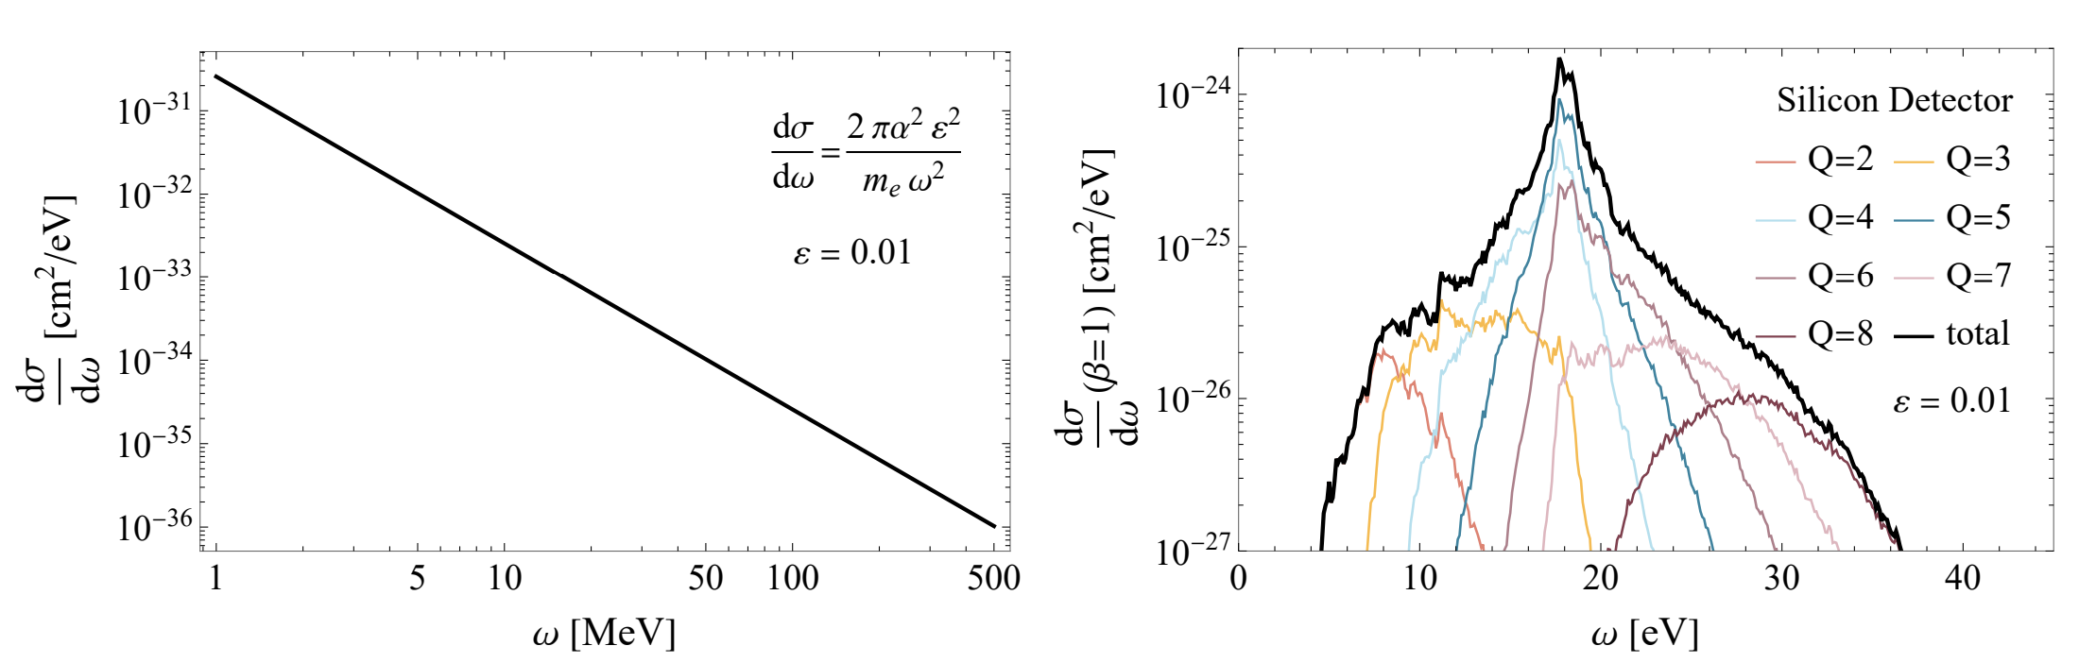
Higher threshold detectors miss enhancement from collective excitations
Skipper-CCDs
Csi (BDX proposed)

Slide 8
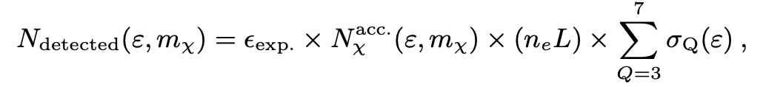

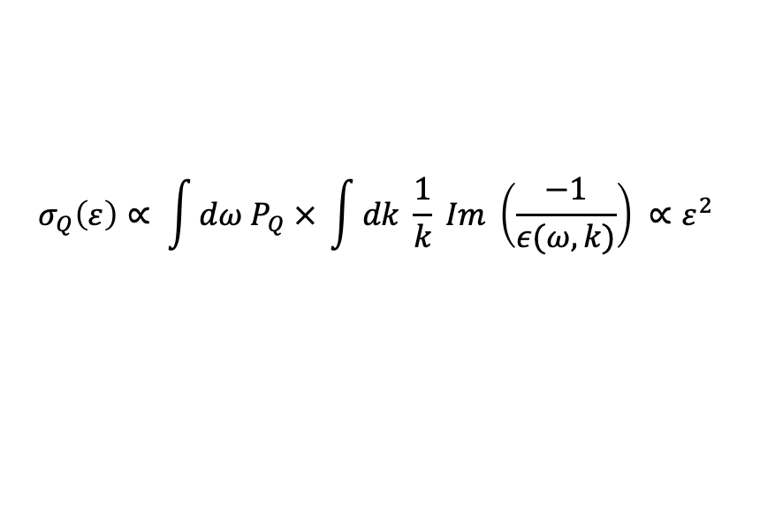
Expected number of signal events
Detector width
and electron number density
Detector efficiency ~0.20
$$σ_{Q}\left(ε\right)∝ \int{dω P_{Q} × \int{dk \frac{1}{k} Im \left(\frac{−1}{ε(ω,k)}\right) }∝ε^{2} }$$
$$∝ε^{2}$$
Notes:
Detector efficiency included due to masking pixels to minimizes background – this changes the effective area of the detector.
Masking high energy events

Slide 9
Backgrounds
Interesting backgrounds to consider:
  beam-induced neutrons, gammas, and muons
  cosmic rays
  pile up from single-electron events
High energy events are masked. This lowers the effective area of the detector. We estimate a detector efficiency of 20%, loosely motivated by SENSEI.
Low energy events (ie. 1 electron excitations) are not considered/thrown out.
Beam induced neutrons with energy O(100 keV) could reproduce mCP signal.
  We find that these backgrounds are minimal (< 1 for 10²² EOT), with sufficiently shielding (concrete and iron) after the dump. Simulations are running now.
Background analysis should be done carefully, and discussions with experimentalists at Jlab are ongoing.

Slide 10
One (2g) Skipper-CCD exceeds sensitivity of existing experiments

Slide 11
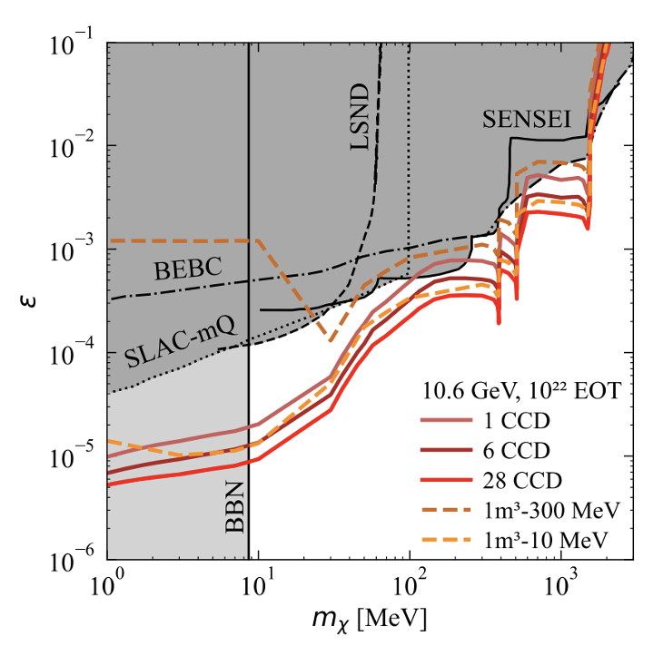
One (2g) Skipper-CCD exceeds sensitivity of existing experiments
… and performs better than a hypothetical 1m³ BDX-like detector with threshold energy 300 MeV
Notes:
We also show 10 MeV where the constrain is comparable.

Slide 12
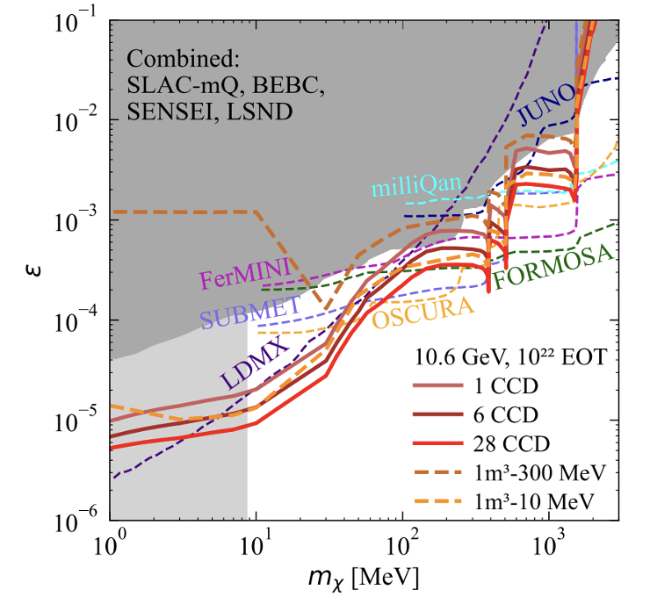
Skipper-CCDs are competitive with other proposed experiments
… and world leading at low masses

Slide 13
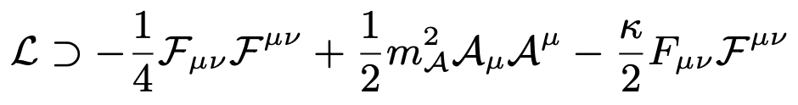

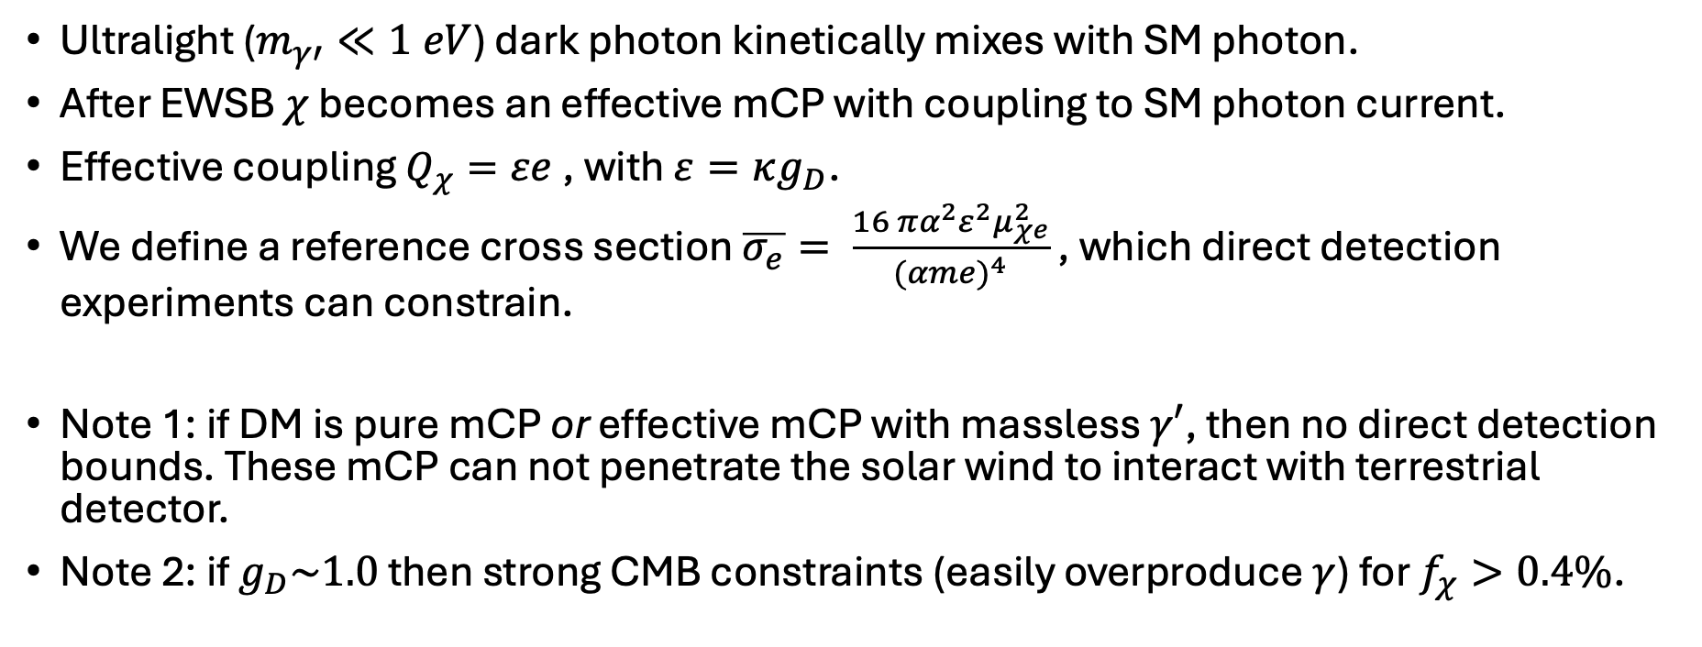
Dark matter interacting with an ultralight dark photon
Ultralight ($m_{γ′}≪1 eV$) dark photon kinetically mixes with SM photon.
After EWSB $χ$ becomes an effective mCP with coupling to SM photon current.
Effective coupling $Q_{χ}=εe$, with $ε=κg_{D}$.
We define a reference cross section $\overline{σ_{e}}= \frac{16 πα^{2}ε^{2}μ_{χe}^{2}}{{(αme)}^{4}}$ , which direct detection experiments can constrain.
Note 1: if DM is pure mCP or effective mCP with massless $γ′$, then no direct detection bounds. These mCP can not penetrate the solar wind to interact with terrestrial detector.
Note 2: if $g_{D}\sim 1.0$ then strong CMB constraints (easily overproduce $γ$) for $f_{χ}>0.4\%$.
Notes:
We note that pure mCPs may constitute the dark matter, but in the parameter region of interest for accelerator-based probes, if the dark matter were pure mCP, then (given its non-relativistic virial velocity) it would not be able to penetrate the solar wind to intersect a terrestrial detector, and there are thus no direct-detection constraints.
Instead, the presence of a massive dark photon screens the magnetic fields on length scales ≫ 1/mA, allowing the χ to penetrate the solar wind for appropriate choices of mA.

Slide 14
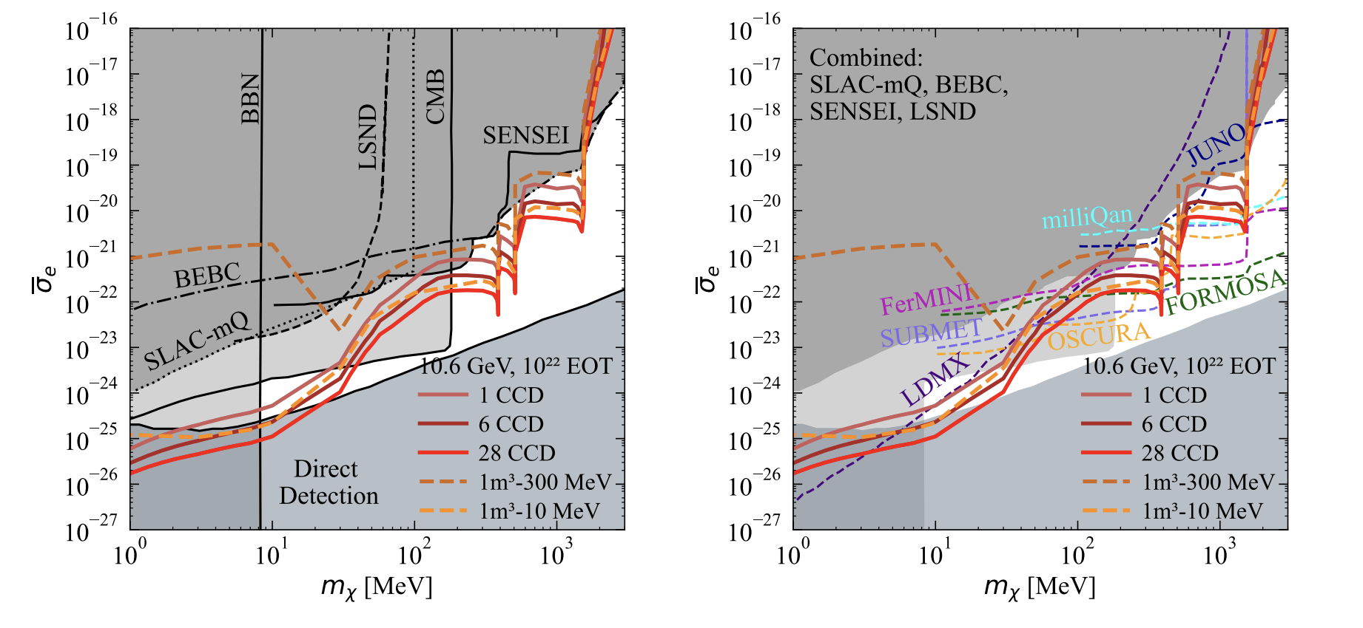
Dark matter interacting with an ultralight dark photon

Slide 15
Summary
Millicharged particles are theoretically motivated as a natural extension to the SM.
mCP are a possible DM candidate (although do not have to be).
We properly calculate the mCP production rates in all channels relevant at an electron beam dump.
Including a Skipper-CCD detector near the proposed BDX detector seems possible and relatively inexpensive.
We can probe new mCP parameter space at JLab with ONE Skipper-CCD.

Slide 16
Appendix

Slide 17
Comparison with other experiments
SLAC-mQ (1990s): electron beam, more energy, larger detector, farther away
Liquid Scintillator Neutrino Detector (LSND) (1990s): electron beam dump
BEBC (1970s-80s): proton beam dump + Bubble Chamber detector
SENSEI (with NUMI beam): proton beam, higher energy, lower POT

Slide 18
Comparison with other proposed experiments
SUBMET: proton beam @ J-PARC, currently taking data.
milliQan: proton beam @ CERN, demonstrator already produced results.
FerMINI: milliQan-like detector with NUMI beam
FORMOSA: milliQan-like detector @ LHC
OSCURA: skippers at NUMI beam, same as SENSEI but 500x larger detector
Nominal BDX design: larger detector, larger threshold energies
LDMX: electron beam, missing momentum search @ SLAC
JUNO: mcp produced from cosmic ray showers

Slide 19
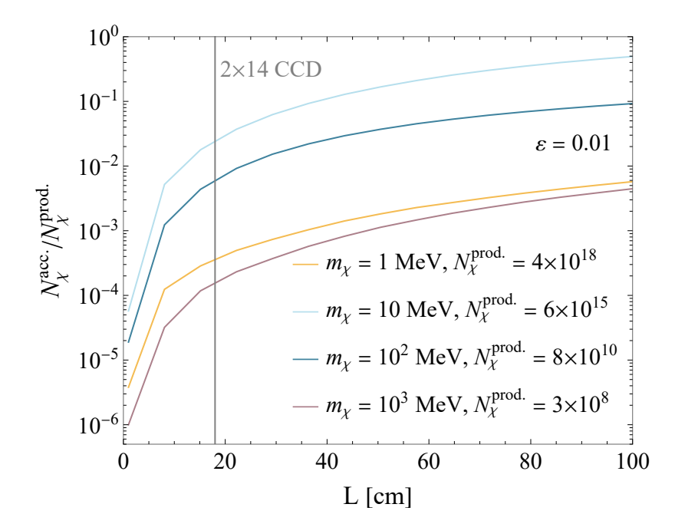
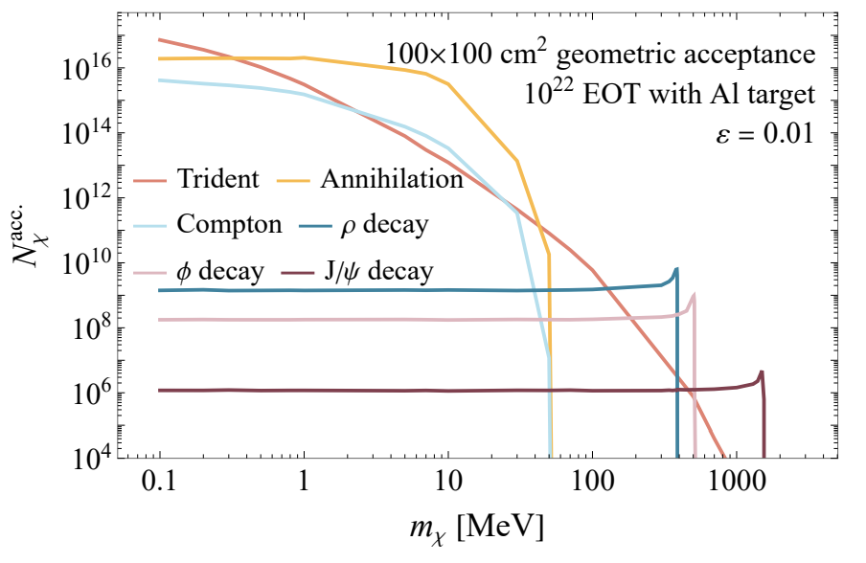
Geometric acceptance for other designs
Geometric Acceptance for a $L×L$ skipper CCD detector
BDX-like Detector

