Slide 1
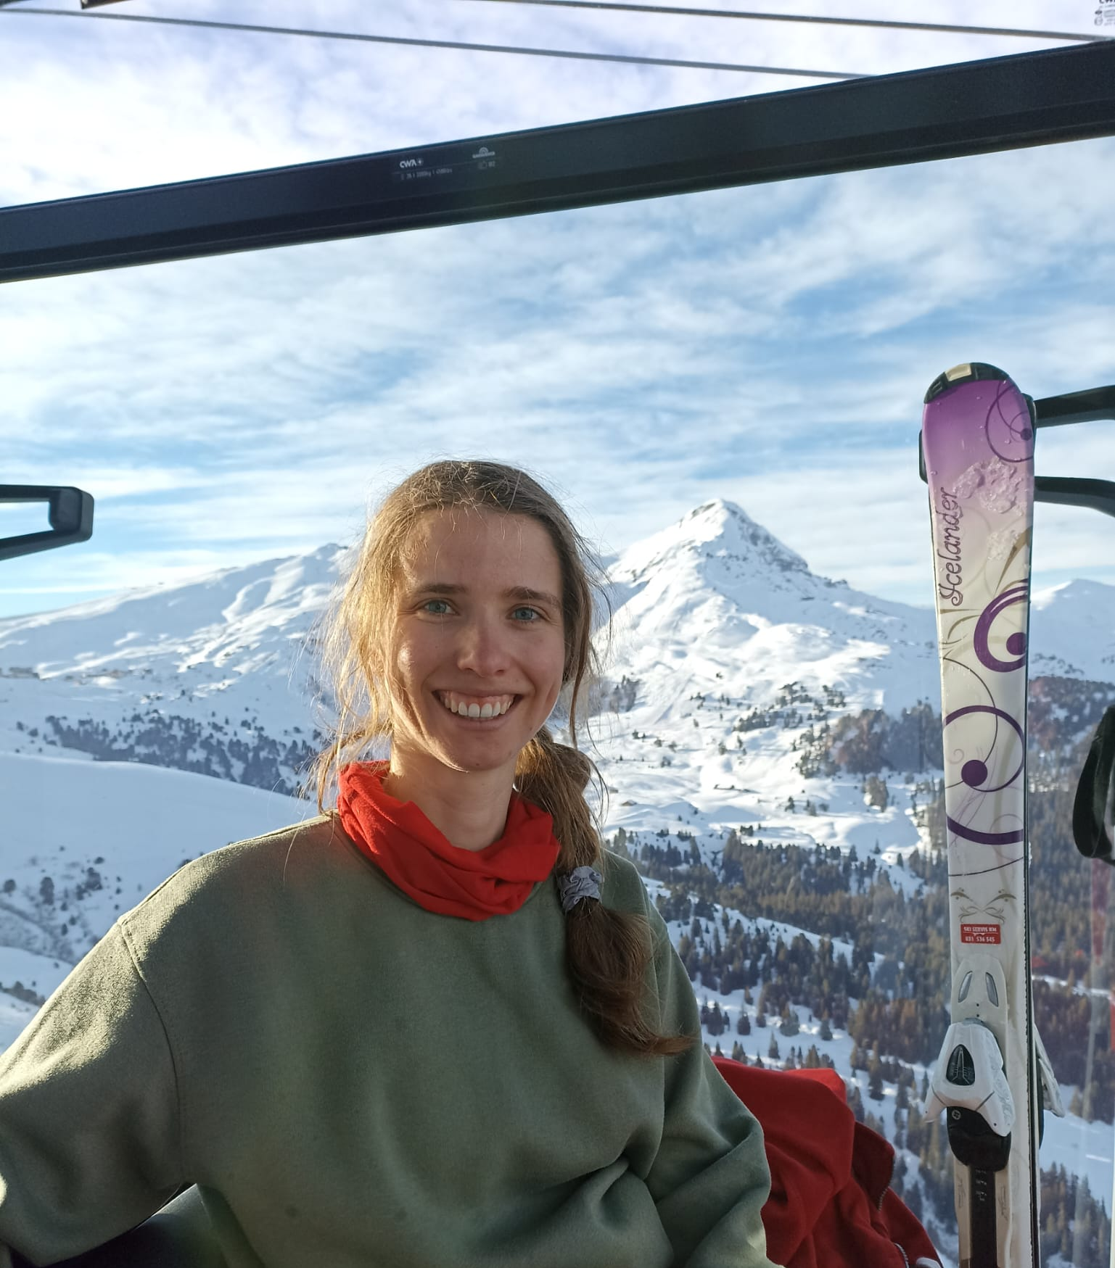
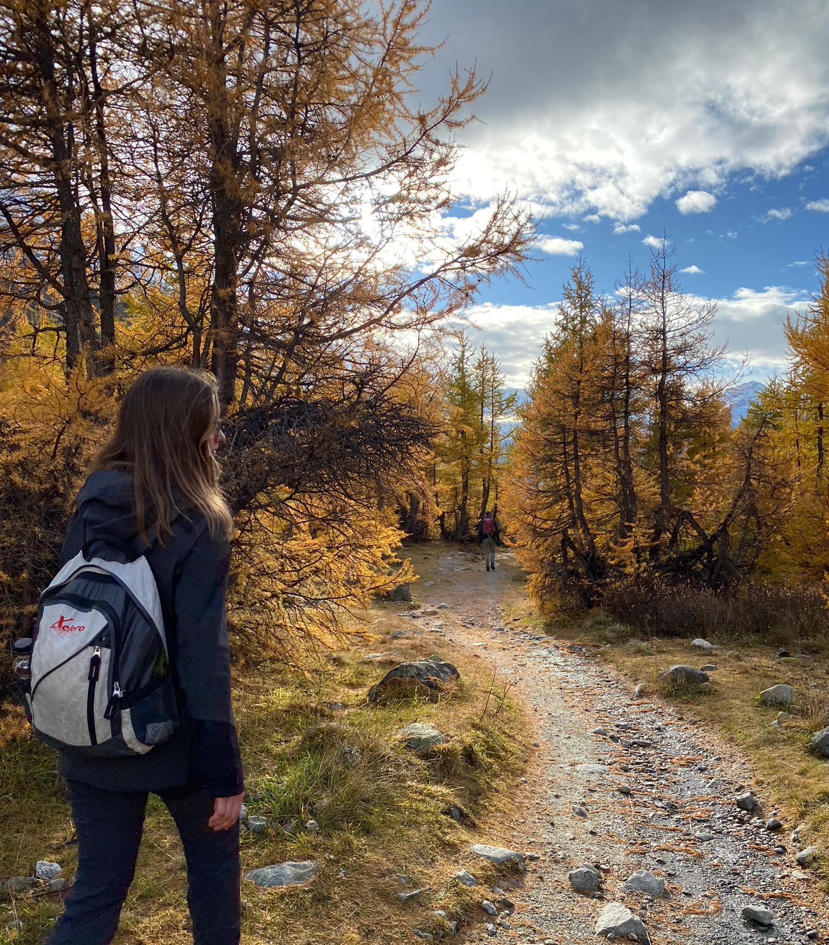
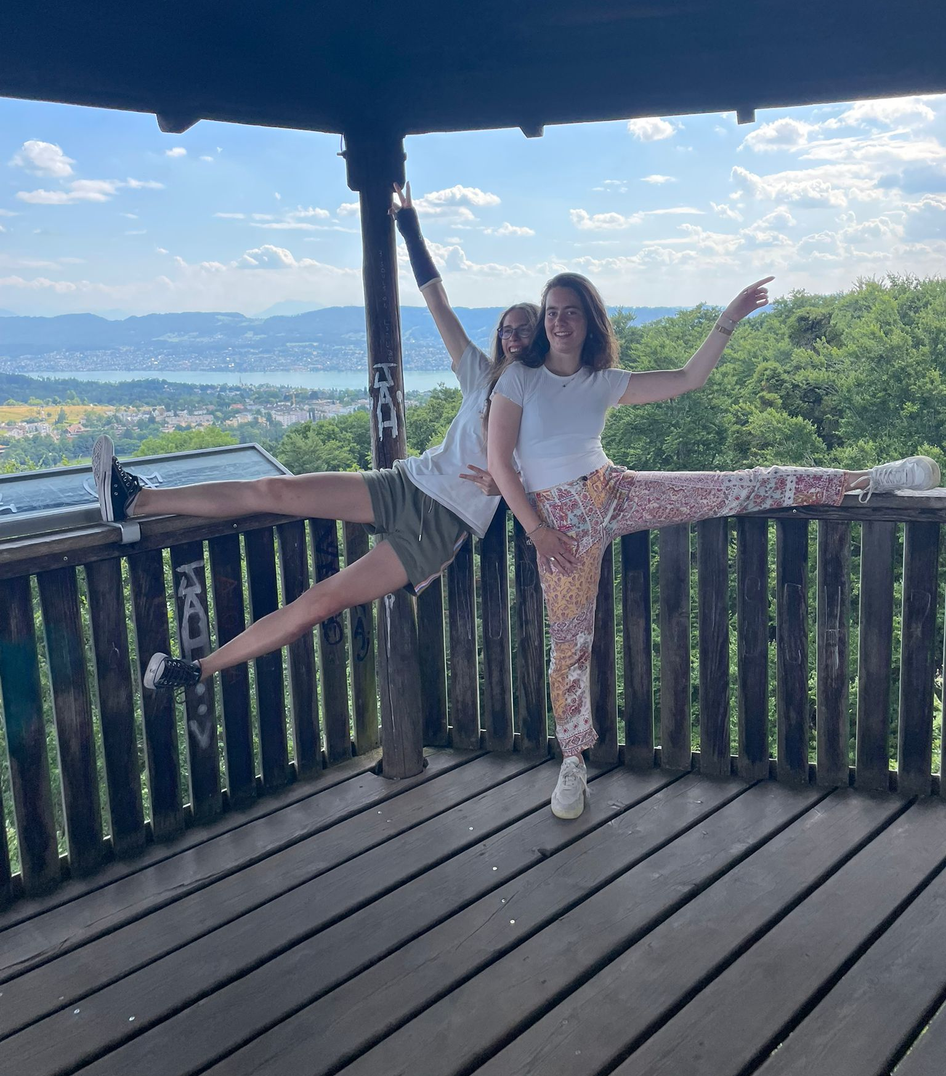
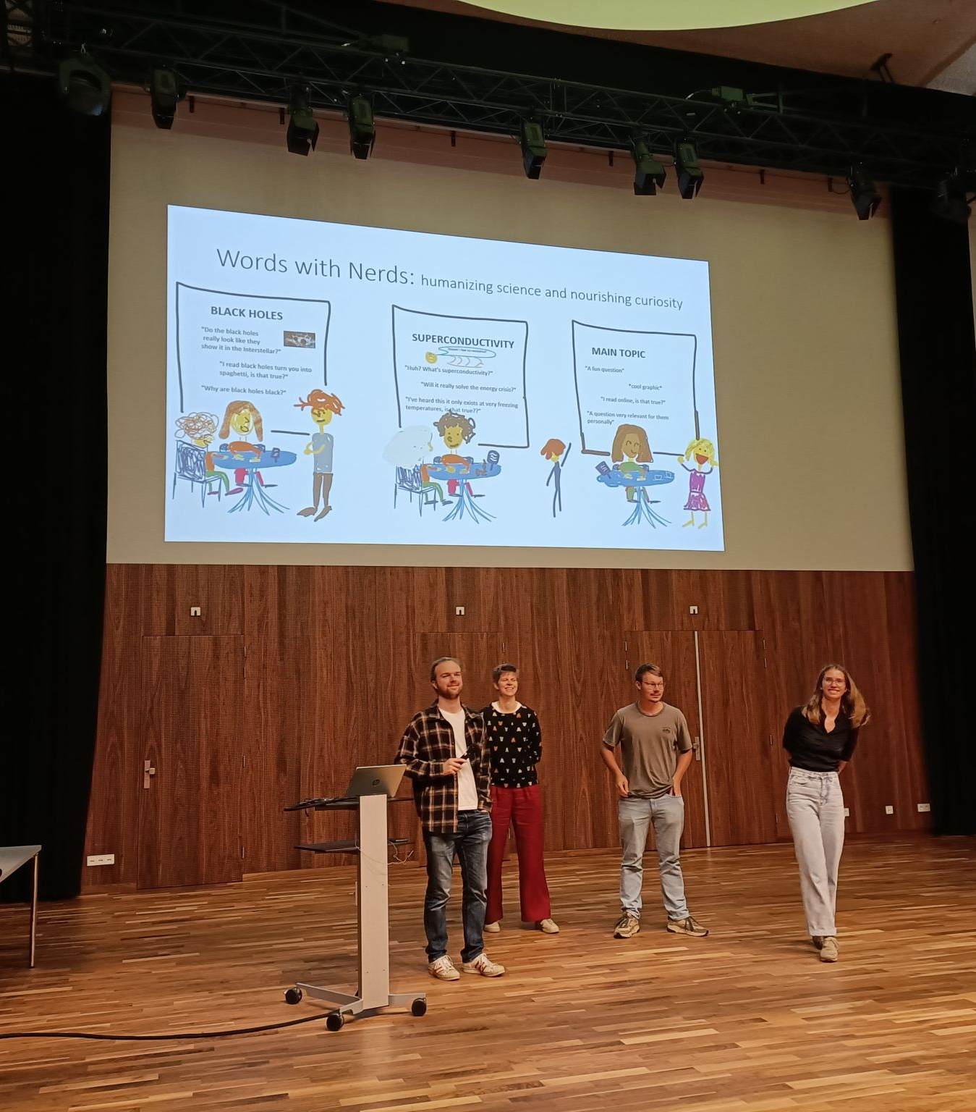
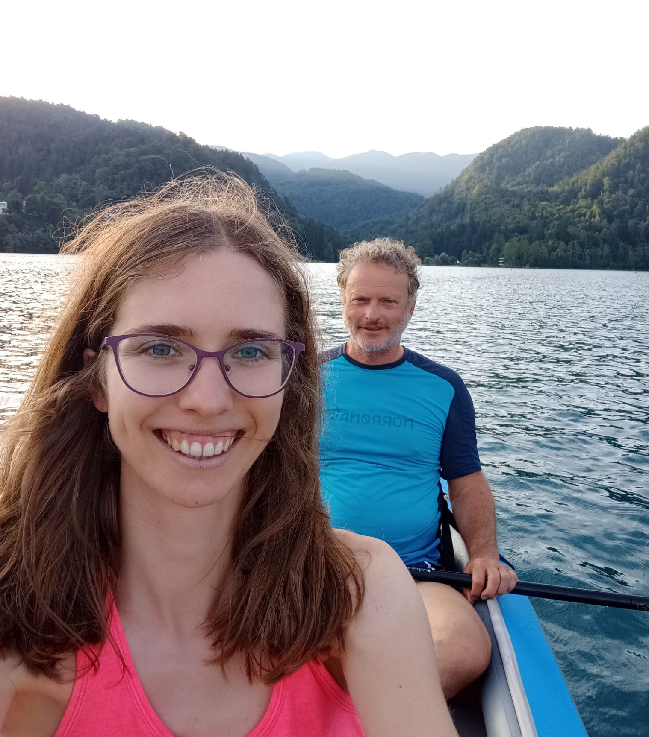
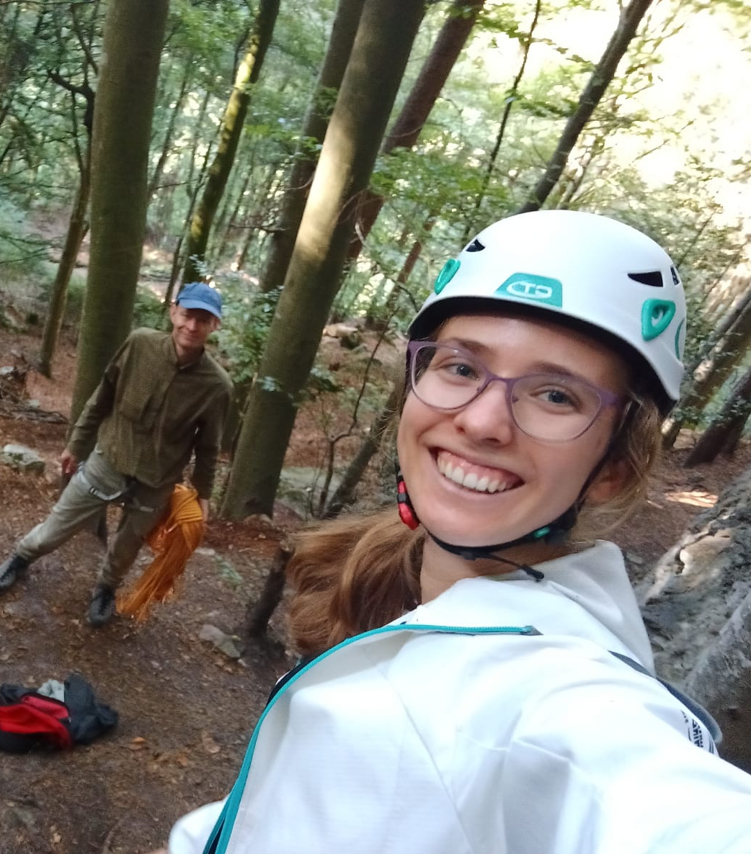
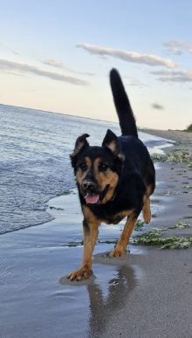
About Alica
Slovenia -> the Netherlands -> Switzerland (Bern)
Supervisor: Mikko Laine
Interests: physics & science communication, climbing, hiking, kayaking, skiing, dancing, exploring, petting animals

Slide 2
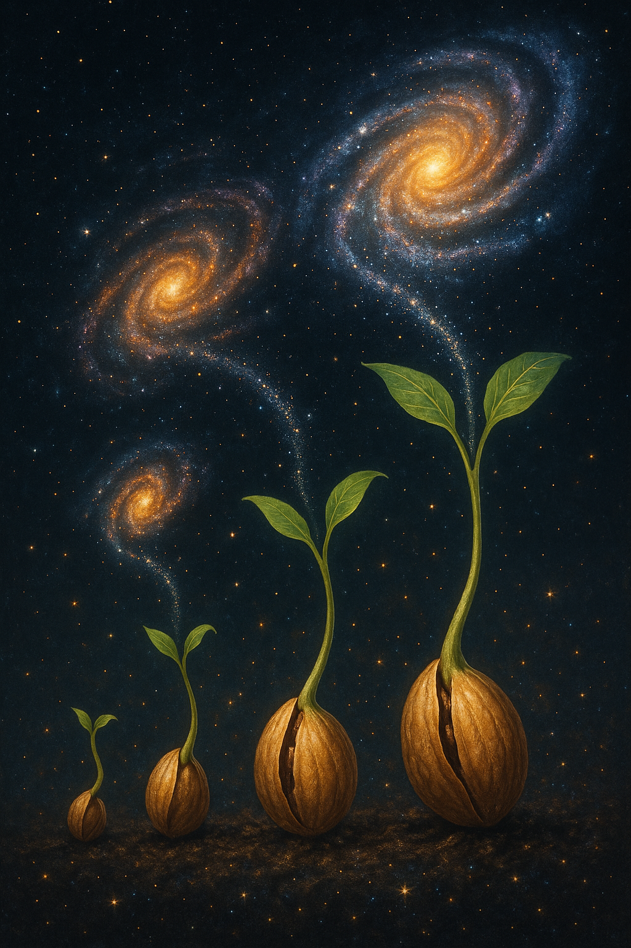
Evolution of coupled scalar perturbations through smooth reheating
Alica Rogelj, Mikko Laine & Simona Procacci
The best summer school, Cargese, 29.7.2025
ArXiv: 2507.12849 & 2407.17074

Slide 3
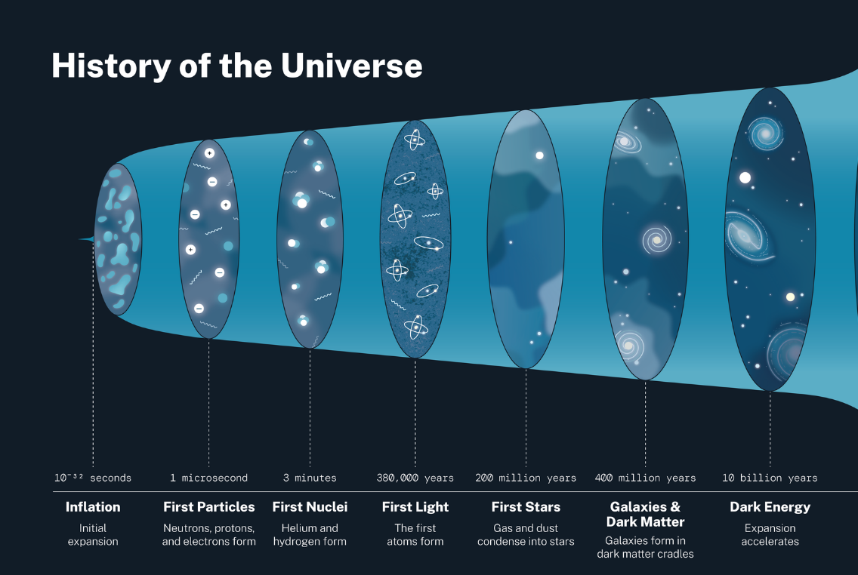
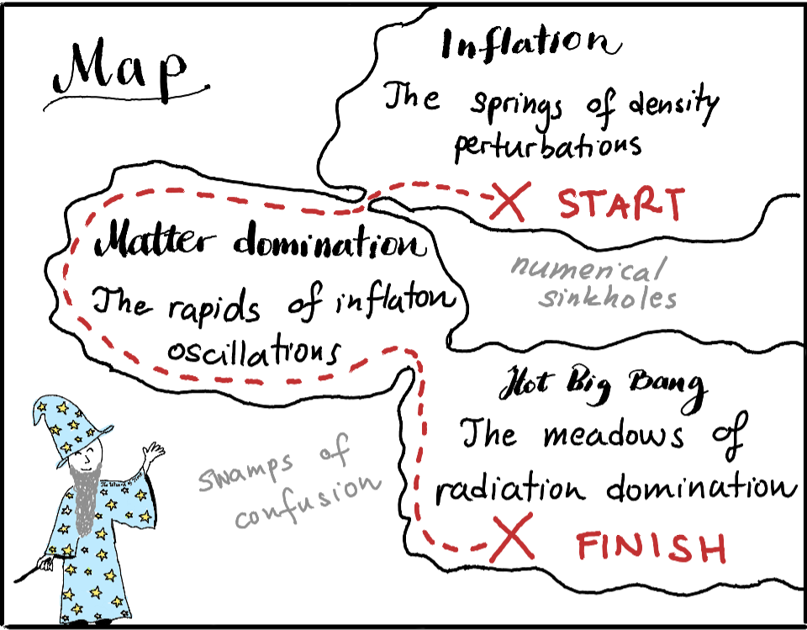
Reheating: from inflation until radiation domination

Slide 4
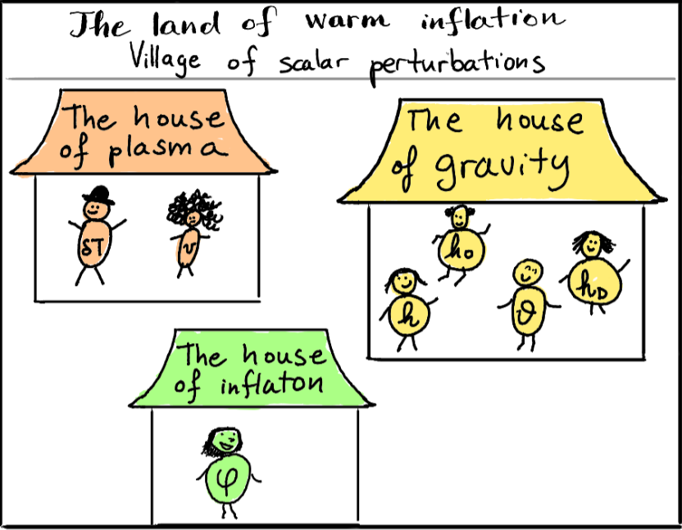
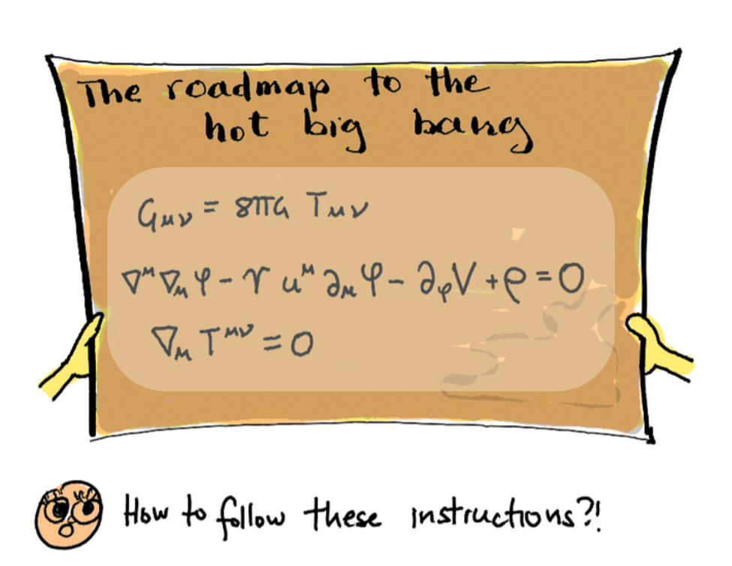
Setup

Slide 5

Goal
Model independence of reheating?
Describe evolution of scalar perturbations through reheating:
- analytical equations
- numerical solutions
Gauge invariance
Careful noise treatment
No slow roll
...
A concrete example: Standard Model
Berghaus et al. 2503.18829

Slide 6
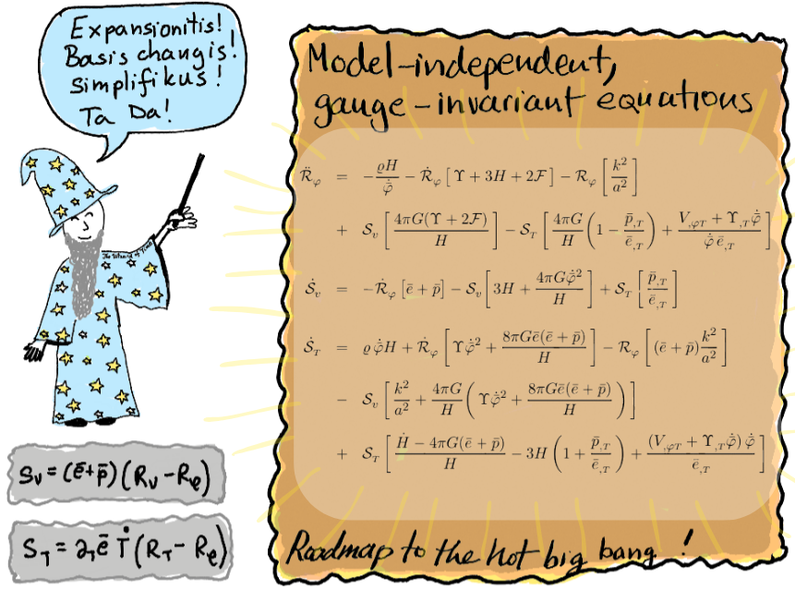
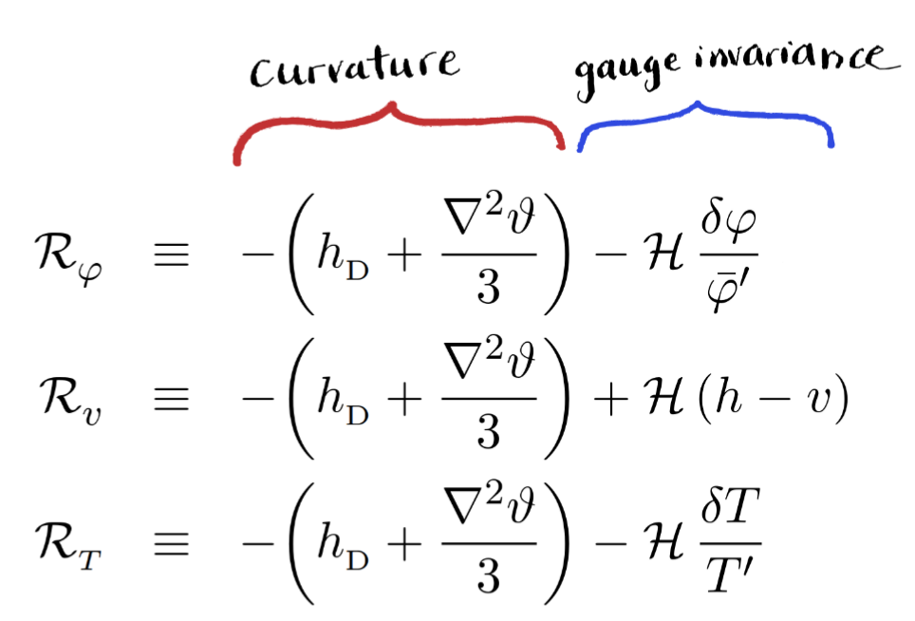
Goal 1: derive evolution equations

Slide 7
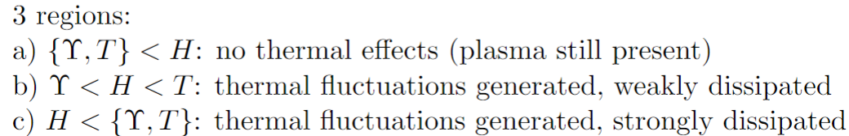
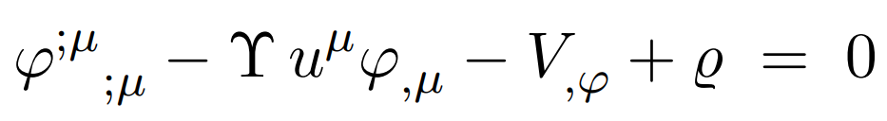



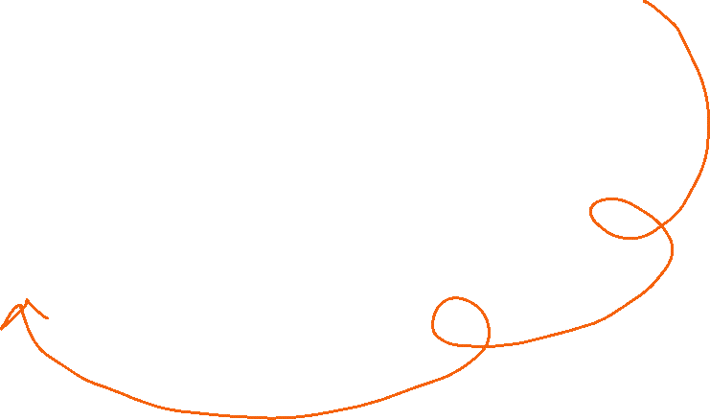

Strong vs Weak regime
Vary friction coefficient to access different regimes!

Slide 8
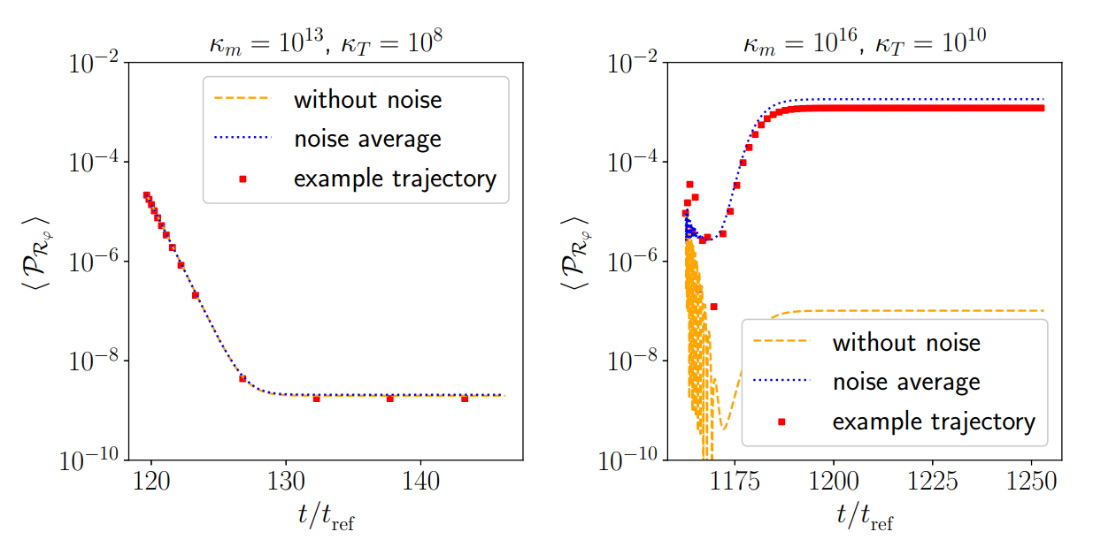



Power Spectrum: Weak versus Strong regime
Noise is important in strong regime!

Slide 9
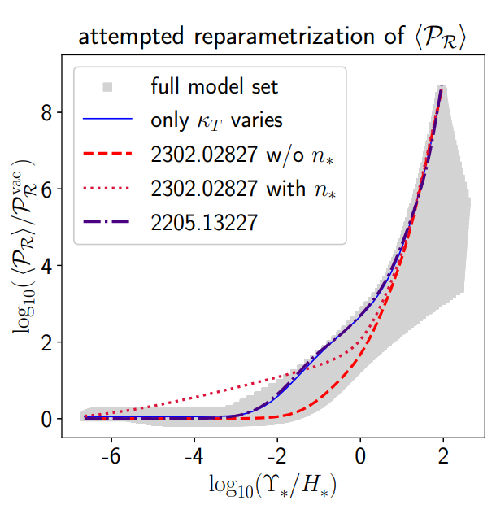
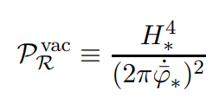
Model independence?

Slide 10
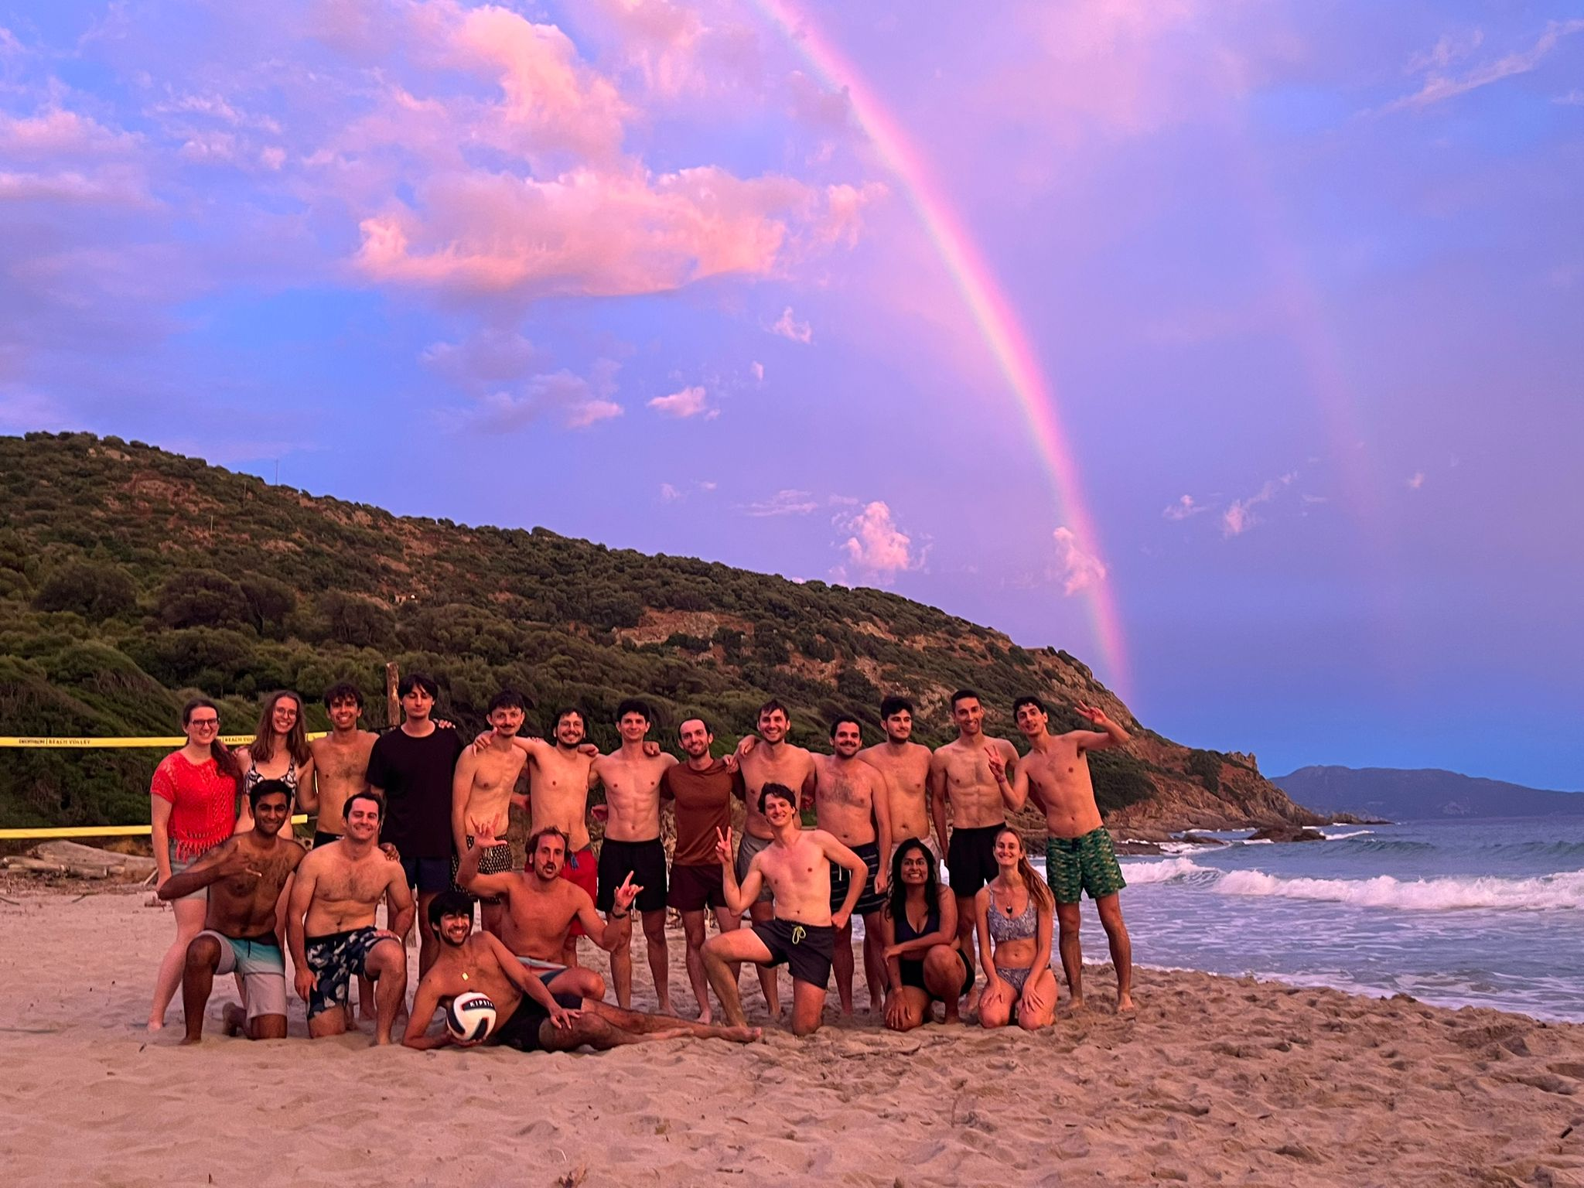

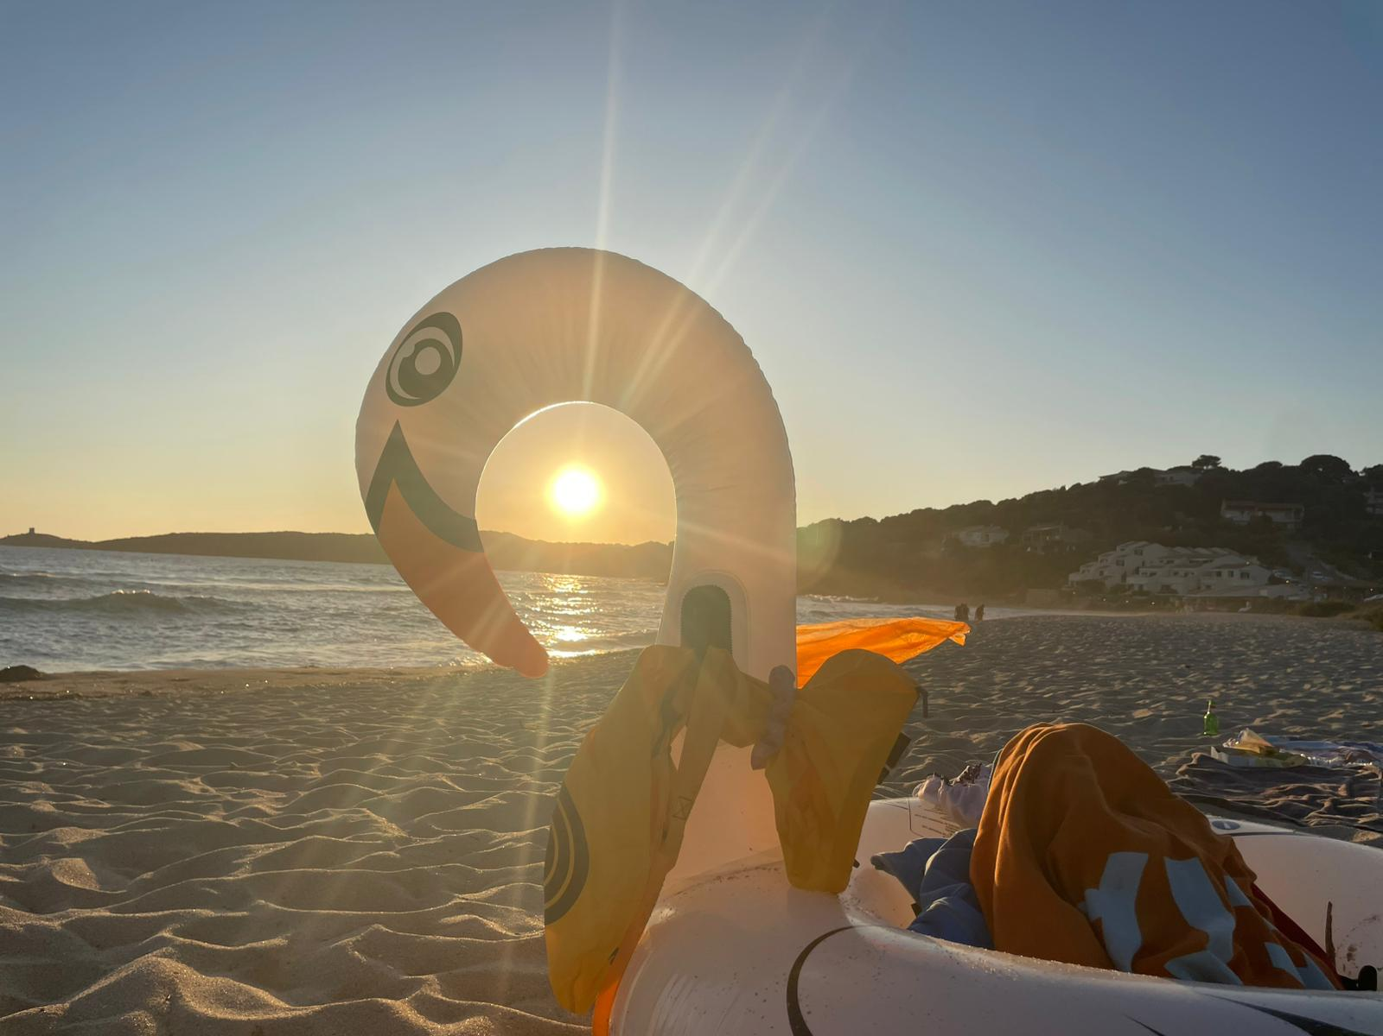
Thanks!

Slide 11

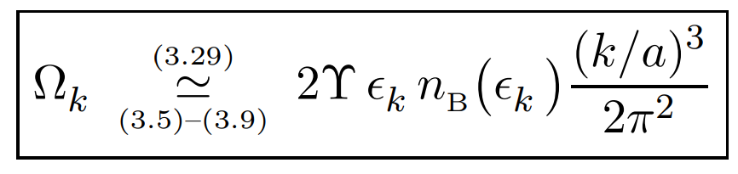
Noise autocorrelator
Match quantum-statistical power spectrum to classical thermal (non-equilibrium)
→ noise autocorrelator

