Slide 1
Summary of KW8
 | Monday 13th November | Tuesday 14th November | Wednesday 15th November | Thursday 16th November | Friday 17th November
Achievements | * MDI BPM check * First test of Petra IV kicker magnet * Transmission of unfocused 2.5 pC beam through all (unaligned) TWAC tubes | * Degaussing all quads (much nicer beam shape) * 7.5 pC TWAC WP1 focused on EA.A1 * Center of the 6 (unaligned) TWAC tubes found | * Investigation on hexapod motion problem * Starting to transport 7.5 pC WP1 beam to SH.D1 * Quick MDI BPM and DAMON tests * First vertical alignment scan overnight (steerer-based) | * 7.5 pC WP1 beam transported to SH.E2 without losses * Manual vertical alignment scan with larger steerers ranges * Gun phase stability measurement overnight | * Horizontal alignment of the TWAC tubes 4 and 5 (hexapod-based) * Bunch duration measurement with PolariX (close to simulation) * Scanning dielectric thickness and aperture of tubes 4 and 5 * Trying to see streaking
Perturbating events | - | - | * Hexapod problem, Y translation and X angle not useable (Smaract informed) | * Petra IV kicker aperture strongly limiting transport * TWS2 water issue | * Streaking visible but too weak for measurement yet (suspicion that transport is limiting)

Slide 2
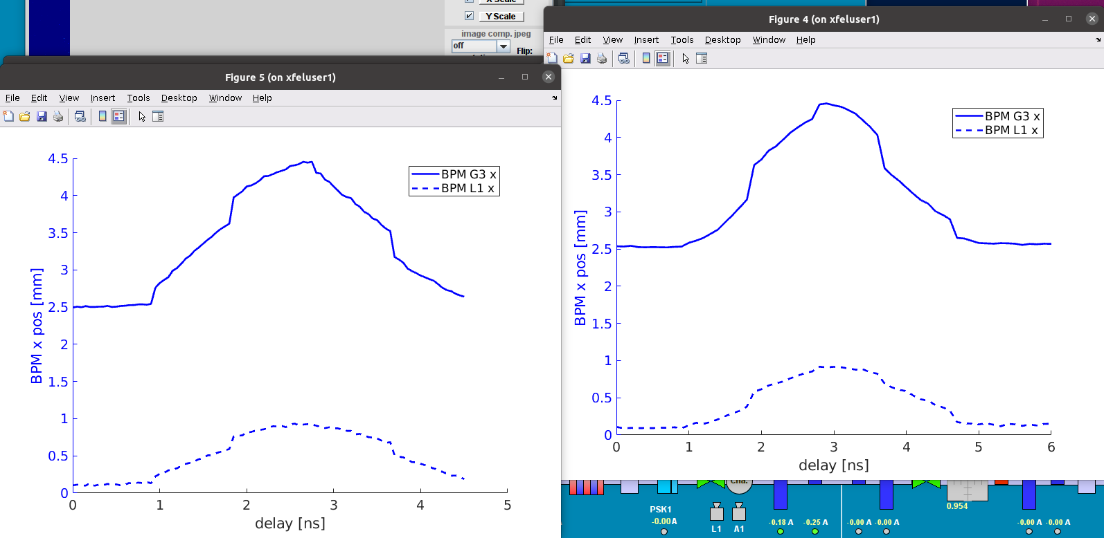
Petra IV kicker magnet tests
Timing overlap found, but first measurements compromised by script error. Everything ready for next measurement campaign

Slide 3
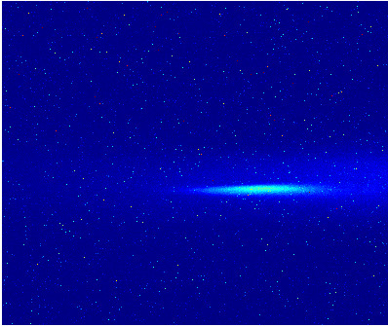
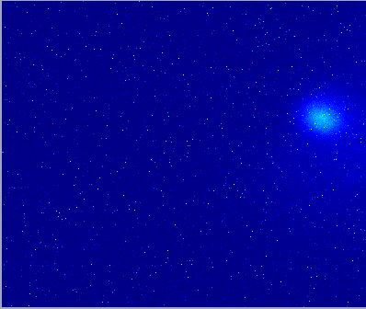
Degaussing quads
All quads were off since more than 10 days, but still disturbing significantly the beam.
Before
After

Slide 4
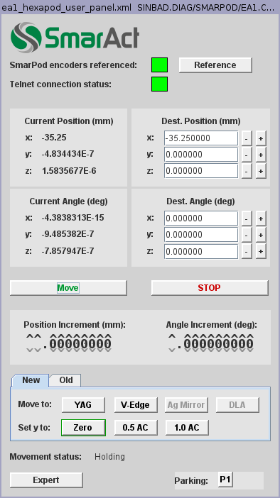
Hexapod motion problem
Rotation happens in X when asking for pure translation in Y

Slide 5
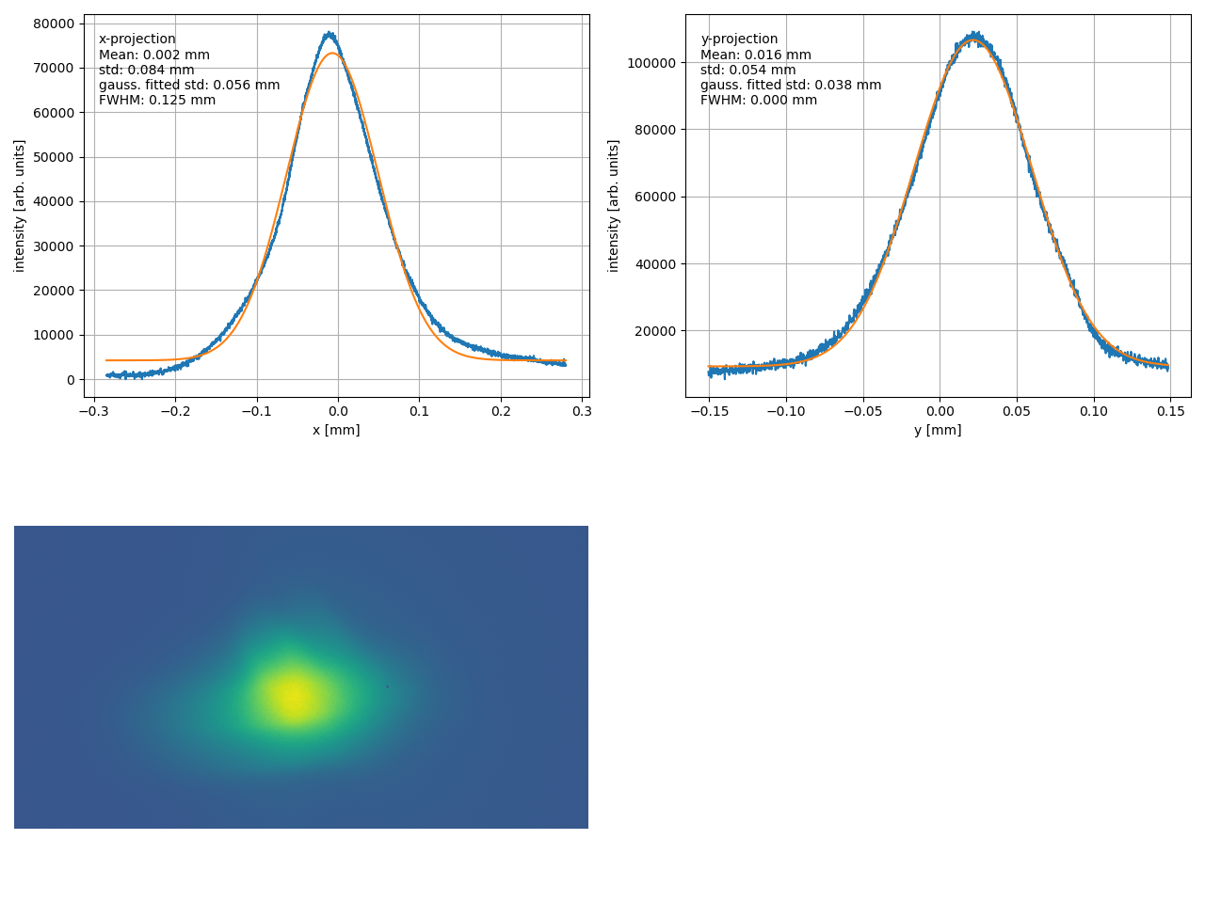
Beam on EA.A1
Small enough to pass through the tubes with significant offset.

Slide 6
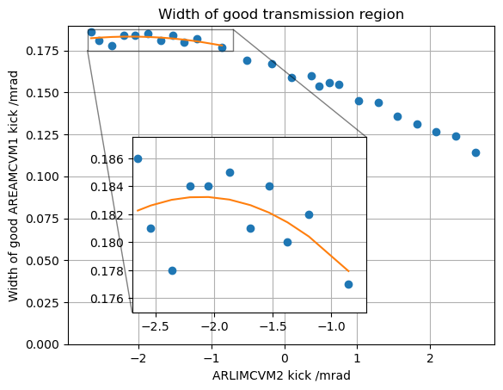
Steerer-based vertical alignment with TWAC tubes
Quite lengthy procedure (≈ 5 hours) and limited by the steerers strenghts.

Slide 7
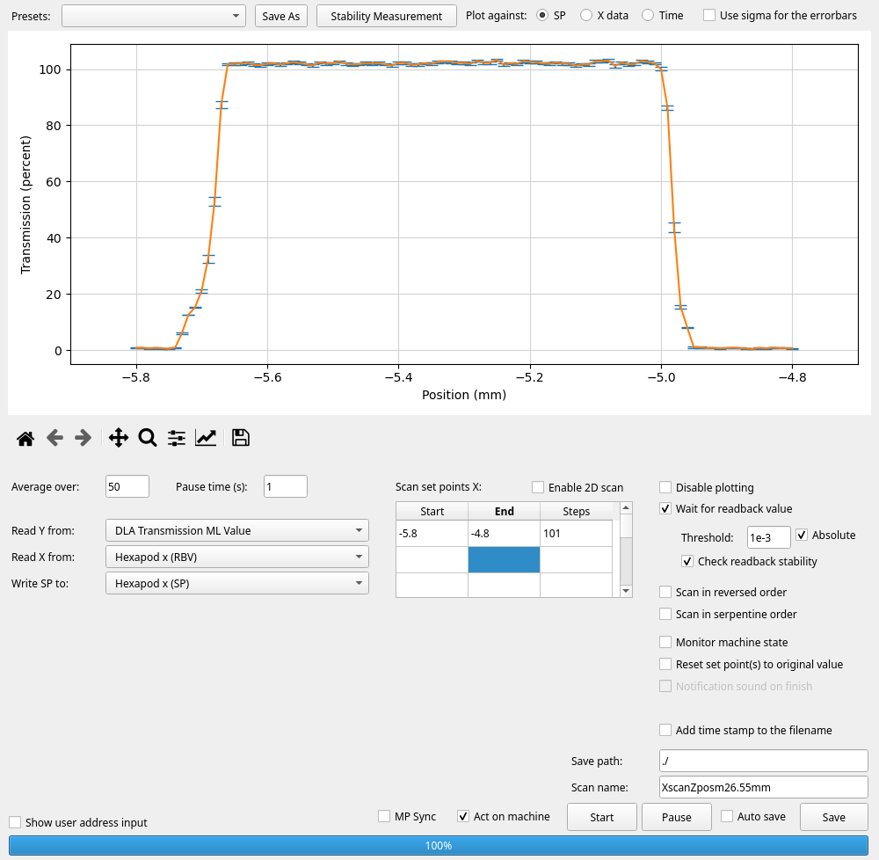
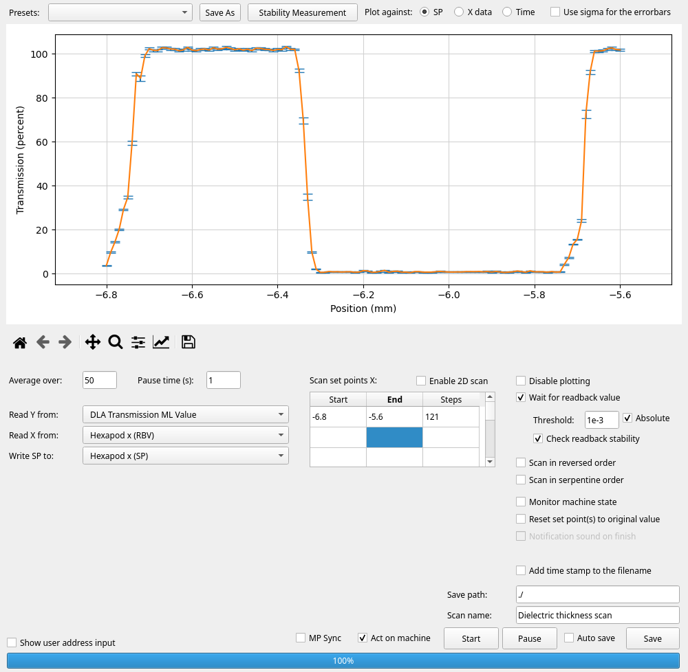
Tube characterization
695 µm (700 µm design)
650 µm (650 µm design)
Tube parameters (aperture and dielectric thickness are quite close to the manufacturer design values)

Slide 8
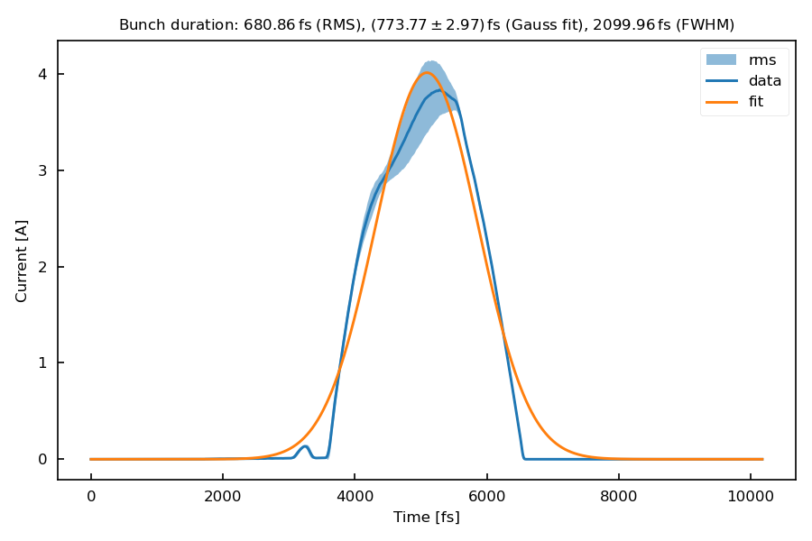
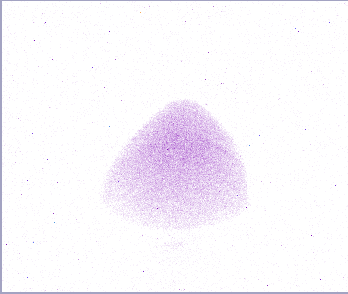
PolariX bunch duration measurement (S. Jaster-Merz)
Not moving when moving tube (head)
Moving when moving tube (tail)
Simulation predicts 650 fs rms at TWS2 exit (transport and phases uncertainties could easily explained the discrepancy) → Good agreement. Head and tail of the bunch has been identified (through wakefield effect).

Slide 9
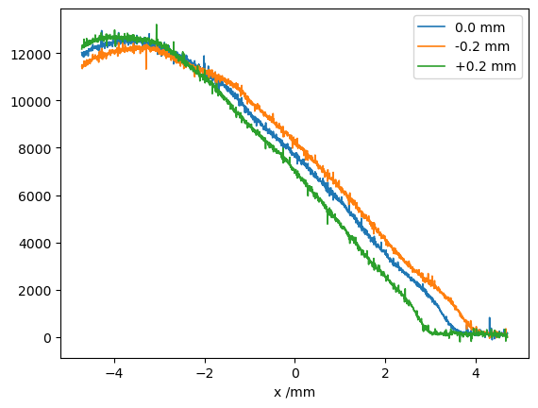
Wakefield effect
Visible, but too weak → The transport (R33 and R34) are likely not optimized enough.

Slide 10
Plan for KW9
Install JAI camera again
Setup new (lower momentum) TWAC working point and optimize transport to find stronger streaking
Discuss with Artem about enlarging MR screens field of view

Slide 11
Schedule
Week 9
Date | Shift leader
16.10. | Thomas, Max (remote)
17.10. | Thomas, Max (?)
18.10. | Thomas, Max (?)
19.10. | Thomas, Max (?)
20.10. | Max, Thomas (?)
If you want to learn or join the shift: please give the shift leader a call (BKR 2840 / SINBAD Box 2454)

