Slide 1
ARES Operation Meeting
Summary of week 09 / 2024
Max Kellermeier, on behalf of the ARES crew

Slide 2
Summary of week 09
Mon. 26th Feb | Tue. 27th Feb | Wed. 28th Feb | Thu. 29th Feb | Fri. 1st Mar
On-crest phases reset JAI cam (timing setup) reinstalled New working point established (low momentum) Overnight gun phase stability measurement | 2D steerer scan for vertical alignment on wakefield tube Horizontal alignment Streaking observed on two screens 2D steerer scan for vertical alignment on different tube (tube 3) overnight | Horizontal scan and comparison to parking position to determine center of tube Offset scan for streaked beam data acquisition on MR.R1, MR.R2 and BC.E1 Beam transport for Momentum measurement and Bunch duration measurement (TDS Modulator faulty) | After re-established WP: Longitudinal Bunch profile measurement with PolariX Triple On-crest WP for checking phases TWAC WP2 set up Beam focused on EA.A1 Transport to SH.D1 & PolariX measurement 2D steerer scan for vert. alignment on two tubes, overnight | Horizontal alignment on both tubes Aperture and dielectric thickness scans (low charge) Offset scan for streaked beam on BC.E1 with tube 1 Offset scan for streaked beam on BC.E1 with tube 2 Spectrum measurement with influence of wakefields PolariX measurement with beam unfocused in EA
No success in focusing beam on EA.A1 screen | TWS solenoids cannot be degaussed (no procedure defined) | TDS modulator not going to trigger mode
Tunnel open at lunch time LI.R2 & MR.R1 cam back in operation LI.R2 calibrated (MDI) |  | Tunnel opened at night for TDS modulator inspection
Achievements
Difficulties
Notes

Slide 3
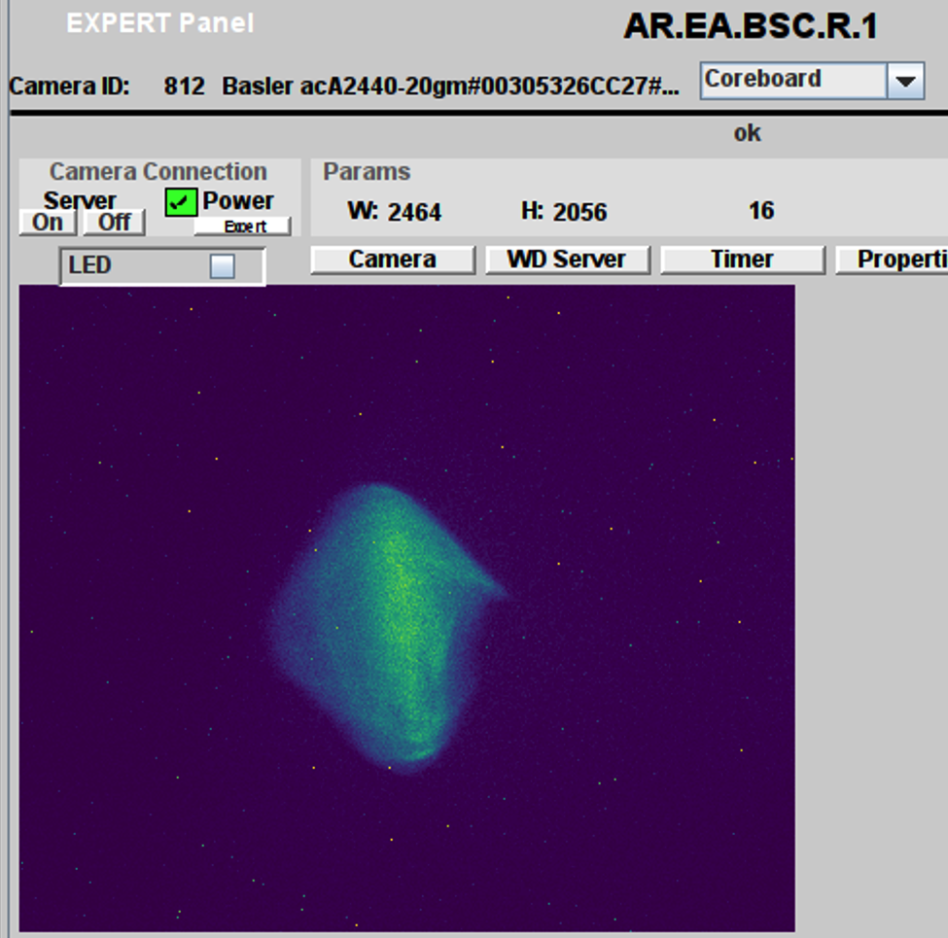
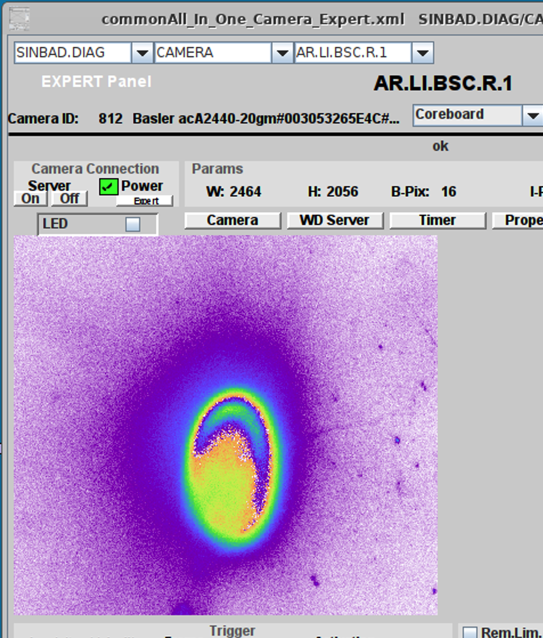
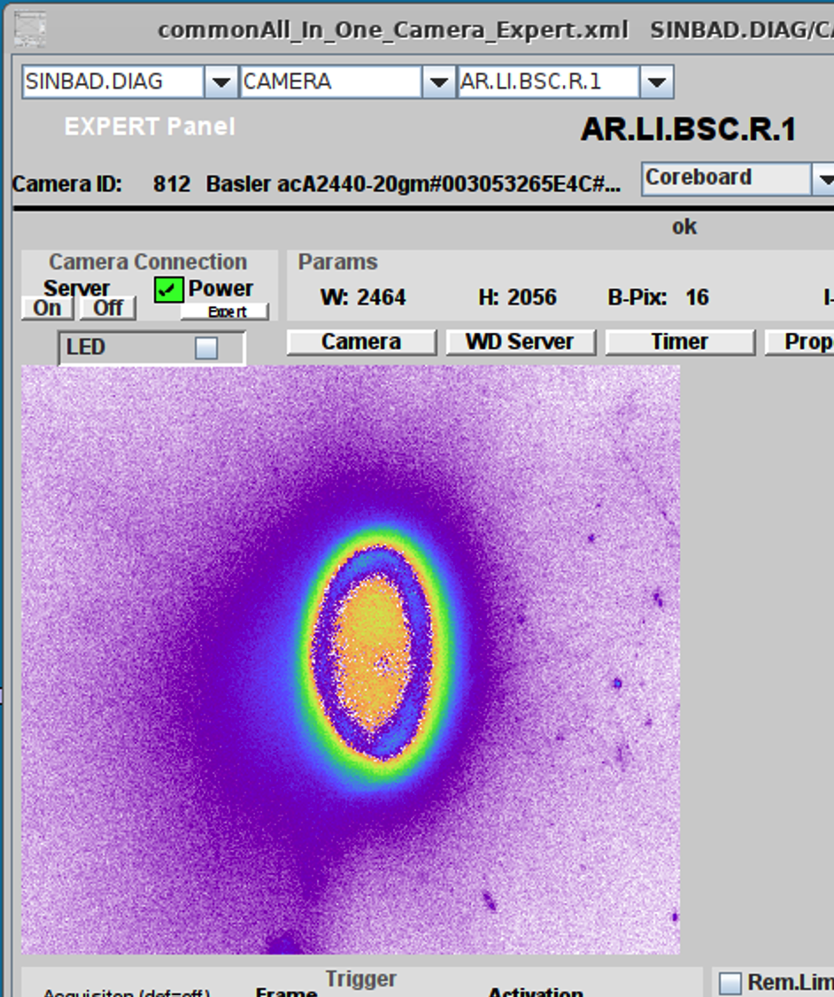

Monday: new working point
Around 64 MeV
before
after
No success in focusing beam on EA.A1
Steering of UV pulse on cathode via Picomotors

Slide 4
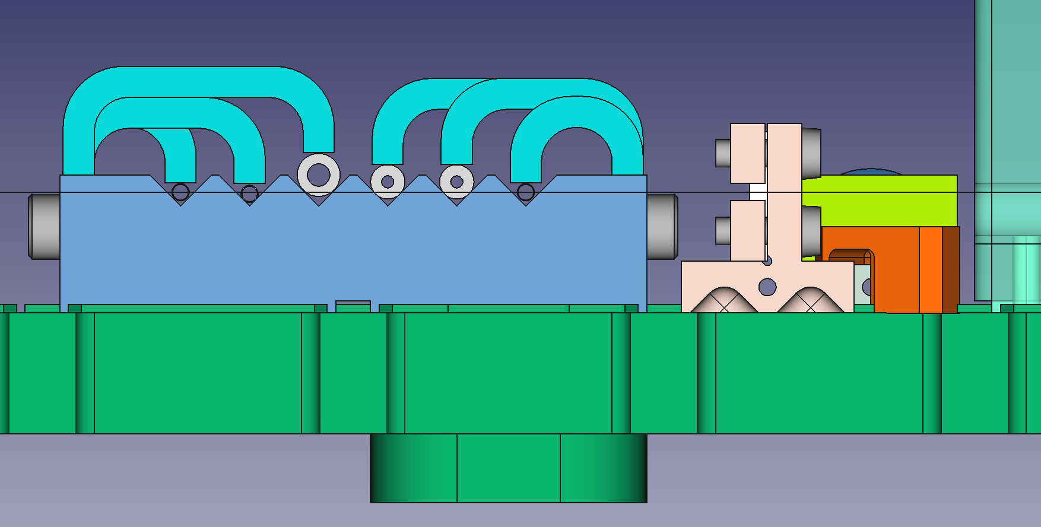
Remark: Finding beam on JAI cam
More challenging now due to clamp on DLA holder
Vertically more limited. Might see clipped beam if unfocused

Slide 5
Gun phase stability measurement
The gun reference phase was rather stable (0.2 degree deviation at maximum) but the global gun phase drifted monotonically by around 1 degree. Something (laser timing ?) is making the gun phase drift continuously.

Slide 6
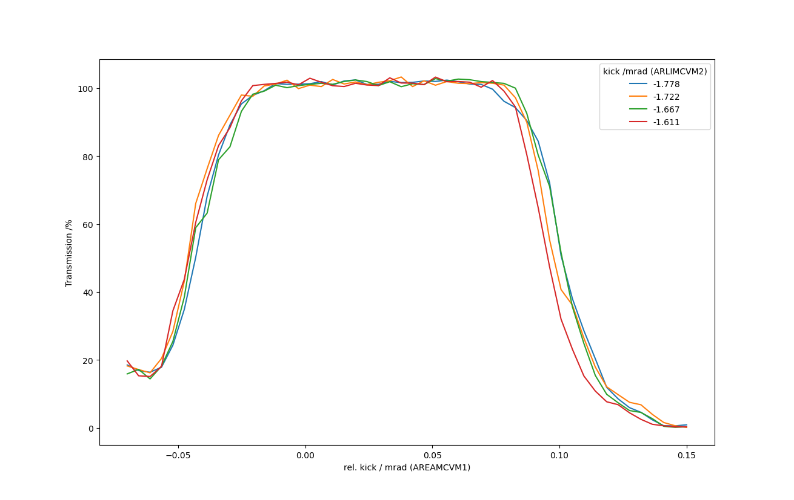
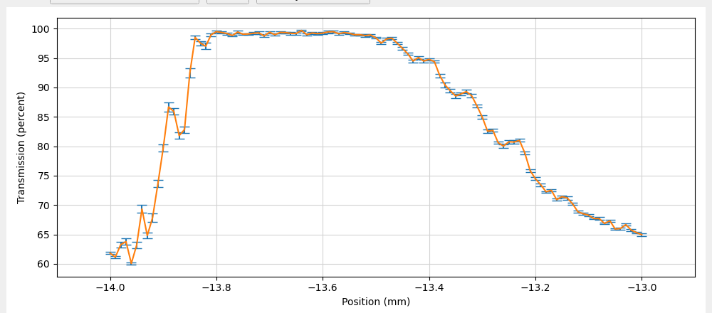
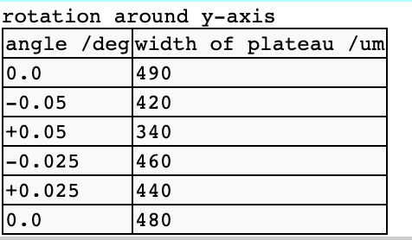
Tuesday: Alignment on tube
Using established WP
Beam on EA.A1 too large, beam size estimated
2D vertical steerer scan: LI.CVM2 & EA.CVM1, low charge (0.4 pC)
Horizontal alignment with hexapod

Slide 7
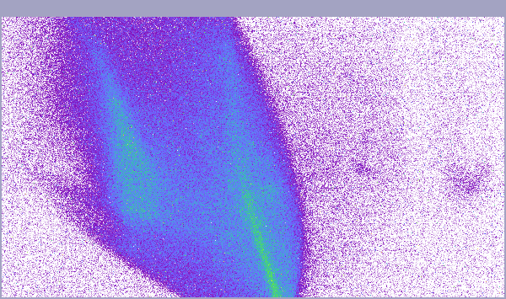
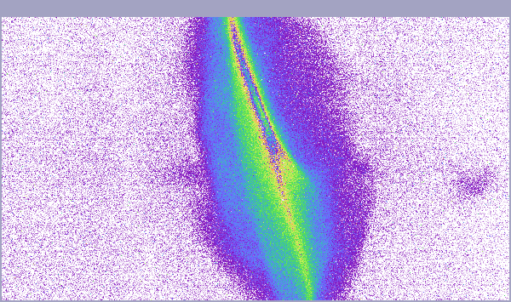
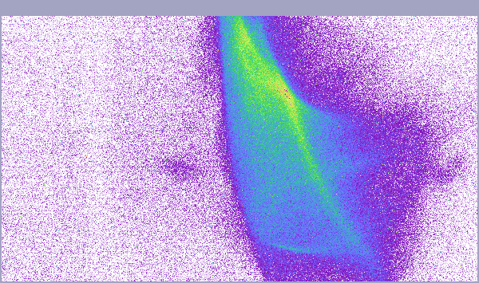
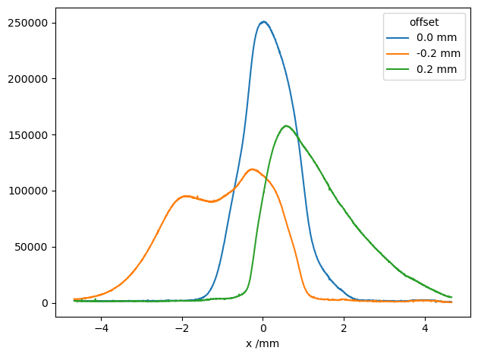
Streaked Beam On MR.R2
(wrong tube)
Offset: -0.2mm
Centered in tube
Offset: +0.2mm
Only 95% transmission

Slide 8
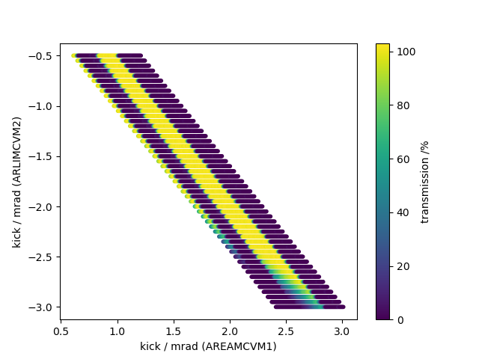
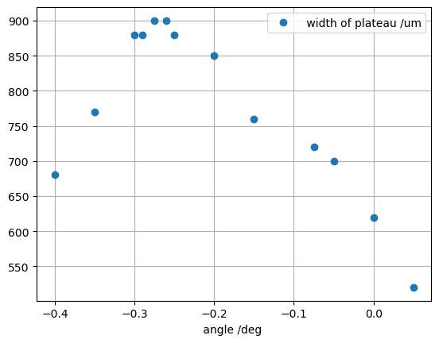
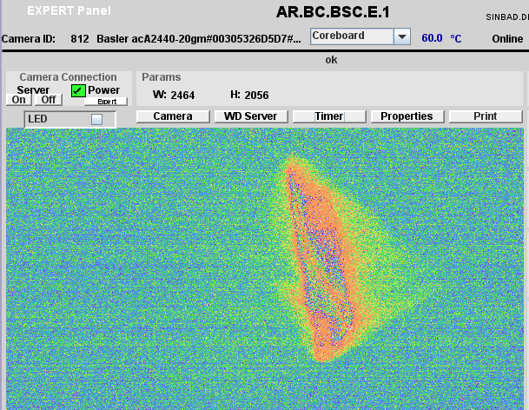
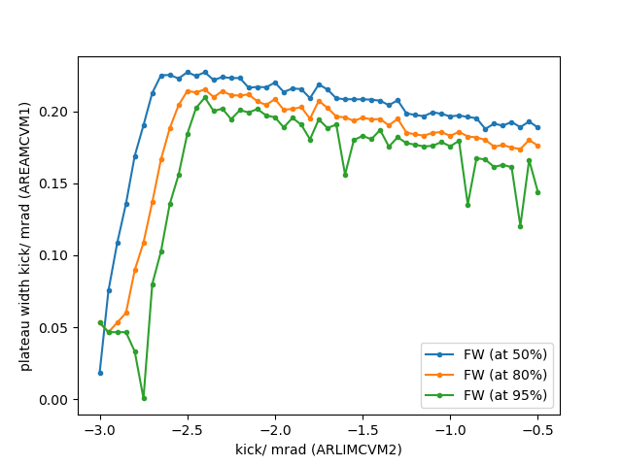
Wednesday
Three offset scans with this WP
Streaked beam on BC.E1 (no depth of field issue)
Vertical alignment analysis and horizontal alignment (rotation of hexapod around y-axis)
on intended tube (tube 3)

Slide 9
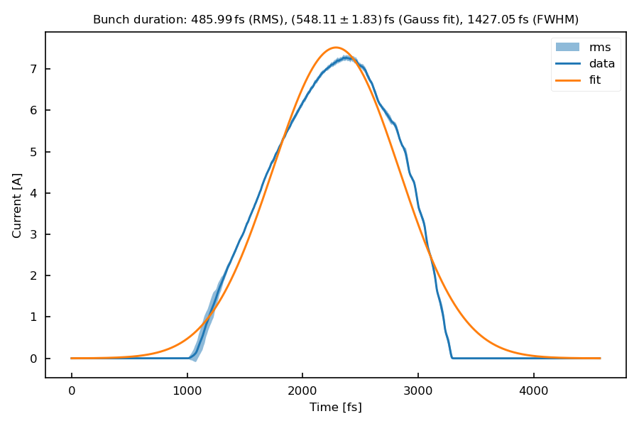
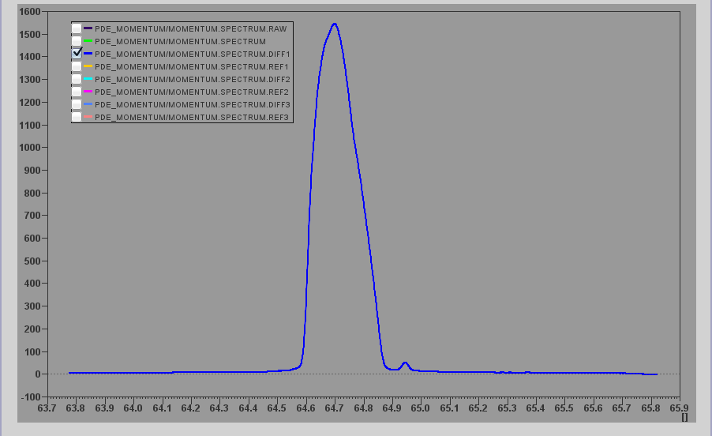
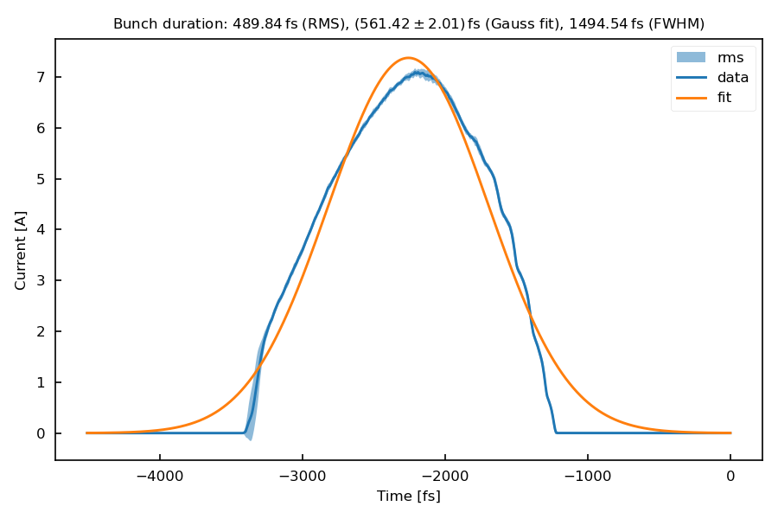
Thursday: First WP
WP re-established
PolariX measurement
WP2 set up

Slide 10
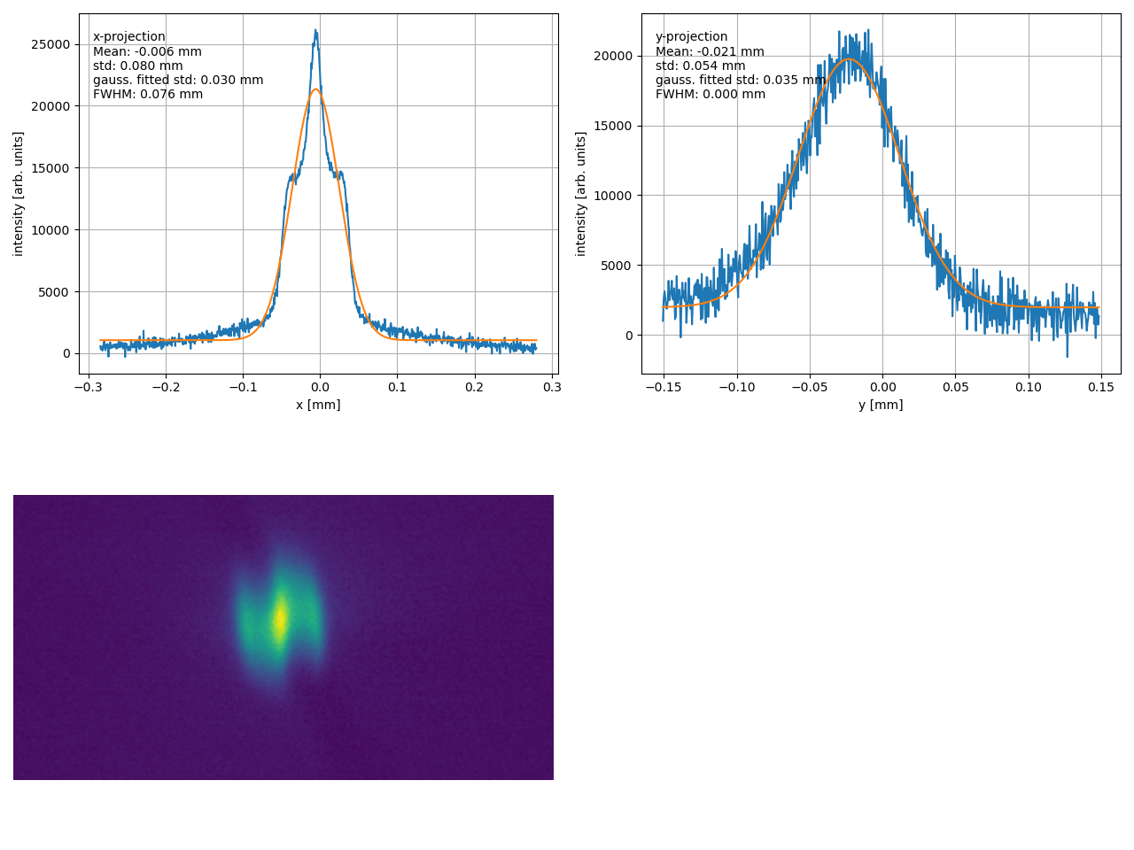
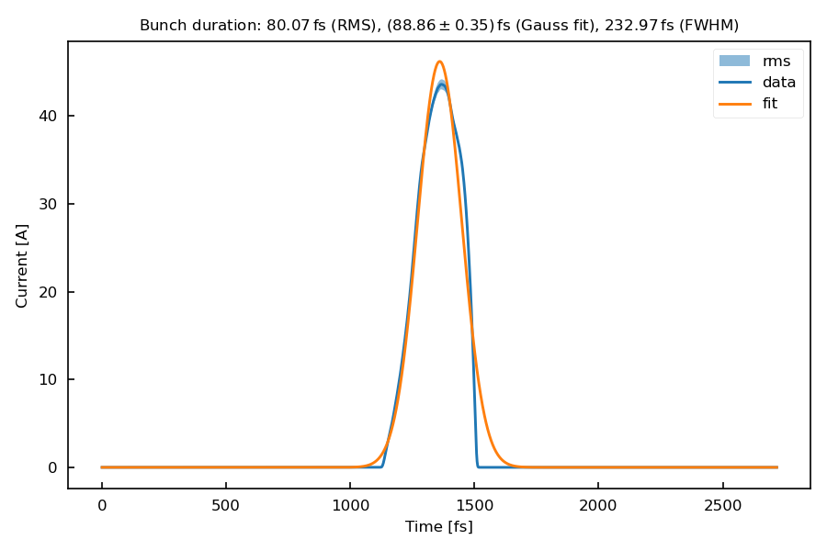
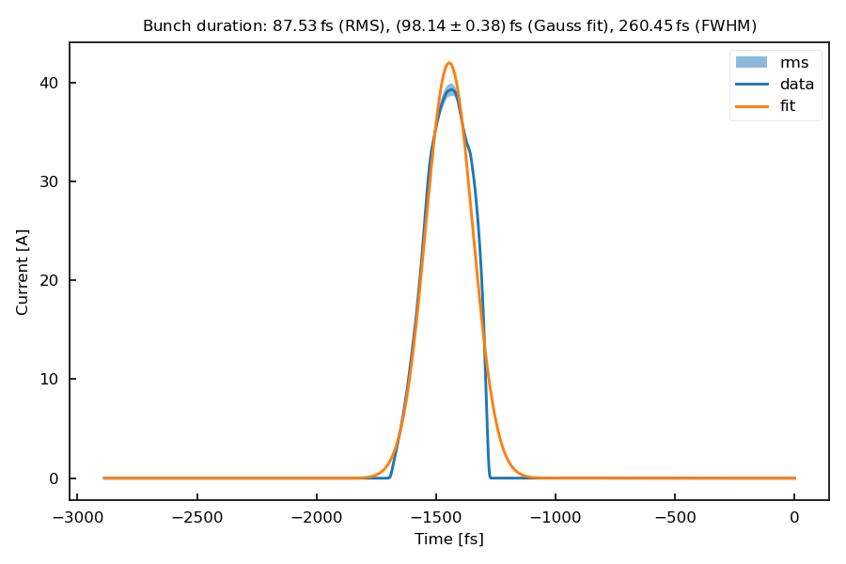
Setting up WP2
Nicely focused on EA.A1 (low charge)
Transported to PolariX
2D steerer scan preparation

Slide 11
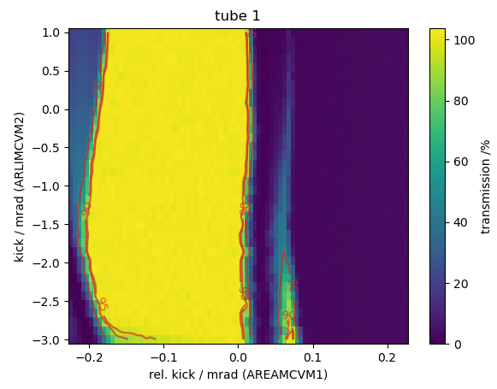
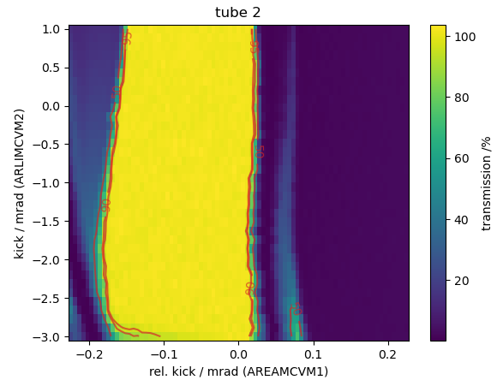
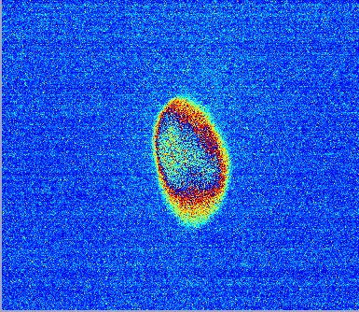
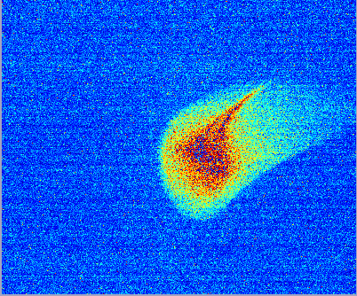
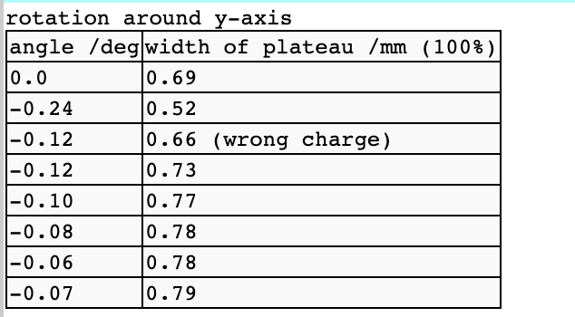
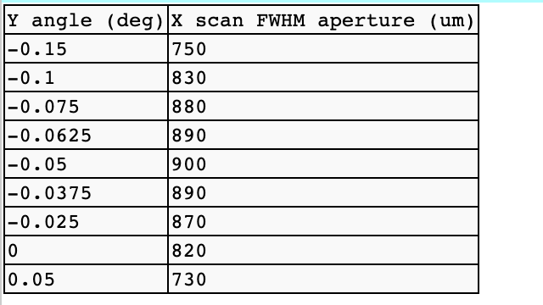
Friday: Alignment and Offset scan
On BC.E1

Slide 12
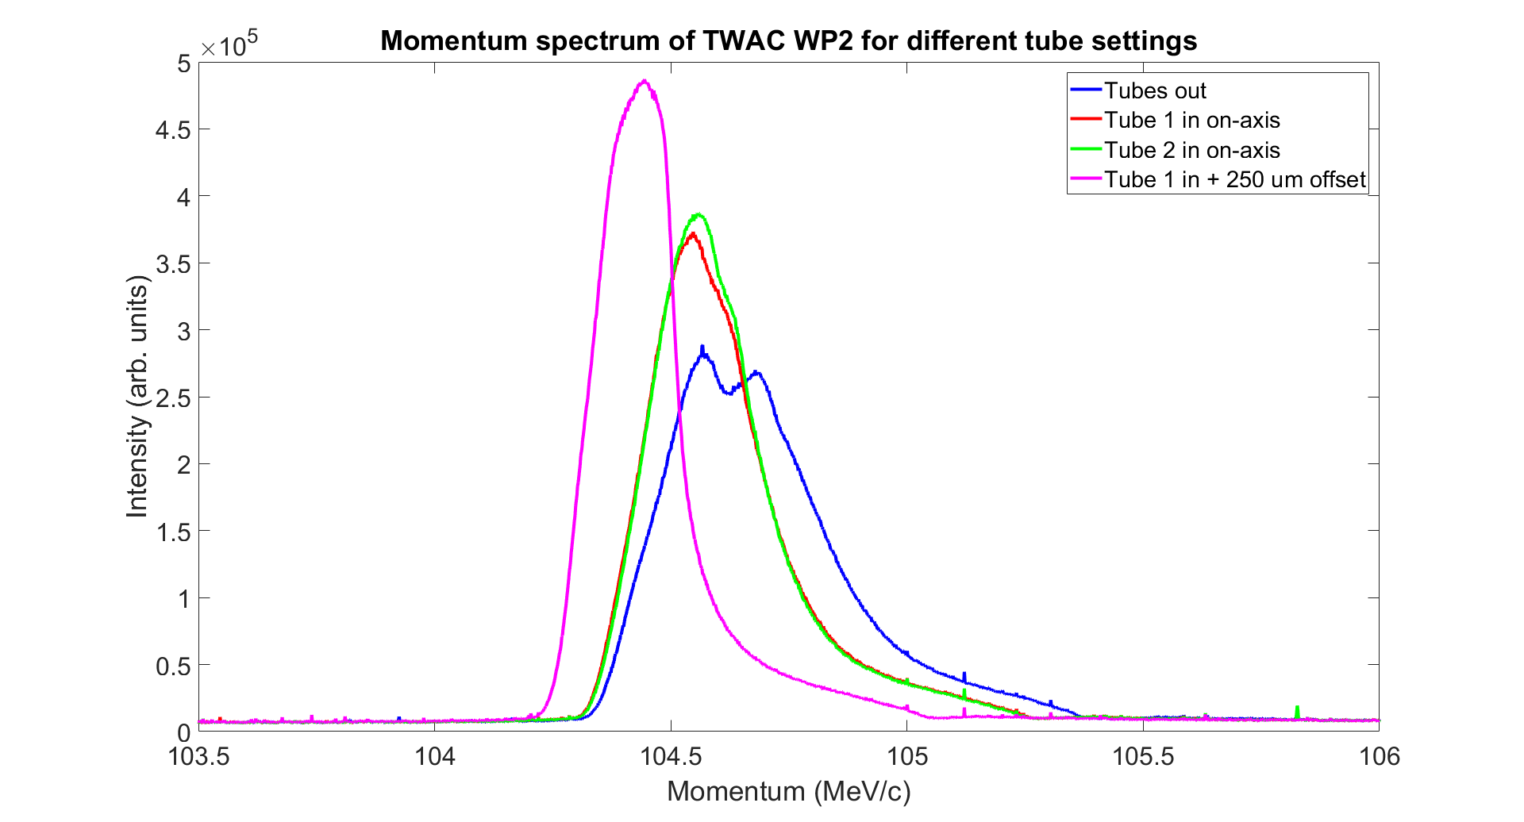
Spectrum measurements with tubes
Influence of longitudinal wakefield

Slide 13
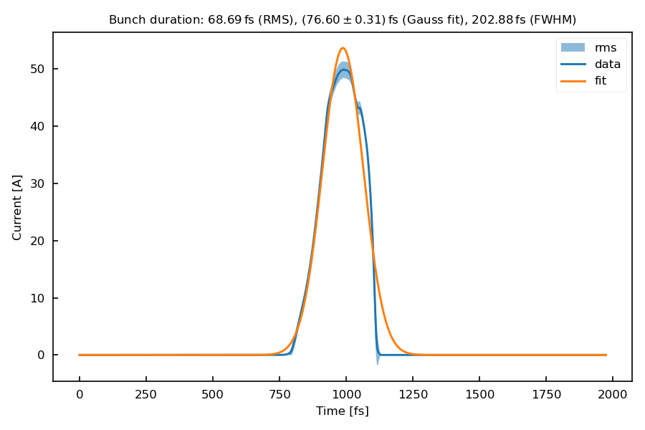
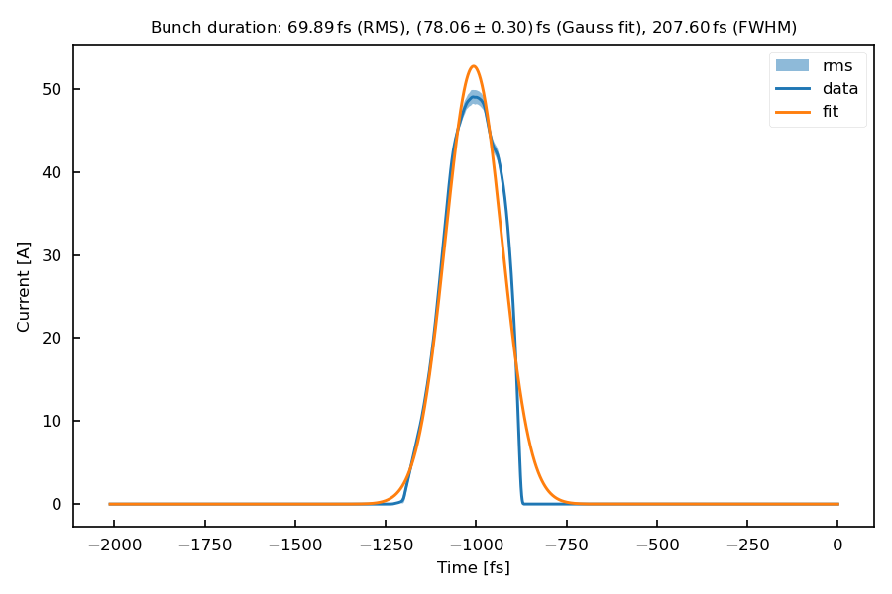
PolariX meausurements with unfocused beam
10 to 20 fs shorter than with focus in EA

Slide 14
Required Next Steps for TWAC
With respect to beamtime
Probing Monotonicity Condition and Cross-streaking with PolariX
Setting up 20 MeV WP and Streaking

Slide 15
Schedule and Plan for the Week
Week 10
Date | Shift Crew
04.03. | --
05.03. | Hannes
06.03. | Hannes, Max
07.03. | Hannes
08.03. | Sonja (?)
Tue: MPC tests, Setting up WP for UKE
Wed - Thu: UKE beamtime
If you want to learn or join the shift: please give the shift leader a call (BKR 2840 / SINBAD Box 2454)

