Slide 1

PUNCH4NFDI Project
TA4
Digital research product: Data portal and Metadata Schema
Ivan Knežević 20th of June 2024

Slide 2







WP1 - Federated science data platform
Storage4PUNCH
Compute4PUNCH
Results visualisation
Reference the Dataset
Execute the code
Reference
the code
Request computing
resources
Save the results
Request a dataset
Home institute
Information regarding resource and access rights within the institution
Create and execute a workflow
Save the workflow
Guarantee reproducibility
PLATFORM
AAI request

Slide 3
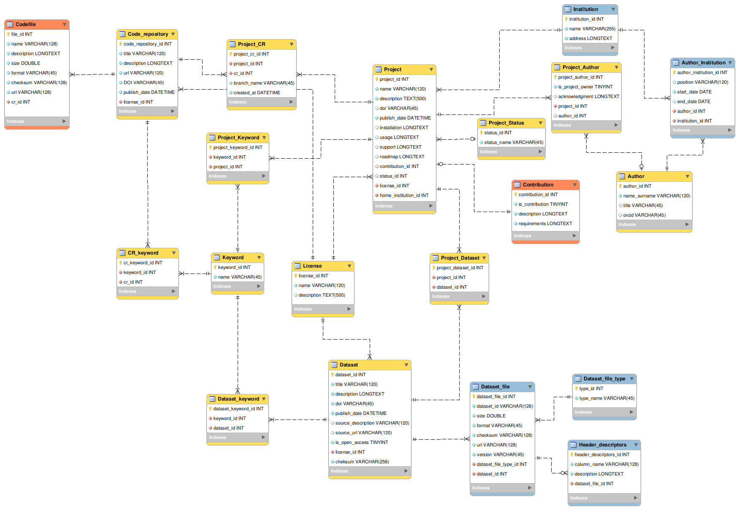
Digital Research Products
General project data
Code repository
Dataset
Minimal Viable Product

Slide 4
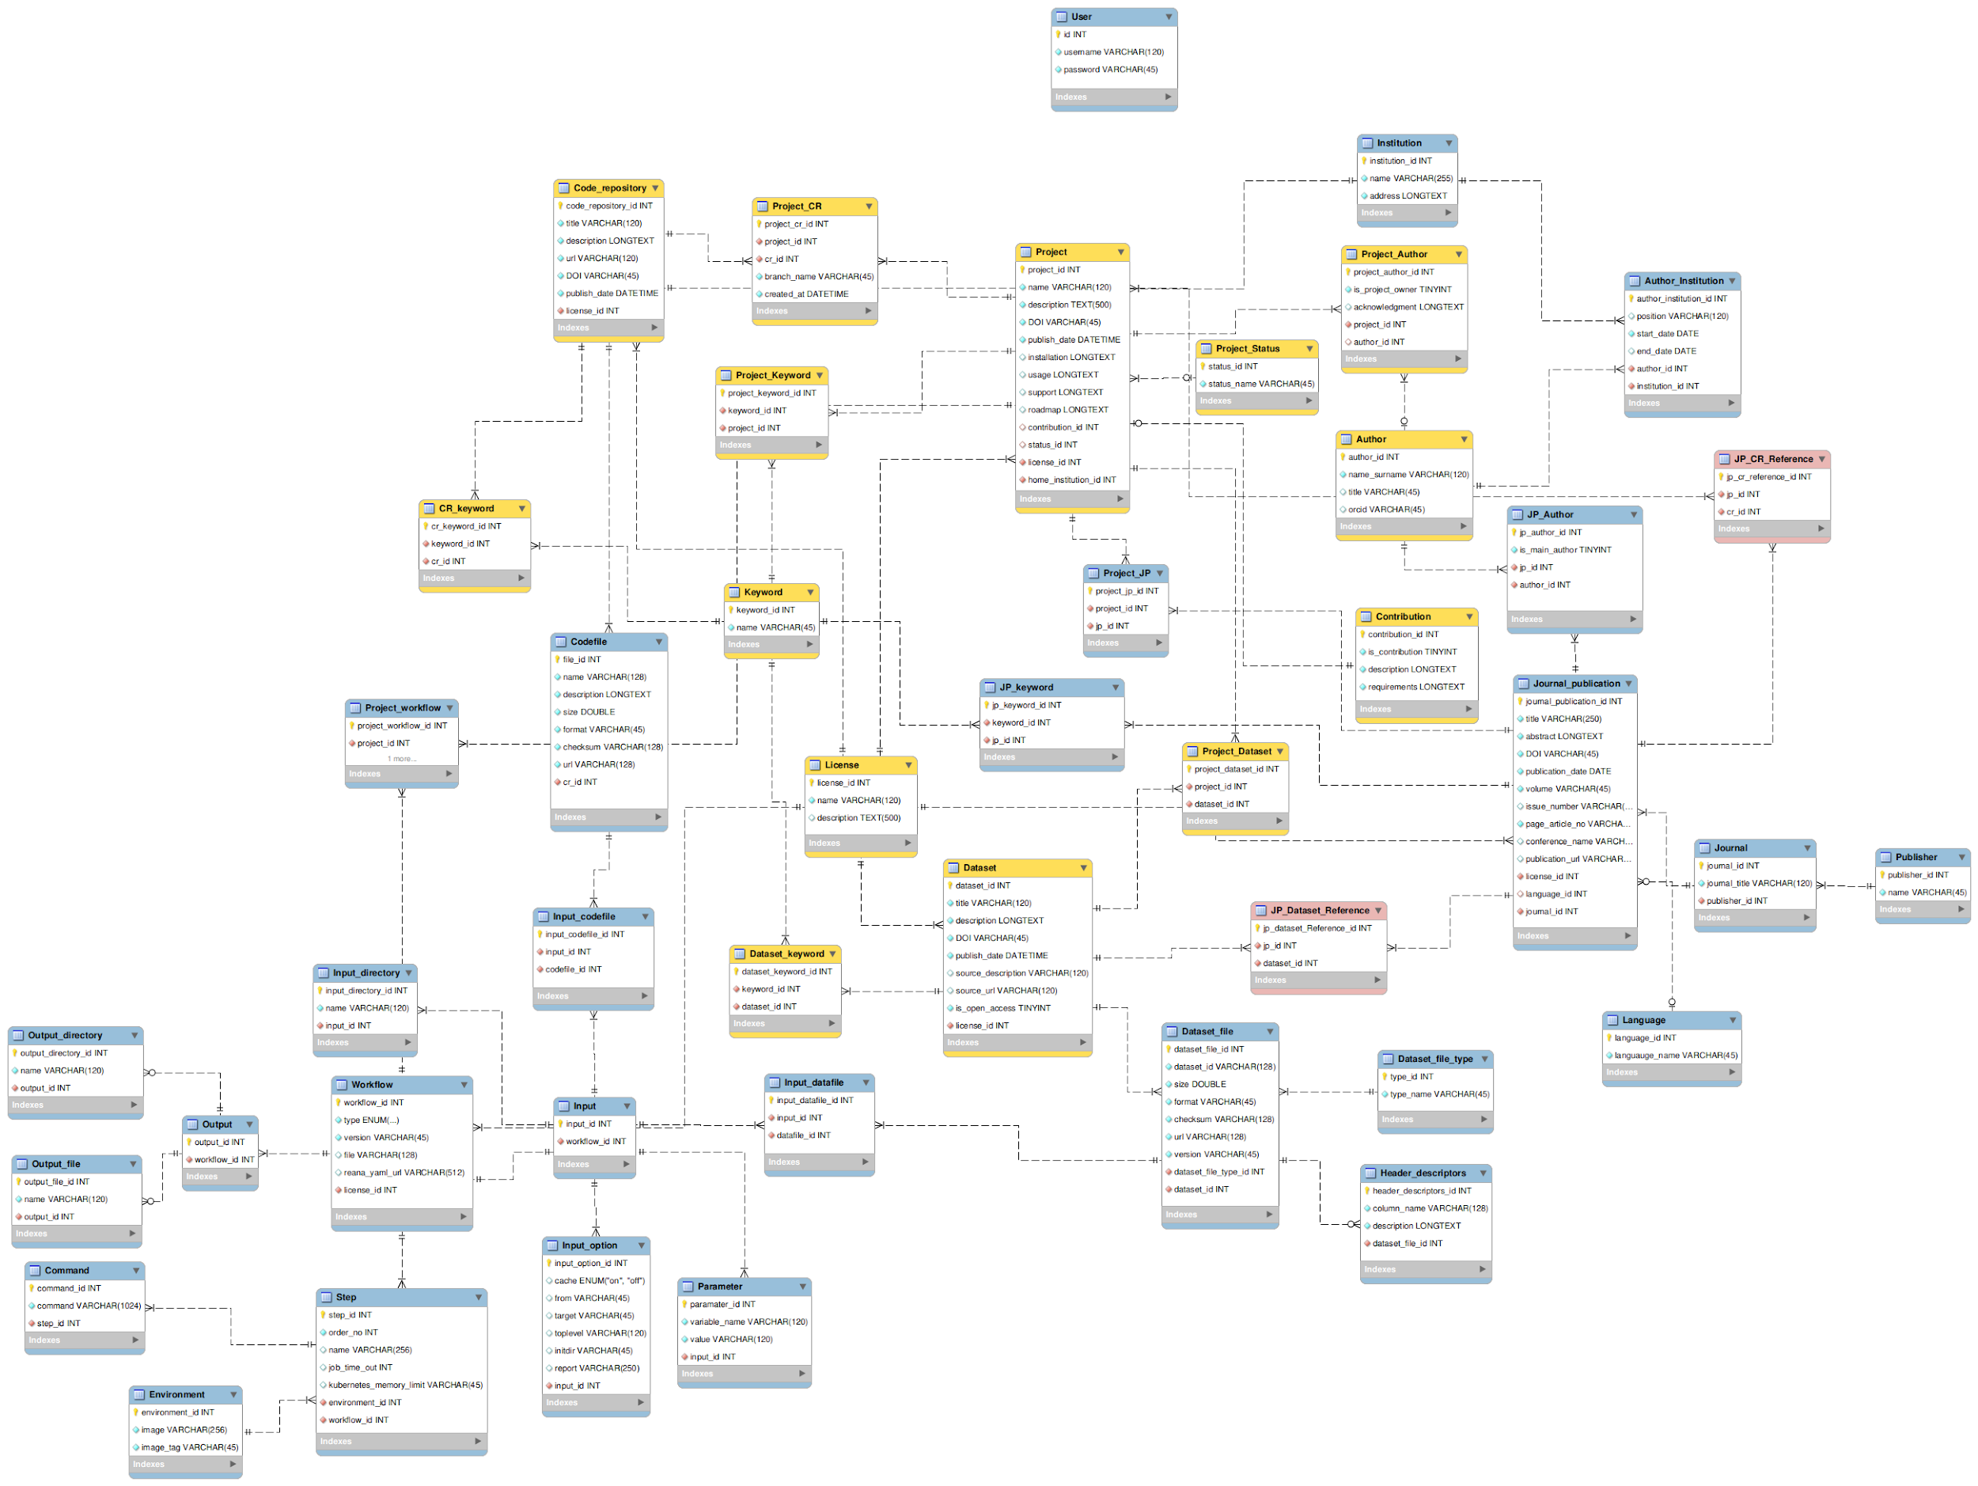
Digital Research Products
Infrastructure metadata
Code repository
General project data
Journal publication
Dataset
Workflow

Slide 5
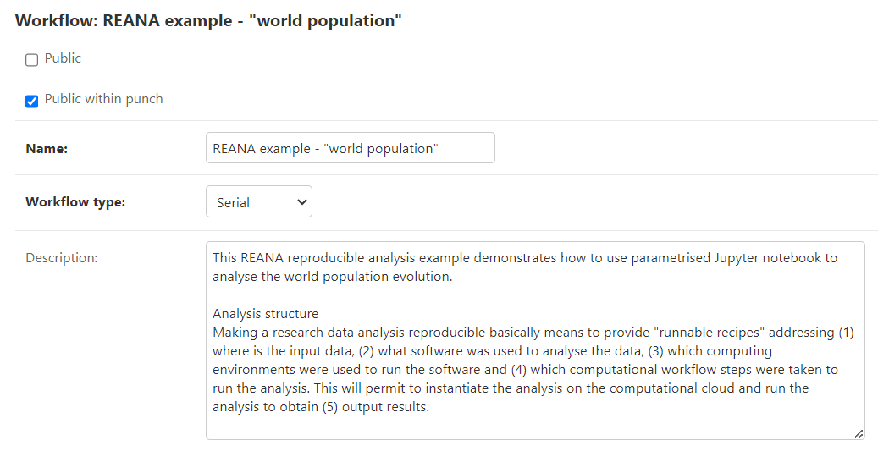
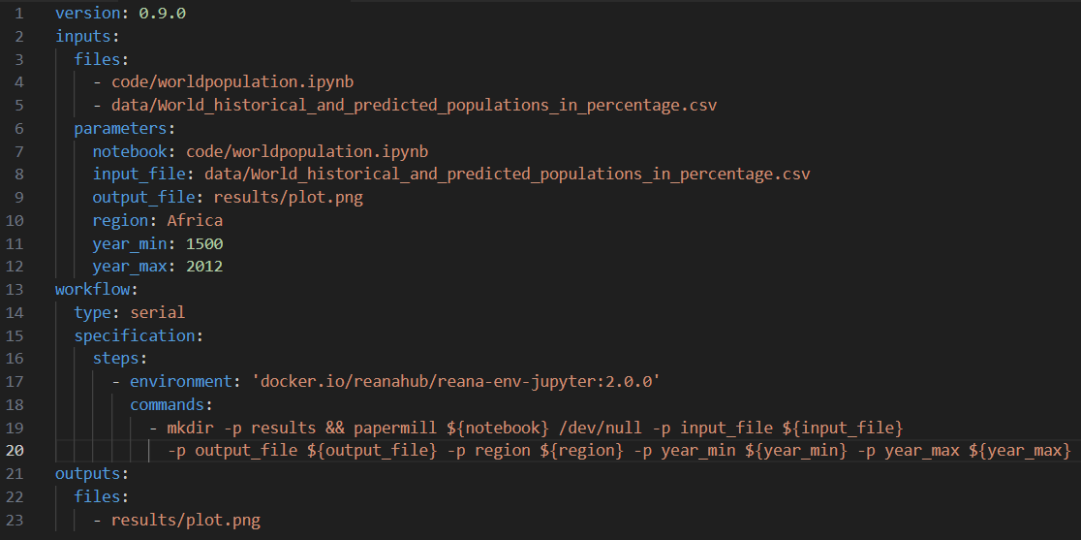
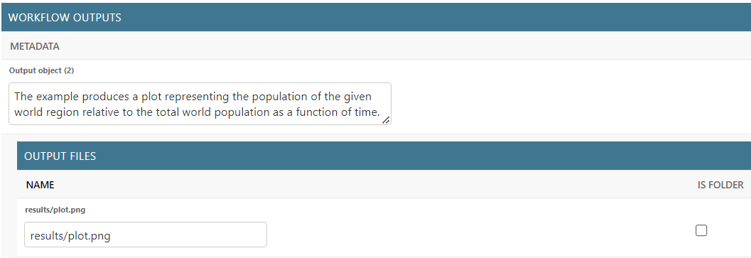
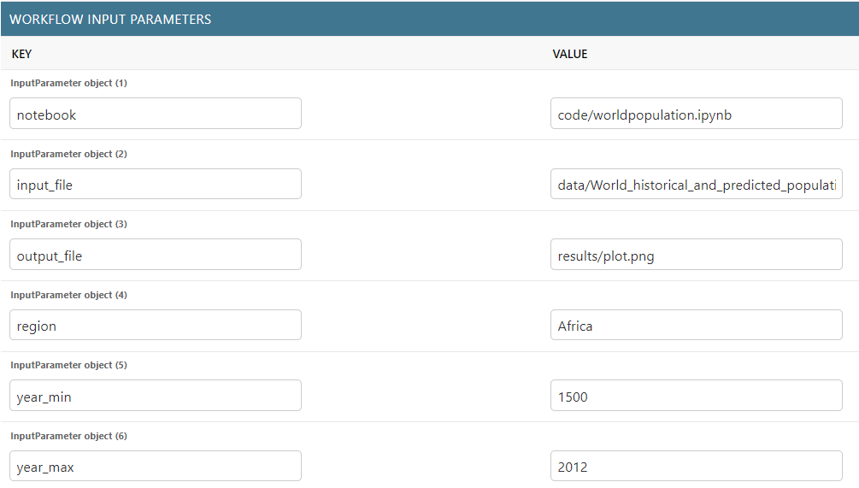
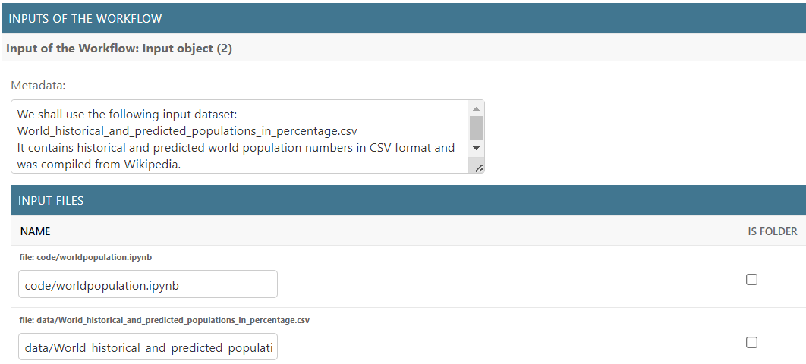
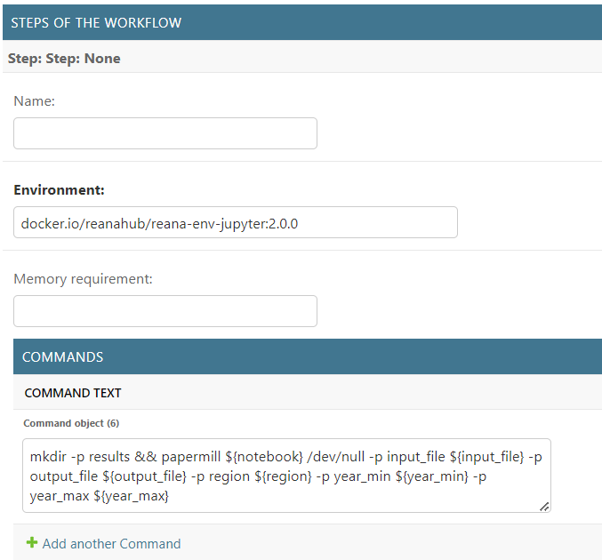
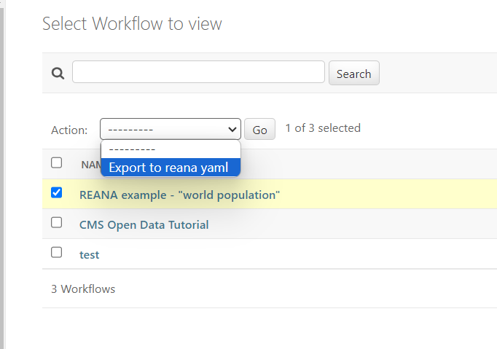
Workflows

Slide 6
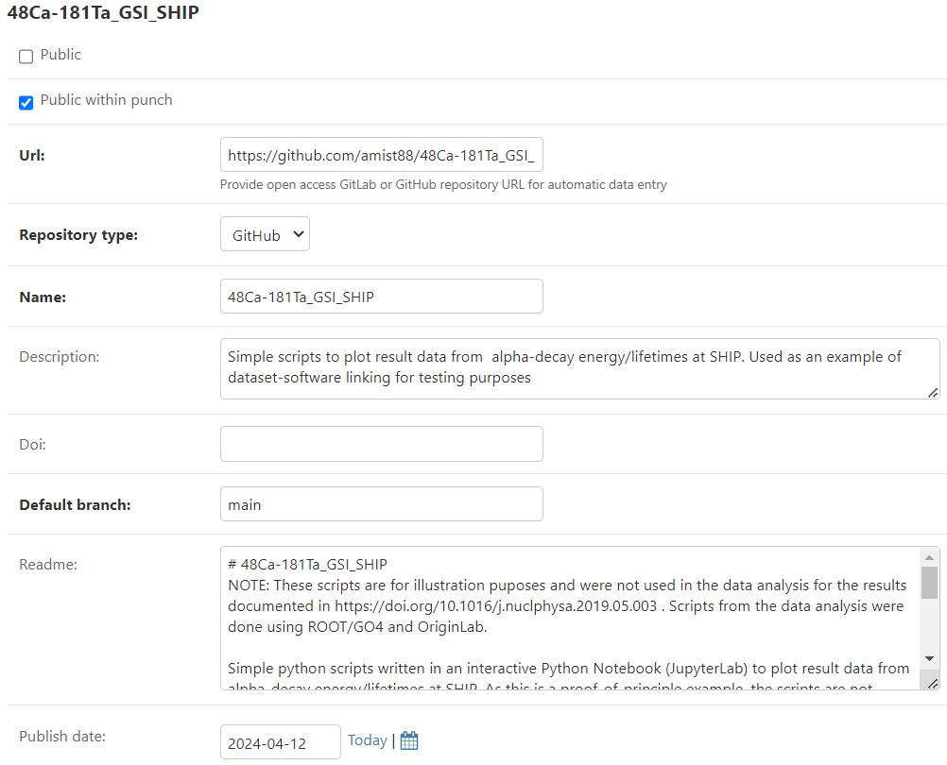
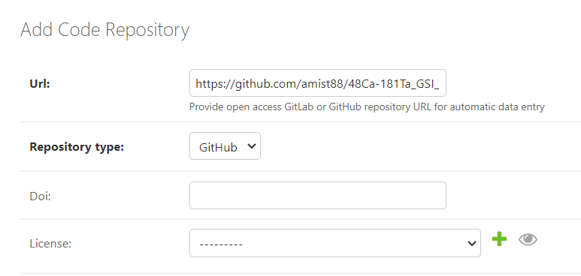
Code Repository automation

Slide 7
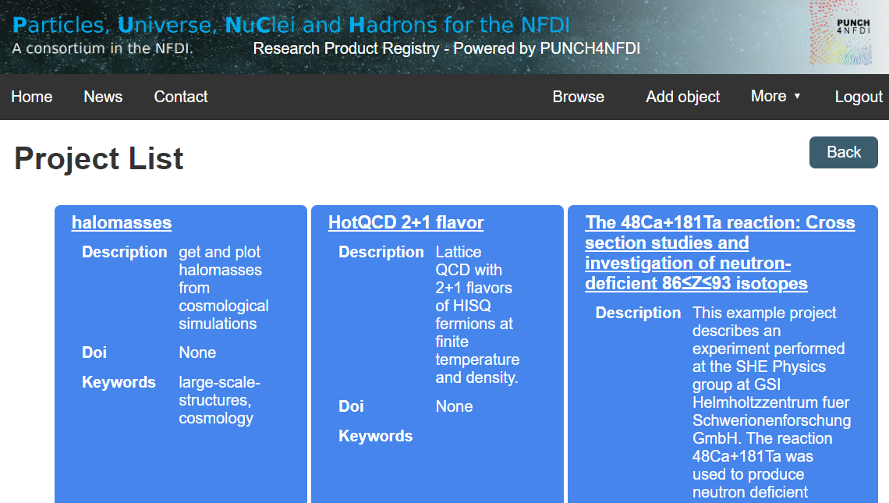
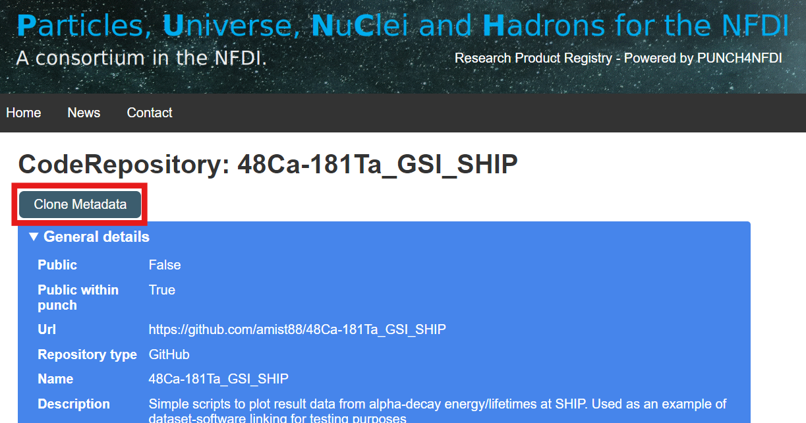
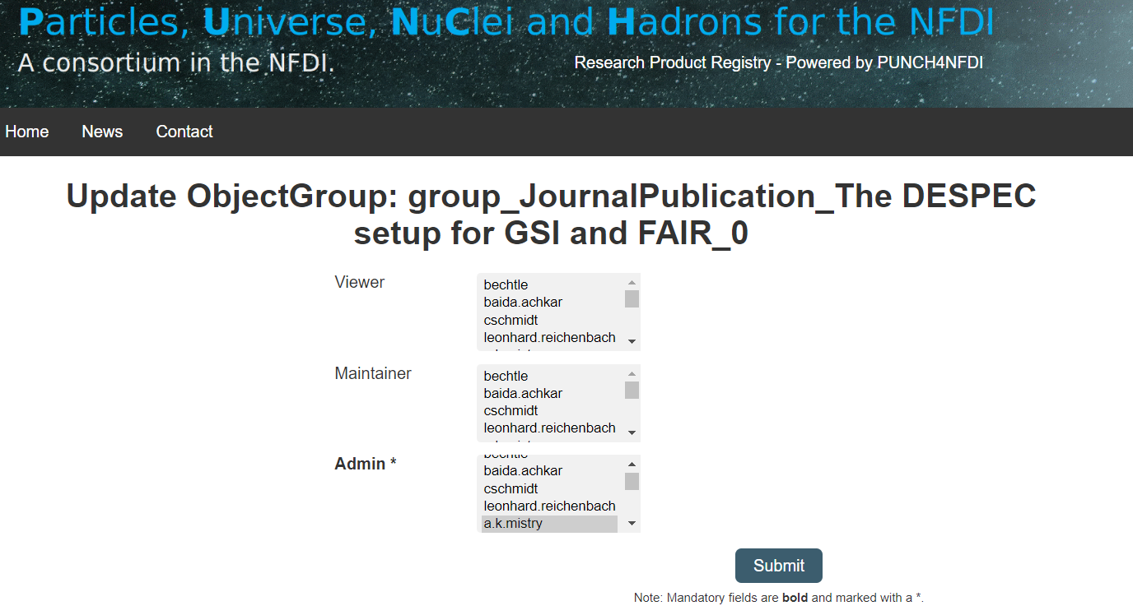
Repository Front End development

Slide 8
Future implementation
Future front end development.
Integration with REANA.
Research infrastructure as Digital Research Product.
Automatic export of the Metadata Schema from the data on the portal.
Automatization of the data import procedures in the database (from the MD schema)

Slide 9
Questions
Questions?

