Slide 1
ALPS
(name invented by Andreas)
for today:
Andreas‘ Lucid Physics Laboratory

Slide 2
Andreas:
The visionary
The person
Summary
(everything from a total subjective perspective)

Slide 3
The visionary
https://www.merriam-webster.com/dictionary/visionary:
A visionary is someone with a strong vision of the future. Since such visions aren't always accurate, a visionary's ideas may either work brilliantly or fail miserably. Even so, visionary is usually a positive word.
…
The word is also an adjective; thus, for example, we may speak of a visionary project, a visionary leader, a visionary painter, or a visionary company.

Slide 4
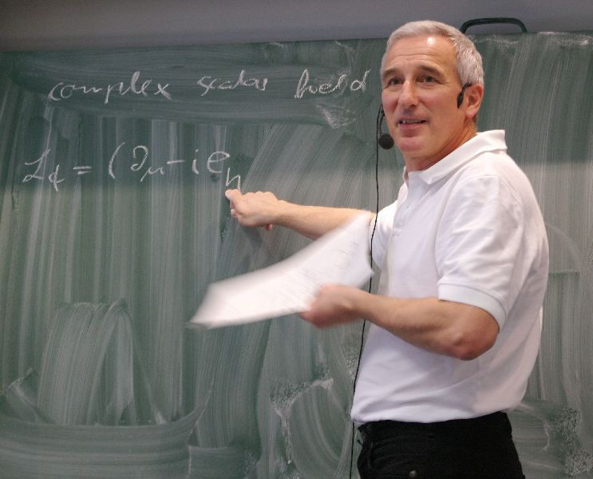
The visionary
Andreas was and is always driven by curiosity and a genuine interested in deciphering nature.
Finally, experiments decide on theories!
Think of ways to probe theories!
Teach and value your experimental colleagues!

Slide 5
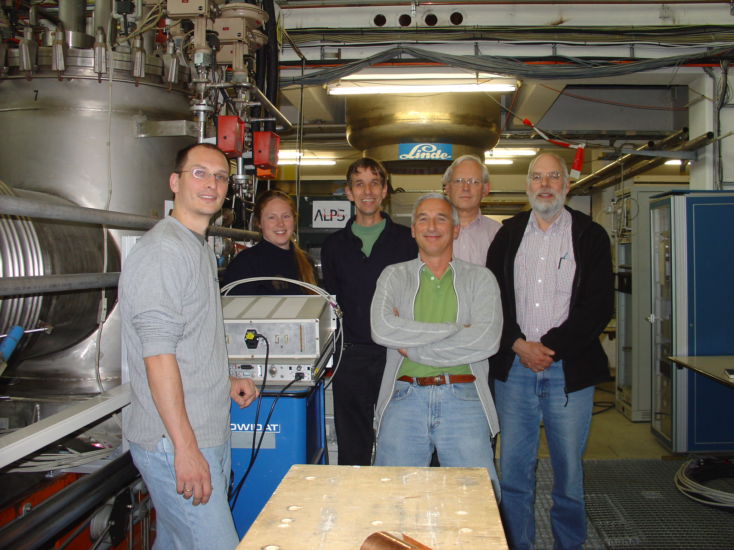
The visionary
September 2007

Slide 6
The visionary

Slide 7
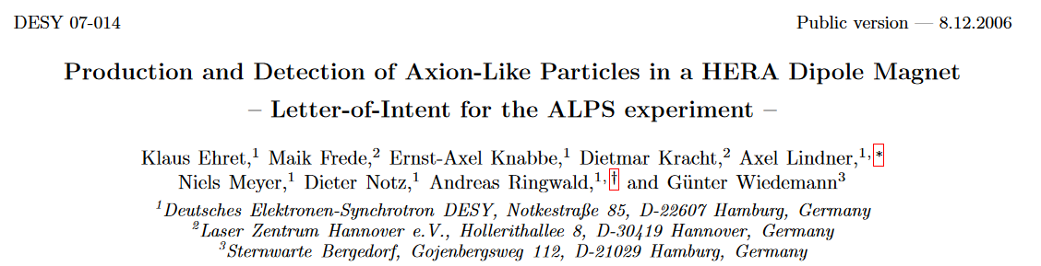
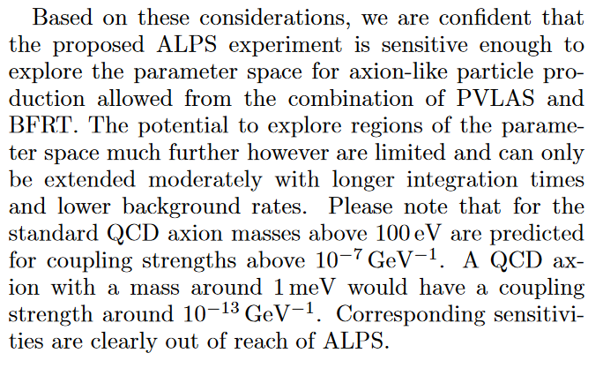
The visionary

Slide 8
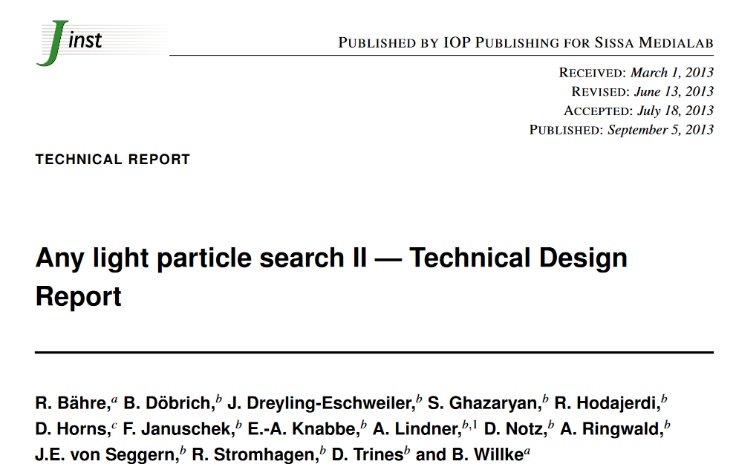
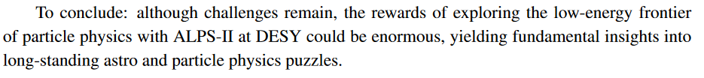
The visionary

Slide 9
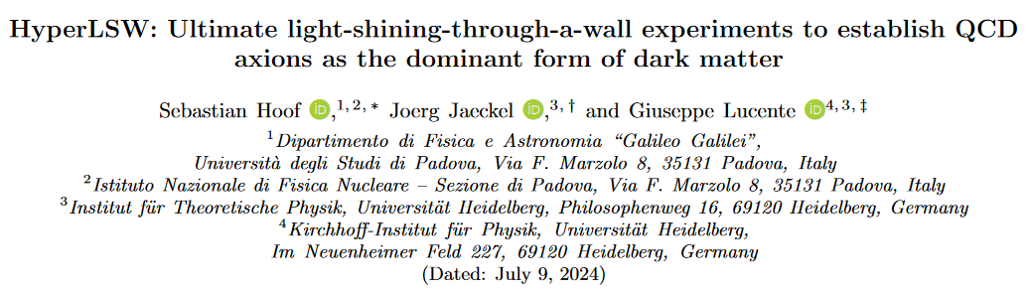

The visionary
Some of your former fellows are even more ambitious!

Slide 10
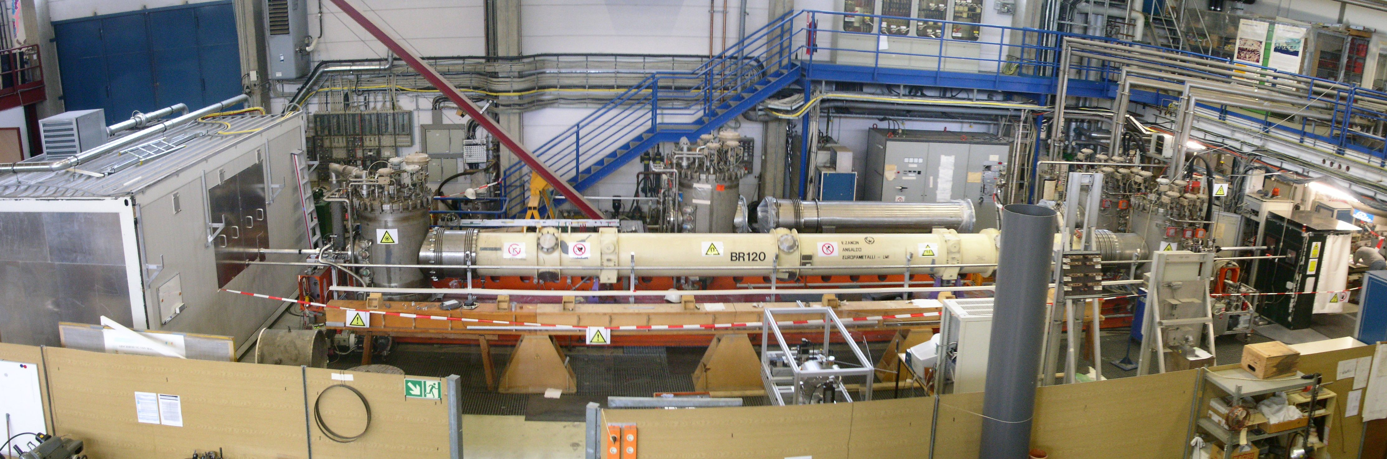
Visions turn into reality
2007

Slide 11
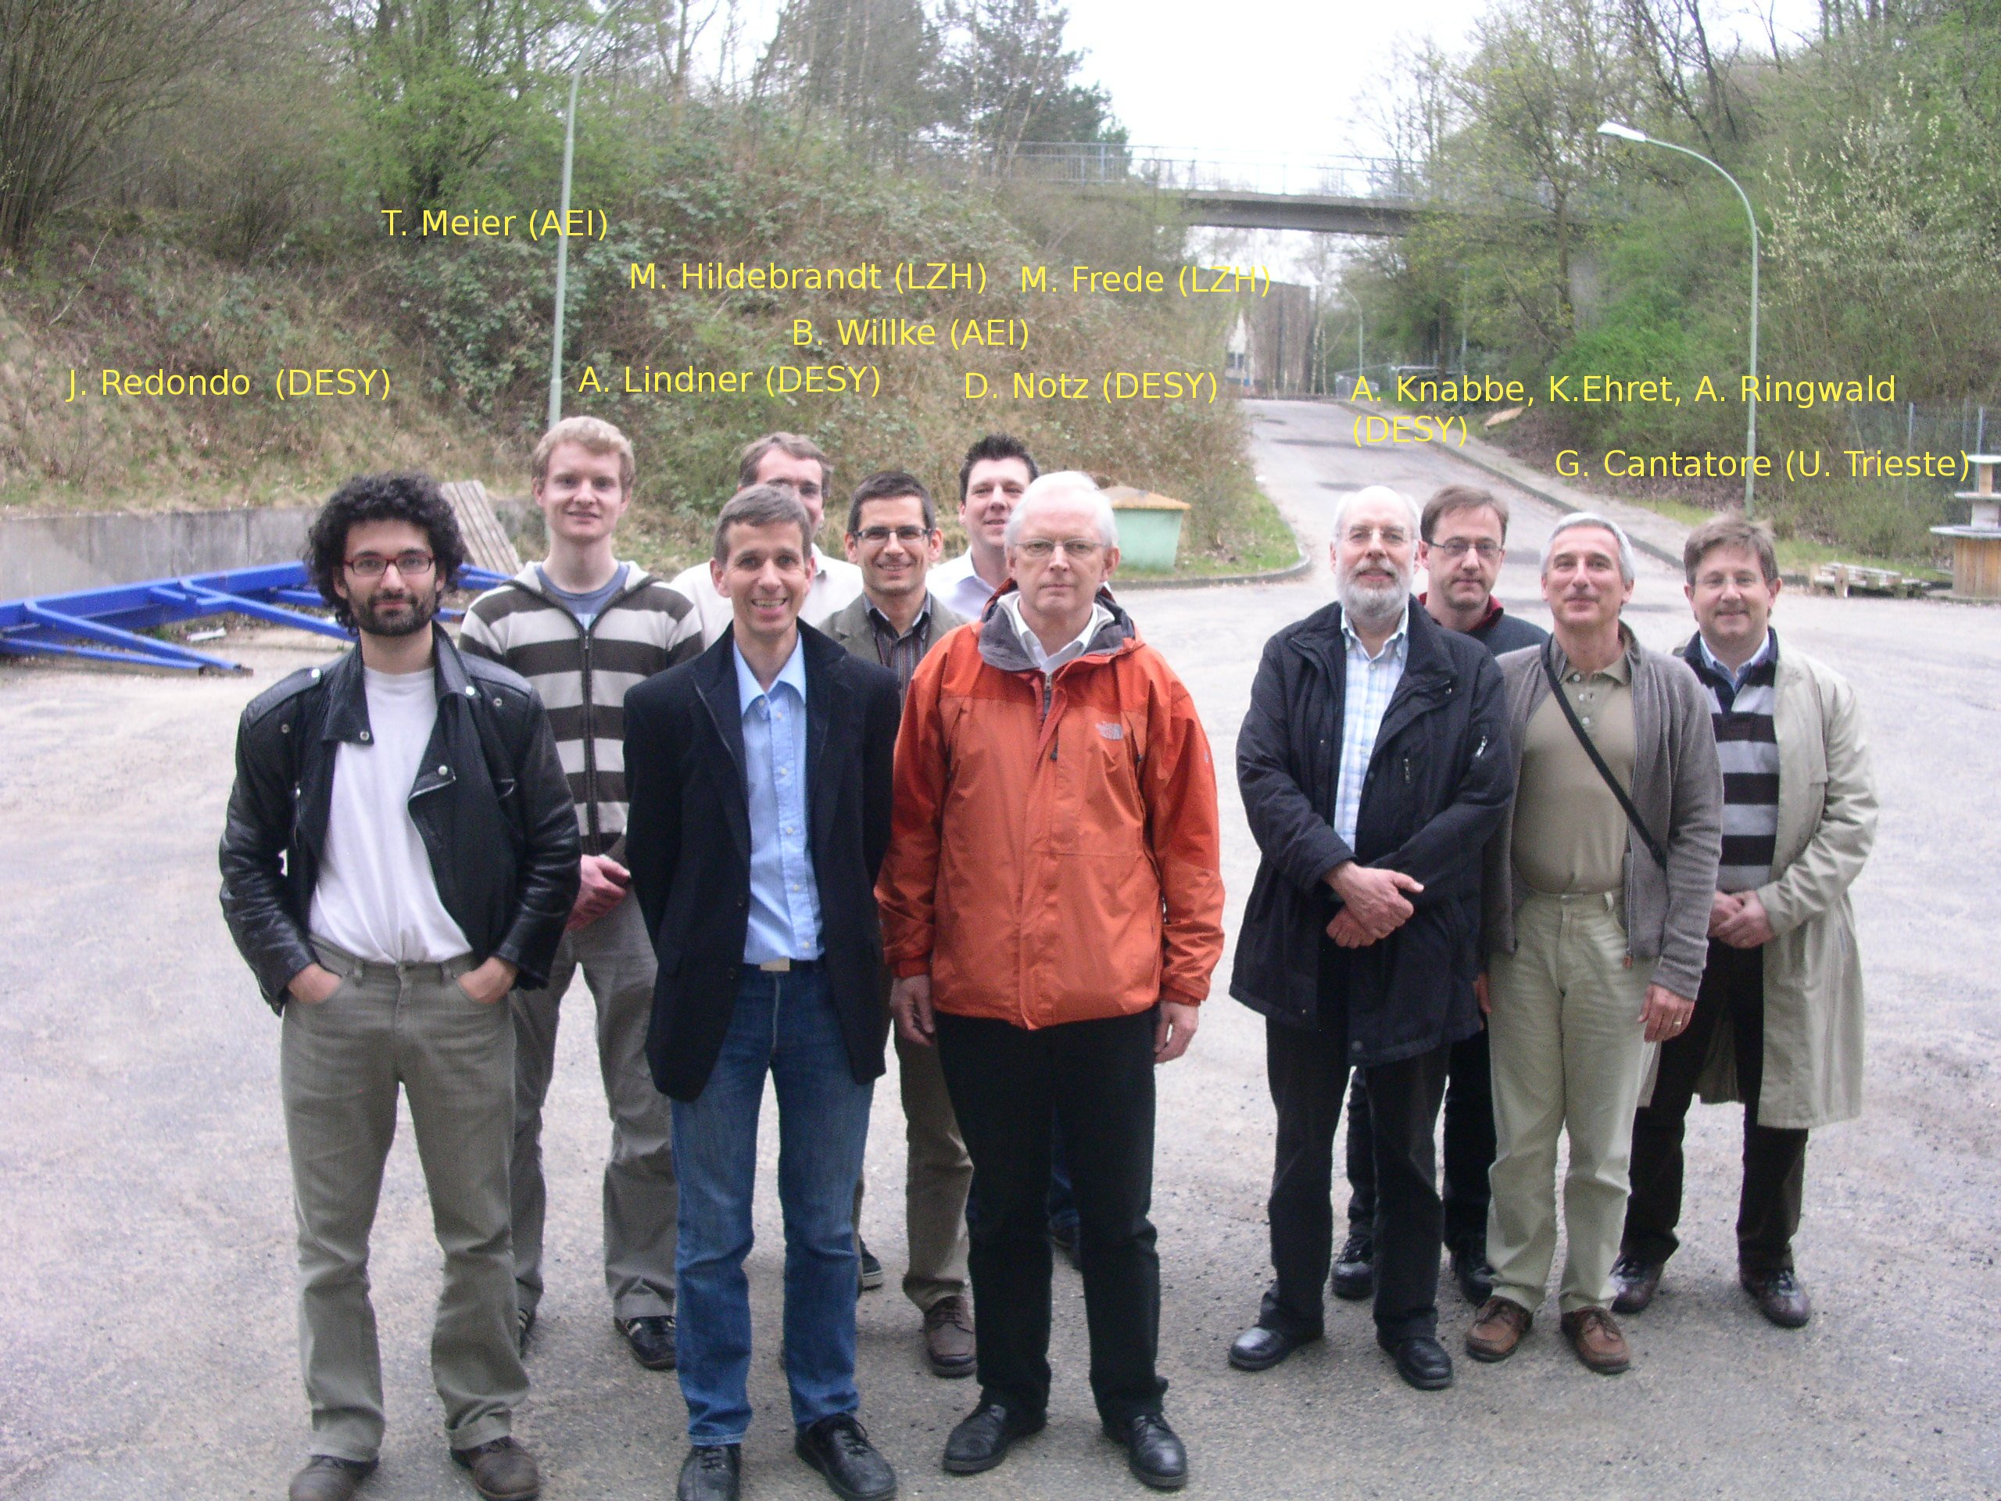
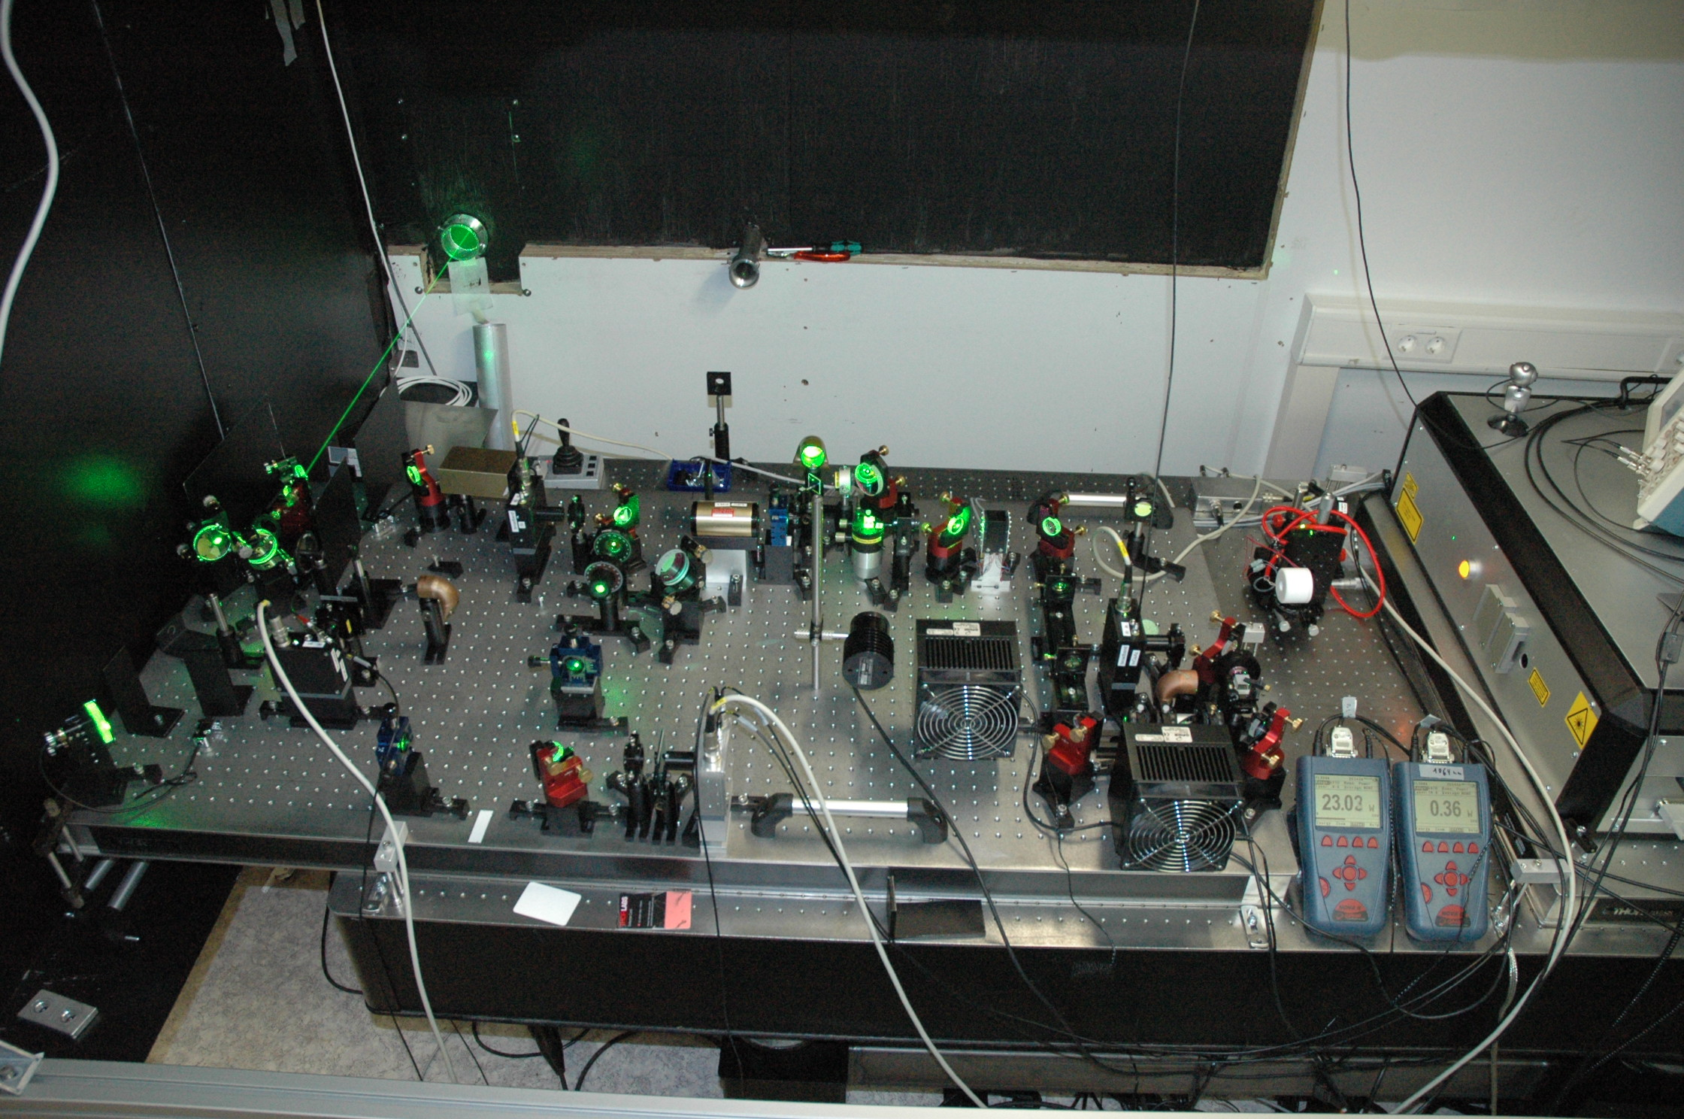
Visions turn into reality

Slide 12
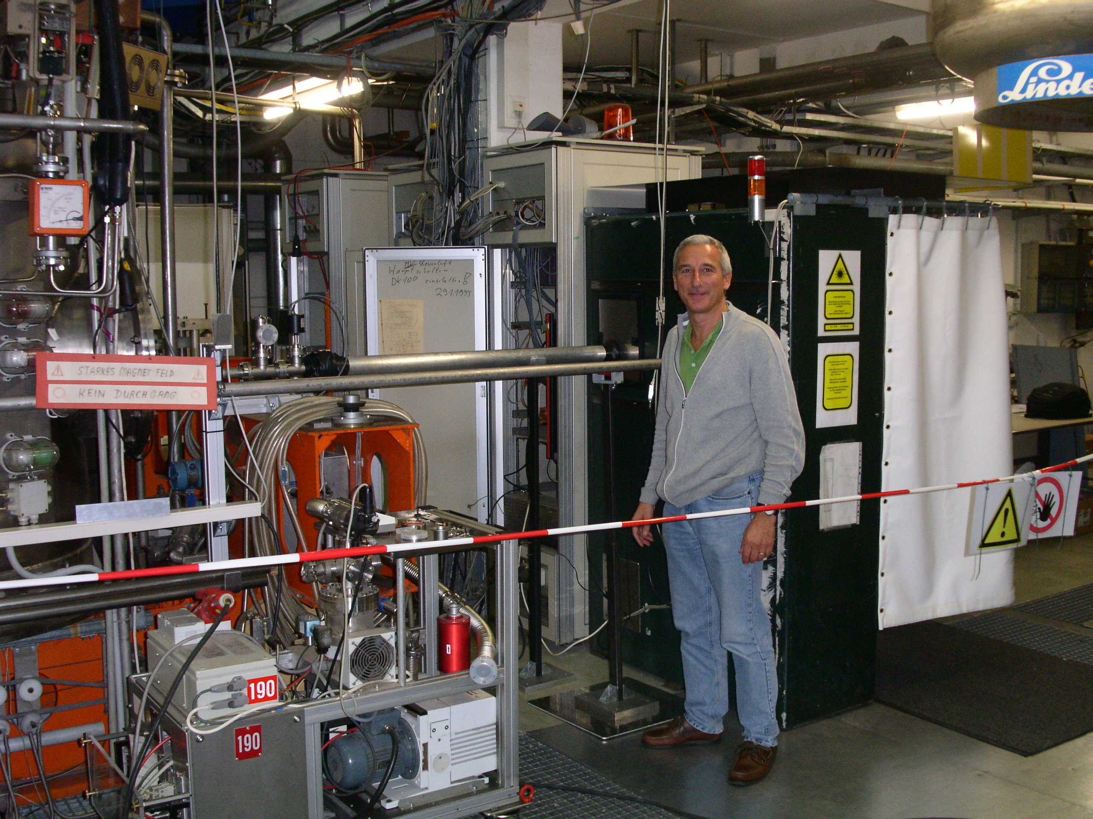
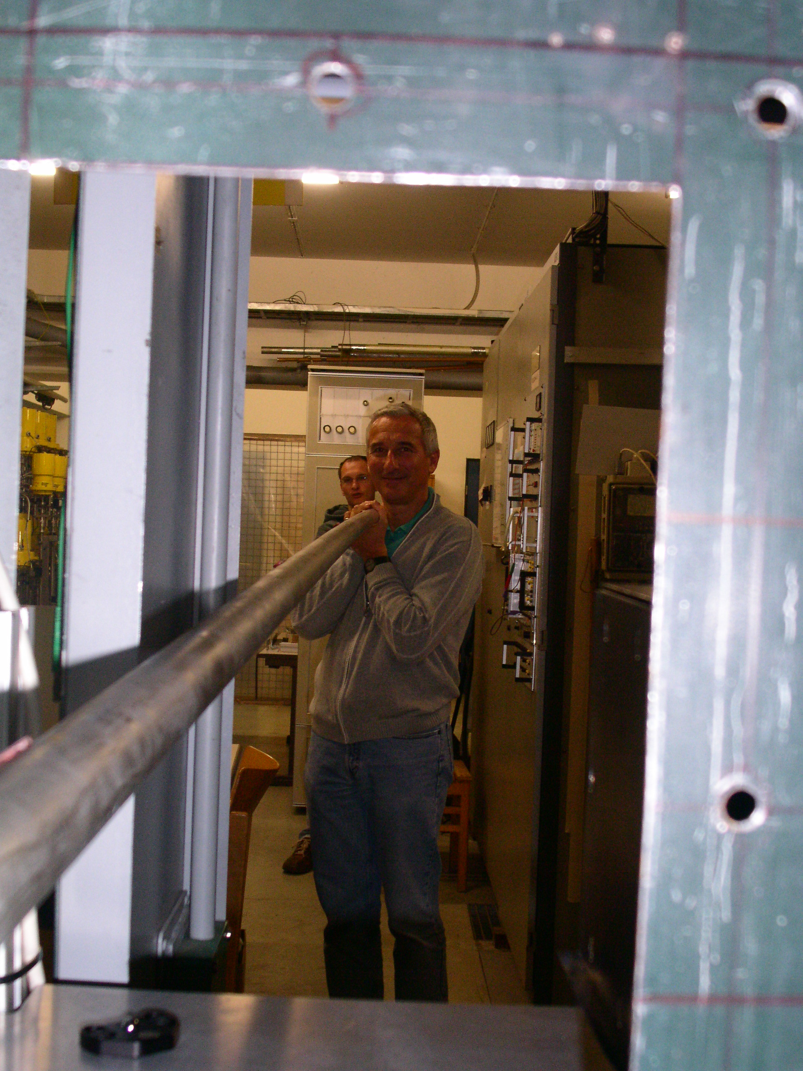
Andreas on duty at ALPS I

Slide 13
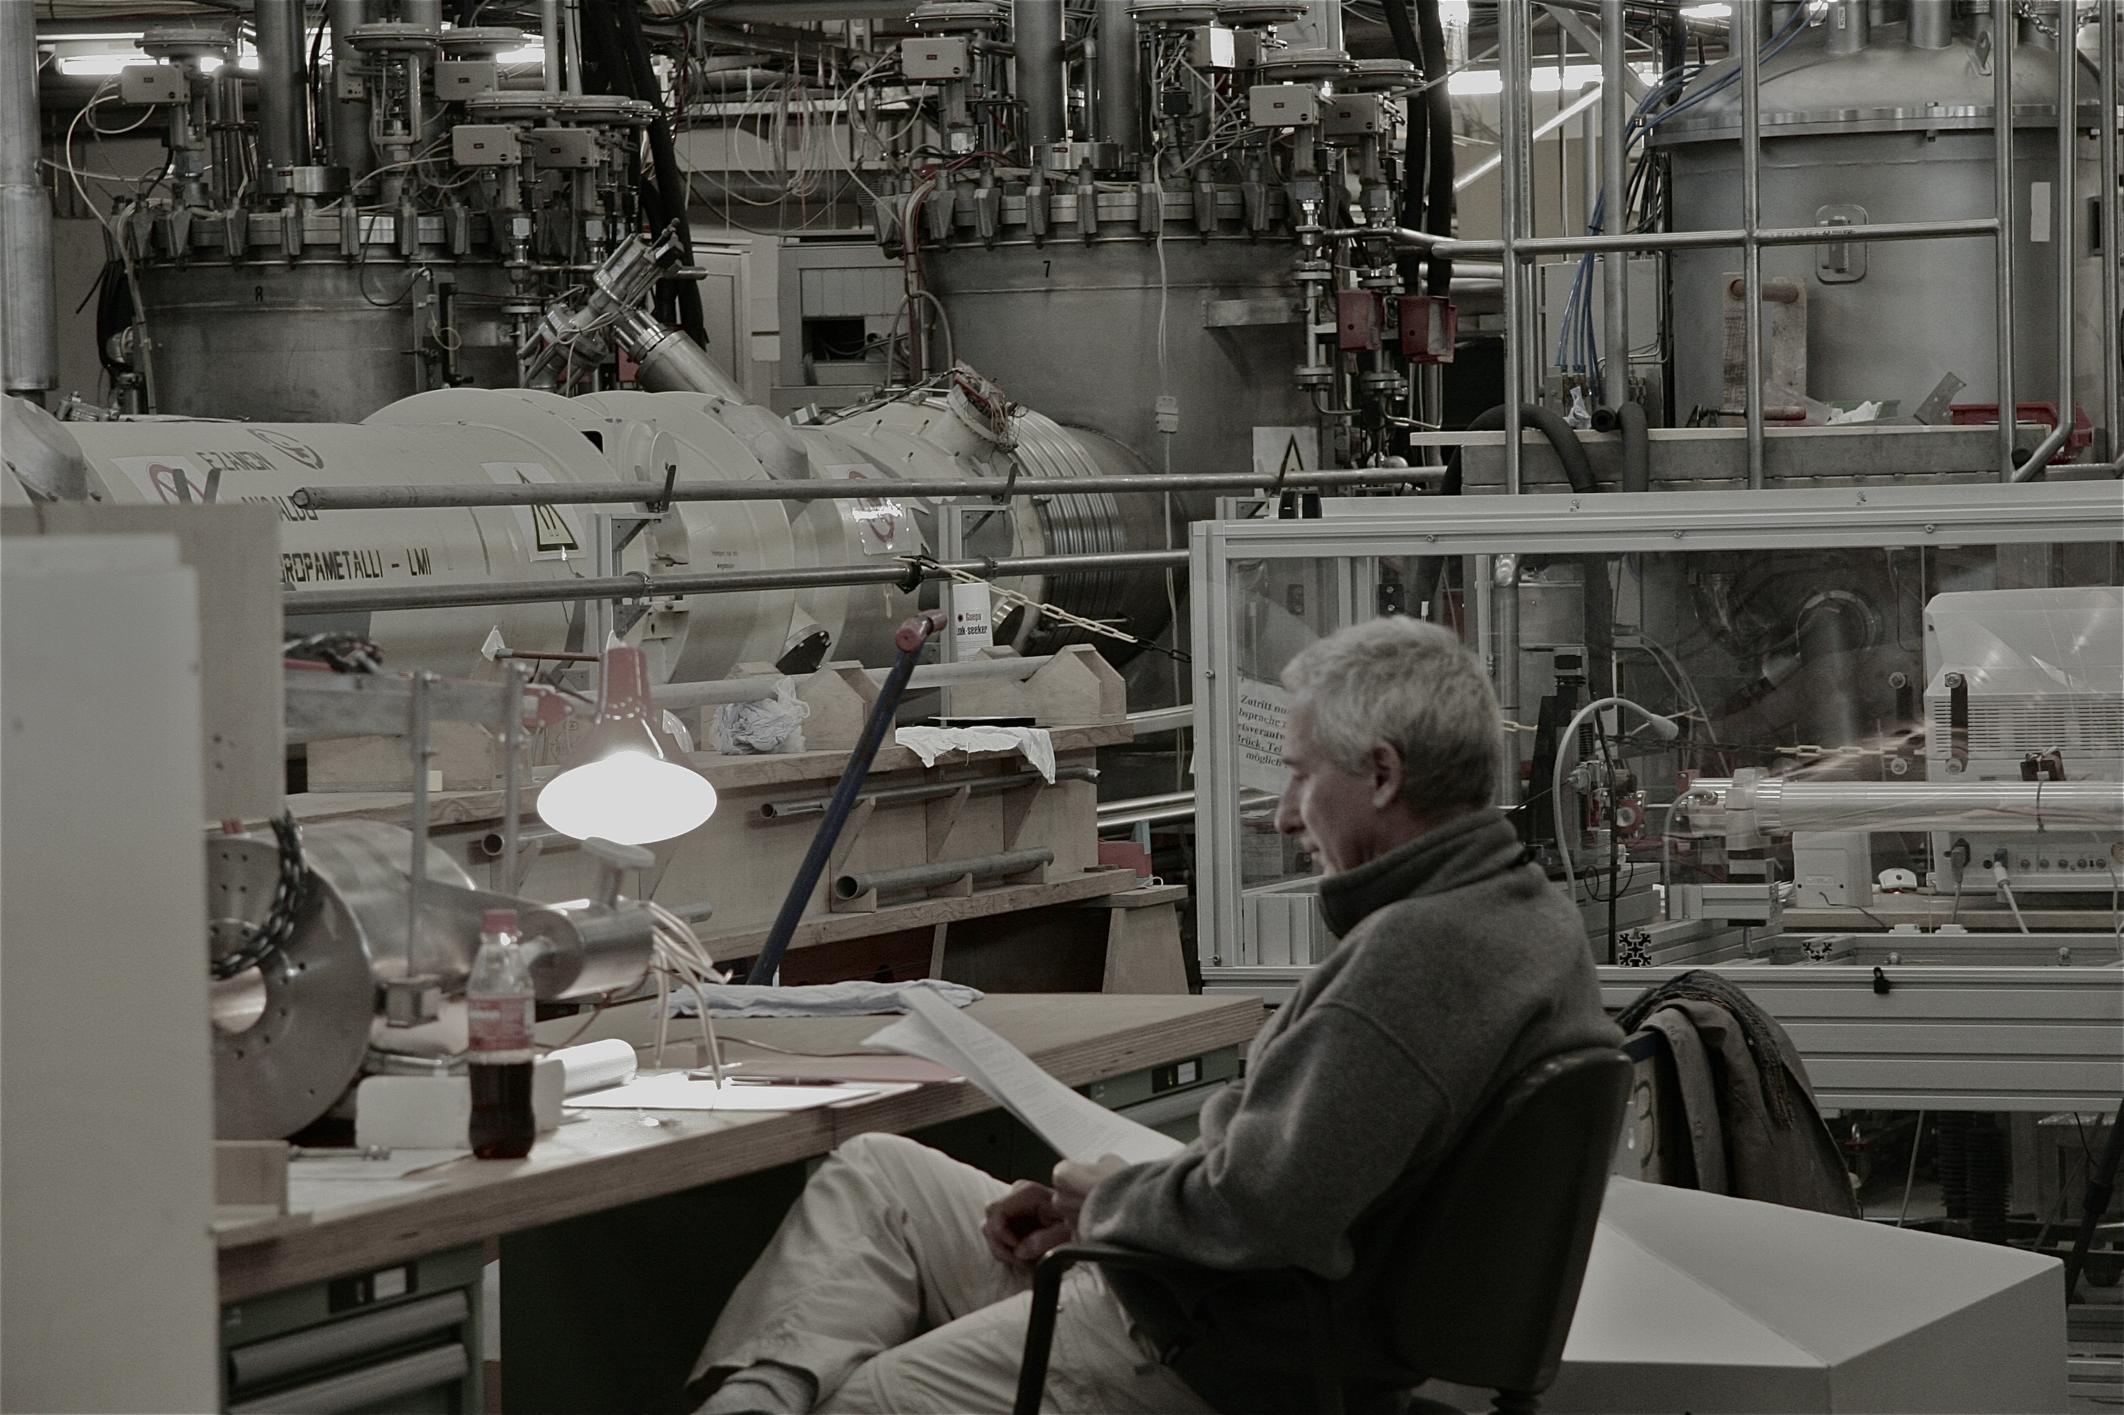
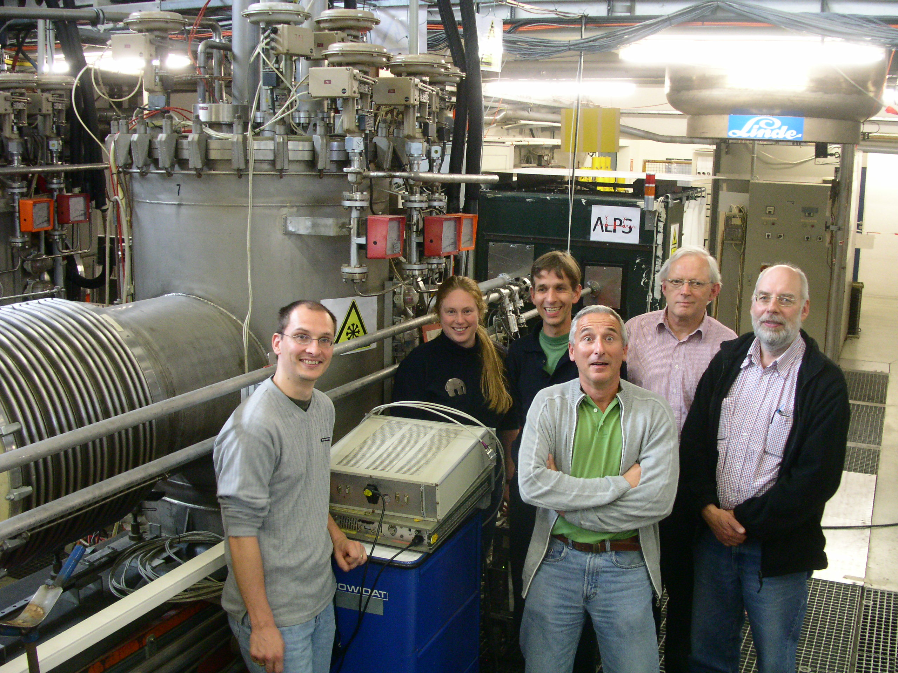
Andreas on duty at ALPS I

Slide 14
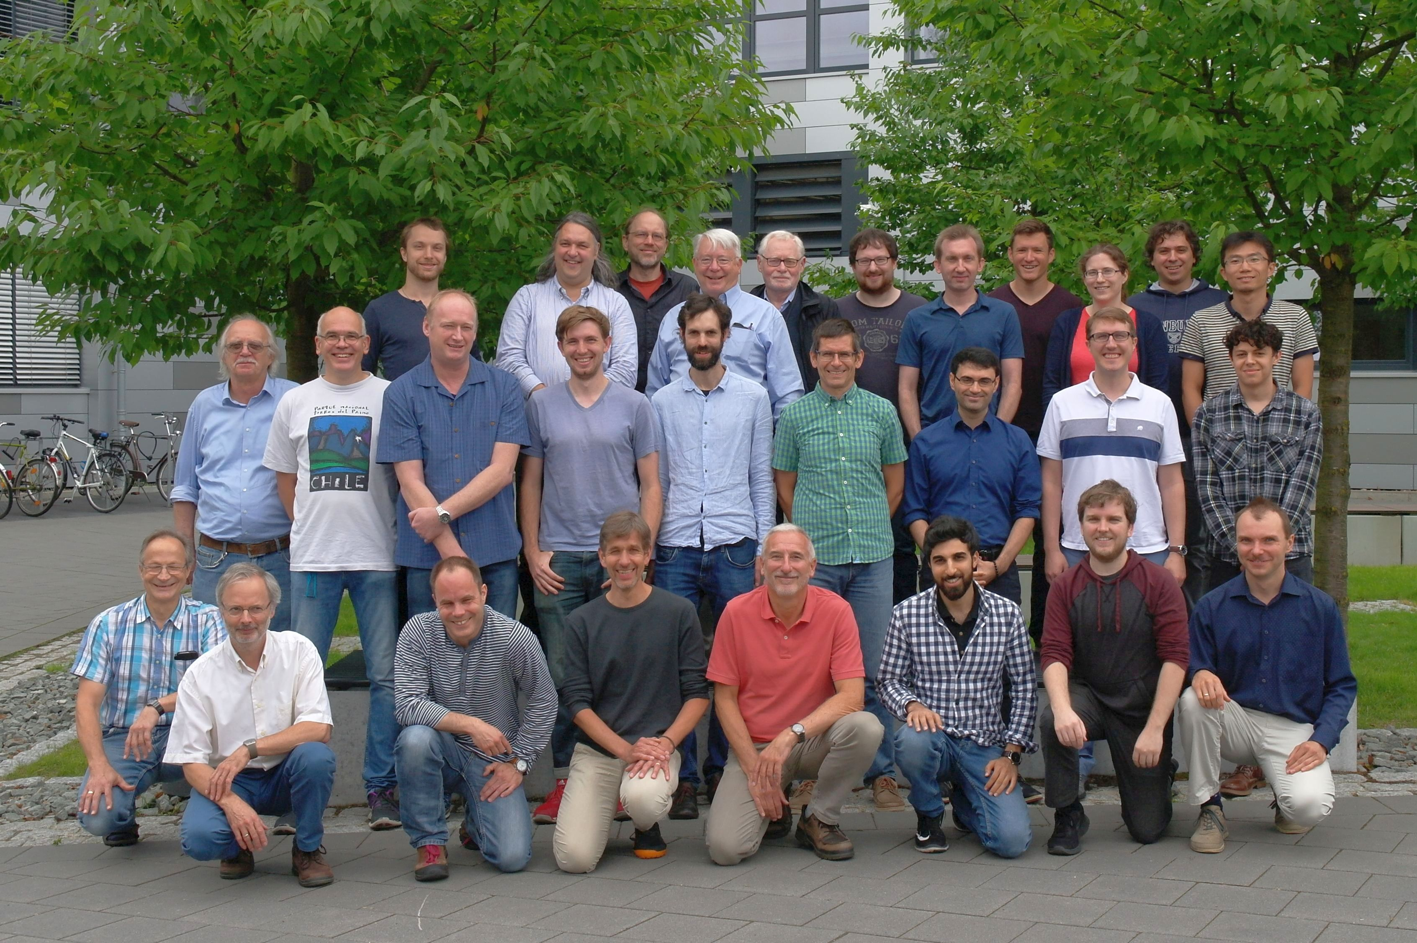
Andreas and the ALPS II team
2018

Slide 15
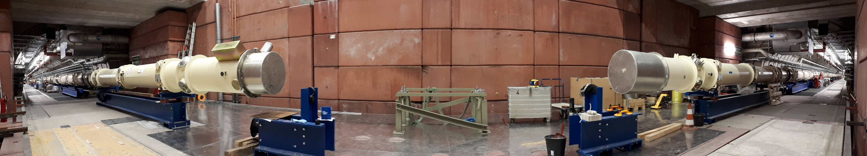
2020: ALPS II is getting real

Slide 16
The visionary
Andreas was and is always driven by curiosity and a genuine interested in deciphering nature.
Finally, experiments decide on theories!
Think of ways to probe theories!
Teach and value your experimental colleagues!
Andreas sparked a new research line at DESY: on-site particle physics experiments searching for new particles and investigating strong-field QED.

Slide 17
A particular challenge for a collaboration

Slide 18
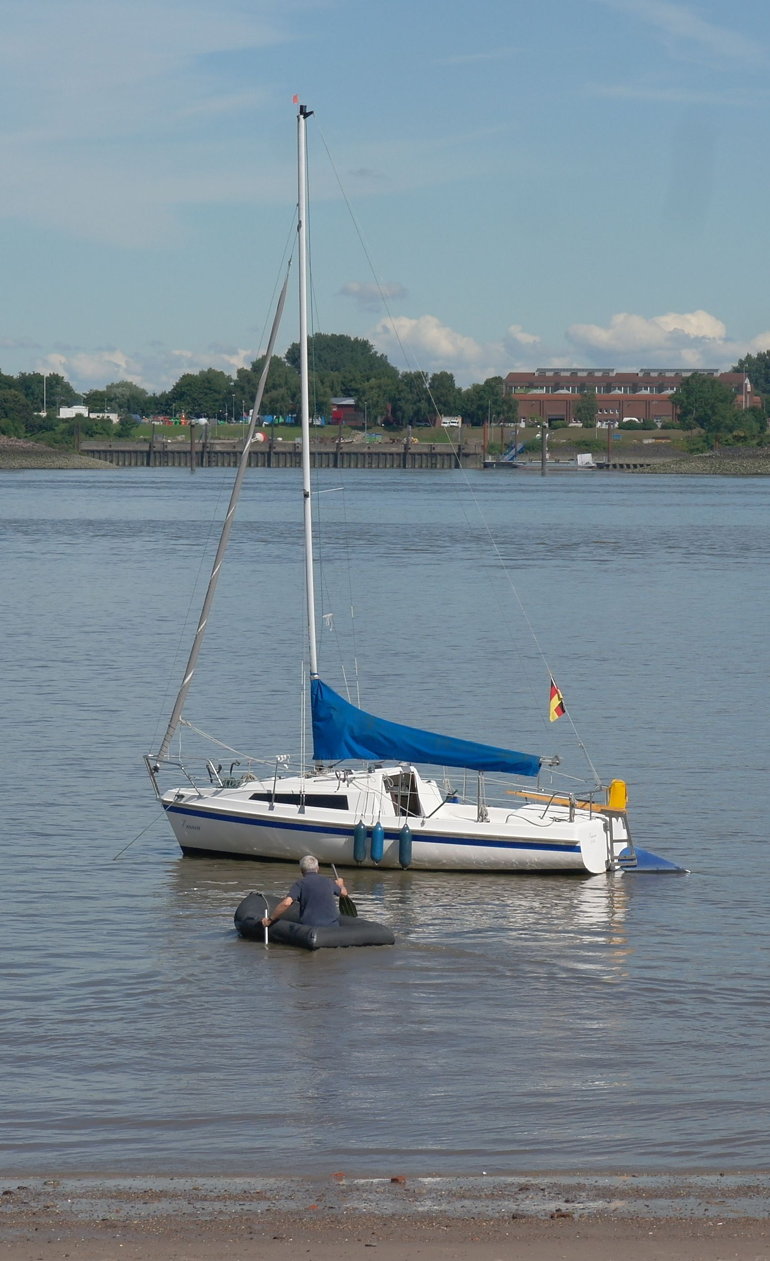
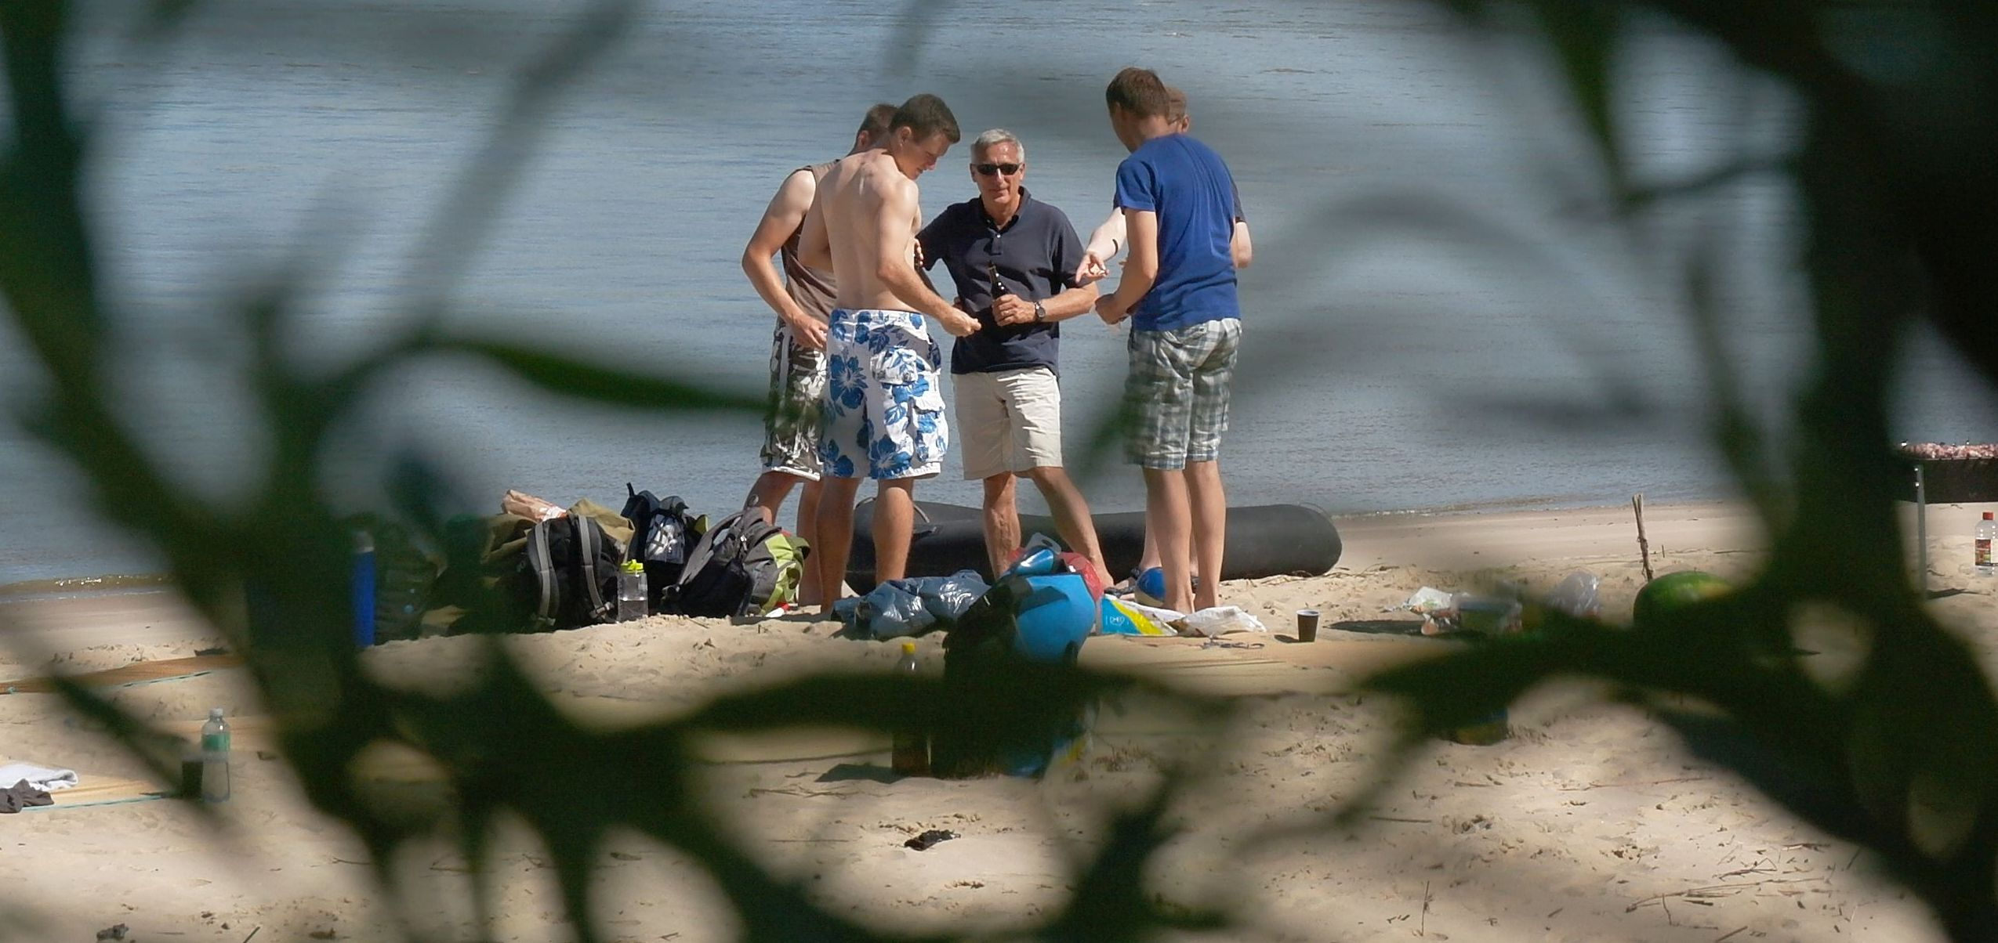
Adventures with Emma

Slide 19
The person
Andreas is a prime example for a successful career. A simplified recipe:
Find out where you are strong.
Find out what you like.
Combine (1) & (2) for your work.
Resist prestigious job offers driving you away from (3).
Collaborate: give and you’ll be given.
Pay attention to new science opportunities.
Stay authentic.
Care for a real work-life balance.
To me: a prime role model for the “DESY spirit”, also leading to enormous productivity.

Slide 20
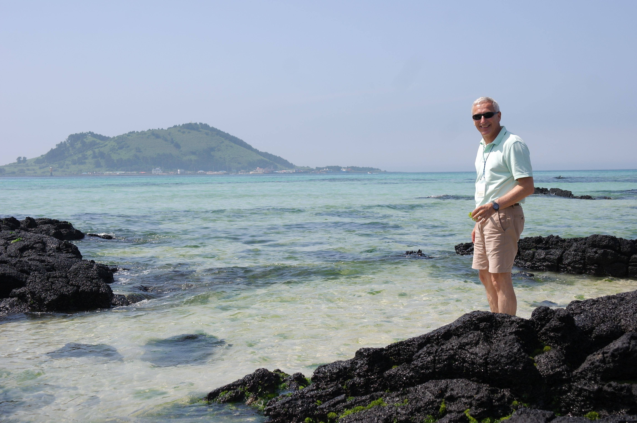
The person
Andreas is a prime example for a successful career. A simplified recipe:
Find out where you are strong.
Find out what you like.
Combine (1) & (2) for your work.
Resist prestigious job offers driving you away from (3).
Collaborate: give and you’ll be given.
Pay attention to new science opportunities.
Stay authentic.
Care for a real work-life balance.
To me: a prime role model for the “DESY spirit”, also leading to enormous productivity.

Slide 21
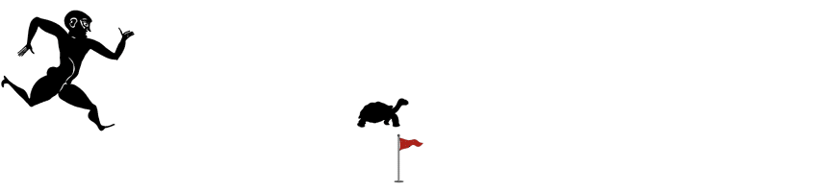
He is just too fast
Andreas keeps on challenging experimental colleagues. A reverse Xeno’s paradox?
ALPS I: “You just need to improve on the axion-photon coupling by one order of magnitude.”
ALPS II: “You just need to improve on the axion-photon coupling by three orders of magnitude.”
HF-GW: “You just need to improve by about 10 orders of magnitude.”
Life is getting harder for experimentalists!

Slide 22
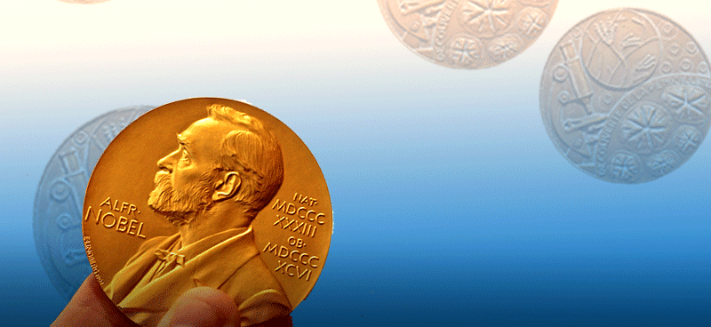
Trying to sum up
Andreas’ research topics related to new DESY on-site experiments: axions, QED, high-frequency gravitational waves.
A physicist's career in one sentence:
Options for more than one Nobel prize!

