Slide 1
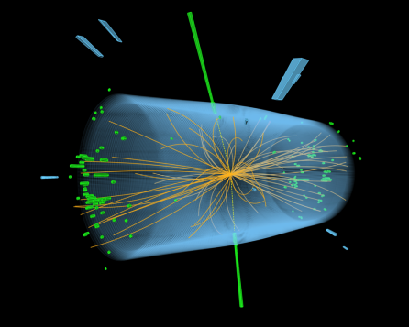


The DESY HEP onsite program
2024 Fellow Day
Ties Behnke (DESY)

Slide 2
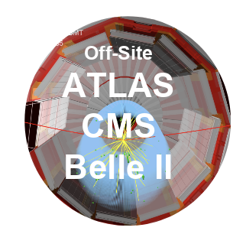
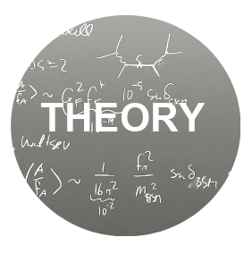


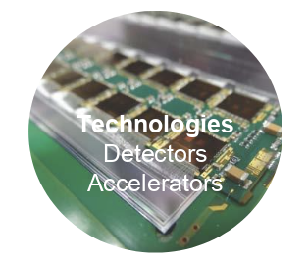
Four pillars of particle physics at DESY
Implement our strategy of exploration
?
Key contributions to global projects at CERN and KEK
HL-LHC
Belle II
Closely work with German universities (natl. hub)
Future perspective
Establish WPC as world-leading interdisciplinary centre for theoretical physics
Ideas factory for future science endeavours
ALPS II: first data 2023
BabyIAXO, LUXE MADMAX: >2029
New ideas: VMB @ ALPS II, R&D on HF GW local exp’ts (complements ET)
Strengthen innovation in detectors and computing
Strengthen exchange across divisions
Work closely with German universities

Slide 3
DESY opportunities
Decoding Matter
PETRA IV
FLASH
XFEL
photon science facilties
Infrastructure
The DESY research center
Broad infrastructure
Broad science competence
Enormous technical competence
DESY is much more than particle
physics
SCRF R&D
Plasma R&D
accelerator science
Campus
Computing
LHC BELLE ESRF XFEL ICECUBE CTA
international projects
Detector

Slide 4
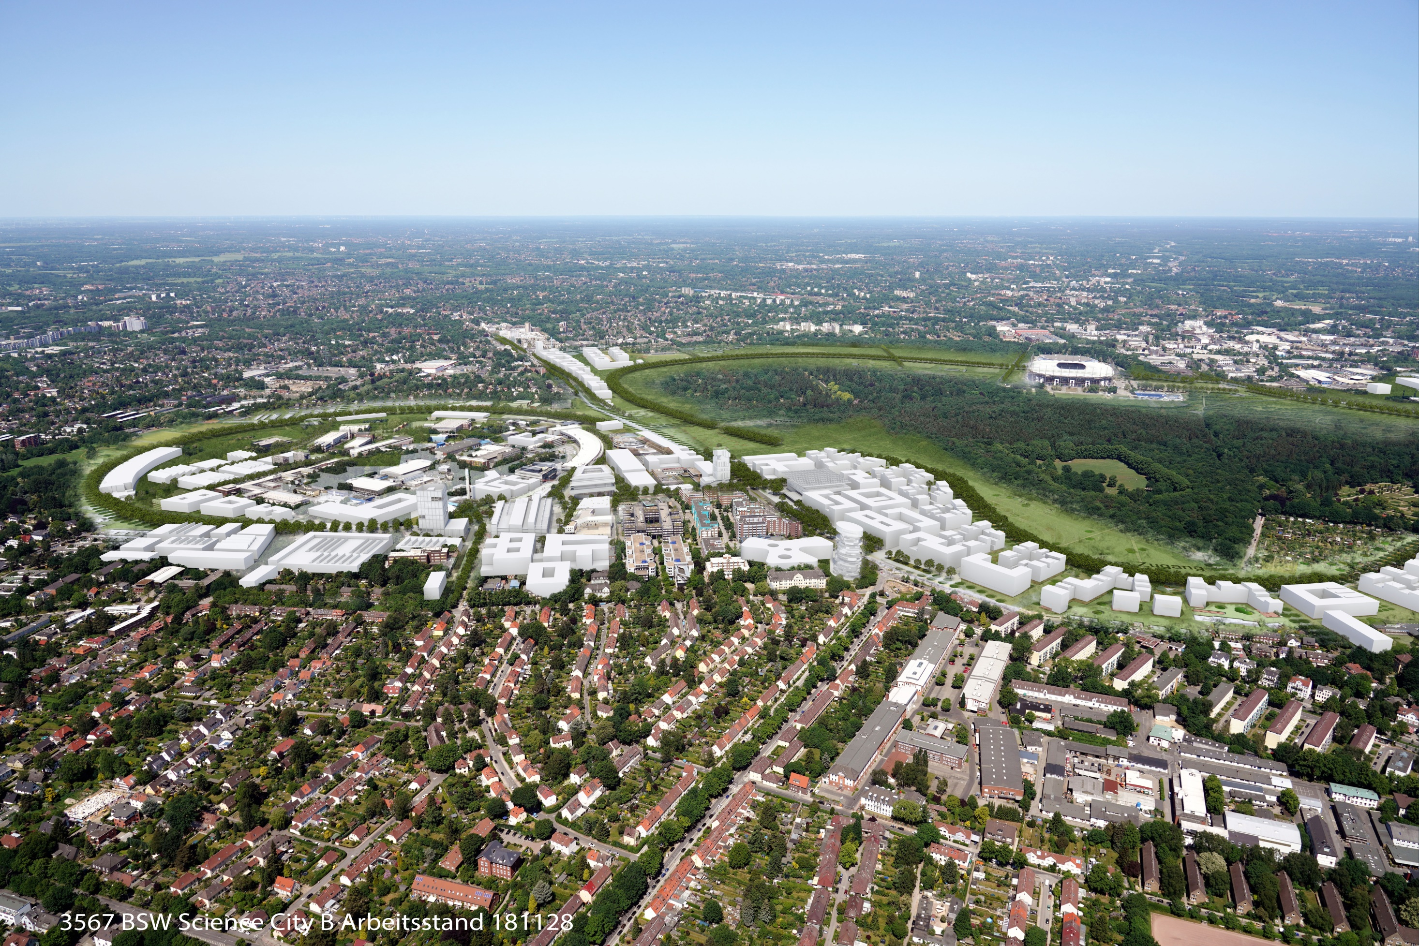
DESY Campus Development
Science City Bahrenfeld
XFEL
Innovation
Accelerator
FLASH
PETRA IV
HEP
Photon
University
Biology
Chemistry
WPC

Slide 5
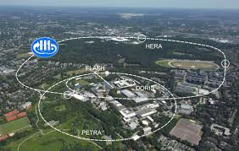

Slide 6

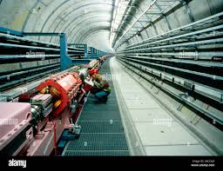


The onsite program
The HERA accelerator
Infrastructure
Equipment
opportunities
LABORATORY
“Light through the wall”
Based on HERA components
and infrastructure
HELIOSCOPE
Axions from the sun
An Axion telescope
In HERA South
HALOSCOPE
Axions from dark matter
conversions in the universe

Slide 7


Slide 8
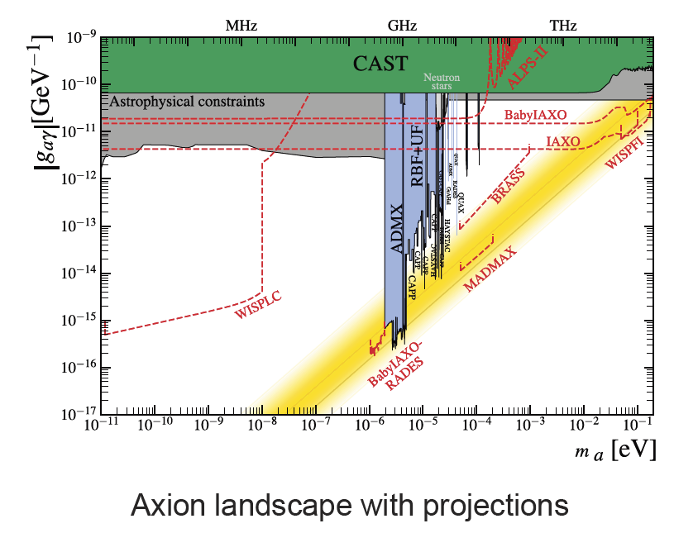
The onsite program
LABORATORY
“Light through the wall”
Based on HERA components
and infrastructure
HELIOSCOPE
Axions from the sun
An Axion telescope
In HERA South
HALOSCOPE
Axions from dark matter
conversions in the universe

Slide 9
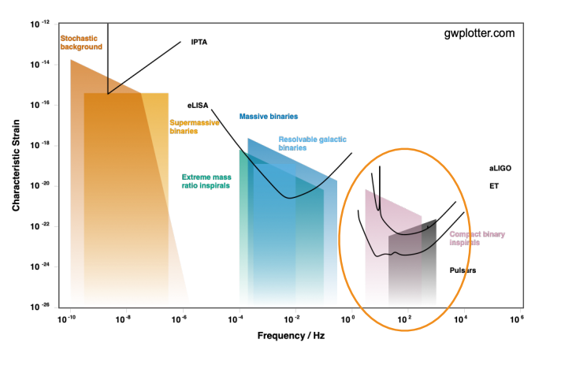
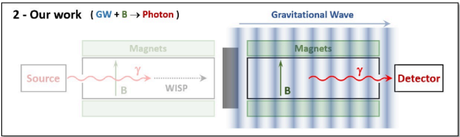
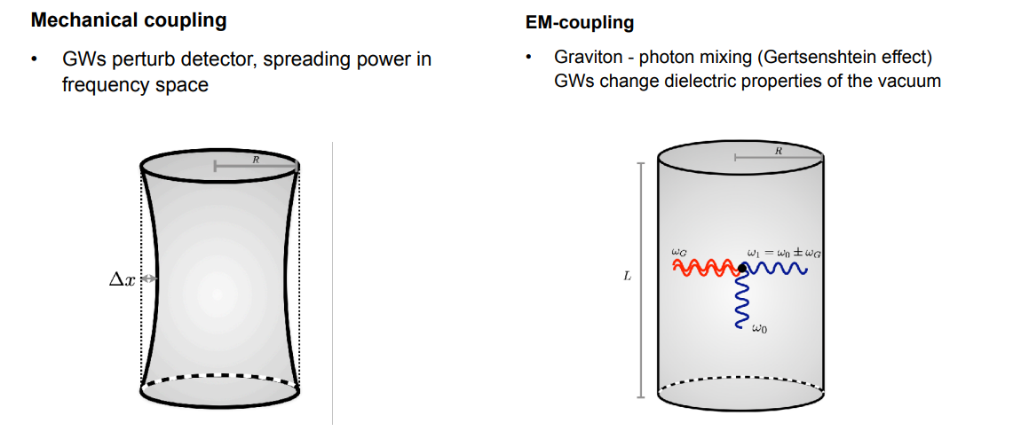
Gravitational waves
“small scale” experiments for large questions
High frequency gravitational waves: an unexplored territory
ALPS
reinterpretation
ALPS reintergpretation/ optimiziation
Superconducting cavities
Nano-membranes
Levitated sensors
Fundamental
principle of
detection

Slide 10
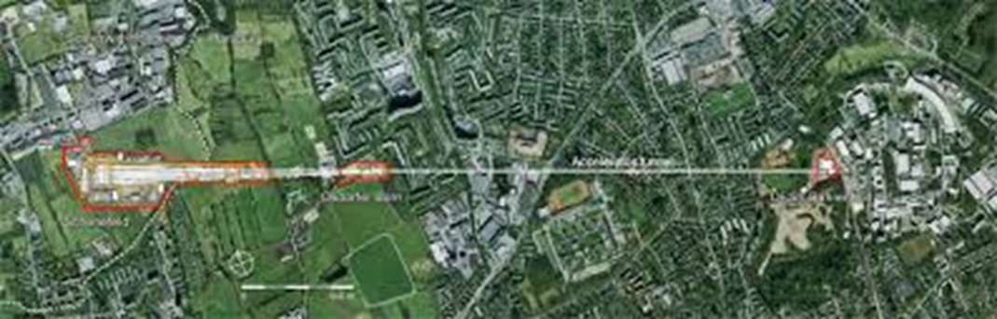
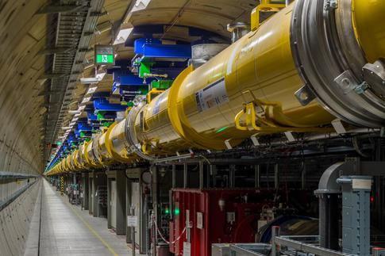
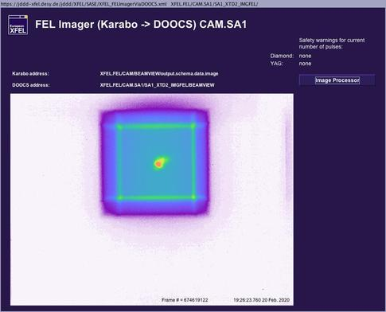
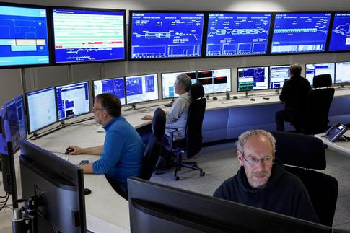
European XFEL
DESY responsible for linac operation
2km long superconducting
accelerator
(ILC like technology)
17.5 GeV
ILC bunch structure
Stable, efficient user operation
also during Corona times
Reached top energy (17.5)
and long stable operation for
full bunch train in 2020

Slide 11

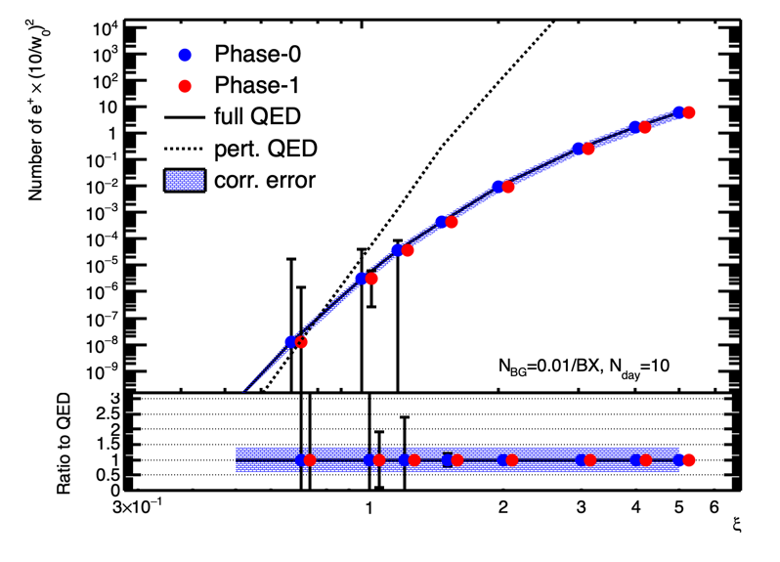
LUXE: a new experiment proposal at DESY
Non linear QED – search for New Physics
Collision of XFEL Electron bunch with laser beam
Collaboration with about 100 members
International participation from UK, Israel, others
Funding under discussion
Realisation at XFEL and DESY
Status
Challenges in implementation
EU project to build the beam line
Realisation >2028
http://luxe.desy.de

Slide 12
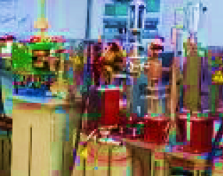
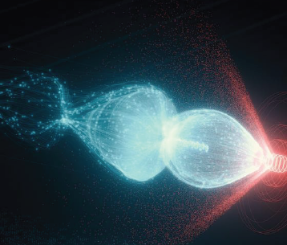

Plasma acceleration?
Plasma Accelerators for HEP
O(20) GeV Linac
eLUXE/ LUPE
Others?
Proof of principle
6 GeV single stage
>10 GeV multi stage
PETRA IV
Injector
LUX
FlashForward
ATHENA

Slide 13
Conclusion
DESY HEP is developing a competitive “on-site” program
It complements DESY’s participation in major international collider projects (LHC, BELLE, …)
It is unique in scope and scientific reach
It is leveraging the DESY infrastructure and know-how

