Slide 1




LEAPS-INNOV 3nd Annual Meeting
08 April 2024
WP7: DATA parallel sessions – Welcome and overview
David Pennicard, DESY Zdenek Matej, MAX-IV
WP co-leaders
This project has received funding from the European Union´s Horizon 2020 research and innovation programme under grant agreement No. 101004728

Slide 2
Introduction
Original 3-year period of LEAPS-INNOV WP7 is coming to an end
Change from original plan – consulting with IronArray / Blosc paid by ALBA, ESRF, MAX-IV and PSI
Work continued on developing data compression and holding events
Applied for 1-year extension (no additional funding)
Goals of meeting:
  Update everyone on workpackage status
  Plan for final deliverable, D7.4
  Discuss continuation
Notes:
As our light sources and instrumentation get better and better, they produce bigger volumes of data. Secondly, data reduction often involves initial processing steps on data to extract useful information
Can give an overview here – might be talking about this
Somewhat a „ticking boxes“ exercise – should think in light of this; satisfying EU.
Improve data analysis

Slide 3
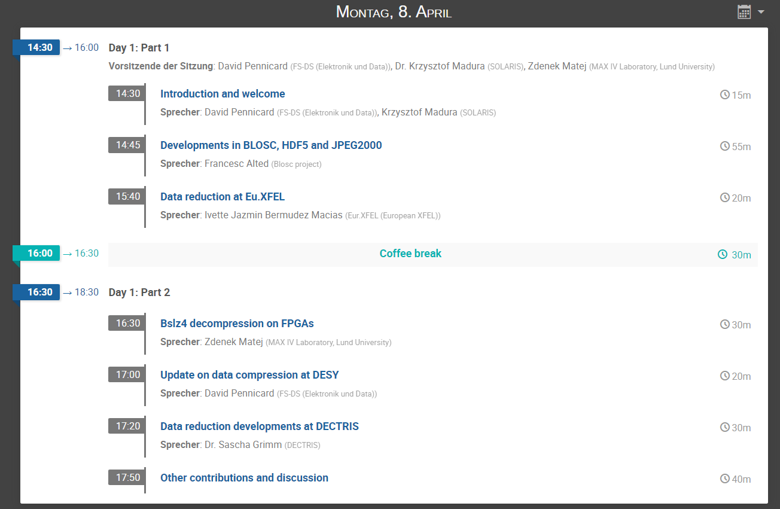
Overview and organization
https://indico.desy.de/event/44385/ - Two half-day parallel sessions

Slide 4
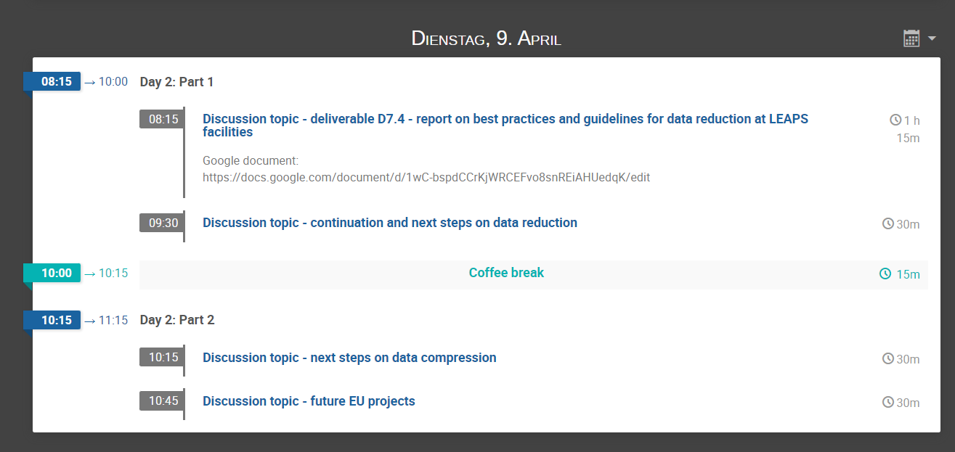
Overview and organization
https://indico.desy.de/event/44385/ - Two half-day parallel sessions

Slide 5
WP7 - overview
Tasks:
  Task 7.1 - Collaboration platform
    David Pennicard (DESY), Zdenek Matej (MAX-IV), previously Darren Spruce (MAX-IV)
  Task 7.2 – Assessing future needs, and developing metrics for compression
    Nicolas Soler (ALBA), Vincent Favre-Nicolin (ESRF)
  Task 7.3 – Evaluate and adopt new strategies for data reduction
    Peter Steinbach (HZDR)
  Task 7.4 – Knowledge exchange with industry
    Markus Janousch (PSI)

Slide 6
WP7 members
Large work package, many members, many activities
Much of the work is on:
  Increasing exchange of ideas and methods
  Improving co-ordination
Notes:
Scene setting

Slide 7
WP7 - milestones and deliverables
MS No. | Milestones Title | Due Date (in months) | Delivery (in months) | Status
MS28 | Collaboration platform setup (task 7.1) | M6 | M6 | achieved
MS29 | Start of tests with industrial detector developers (task 7.4) | M13 | M14 | achieved
Del. No. | Deliverable Title | Due Date (in months) | Delivery (in months) | Status
D7.1 | Evaluation report on data rates and volumes and assessment of future needs of LEAPS facilities (task 7.2) | M12 | M12 | submitted
D7.2 | Report on metrics for data reduction and compression (task 7.2) | M18 | M18 | submitted
D7.3 | Report results on promising data reduction pipelines on datasets provided by LEAPS facilities and release as open-source to the community (task 7.3) | M33 (Dec 2023) | M33 | submitted
D7.4 | Best practices and guidelines for applying data reduction and compression at LEAPS facilities (task 7.3) | M35 (Feb 2024) originally | Shifted to M38 (May 2024)
NB – deliverable numbers don’t directly correspond to task numbers

Slide 8
Deliverable 7.3 – Dec 2023
Report results on promising data reduction pipelines on datasets provided by LEAPS facilities and release as open-source to the community
  Part of task 7.3 (Peter Steinbach, HZDR)
Studies on lossy and lossless compression of tomography images
Denoising algorithms and their effect on compression
Co-working sprint on reproducible workflows
  Virtual hackaton, with 4 teams working with experts on workflows
  Kickoff with seminar on workflows, and closing event with teams presenting their works

Slide 9
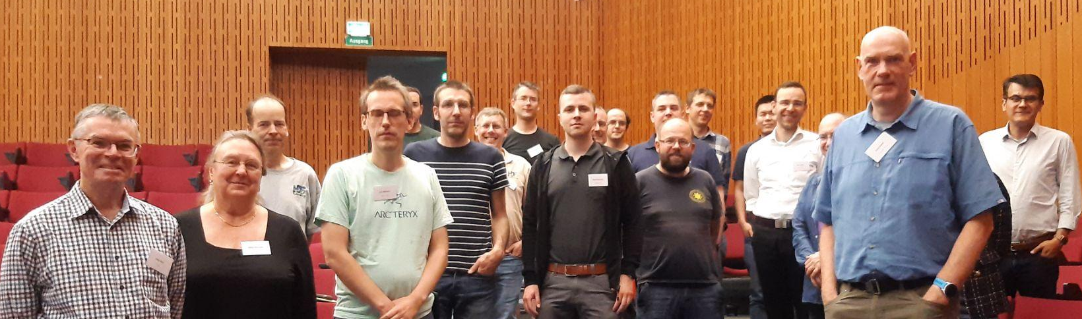

Events
European HDF Group User Summit on plugins and compression – DESY
  86 participants, 3 days, including presentations from companies
  Agreed next steps on maintaining and adding new compression methods
Continued seminar series on compression
  Looking for more speakers!
Notes:
As our light sources and instrumentation get better and better, they produce bigger volumes of data. Secondly, data reduction often involves initial processing steps on data to extract useful information
Can give an overview here – might be talking about this
Somewhat a „ticking boxes“ exercise – should think in light of this; satisfying EU.
Improve data analysis

Slide 10
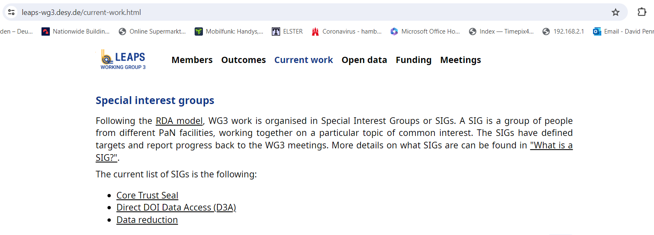
LEAPS WG3 and Special Interest Groups
https://leaps-wg3.desy.de/

Slide 11
Summary
LEAPS-INNOV usefully improved exchange between our institutes, and funded new efforts
Next steps – continuing to collaborate on data reduction
  Will have next LEAPS-INNOV annual meeting
  Plan to keep up periodic meetings and events
Notes:
What to say – data reduction hot topic, and so far have helped share work etc, and should keep this up.

Slide 12


Tak
Tack
Thanks
“ Foster open innovation for accelerator-based lightsources in Europe”
Bedankt
Dziękuję
Danke
Merci
Grazie
https://www.leaps-innov.eu
Gracias
شك
This project has received funding from the European Union´s Horizon 2020 research and innovation programme under grant agreement No. 101004728

