Slide 1
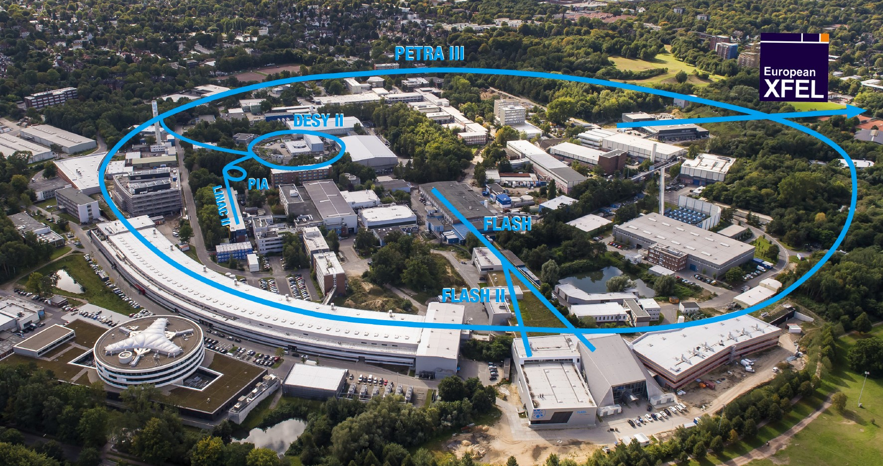
LEAPS-INNOV WP7 annual meeting 2024 – DESY update
David Pennicard
Notes:
Structure:
CERN – chip info etc
Photon counting vs event-by-event readout
Current uses
Eng stuff?
What about Fabian Borstal’s work? (“Getting to grips”?)

Slide 2
Internal organization at DESY
Photon science scientific computing group (Anton Barty) – created 2021
  Implementation of high-performance computing at beamlines
Computational imaging group (Martin Burger) – created 2023
  Research into solving inverse problems
Experiment control group (Linus Pithan)
  Beamline control
Central DESY IT
  Services such as storage and computing clusters; increasing work on beamline applications
Scientific groups, e.g. Cohrent Imaging Group

Slide 3
Compression in serial crystallography
“Data reduction in protein serial crystallography”, Marina Galchenkova et al., IUCrJ. 2024 11: 190-201. doi: 10.1107/S205225252400054X
  Previously presented at LEAPS-INNOV seminar
Tests of lossless and lossy image compression for a variety of datasets (FEL data with integrating detectors and synchrotron data with photon counting)
Evaluation of data quality after lossy compression

Slide 4
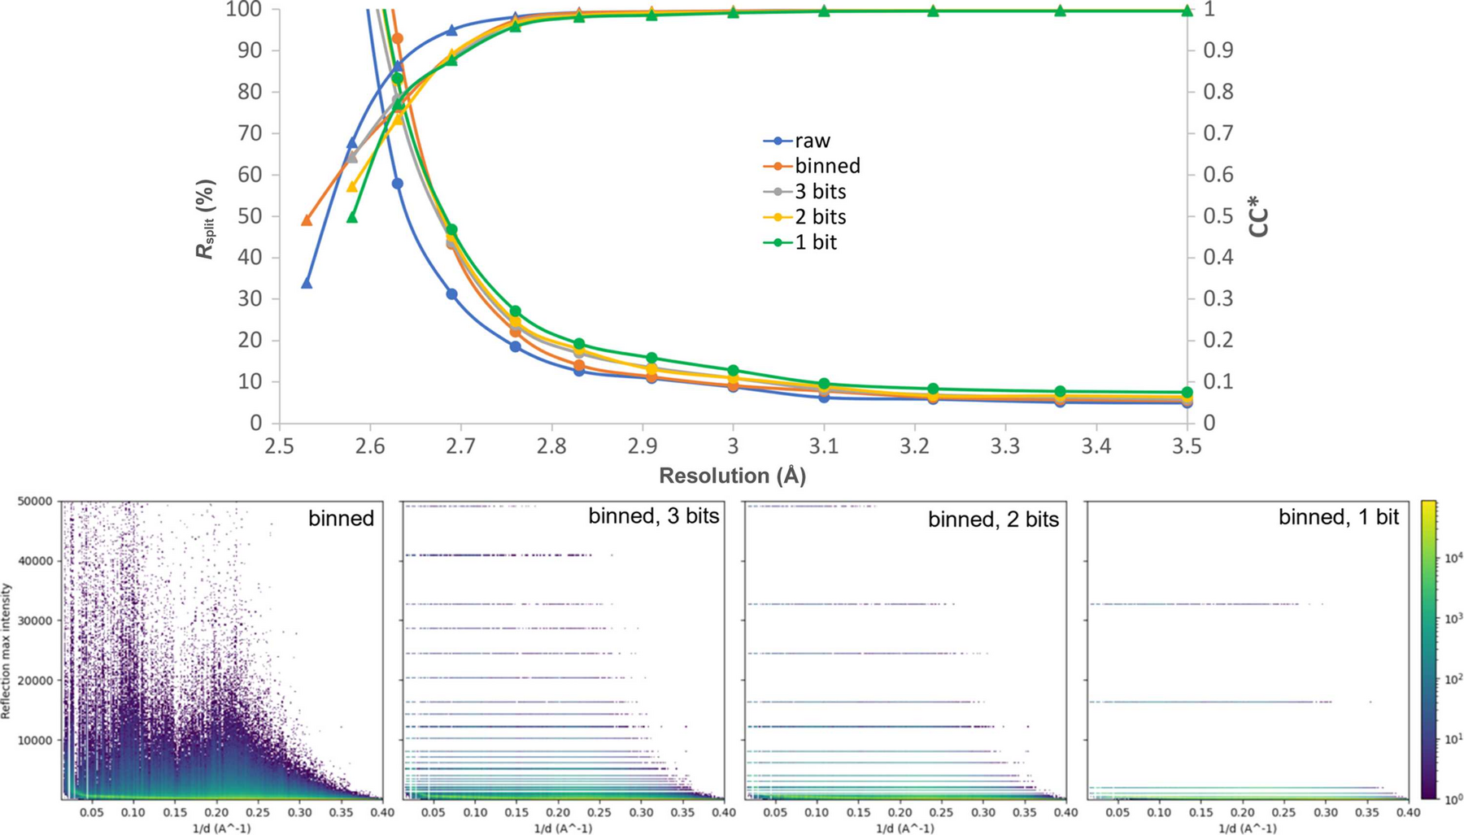
Compression in serial crystallography with quantization
Data from Thaumatin at SwissFEL with JUNGFRAU 16M
Compression ratio with Gzip level 6 and shuffle
Type | CR
Raw | 1
Binned | 5
Binned, 3 bits | 32.18
Binned, 2 bits | 38.84
Binned, 1 bit | 49

Slide 5
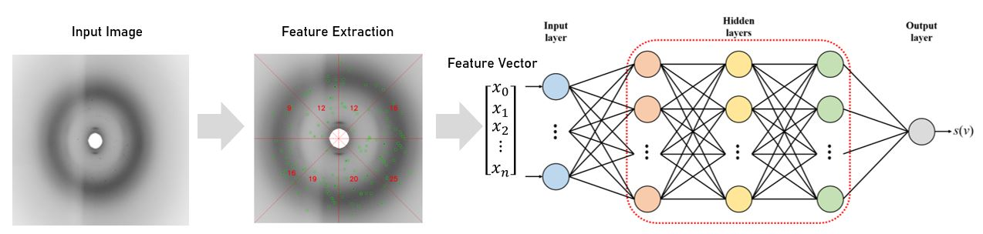
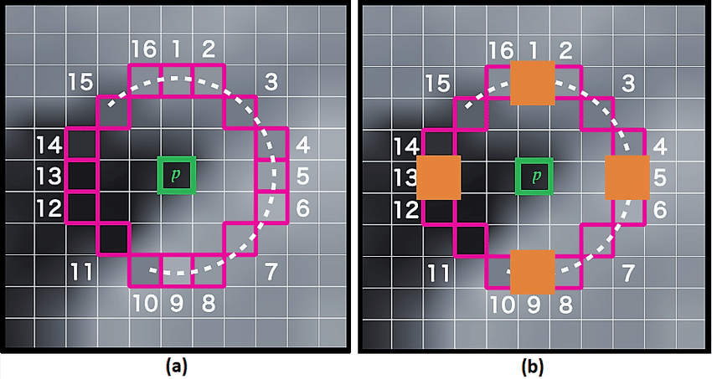
Machine learning for serial crystallography – bad image rejection
“Robust image descriptor for machine learning based data reduction in serial crystallography”, Vahid Rahmani et al., J. Appl. Cryst. (2024) 11 190-201. doi: 10.1107/S205225252400054X
Aim – try to find computationally cheap and robust alternative to traditional Bragg spot detection
Keypoint finding
Fully-connected NN
Hit / miss class
Input image
Feature extraction
Feature vector
Notes:
Need to decide what to say about this.

Slide 6
Machine learning for serial crystallography – bad image rejection
Classification performance (% accuracy)
Hardware acceleration
MP-FAST execution time (ms) per 1 Mpixel image
 | CPU - Intel Core i7-11370 | GPU - NVIDIA RTX 3070 | FPGA – Alveo U280
Excluding data transfer | 0.83 ms | 0.02 ms | 3.02 ms
Including data transfer | 3.17 ms | 0.49 ms | 3.02 ms
NB – FPGA implementation uses ~1% of FPGA resources. Programmed using Xilinx HLS rather than HDL
*NB – Current FPGA implementation only uses <1% of FPGA resources
Notes:
Need to decide what to say about this.

Slide 7
Review paper on data reduction and processing for X-ray detectors
“Data reduction and processing for photon science detectors”, David Pennicard et al., Frontiers in Physics – Radiation Detection and Imaging, 2024, https://doi.org/10.3389/fphy.2024.1285854
Part of a special edition on detectors for synchrotrons and FELs
Thanks to people presenting at LEAPS-INNOV meetings!

Slide 8
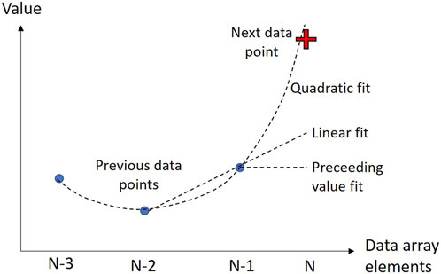
Topic – compression with SZ; error-bound lossy compression
If next number can be “predicted” from previous ones (within specified accuracy), represent with 2-bits
  Di S, Cappello F. Fast error-bounded lossy HPC data compression with SZ. In: 2016 IEEE international parallel and distributed processing symposium. IPDPS (2016). p. 730–9. doi:10.1109/IPDPS.2016.11
LCLS work on ROIBIN-SZ for crystallography; apply lossless compression to Bragg peaks, SZ to rest of image – CR 45
  Underwood R, Yoon C, Gok A, Di S, Cappello Froibin- SZ. ROIBIN-SZ: fast and science-preserving compression for serial crystallography. Synchrotron Radiat News (2023) 36:17–22. doi:10.1080/08940886.2023.2245722

Slide 9
Topic – data compression within the pixel detector readout chip
Developments mostly at US labs – ANL, SLAC, Fermilab
E.g. M. Hammer et al 2021 JINST 16 P01025, DOI 10.1088/1748-0221/16/01/P01025
Compression method:
In-pixel digital denoising and nonuniform (sqrt) encoding
In edge – bit shuffling then efficient encoding of zeroes

Slide 10
Thanks for listening

