Slide 1
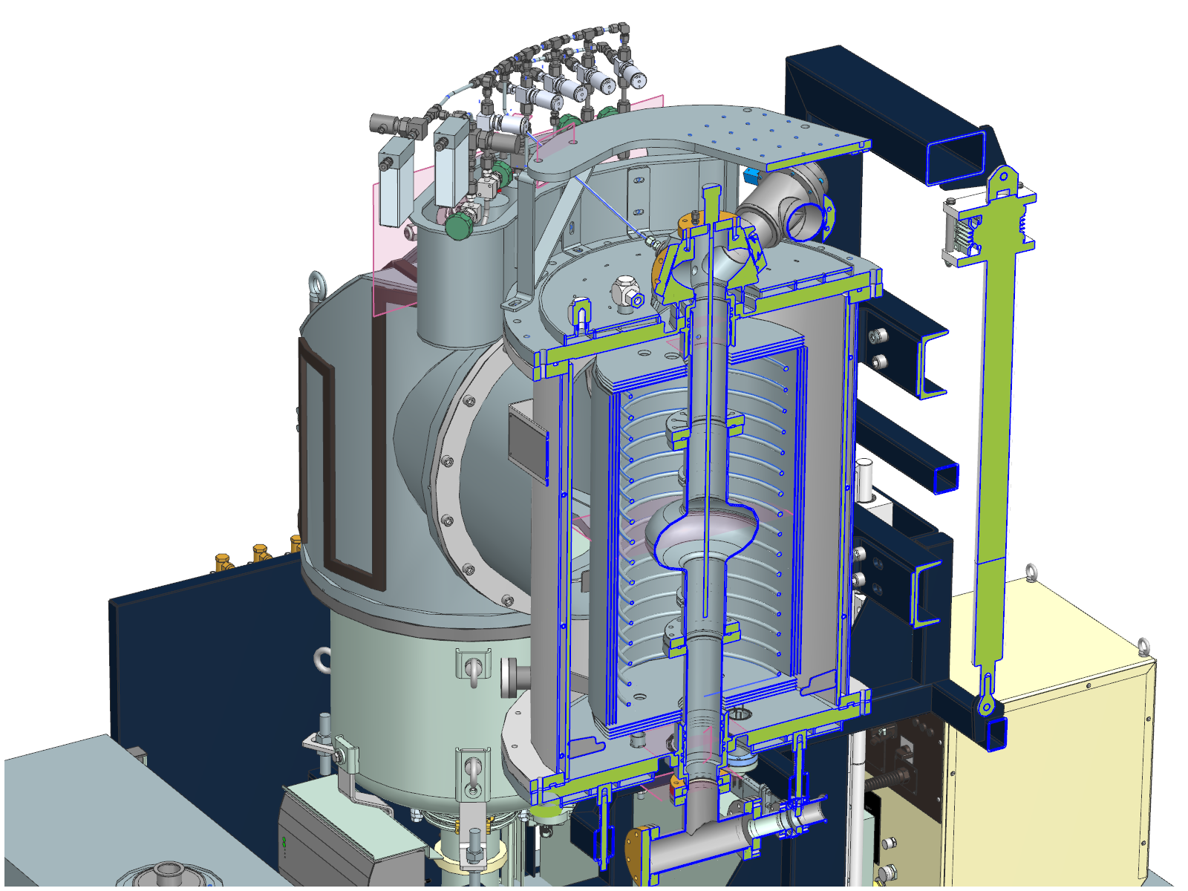
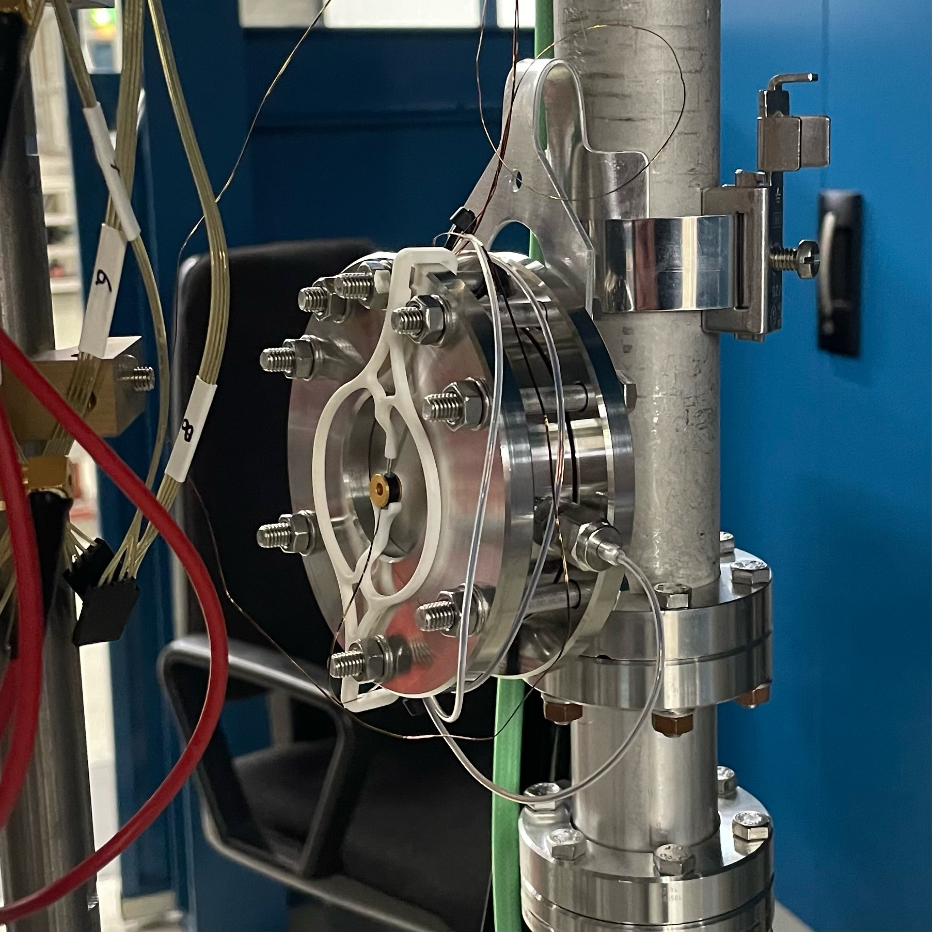
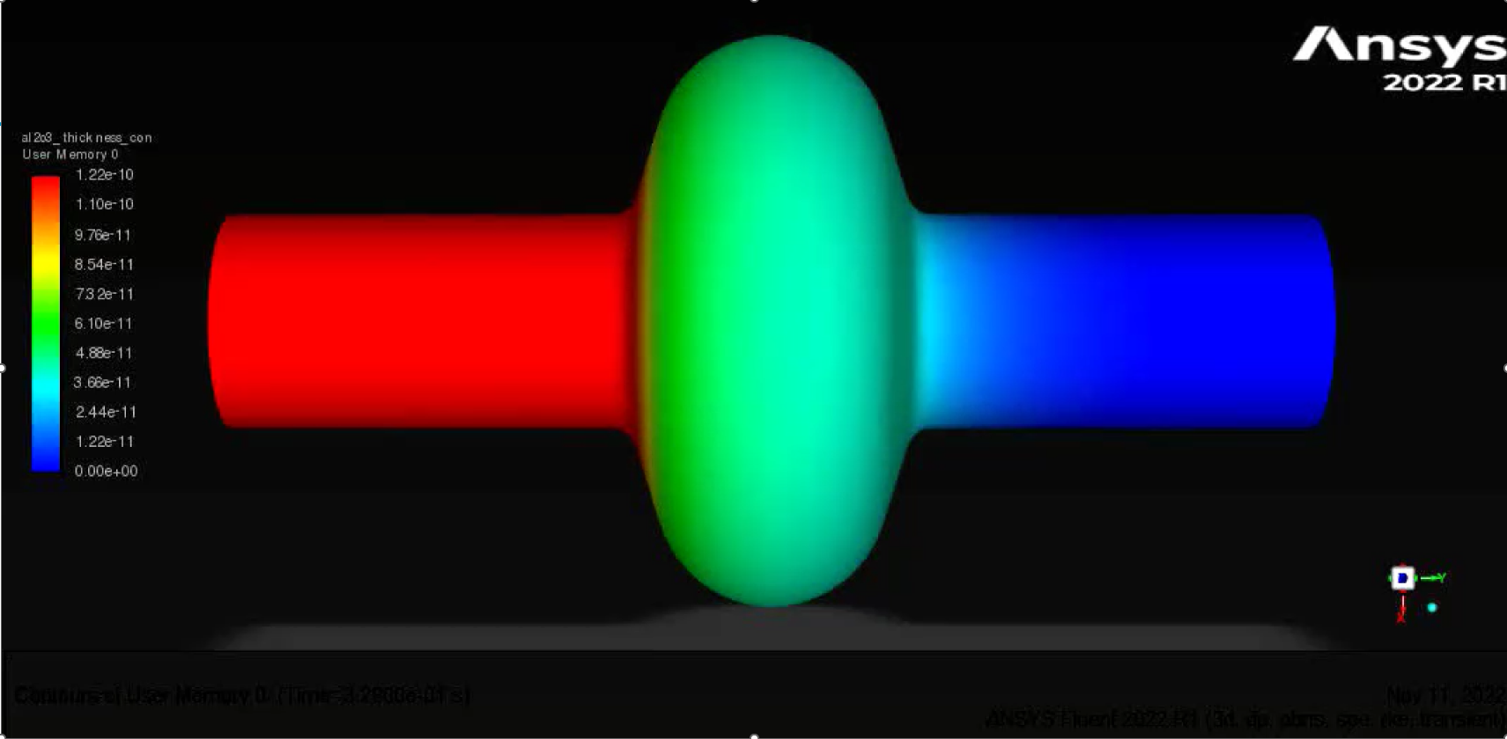
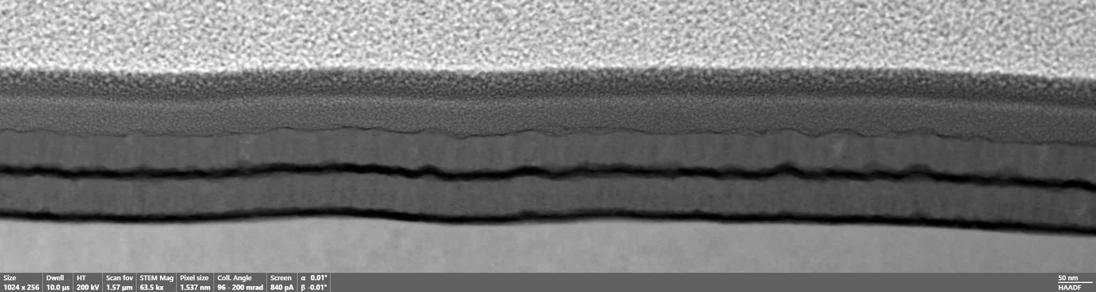
SIS Activities at Universität Hamburg
Marc Wenskat - on behalf of the SRF R&D team
3.5.2024 | Universität Siegen

Slide 2
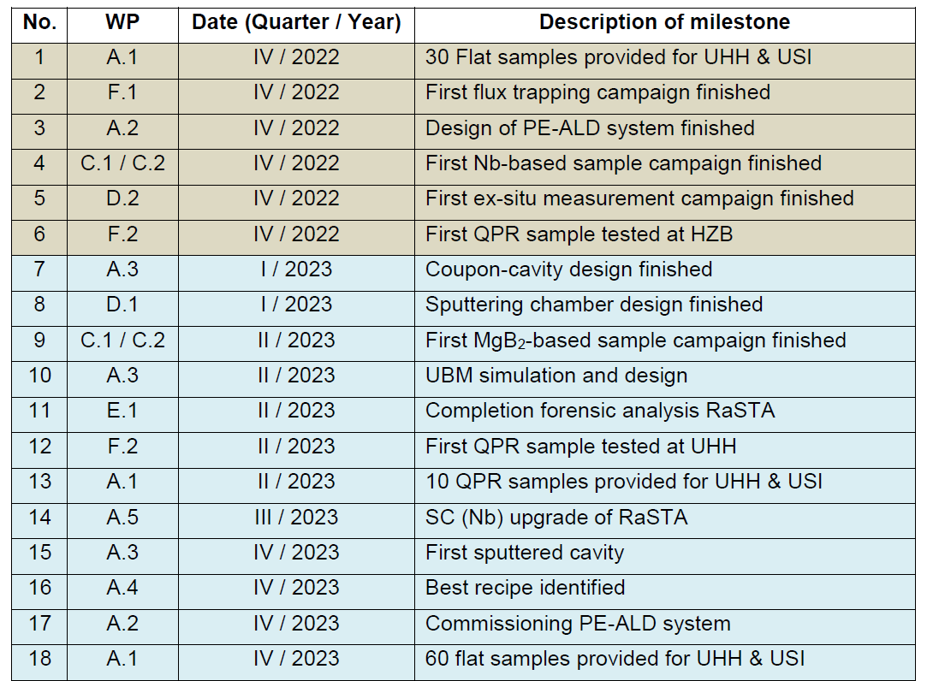

What did we achieve so far?
@CERN, next with HZB
@BUW & UHH
@HZDR, data from the past
Fabrication ongoing
Delay +1y

Slide 3
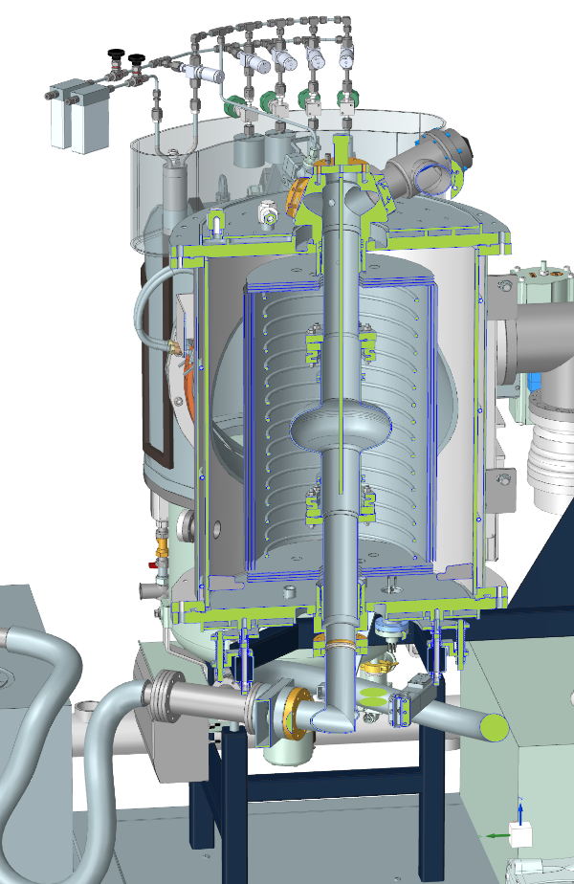
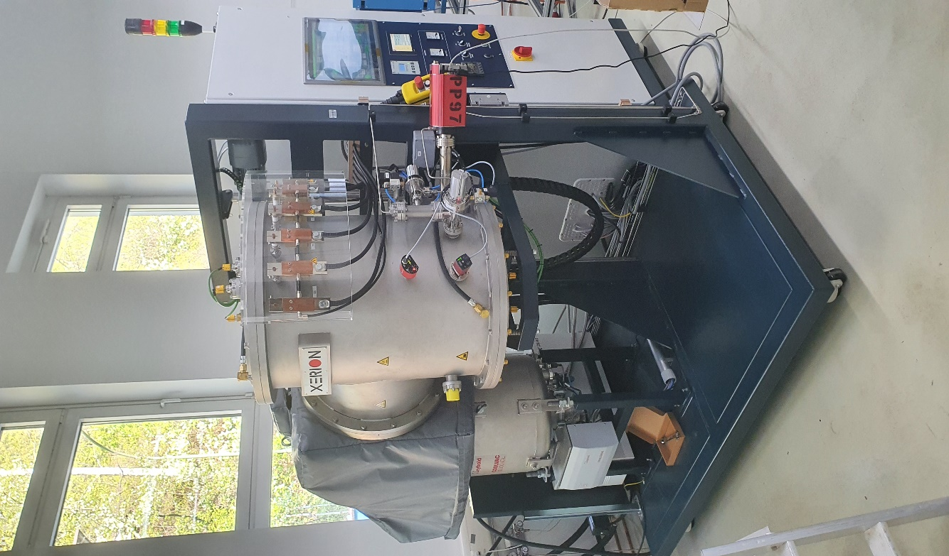
Single-Cell PEALD System
Last parts getting fabricated
Bottle neck: Control
  Many I/O with various properties
  PLC?
Focus on this system now 100%

Slide 4
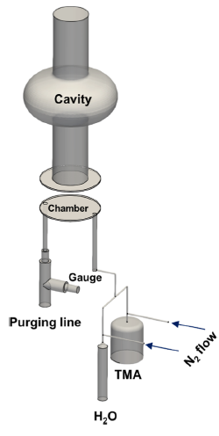
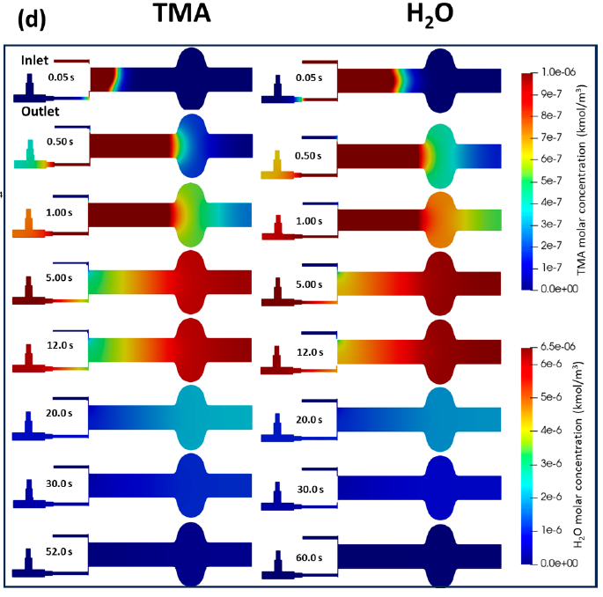
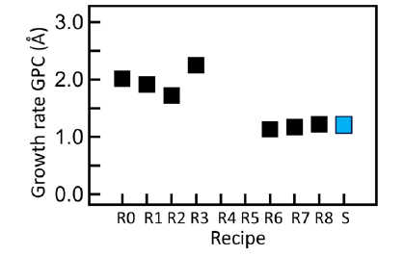
Optimizing the process
[G. Deyu et al., Chem. Mater. 2024, 36, 2846−2856]
Simulating the Al₂O₃ coating process using ANSYS
  Want to do the same for PEALD system
Simulation and experimental data agree well
  p vs. t in chamber
  Calculated & measured GPC → extraordinary, as it contains complex chemical reactions on the surfaces!
Cycle time down but GPC as well → overall t reduction by 33%
  Saves time
  Less parasitic annealing
Simulation

Slide 5
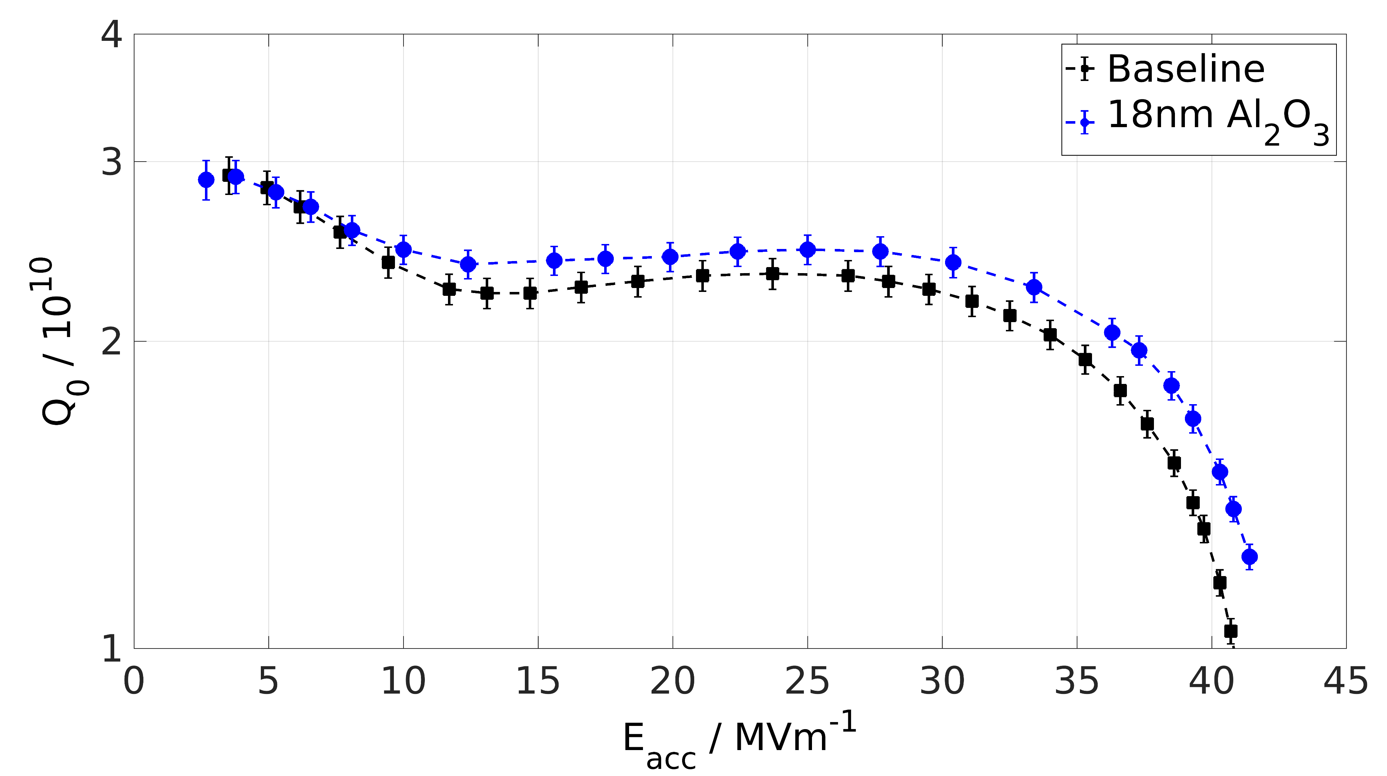
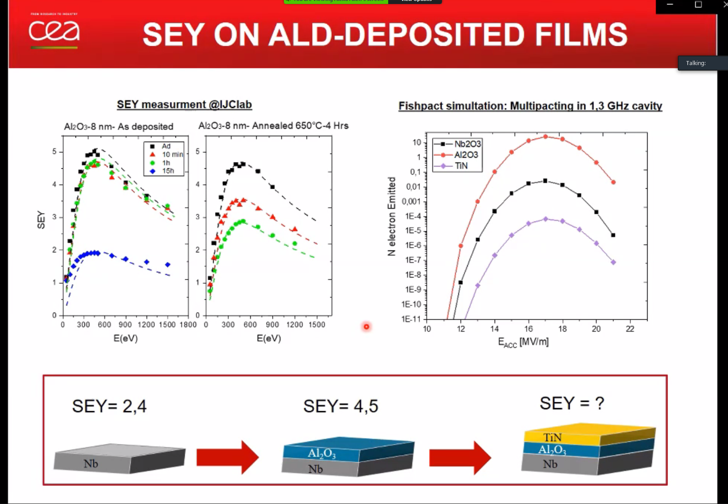
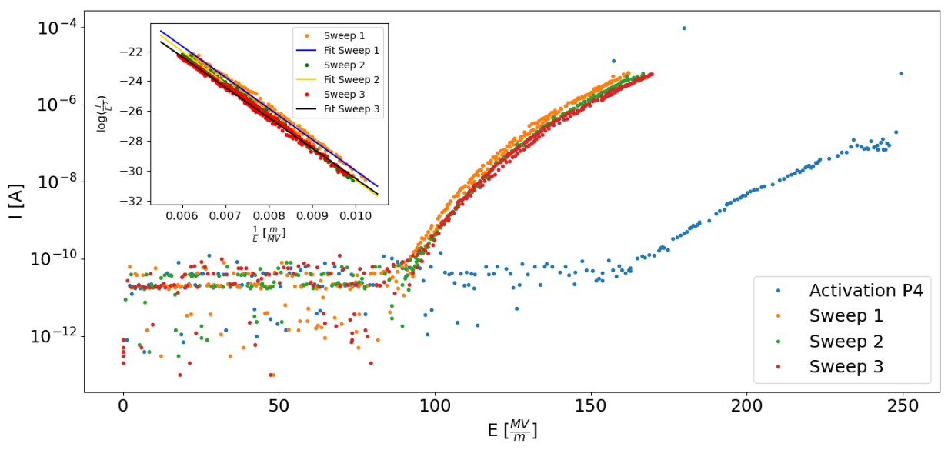
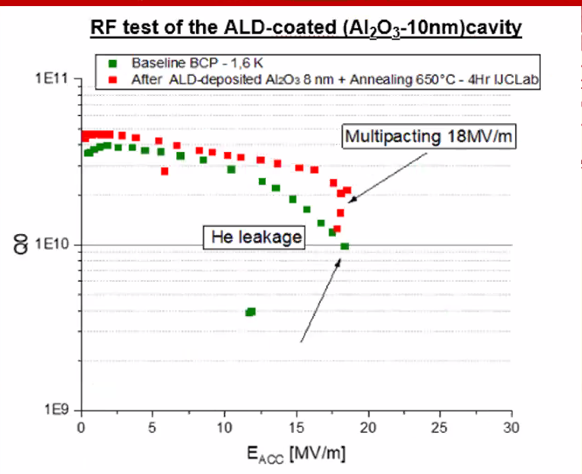

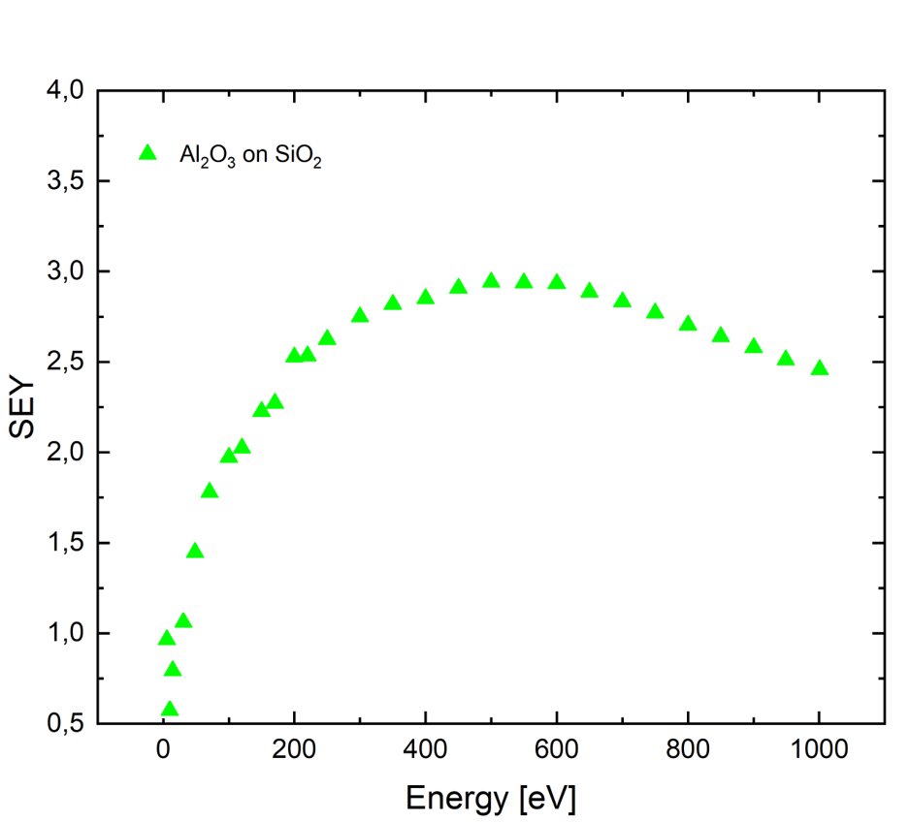
FE and SEY Studies
Frederic Braun
Cavities coated at CEA Saclay with Al₂O₃ were limited around 18 MV/m
  Argument: FE due to higher SEY
Why did we achieve 42 MV/m then?
SEY measurements of our Al₂O₃ layer
  Lower then CEA (4.5) – why?
  Higher deposition temperature at CEA ?
on SIS

Slide 6
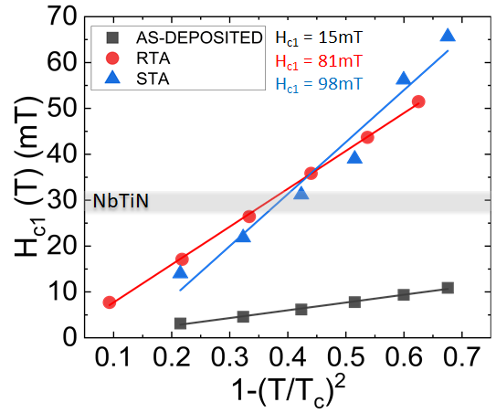

Pancake effect
PhD Thesis Isabel Gonzalez
Original argument for Multilayer: thin films enhance H_{c1}
We measured H_{c1} using a VSM
  75nm of NbTiN on Si
As-deposited is not good
  We know that from T_{c} as well
Best explanation for H_{c1} enhancement is pancake effect
$$µ_{0}H_{c1}= \frac{2ϕ_{0}}{πd^{2}}ln\frac{d}{ξ}$$
[G. Stejic et al., PRB 49.2 (1994)]
Co-Autor: Alex Gurevich
[A. Gurevich, APL 88 (2006)]

Slide 7
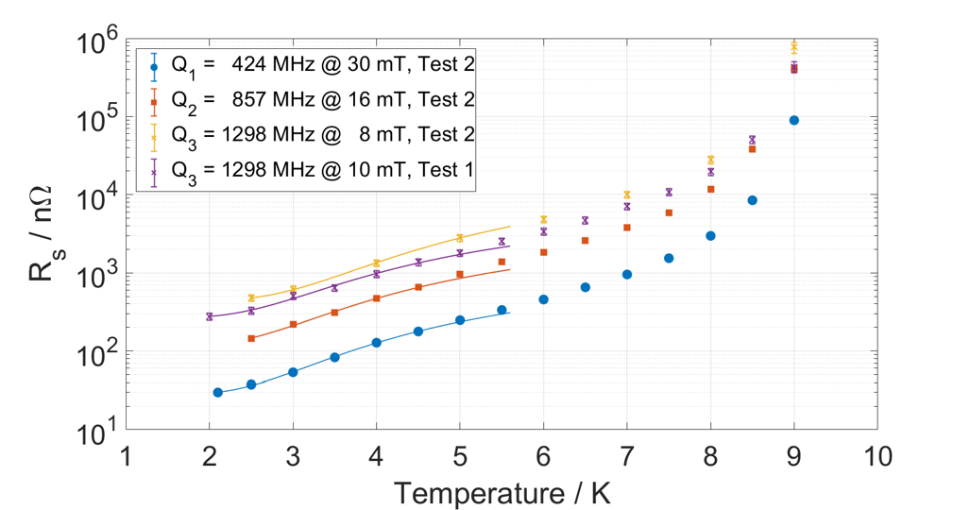
The QPR is ready
PhD Thesis Ricardo Monroy-Villa
Commissioning done
Transition to regular operation next
5 QPR samples currently fabricated at RI
Looking for PhD student & funding

Slide 8
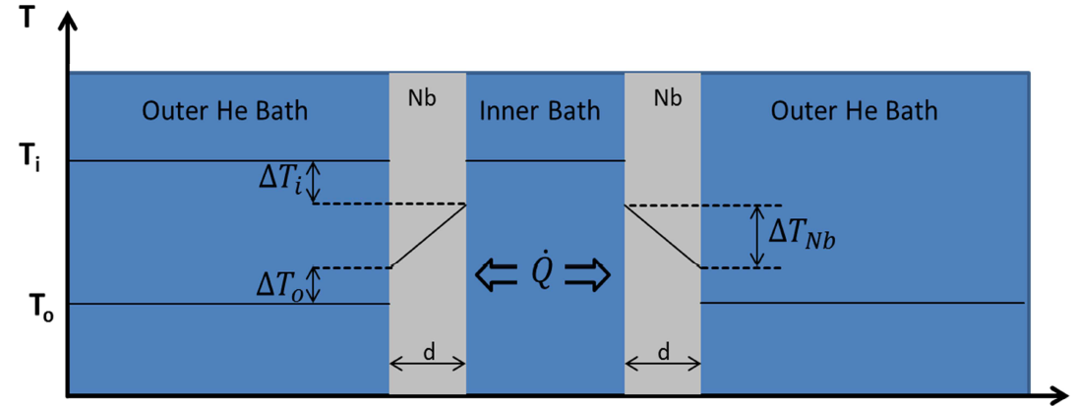
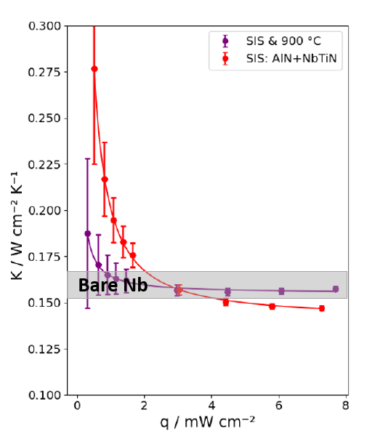
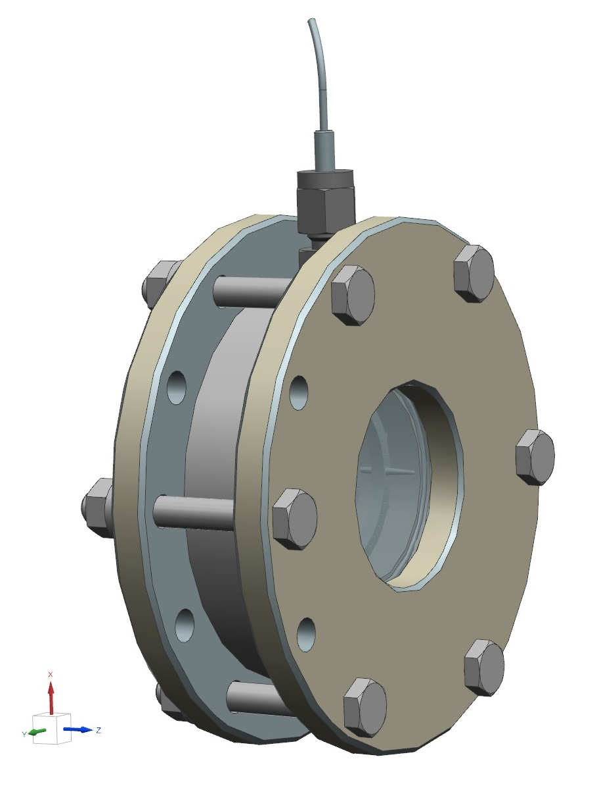
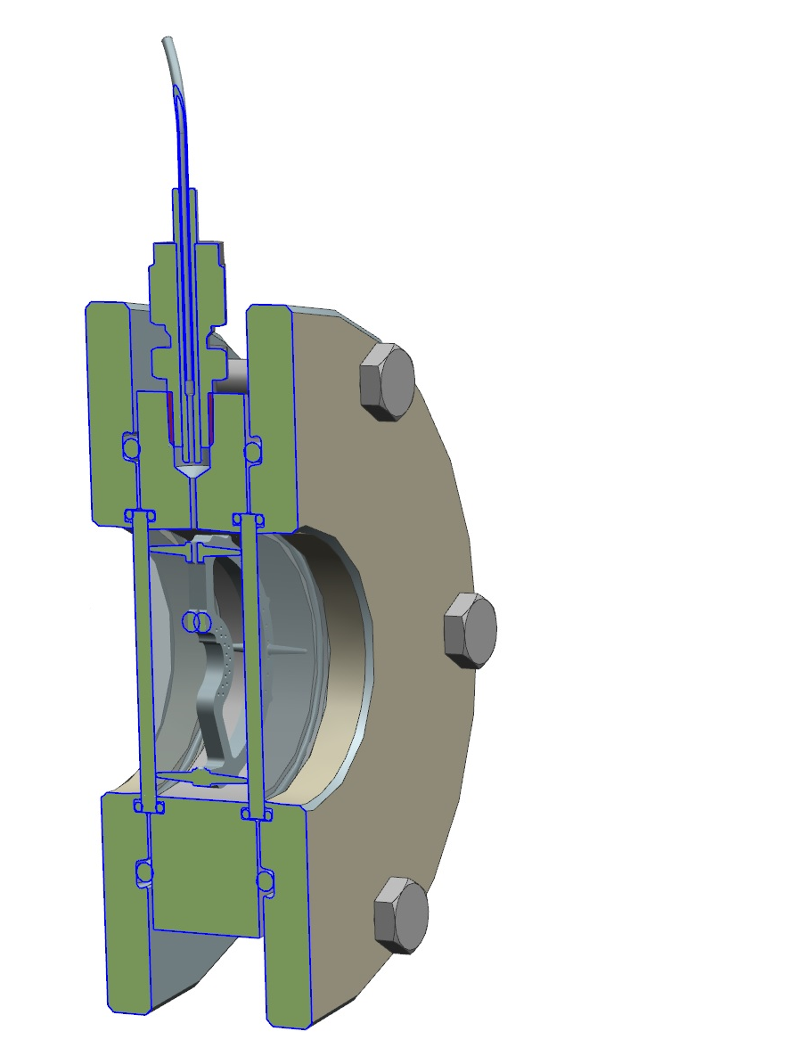
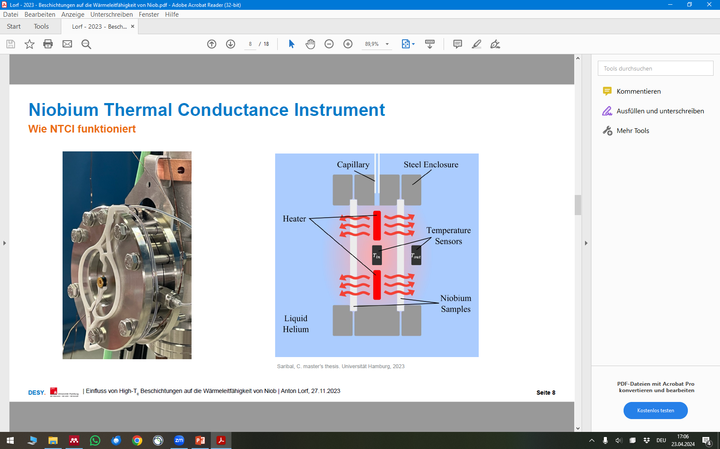
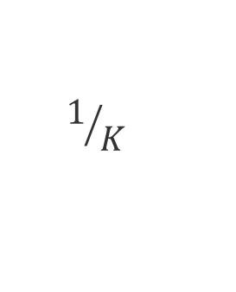
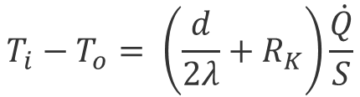
Thermal resistance of thin films
MSc Thesis Cem Saribal
BSc Theses Anton Lorf / Leon King
$$T_{i}−T_{o}= \left(\frac{d}{2λ}+R_{K}\right)\frac{\dot{Q}}{S}$$
$$1/K$$
x
10 Nb sample pairs, multiple tests:
  as fabricated (2)
  + coarse BCP (4)
  + 800°C (10) → Baseline
  repetitive cooldowns (4)
  SIS (1) + anneal (1)
  Nb₃Sn (2)
  Mid-T next
Based on old work from C. Antoine (CEA) and Jay Amrit (U Paris-Saclay)

Slide 9

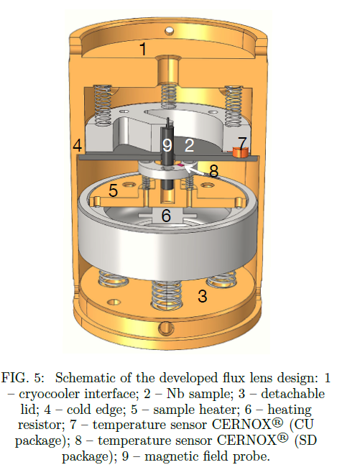
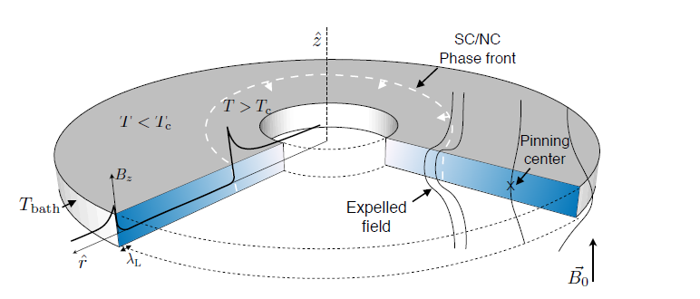
Flux trapping effciency
MSc Thesis Lea Preece
A. MacPherson
D. Turner
A. Ivanov, T. Koettig, and A. Macpherson. "Partial Meissner effect measurement by a superconducting magnetic flux lens." arXiv preprint arXiv:2103.06697 (2021).
Argument from Cornell:
Multilayers have to many defects → enhancement
is nullified
Study trapping efficiency as a first measure
90 mm

Slide 10
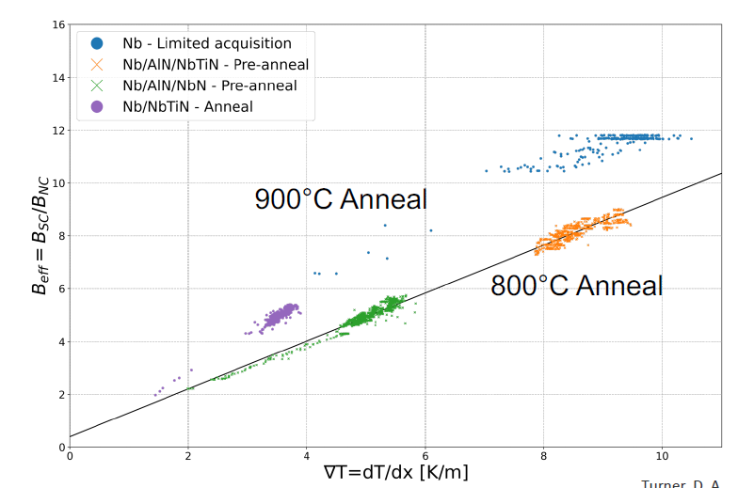
Results are consistent and exciting…
MSc Thesis Lea Preece
A. MacPherson
D. Turner
Observed behaviour fits experience:
  Higher T higher expulsion
What about S-S and S-I-S?

Slide 11
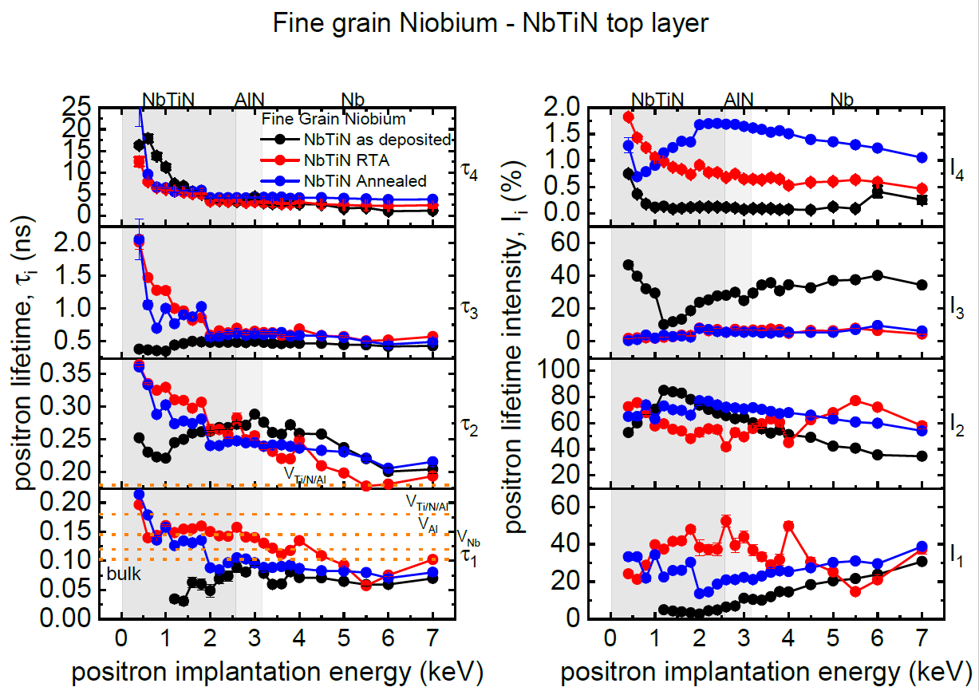
Vacancy studies important for flux trapping
25nm
15nm
25nm
15nm
First studies on S-I-S samples „back then“
New post-processing recipe since then
Now (flux trapping!) also S-S relevant
Application for beamtime submitted
TEM studies in parallel

Slide 12
Summary & next steps
Busy 15 months – many studies about SIS and its various aspects
PEALD single-cell system delayed
Our two pillars for SESAM would be:
  Coat a cavity + accompanying studies
  Flux expulsion studies + accompanying studies
  Request 2x PhDs – no significant invest

