Slide 1
DRD6 summary
Lot of interesting talks : https://indico.cern.ch/event/1368231/timetable/

Slide 2
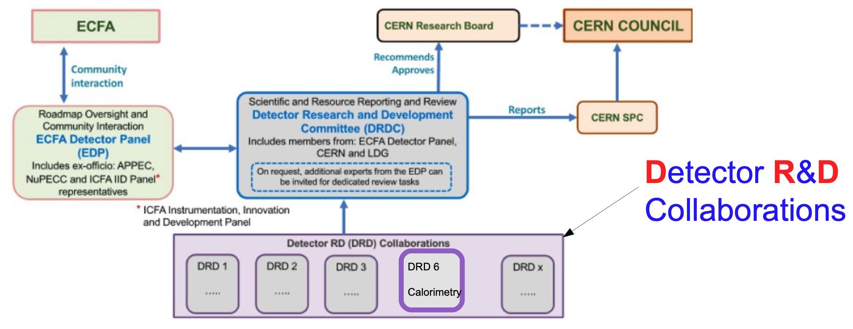
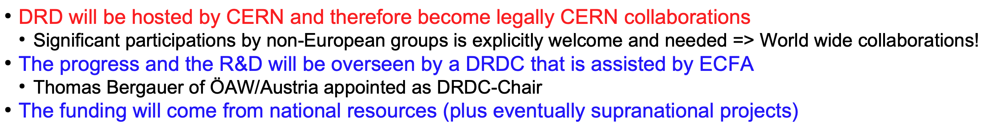

Slide 3
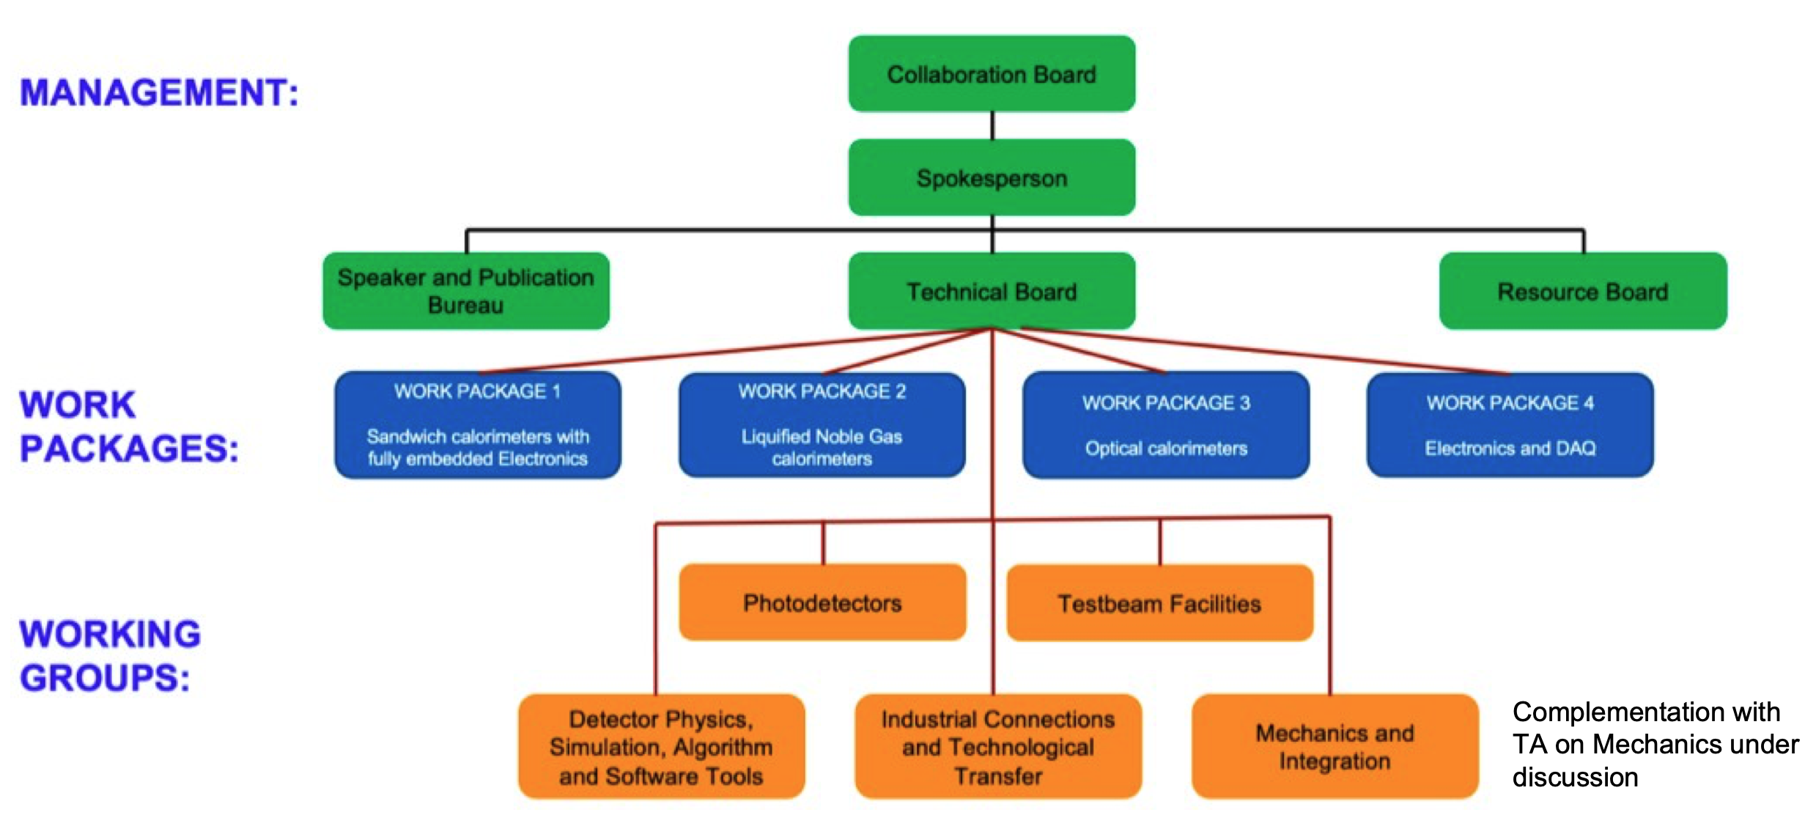
DRD6 collaboration

Slide 4


Slide 5
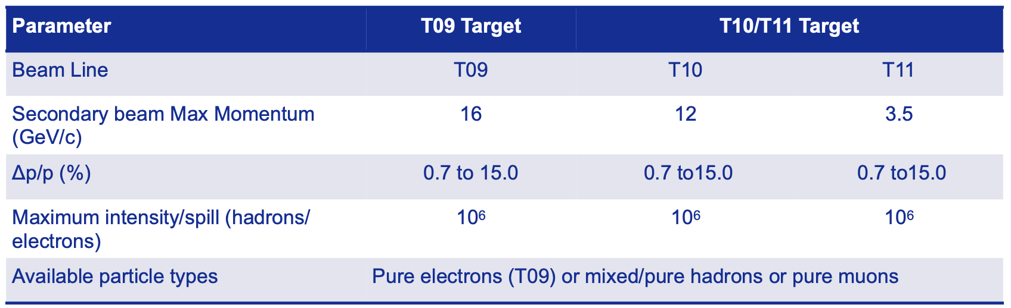
Test beam : new PS beam line @ CERN

Slide 6
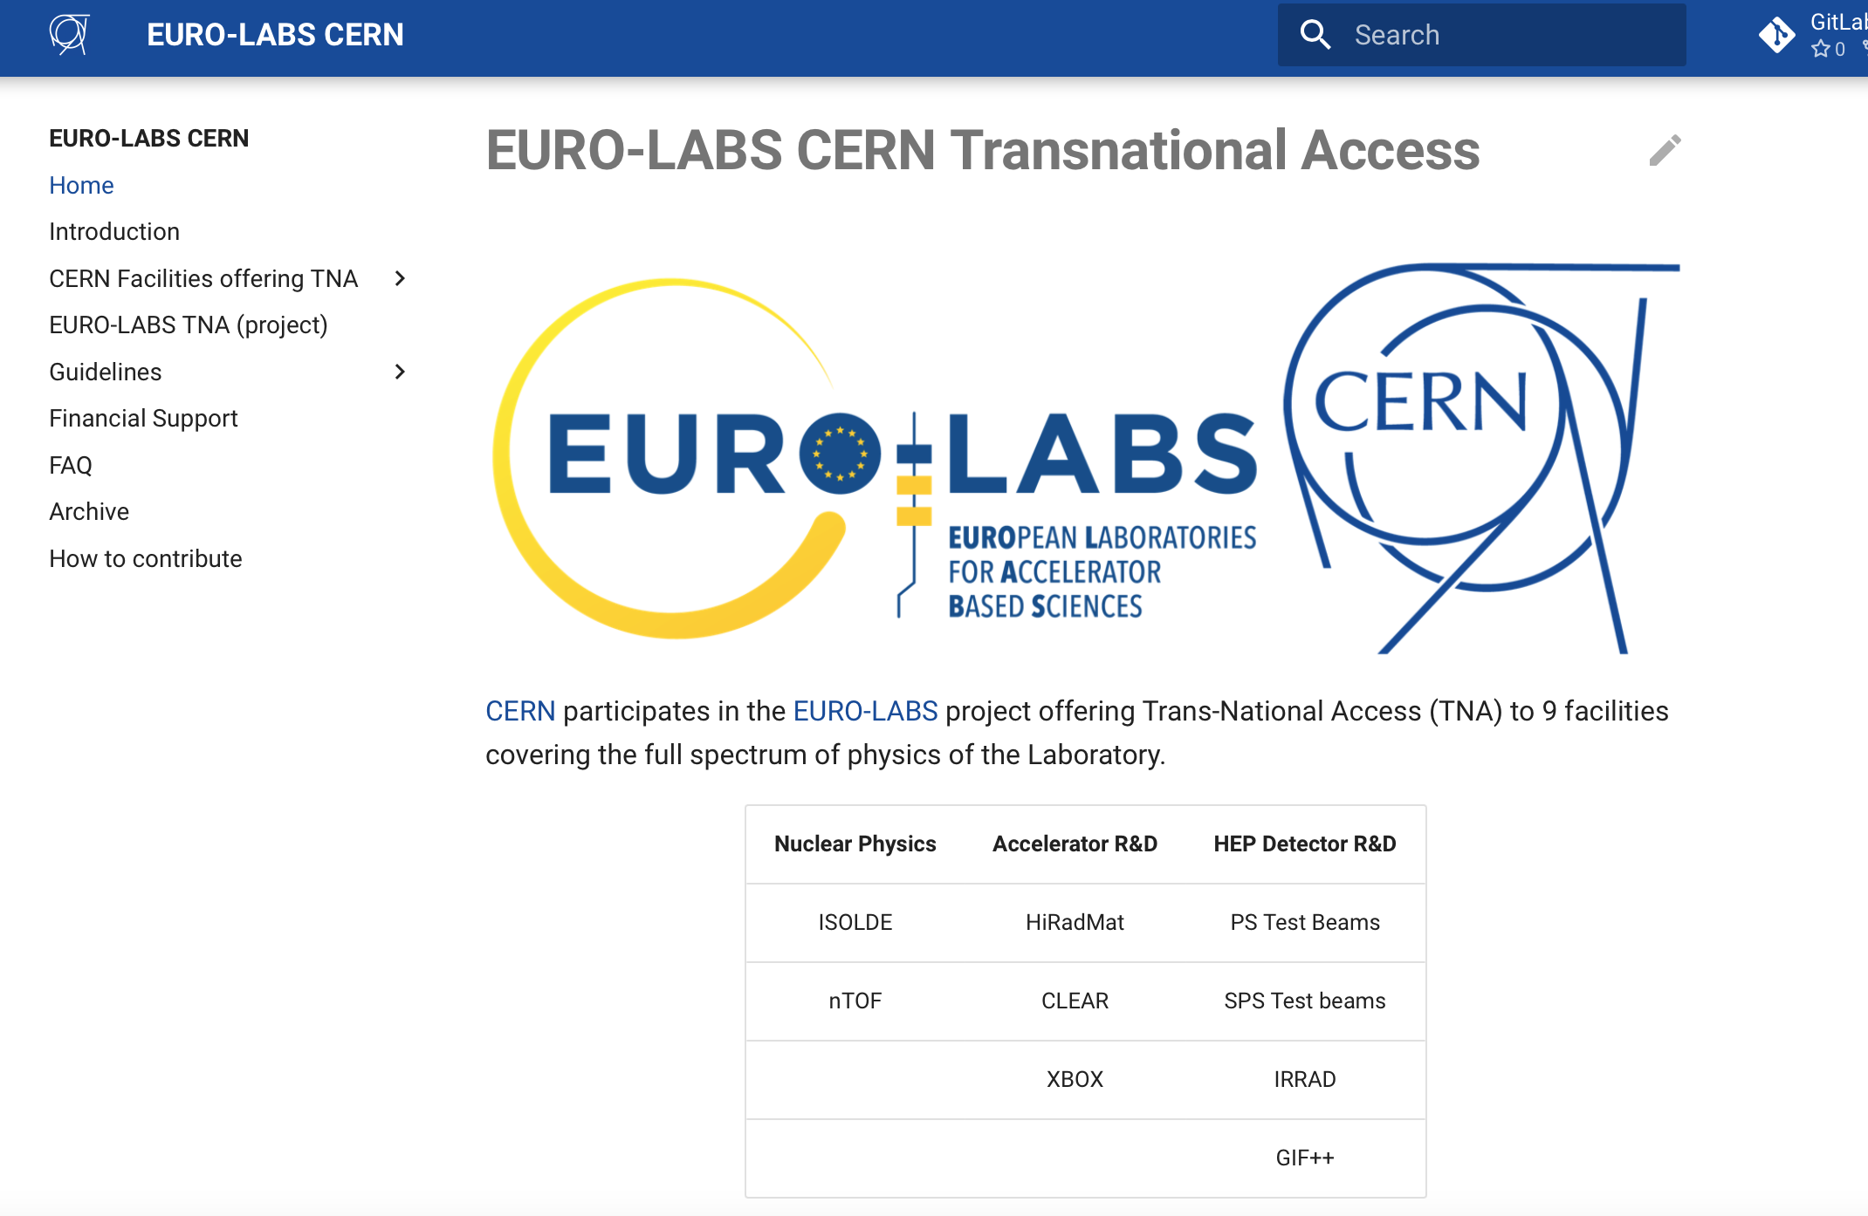
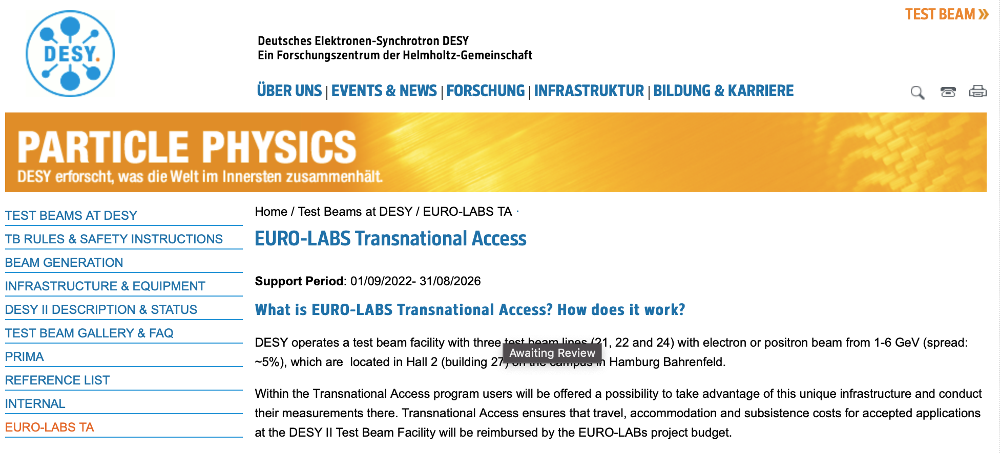
EURO-LABS transnational Access

Slide 7
thanks

