Slide 1


Christiane Schneide (DESY)
for the PUNCH4NFDI Consortium
DESY, 1 July 2024

Slide 2
Outline
The ”Nationale Forschungsdaten-Infrastruktur NFDI e.V.”
Base4NFDI
PUNCH4NFDI: present and future
FH SciComp Workshop 01.07.24 | PUNCH4NFDI | CS

Slide 3
NFDI
Notes:
<number>

Slide 4


Nationale Research
Data Infrastructure (NFDI)
Sustainable utilisation of research data
Establishment of FAIR RDM
Connection to Europe & the world
Bottom-up approach: 27 consortia
Base service initiative
5 (+5) year funding (PUNCH4NFDI: 3,5MEUR/a from 10/2021-09/2026)
See also DFG.de/nfdi and nfdi.de
FH SciComp Workshop 01.07.24 | PUNCH4NFDI | CS
https://axveco.com/wp-content/uploads/2020/11/FAIR_data_principles-1030x349.jpg
Notes:
By now >300 organisations
<number>

Slide 5

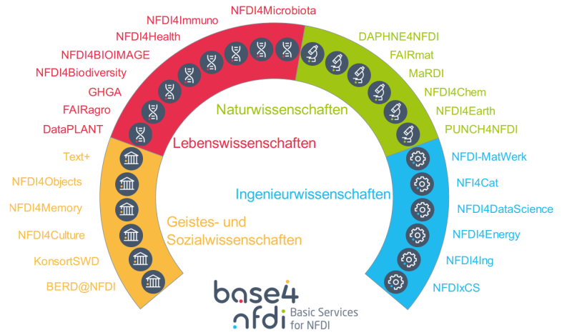




NFDI Consortia
FH SciComp Workshop 01.07.24 | PUNCH4NFDI | CS
Notes:
<number>

Slide 6
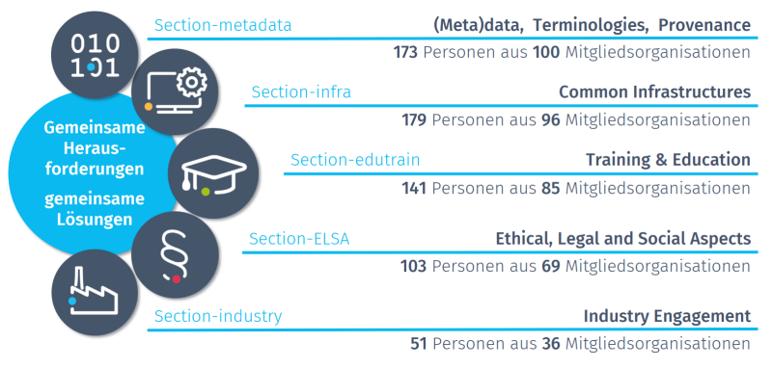
NFDI Sections – with (too) many working groups
FH SciComp Workshop 01.07.24 | PUNCH4NFDI | CS
Notes:
<number>

Slide 7
Base4NFDI
Notes:
<number>

Slide 8
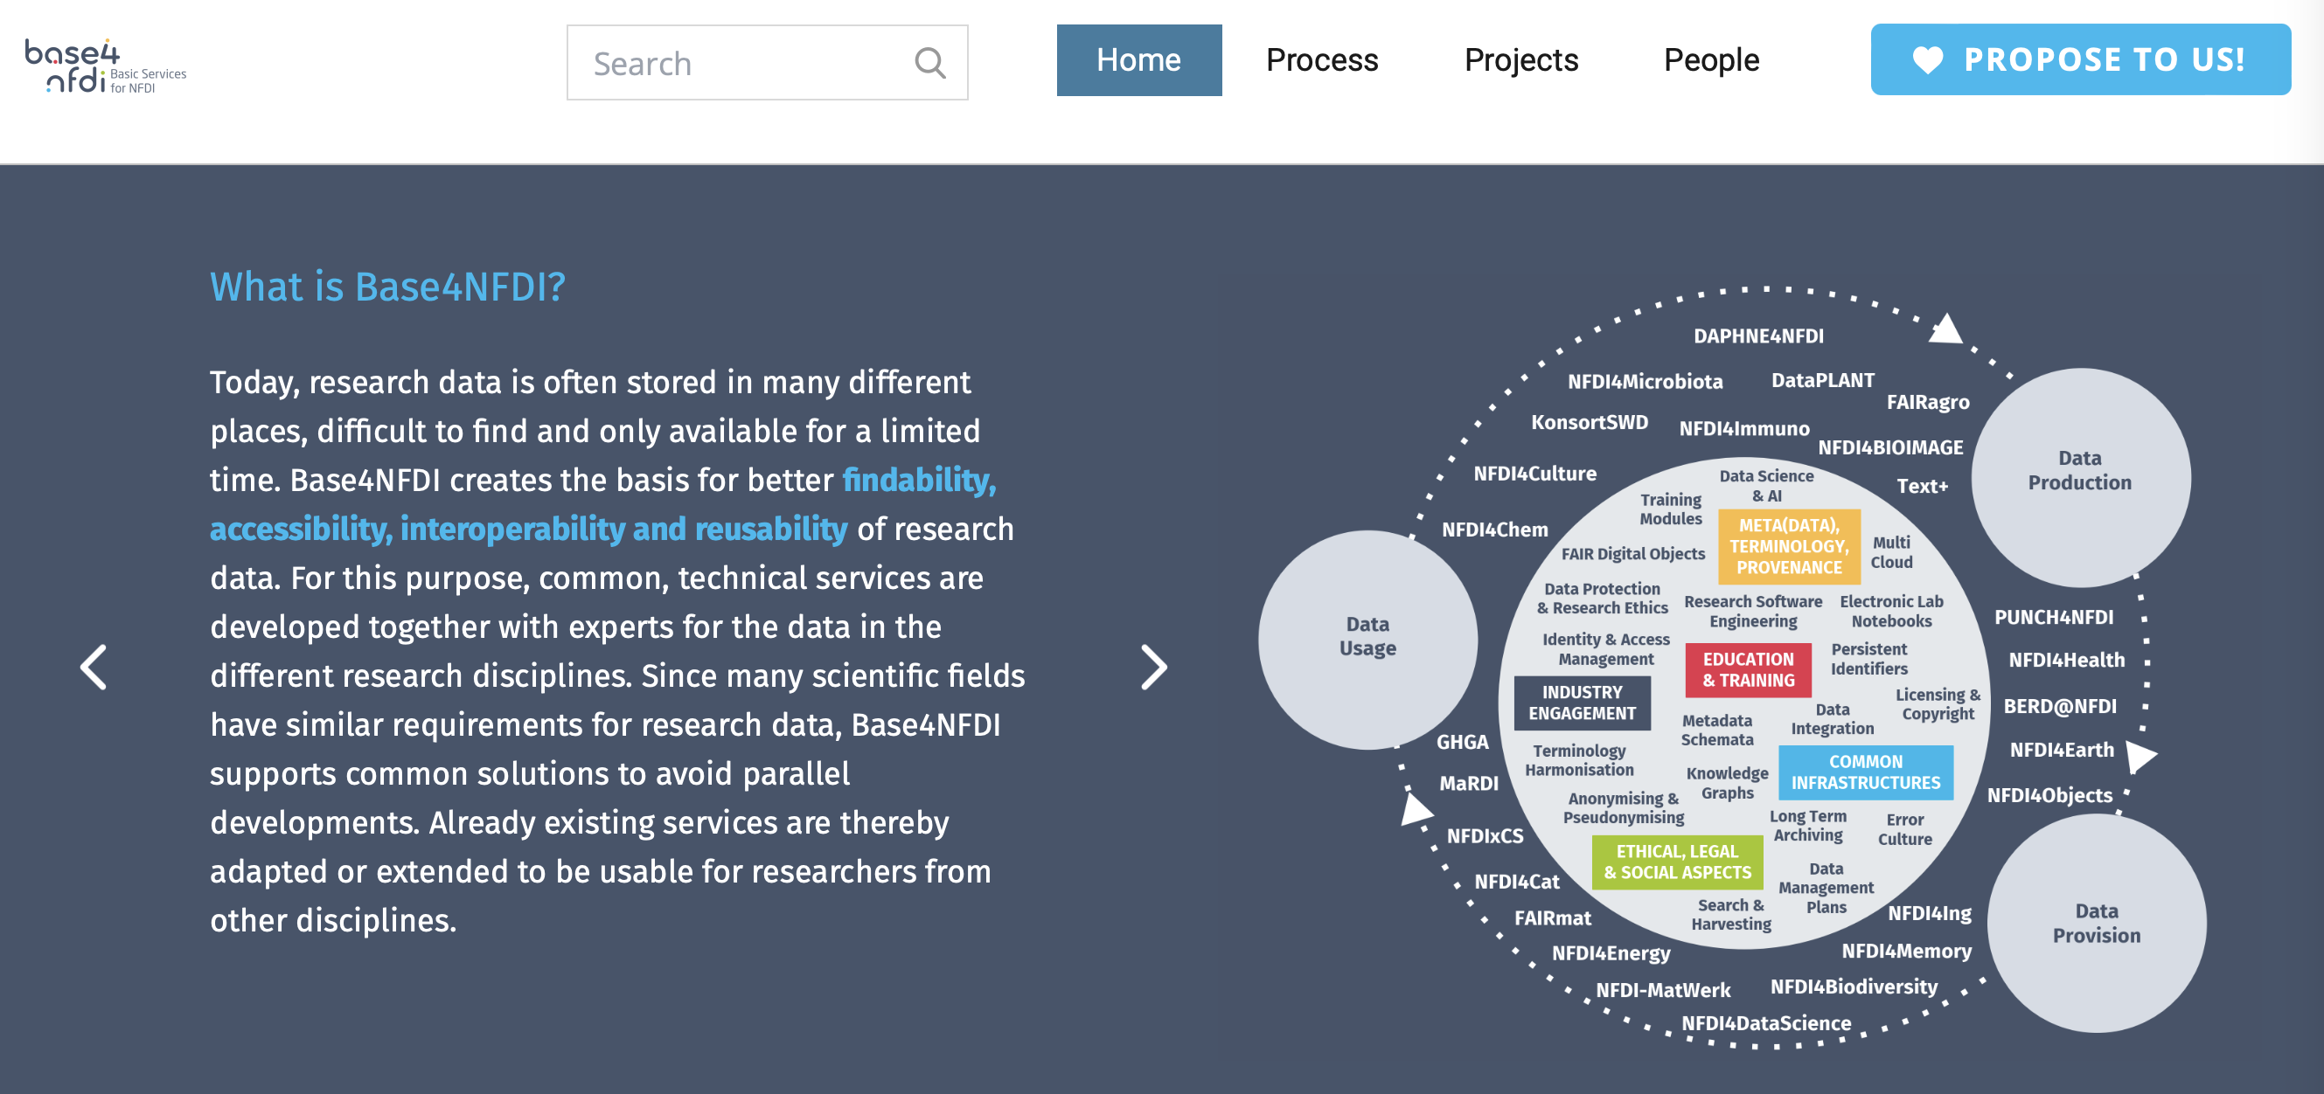
Base4NFDI
Besuch V. Beckmann @ DESY 12. April 2024 | NFDI etc. | CS/TS
Notes:
From Bridget: Daphne data – in which time frame? Annual?
From bridget: All smartphones in the world: 7 billion times 50 GB = 350 billion GB = 350 million TB = 350.000 PB = 350 EB → too large for here?
HL-LHC data estimate from official ATLAS and CMS numbers, entire Run 3, a few years, unclear if simulation included
FAIR@GSI – online data per year – will be massively reduced (trigger, irreversibility)
Quelle fuer globally created data: https://www.researchgate.net/figure/Global-growth-trend-of-data-volume-2006-2020-based-on-The-digital-universe-in-2020_fig5_274233315#:~:text=Data%20volume%20is%20continuously%20increasing,video%2C%20text%2C%20and%20images.
<number>

Slide 9
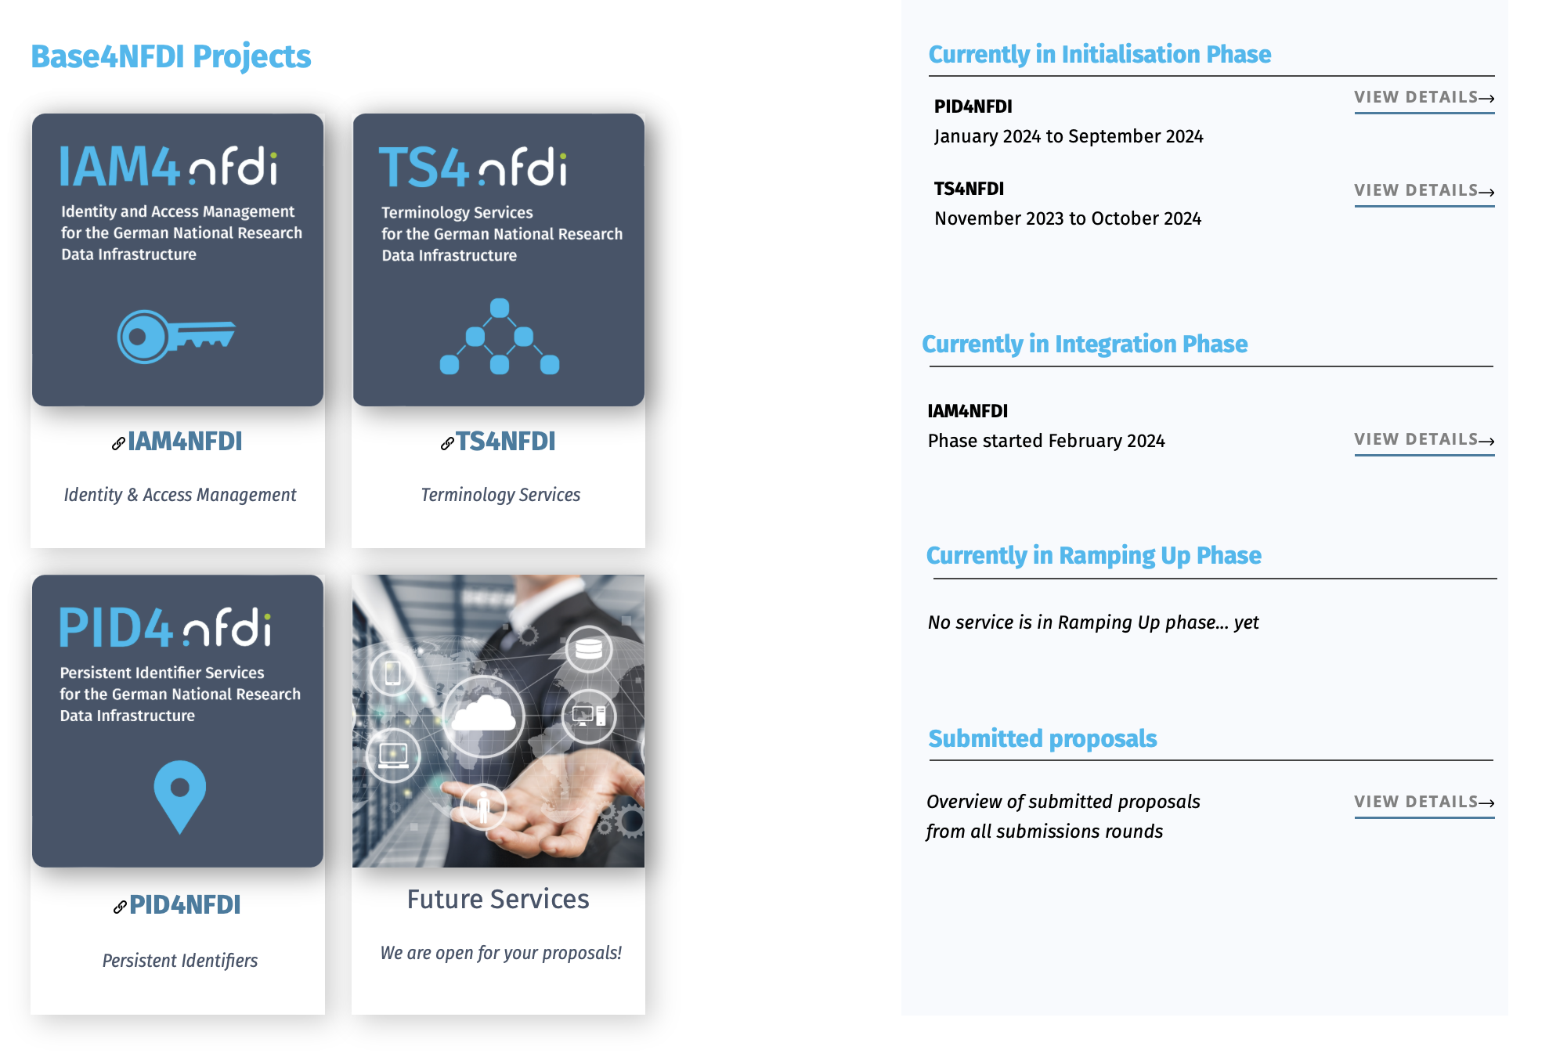
Besuch V. Beckmann @ DESY 12. April 2024 | NFDI etc. | CS/TS
Notes:
From Bridget: Daphne data – in which time frame? Annual?
From bridget: All smartphones in the world: 7 billion times 50 GB = 350 billion GB = 350 million TB = 350.000 PB = 350 EB → too large for here?
HL-LHC data estimate from official ATLAS and CMS numbers, entire Run 3, a few years, unclear if simulation included
FAIR@GSI – online data per year – will be massively reduced (trigger, irreversibility)
Quelle fuer globally created data: https://www.researchgate.net/figure/Global-growth-trend-of-data-volume-2006-2020-based-on-The-digital-universe-in-2020_fig5_274233315#:~:text=Data%20volume%20is%20continuously%20increasing,video%2C%20text%2C%20and%20images.
<number>

Slide 10
PUNCH4NFDI
Notes:
<number>

Slide 11

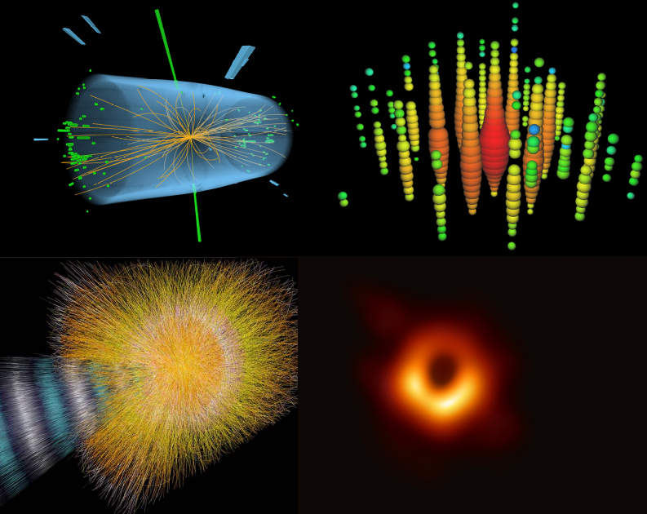
Particle physics
Astroparticle physics
Particles, Universe, NuClei and Hadrons for the NFDI
The prime goal of PUNCH4NFDI is the
setup of a federated and "FAIR" science
data platform, offering the infrastructures
and interfaces necessary for the access
to and use of data and computing resources of the involved communities and beyond. This will help to master the challenges of big data, open data, and FAIR workflows.
Hadron & nuclear physics
Astronomy
FH SciComp Workshop 01.07.24 | PUNCH4NFDI | CS

Slide 12










































Who We Are
Universities, Helmholtz, Max Planck, Leibniz
42 Partners
20 Co-applicants
22 Participants
Currently more than 130 people actively working
Representing close to 10000 scientists in Germany
(KAT, KET, KHuK, RdS)
KAT, KET, KHuK and RdS
representatives
in our
User Committee
Closely connected to many large data & compute infrastructures
FH SciComp Workshop 01.07.24 | PUNCH4NFDI | CS
Notes:
So who is PUNCHF4NFDI - …well, in a sense, probably all of us, because I would assume that there are not too many participants of today’s meeting that are not member of one of the institutions mentioned here.

Slide 13









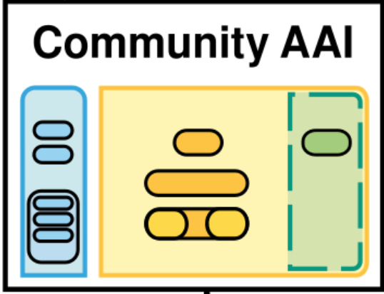
Federated Science Data Platform
Storage4PUNCH
Compute4PUNCH
Results, visualisation
Reference the Dataset
Execute the code
Reference
the code
Request computing
resources
Save the results
Request a dataset
PLATFORM
Home institute
Information regarding resource and access rights within the institution
Create and execute a workflow
Save the workflow
AAI request
FH SciComp Workshop 01.07.24 | PUNCH4NFDI | CS
Notes:
So these are our task areas – I will not go through them in detail – this is part of the general meeting later today. Instead,let me address two fundemantal ingredients of what we would like to implement, at least in a prototype using this computing and data mamagement model.
==============================
Without going into any detail these are concerned with
the storage/compute/access technology to large and distributed data sets on federated infrastructures,
With data transformations and the necessary algorithms,
and with relevant training and education measures needed to bring scientists from the NFDI up to speed in data management issues.
I will a slide or two on each of these task areas.

Slide 14
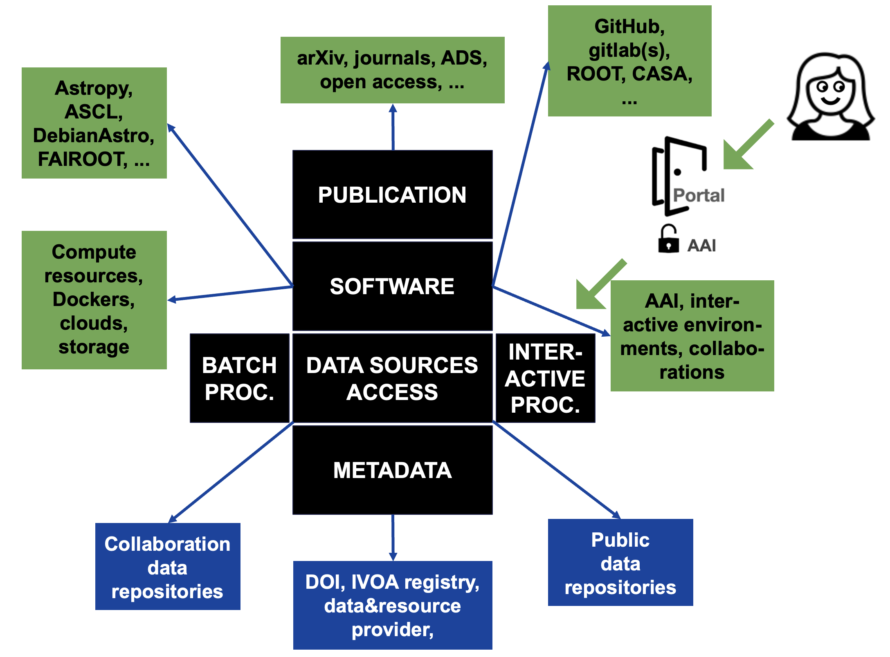
FAIR Digital Research Products (DRPs)
FH SciComp Workshop 01.07.24 | PUNCH4NFDI | CS
Notes:
From Bridget: Daphne data – in which time frame? Annual?
From bridget: All smartphones in the world: 7 billion times 50 GB = 350 billion GB = 350 million TB = 350.000 PB = 350 EB → too large for here?
HL-LHC data estimate from official ATLAS and CMS numbers, entire Run 3, a few years, unclear if simulation included
FAIR@GSI – online data per year – will be massively reduced (trigger, irreversibility)
Quelle fuer globally created data: https://www.researchgate.net/figure/Global-growth-trend-of-data-volume-2006-2020-based-on-The-digital-universe-in-2020_fig5_274233315#:~:text=Data%20volume%20is%20continuously%20increasing,video%2C%20text%2C%20and%20images.
<number>

Slide 15
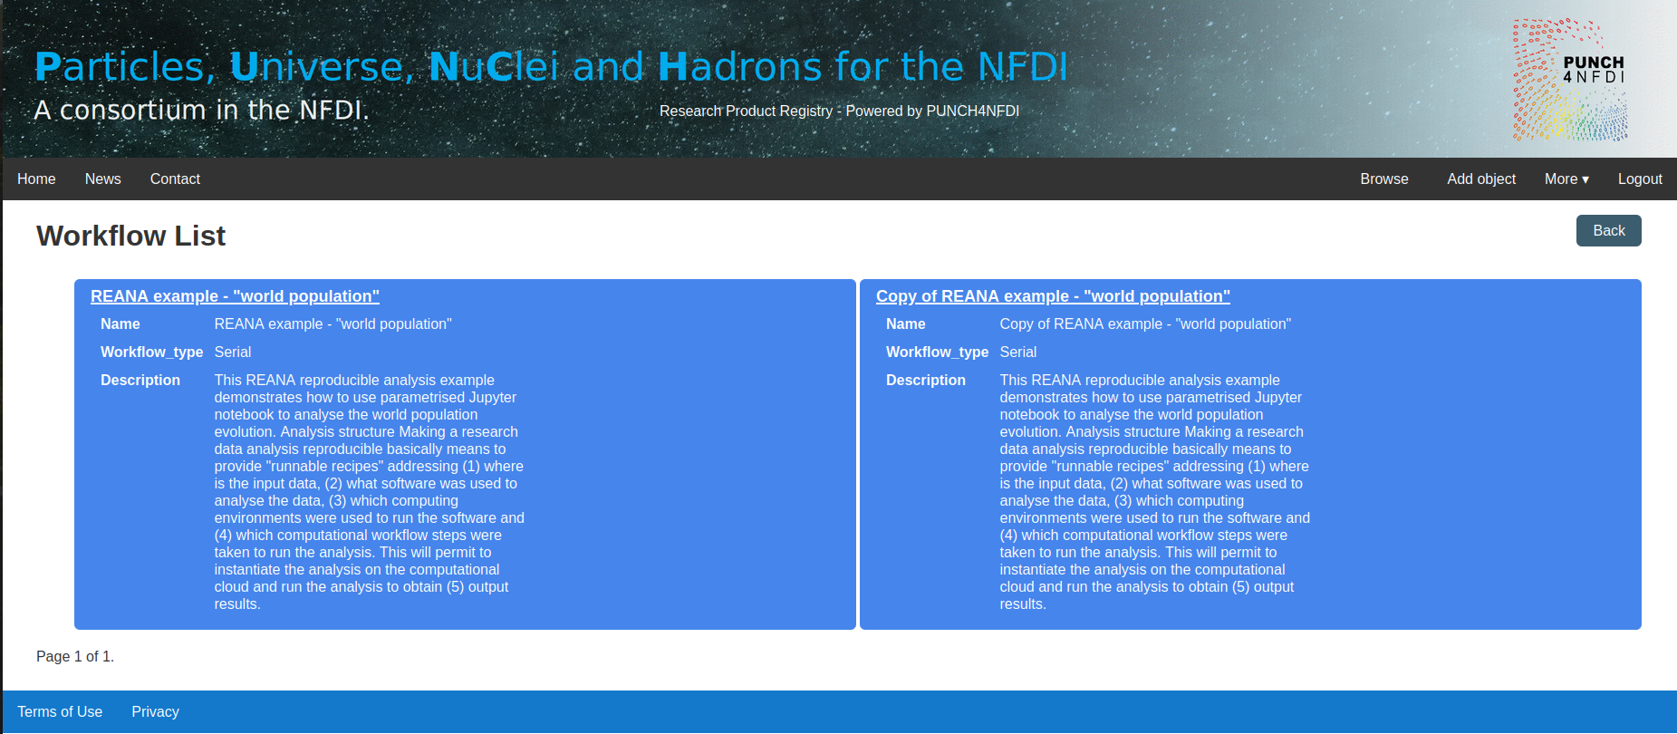
(Pre-)prototype stage available: RPR
Brows for: dataset, project, code repository, journal publication, workflow
Publication of RPR not yet possible, Internally available: https://rpr-p4n.sirrah.aip.de/browse/
FH SciComp Workshop 01.07.24 | PUNCH4NFDI | CS
Notes:
From Bridget: Daphne data – in which time frame? Annual?
From bridget: All smartphones in the world: 7 billion times 50 GB = 350 billion GB = 350 million TB = 350.000 PB = 350 EB → too large for here?
HL-LHC data estimate from official ATLAS and CMS numbers, entire Run 3, a few years, unclear if simulation included
FAIR@GSI – online data per year – will be massively reduced (trigger, irreversibility)
Quelle fuer globally created data: https://www.researchgate.net/figure/Global-growth-trend-of-data-volume-2006-2020-based-on-The-digital-universe-in-2020_fig5_274233315#:~:text=Data%20volume%20is%20continuously%20increasing,video%2C%20text%2C%20and%20images.
<number>

Slide 16
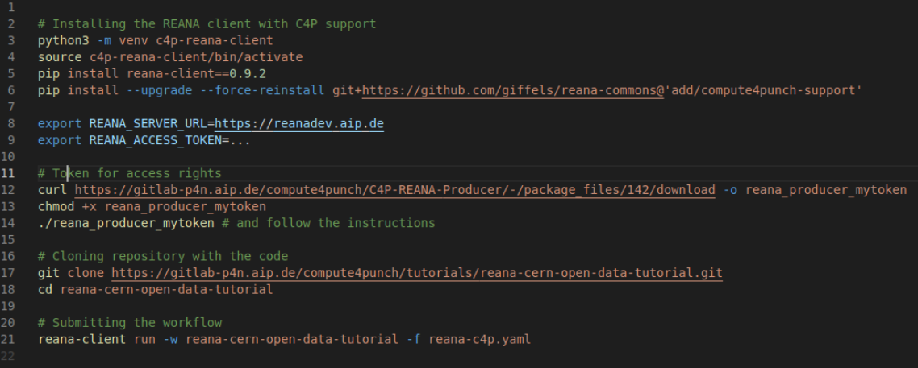
(Pre-)prototype stage available: REANA, S4P, C4P
Storage technologies: dCache & XrootD (at DESY, GSI, KIT, U Bonn)
Metadata Catalogue (ILDG)
Compute: container registry, distribution via CVMFS, HTCondor
FH SciComp Workshop 01.07.24 | PUNCH4NFDI | CS
Notes:
From Bridget: Daphne data – in which time frame? Annual?
From bridget: All smartphones in the world: 7 billion times 50 GB = 350 billion GB = 350 million TB = 350.000 PB = 350 EB → too large for here?
HL-LHC data estimate from official ATLAS and CMS numbers, entire Run 3, a few years, unclear if simulation included
FAIR@GSI – online data per year – will be massively reduced (trigger, irreversibility)
Quelle fuer globally created data: https://www.researchgate.net/figure/Global-growth-trend-of-data-volume-2006-2020-based-on-The-digital-universe-in-2020_fig5_274233315#:~:text=Data%20volume%20is%20continuously%20increasing,video%2C%20text%2C%20and%20images.
<number>

Slide 17
Current plans for big data & open data
Neural networks on FPGAs
ML pipelines: pulsar analysis
Dynamic archives: measure effects of filtering and validate new filters
Metadata for (astro) simulations
...
FH SciComp Workshop 01.07.24 | PUNCH4NFDI | CS
Notes:
From Bridget: Daphne data – in which time frame? Annual?
From bridget: All smartphones in the world: 7 billion times 50 GB = 350 billion GB = 350 million TB = 350.000 PB = 350 EB → too large for here?
HL-LHC data estimate from official ATLAS and CMS numbers, entire Run 3, a few years, unclear if simulation included
FAIR@GSI – online data per year – will be massively reduced (trigger, irreversibility)
Quelle fuer globally created data: https://www.researchgate.net/figure/Global-growth-trend-of-data-volume-2006-2020-based-on-The-digital-universe-in-2020_fig5_274233315#:~:text=Data%20volume%20is%20continuously%20increasing,video%2C%20text%2C%20and%20images.
<number>

Slide 18
Future plans
Near future plans
Implement use cases from different communities
Improve developed services based on user feedback
Integrate further sites into Compute4PUNCH and Storage4PUNCH
Second funding phase (from Fall 2026)
Strong focus on service deployment and support/ training
Stronger interaction with & integration in NFDI
Your ideas?
FH SciComp Workshop 01.07.24 | PUNCH4NFDI | CS
Notes:
From Bridget: Daphne data – in which time frame? Annual?
From bridget: All smartphones in the world: 7 billion times 50 GB = 350 billion GB = 350 million TB = 350.000 PB = 350 EB → too large for here?
HL-LHC data estimate from official ATLAS and CMS numbers, entire Run 3, a few years, unclear if simulation included
FAIR@GSI – online data per year – will be massively reduced (trigger, irreversibility)
Quelle fuer globally created data: https://www.researchgate.net/figure/Global-growth-trend-of-data-volume-2006-2020-based-on-The-digital-universe-in-2020_fig5_274233315#:~:text=Data%20volume%20is%20continuously%20increasing,video%2C%20text%2C%20and%20images.
<number>

Slide 19

Thank you!
The PUNCH4NFDI Consortium
Spokespersons
PD Dr. Thomas Schörner (BLV, DESY, thomas.schoerner@desy.de)
Dr. Andreas Haungs (Satzung, KIT, andreas.haungs@kit.edu)
Dr. Christiane Schneide (deputy Satzung, DESY, christiane.schneide@desy.de)
Contact
Mail: punch4nfdi@desy.de
Web: www.punch4nfdi.de
Mastodon: @punch4nfdi@nfdi.social
FH SciComp Workshop 01.07.24 | PUNCH4NFDI | CS

Slide 20



Acknowledgements
Funded in parts by the Deutsche Forschungsgemeinschaft (DFG, German Research Foundation) – project number 460248186 (PUNCH4NFDI).
FH SciComp Workshop 01.07.24 | PUNCH4NFDI | CS

Slide 21
Backup
Notes:
<number>

Slide 22
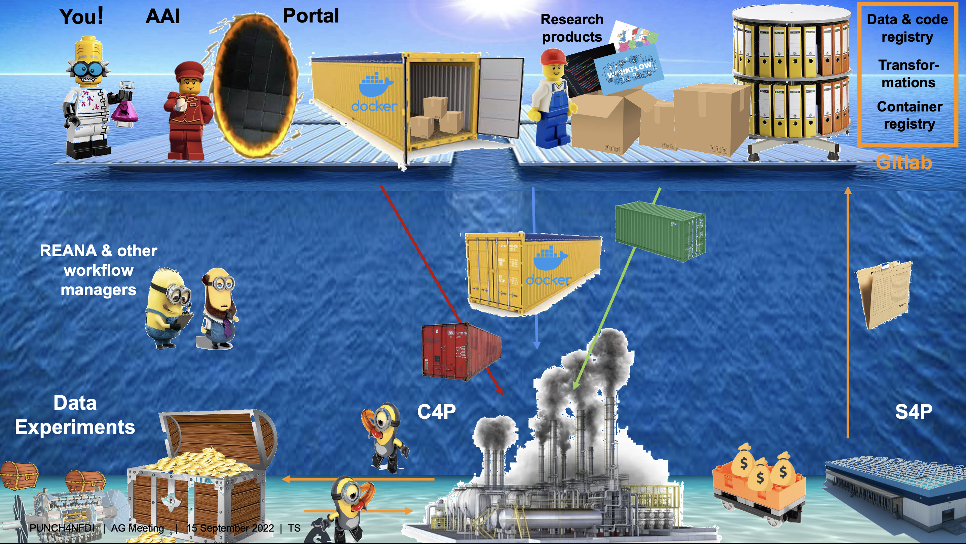
Science Data Platform SDP
Besuch V. Beckmann @ DESY 12. April 2024 | NFDI etc. | CS/TS

