Slide 1
RIC’s contribution to FS SciCom
A super brief overview
Djiana, Jennie, Melanie, Sophie, David, Engin, Franz, Paul, Peter, Philipp, Sebastian, Thomas, Tim, Uwe and Patrick
Were: DESY, Hamburg,
When: 2024-07-02
Funded by

Slide 2
Content
RIC in a Nutshell
The European Open Science Cloud (very quickly)
Understanding your data/Meta Data/Ontologies
Data Orchestration
HIFIS by Sebastian
Helmholtz Imaging by Philipp
Later today: Open Science by Tim

Slide 3
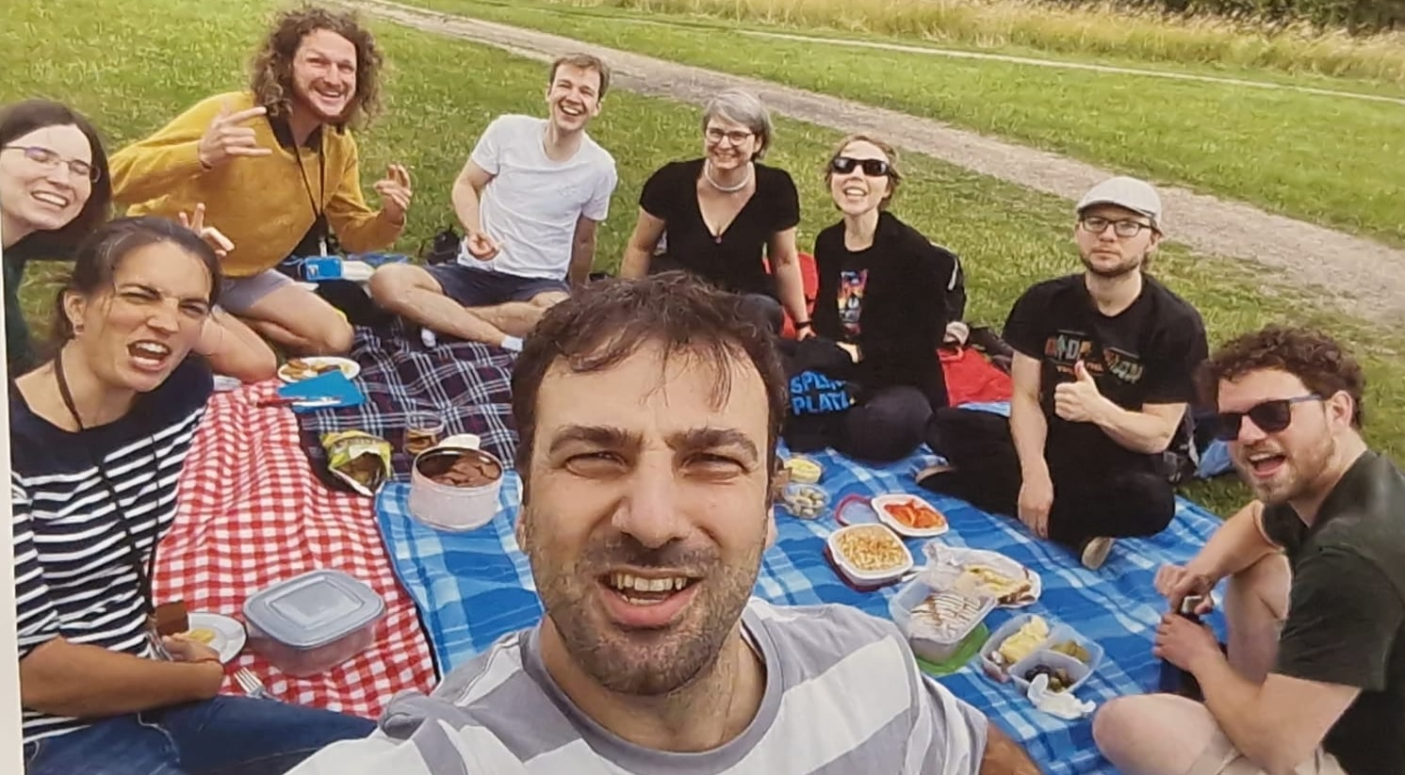
RIC in a Nutshell
People
14 ( + 2 soon) ( + 2 hopefully in September)
Mandate:
Exploring innovations in Scientific Computing by using synergies across Science Domains and Stakeholders.
With background knowledge in:
High Energy- Plazma- Astro Physics
AI, Imaging, Structural Biology
Professional Project Manager
HPC, Infrastructure Management
Software Developers
Funding
Almost entirely funded by
Helmhotlz directly and the
EC

Slide 4
How does RIC work?
Federated AAI
Project
Management
AI
Imaging
FAIR Data
Metadata
Ontologies
Data
Orchestration
Cloud
Infrastructure
Software
Development

Slide 5
The European Open Science Cloud

Slide 6
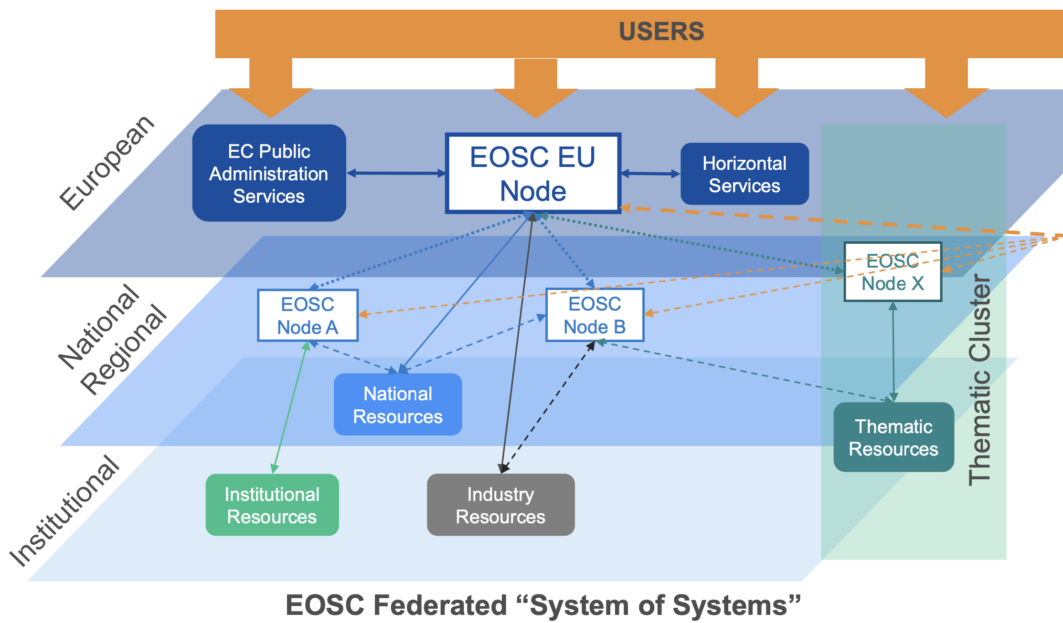
The European Open Science Cloud
Idea of the EOSC: Low barrier access to cross domain, transnational scientific services and data spaces.
Commission in process of defining the governance of the EOSC (Countries, Association and EC)
EOSC will be a federation of thematic, infrastructure and national Nodes
EOSC Nodes are collections of services provided by Countries, RI’s or e-Infrastructures
The Commission is providing the Central EU Node, with core services, compute and storage for 3 years.

Slide 7
RIC to help NFDI / HIFIS to build a national/thematic EOSC Node
Portal
Thematic Catalogues
Prototype Node
We are hiring
EOSC
Thematic/National
Node
Services
ILDG
Configuration
Catalogue
DESY
Open
Infrastructure

Slide 8
Dr. Millar on the foundation of data and data management

Slide 9
Foundation of data
Because
We can help you with
We got practical experience with maintaining a community-driven metadata standardisation for the Photon and Neutron community with:
ExPaNDS: PaN EU Project on FAIR data
LEAPS: LEAPS-IT Speaker
Member of Helmholtz-Open Science AK
NeXus file format: NIAC Member for DESY
PaNET ontology : Driving force behind an ontology for Photon and Neutron Experiment Techniques
Understanding the underlying meaning and semantic of your data.
Describing your data (meta data) using machine actionable language(s).
Transforming data representation and data model.
This helps with the validation, documentation.
Why is that important
If you want your data to become Open, you better make it FAIR, which significantly improves it quality and the probability of its reuse.
That requires to annotate your data with meaningful metadata and place it catalogues (Findable)
To do that your meta data needs to be standardized (following an ontology)

Slide 10
Orchestrating and distributing data
We can help you with
Because we are working on
training on federated data management using RUCIO and FTS.
a core federated data orchestration infrastructure (aka Datalake) like RUCIO and (FTS).
We are in charge of transferring Cancer Images between European Research Infrastructures and Hospitals (EUCAIM)
We are organizing data transfers between HPC sites to support digital Twins across a variety of scientific domains
FTS

Slide 11
Following now: Topics in depth:
Helmholtz ICT Infrastructure
Sebastian
Helmholtz Imaging, AI
Philipp
Open Science, Open Data, Open Infrastructure
Tim (Later today)

Slide 12
HIFIS By Sebastian

Slide 13
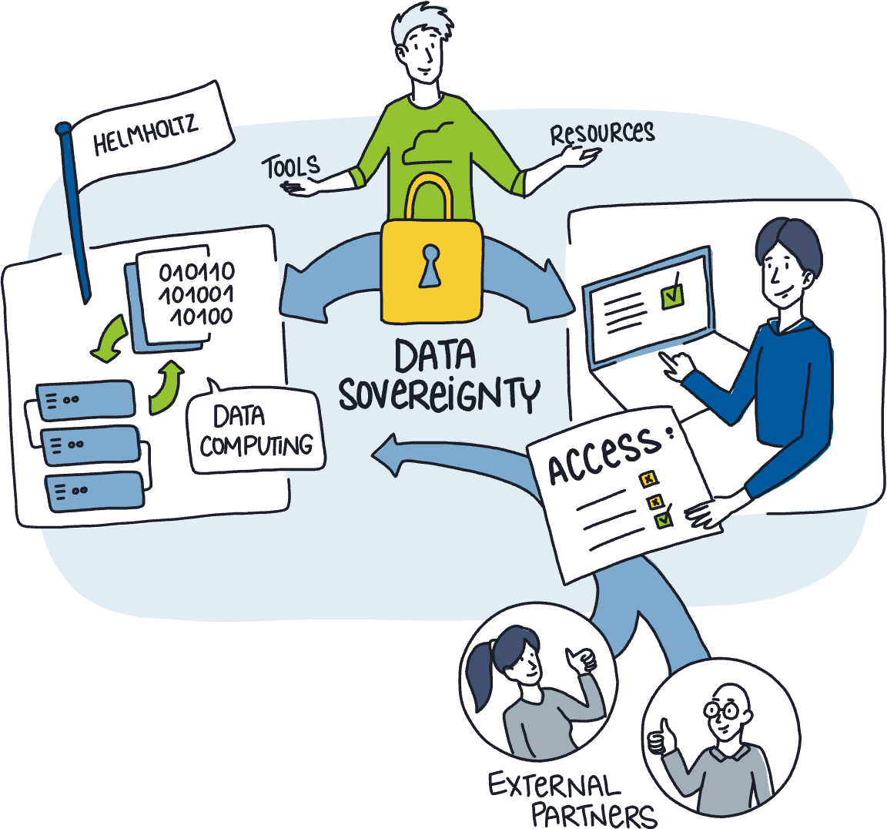
HIFIS – Empowering scientists with digital services
Helmholtz-wide platform for digital tools and services
Why
Results depend on software, we’re looking to help make this more sustainable
Wider selection of services than what would be possible at a single center
Strengthen digital and resilience

Slide 14
Helmholtz Cloud
Go to helmholtz.cloud → Services
Around 30 services available
Collaboration Notekeeping, LaTeX editing, Nextcloud, Survey ...
Compute and Storage Jupyter, GPU, Kubernetes, OpenStack, dCache
Science Sensor management, Ocean Data Viewer, SciFlow ...

Slide 15
Software Services
hifis.net → Software Services
Software is at the core of many research efforts
Quality software → quality publications
Training and consulting for software development in science
Community-building around Research Software Development
Get connected!

Slide 16
Helmholtz-Imaging by Philipp

Slide 17
Patrick Fuhrmann
DESY IT RIC
Patrick.fuhrmann@desy.de
Ext 4474

