Slide 1
ARES Operation Meeting
Summary of week 14 / 2024
Max Kellermeier, on behalf of the ARES crew

Slide 2
Summary of week 14
Mon. 1st Apr | Tue. 2nd Apr | Wed. 3rd Apr | Thu. 4th Apr | Fri. 5th Apr
 |  | Machine set up for low DC beam, focused on Timepix Nickel calibration sample scans with respect to Timepix | ZZ: Nickel sheets replaced with Aluminum Beam steering to achieve similar beam properties on Timepix Overnight: Slice scans | 2x Line scans in 3D for Beam envelope by Timepix MDI BPM tests
 |  | TWS2 in fault state (water flow rate too low) Cable of rotation mount interferes with vertical stage | TWS1 in fault state (water flow rate for waveguide too low)
Public holiday | Maintenance : Setup of eCT experiments MSK: attenuators replaced for TWS2 power readout | FL camera pos. needed to be modified |  | Setup on FL stages removed, Timepix mounted FL camera moved back to its original
Achievements
Difficulties
Notes

Slide 3
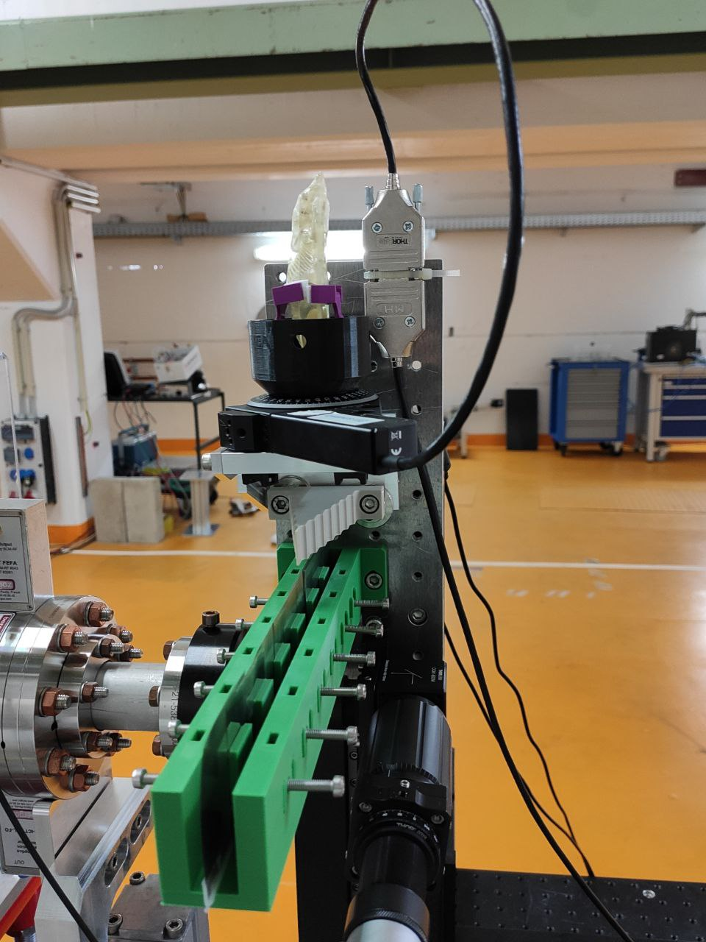
eCT Setup
Berta on rotation stage
calibration sample "Burj”: PEEK, different thicknesses (1 -> 36 mm, 5 mm steps)
calibration samples metal:
Nickel, sheets from 0.025 -> 2 mm
Aluminum

Slide 4
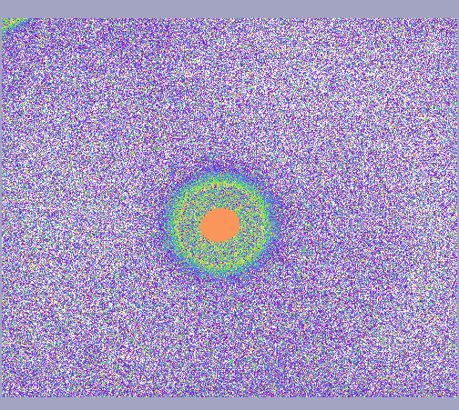
Photobeam on FL.A1
Before Collimator Insertion
Gun and BC Collimators used for Dark charge
Dark charge used for experiments
Around 7px RMS beam size on Timepix

Slide 5
Calibration sample “Burj” (PEEK)
Different thicknesses of PEEK, 10 mm "steps"

Slide 6
2D Berta scan
To determine range for overnight slice scans
Overnight scan:
slices at y=(245, 267)
angles = 0, 180 at 1 deg steps (coarse at 9 deg steps)

Slide 7
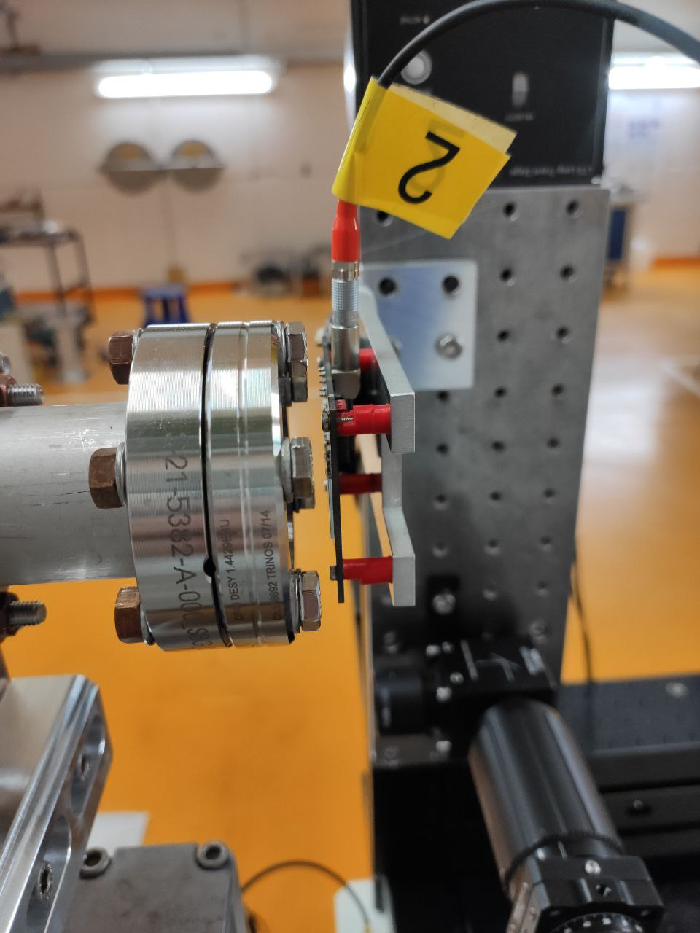
Beam Envelope Scan
Stages moved along line in 3D to keep beam centered on Timepix
First scan with lowered gun gradient (59.70 → 59.65)
Second scan with even lower gun gradient (59.65 → 59.0 )
Beam energy: 153.5 MeV/c

Slide 8
Schedule and Plan for the Week
Week 15
Date | Shift Crew
08.04. | --
09.04. | Max, Frank
10.04. | Blae, Willi
11.04. | Blae, Willi
12.04. | Blae, Willi
Mon:
Laser work
De-assembly of eCT-setup
Preparation for P4 kicker tests
Tue: Petra IV kicker tests
Wed – Fri : Spacechip
If you want to learn or join the shift: please give the shift leader a call (BKR 2840 / SINBAD Box 2454)

