Slide 1
FCC Week @ San Francisco, June 10-14, 2024
June 10-14, 2024, https://indico.cern.ch/event/1298458/

Slide 2
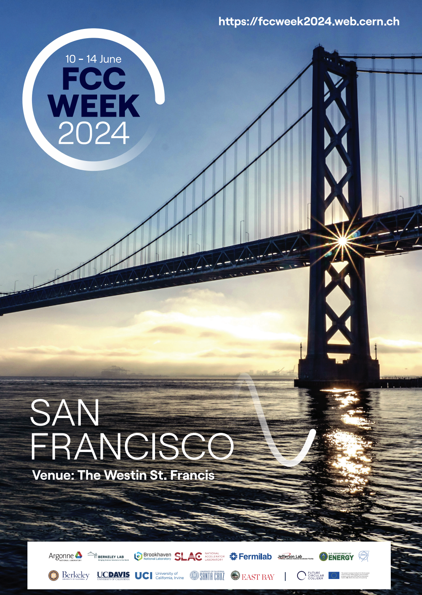
FCC Week @ San Francisco, June 10-14, 2024
June 10-14, 2024, https://indico.cern.ch/event/1298458/
449 participants : 75 remote and 374 on site (incl. 8 from DESY)
50 public sessions, 216 oral presentations, 32 posters
Much progress, US efforts getting organized on the best way to completing the Feasibility Study by March 2025
Talks by DOE and NSF representatives (Regina Rameika and Jim Shank): US-CERN Statement of Intent for the United States to collaborate on the FCC-ee should the CERN Member States determine it is likely to be CERN’s next research facility following the HL-LHC.
DOE and NSF have jointly issued a charge that forms a nationally coordinated U.S. Higgs Factory Coordination Consortium (HFCC) for developing the physics, experiments, and detectors (PED) program. Chair: Srini Rajagopal.
DRAFT

Slide 3
FCC Week @ San Francisco, June 10-14, 2024
June 10-14, 2024, https://indico.cern.ch/event/1298458/
Special ECR session:
Exciting times ahead if a future collider is built
Guaranteed deliverables & potential discoveries
Decision on FCC is needed soon
Need long term R&D projects (e.g. through DRD collaborations)
Interesting developments:
New optics design: 50% luminosity more at 240 GeV!
Discussion on the feasibility and the benefit of injecting already polarized bunches.
“This wonderful workshop is another step in our path to a machine that will be worth the investment, paying back with a broad long-range physics program” Sarah Enno
DRAFT

