Slide 1
News and Dates.
FC @ DESY Meeting
Benno List
21.6.2024

Slide 2
Dates
Save-the-date: FutureCollider@DESY Day: July 1, 2024 https://indico.desy.de/event/43916/ -> next slide
Jun 10-14, San Francisco: FCC Week, https://indico.cern.ch/event/1298458/ https://fccweek2024.web.cern.ch/
LCWS2024: Tokyo July 8-11 + 12 for satellite meetings https://agenda.linearcollider.org/event/10134/
This week: ECFA study convenor workshop at CERN
3rd ECFA workshop on e+e- Higgs, Top and Electroweak factories: Paris, Oct 9-11, 2024 https://indico.in2p3.fr/event/32629/

Slide 3
FH Future Collider Day July 1st
Please register: https://indico.desy.de/event/43916/
In presence
Free Pizza lunch
ZOOM available upon request for external participants not at DESY

Slide 4
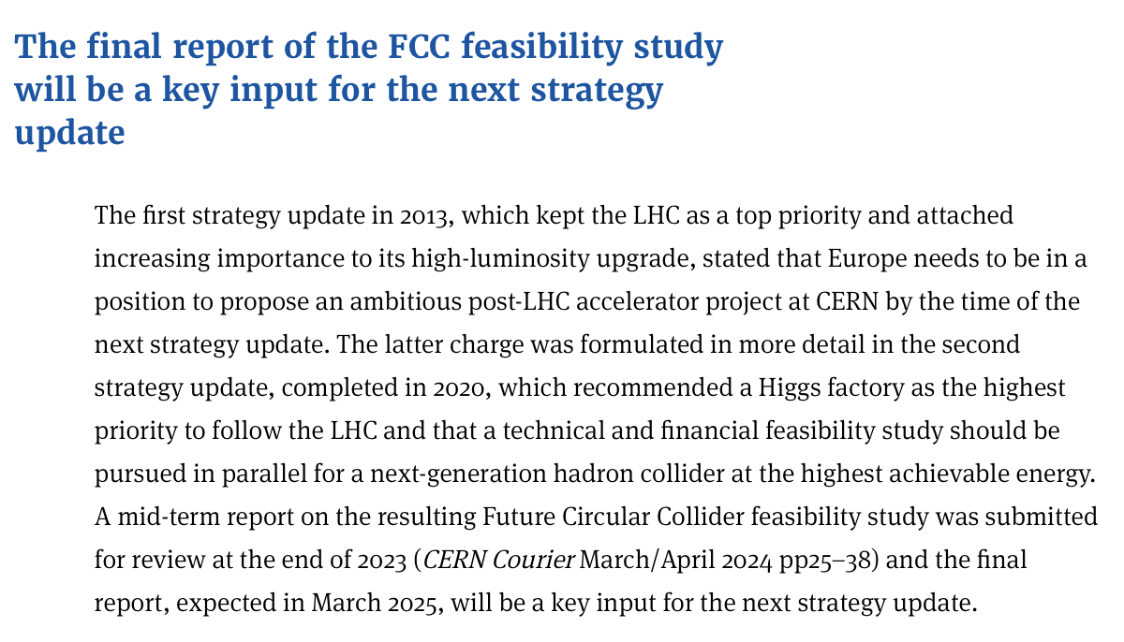
European Strategy Update 2026
Schedule (re)defined:
Deadline written input: March 31, 2025
Conclude process June 2026
Scientific secretary to be announced soon
https://cerncourier.com/a/european-strategy-update/

Slide 5
Bonn Workshop aftermath
Official summary (by KET) soon to appear. Watch workshop page: https://indico.desy.de/event/44074/
https://x.com/christiangrefe/status/1796640564743446625?s=43&t=Ur1-_nQAzxSqTqupIXz7GA
https://www.nature.com/articles/d41586-024-01671-8
https://t.co/tHbfV8AMV5

Slide 6
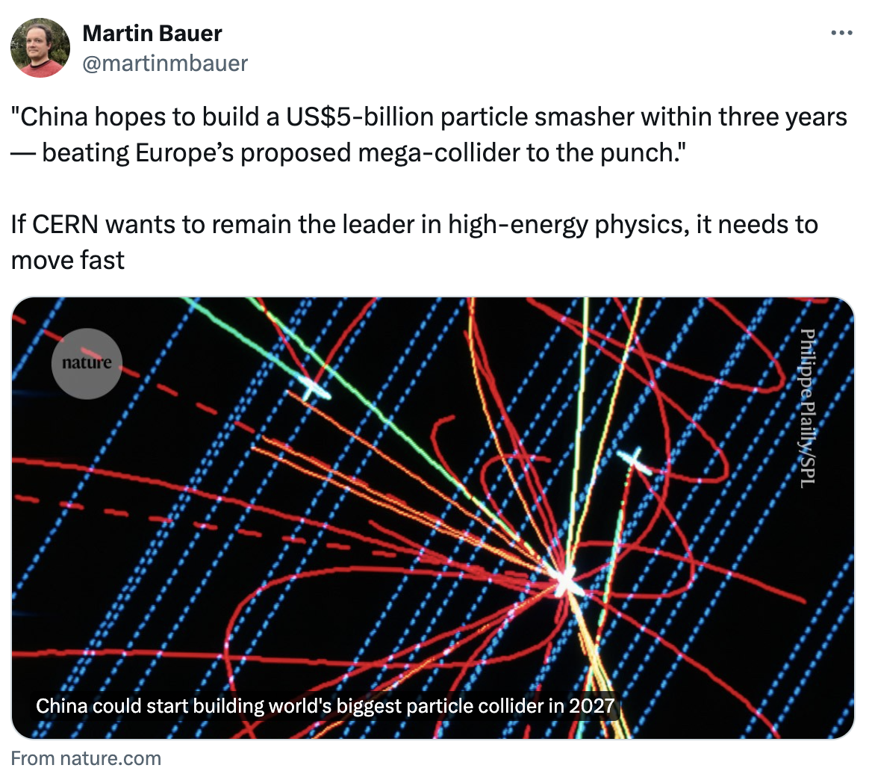
CEPC Technical Design Report published
Publication seems to have triggered some more interest in CEPC, also on social media
https://x.com/skdh/status/1803109777397997877?s=43&t=Ur1-_nQAzxSqTqupIXz7GA
https://doi.org/10.1007/s41605-024-00463-y
https://www.nature.com/articles/d41586-024-02005-4
https://x.com/martinmbauer/status/1803313678860566584?s=43&t=Ur1-_nQAzxSqTqupIXz7GA

