Slide 1



I had zero ideas for a title
Pikabu
Pavlo Plotko
22.08.2023
plotkopavlo.com
pavlo.plotko@desy.de
Notes:
Introduce myself if necessary

Slide 2
Purposes
You will learn something from my experiences
I will share information, I wish I'd known earlier
Break
Useful frameworks, which can be used during the summer school

Slide 3
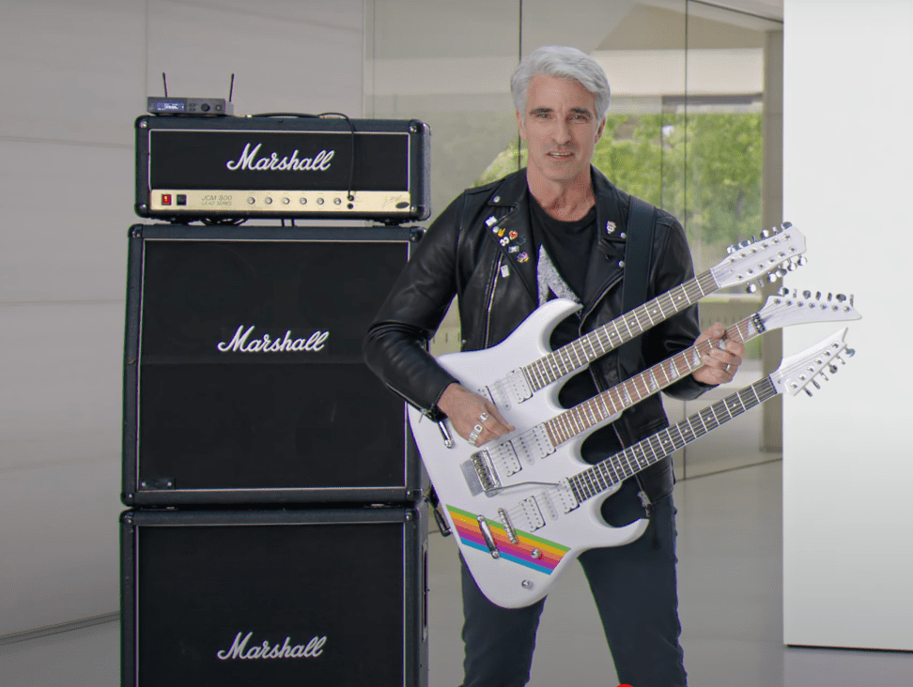

Slide 4
Craig Federighi
Senior vice president of Software Engineering
View from the Top: Craig Federighi
This View from the Top conversation with Dean Tsu-Jae King Liu was delivered Nov. 21, 2019, in Banatao Auditorium at UC Berkeley
https://youtu.be/43sjym5ZS68

Slide 5
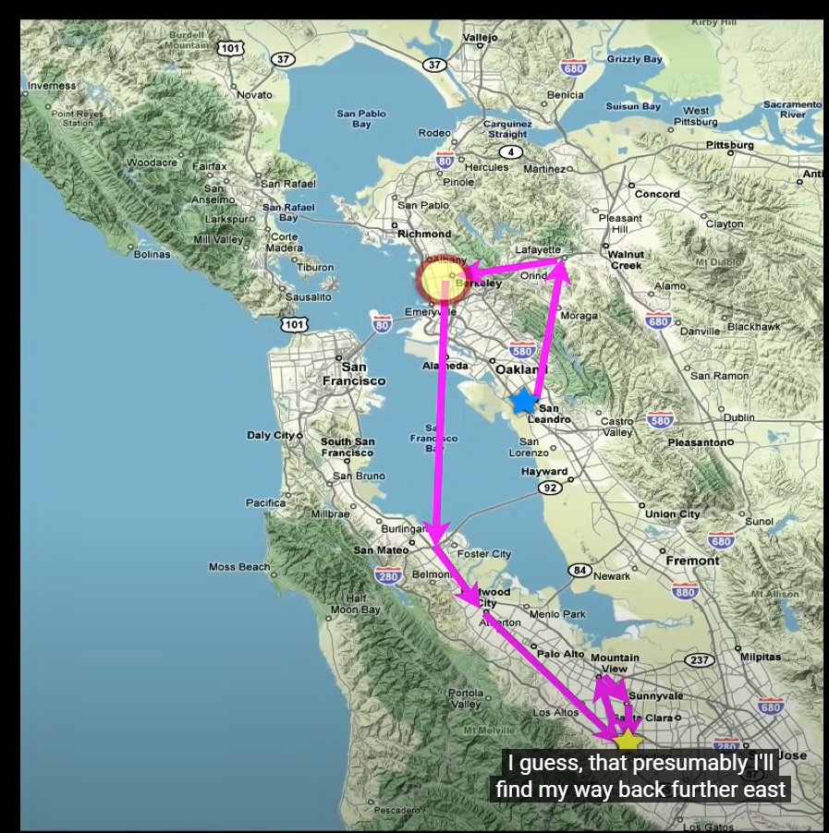

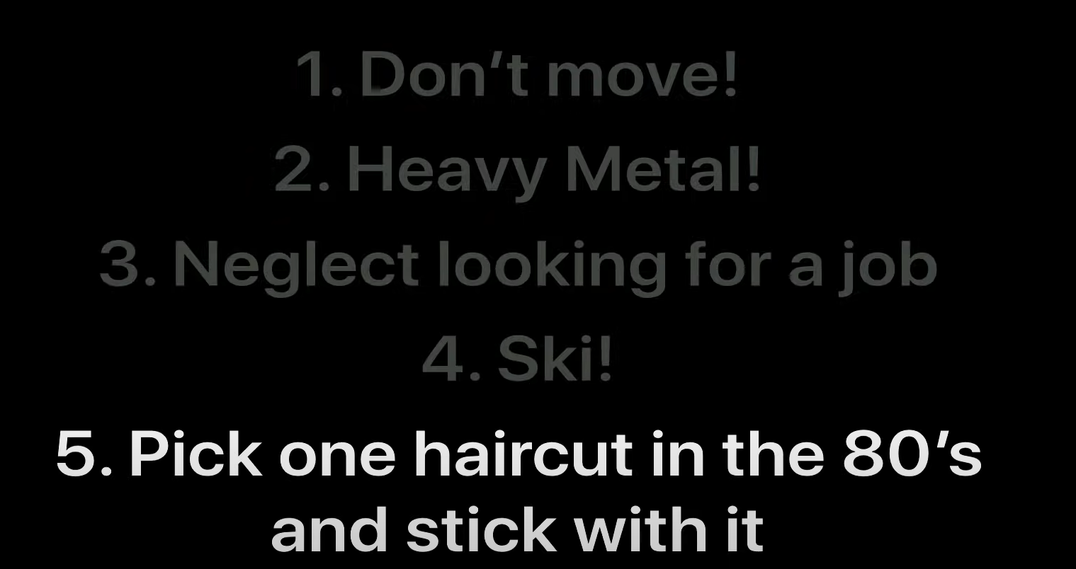
Wherever you are born, stay there and wait for the industry that you need to erupt around you.

Slide 7
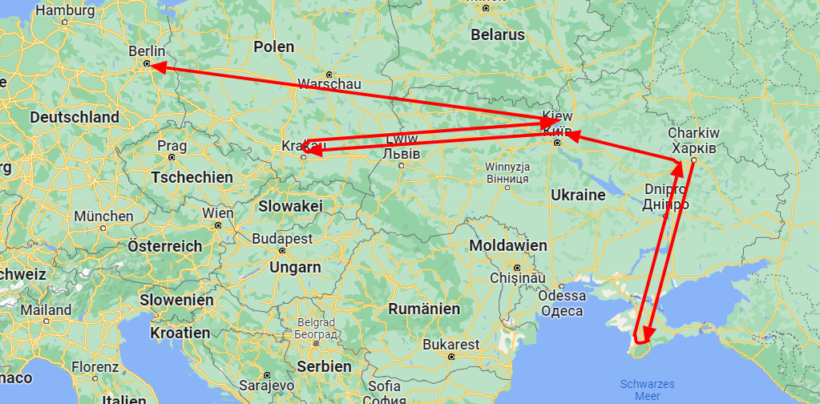
My story
Good background knowledge
Good hard skills
Very competitive environment
Bad English
Low self-esteem
Usually no soft-skills
Usually difficult childhood

Slide 8


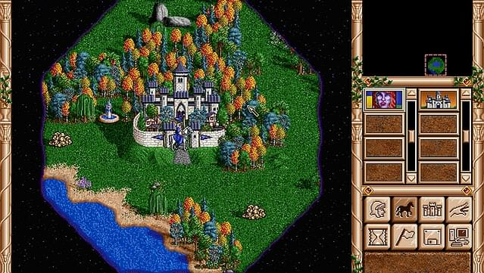
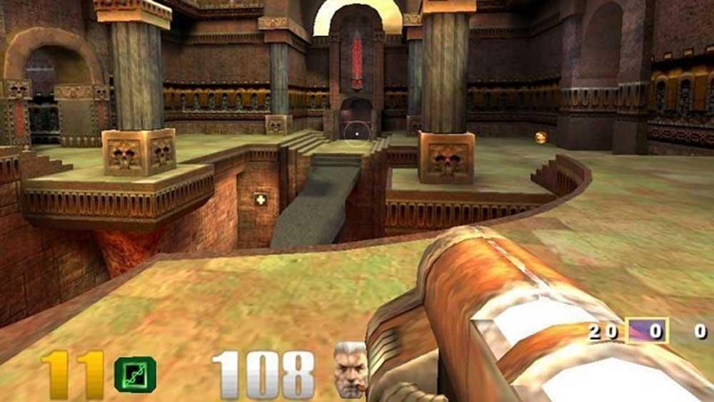
My story
How it started
I was playing computer games when I was 5 (2003)
2001

Slide 9
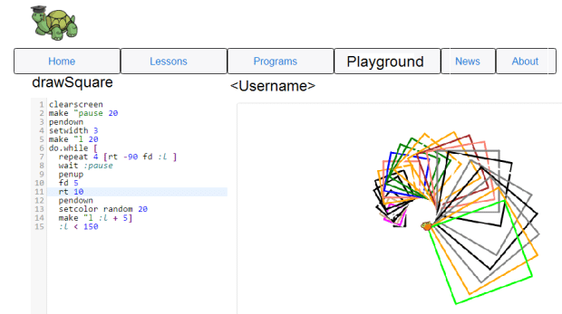
My story
I was playing computer games when I was 5 (2003)
I wrote my first program when I was 7 and I have been learning programing since then
I wrote my fist web site when I was 11

Slide 10
My story
I was playing computer games when I was 5 (2003)
I wrote my first program when I was 7 and I have been learning programing since then
I wrote my fist web site when I was 11
I diced then I want to do physics/math/astronomy after 9th grade (I was ~ 15)
  I was too old to do math and physics.

Slide 11
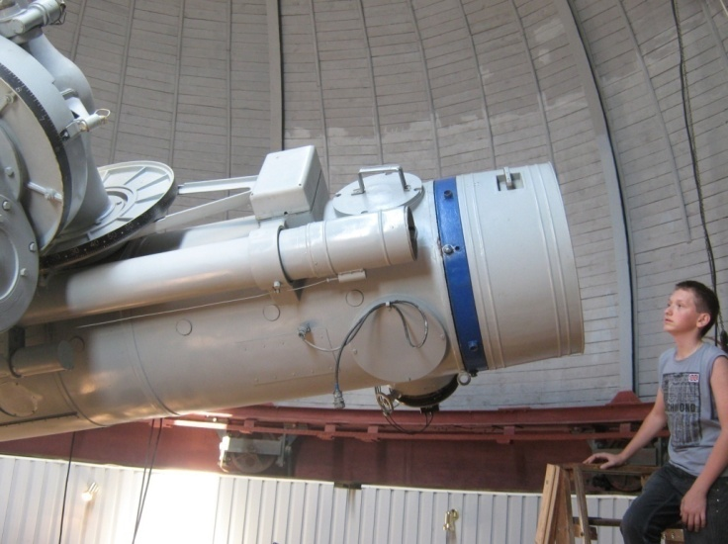
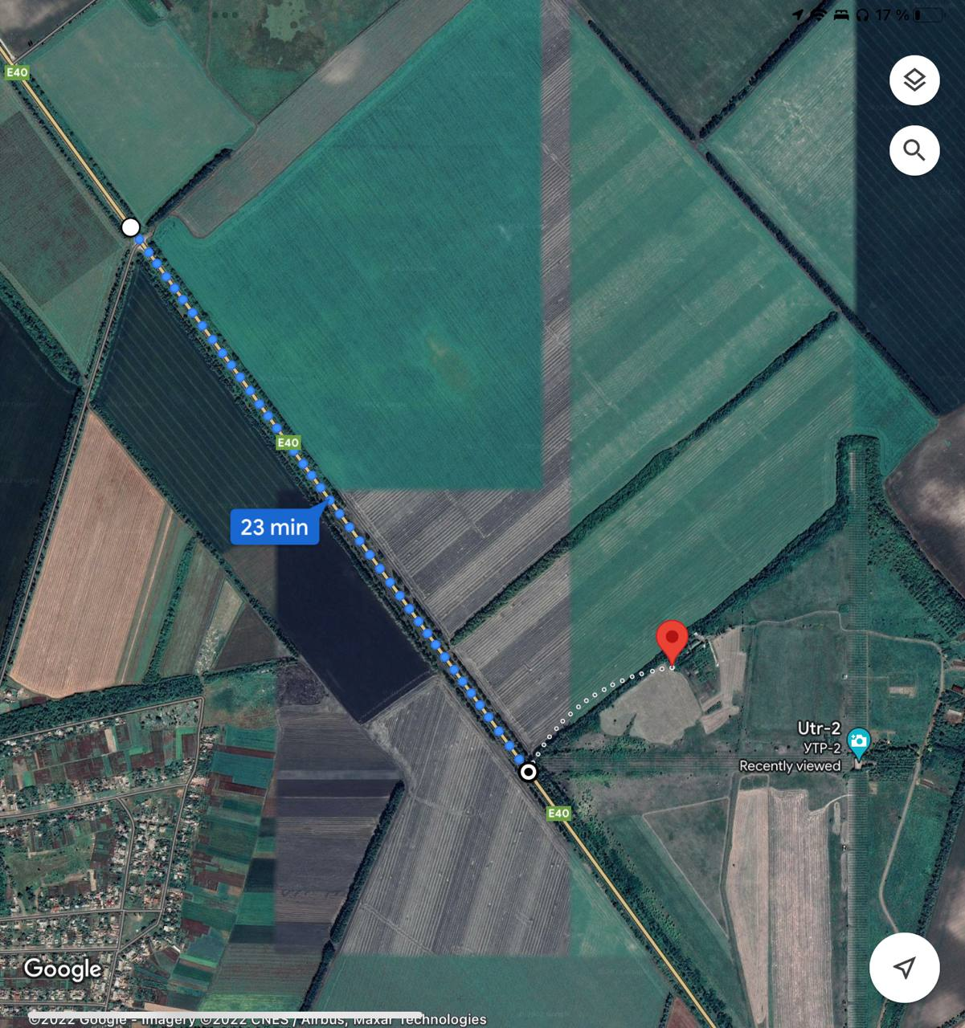
My story
Summer 2012 (or 2011)
Our journey to meet fist my supervisor:
“Easy” to get to the observatory
1 hour by a bus, 5 min walking
Reality:
2 buses, 30 min walking (4 hours in general)
No google maps
Conclusion:
when someone says, “It is very simple”
-> means that is not simple at all

Slide 12
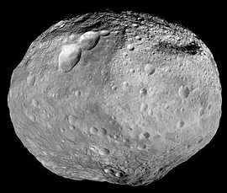
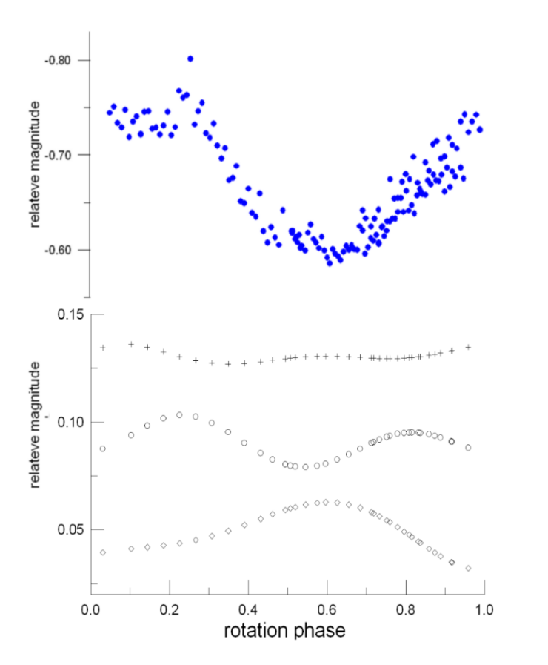
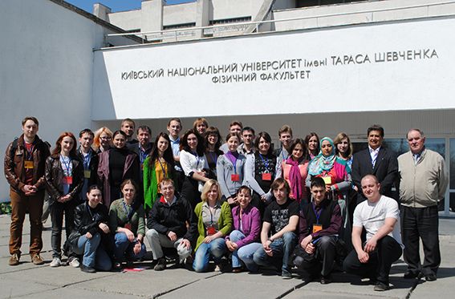

PHOTOMETRY OF ASTEROID 4 VESTA
B
Young Scientists’ Conference on Astronomy and Space Physics in Ukraine
B-V
V-R
R-I

Slide 13



My Story
Bachelor and Master in Ukraine
  Without any breaks

Slide 14

My Story
Bachelor degree, Astrophysics
  Spherical Astronomy
  General Astronomy
  General Astrophysics
  Stellar Astronomy
  Astronomy Workshop
  General Astrometry
  Observational Astrophysics
  Background of the Cosmology
  The planets
  Astrophysical practice
  Solar physics
  Theoretical Astrophysics
  Space Geophysics
  Comets Physics and Chemistry
  Orbit determination
  Radioastronomy
  Celestial Mechanics
  Plasma Physics Basic for Astronomy
  Extragalactic Astronomy

Slide 15
My Story
Master degree, Astrophysics
  Astronomical Catalogues
  Astrophysics
  High energy Astrophysics
  Astrophysical practice
  Structure and Evolution of Stars
  Galaxies
  Heliosphere
  Geodynamics
  Space Geodynamics
  Cosmology
  Methods of Astrophysics
  Non-stationary Objects
  Background of the Cosmology
  Comparative planetology
  Early Universe
  Special computational technologies in astrophysics
  Observational background of the cosmology
  Modern Computational Technologies in Astrophysics
  Modern astrophysics problems
  Physics of interstellar medium
  Nuclear astrophysics

Slide 16
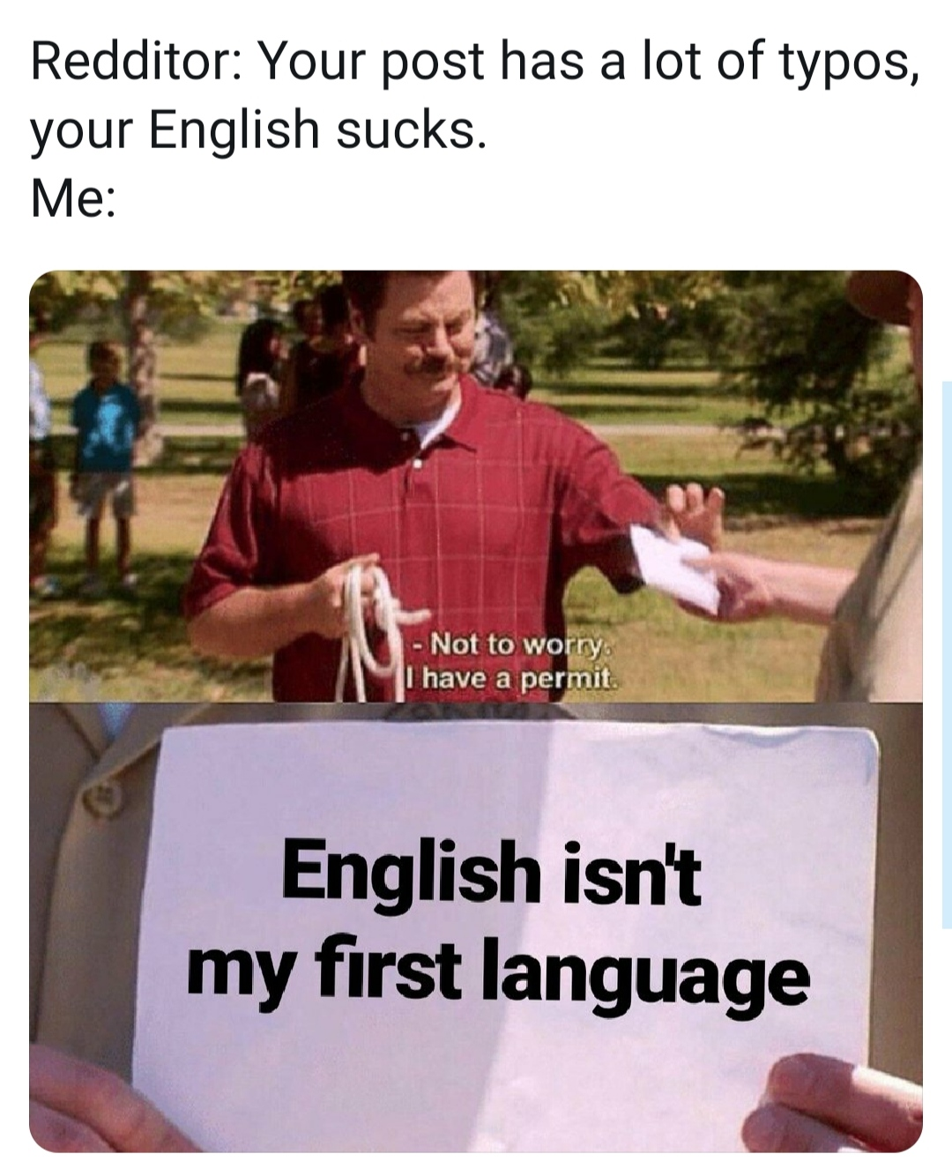
My Story
Bachelor and Master
My English was (is) terrible

Slide 17
My Story
Bachelor and Master
My English was (is) terrible – I had (have) to spend a lot of time to learn English. I thought that I’m not good for English
My uni doesn’t really have soft skill courses

Slide 18

My Story
Bachelor and Master
My English was (is) terrible – I had (have) to spend a lot of time to learn English. I thought that I’m not good for English
My uni doesn’t really have soft skill courses – I organized conferences, volunteer at events, was a judge etc.
I was afraid of talking to people
Young Scientists’ Conference on Astronomy and Space Physics in Ukraine

Slide 19
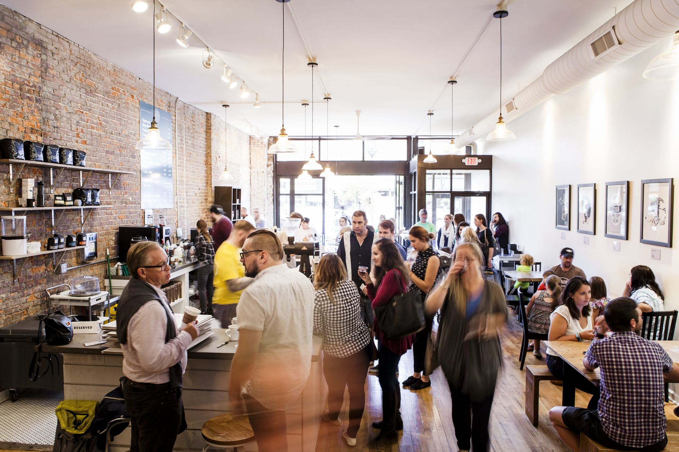
My Story
Bachelor and Master
My English was (is) terrible – I had (have) to spend a lot of time to learn English. I thought that I’m not good for English
My uni doesn’t really have soft skill courses – I organized conferences, volunteer at events, was a judge etc.
I was afraid of talking to people – I spent my time going to coffee shops to talk to different pll.
I didn’t knot how to make not a boring presentation

Slide 20
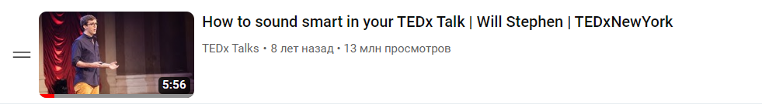
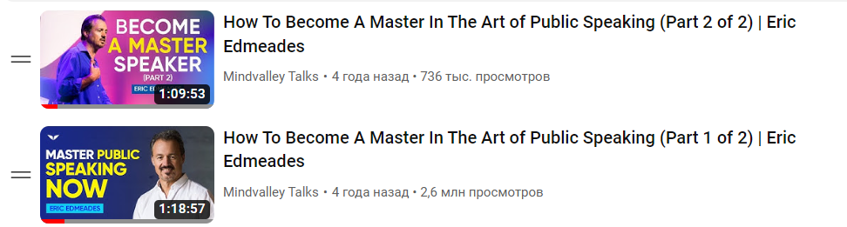
My Story
Bachelor and Master
My English was (is) terrible – I had (have) to spend a lot of time to learn English. I thought that I’m not good for English
My uni doesn’t really have soft skill courses – I organized conferences, volunteer at events, was a judge etc.
I was afraid of talking to people – I spent my time going to coffee shops to talk to different pll.
I didn’t knot how to make not a boring presentation – I spent hours watching good presentations and reading/watching how to make them
I almost left science 3 times. I needed money to live

Slide 21
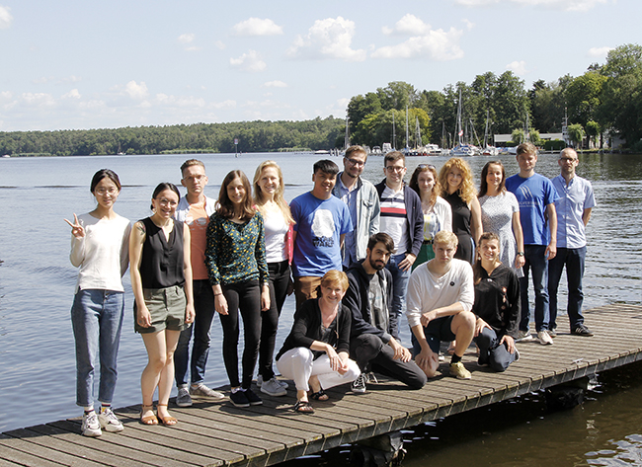
My Story
How I got a phd position
Master project with a postdoc from DESY (a former student of my supervisor in Ukraine).
Notes:
I went to DESY to learn how to do proper science and get money for living in Ukraine

Slide 22
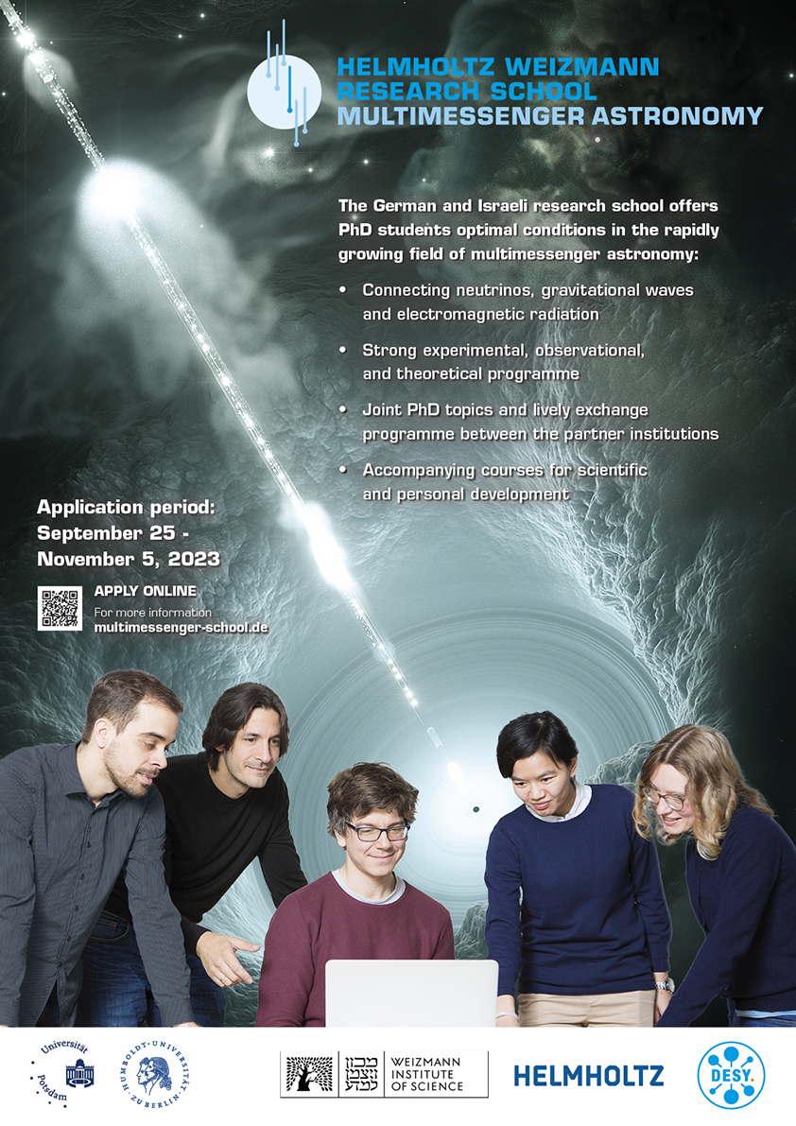
My Story
How I got a phd position
Master project with a postdoc from DESY( a former student of my supervisor in Ukraine).
A position was opened during my visit to DESY, since the candidate refused the position last year.
I got an offer before I could apply for others positions.
I moved to Germany on 1.09.2023
Notes:
I went to DESY to learn how to do proper science and get money for living in Ukraine

Slide 23
What is phd about
Hard skills
  Become an expert on a topic
  Understand what method you use
  Understand physics behind results
Soft skills
  Manage a project
  Work in a team
  Lead students
  To be leaded by a supervisor
Networking
  Know ppl in your uni
  Know ppl in you collaboration
  Know ppl in you research filed
You
  Develop yourself
  Enjoy your time
  Hobby

Slide 24
What is phd about
Hard skills
  Become an expert on a topic
  Understand what method you use
  Understand physics behind results
Soft skills
  Manage a project
  Work in a team
  Lead students
  To be leaded by a supervisor
Networking
  Know ppl in your uni
  Know ppl in you collaboration
  Know ppl in you research filed
You
  Develop yourself
  Enjoy your time
  Hobby
Be lucky

Slide 25
What is phd about
Hard skills
  Become an expert on a topic
  Understand what method you use
  Understand physics behind results
Soft skills
  Manage a project
  Work in a team
  Lead students
  To be leaded by a supervisor
Networking
  Know ppl in your uni
  Know ppl in you collaboration
  Know ppl in you research filed
You
  Develop yourself
  Enjoy your time
  Hobby
Be prepared and ready when you find yourself in the right place at the right time

Slide 26
I wish I'd known earlier
A group and a supervisor as important as a topic

Slide 27
I wish I'd known earlier
A group and a supervisor as important as a topic
Do a research on a group and a supervisor.
  Ask current/former employ. Look what and how they say. What they don’t say
  As a female student, check if a supervisor isn’t an asshole. If you know how to deal with it, then fine.
  Good scientist != good supervisor or group leader

Slide 28
I wish I'd known earlier
A group and a supervisor as important as a topic
Do a research on a group and a supervisor.
  Ask current/former employ. Look what and how they say. What they don’t say
  As a female student, check if a supervisor isn’t an asshole. If you know how to deal with it, then fine.
  Good scientist != good supervisor or group leader
Make sure that you and your supervisor have the same understanding what phd is.

Slide 29
I wish I'd known earlier
A group and a supervisor as important as a topic
Do a research on a group and a supervisor.
  Ask current/former employ. Look what and how they say. What they don’t say
  As a female student, check if a supervisor isn’t an asshole. If you know how to deal with it, then fine.
  Good scientist != good supervisor or group leader
Make sure that you and your supervisor have the same understanding what phd is
Write down everything what you do
  Microsoft Note
  Trello or other task manager
  Small weekly reports (plots and text)

Slide 30
I wish I'd known earlier
Long-distance relational is difficult.

Slide 31
I wish I'd known earlier
Long-distance relational is difficult.
Scientist are not software developers
Collaboration member to new PhD student: “The software is super easy to install, you only need to follow this 10 page manual and run an obscurely old version of an operating system and it will work out of the box.”
Senior PhD student to young PhD student: “I did the analysis with this random set of scripts that I dumped without documentation on this cluster. You can probably understand what they do.”

Slide 32
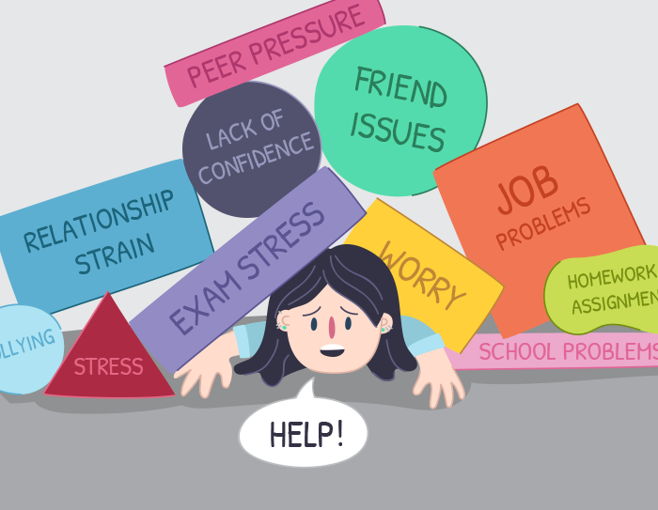
I wish I'd known earlier
Long-distance relational is difficult.
Scientist are not software developers
Soft-skills as important as hard skills.
There is actually theory behind soft-skills and leadership
A tough childhood makes good observers and good decision-makers as well. Having gone through suffering, one can understand the pain and the circumstances that have caused it.

Slide 33
Soft skills as important as hard skills

Slide 34
Feedback
So, how do I give feedback? (PARC)
  Permission – “can I offer you some feedback?”
  Action – “when you said / did….”
  Reaction – “I thought…..I felt…”
  Consequences – “as a result I felt…..”
How can you get the feedback you want? – Ask for it.
  Receive it with good grace (otherwise you may not receive it again!)
  Think about how you might effect change as a result, so that others recognise that you are listening and taking notice.
Some Guidelines for Feedback

Slide 35
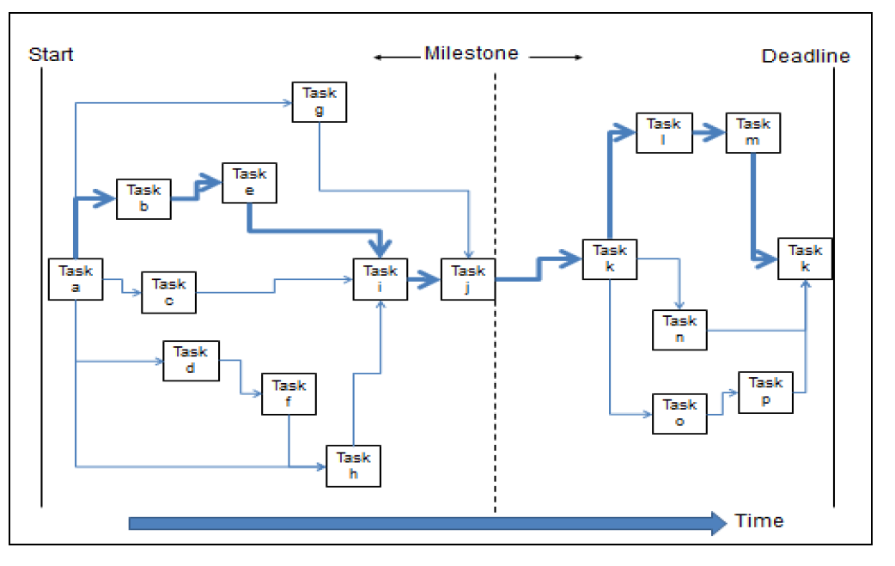
Project Planning
Many people find that project planning is a chore and underestimate the importance of developing this essential skill.

Slide 36
CV
Do you research
Different organizations/industries/ careers require different CVs – two pages, academic papers etc.
Different countries require different format of CV:
  Germany – Personal details, Education, Employment history, Extracurricular activates
  USA – Personal details, Work experience, Achievements, Education, Awards…
  UK – Personal details, Education, Work Experience, Extracurricular activates
Bullet points and evidence – not lots of text
Decisions made in 30 seconds or by reading one third of the document. (the same for cover letters)

Slide 37
CV
Do you research
Photo or not?
  Germany – Yes?
  USA – No
  UK – No
Evidence of when you have actually done it
  Situation
  Task
  Action
  Result
What, How, When, Where, Why, Quantify, Context

Slide 38
Evidence
I waitressed at Henley Regatta

Slide 39
Evidence
I waitressed at Henley Regatta
Waitress at Henley Regatta for the organization of a team of 20 waiting staff, delivering 150 covers a night and managing all bills in line with Managers Targets

Slide 40
Evidence
Secretary of Local Organizing Committee of Young Scientists’ Conference on Astronomy and Space Physics in Ukraine

Slide 41
Evidence
Secretary of Local Organizing Committee of Young Scientists’ Conference on Astronomy and Space Physics in Ukraine
Secretary of Local Organizing Committee, which consists 15 student, of international Astronomy and Space Physics Conference in Ukraine. The typical number of participants are 40-70. My duties were to deal with all bureaucracy; communicate with the participants and university; assign responsibilities for the LOC

Slide 42
Evidence
DESY Summer Student Programme 2019
DESY Zeuthen [17/07/2019 – 05/09/2019]
Topic: Acceleration and non-thermal emission of cosmic rays in Supernova remnants
Supervisors: Iurii Sushch
Zeuthen, Germany

Slide 43
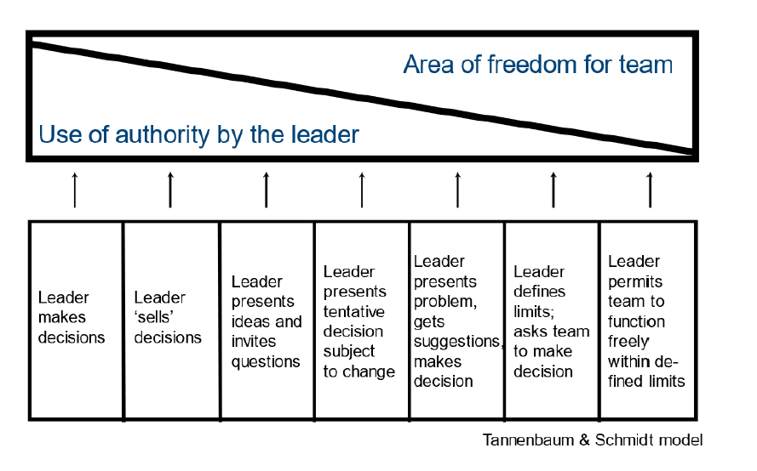
Supervisor

Slide 44
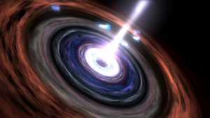
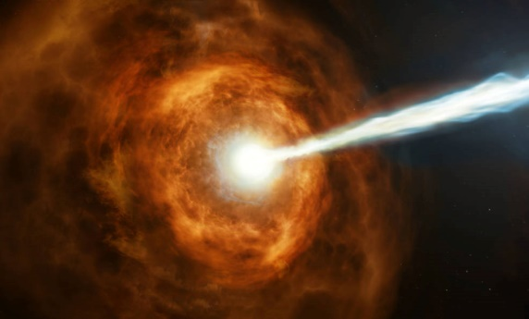
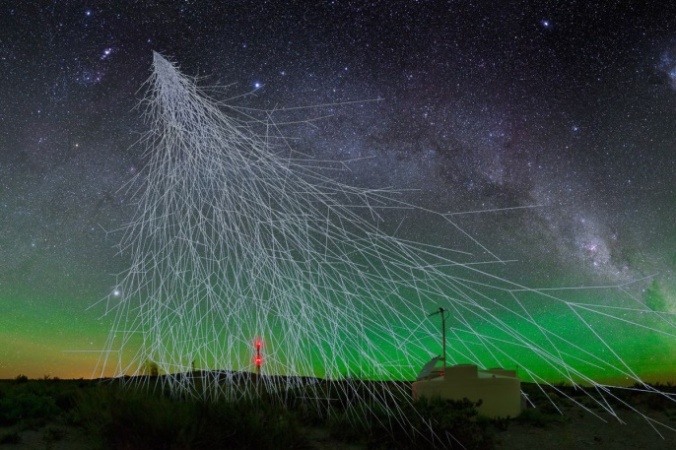
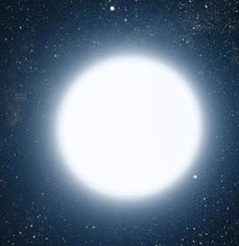
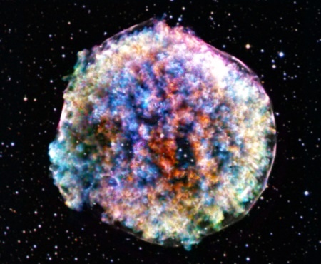
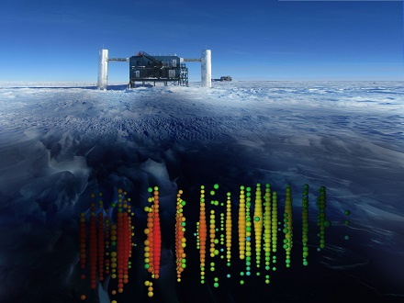
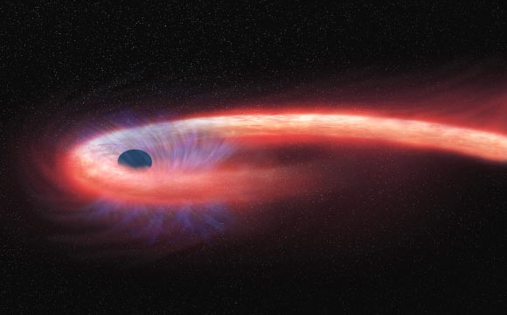
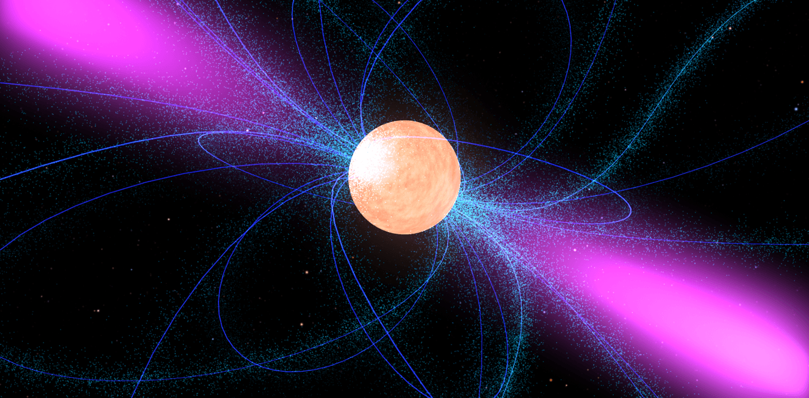
UHECR nuclei
Spectrum and composition
Motivation
Cosmic ray accelerators
My project
Image by A. Chantelauze, S. Staffi, and L. Bret
NASA
Need propagation simulations (from source to observer)
to connect measurements and theory
Ice cube
Notes:
We must combine
My main task is improved
For example, I can provide
Furthermore, propagation code
I hope I answer for Pau's favorite question

Slide 45

PriNCe
Propagation including Nuclear Cascade
PriNCe Analisys Tools
Written in pure Python
using Numpy and Scipy
Directly solve the transport equation
Large speed boost from
sparse matrix algorithms
Public available Analysis tools for parameters scan
was developed by Jonas Heinze and Anatoli Fedynitch at DESY
PriNCe
Master+
LEGO
>28 models → >200 different scenarios
Notes:
I like to think of
The code contains more
I was thinking about

Slide 46
PriNCe
Propagation including Nuclear Cascade
Collaboration member to new PhD student: “The software is super easy to install, you only need to follow this 10 page manual and run an obscurely old version of an operating system and it will work out of the box.”
Install: pip install prince-cr prince-analysis-tools
Senior PhD student to young PhD student: “I did the analysis with this random set of scripts that I dumped without documentation on this cluster. You can probably understand what they do.”
Simple examples and tutorial:
git clone git@github.com:joheinze/PriNCe-examples.git
git clone git@github.com:joheinze/PriNCe-analysis-tools
Documentation:
prince.readthedocs.io/ from Anna Nelles
Software for Large Astroparticle Physics Projects - The Example of Radio Detection of Neutrinos
Notes:
Where she was

Slide 47

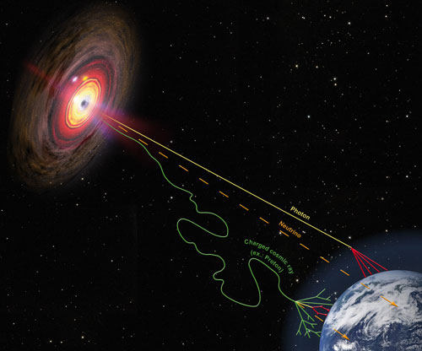
Propagation including Nuclear Cascade
Heinze et al. (2019)
github.com/joheinze/PriNCe
Propagation
UHECR escape
Interaction
cross section
CMB and EBL photons
Detection
Air-showers
models
Detector
systematics
Sources
Physical properties
Cosmological evolution
Notes:
Different modular
3 different air shower
Different air shower model predict very different results((((

