Slide 1
Welcome!
Summer Student Program 2024
Gernot Maier & Sarah Seibt
Zeuthen, 16 July 2024

Slide 2
Today & Tomorrow
Today
Intro
Organization
Safety Briefing by Safety Engineer Mr. Zinke
Group Picture
Meet Research Groups
Tomorrow
3 pm – Welcome at the Lake
(bring your supervisors…)

Slide 3
Contact.
Coordination of Program at DESY Zeuthen Site
Gernot Maier (gernot.maier@desy.de)
+49 176 46689020
Sarah Seibt (sarah.seibt@desy.de)
+49 157 79757001
Primary contact is always your research group.

Slide 4
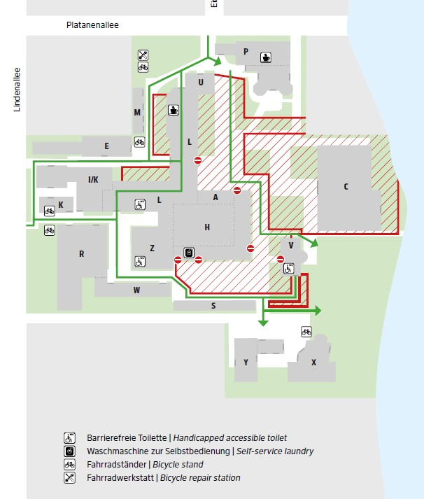
DESY Zeuthen Site
Map

Slide 5
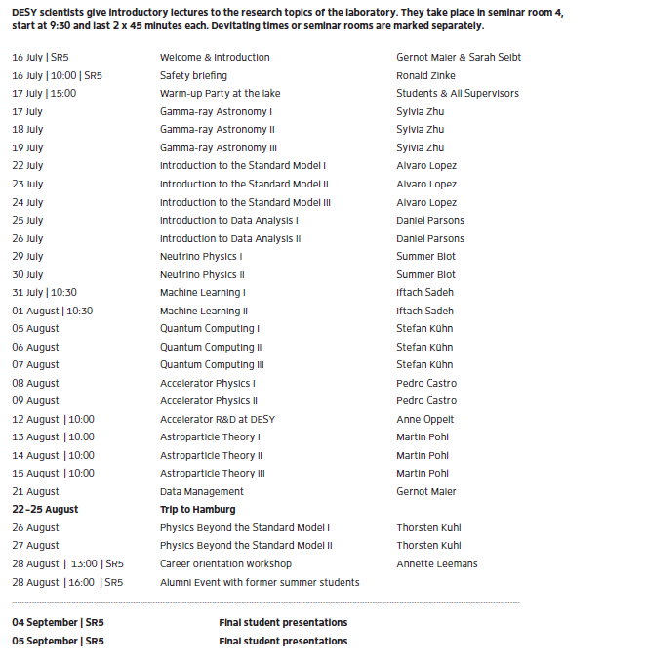
Lectures
2024

Slide 6
Important Dates
Friday, 26 July
Lunch at Restaurant Nolle and City Tour in Berlin ( by foot / public transport)
22 – 25 August
Trip to DESY Hamburg Site
Other Points
Music Band
Water Sports
Bicycles
Indico
Notes:
https://swapfiets.de/en-DE/berlin

Slide 7
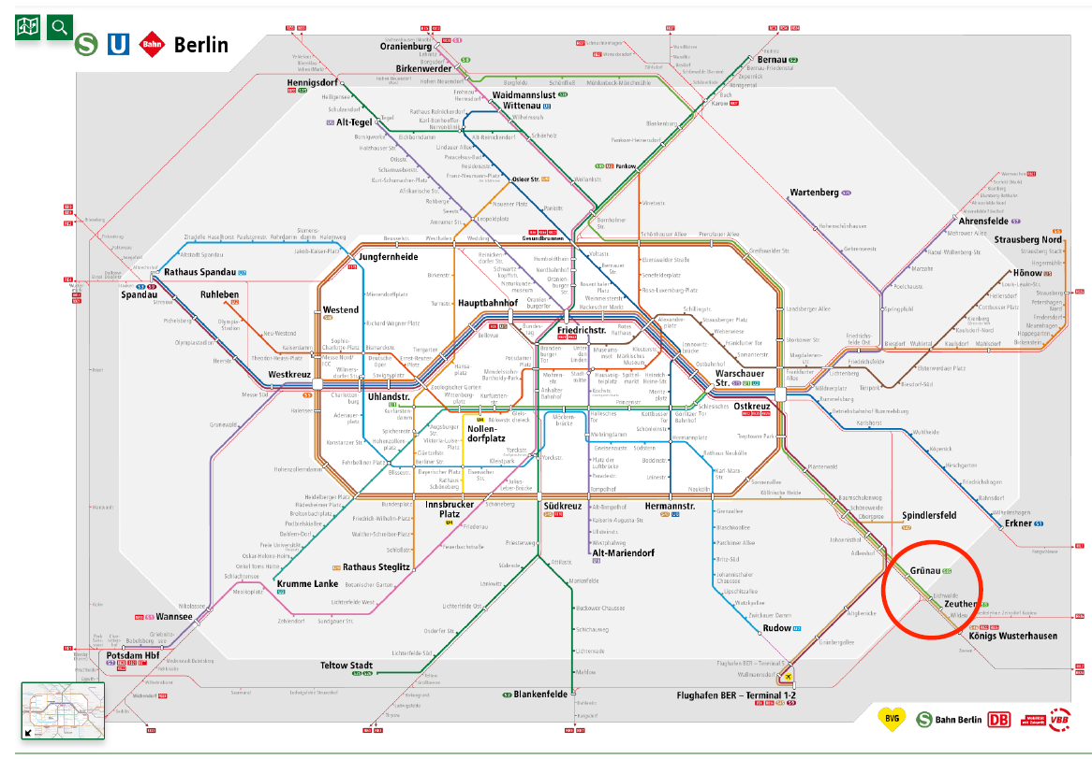

Slide 8
Hostel
General Information
Rules
Please housing rules
No additional guests
Check out: 10:00
Cleaning
Please clean kitchen after using
Use appropriate containers for rubbish
Rooms are cleaned three times a week
Restrooms and kitchens are cleaned daily
Notes:
In your living room you will find the DESY housing rules. Please read and follow them.
Please do not move the furniture in the guest rooms.
Additional overnight guests are not allowed.
Lost Keys: There is a charge of Eur 50.00 for each key.
Check out until 10:00 am. You will be charged for an extra night if you do not return your key on time, unless notification has not been given in advance to the Hostel Office.
Please inform the Hostel Office as soon as possible about any changes in departure plans
The kitchen is used by all guests. After your using of the kitchen, please clean up.
We request that the rubbish and empty bottles be disposed of in the appropriate containers themselves.
Please dispose the kitchen scraps in the garbage bin near the bicycle stands.
The rooms are cleaned every Monday, Tuesday and Friday from 9:00, last about 3 hours.
Restrooms and kitchens are cleaned daily.
Bed linen and towls are changed once a week.

Slide 9
Computer Account
Login and Authentification
Accounts created last week
Additional authentification
Authentification app
Msa.desy.de
UCO uco-zn@desy.de
Notes:
Accounts last week, Mathias Stahl, white folder
Most of you have changed Log In
Other information from me
Help UCO
privacyIDEA Authentificator
Microsoft, goggle… etc
Information in mail about account

Slide 10
Key & Forms
Key
Forms you have to sign in white folder
Travel application form
Consent form
Reimbursement travel costs
Form from personnel department
Notes:
Key for office, have to sign
Key for hostel→ washing machine
Lost office key costs 50 Euros
Travel application 2 signatures
V2 two versions
Consent form: make a selection and sign
Travel costs: fill, sign and add invoices, tickets… or send to me via mail
As a reward for signatures you get desy bag and voucher for t-shirt

