Slide 2
today
~ 6. August 2025
Renewal proposal
Runde 2
PUNCH4NFDI | CS

Slide 3
PUNCH mid-term review
process
https://www.dfg.de/foerderung/programme/nfdi/
30 Sep 2024: consortia report
review of report by referees
report symposium (early 2025): evaluate the status of the consortium based on
the report
the reviews
in dialogue with deputies of the consortium
receive feedback (in written form) => important for the proposal of continuation
March 2025: publication of documents for the application (March 2024, if identical to documents for 1st round)
mid June 2025: deadline for submission of a binding declaration for a follow-up proposal
early August 2025: deadline for submission of follow-up proposal
Nov/ Dec 2025: review of proposals
Feb 2026: feedback on review
early 2026: NFDI expert committee (members) => recommendation to GWK
summer 2026: decision of GWK
1 Oct 2026: beginning of second phase
PUNCH4NFDI | CS

Slide 4
DFG template
General Instructions for mid-term review
https://www.dfg.de/formulare/nfdi140/nfdi140_en.pdf
the report consists of two documents:
a public part
a restricted part - not more than 25 pages, Arial, 11pt, 1.5 line spacing
templates with mandatory structure and a number of tables to be completed
most important section of the public part:
2 Summary The summary describes in no more than two pages the main results and notable success stories. While the summary is a retrospective one, you may also briefly outline challenges still to be addressed. Since this summary is for publication on widely used platforms, it should be informative for a broad academic public, not only the communities served by the consortium.
PUNCH4NFDI | CS

Slide 5
DFG template
Progress report template – restricted part (I)
Integration of communities of interest,3 relevance for the research system By which procedures have communities of interest been given an active role in the consortium? How have the needs of the communities been identified and how has the consortium reacted to changing needs? Please describe qualitatively, and whenever possible also by means of quantitative indicators, which benefits the consortium has generated for the communities that it addresses as well as for other disciplines and the research system at large.
The consortium within the NFDI / General Contribution to the development of the NFDI How has the consortium contributed to the building of the NFDI as a whole? How have collaborations with related consortia developed? Which cross-cutting topics have been specifically addressed by this consortium? What has been achieved with respect to these cross-cutting topics and with respect to cross-cutting topics in general? How does the consortium interact with Base4NFDI and which basic services 4 is the consortium participating in?
International networking How have you implemented and further developed your strategy for embedding your activities in the international context? What forms of international cooperation does the consortium pursue? How do you perceive the services you have established with a view to international activities and services in this area?
Data storage and computing power Which infrastructures not funded by the NFDI with data storage and computing power have contributed in a relevant manner to the services you have developed? Please describe in quantitative terms.
Internal collection of meetings/ infos etc on NFDI sections:
https://intra.punch4nfdi.de/?md=/docs/NFDI/sections.md
This we hope to cover by some of the questions in the “Services” questionnaire.
PUNCH4NFDI | CS

Slide 6
DFG template
Progress report template – restricted part (II)
Scientific relevance and quality of the measures How successful has the implementation of the planned measures been (with respect to the description in the proposal)? Have you achieved the aims of your task areas? How has progress related to the timeline sketched in the proposal? What deviations from or reorganisation of the work programme became necessary, possibly also due to contributions to the NFDI as a whole? What relevance do the implemented measures have for the community they address and/or for the individual members of this community? How, i.e. based on what criteria, would you measure the relevance and quality of your RDM strategy?
Metadata standards and reliable services To which metadata standards or other RDM standards did your consortium contribute? Which reliable and sustainable services have you established? Please explain each item in some detail.
Implementation of the FAIR principles and data quality assurance To what degree and in what way have you achieved implementation of the FAIR principles?5 Have your procedures and regulations for access to and use of data proved of value? How have you implemented protection of personal data? If applicable: What is the consortium’s contribution to reducing uncertainties regarding General Data Protection Regulation-compliant handling of research data?
Services provided by the consortium In describing the services currently provided by the consortium, distinguish clearly between services that consortium members provide as part of their institutional mission (Grundaufgaben) based on existing funding, and new services that have been established within the NFDI framework.
This we hope to cover by some of the questions in the “Services” questionnaire.
PUNCH4NFDI | CS

Slide 7
DFG template
Progress report template – restricted part (III)
Equal opportunities and diversity are of general concern in research and not limited to individual criteria as listed above Please explain your measures and achievements either in the preceding sections, e.g. composition of the consortium, integration of user communities, governance, quality assurance etc., and refer here to the respective paragraphs, or address the topic in full in this section.
Appendix
The appendix may only include the following information and documents:
List of outputs produced by the consortium Please list the different kinds of outputs (in the broad sense of the classes of the FRBR-aligned Bibliographic Ontology, FaBiO6) documents / services / procedures that you have produced and published briefly, but including at least the following data: title, year, and persistent identifier / web link.
Bibliography
Could be interpreted as “how diverse is your consortium”. We might send another survey asking, e.g., for nationality etc.
PUNCH4NFDI | CS

Slide 8
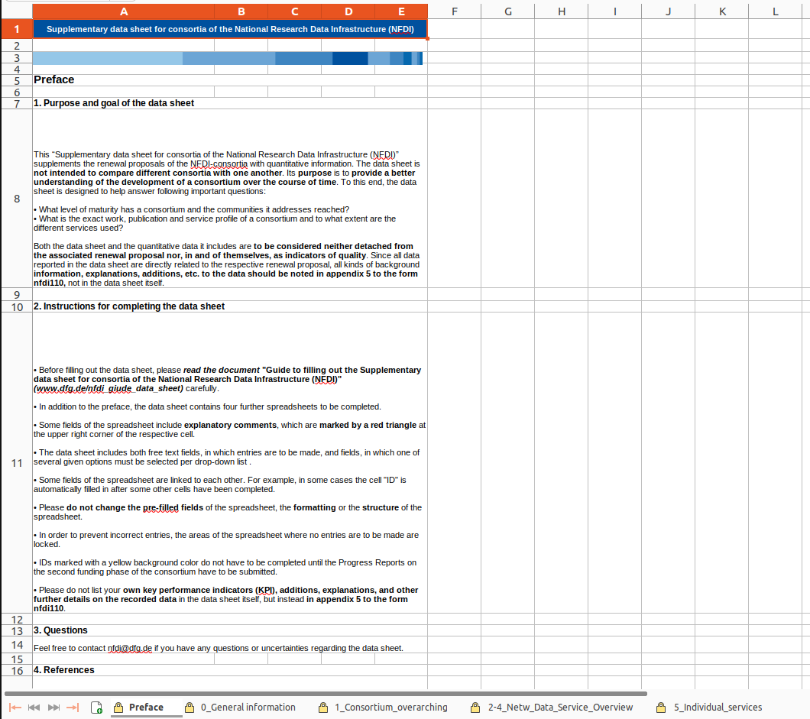
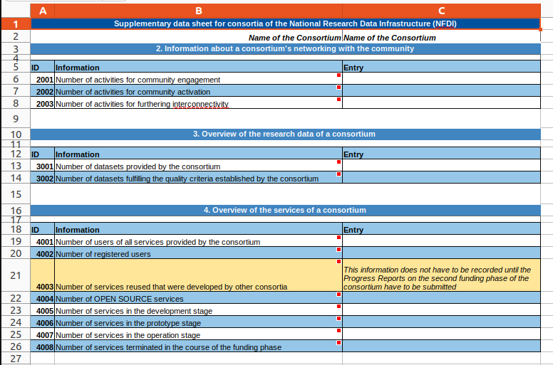
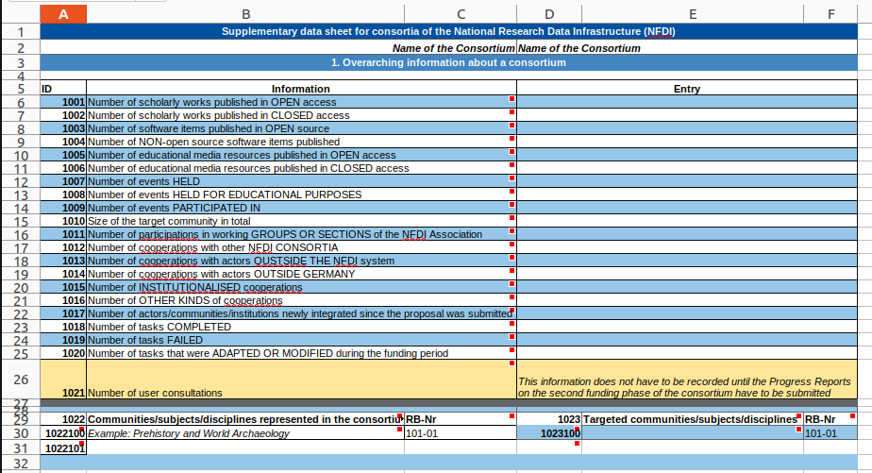
Data Sheet
This is why we need you to fill out these crazy tables!
nfdi1000 https://www.dfg.de/de/foerderung/foerderinitiativen/nfdi/formulare-merkblaetter
PUNCH4NFDI | CS

Slide 9
NFDI questionnaires
This is why we need you to fill out these crazy tables!
PUNCH4NFDI | CS

