Slide 1
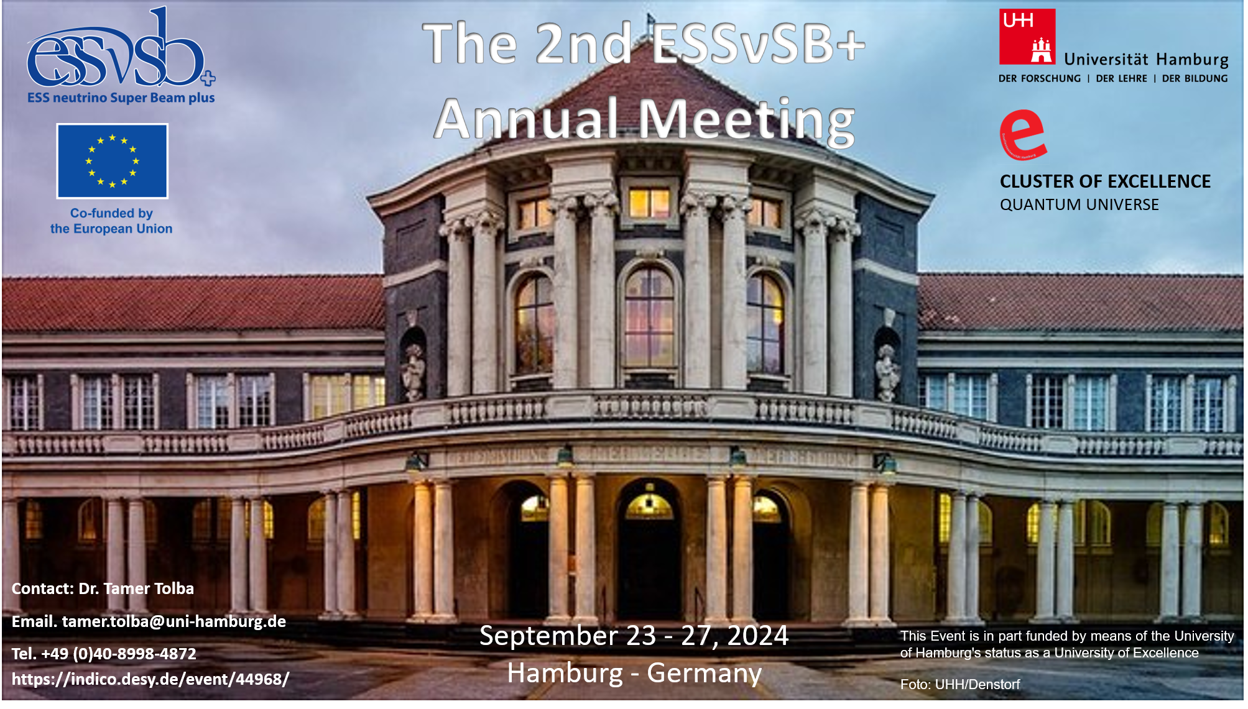
2024 Annual Meeting
Marcos Dracos

Slide 2
Agenda
https://indico.desy.de/event/44968/timetable/#20240923
 | Monday (23/09) | Tuesday (24/09) | Wednesday (25/09) | Thursday (26/09) | Friday (27/09)
Morning | Arrival | WP parallel sessions Collaboration photo | WP Plenary sessions | Plenary session: WPs (summary and future plans) discussion | Governing Board +IAP preliminary report (open session)
Afternoon | Plenary session introduction Status of ESSnuSB+ report from DEB WPs (status report) | DESY Tour Dinner | THEIA Detector WP Plenary sessions (cont.) Zinkgruvan visit and Far Detector design project | IAP (closed) MT + ESFRI Task Force (open session) DEB (open session)

Slide 3

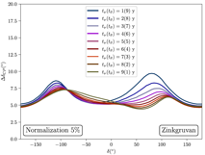




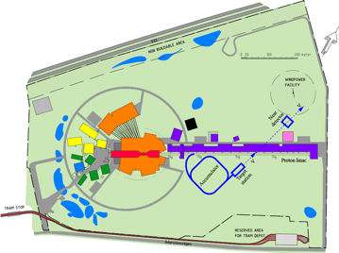
Where are we...
physics
2008-2012: EUROν Design Study (FP7)
2012: inception of the ESSnuSB project
2016-2020: COST Action EuroNuNet
2018-2022: ESSνSB Design Study, CDR (EU-H2020)
2023-2026: ESSνSB+ Design Study, CDR (EU-HE) and preparatory phase
2026-2028: TDR Phase, International Agreement
2028-2038: Construction of the facility and detectors, including commissioning
Data Taking
θ₁₃ measurement
Nobel prize:
T. Kajita &
A. McDonald
2015
Nucl. Phys. B 885 (2014) 127
ESSνSB CDR

Slide 4
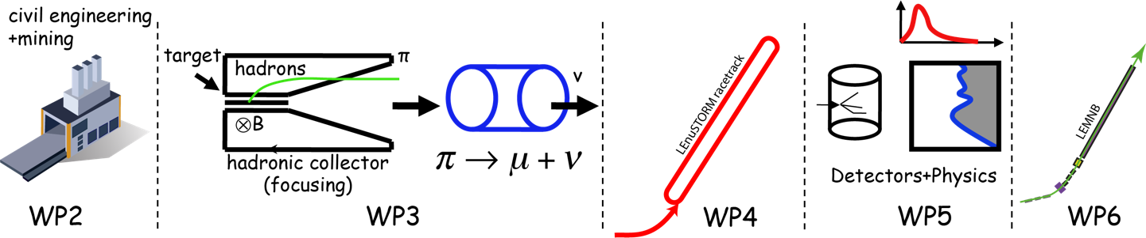
And now at the 2nd year of ESSνSB+
EU Design Study has been submitted end of April (HORIZON-INFRA2022-DEV-01)
Title of Proposal: Study of the use of the ESS facility to accurately measure the neutrino cross-sections for ESSνSB leptonic CP violation measurements and to perform sterile neutrino searches and astroparticle physics
Duration: 4 years
Total cost: 5 M€
Requested budget: 3 M€
20 participating institutes from
11 European countries including CERN and ESS (+ 4 observers)
6 Work Packages
Zinkgruvan mine (location of the far detector)
Ghent University, Belgium;
The Hellenic Open University, Greece;
AGH University in Krakow, Poland.

Slide 5
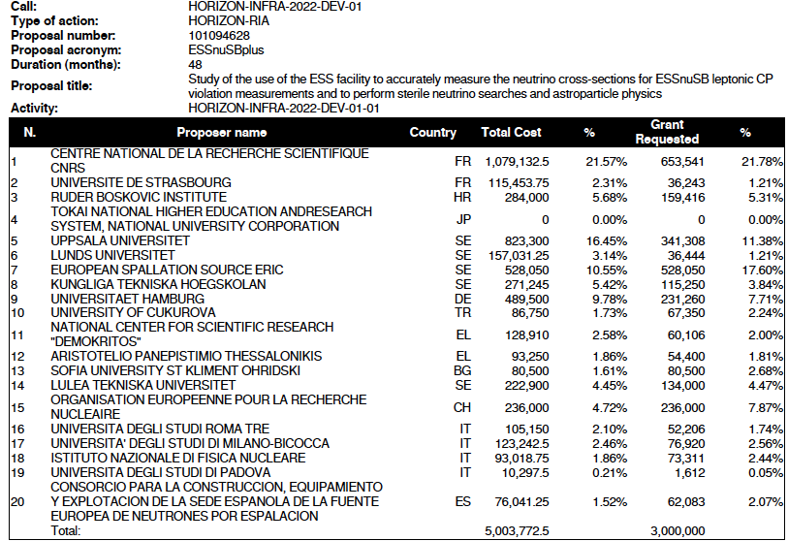
Proposal Evaluation Form

Slide 6
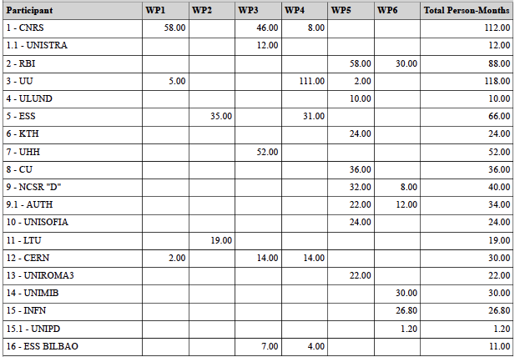
Project Effort in person-months

Slide 7
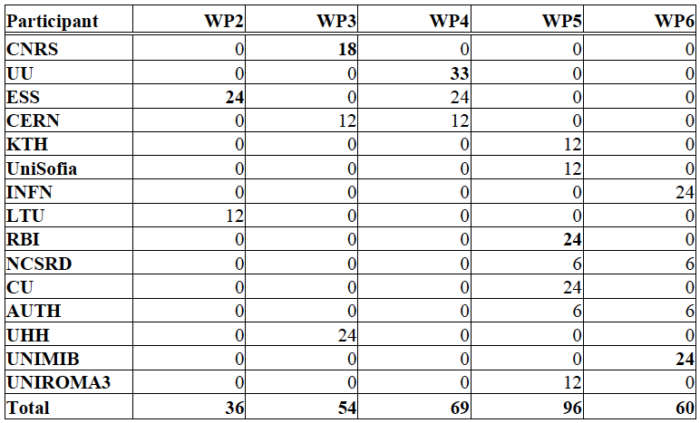
Official Post-doc list
(person-months)
Total: 315 months
~13 two-years postdocs

Slide 8
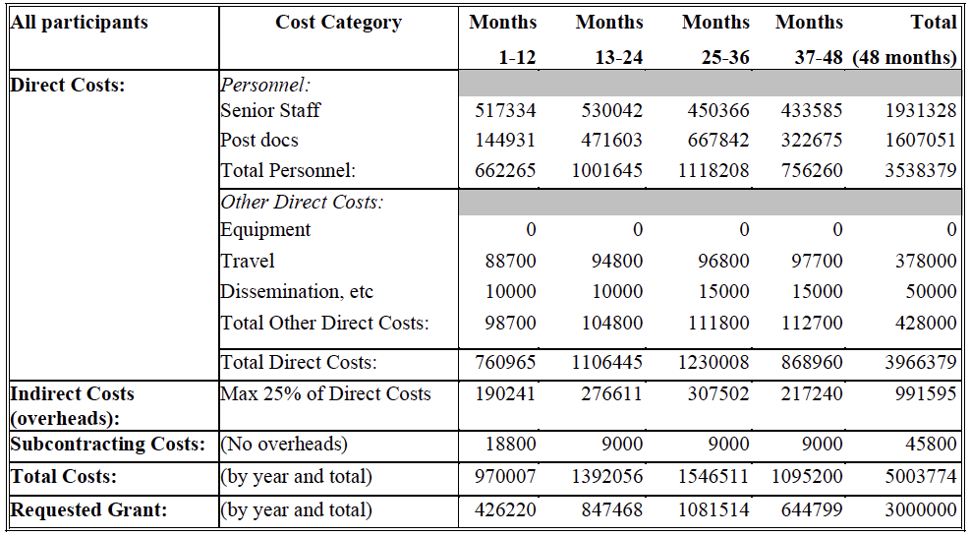
Project Budget

Slide 9
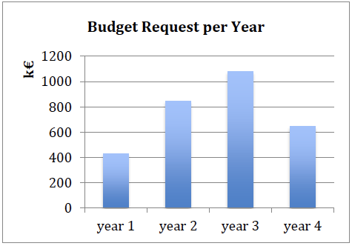
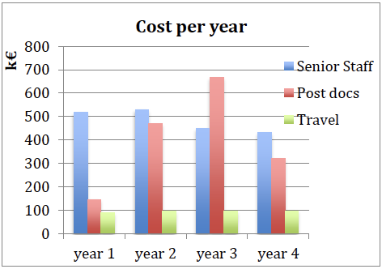
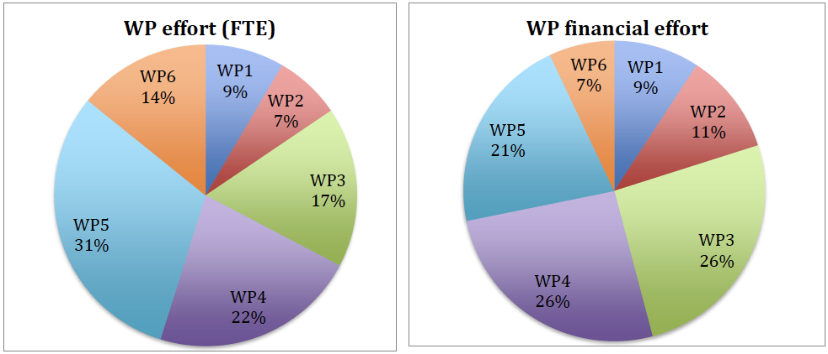
Project effort per year
Expenditure profile of the EC requested budget per year.
Cost per year for senior staff, postdocs and traveling.

Slide 10
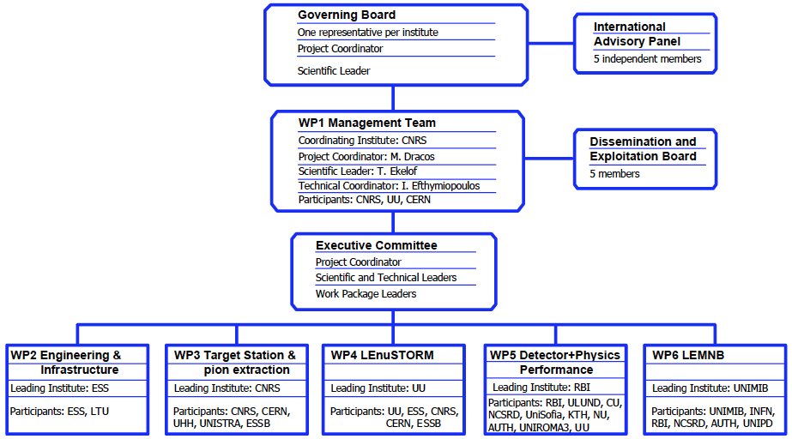
ESSνSB+ Structure
ESFRI Task Force
6 members
+Carole Mabrouk

Slide 11
Project Administration
Grant Agreement
  Signed in December 2022
Consortium Agreement
  internal document, required by EU
  signed by all members during Spring 2023
All documents can be found on DocDB
  private part (userid: xxx / pw: yyy): https://essnusb.eu/DocDB/private/DocumentDatabase
  public part: https://essnusb.eu/DocDB/public/DocumentDatabase
Our web-site: https://essnusb.eu
EU: https://cordis.europa.eu/project/id/101094628

Slide 12
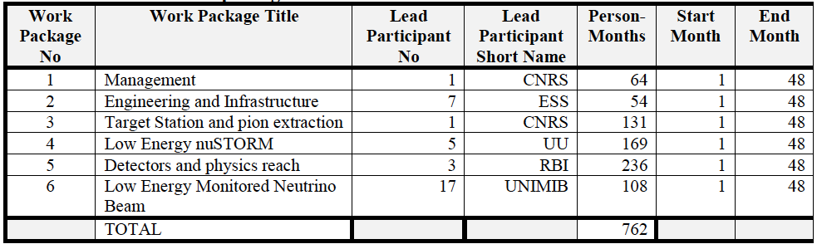
Work Packages

Slide 13
Appointment of the Work Package Coordinators
WP2: Engineering and Infrastructure: leading institute ESS
  Coordinator: Nick Gazis
  Co-coordinator: David Saiang
WP3: Target Station and pion extraction: leading institute CNRS
  Coordinator: Eric Baussan
  Co-coordinator: Tamer Tolba
WP4: Low Energy nuSTORM: leading institute UU
  Coordinator: Maja Olvegård
  Co-coordinator: Natalia Milas
WP5: Detectors and physics reach: leading institute RBI
  Coordinator: Budimir Kliček -> Monojit Ghosh
  Co-coordinator: Monojit Ghosh -> George Fanourakis
WP6: Low Energy Monitored Neutrino Beam: leading institute UNIMiB
  Coordinator: Francesco Terranova
  Co-coordinator: Andrea Longhin

Slide 14
DEB Members
+ PC and SL
5 members
  Tamer Tolba (Chair, Hamburg U.)
  Elian Bouquerel (CNRS)
  Colin Carlile (Lund)
  George Fanourakis (Demokritos)
  Natalia Milas (ESS)

Slide 15
International Advisory Panel
Composed of 5 international experts.
Gives recommendations on:
  the crucial technical choices according to the international context,
  the distribution of resources to comply with priorities,
  activity planning.
It meets once a year (at every ESSνSB+ Annual Meeting).
  presents a preliminary report to the GB,
  provides a written report two months later.

Slide 16
International Advisory Panel
Gerardo d’Auria, Elettra, Sincrotrone Trieste, Italy,
  ~Civil engineering / WP2
Teppei Katori, Dept of Physics, King’s College London, UK,
  ~Cross-sections / WP5 + WP6
Yong Joong Lee, Target Systems R&D, Second Target Station, Oak Ridge National Laboratory, USA,
  ~Target station / WP3
Livia Ludhova, Jülich Forschungszentrum, IKP-2 Neutrino Group, Germany,
  ~Detectors / WP5 + WP6
Shinji Machida, STFC, ISIS Neutron and Muon Source, UK,
  ~Accelerator / WP4
to be replaced

Slide 17
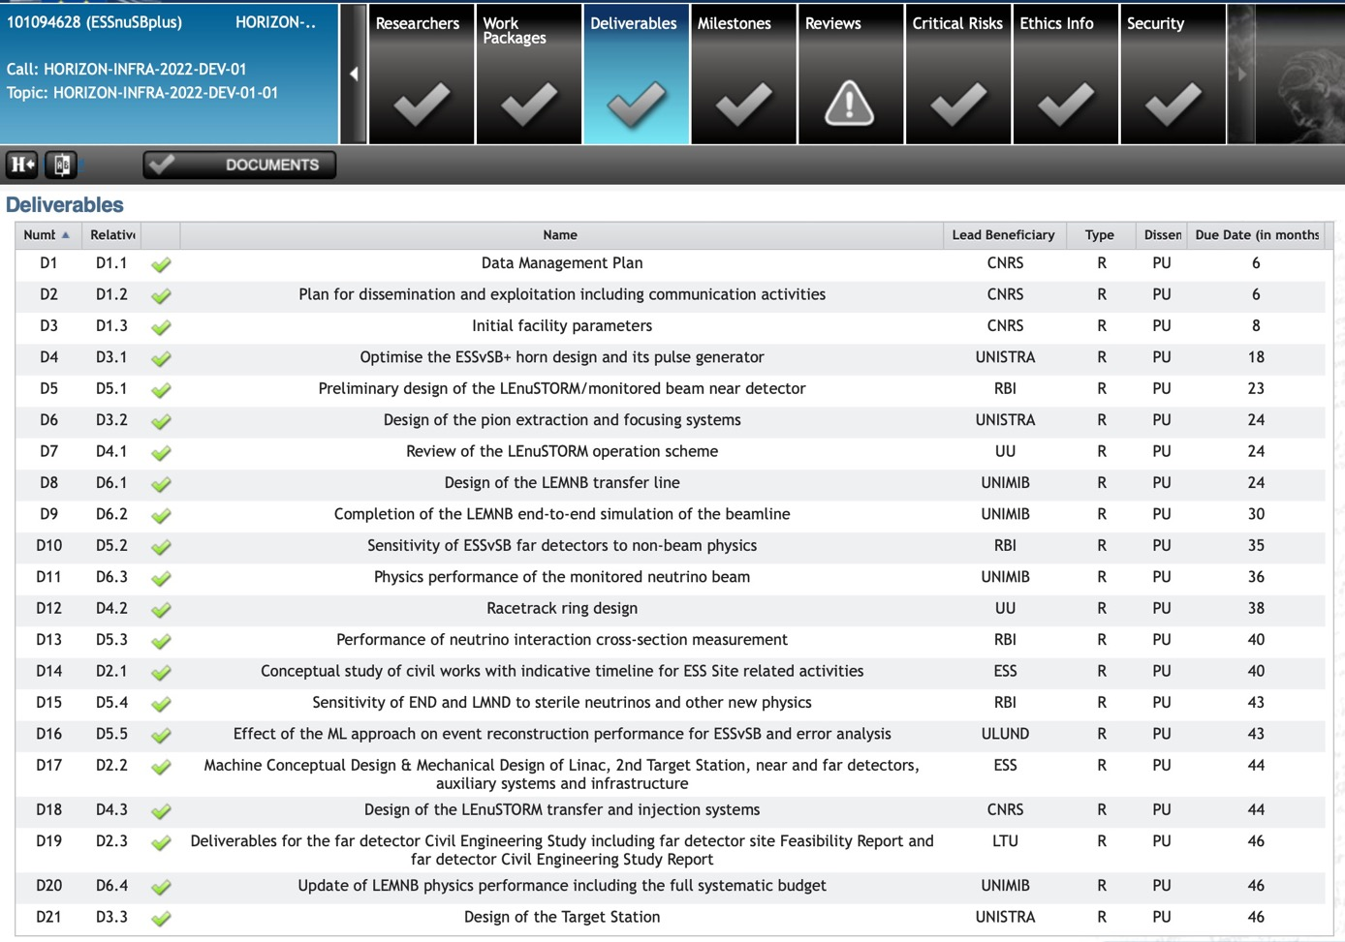
Deliverables
approved
delivered
approved
approved
pending

Slide 18
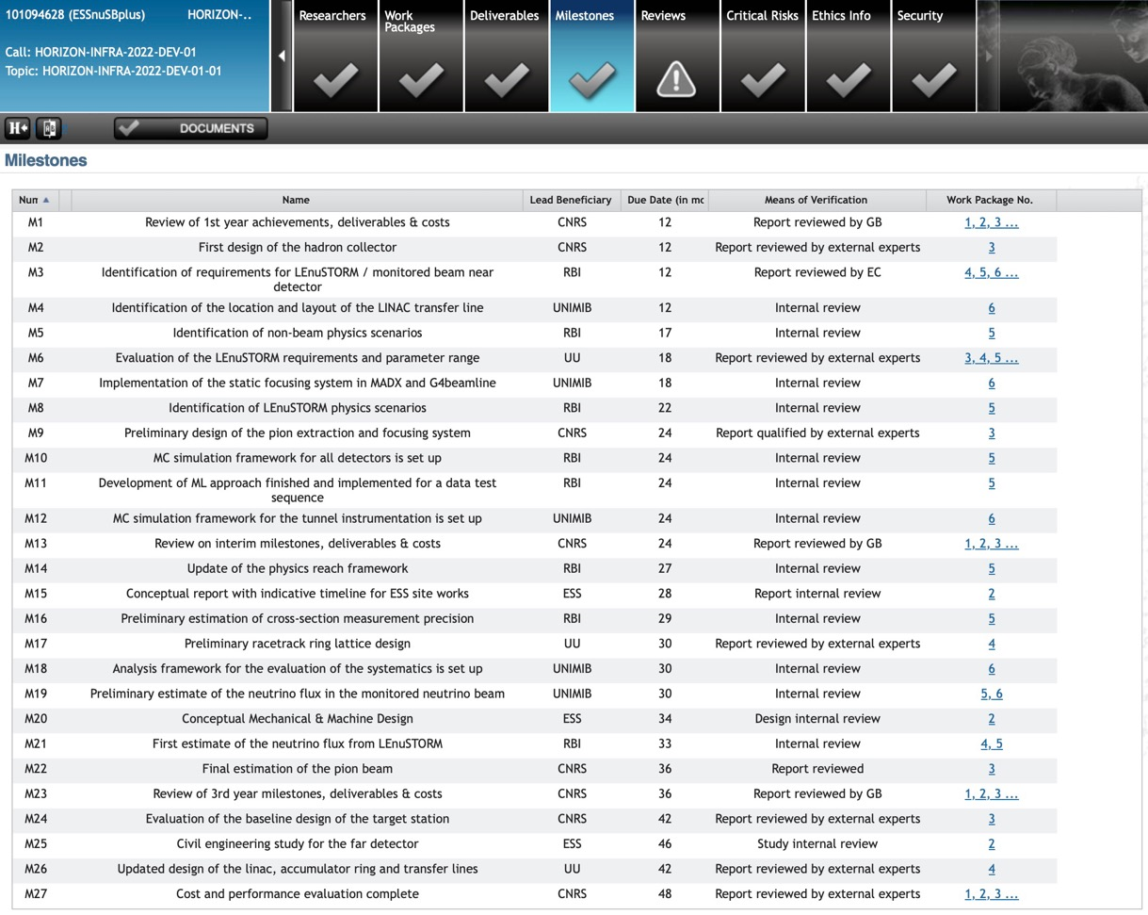
Milestones
achieved
postponed to month 27

Slide 19
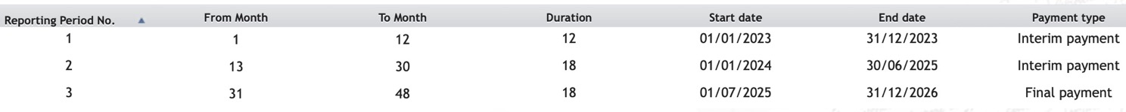
Reporting Periods
(imposed by EU)
for ESSnuSB+:
Three parts:
Financial (administration)
Technical (WPs)
New: Policy brief (2-pages, imposed by EU after approval):
  Implementation of RI
  Access to RI
  Funding of RI
  International cooperation of RI
  Employment and skills in RI
  Greening of RI
  Interaction of RI with industry
  ERIC legal framework
  Technology development, data and digital services, digitalisation
  Level of connection of RI to European Open Science Cloud
  Contribution to other research areas and to broader EU priorities
  Sustainability of RI

Slide 20
First Periodic Report
(12 months)
Project review:
when: 07 March 2024 (remotely)
reviewer: Ioana Maris (ULB, New York University Abu Dhabi)
Agenda:
09:00 Introduction to the project (30+10’),
09:40 WP1 (20+10’),
10:10 Dissemination (15+5'),
10:30 break (10'),
10:40 WP2 (30+10’),
11:20 WP3 (30+10’),
12:00 Lunch,
13:30 WP4 (30+10’),
14:10 WP5 (30+10’),
14:50 WP6 (30+10’),
15:30 Discussion.
https://essnusb.eu/DocDB/private/DocumentDatabase
all ESSνSB documents can be found here:
https://essnusb.eu/DocDB/private/DisplayMeeting?conferenceid=412

Slide 21
First Periodic Report
(12 months)
Points examined:
the degree to which the work plan has been carried out and whether all deliverables were completed,
whether the objectives are still relevant and provide scientific or industrial breakthrough potential,
how resources were planned and used in relation to the achieved progress, and if their use respects the principles of economy, efficiency and effectiveness,
the management procedures and methods of the project,
the beneficiaries’ contributions and their integration within the project,
the expected potential scientific, technological, economic, competitive and social impact, and plans for using and disseminating results,
eligibility of the costs claimed,
compliance with other Grant Agreement obligations.

Slide 22
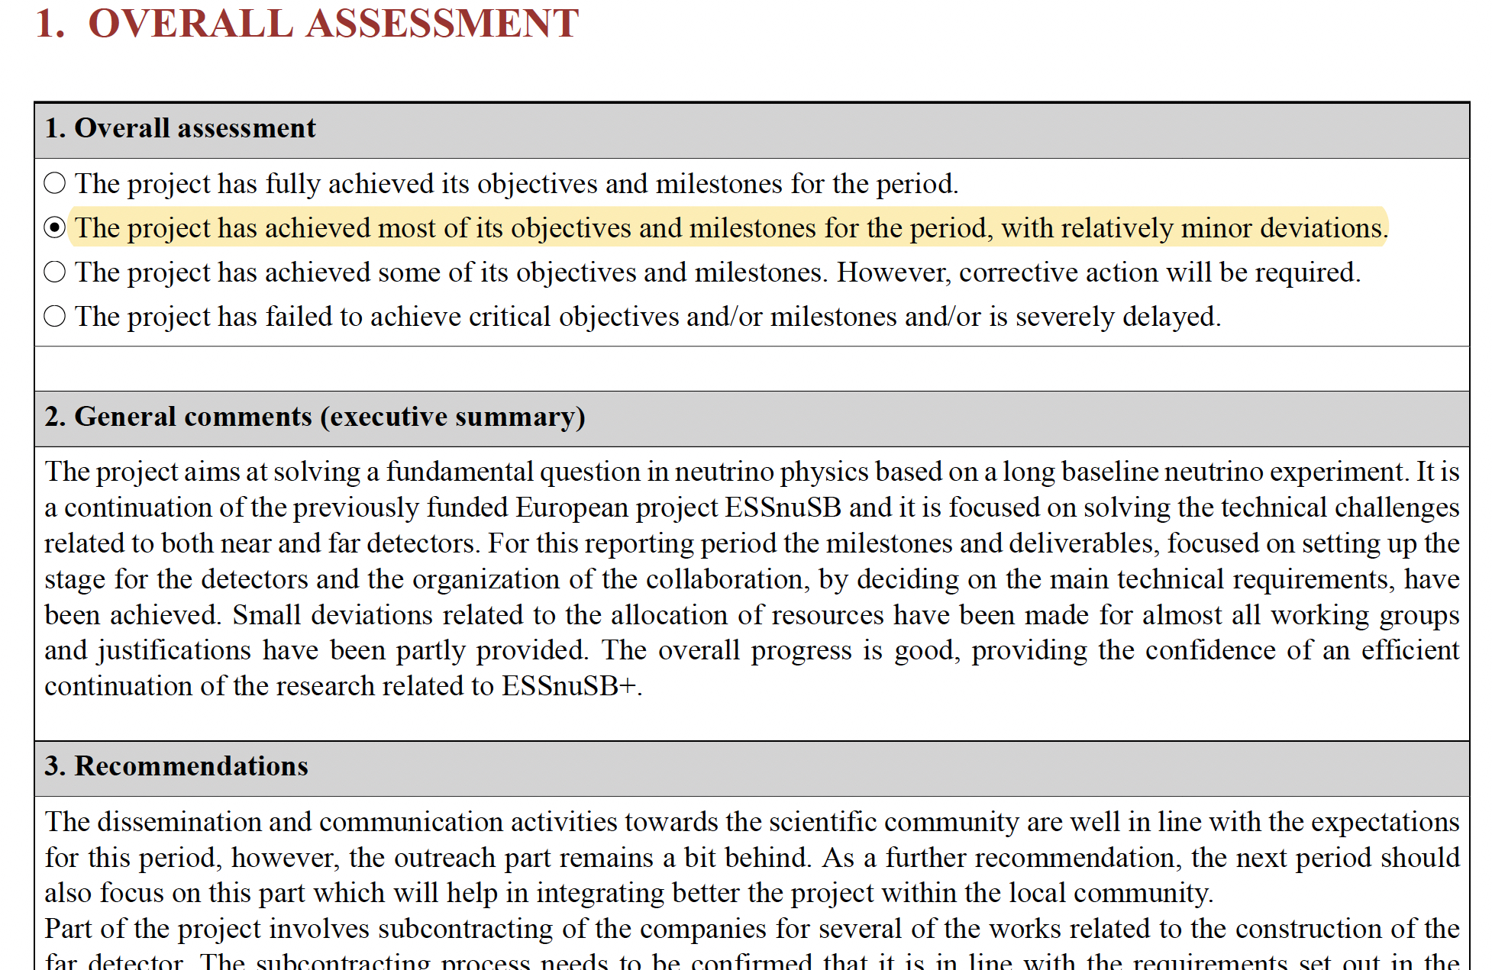
General Project Review Consolidated Report
https://essnusb.eu/DocDB/private/ShowDocument?docid=1842

Slide 23
General Project Review Consolidated Report
Main recommendations
The dissemination and communication activities towards the scientific community are well in line with the expectations for this period, however, the outreach part remains a bit behind. As a further recommendation, the next period should also focus on this part which will help in integrating better the project within the local community.
One of the risks that might influence the timely continuation of the project is the difficulty in finding appropriate postdoctoral researchers for the very specialized tasks. This might constitute an issue that will be hard to mitigate if the hiring does not proceed as planned.
The data management plan, one of the deliverables for this time interval, properly includes open-science practices and the archiving of data. The consortium organised a very good data base for the relevant documents and committed to submitting relevant publications in open science journals. However, a commitment of just 5 years for the archiving of data seems rather small and should be discussed within the consortium.
+ special recommendations for each WP.

Slide 24

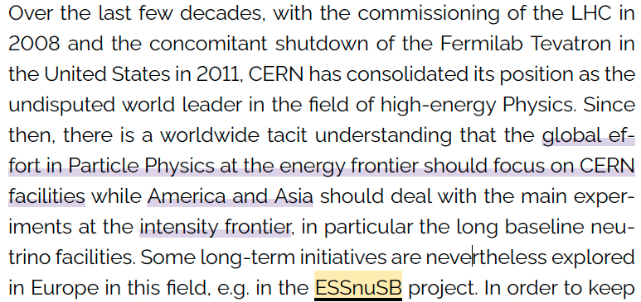
Road Maps
  4-5 June meeting in Brussels
ESFRI Landscape analysis

Slide 25
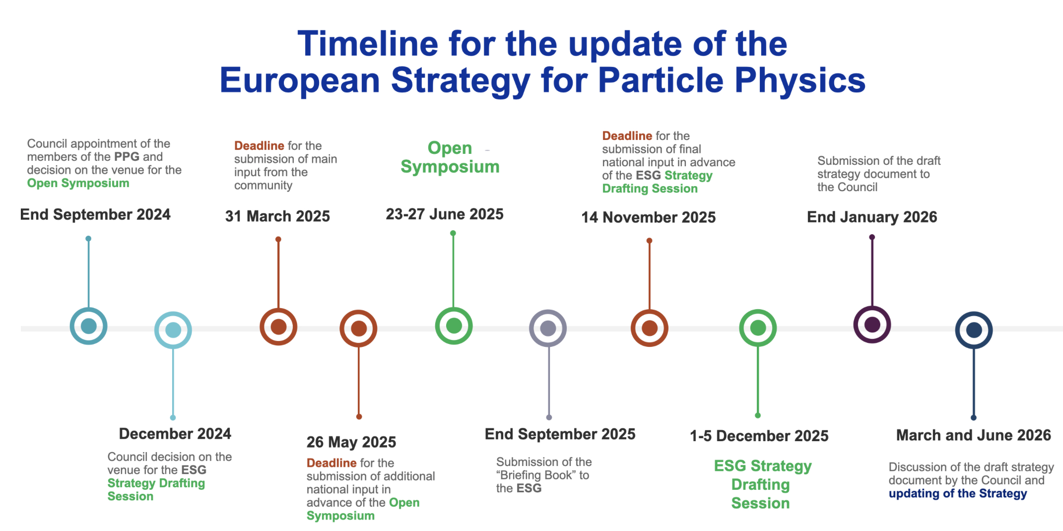
ESFRI/CERN strategy
  Future events & deadlines:
  ESFRI Info Day, Brussels, 8 October 2024
  EU Roadmap
  Deadline for contribution submissions: 31/03/2025

Slide 26
European or CERN strategy
STRATEGY SECRETARIAT
Strategy Secretary (Chair) | Prof. Karl Jakobs
SPC Chair | Dr Hugh Montgomery
LDG Chair | Prof. Dave Newbold
ECFA Chair | Prof. Paris Sphicas
https://europeanstrategyupdate.web.cern.ch/european-strategy-group-esg
+CERN Director-General: Dr Fabiola Gianotti
+CERN Director-General-Elect: To be appointed in late 2024
+European Strategy Group (ESG)
  One representative per member state
  Major European National Labs
  Strategy secretariat
  ESG invitees
    President of the CERN Council
    Associate Member States
    Associate Member States in the pre-stage to Membership
    Observer States
    Organisations with Observer status: EC (Patricia Postigo McLaughlin)
    Other invitees: Chair ApPEC, Chair NuPECC, Chair ESFRI, Other members of the PPG

Slide 27
2024 Annual Meeting
Thanks

Slide 28
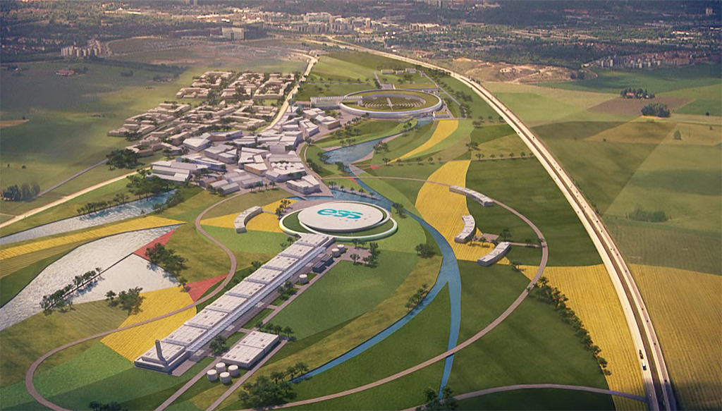
Backup

Slide 29
Meetings
(from CA)
 | Ordinary meeting | Extraordinary meeting
Governing Board | At least once a year | At any time upon written request of the Executive Committee or 1/3 of the Members of the Governing Board.
Executive Committee | At least 3 times per year | At any time upon written request of any Member of the Executive Committee.
Management Team | At least 6 times per year | According to needs.
International Advisory Panel | Once per year | Upon request of the Governing Board.
Dissemination and Exploitation Board | At least 3 times per year | Upon request of the Governing Board.

Slide 30

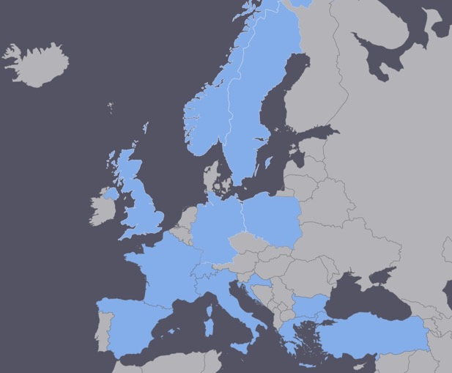
Lepton CP Violation at the European level
COST application for networking has been succeeded: CA15139 (2016-2020)
  EuroNuNet : Combining forces for a novel European facility for neutrino-antineutrino symmetry violation discovery (http://www.cost.eu/COST_Actions/ca/CA15139)
  Major goals of EuroNuNet:
    to aggregate the community of neutrino physics in Europe to study the ESSνSB concept in a spirit of inclusiveness,
    to impact the priority list of High Energy Physics policy makers and of funding agencies to this new approach to the experimental discovery of leptonic CP violation.
  13 participating countries (network still growing).

Slide 31
ESSνSB at the European level
A H2020 EU Design Study has been submitted end of March (Call INFRADEV-01-2017)
Title of Proposal: Discovery and measurement of leptonic CP violation using an intensive neutrino Super Beam generated with the exceptionally powerful ESS linear accelerator
Duration: 4 years
Total cost: 4.7 M€
Requested budget: 3 M€
15 participating institutes from
11 European countries including CERN and ESS
6 Work Packages
Decision: end of August
ESSνSB
BENE (2004-2008)
ISS (2005-2007)
EUROν (2008-2012)
LAGUNA (2008-2010)
LAGUNA-LBNO (2010-2014)
COST Action CA15139 (2015-2019)

Slide 32

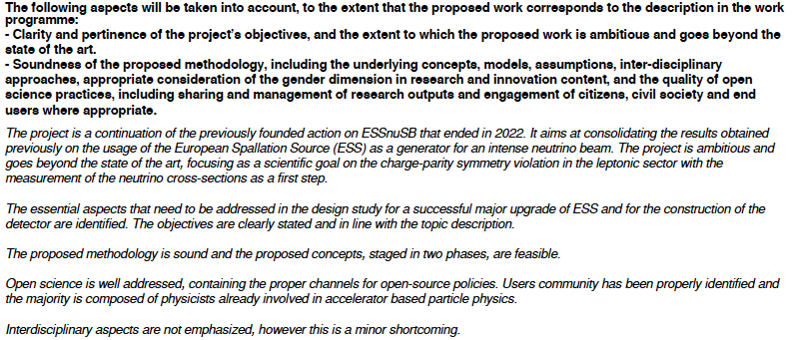
Evaluation Summary Report
/15

Slide 33
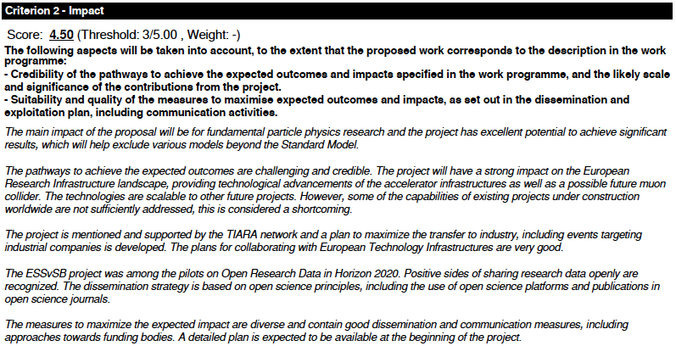
Evaluation Summary Report

Slide 34
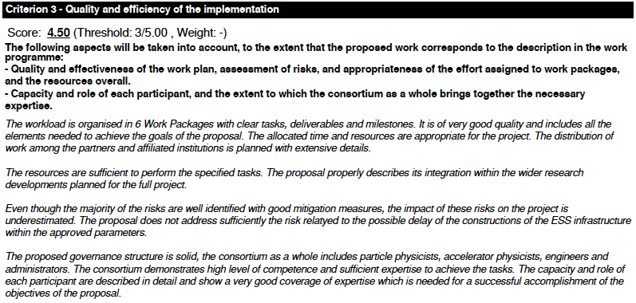
Evaluation Summary Report

Slide 35
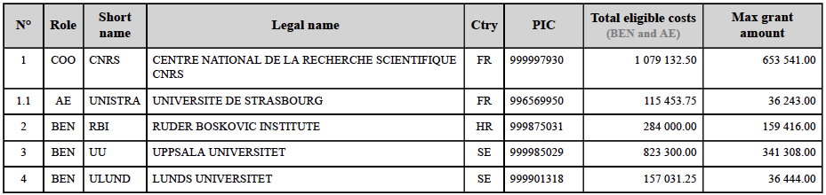
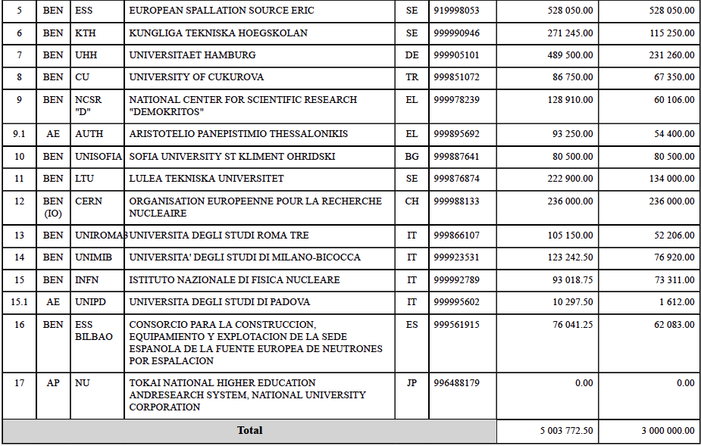
Project Budget per institute

Slide 36
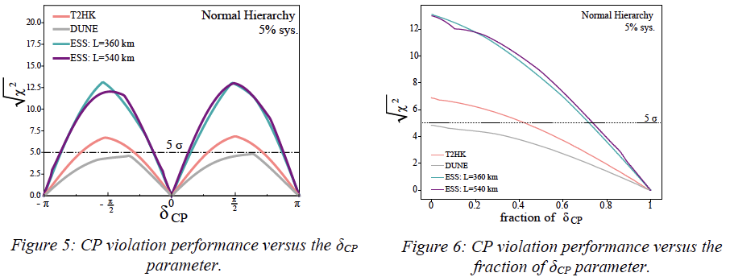
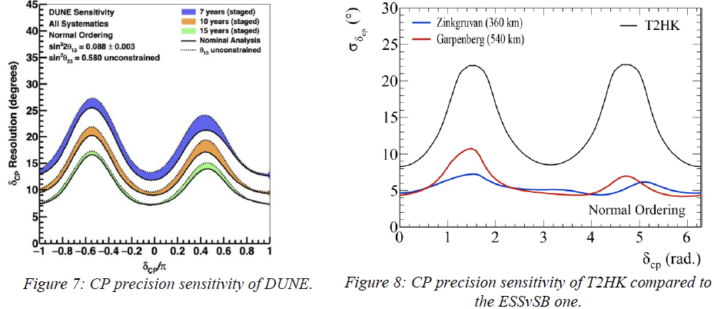
Evaluation Summary Report
included in the submitted project

Slide 37
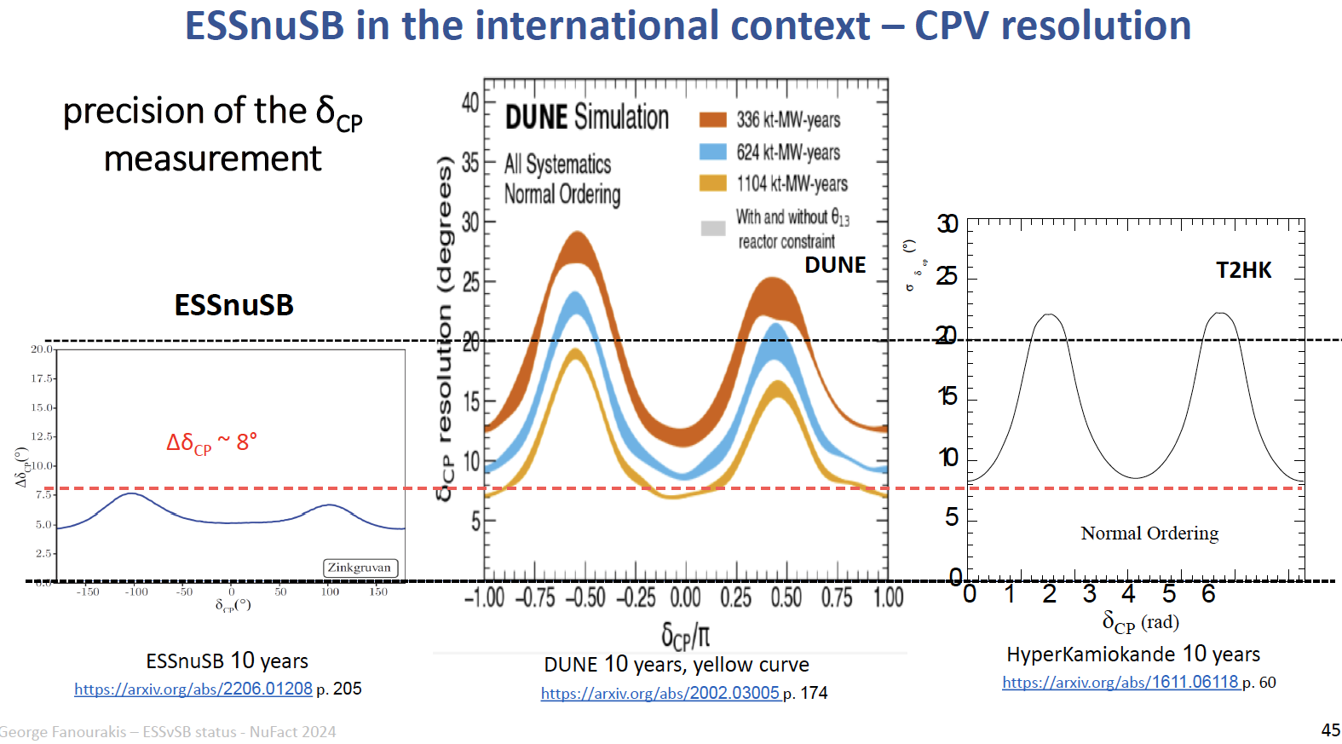
Comparisons

Slide 38
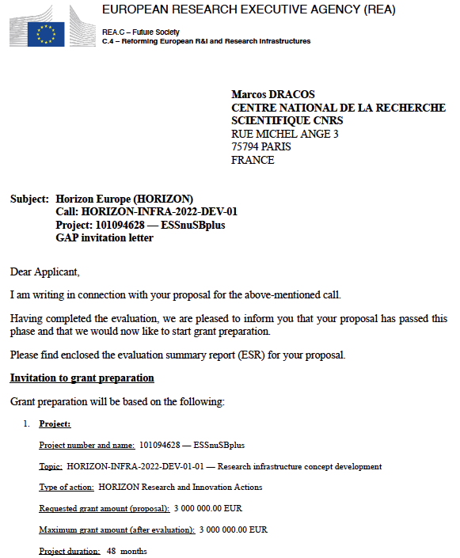
Design Study ESSνSB+
approved!
Project: 101094628 - ESSnuSBplus

